Slide 1
SLR PARSING TECHNIQUES
Submitted By:
Abhijeet Mohapatra
04CS1019.

Slide 2
A Simple LR parser or SLR parser is an LR parser for which the parsing tables are generated as for an LR(0) parser except that it only performs a reduction with a grammar rule A → w if the next symbol on the input stream is in the follow set of A

Slide 3
CONSTRUCTION OF SLR – PARSING TABLES
INPUT: Grammar G with production rules.
CENTRAL IDEA
To construct from the input grammar, a DFA to recognize viable prefixes. This is done by grouping items into sets which can be visualized as subset construction from the states of a NFA recognizing the viable prefixes.

Slide 4
Item: An LR (0) item or simply, an item of a grammar G is a production of G with a dot ‘.’ at some position of the right side. For example, the production A → XYZ yields four items,
  A → .XYZ
  A → X.YZ
  A → XY.Z
  A → XYZ.
A production rule of the form A → ε yields only one item A → . . Intuitively, an item shows how much of a production we have seen till the current point in the parsing procedure.

Slide 5
Augmented Grammar G’: This equals G ∪ {S’ → S} where S is the start state of G. The start state of G’ = S’. This is done to signal to the parser when the parsing should stop to announce acceptance of input.

Slide 6
Closure Operation: If I[] is a set of items for a grammar G,
closure(I) = I ∪ {B → .γ | (A → α.Bβ ∈ closure(I)) ∧ ((B → γ) ∈ grammar G}

Slide 7
Goto Operation: For a set of items I, and grammar symbol X,
goto(I, X) = { Closure (all items containing A → αX.β) such that A → α.Xβ is in I}
= set of items that are valid for the viable prefix γX, where I is valid for some viable prefix γ.

Slide 8
Kernel and Non-Kernel items: Kernel items include the set of items that do not have the dot at leftmost end, along with S’→ .S
Non-kernel items are the items which have the dot at leftmost end.

Slide 9
void items (grammar G){
set C;
int i, j, n;
C = {closure ({[S’ → .S]})};
do{
n = 0;
for (i = 0; i < size(C); i++)
for (j = 0; G.symbol[j] != 0; j++)
if (size(goto(C[i],X)) > 0 && !iselement(goto(C[i],X),C) )
{ C = union(C, goto(C[i],X)); n++;}
} while (n != 0);
} // size of items in grammar G.

Slide 10
Example:
Grammar G:
S’ → S
S → aABe
A → Abc
A → b
B → d

Slide 11
Set of items generated:-
I0 = {[S’ → .S], [S → .aABe]}
I1 = {S’ → S.}
I2 = {S → a.ABe, A → .Abc, A → .b}
I3 = {S → aA.Be, A → A.bc, B → .d}
I4 = {A → b.}
I5 = {S → aAB.e}
I6 = {A → Ab.c}
I7 = {B → d.}
I8 = {S → aABe.}
I9 = {A → Abc.}

Slide 12
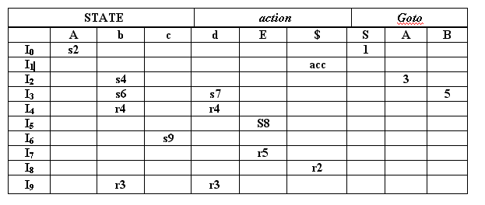
The table for parsing action and goto function for the given grammar is:-
Where
1. rj means reduce by production numbered j,
2. acc means accept
3. si means shift and stack state i.
4. blank means error.

Slide 13
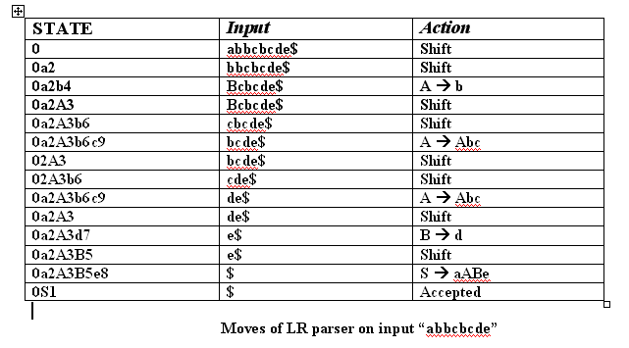

Slide 14
GOTO GRAPH
Transition Rules:
If there is a transition from,
A->α . Xβ to A-> αX . β
then, the transition in the GOTO Graph is labeled X
If there is a transition
A-> α . Bβ to B-> .γ
then, the transition is labeled ε, and since we take ε-closure of all items, these productions lie in the same item as that of A->α . Bβ to A-> αB . β.

Slide 15
RULES FOR FILLING THE SLR PARSE TABLE
The Rules for filling the action entries in the table are:
1.If [ A-> α .a β ] is in Ii and goto ( Ii , a ) = Ij, then set action [i ,a] to “shift j “.Here a must be a terminal.
2. If [A-> α .] is in Ii, then set action[i , a ] to “reduce A -> α “ for all a in FOLLOW (A); here A may not be in S’.
3. If [ S’-> S.] is in Ii , then set action [I, $] to accept.
If any conflicting actions are generated by the given rules, then we say the grammar is not in SLR or LR (0) and we fail to produce a parser.
We then fill the goto entries.
The goto transitions for the state i are constructed for all the non-terminals A using the Rule:
If goto( Ii, A ) = Ij , then goto [i , A ] = j .

Slide 16
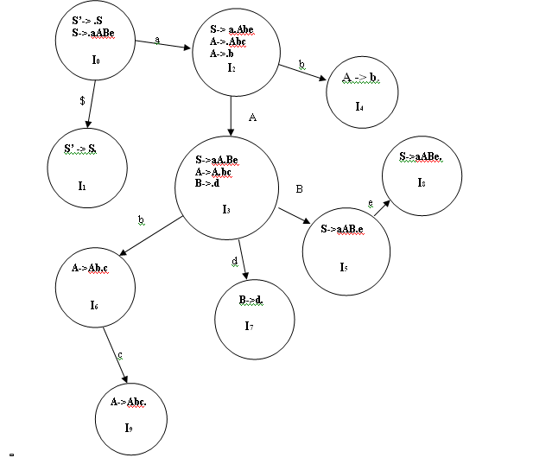
GOTO GRAPH FOR GRAMMAR G

