Slide 1
What is Three Address Code?
A statement of the form x = y op z is a three address statement. x, y and z here are the three operands and op is any logical or arithmetic operator.
Here three address refers to the three addresses in the statement viz addresses of x , y and z.

Slide 2
Say for example we have a statement
a = b + c * d
Then three address code for this statement is :-
t1 = c * d
a = b + t1

Slide 3
Types :-
There are different types of three address statements. Some of them are
Assignment statements. They are of the form x := y op z where op is a binary arithmetic or logical operation.
Assignment Instructions. They are of the form x := op y where op is an unary operation like unary plus, unary minus shift etc

Slide 4
Copy statements. They are of the form x := y where the value of y is assigned to x.
Unconditional Jump goto L. The three address statement with label L is the next to be executed.
Conditional Jumps such as if x relop y goto L. This instruction applies a relational operator (<,>,<=,>=) to x and y and executes the statement with label L if the conditional statement is satisfied. Else the statement following if x relop y goto L is executed

Slide 5
param x and call p,n for procedure calls and return y where y representing a returned value (optional).Three Address statements for it are as follows.
param x1
param x2
param x3
.
param xn
call p,n
generated as a part of the three address code for call of the procedure p(x1,x2,x3,....xn) where n are the number of variables being sent to the procedure

Slide 6
Structure for Three Address Code
It is a quadruple of an operator, arg1 , arg2 and a result or it is a triple of an operator , arg1 and arg2. In triple form arg2 is generally a pointer to the triple structure.

Slide 7
Three Address Code Generation
Suppose we have the grammar
S ->id := E
E -> E+E
E -> E*E
E -> - E
E -> (E)
E -> id

Slide 8
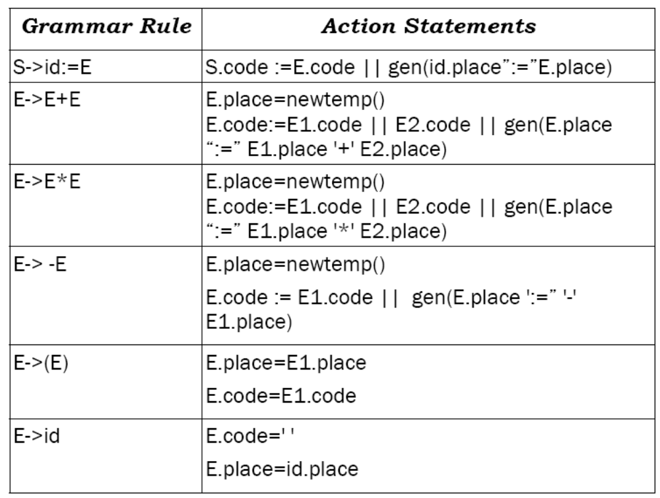
Then the three address code for this grammar can be written as:-

Slide 9
E1 refers to the first E that comes in the production.
E2 refers to the second E that comes in the production.
Here E.code stands for the three address code generated by E and E.place stands for the variable name

