Slide 1
THREE ADDRESS CODE GENERATION
Notes:
Consider the following grammar with its translation scheme for producing 3-address statements
S → id:= E S.Code := E.Code || gen(id.place ‘=’ E.place)
E → E + E E.place := newtemp( ) , E.Code =E1.Code || E2.Code || gen(E.place ‘=’ E1.place + E2.place)
E → E * E E.place = newtemp( ) , E.Code := E1.Code || E2.Code || gen(E.place ‘=’ E1.place * E2.place)
E → -E E.place = newtemp( ), E.Code := E1.Code || gen (E.place ‘=’ ‘uni –‘ ‘E1.place)
E → (E1) E.place = E1.place , E.Code = E1.Code
E → id E.place = id.place , E.Code := ‘ ’
Consider the expression x := ( y + z ) * ( -w + v) <number>

Slide 2
Consider the following grammar with its translation scheme for producing 3-address statements
S → id:= E S.Code := E.Code || gen(id.place ‘=’ E.place)
E → E + E E.place := newtemp( ) , E.Code =E1.Code || E2.Code || gen(E.place ‘=’ E1.place + E2.place)

Slide 3
E → E * E E.place = newtemp( ) , E.Code := E1.Code || E2.Code || gen(E.place ‘=’ E1.place * E2.place)
E → -E E.place = newtemp( ), E.Code := E1.Code || gen (E.place ‘=’ ‘uni –‘‘E1.place)

Slide 4
E → (E1) E.place = E1.place , E.Code = E1.Code
E → id E.place = id.place , E.Code := ‘ ’

Slide 5
Consider the expression x := ( y + z ) * ( -w + v)
Annotated parse tree for the above expression will be :

Slide 6
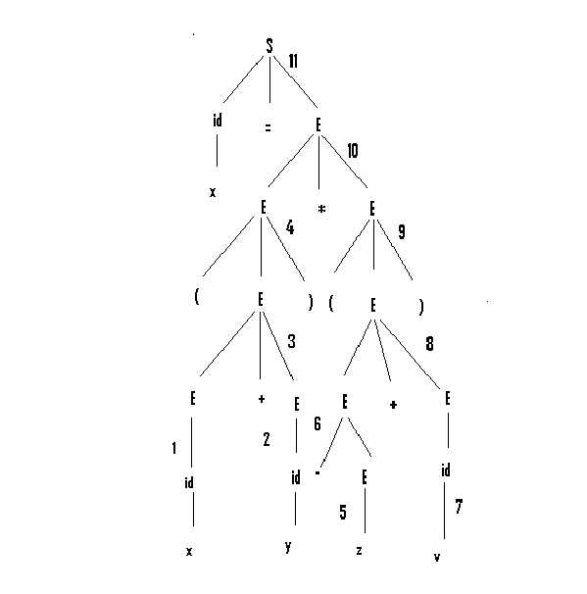

Slide 7
Three-address code statements for the above expression will be as follows:
t1 = y +z
t2 = -w
t3 = t2 +v
t4 = t1 * t3
x = t4

Slide 8
Syntax directed translation for the above expression:
E→id | E.place := y
E→id | E.place := z
E→E + E | E.place := t1 E.Code := gen( t1 = y + z )
E→(E) | E.place := t1 E.Code := gen( t1 = y + z )

Slide 9
E→id | E.place := w
E→ -E | E.place := t2 E.Code := gen( t2 = -w)
E→id | E.place := v
E→E + E | E.place := t3 E.Code := gen( t2 = -w , t3 = t2 +v )

Slide 10
E →(E) | E.place := t3 E.Code := gen( t2 = -w , t3 = t2 + v )
E→E * E | E.place = t4 E.Code := gen( t1= y + z , t2 = -w , t3 = t2 + v , t4 = t1 * t3)
S→id:=E | S.Code := gen(t1= y + z , t2 = -w , t3 = t2 + v , t4 = t1 * t3 , x=t4)

Slide 11
NOTES
    S.code represents the three address code for assignment S
    Non terminal E has 2 attributes
    E.place, the name that will hold the value of E
    E.code, the sequence of three-address statements evaluating E
    The function newtemp returns a sequence of distinct names t1,t2 … in successive calls

Slide 12
ARRAYS:
1 Dimensional array
X[i] = A
A = X[i]
where X is the starting point and i is the offset from X.
Address of A[i] in terms of base address , low and high (generally low = 0)

Slide 13
=Base + ( i – low)*w (w= size of each address block in bytes)
= ( Base – low*w ) + i * w.

Slide 14
2 Dimensional array
A[ i , j ]
Address of A[i] in terms of base n1 , n2 , l1 , l2
( l1 , l2 correspond to low of the two dimensions
n1 , n2 correspond to the size of each array)

Slide 15
=Base + n2 * w * ( i – l1 ) + ( j – l2 ) * w
= ( Base –( n2*l1 + l2 )*w ) + w*(n2*i + j)

Slide 16
-Prepared By
-ARINDAM BARAL(04CS1034).

