Slide 1
Three-address code
A more common representation is THREE-ADDRESS CODE .
Three address code is close to assembly language, making machine code generation easier.
Three address has statements of the form
  x := y op z
To get an expression like x + y * z, we introduce TEMPORARIES:
  t1 := y * z
  t2 := x + t1
Three address is easy to generate from syntax trees. We associate a temporary with each interior tree node.

Slide 2
Types of Three Address code statements
Assignment statements of the form x := y op z, where op is a binary arithmetic or logical operation.
Assignement statements of the form x := op Y, where op is a unary operator, such as unary minus, logical negation
Copy statements of the form x := y, which assigns the value of y to x.
Unconditional statements goto L, which means the statement with label L is the next to be executed.
Conditional jumps, such as if x relop y goto L, where relop is a relational operator (<, =, >=, etc) and L is a label. (If the condition x relop y is true, the statement with label L will be executed next.)

Slide 3
Types of Three Address Code statements
Statements param x and call p, n for procedure calls, and return y, where y represents the (optional) returned value. The typical usage: p(x1, …, xn)
  param x1
  param x2
  …
  param xn
  call p, n
Index assignments of the form x := y[i] and x[i] := y. The first sets x to the value in the location i memory units beyond location y. The second sets the content of the location i unit beyond x to the value of y.
Address and pointer assignments:
  x := &y
  x := *y
  *x := y

Slide 4
Syntax-directed generation of Three Address Code
Idea: expressions get two attributes:
  E.place: a name to hold the value of E at runtime
    id.place is just the lexeme for the id
  E.code: the sequence of 3AC statements implementing E
We associate temporary names for interior nodes of the syntax tree.
  The function newtemp() returns a fresh temporary name on each invocation

Slide 5
Syntax-directed translation
For ASSIGNMENT statements and expressions, we can use this SDD:
  Production Semantic Rules
  S -> id := E S.code := E.code || gen( id.place ‘:=‘ E.place )
  E -> E1 + E2 E.place := newtemp();
  E.code := E1.code || E2.code ||
  gen( E.place ‘:=‘ E1.place ‘+’ E2.place )
  E -> E1 * E2 E.place := newtemp();
  E.code := E1.code || E2.code ||
  gen( E.place ‘:=‘ E1.place ‘*’ E2.place )
  E -> - E1 E.place := newtemp();
  E.code := E1.code || gen( E.place ‘:=‘ ‘uminus’
  E1.place )
  E -> ( E1 ) E.place := E1.place; E.code := E1.code
  E -> id E.place := id.place; E.code := ‘’

Slide 6
Three Address Code implementation
The main representation is QUADRUPLES (structs containing 4 fields)
  OP: the operator
  ARG1: the first operand
  ARG2: the second operand
  RESULT: the destination

Slide 7
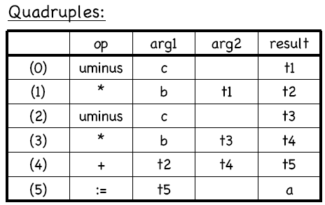
Three Address Code implementation
Code:
a := b * -c + b * -c
Three Address Code:
t1 := -c
t2 := b * t1
t3 := -c
t4 := b * t3
t5 := t2 + t4
a := t5

Slide 8
Declarations
When we encounter declarations, we need to lay out storage for the declared variables.
For every local name in a procedure, we create a ST(Symbol Table) entry containing:
  The type of the name
  How much storage the name requires
  A relative offset from the beginning of the static data area or beginning of the activation record.
For intermediate code generation, we try not to worry about machine-specific issues like word alignment.

Slide 9
Declarations
To keep track of the current offset into the static data area or the AR, the compiler maintains a global variable, OFFSET.
OFFSET is initialized to 0 when we begin compiling.
After each declaration, OFFSET is incremented by the size of the declared variable.

Slide 10
Translation scheme for decls in a procedure
  P -> D { offset := 0 }
  D -> D ; D
  D -> id : T { enter( id.name, T.type, offset );
  offset := offset + T.width }
  T -> integer { T.type := integer; T.width := 4 }
  T -> real { T.type := real; T.width := 8 }
  T -> array [ num ] of T1 { T.type := array( num.val, T1.type );
  T.width := num.val * T1.width }
  T -> ^ T1 { T.type := pointer( T1.type );
  T.width := 4 }

Slide 11
Keeping track of scope
When nested procedures or blocks are entered, we need to suspend processing declarations in the enclosing scope.
Let’s change the grammar:
  P -> D
  D -> D ; D | id : T | proc id ; D ; S

Slide 12
Keeping track of scope
Suppose we have a separate ST(Symbol table) for each procedure.
When we enter a procedure declaration, we create a new ST.
The new ST points back to the ST of the enclosing procedure.
The name of the procedure is a local for the enclosing procedure.

Slide 13
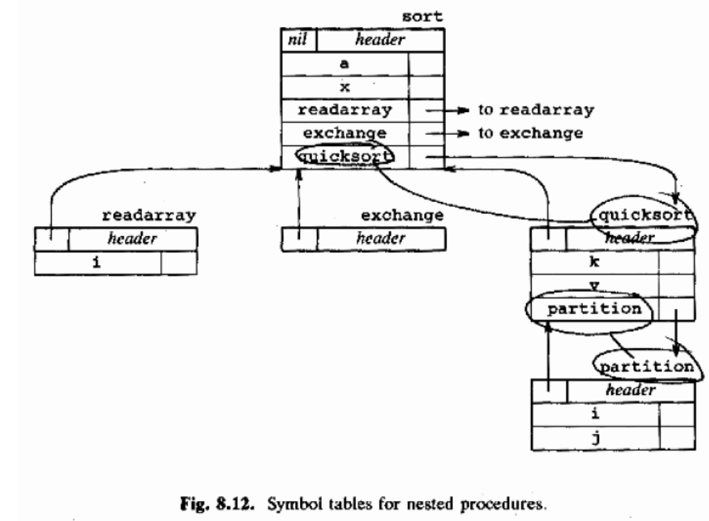

Slide 14
Operations supporting nested STs
mktable(previous) creates a new symbol table pointing to previous, and returns a pointer to the new table.
enter(table,name,type,offset) creates a new entry for name in a symbol table with the given type and offset.
addwidth(table,width) records the width of ALL the entries in table.
enterproc(table,name,newtable) creates a new entry for procedure name in ST table, and links it to newtable.

Slide 15
Translation scheme for nested procedures
P -> M D { addwidth(top(tblptr), top(offset));
pop(tblptr); pop(offset) }
M -> ε { t := mktable(nil);
push(t,tblptr); push(0,offset); }
D -> D1 ; D2
D -> proc id ; N D1 ; S { t := top(tblptr);
addwidth(t,top(offset));
pop(tblptr); pop(offset);
enterproc(top(tblptr),id.name,t) }
D -> id : T { enter(top(tblptr),id.name,T.type,top(offset));
top(offset) := top(offset)+T.width }
N -> ε { t := mktable( top( tblptr ));
push(t,tblptr); push(0,offset) }
Stacks

Slide 16
Records
Records take a little more work.
Each record type also needs its own symbol table:
  T -> record L D end { T.type := record(top(tblptr));
  T.width := top(offset);
  pop(tblptr); pop(offset); }
  L -> ε { t := mktable(nil);
  push(t,tblptr); push(0,offset); }

Slide 17
Adding ST lookups to assignments
Let’s attach our assignment grammar to the procedure
declarations grammar.
  S -> id := E { p := lookup(id.name);
  if p != nil then emit( p ‘:=‘ E.place ) else error }
  E -> E1 + E2 { E.place := newtemp();
  emit( E.place ‘:=‘ E1.place ‘+’ E2.place ) }
  E -> E1 * E2 { E.place := newtemp();
  emit( E.place ‘:=‘ E1.place ‘*’ E2.place ) }
  E -> - E1 { E.place := newtemp();
  emit( E.place ‘:=‘ ‘uminus’ E1.place ) }
  E -> ( E1 ) { E.place := E1.place }
  E -> id { p := lookup(id.name);
  if p != nil then E.place := p else error }
lookup() now starts with the table top(tblptr) and searches all enclosing scopes.
write to output file

Slide 18
prepared by
Anmol Ratan Bhuinya
(04CS1035)

