Slide 1
Translation Scheme for Addressing Array Elements
S.Sai Prashanth
04CS1037

Slide 2
Semantic actions will be added to the following grammar:
S → L : = E
E → E + E
E → ( E )
E → L
L → Elist ]
L → id
Elist → Elist , E
Elist → id [ E

Slide 3

Notions
  The three-address code is produced by the emit procedure which is invoked in the semantic actions.
  Normal assignment is generated if L is a simple name.
  Indexed assignment is generated into the location denoted by L otherwise.

Slide 4
1. S → L : = E | { if L.offset = null then /* L is a simple id*/ emit(L.place ‘: =’ E.place) else emit(L.place ‘[‘ L.offset ‘]’ ‘: =’ E.place) }
2. E → E1 + E2 | { E.place : = newtemp; emit(E.place ‘: =’ E1.place ‘+’ E2.place) }
3. E → (E1) | { E.place : = E1.place }
4. E → L | { if L.offset = null then /* L is a simple id*/ E.place : = L.place else begin E.place : = newtemp

Slide 5
5. L → Elist ] | { L.place : = newtemp L.offset : = newtemp emit(L.place ‘: =’ c(Elist.array)) emit(L.offset ‘: =’ Elist.place ‘*’ width(Elist.array)) }
6. L → id | { L.place : = id.place L.offset : = null }
7. Elist → Elist1 , E | { t : = newtemp m : = Elist1.ndim + 1 emit(t ‘: =’ Elist1.place ‘*’ limit(Elist1.array,m)) emit(t ‘: =’ t ‘+’ E.place) Elist.array : = Elist1.array Elist.place : = t; Elist.dim : = m }
8. Elist → id [ E | { Elist.array : = id.place Elist.place : = E.place Elist.dim : = 1 }

Slide 6
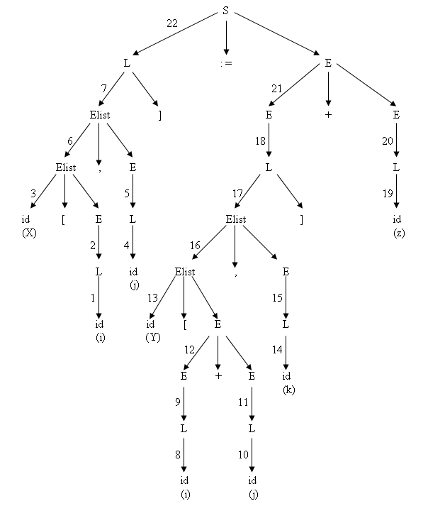
Parse Tree

Slide 7
Example - X [i , j] : = Y [ i + j, k] + z
t1 : = i * d1
t2 : = t1 + j
t3 : = c(X)
t4 : = t2 * width(X)
t5 : = i + j
t6 : = t5 * d4
t7 : = t6 + k
t8 : = c(Y)
t9 : = t7 * width(Y)
t10 : = t8[t9]
t11 : = t10 + z
t3[t4] : = t11

