Slide 1
IN LINE FUNCTION AND MACRO
Macro is processed at precompilation time.
An Inline function is processed at compilation time.
Example : let us consider this C Program
# include <stdio.h>
inlinemax(int a,int b)
{
(a > b) ? a : b ;
}
macromax(int a,int b)
{
(a > b) ? a : b ;
}
main( )
{
int a=1,b=2;
inlinemax(++a,++b);
mmax(++a,++b);
}

Slide 2
In this program :
In macromax(MACRO) , a and b are incremented twice. This is because here ++a
and ++b are copied instead of a and b .
In inlinemax(INLINE FUNCTION), a and b are incremented only once.
-----------------------------------------------------------------------------------------------
LAEXICAL ANALYSER
-----------------------------------------------------------------------------------------------
THE ROLE OF LEXICAL ANALYSER :
It is the first phase of the compiler. It reads the input characters and produces
as output a sequence of tokens that the parser uses for syntax analysis.it also stripps
out from the source program comments and white spaces in the form of blank , tab ,
and newline characters .it also correlates error messages from the compiler with the
source program.
NOTE: here merging of lexical analyser and syntax analyzer is possible-----------
LEXICAL SYNTAX ANALYSER

Slide 3
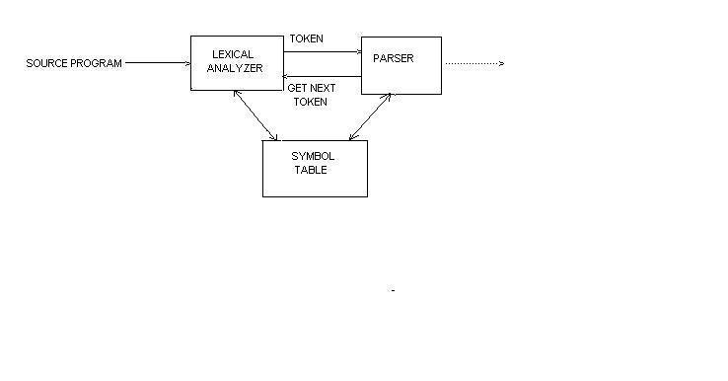
Interaction of lexical analyzer withparser
CREATING A LEXICAL ANALYSER WITH LEX:
* Lex program (lex.l) -------------->LEX COMPILER--------------------->lex.yy.c
* lex.yy.c ---------------->C COMPILER --------------------> a.out
* input stream -----------------> a.out ----------------> sequences of tokens

Slide 4
TYPES OF TOKENS :
INDETIFIERS : has attributes …which contains entry point in the symbol table
CONSTANTS : two types (1) integer , and (2) real
KEYWORDS : (if, while , for , else)
OPERATORS : * ,+ ,(, ), -
RELATION : <,<=,=,<>,>,>= etc
PUNCTUATIONS : , and ; and : etc
LITERAL STRINGS : printf (“hello”)
IDENTIFIERS :
RULES :
Start with a _(underscore) or alphabet followed by digit / alphabet / _
_ _ _ [digit] is a variable.
_ _ _ is not a variable .
_ _ _ [alphabet] is a variable
REGULAR EXPRESSION FOR IDENTIFIERS :
( _ ) (alphabet / _ digit ) (alphabet / digit / _ ) *

Slide 5
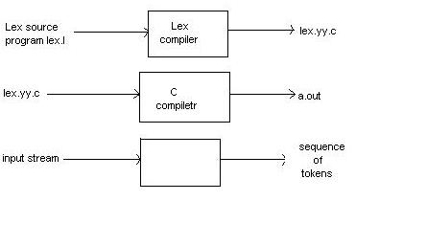
BUILDING LEXICAL ANALYZER USING LEX TOOLS:
Using lex tools one can build a lexical analyzer in an easy way. For this ,
A specification of a lexical analyzer is prepared by creating a program lex.l in
the lex language. Then, lex.l is run through the Lex compiler to produce a C
program lex.yy.c . The program lex.yy.c consists of a tabular representation
of a trasition diagram constructed from the regular expressions of lex.l,
together with a standard routine that uses the table to recognize lexemes.
The actions associated with regular expressions in lex.l are pieces of C code
and are carried over directly to lex.yy.c . Finally, lex.yy.c is run through the C
compiler to produce an object program a.out, which is the lexical analyzer
that transforms an input stream into a sequence of tokens.
Creating a lexical analyzer with Lex.

Slide 6
LEX SPECIFICATIONS:
A Lex program cinsists of three parts:
declarations
%%
translation rules
%%
auxillary procedures
The declarations section includes declarations of variables,manifest constants,
and regular definitions.
The translation rules of a Lex program are statements of the form
p1 { action1 }
p2 { action2 }
…………………….
pn { action n }
where each p is a regular expression and each action is a program fragment
describing what action the lexical analyzer should take when pattern p matches
a lexeme.
The third section holds whatever auxiliary procedures are needed by the actions.

