Slide 1

General Announcements
CS10001: Programming & Data Structures
Dept. of Computer Sc. & Engg.,
Indian Institute of Technology Kharagpur

Slide 2
Items
Load and Credit Distribution
Availability of Course Material
Attendance matters
References

Slide 3
About the Course
L-T-P rating of 3-1-0.
There is a separate laboratory of 0-0-3.
  Grading will be separate.
Tutorial classes (one hour per week) will be conducted on a “per section” basis.
Evaluation in the theory course:
  Mid-semester 30%
  End-semester 50%
  Two class tests and attendance 20%
  5% of all components for regularity & performance

Slide 4
Course Materials
The slides for the lectures will be made available on the web (in PDF form).
  http://144.16.192.60/~pds
All important announcements will be put up on the web page.
A copy of the slides will be kept at the Ramakrishna Xerox Centre. You may choose to bring the handouts to the class and take notes on them.

Slide 5
Attendance REALLY matters
Students having poor attendance will loose credits
Any student with less than 75% attendance may be debarred from appearing in the examinations
Leave due to medical reasons must be certified by the B.C. Roy Technology Hospital

Slide 6
Text / Reference Books
Classroom lectures are not substitutes for books. You must use reference books to clarify your doubts and enhance your knowledge.
Programming with C (Second Edition)
  B.S. Gottfried, Schaum’s Outline Series, Tata McGraw-Hill, 2006.
Programming in ANSI C (Second Edition)
  E. Balagurusamy, Tata McGraw-Hill, New Delhi, 1992.
Data structures
  S. Lipschutz, Schaum’s Outline Series, Tata McGraw-Hill, 2006.
Data structures using C and C++ (Second Edition)
  Y. Langsam, M.J. Augenstein, A.M. Tanenbaum, Prentice-Hall of India.

Slide 7
Acknowledgements
Several slides used in my presentations are adapted from the slides used by Prof. Indranil Sengupta when he took this course a few semesters ago.

Slide 8
Introduction
CS10001: Programming & Data Structures
Niloy Ganguly
Dept. of Computer Sc. & Engg.,
Indian Institute of Technology Kharagpur

Slide 9
The Evolution of Electronic Computing
Communication
becoming
Free !!
Storage
became
Free !!
Computation
became
Free !!
1980
1990
2000
2010

Slide 10
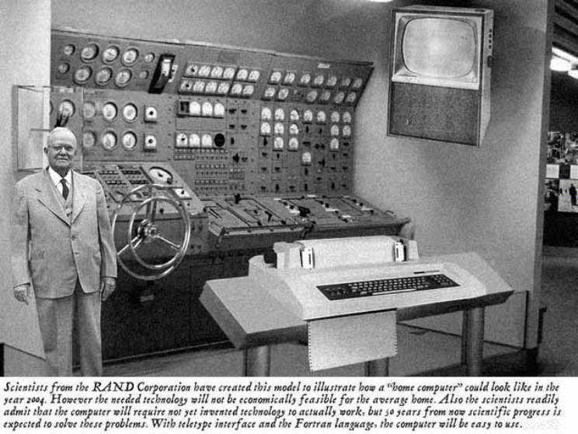
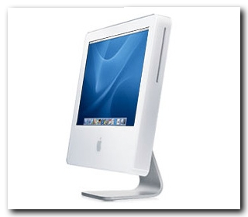
Home Computer @ 2004: Predicted versus Real
Predicted in 1954
Reality

Slide 11

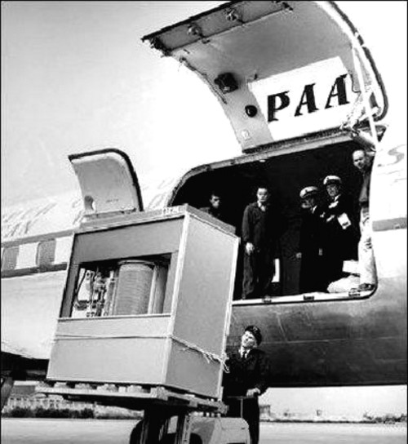
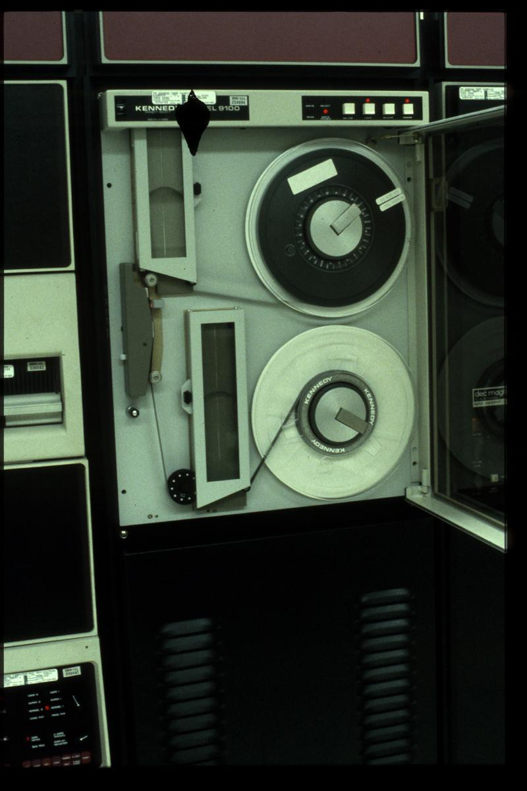
Storage has become free!!
Magnetic Tape Drive
4 GB Pen Drive
5 MB Hard Disk [1956]

Slide 12
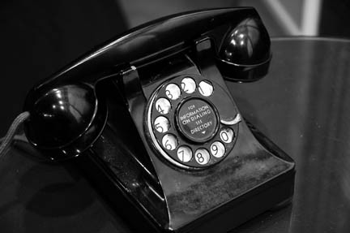
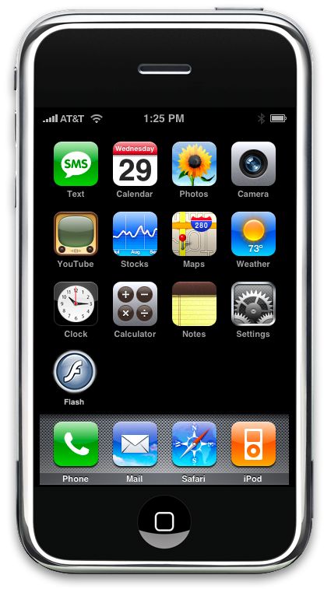
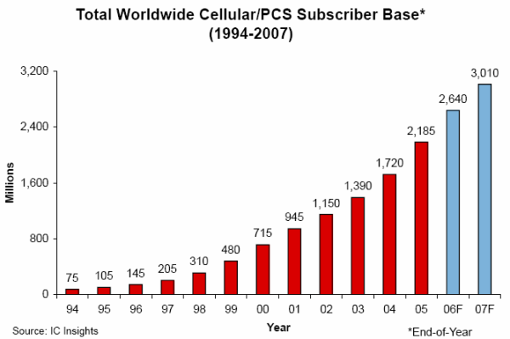
Communication??

Slide 13

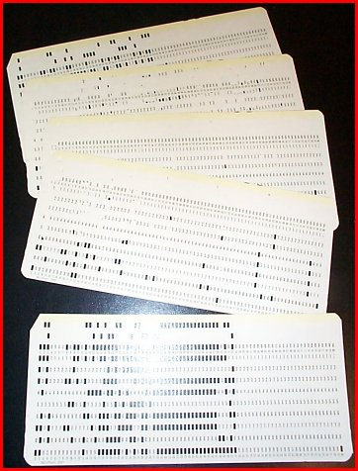
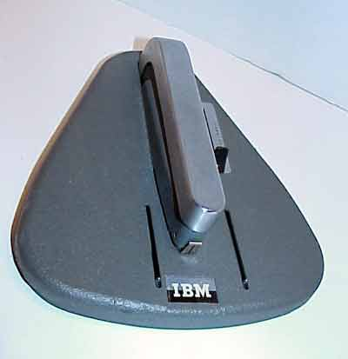
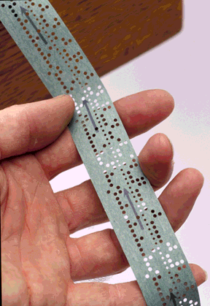
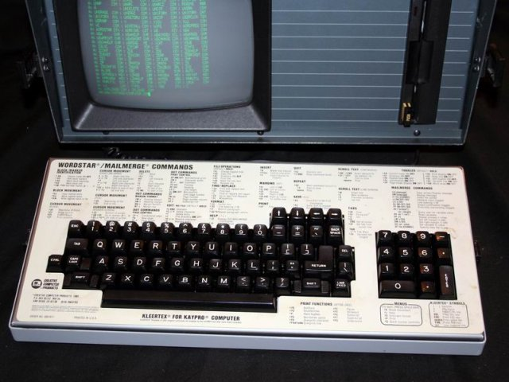
Interfaces
A Bluetooth Laser
Virtual Keyboard
From punch cards
to paper tapes
to keyboards

Slide 14
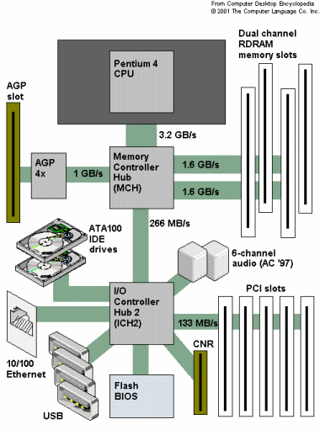
Architecture
Typical system architecture
for a desktop PC

Slide 15
CPU (Central Processing Unit)
  All computations take place here in order for the computer to perform a designated task.
  It has a large number of registers which temporarily store data and programs (instructions).
  It has functional units (circuitry) to carry out arithmetic and logic operations
  It retrieves instructions from the memory, interprets (decodes) them, and performs the requested operation
  Fetch → Decode → Execute cycle
CPU is also referred to as the processor
Computers may have multiple processors
Modern processors are multi-core (multiple processors in one chip)

Slide 16
Main Memory
  Uses semiconductor technology
    Allows direct access
  Memory sizes in the range of 256 MegaBytes to 8 GigaBytes are typical today.
  Some measures to be remembered
    1 K = 2¹⁰ (= 1024)
    1 M = 2²⁰ (= one million approx.)
    1 G = 2³⁰ (= one billion approx.)

Slide 17
I/O and Peripherals
Input Device
  Keyboard, Mouse, Scanner, Digital Camera
Output Device
  Monitor, Printer
Storage Peripherals
  Magnetic Disks: hard disk, floppy disk
    Allows direct (semi-random) access
  Optical Disks: CDROM, CD-RW, DVD
    Allows direct (semi-random) access
  Flash Memory: pen drives
    Allows direct access
  Magnetic Tape: DAT
    Only sequential access

Slide 18
Typical Configuration of a PC
CPU: Pentium IV, 3 GHz
Main Memory: 1 GB
Hard Disk: 160 GB
Floppy Disk: Not present
CDROM: DVD combo-drive
Input Device: Keyboard, Mouse
Output Device: 17” color monitor
Ports: USB, Firewire, Infrared

Slide 19
How does a computer work?
Stored program concept.
  Main difference from a calculator.
What is a program?
  Set of instructions for carrying out a specific task.
Where are programs stored?
  In secondary memory, when first created.
  Brought into main memory, during execution.

Slide 20
Number System – The Basics
We are accustomed to using the so-called decimal number system.
  Ten digits :: 0,1,2,3,4,5,6,7,8,9
  Every digit position has a weight which is a power of 10.
Examples:
  234 = 2 x 10² + 3 x 10¹ + 4 x 10⁰
  250.67 = 2 x 10² + 5 x 10¹ + 0 x 10⁰ + 6 x 10⁻¹ + 7 x 10⁻²

Slide 21
A computer works on the binary number system
Binary number system:
  Two digits :: 0,1
  Every digit position has a weight which is a power of 2.
Examples:
  101 (Binary) = 1 x 2² + 0 x 2¹ + 1 x 2⁰ = 5 (Decimal)
  11001 (Binary)
  = 1 x 2⁴ + 1 x 2³ + 0 x 2² + 0 x 2¹ + 1 x 2⁰
  = 25 (Decimal)

Slide 22
Bits and Bytes
Bit
  A single binary digit (0 or 1).
Nibble
  A collection of four bits (say, 0110).
Byte
  A collection of eight bits (say, 01000111).
Word
  Depends on the computer.
  Typically 4 or 8 bytes (that is, 32 or 64 bits).

Slide 23
Contd.
An k-bit decimal number
  Can express unsigned integers in the range
  0 to 10^{k} – 1
    For k=3, from 0 to 999.
An k-bit binary number
  Can express unsigned integers in the range
  0 to 2^{k} – 1
    For k=8, from 0 to 255.
    For k=10, from 0 to 1023.

Slide 24
Classification of Software
Two categories:
  Application Software
    Used to solve a particular problem.
    Editor, financial accounting, weather forecasting, etc.
  System Software
    Helps in running other programs.
    Compiler, operating system, etc.

Slide 25
Computer Languages
Machine Language
  Expressed in binary.
  Directly understood by the computer.
  Not portable; varies from one machine type to another.
    Program written for one type of machine will not run on another type of machine.
  Difficult to use in writing programs.

Slide 26
Contd.
Assembly Language
  Mnemonic form of machine language.
  Easier to use as compared to machine language.
    For example, use “ADD” instead of “10110100”.
  Not portable (like machine language).
  Requires a translator program called assembler.
Assembly language program
Assembler
Machine language program

Slide 27
Contd.
Assembly language is also difficult to use in writing programs.
  Requires many instructions to solve a problem.
Example: Find the average of three numbers.
    MOV A,X ; A = X
    ADD A,Y ; A = A + Y
    ADD A,Z ; A = A + Z
    DIV A,3 ; A = A / 3
    MOV RES,A ; RES = A
In C,
RES = (X + Y + Z) / 3

Slide 28
High-Level Language
Machine language and assembly language are called low-level languages.
  They are closer to the machine.
  Difficult to use.
High-level languages are easier to use.
  They are closer to the programmer.
  Examples:
    Fortran, Cobol, C, C++, Java.
  Requires an elaborate process of translation.
    Using a software called compiler.
  They are portable across platforms.

Slide 29
From HLL to executable
HLL
Program
Compiler
Linker
Object
Code
Executable
Code
Libraries

Slide 30
Operating Systems
Makes the computer easy to use.
  Basically the computer is very difficult to use.
  Understands only machine language.
Operating systems make computers easy to use.
Categories of operating systems:
  Single user
  Multi user
    Time sharing
    Multitasking
    Real time

Slide 31
Contd.
Popular operating systems:
  Windows 2000/XP: single-user multitasking
  Unix: multi-user
  Linux: a free version of Unix
The laboratory class will be based on Linux.
Question:
  How multiple users can work on the same computer?

Slide 32
Contd.
Computers connected in a network.
Many users may work on a computer.
  Over the network.
  At the same time.
  CPU and other resources are shared among the different programs.
    Called time sharing.
    One program executes at a time.

Slide 33
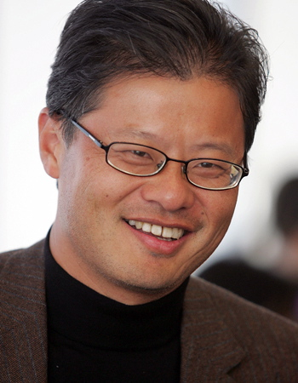
Quiz

Slide 34
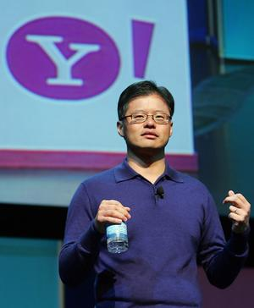
Quiz

Slide 35
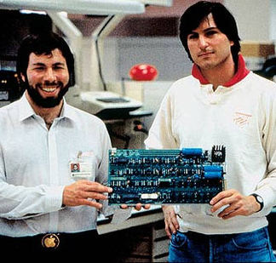
Quiz

Slide 36

Quiz

Slide 37

Quiz

Slide 38

Quiz

Slide 39
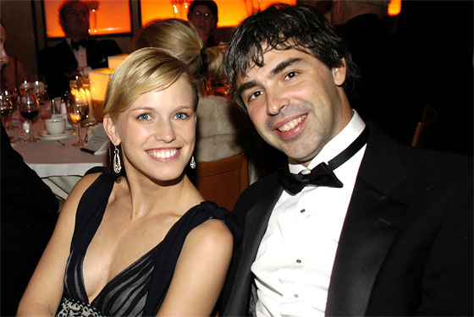
Quiz

Slide 40
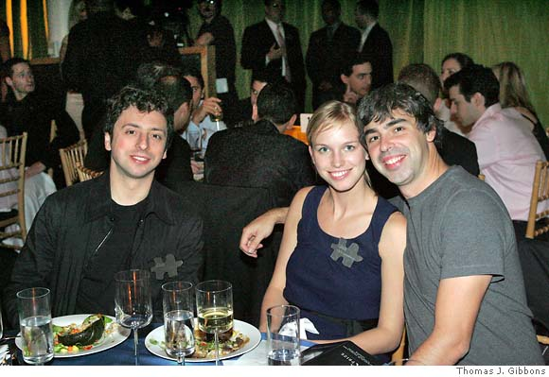
Quiz

Slide 41
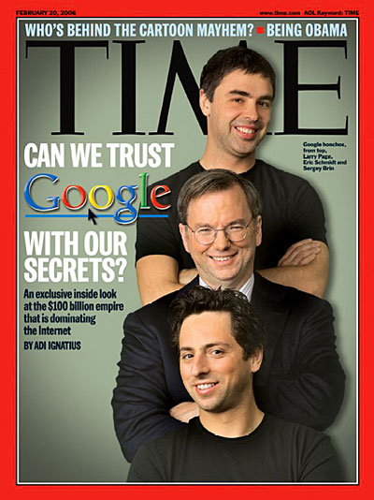
Quiz

Slide 42
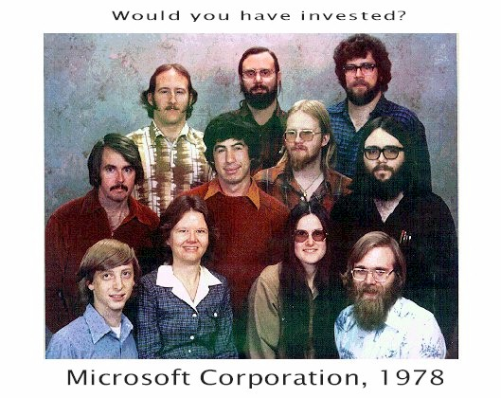
Quiz

Slide 43
Basic Programming Concepts
CS10001: Programming & Data Structures
Niloy Ganguly
Dept. of Computer Sc. & Engg.,
Indian Institute of Technology Kharagpur

Slide 44
Some Terminologies
Algorithm / Flowchart
  A step-by-step procedure for solving a particular problem.
  Independent of the programming language.
Program
  A translation of the algorithm/flowchart into a form that can be processed by a computer.
  Typically written in a high-level language like C, C++, Java, etc.

Slide 45
Variables and Constants
Most important concept for problem solving using computers
All temporary results are stored in terms of variables
  The value of a variable can be changed.
  The value of a constant do not change.
Where are they stored?
  In main memory.

Slide 46
Contd.
How does memory look like (logically)?
  As a list of storage locations, each having a unique address.
  Variables and constants are stored in these storage locations.
  A variable is like a bin
    The contents of the bin is the value of the variable
    The variable name is used to refer to the value of the variable
    A variable is mapped to a location of the memory, called its address

Slide 47
Memory map
Address 0
Address 1
Address 2
Address 3
Every variable is mapped to a particular memory address
Address 4
Address 5
Address 6
Address N-1

Slide 48
Variables in Memory
Instruction executed
Variable X
X = 10
10
T
i
m
e
X = 20
20
X = X + 1
21
X = X * 5
105

Slide 49
Variables in Memory (contd.)
Variable
X Y
Instruction executed
X = 20
20
?
T
i
m
e
Y = 15
20
15
X = Y + 3
18
15
Y = X / 6
18
3

Slide 50
Data Types
Three common data types used:
  Integer :: can store only whole numbers
    Examples: 25, -56, 1, 0
  Floating-point :: can store numbers with fractional values.
    Examples: 3.14159, 5.0, -12345.345
  Character :: can store a character
    Examples: ‘A’, ‘a’, ‘*’, ‘3’, ‘ ’, ‘+’

Slide 51
Data Types (contd.)
How are they stored in memory?
  Integer ::
    16 bits
    32 bits
  Float ::
    32 bits
    64 bits
  Char ::
    8 bits (ASCII code)
    16 bits (UNICODE, used in Java)
Actual number of bits vary from one computer to another

Slide 52
Problem solving
Step 1:
  Clearly specify the problem to be solved.
Step 2:
  Draw flowchart or write algorithm.
Step 3:
  Convert flowchart (algorithm) into program code.
Step 4:
  Compile the program into object code.
Step 5:
  Execute the program.

Slide 53
Flowchart: basic symbols
Computation
Input / Output
Decision Box
Start / Stop

Slide 54
Contd.
Flow of control
Connector

Slide 55
Example 1: Adding three numbers
START
READ A, B, C
S = A + B + C
OUTPUT S
STOP

Slide 56
Example 2: Larger of two numbers
START
READ X, Y
YES
IS
X>Y?
NO
OUTPUT X
OUTPUT Y
STOP
STOP

Slide 57
Example 3: Largest of three numbers
START
READ X, Y, Z
YES
IS
X > Y?
NO
Max = X
Max = Y
YES
IS
Max > Z?
NO
OUTPUT Max
OUTPUT Z
STOP
STOP

Slide 58
Example 4: Sum of first N natural numbers
START
READ N
SUM = 0
COUNT = 1
SUM = SUM + COUNT
COUNT = COUNT + 1
NO
IS
COUNT > N?
YES
OUTPUT SUM
STOP

Slide 59
Example 5: SUM = 1² + 2² + 3² + N²
START
READ N
SUM = 0
COUNT = 1
SUM = SUM + COUNT ∗ COUNT
COUNT = COUNT + 1
NO
IS
COUNT > N?
YES
OUTPUT SUM
STOP

Slide 60
Example 6: SUM = 1.2 + 2.3 + 3.4 + to N terms
START
READ N
SUM = 0
COUNT = 1
SUM = SUM + COUNT ∗ (COUNT + 1)
COUNT = COUNT + 1
NO
IS
COUNT > N?
YES
OUTPUT SUM
STOP

Slide 61
Example 7: Computing Factorial
START
READ N
PROD = 1
COUNT = 1
PROD = PROD * COUNT
COUNT = COUNT + 1
NO
IS
COUNT > N?
YES
OUTPUT PROD
STOP

Slide 62
Example 8: Computing e^{x} series up to N terms
START
READ X, N
TERM = 1
SUM = 0
COUNT = 1
SUM = SUM + TERM
TERM = TERM * X / COUNT
COUNT = COUNT + 1
NO
IS
COUNT > N?
YES
OUTPUT SUM
STOP

Slide 63
Example 8: Computing e^{x} series up to 4 decimal places
START
READ X, N
TERM = 1
SUM = 0
COUNT = 1
SUM = SUM + TERM
TERM = TERM * X / COUNT
COUNT = COUNT + 1
NO
IS
TERM < 0.0001?
YES
OUTPUT SUM
STOP

Slide 64
Example 10: Roots of a quadratic equation
ax² + bx + c = 0
TRY YOURSELF

Slide 65
Example 11: Grade computation
MARKS ≥ 90 ➔ Ex
89 ≥ MARKS ≥ 80 ➔ A
79 ≥ MARKS ≥ 70 ➔ B
69 ≥ MARKS ≥ 60 ➔ C
59 ≥ MARKS ≥ 50 ➔ D
49 ≥ MARKS ≥ 35 ➔ P
34 ≥ MARKS ➔ F

Slide 66
Grade Computation (contd.)
START
READ MARKS
MARKS ≥ 90?
NO
NO
NO
MARKS ≥ 80?
MARKS ≥ 70?
A
YES
YES
YES
OUTPUT “Ex”
OUTPUT “A”
OUTPUT “B”
STOP
STOP
STOP

Slide 67
NO
NO
NO
MARKS ≥ 60?
MARKS ≥ 50?
MARKS ≥ 35?
A
YES
YES
YES
OUTPUT “C”
OUTPUT “D”
OUTPUT “P”
OUTPUT “F”
STOP
STOP
STOP
STOP

Slide 68
Programming in C: Basics
CS10001: Programming & Data Structures
Niloy Ganguly
Dept. of Computer Sc. & Engg.,
Indian Institute of Technology Kharagpur

Slide 69
History of C
Originally developed in the 1970’s by Dennis Ritchie at AT&T Bell Laboratories.
  Outgrowth of two earlier languages BCPL and B.
Popularity became widespread by the mid 1980’s, with the availability of compilers for various platforms.
Standardization has been carried out to make the various C implementations compatible.
  American National Standards Institute (ANSI)
  GNU

Slide 70
Why teach C?
C is small (only 32 keywords).
C is common (lots of C code about).
C is stable (the language doesn’t change much).
C is quick running.
C is the basis for many other languages (Java, C++, awk, Perl).
It may not feel like it but C is one of the easiest languages to learn.

Slide 71
Some programmer jargon
Some words that will be used a lot:
  Source code: The stuff you type into the computer. The program you are writing.
  Compile (build): Taking source code and making a program that the computer can understand.
  Executable: The compiled program that the computer can run.
  Language: The core part of C central to writing C code.
  Library: Added functions for C programming which are bolted on to do certain tasks.
  Header file: Files ending in .h which are included at the start of source code.

Slide 72
Our First C Program: Hello World
Preprocessor
#include <stdio.h>
/* This program prints “Hello World” */
main()
{
printf(“Hello World!\n”);
}
Comments are good
main( ) means “start here”
Library command
Brackets define code blocks

Slide 73
C doesn’t care much about spaces
#include <stdio.h> /* This program prints “Hello World” */
int main( ) {printf(“Hello World!\n”);}
#include <stdio.h>
/* This program
prints “Hello
World”
*/
int
main( )
{
printf(“Hello
World!
\n”)
;
}
Both of these programs are exactly
the same as the original as far as
your compiler is concerned.

Slide 74
Keywords of C
Flow control (6) – if, else, return, switch, case, default
Loops (5) – for, do, while, break, continue
Common types (5) – int, float, double, char, void
structures (3) – struct, typedef, union
Counting and sizing things (2) – enum, sizeof
Rare but still useful types (7) – extern, signed, unsigned, long, short, static, const
Evil keywords which we avoid (1) – goto
Wierdies (3) – auto, register, volatile

Slide 75
The C Character Set
The C language alphabet:
  Uppercase letters ‘A’ to ‘Z’
  Lowercase letters ‘a’ to ‘z’
  Digits ‘0’ to ‘9’
  Certain special characters:
! # % ^ & * ( )
_ + = ~ [ ] \
| ; : ‘ “ { } ,
. < > / ? blank

Slide 76
Some simple operations for variables
In addition to +, -, * and / we can also use
+=, -=, *=, /=, -- and % (modulo)
  n++ increment n
  n-- decrement n
  a+=5 is equivalent to a = a+5;
  a-=5 is equivalent to a = a-5;
  a*=5 is equivalent to a = a*5;
  a/=5 is equivalent to a = a/5;
  (x % y) gives the remainder when x is divided by y

Slide 77
Types of variable
We must declare the type of every variable we use in C.
Every variable has a type (e.g. int) and a name.
This prevents some bugs caused by spelling errors (misspelling variable names).
Declarations of types should always be together at the top of main or a function (see later).
Other types are char, signed, unsigned, long, short and const.

Slide 78
Identifiers and Keywords
Identifiers
  Names given to various program elements (variables, constants, functions, etc.)
  May consist of letters, digits and the underscore (‘_’) character, with no space between.
  First character must be a letter or underscore.
  An identifier can be arbitrary long.
    Some C compilers recognize only the first few characters of the name (16 or 31).
  Case sensitive
    ‘area’, ‘AREA’ and ‘Area’ are all different.

Slide 79
Valid and Invalid Identifiers
Valid identifiers
  X
  abc
  simple_interest
  a123
  LIST
  stud_name
  Empl_1
  Empl_2
  avg_empl_salary
Invalid identifiers
  10abc
  my-name
  “hello”
  simple interest
  (area)
  %rate

Slide 80
Another Example: Adding two numbers
START
#include <stdio.h>
main()
{
int a, b, c;
scanf(“%d%d”,&a, &b);
c = a + b;
printf(“%d”,c);
}
Variable Declaration
READ A, B
C = A + B
PRINT C
STOP

Slide 81
Example: Largest of three numbers
#include <stdio.h>
/* FIND THE LARGEST OF THREE NUMBERS */
main()
{
int a, b, c, max;
scanf (“%d %d %d”, &x, &y, &z);
if (x>y)
max = x;
else max = y;
if (max > z)
printf(“Largest is %d”, max);
else printf(“Largest is %d”, z);
}
START
READ X, Y, Z
YES
IS
X > Y?
NO
Max = X
Max = Y
YES
IS
Max > Z?
NO
OUTPUT Max
OUTPUT Z
STOP
STOP

Slide 82
Largest of three numbers: Another way
#include <stdio.h>
/* FIND THE LARGEST OF THREE NUMBERS */
main()
{
int a, b, c;
scanf (“%d %d %d”, &a, &b, &c);
if ((a>b) && (a>c)) /* Composite condition check */
printf (“\n Largest is %d”, a);
else
if (b>c) /* Simple condition check */
printf (“\n Largest is %d”, b);
else
printf (“\n Largest is %d”, c);
}

Slide 83
Use of functions: Area of a circle
#include <stdio.h>
#define PI 3.1415926
/* Function to compute the area of a circle */
float myfunc (float r)
{ float a;
a = PI * r * r;
return (a); /* return result */
}
main()
{ float radius, area;
float myfunc (float radius);
scanf (“%f”, &radius);
area = myfunc (radius);
printf (“\n Area is %f \n”, area);
}
Macro definition
Function definition
Function argument
Function declaration
(return value defines the type)
Function call

Slide 84
Structure of a C program
Every C program consists of one or more functions.
  One of the functions must be called main.
  The program will always begin by executing the main function.
Each function must contain:
  A function heading, which consists of the function name, followed by an optional list of arguments enclosed in parentheses.
  A list of argument declarations.
  A compound statement, which comprises the remainder of the function.

Slide 85
Desirable Programming Style
Clarity
  The program should be clearly written.
  It should be easy to follow the program logic.
Meaningful variable names
  Make variable/constant names meaningful to enhance program clarity.
    ‘area’ instead of ‘a’
    ‘radius’ instead of ‘r’
Program documentation
  Insert comments in the program to make it easy to understand.
  Never use too many comments.
Program indentation
  Use proper indentation.
  Structure of the program should be immediately visible.

Slide 86
Indentation Example: Good Style
#include <stdio.h>
/* FIND THE LARGEST OF THREE NUMBERS */
main()
{
int a, b, c;
scanf(“%d%d%d”, &a, &b, &c);
if ((a>b) && (a>c))
printf(“\n Largest is %d”, a);
else
if (b>c)
printf(“\n Largest is %d”, b);
else
printf(“\n Largest is %d”, c);
}

Slide 87
Indentation Example: Bad Style
#include <stdio.h>
/* FIND THE LARGEST OF THREE NUMBERS */
main()
{
int a, b, c;
scanf(“%d%d%d”, &a, &b, &c);
if ((a>b) && (a>c))
printf(“\n Largest is %d”, a);
else
if (b>c)
printf(“\n Largest is %d”, b);
else
printf(“\n Largest is %d”, c);
}

Slide 88
Data Types in C
int :: integer quantity
  Typically occupies 4 bytes (32 bits) in memory.
char :: single character
  Typically occupies 1 bye (8 bits) in memory.
float :: floating-point number (a number with a decimal point)
  Typically occupies 4 bytes (32 bits) in memory.
double :: double-precision floating-point number

Slide 89
Contd.
Some of the basic data types can be augmented by using certain data type qualifiers:
  short
  long
  signed
  unsigned
Typical examples:
  short int
  long int
  unsigned int

Slide 90
Some Examples of Data Types
int
  0, 25, -156, 12345, −99820
char
  ‘a’, ‘A’, ‘*’, ‘/’, ‘ ’
float
  23.54, −0.00345, 25.0
  2.5E12, 1.234e-5
E or e means “10 to the power of”

Slide 91
Constants
Constants
Numeric
Constants
Character
Constants
integer
floating-point
single
character
string

Slide 92
Integer Constants
Consists of a sequence of digits, with possibly a plus or a minus sign before it.
  Embedded spaces, commas and non-digit characters are not permitted between digits.
Maximum and minimum values (for 32-bit representations)
  Maximum :: 2147483647
  Minimum :: – 2147483648

Slide 93
Floating-point Constants
Can contain fractional parts.
Very large or very small numbers can be represented.
  23000000 can be represented as 2.3e7
Two different notations:
  Decimal notation
    25.0, 0.0034, .84, -2.234
  Exponential (scientific) notation
    3.45e23, 0.123e-12, 123E2
e means “10 to the power of”

Slide 94
Single Character Constants
Contains a single character enclosed within a pair of single quote marks.
  Examples :: ‘2’, ‘+’, ‘Z’
Some special backslash characters
  ‘\n’ new line
  ‘\t’ horizontal tab
  ‘\’’ single quote
  ‘\”’ double quote
  ‘\\’ backslash
  ‘\0’ null

Slide 95
String Constants
Sequence of characters enclosed in double quotes.
  The characters may be letters, numbers, special characters and blank spaces.
Examples:
  “nice”, “Good Morning”, “3+6”, “3”, “C”
Differences from character constants:
  ‘C’ and “C” are not equivalent.
  ‘C’ has an equivalent integer value while “C” does not.

Slide 96
Declaration of Variables
There are two purposes:
    It tells the compiler what the variable name is.
    It specifies what type of data the variable will hold.
General syntax:
    data-type variable-list;
Examples:
  int velocity, distance;
  int a, b, c, d;
  float temp;
  char flag, option;

Slide 97
A First Look at Pointers
A variable is assigned a specific memory location.
  For example, a variable speed is assigned memory location 1350.
  Also assume that the memory location contains the data value 100.
  When we use the name speed in an expression, it refers to the value 100 stored in the memory location.
      distance = speed * time;
Thus every variable has an address (in memory), and its contents.

Slide 98
Contd.
In C terminology, in an expression
  speed refers to the contents of the memory location.
  &speed refers to the address of the memory location.
Examples:
  printf (“%f %f %f”, speed, time, distance);
  scanf (“%f %f”, &speed, &time);

Slide 99
An Example
#include <stdio.h>
main()
{
float speed, time, distance;
scanf (“%f %f”, &speed, &time);
distance = speed * time;
printf (“\n The distance traversed is: \n”, distance);
}

Slide 100
Assignment Statement
Used to assign values to variables, using the assignment operator (=).
General syntax:
  variable_name = expression;
Examples:
  velocity = 20;
  b = 15; temp = 12.5;
  A = A + 10;
  v = u + f * t;
  s = u * t + 0.5 * f * t * t;

Slide 101
Contd.
A value can be assigned to a variable at the time the variable is declared.
  int speed = 30;
  char flag = ‘y’;
Several variables can be assigned the same value using multiple assignment operators.
  a = b = c = 5;
  flag1 = flag2 = ‘y’;
  speed = flow = 0.0;

Slide 102
Operators in Expressions
Operators
Arithmetic
Operators
Relational
Operators
Logical
Operators

Slide 103
Arithmetic Operators
Addition :: +
Subtraction :: –
Division :: /
Multiplication :: *
Modulus :: %
Examples:
  distance = rate * time ;
  netIncome = income - tax ;
  speed = distance / time ;
  area = PI * radius * radius;
  y = a * x * x + b*x + c;
  quotient = dividend / divisor;
  remain =dividend % divisor;

Slide 104
Contd.
Suppose x and y are two integer variables, whose values are 13 and 5 respectively.
x + y | 18
x – y | 8
x * y | 65
x / y | 2
x % y | 3

Slide 105
Operator Precedence
In decreasing order of priority
    Parentheses :: ( )
    Unary minus :: –5
    Multiplication, Division, and Modulus
    Addition and Subtraction
For operators of the same priority, evaluation is from left to right as they appear.
Parenthesis may be used to change the precedence of operator evaluation.

Slide 106
Examples: Arithmetic expressions
  a + b * c – d / e ➔ a + (b * c) – (d / e)
  a * – b + d % e – f ➔ a * (– b) + (d % e) – f
  a – b + c + d ➔ (((a – b) + c) + d)
  x * y * z ➔ ((x * y) * z)
  a + b + c * d * e ➔ (a + b) + ((c * d) * e)

Slide 107
Integer Arithmetic
When the operands in an arithmetic expression are integers, the expression is called integer expression, and the operation is called integer arithmetic.
Integer arithmetic always yields integer values.

Slide 108
Real Arithmetic
Arithmetic operations involving only real or floating-point operands.
Since floating-point values are rounded to the number of significant digits permissible, the final value is an approximation of the final result.
  1.0 / 3.0 * 3.0 will have the value 0.99999 and not 1.0
The modulus operator cannot be used with real operands.

Slide 109
Mixed-mode Arithmetic
When one of the operands is integer and the other is real, the expression is called a mixed-mode arithmetic expression.
If either operand is of the real type, then only real arithmetic is performed, and the result is a real number.
  25 / 10 ➔ 2
  25 / 10.0 ➔ 2.5
Some more issues will be considered later.

Slide 110
Type Casting
int a=10, b=4, c;
float x, y;
c = a / b;
x = a / b;
y = (float) a / b;
The value of c will be 2
The value of x will be 2.0
The value of y will be 2.5

Slide 111
Relational Operators
Used to compare two quantities.
< is less than
> is greater than
<= is less than or equal to
>= is greater than or equal to
== is equal to
!= is not equal to

Slide 112
Examples
  10 > 20 is false
  25 < 35.5 is true
  12 > (7 + 5) is false
When arithmetic expressions are used on either side of a relational operator, the arithmetic expressions will be evaluated first and then the results compared.
  a + b > c – d is the same as (a+b) > (c+d)

Slide 113
Examples
Sample code segment in C
    if (x > y)
    printf (“%d is larger\n”, x);
    else
    printf (“%d is larger\n”, y);

Slide 114
Logical Operators
There are two logical operators in C (also called logical connectives).
  && ➔ Logical AND
  | | ➔ Logical OR
What they do?
  They act upon operands that are themselves logical expressions.
  The individual logical expressions get combined into more complex conditions that are true or false.

Slide 115
Logical Operators
  Logical AND
    Result is true if both the operands are true.
  Logical OR
    Result is true if at least one of the operands are true.
X | Y | X && Y | X | | Y
FALSE | FALSE | FALSE | FALSE
FALSE | TRUE | FALSE | TRUE
TRUE | FALSE | FALSE | TRUE
TRUE | TRUE | TRUE | TRUE

Slide 116
Input / Output
printf
  Performs output to the standard output device (typically defined to be the screen).
  It requires a format string in which we can specify:
    The text to be printed out.
    Specifications on how to print the values.
    printf ("The number is %d.\n", num) ;
    The format specification %d causes the value listed after the format string to be embedded in the output as a decimal number in place of %d.
    Output will appear as: The number is 125.

Slide 117
Input / Output
scanf
  Performs input from the standard input device, which is the keyboard by default.
  It requires a format string and a list of variables into which the value received from the input device will be stored.
  It is required to put an ampersand (&) before the names of the variables.
    scanf ("%d", &size) ;
    scanf ("%c", &nextchar) ;
    scanf ("%f", &length) ;
    scanf (“%d %d”, &a, &b);

