Slide 1
A Cellular Automaton Model for an Immune System Derived Search Algorithm
  Niloy Ganguly, Andreas Deutsch
  Center for High Performance Computing
  Technical University
  Dresden, Germany

Slide 2
Talk Overview
Problem Definition
Cellular Automata Design
Experimental Results
Theoretical Explanation

Slide 3
Talk Overview
Problem Definition
Search in p2p Network
Immune Inspiration
Cellular Automata Design
Experimental Results
Theoretical Explanation

Slide 4
Unstructured Peer to Peer Networks
Each Network consists of peers (a, b, c, ..).
Peers host data (1, 2, 3, …)
5
a
4
b
1
a
2
b
3
4
d
6
d
5
e
e
2
c
3
c
g
7
g
7
1
6
f
f
Structured Network
Unstructured Network

Slide 5
Unstructured Networks
Searching in unstructured networks –
Non-deterministic Algorithms
Flooding, random walk
5
a
4
b
6?
3
d
6
e
2
c
6!!!
6?
6?
Our algorithms – Immune System inspired concept of packet proliferation
g
7
6?
1
6?
f
6?
Unstructured Network

Slide 6
Immune Inspiration
Affinity-governed proliferation based search algorithm
Message proliferation
Similarity (message, searched item)
Interaction between message and searched item
P2p Network
Query Message
Searched Item
Human Body
Antibody
Antigen

Slide 7
Talk Overview
Problem Definition
Cellular Automata Design
Representing network by a 2-dimensional CA
Data and query distribution
Update rules
Experimental Results
Theoretical Explanation

Slide 8
Mapping an unstructured network to a
2-dimensional CA
Network = (peers, neighborhood)
5
a
4
b
5
4
3
d
a
b
6
e
2
c
1
2
3
f
c
d
g
7
1
7
6
f
g
e
Peers host data
Asynchronous update

Slide 9
Query and Data Distribution
Query/Data
– 10-bit strings
– 1024 unique queries/data (tokens)
– Distribution based on Zipf’s law
power law - frequency of occurrence
of a token T α 1/r, rank of the token
eg. Most popular word = 1000 times
2nd most popular word = 500 times
3rd most popular word = 333 times
5
4
a
b
1
2
3
1001001001
f
c
d
7
6
1001001001?
g
e

Slide 10
CA Rules
Query Initiation Rule (QIR) – Start a search by flooding k query message packets to the neighborhood
Query Processing Rule (QPR) – Compare query message with data. Report a match if message = data.
Query Forwarding Rule (QFR) – Forward the message to the neighbors
a
b
a
b
5
4
5
4
6?
6?
1
2
3
1
2
3
f
c
d
f
c
d
6?
7
6
7
6
g
g
6 !
e
e
QIR
QPR

Slide 11
Query Forwarding Rules (QFR)
Proliferation Rules
Simple Proliferation (P)
Restricted Proliferation (RP)
Random Walk Rules
Simple Random Walk Rule (RW)
Restricted Random Walk Rule (RRW)

Slide 12
Proliferation Rules
Simple Proliferation (P)
Produce N message copies of the single message.
Spread the messages to the neighboring nodes
5
4
N = 3
b
a
1
2
3
f
c
d
7
6
g
e

Slide 13
Proliferation Rules
Restricted Proliferation (RP)
Produce N message copies of the single message.
Spread the messages to the neighboring nodes if free
5
4
N = 3
b
a
1
2
3
f
c
d
7
6
g
e

Slide 14
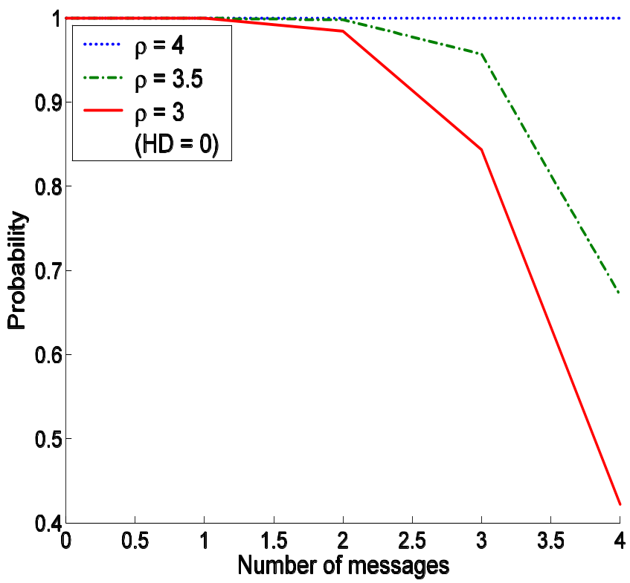
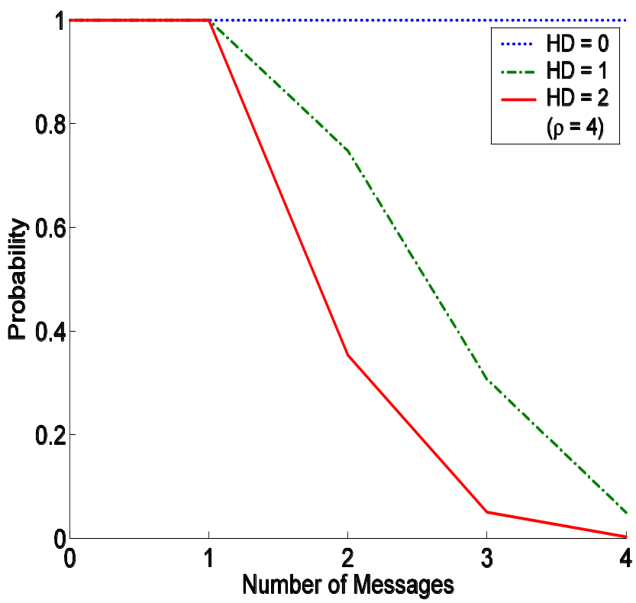
Proliferation Controlling Function
Production of message copies depends on
a. Proliferation constant (ρ)
b. Hamming distance between message and data
a
b

Slide 15
Random Walk Rules
Simple Random Walk (RW)
Forward the message to a randomly selected neighbor
5
4
a
b
1
2
3
f
c
d
7
6
g
e

Slide 16
Random Walk Rules
Restricted Random Walk (RRW)
Forward the message to a randomly selected free neighbor
5
4
a
b
1
2
3
f
c
d
7
6
g
e

Slide 17
Talk Overview
Problem Definition
Cellular Automata Design
Experimental Results
Experiment Coverage
Experiment Search
Theoretical Explanation

Slide 18
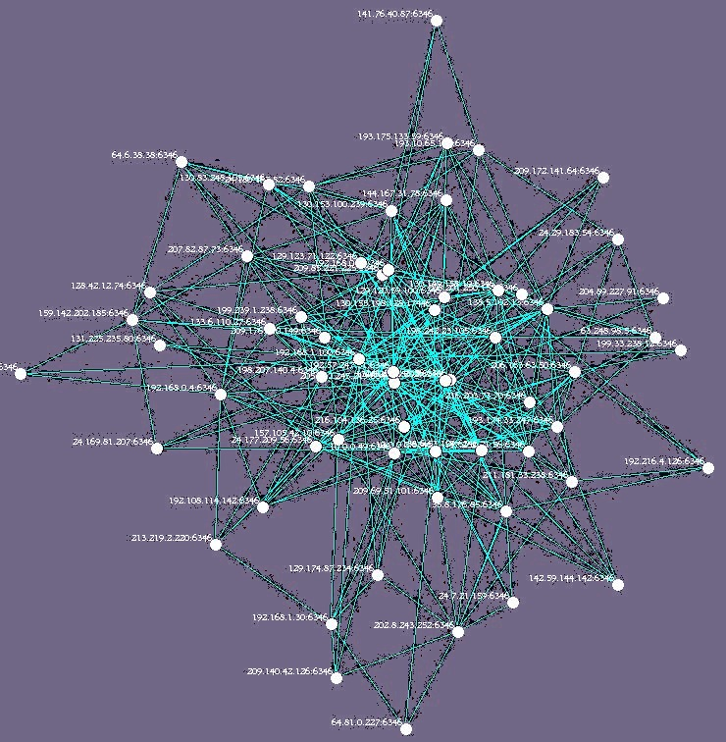
Experiment -1
Experiment Coverage – Calculate time taken to cover the entire network after initiation of a search from a randomly selected initial node. Repeated for 500 such searches.

Slide 19
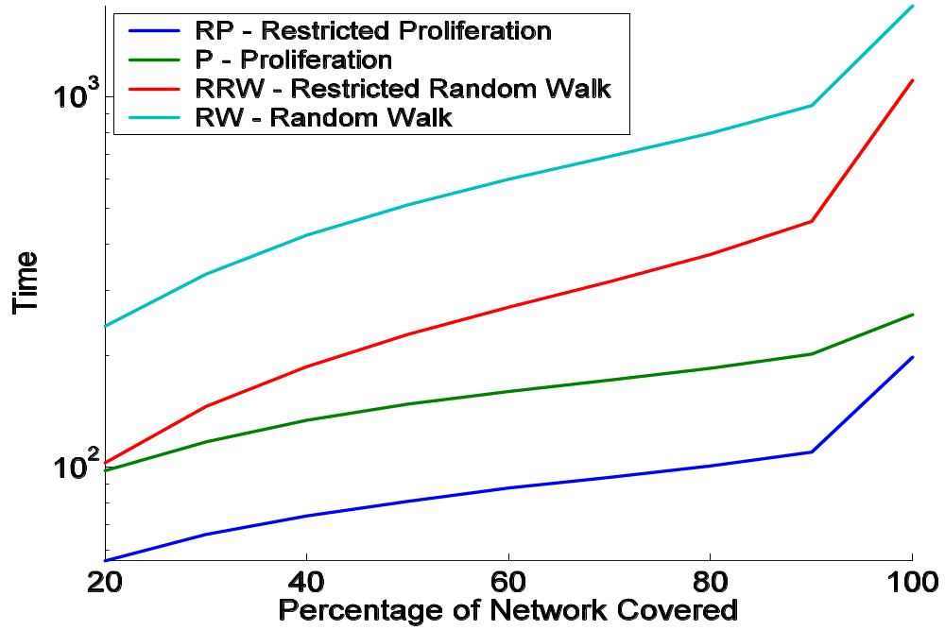
Performance of Different Schemes
Performance of restricted proliferation is best, followed by proliferation, restricted random walk and random walk.

Slide 20
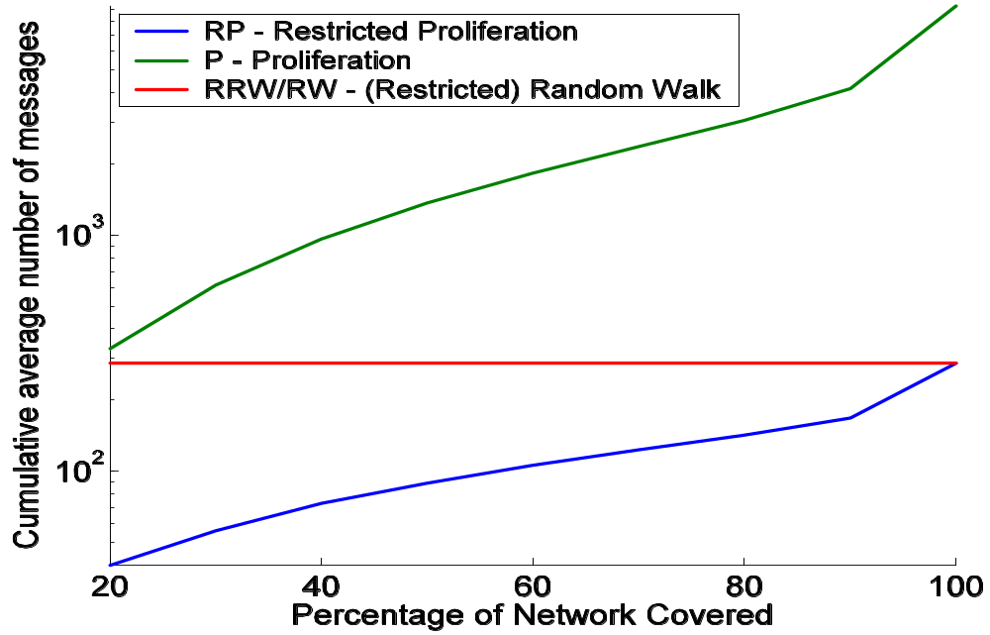
Cost Incurred by Different Schemes
Fairness of power – The average number of messages used is same for random walks and restricted proliferation.

Slide 21
Experiment - 2
Experiment Search - Calculate the number of search items
found after 50 time steps from initiation of a search. Average the result over 100 searches (a generation).

Slide 22
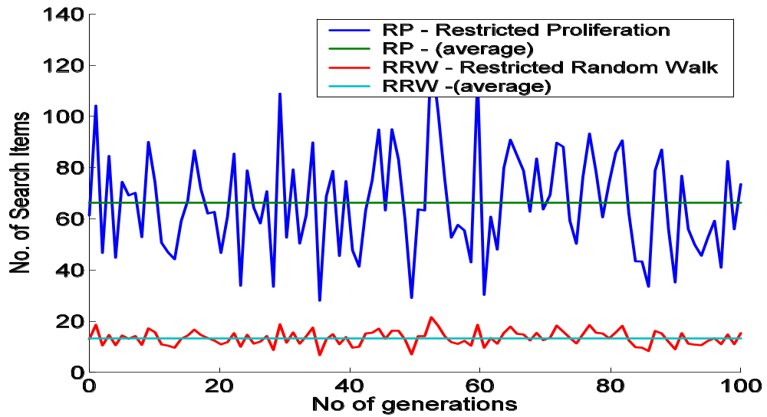
Search Efficiency and Cost Regulation
Spanning over 100 generations (1 generation = 100 searches)
Search efficiency of RPM is 5 times better than RRW

Slide 23
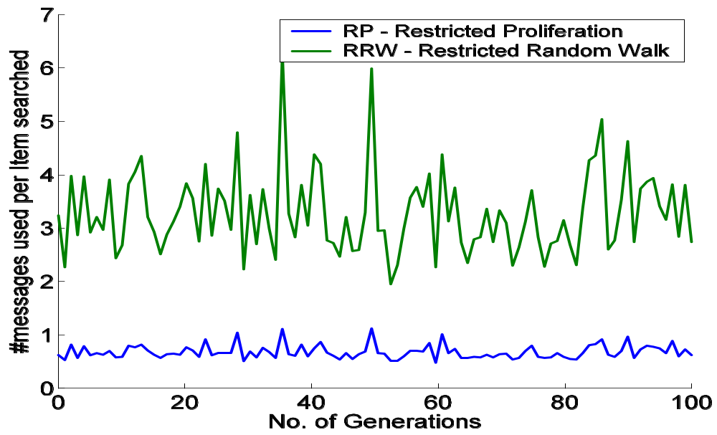
Search Efficiency and Cost Regulation
Excellent cost regulation, number of messages required by RP is virtually constant in spite of varying search output

Slide 24
Talk Overview
Problem Definition
Cellular Automata Design
Experimental Results
Theoretical Explanation
Preliminary Ideas

Slide 25
Why?
Random Walk = Diffusion
Proliferation = Reaction-Diffusion System
(Diffusion + Addition of New Materials)
Calculate the frontal speed (c) of the particles
Diffusion c α Reaction-Diffusion c = Const.
√
1
_
t

Slide 26
Summary
Proliferation covers the network much faster than random walk
A much higher search output is achieved through proliferation than random walk
Restricted proliferation is better than simple proliferation
Proliferation has a special cost regulatory function inbuilt
Proliferation scheme is also scalable
These results hold for other types of networks – random network, power-law network etc.

Slide 27
Dank U
Thank you

Slide 28
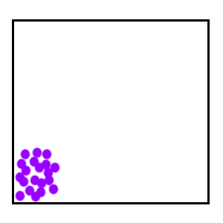
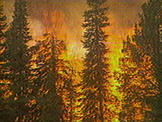
Why?
Random Walk = Diffusion
Proliferation = Reaction-Diffusion System
(Diffusion + Addition of New Materials)

Slide 29
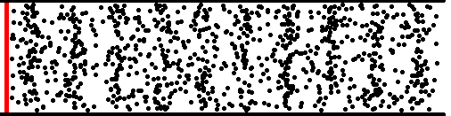
Why?
c
Calculate the frontal speed (c) of the particles
Diffusion c α Diffusion +Proliferation c = Const.
√
1
_
t

