Slide 1
Cellular Automata Based Authentication (CAA )
Monalisa Mukherjee¹ Niloy Ganguly ²
P Pal Chaudhuri ¹
¹ Department of Computer Science & Technology ,
Bengal Engineering College ( D . U ) , Howrah ,
West Bengal , India 711103
²Department of Business Administration ,
Indian Institute of Social Welfare and Business Management , Calcutta ,
West Bengal , India 700073

Slide 2
Authentication
Importance
1. Authentication & Verification of data source
2. Protection of copyright & detection of intrusion
3. Prevention of Cyber-Crime
Wide Applications
E-Commerce, Medical, Technology,
Government , Law

Slide 3
Message Digest Generation Function
Message Digest Generation Functions
Accepts a message of arbitrary length as the input
Transforms a key of fixed length called “fingerprint”
or “message digest” as the output
One-way hash function with the addition of a
secret key forms the basis of this transformation
Authentication
Compares fingerprint produced at source and destination end
Important for the security protocols in
Message authentication , Data integrity and Digital signature

Slide 4
Cellular Automata (CA) based Authentication (CAA)
Hacker
DESTINATION
Digest
Message
Private key
Hash
Compare Same Not Hacked
Hash
Digest
Message
Private key
Digest
SOURCE

Slide 5
Importance of Proposed Method
Limitations of the conventional MD5 based message authentication
Not withstand the advanced cryptanalytic attacks
The hash function used is weak
In the above background, we propose an efficient message digest generation scheme.
The proposed scheme employs a special class of GF(2^{p}) Cellular Automata (CA )
2^{p} Predecessor Single Attractor Cellular Automata(SACA)

Slide 6
An n Cell GF(2^{P}) CA
0 --- 2^{p} - 1
1
i-1
i
i+1
n
Input
Input
Input
Input
Input
0/1
0/1
Output
Output
Output
Output
Output
p
p
p
p
W _{i}
W _{i-1}
W _{i+1}

Slide 7
Structure of a 3 Cell GF ( 2 ² ) CA
Clock
Cell 0
Cell 1
Cell 2
3
1
2
0
2
3
3
2
0
XOR
XOR
XOR
3 2 0
S ₁ = T S ₀
T =
3 1 2
0 3 2

Slide 8
STATE TRANSITION OF A 3 CELL GF ( 2 ² ) SACA
300
301
302
303
333
200
233
100
130
131
132
133
030
032
033
031
010
012
013
011
020
022
023
021
002
001
003
3 2 0
000
T =
3 1 2
Depth = 3 , Attractor - 0
No. of predecessors = 2 ^{p} = 4
No. of non reachable states = 48
0 3 2

Slide 9
Structure of a 3 Cell GF ( 2 ² ) CA
Clock
Cell 0
Cell 1
Cell 2
3
1
2
0
2
3
3
2
0
XNOR
XNOR
XNOR
3 2 0
1
1
1
T =
F =
S ₁ = T S ₀ + F
3 1 2
0 3 2

Slide 10
DUAL SACA
010
011
012
013
003
200
233
330
310
311
312
313
121
122
123
120
113
112
110
111
100
101
102
103
133
132
131
3 2 0
130
1
1
1
T =
3 1 2
F =
0 3 2

Slide 11
SACA AND ITS DUAL
300
301
302
303
333
200
233
100
130
131
132
133
030
032
033
031
010
012
013
011
020
022
023
021
002
001
003
SACA
000
010
011
012
013
003
200
233
330
310
311
312
313
121
122
123
120
113
112
110
111
100
101
102
103
133
132
131
130
DUAL SACA

Slide 12
HASHING USING SACA AND ITS DUAL
300
301
302
303
333
200
233
100
130
131
132
133
030
032
033
031
010
012
013
011
020
022
023
021
002
001
003
Hashing 300
Hashed value 113
SACA
000
010
011
012
013
003
200
233
330
310
311
312
313
121
122
123
120
113
112
110
111
100
101
102
103
133
132
131
130
DUAL SACA

Slide 13
Message Authentication Through CAA
1 0 1 1 1 1 1 0
1 0 1 1 1 1 1 0
2 3 3 2
8 bits Message
Hash Function – 2-cell
GF(2²) SACA
Key Size = 4
2 3
0 0
2 0
Matrix from
first token
2 1
1 3
3
2
Private Key
3 2

Slide 14
Message Authentication Through CAA
2 3 3 2
Private Key
1 3
2 3
DUAL SACA
Matrix from
first token
0 0
2 0
0
1
1
3
2 1
1 3
3
2
F =
SACA
0 0
2 0
3
2
3 2

Slide 15
Message Authentication Through CAA
2 3 3 2
Message Digest
1 2
3 2
Matrix from
first token
0 0
2 0
0
1
1
2
3 1
1 2
1
3
F =
0 0
2 0
0
0
0 0

Slide 16
Security Analysis For CAA
Brute Force Attack
Key Size can be increased with minimum cost
Attack Changing key
Related Key Cryptanalysis
Differential Cryptanalysis

Slide 17
Attack changing Message
P1 = 101010111111 C1 = 110101
P2 = 101010111101 C2 = 011011
XORED = 101110
No of 1’s = 4
File Size | No of Ones in xored cyphertext
 | Key 128bit |  | Key 256bit |  | 128
 | P=4 | P=8 | P=8 | P=16 | MD5
3239 | 34 | 70 | 128 | 122 | 69
65780 | 55 | 76 | 114 | 138 | 64
259120 | 51 | 64 | 130 | 136 | 70

Slide 18
Attack changing key
K1 = 101010111111 C1 = 110101
K2 = 101010111101 C2 = 011011
XORED = 101110
No of 1’s = 4
File Size | No of Ones in xored cyphertext
 | Key 128bit |  | Key 256bit |  | 128
 | P=4 | P=8 | P=8 | P=16 | MD5
3239 | 54 | 63 | 134 | 130 | 64
65780 | 45 | 64 | 104 | 134 | 68
259120 | 55 | 64 | 132 | 128 | 66

Slide 19
Differential Cryptanalysis
P1 = 11001011 C1 = 00110101
P2 = 10011001 C2 = 10000110
XORED=0101010 XORED=10110011
No of 1’s = 3
No of 1’s = 5
P1 = 11000011 C1 = 10110101
P2 = 00001001 C2 = 00100110
XORED=0101010 XORED=10010011
No of 1’s = 3
No of 1’s = 4

Slide 20
Differential Cryptanalysis
P1 P2 = 3
C1 C2 | Freq
1 | n₁
2 | n₂
3 | n₃
4 | n₄
5 | n₅
6 | n₆
7 | n₇
8 | n₈
P1 = 11001011 C1 = 00110101
P2 = 10011001 C2 = 10000110
XORED=0101010 XORED=10110011
No of 1’s = 3
No of 1’s = 5
P1 = 11000011 C1 = 10110101
P2 = 00001001 C2 = 00100110
XORED=0101010 XORED=10010011
Standard Deviation of distribution
No of 1’s = 3
No of 1’s = 4

Slide 21
Differential Cryptanalysis
Avg. Std. Devn. Of XOR
Distribution (%) using CAA
File Size
Key 128bit
Key 256bit
P=4
P=8
P=8
P=16
35860
8.458
6.134
6.123
5.122
65780
6.667
5.034
5.002
4.986
259120
10.213
7.982
6.102
4.033

Slide 22
Time Needed for MD5 & CAA
File Size | CPU Time in Seconds
 | P=1 | P=2 | P=4 | P=8 | MD5
 | n=128 | n=64 | n=32 | n=16
1608 | 0.055 | 0.050 | 0.04 | 0.04 | 0.55
142164 | 0.205 | 0.165 | 0.118 | 0.081 | 0.220
852984 | 0.293 | 0.252 | 0.205 | 0.205 | 0.330
Speed calculated in WindowsNT 4.00 -1381 , IBM

Slide 23
Watermarking – Its Importance
Invisible Fragile Watermarking
- Image Authentication / Ownership
- Tamper Detection
- Verification of Image Integrity
Application
    - Legal matters
- News reporting, Medical

Slide 24
Watermarking
Existing Tools
- MD5 based One-way Hash Function
Advantages
- Easy Software implementation
- License free nature
Disadvantages
- Non-keyed primitive
- Lacks sound & realistic cryptanalysis

Slide 25



Watermark Insertion / Extraction
Host Image
Watermark Image
255 128
108 11
11111111 10000000
01101100 00001011
11111110 10000000
01101100 00001010
CA Based Hashing
254 129
108 11
Insertion Scheme
1 0
1 1
1 1
1 0
11111110 10000001
01101100 00001011
0 1 0 1
Watermarked Image

Slide 26
Watermark Insertion / Extraction
Host Image
Watermarked Image
Watermark Image
Insertion Scheme
Extraction Scheme
Watermarked Image
Watermark Image

Slide 27
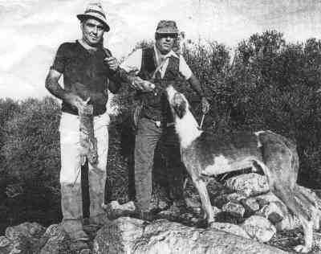
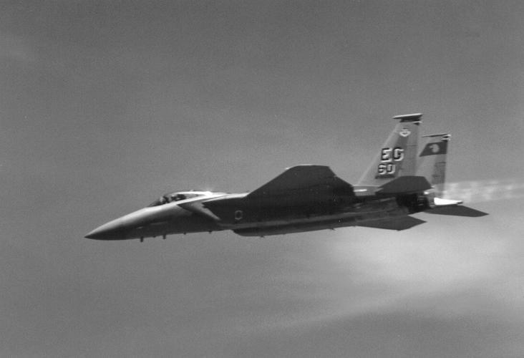
Watermarking
Proposed Scheme
Resists Holliman-Memon Attack
Vector Quantization Attack
Higher PSNR
Image Name | Data in Bytes | PSNR Values in dB unit
 |  | P = 4 | P = 8 | MD5
Lena | 1064071 | 53.463 | 53.788 | 51.243
Concord | 1485604 | 54.020 | 54.527 | 51.318
Rabbit | 964451 | 52.444 | 52.725 | 51.104

Slide 28
Current & Future Works on Watermarking
Invisible Robust Watermarking
- Survives Image Cropping & Compression
Audio & Video Watermarking
Application
- Prevent Unauthorized Access & Forgery
- Copyright Protection & Authentication

Slide 29
Thank you
Niloy Ganguly
n_ganguly@hotmail.com
http://ppc.becs.ac.in

