Slide 1
CELLULAR AUTOMATA BASED HAMMING HASH FAMILY : SYNTHESIS AND APPLICATION
Niloy Ganguly¹ Sandip Dhar²
Anup K Roy² Biplab K Sikdar² P PalChaudhuri²
¹IISWBM, Calcutta, West Bengal, India 700073
²Department of Computer Science & Technology,
Bengal Engineering College, India 711103.

Slide 2
CELLULAR AUTOMATA
A Locally Connected Network.
Decentralized Control Yields Complex Computation.
The paper is an illustration of the theme.

Slide 3
HAMMING HASH FAMILY
A new type of Hash Family generated by a special class of Cellular Automata - Multiple Attractor Cellular Automata(MACA).
What is it ?
The probability of collision between a pair of patterns, hashed in this family, varies inversely with their hamming distance.
It has inherent computational capability
The Hamming Hash Family(HHF) is effectively employed for the computation of average hamming distance in a large volume of data set in linear time.

Slide 4
CELLULAR AUTOMATA
A computational model with discrete cells updated synchronously
………..
CA cell - A memory element (D - flipflop) with some combinatorial logic { an XOR
gate (linear) or XNOR gate (additive) or AND/OR gate (non-linear) }
The state of the cell is dictated by the immediate neighbors of the cell
Clock
CLK
D
Q
Combinational Logic
From Left Neighbor
From Right Neighbor
A typical 2 - State 3 - Neighborhood CA Cell

Slide 5
MACA - AS A HASH FUNCTION
MACA - A special Class of non-group CA
State transition graph of an MACA consists of a number of cyclic and non-cyclic states
The set of non-cyclic states of an MACA forms inverted tree rooted at the cyclic states (attractors)
A member of HHF is an MACA of n cell and forming k attractors
Three neighborhood constraint of CA makes it behave as a hamming hash function

Slide 6
MACA - AS A HASH FUNCTION
MACA - 4 cell 4 attractors
00100
00101
00110
00111
01011
01010
01001
01000
00010
00011
01101
01100
00001
01110
00000
01111
10100
10101
10110
10111
11011
11010
11001
11000
10010
10011
11101
11100
10001
11110
10000
11111

Slide 7
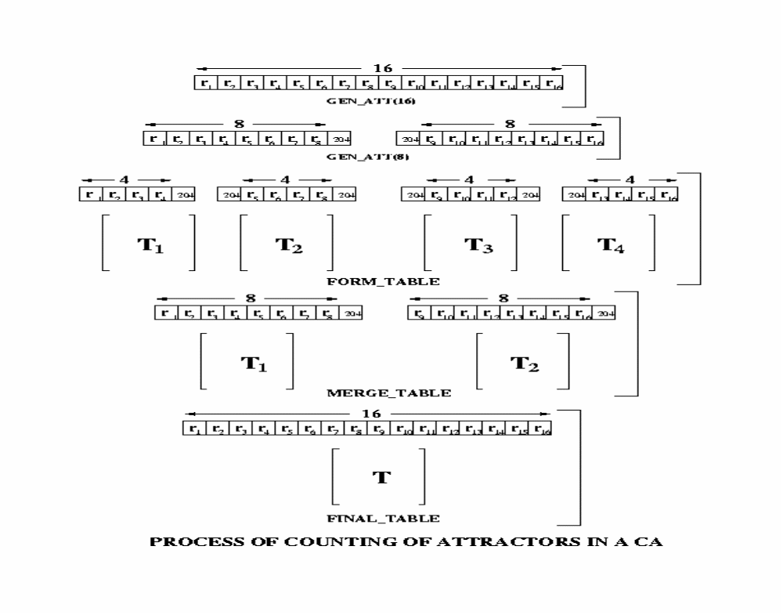
SYNTHESIS OF MACA
Design Objective: Generate set of MACA each having n cells, k no of attractors.
Each MACA a member of HHF.
A probabilistic Divide and
Conquer Algorithm
Heuristically set k1 & k2 from k

Slide 8
PERFORMANCE OF SYNTHESIS ALGORITHM
Synthesis of MACA (Test Run = 1000).
# cell (n)
# attractor( k )
Hit ratio( % )
2⁸
2⁸
2¹²
2¹⁶
66.80
37.60
36.00
34.15
16
20
32
32

Slide 9
AVERAGE HAMMING DISTANCE
What is it ?
Average Hamming Distance( AHD ) of a data set is represented as
AHD = h(c_{i} , c_{j})/k(k - 1)
where h( c_{i} , c_{j} ) is the hamming distance between the pair of patterns c_{i} , c_{j} and k is the number of patterns in the data set.
Application:
Genetic algorithm, Immunology etc.

Slide 10
RELATION BETWEEN HHF AND AHD
Procedure::
Take a set of data.
Calculate its AHD.
Hash it in 30 members of HHF.
Calculate collision.

Slide 11
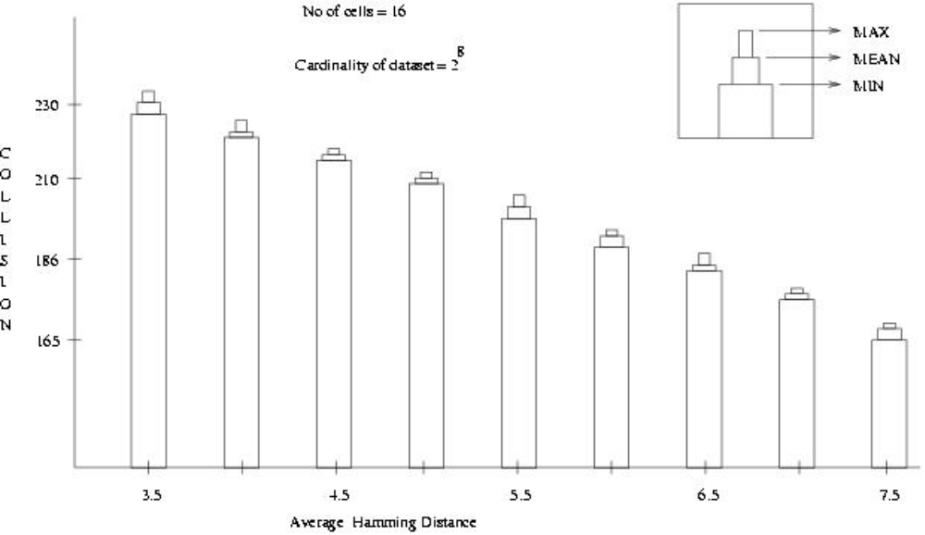
RELATION BETWEEN HHF AND AHD
Observation:: Data sets having same AHD outputs same Collision.

Slide 12
ALGORITHM FOR CALCULATING AHD
For a particular cardinality of data set (say 50)
Train the network with data set of various AHD
Calculate Collision & obtain points (AHD,COLLISION)
Draw regression line with the set of points.
Take a new set & Hash it.
Calculate Collision.
Find AHD from the regression line with that collision.

Slide 13
EXPERIMENTAL RESULTS
Polynomial Equations & Error Mean:
# cell
( n )
# Attr
( k )
Error Mean
E _{mAlgo}
Error Mean
E _{mPE}
Eq of Polynomial hdc-eq
20
32
40
2⁸
2¹⁰
2¹²
Y = 52.16 - 0.19X
Y = 9503.64 - 29.56X
+0.76X² - 2.5(10)⁻⁴X³
0.016
0.016
0.015
0.096
0.091
0.060
Y = 172.72 - 0.04X

Slide 14
THANK YOU

