Slide 1
Developing Analytical Framework to Measure Robustness of Peer-to-Peer Networks
Niloy Ganguly

Slide 2
Client/Server Architecture
Server
Client
Client
Internet
Client
Client
Well known, powerful, reliable server is a data source
Clients request data from server
Very successful model
  WWW (HTTP), FTP, Web services, etc.

Slide 3
Client/Server Limitations
Scalability is hard to achieve (load balancing)
Presents a single point of failure (fault tolerance)
Network bandwidth adds the bottleneck problem
Requires administration
P2P systems try to address these limitations

Slide 4
Peer to Peer Networks
Node
Node
Node
Internet
Node
Node
All nodes are both clients and servers i.e. Servent (SERVer+cliENT)
  Provide and consume data
  Any node can initiate a connection
No centralized data source
  “The ultimate form of democracy on the Internet”

Slide 5
Peer to Peer Networks
Popular medium for file sharing and other applications like IP telephony, distributed storage, publisher subscriber system,etc.
Overlay Networks
  Logical network above the physical p2p network
  Importance of the topology of overlay networks
    Spread of information in the network
    Stability of the network due to dynamic nature of the peers.

Slide 6
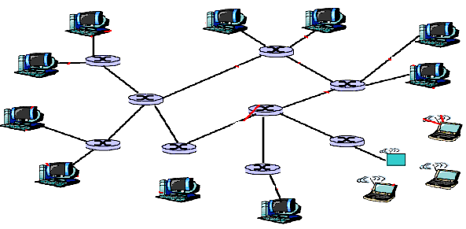
Overlay Network
An overlay network is built on top of physical network. Nodes in the overlay can be thought of as being connected by virtual or logical links, each of which corresponds to a path, perhaps through many physical links, in the underlying network.
Examples:
P2P overlay network run on top of the Internet.

Slide 7
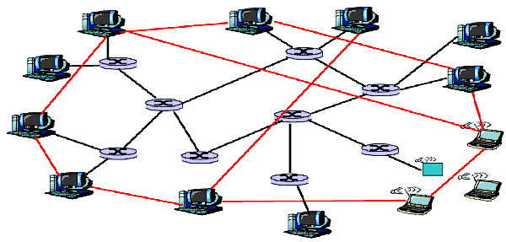
Overlay Network
Overlay edge
An overlay network is built on top of physical network. Nodes in the overlay can be thought of as being connected by virtual or logical links, each of which corresponds to a path, perhaps through many physical links, in the underlying network.
Examples:
P2P overlay network run on top of the Internet.

Slide 8
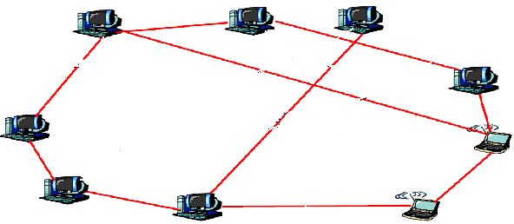
Overlay Network
Overlay edge
An overlay network is built on top of physical network. Nodes in the overlay can be thought of as being connected by virtual or logical links, each of which corresponds to a path, perhaps through many physical links, in the underlying network.
Examples:
P2P overlay network run on top of the Internet.

Slide 9
Motivation
Peers in the p2p system join and leave network randomly without any central coordination.
  Makes overlay structures highly dynamic in nature.
  Frequently it partitions the network into smaller fragments
  Communication between peers become impossible.
In this work, our primary goal is to develop an analytical framework to examine the stability of the various overlay structures against dynamic movement of peers.

Slide 10
Overview
Various Overlay Structures – Topology
Dynamic movements of peers
Stability criterion
Analytical framework

Slide 11
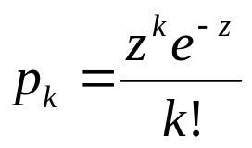
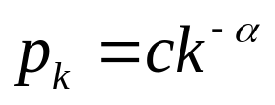
Topology of the Overlay Networks
Topology of the overlay networks can be modeled
  From experimentally collected data of overlay topology
  By various random graphs characterized by degree distribution
Examples:
E-R graph
  N number of vertices are connected with probability p.
  Probability of any randomly chosen node having degree k becomes
  Degree distribution follows Poisson distribution.
  Maintains homogeneous connectivity
Scale free network
  Inhomogeneous connectivity
  Majority of nodes have only a few links and very few highly connected nodes control the connectivity of entire network.
  Degree distribution follows power law distribution

Slide 12



Topology of the Overlay networks
Superpeer networks
  Small fraction of nodes are superpeers and rest are peers
  Each superpeer node is connected with a set of peers
  Superpeers are connected among themselves
  KaZaA adopted this kind of topology
  Follows Bimodal degree distribution
  Mathematically if
  otherwise
Superpeer Node
Peer node

Slide 13
Percolation and Peer Movement
Movement of the peers can be modeled by various kinds of node failures in the random graph
  Degree independent node failure
    Probability of removal of a node is constant & degree independent
  Targeted Attack
    Nodes having highest connectivity is removed first
  Degree dependent node failure
    Probability of removal of a node is inversely proportional to the degree of that node
    Peers having lower connectivity are less stable because they enter and leave network frequently.

Slide 14
Stability Metric - Percolation Threshold
Percolation threshold is the critical fraction of nodes whose removal disintegrates the giant component into smaller fragmented components
We use percolation threshold as the stability metric for our analysis.
Initially all the nodes in the network are connected.
Forms a single giant component.

Slide 15
Percolation Threshold
f fraction of nodes removed
Initial single connected component
Giant component still exists

Slide 16
Percolation Threshold
f_{c} fraction of nodes removed
f fraction of nodes removed
Initial single connected component
The entire graph breaks into smaller fragments
Giant component still exists
Therefore f_{c} becomes percolation threshold

Slide 17
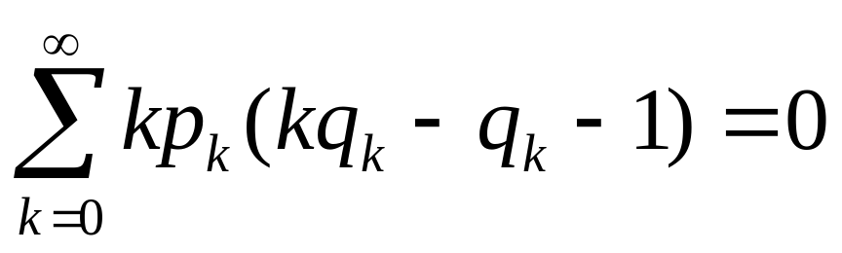
Stability Analysis
We use generating function formalism to perform stability analysis.
According to this formalism, general formula for the stability of the giant component with respect to any type of graph (p_{k}) and any kind of failure (q_{k}) becomes

Slide 18
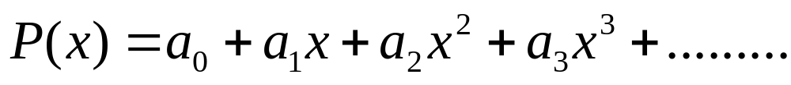
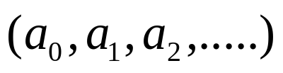
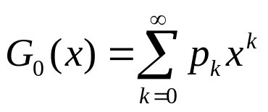

Generating function formalism
Generating function:
  Formal power series whose coefficients encode information.
  Here encode information about a sequence
  Used to understand different properties of the graph
  generates the probability distribution of the vertex degrees.
  Average degree

Slide 19
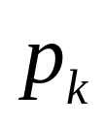

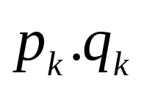

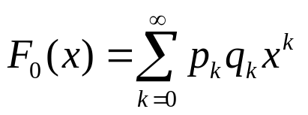
Stability Analysis
and specifies the network topology and failure models respectively.
specifies the probability of a node having degree to be present in the network after the process of removal of some portion of nodes is completed.
becomes the corresponding generating function.

Slide 20

Stability Analysis
Fraction of nodes removed according to
specifies the probability of a node having degree k after the process of node removal
Topology specified by

Slide 21
Stability Analysis
Let F₁(x) generates the distribution of outgoing edges of the first neighbor of a randomly chosen node.
  F₁(x)=F’₀(x)/z
H₁(x) generates the distribution of the component sizes reached by following a random edge.
H₁(x) satisfies a self-consistency condition of the form
  H₁(x)=1-F₁(1)+xF₁(H₁(x))
A
Randomly selected node ‘A’
Degree distribution of the first neighbor of ‘A’

Slide 22
Stability Analysis
=
+
+
+
+
…….
Distribution for the component size to which a randomly selected node belongs to generated by H₀(x) where
H₀(x)=1-F₀(1)+xF₀(H₁(x))
Schematic representation of the sum rule for the connected component of vertices reached by following a random edge. (Self consistency condition)

Slide 23
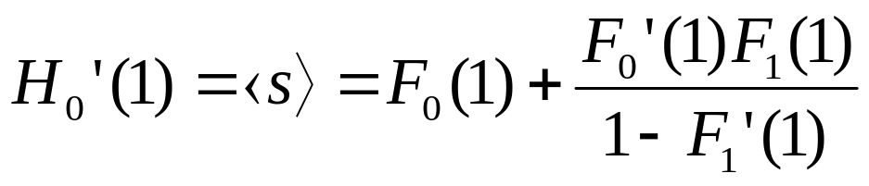
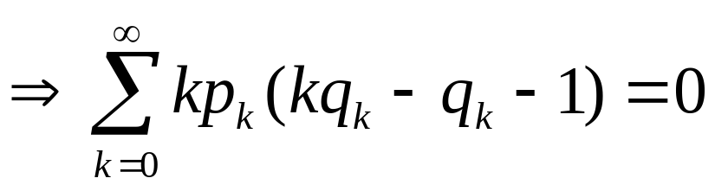
Stability Analysis
Average size of the component
  Which diverges when F₁’(1)=1
  This equation states the critical condition for the stability of giant component
  For any kind of graph ( p_{k})
  Undergoing any kind of failure (1-q_{k})

Slide 24
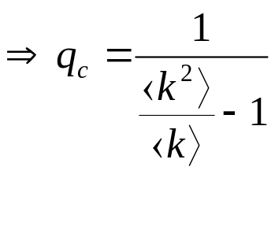
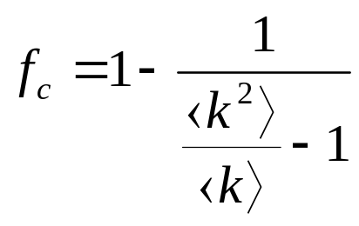
Stability at various scenario
Stability of generalized random graphs undergoing various failures
Degree Independent random failure :
In this case q_{k}=q=q_{c}
Using
Therefore percolation threshold

Slide 25
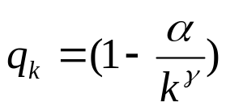
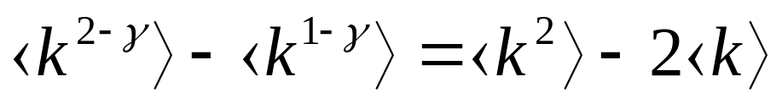
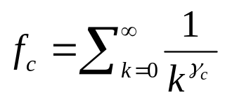
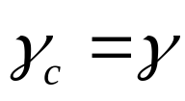
Stability at various scenario
Degree dependent failure:
  In this case
  In extreme case α = 1
  Therefore according to our general formula
  Critical condition for percolation becomes
  Thus critical fraction of node removed becomes
  where which satisfies the
  above equation

Slide 26
Case Study:Superpeer Networks
Recently superpeer networks have been adopted by many p2p systems like KaZaA.
A small fraction of nodes are superpeers and rest are peers.
Connectivity of superpeers are much more higher than the peers.
It can be modeled by bimodal degree distribution.

Slide 27
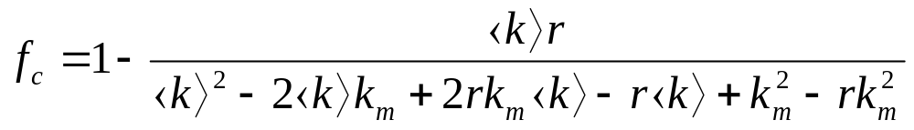
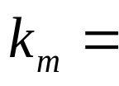

Case Study:Superpeer Networks
Degree independent failure:
  According to our framework, critical fraction for superpeer networks
  where r = fraction of peers
  Superpeer degree
  Average degree of the network

Slide 28
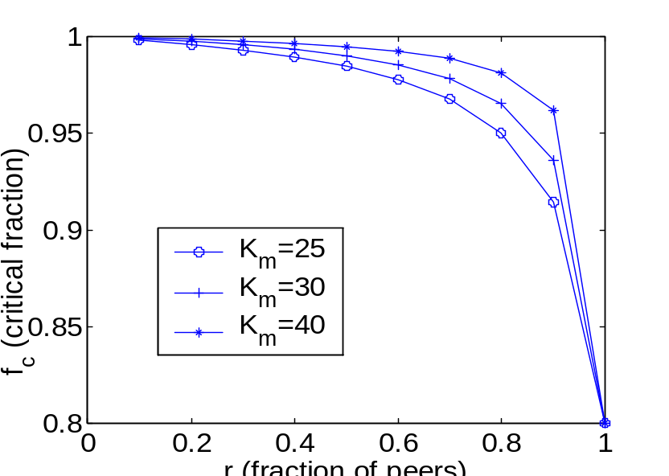
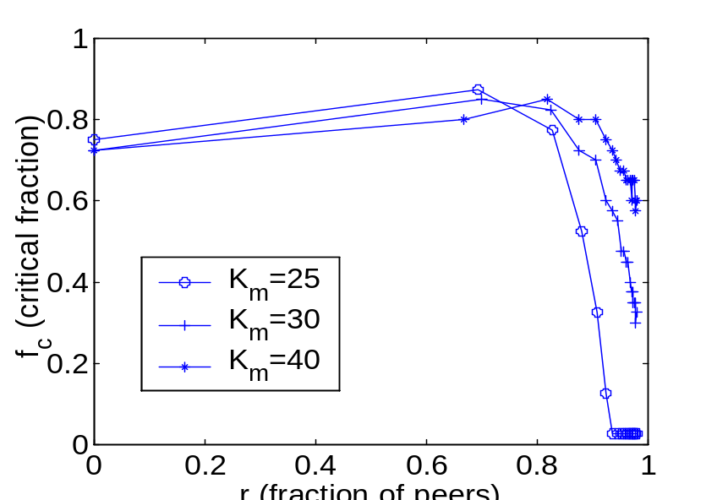
Case Study:Superpeer networks
Degree independent failure
Comparative study between theoretical and experimental results
Theoretical Experimental

Slide 29
Observations
Increase of the fraction of superpeers (specially above 15% to 20%) increases stability of the network.
Experimental result indicates the optimum superpeer to peer ratio for which overlay networks becomes most stable for this kind of failure.
Due to the contradiction of theoretical and practical concept of giant component, there is a little difference between theoretical and experimental results.

Slide 30

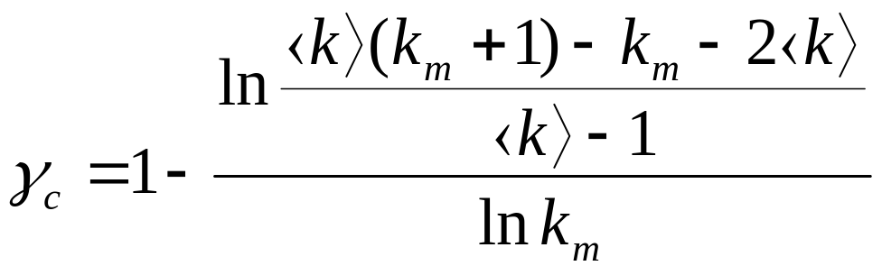


Case Study:Superpeer Networks
Degree dependent failure:
In this case, the value of which percolates the network can be derived from our general formula and becomes
  where Superpeer degree
  Average degree of the network

Slide 31
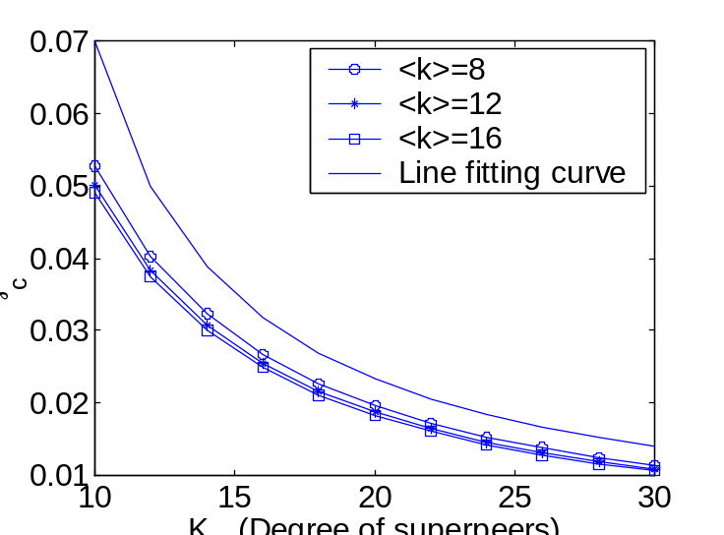
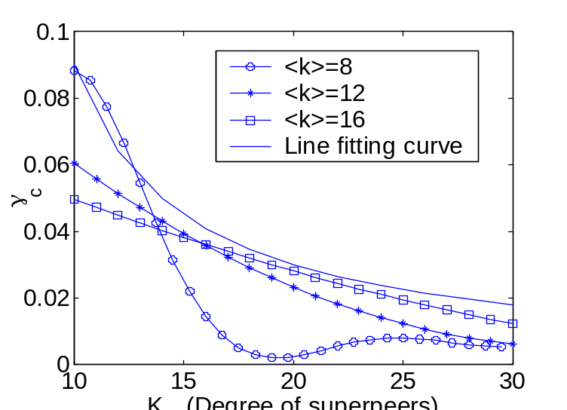
Case Study:Superpeer networks
Degree dependent failure
Comparative study between theoretical and experimental results
Theoretical Experimental

Slide 32
Observations
With the increase of superpeer degree, the value of γ_{c} that percolates the network decreases.
Thus it improves the stability of the network and the improvement follows hyperbolic trajectories.
Result supports our intuitive notion of giant component.

Slide 33
Conclusion
Contribution of our work
  Development of general framework to analyze the stability of p2p overlay networks.
  Modeling the behavior of the peers using degree independent as well as degree dependent node failure.
  Case Study : stability analysis of the superpeer networks.
  Perform a comparative study between theoretical and experimental results to show the effectiveness of our theoretical model.

Slide 34
Future Work
We have to perform a detailed comparative study of stability of various overlay structures.
  Example: E-R networks,scale free networks, various kinds of superpeer networks like Mixed Poisson and bimodal structures.
Peer movements can be modeled by various kinds of node failures and attacks where nodes having more importance are been targeted.
  Importance of a node is determined by degree centrality, betweenness centrality, eigenvector centrality etc
Finally a comparative stability analysis of all these topologies with respect to combination of different attacks and failures.

Slide 35
Stability Criterion
Giant Component
  Most of the nodes in the network are connected to form a large connected component
  After removing a fraction of nodes from the network
    A large fraction of nodes still remains connected.
    Although average distance increases.
A fraction of nodes removed from the network
Percolation process
Giant component

Slide 36
Percolation Process:
Degree independent failure
Occupied Node
Unoccupied Node
Nodes to be removed are selected at random (do not dependent on their degree)

Slide 37
Percolation Process:
Degree independent failure
After random removal of nodes, network disintegrated into disconnected components

Slide 38
Percolation Process:
Targeted Attack
Highly connected nodes
Occupied Node
Unoccupied Node
Highly connected nodes are attacked first

Slide 39
Percolation Process:
Targeted Attack
After targeted attack, network is disintegrated into disconnected components

Slide 40
Percolation Process:
Degree dependent failure
Occupied Node
Unoccupied Node
Nodes to be removed are inversely proportional to its degree

Slide 41
Percolation Process:
Degree dependent failure
After degree dependent failure , network is disintegrated into spited components

Slide 43
Movement of peers
Topology of the overlay networks can be modeled by various real world networks.
Movement of peers can be represented by percolation processes in those graphs.
We study the stability of various topologies by measuring the effect of percolation on the connectivity of the graph.

