Slide 1
Convergent Technology
Niloy Ganguly
Indian Institute of Social Welfare and Business Management
India’s First B-School
Calcutta, India, 700 073.

Slide 2
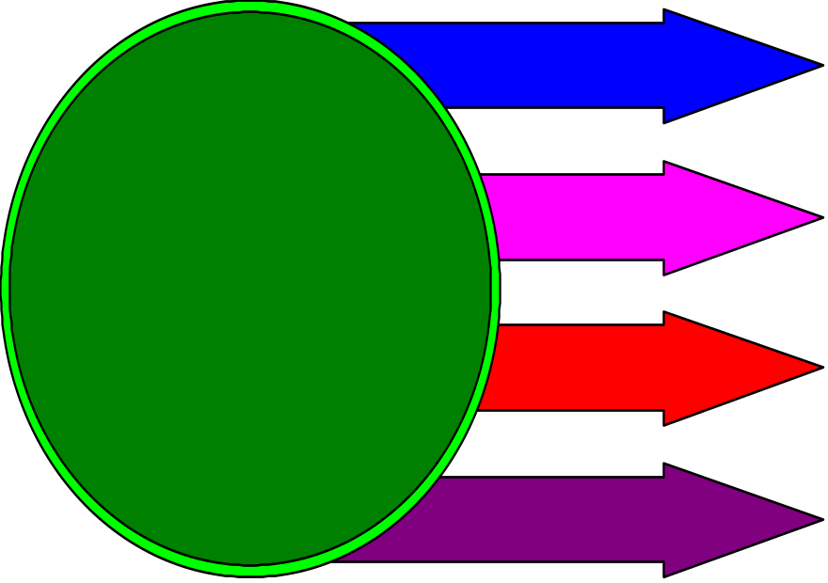
Convergence and Divergence
The age of diversification 40s - 70s
Radio-Physics
Electrical Engineering
Physics
Electronic Engineering
Computer
Science
Concept of Super Specialization
Convergent Technology and knowledge Management

Slide 3
Convergence and Divergence
The age of convergence from 80s
What is Super Specialization?
General Knowledge of Everything!!!
Computer Scientist
Artist
Fractral
Whose Subject?
Physicist
Cryptologist
Mathematician
Chip Designer
Convergent Technology and knowledge Management

Slide 4
Convergence and Divergence
Thesis
Anti - thesis
Synthesis
Culture, Civilization, Science and even human brain progresses through the clash of the opposites
Convergent Technology and knowledge Management

Slide 5
Goods and Services
Unfinished goods + Service
=
Finished Product
Abstraction of human experience
Cloth + Tailor = Shirt
Paper + writer = Letter/Article
Letter + Postman = Communication
Convergent Technology and knowledge Management

Slide 6

The first Convergence
Unfinished goods + Service
=
Finished Product
Abstraction of human experience
How to Abstract
Emergence of Tools
Cloth + Tailor = Shirt
Convergent Technology and knowledge Management

Slide 7

The second Convergence
Unfinished goods + Service
=
Finished Product
Abstraction of human experience
How to avoid repetition
Emergence of Mass
Production
Convergent Technology and knowledge Management

Slide 8
The Third Convergence
Service
Independent of Media
Paper + writer = Letter/Article
The service to be transferred to any form, any where.
Knowledge is transferred in form of audio, text, video
Convergent Technology and knowledge Management

Slide 9
The Third Convergence
All agents of mass production
Cannot replace direct knowledge transfer
Telex, Fax
Television
Telephone, Radio
Knowledge is transferred in form of audio, text, video
Convergent Technology and knowledge Management

Slide 10

The Third Convergence
Direct Knowledge transfer
understanding the context and requirement of the receiver (customer).
requires constant feedback from the receiver.
Doctor + Patient
But it is typically against the philosophy of mass production
Convergent Technology and knowledge Management

Slide 11
The Third Convergence
Punch mass production and Direct Knowledge transfer
Communication Revolution
Doctor + Patient
But it is typically against the philosophy of mass production
Convergent Technology and knowledge Management

Slide 12
Communication Revolution
First Phase (Phase of Diversification)
Telephone with Intelligent Network (1-800)
Internet - providing numerous choice to the customer so that at least one fits with the requirement of the customer
Video Conferencing, video on demand
WAP, Cell Phone to overcome the hurdle of position
Research for high bandwidth
Convergent Technology and knowledge Management

Slide 13
Communication Revolution
Second Phase (Phase of Convergence)
With the introduction of broadband network, converge audio, text, video
Converge machines
Establish two way traffic
A truly free market place
Many to Many
Convergent Technology and knowledge Management

Slide 14

Communication Revolution
One major theoretical question?
Even with all the communication tools how can I communicate with everybody on earth ?
One possible answer?
The requirement of all can be clubbed into some finite number of groups
Convergent Technology and knowledge Management

Slide 15
Convergent Technology
Reinstating the power of the West?
Initial Impact :
A overwhelming globalisation of American’s hegemony
English Language establishing an absolute dominance
All business models oriented according to American Business Scheme
Convergent Technology and knowledge Management

Slide 16

Convergent Technology
Social/Private Life Shattered?
Initial Impacts :
The barriers of private and public life is getting shattered
I have to look into the stock value before I sleep
Convergent Technology and knowledge Management

Slide 17

Convergent Technology
Social/Private Life Shattered?
Initial Impacts :
The barriers of private and public life is getting shattered
The ill-effect of living in a virtual world
I don’t know my neighbor but I know this shady Suzi
Convergent Technology and knowledge Management

Slide 18

Convergent Technology
Social/Private Life Shattered?
Initial Impacts :
The barriers of private and public life is getting shattered
The ill-effect of living in a virtual world
The ever-increasing stress of staying in competition
Convergent Technology and knowledge Management

Slide 19

Convergent Technology
An All Powerful State Machinery?
Introduction of Global Positioning System (GPS) totally tracks down your movement
No Privacy!!
Convergent Technology and knowledge Management

Slide 20
Convergent Technology (The opposites)
Reinstating the power of the West?
Voice over I/p will greatly reduce the importance of English Language
Emergence of powerful translator will greatly facilitate the communications between various language, culture and community
The great story of David (Linux) challenging the Goliath (Microsoft)
Specialized Interest groups merging together to form Web-groups
Convergent Technology and knowledge Management

Slide 21
Convergent Technology (The opposites)
Social/Private Life Shattered?
With the Introduction of real time image and video system, the mystery portion of Internet will slowly disappear
It will be a real boon when people will interact with like minded people around the globe - reverse alienation
Trends - Research group comprising of members around the world is developing
Convergent Technology and knowledge Management

Slide 22
Convergent Technology (The opposites)
Social/Private Life Shattered?
Why differentiate between work and leisure. Because we have two separate identities - producer and consumer
But when the producer consumer identity will merge the basic question/demand will disappear
Stress Factor - Probably Most of us are over-rated.
The fast connectivity will bring in large amount of cooperation to make us understand and adjust and develop accordingly
Convergent Technology and knowledge Management

Slide 23

Business Model (Immediate)
Crisis
Growth
Development
Moving towards personalized product (American Model)
cell phone, personalized web browser, personal advertisement
Convergent Technology and knowledge Management

Slide 24
Business Model (Immediate)
Crisis
Growth
Development
Indian Strategy
Increasing Market Share in Europe, Asia South Pacific (Why not look into the indigenous market?)
Convergent Technology and knowledge Management

Slide 25

Back to the Basics
Green
White
Yellow
Development
Generate Capital from Countryside
Initiate a convergent revolution
Convergent Technology and knowledge Management

Slide 26
Multipurpose Community Telecentre
Functionalities of Kiosks
Communications
Education
TeleMedicine
Weather Report
Expert Consultation about Crop Development
Instead of personalized product, go for community product
This will ensure the emergence the requirement of personal product
Convergent Technology and knowledge Management

Slide 27

Thank you
Niloy Ganguly
n_ganguly@hotmail.com
niloy@iiswbm.edu

