Slide 1
Extracting and Summarizing Information from Microblogs during Disasters
Niloy Ganguly
Department of CSE
IIT Kharagpur, India

Slide 2
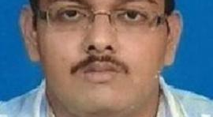
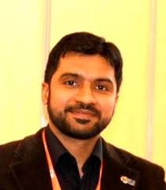

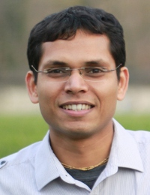
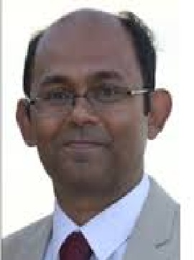
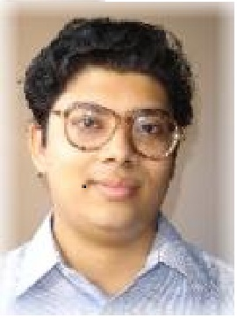

Acknowledgment
Muhammad Imran
Scientist
Social Computing
QCRI
Koustav Rudra
Kalika Bali
Researcher
Microsoft, India
Pawan Goyal
Assistant Professor
IIT Kharagpur
Prasenjit Mitra
Professor
Penn State
Saptarshi Ghosh
Assistant Professor
IIT Kharagpur
Monojit Choudhury
Researcher
Microsoft, India
CIKM, 15, HIPC 16, EMNLP 17 SIGIR 18, TrascCSS 18 Tweb 18

Slide 3
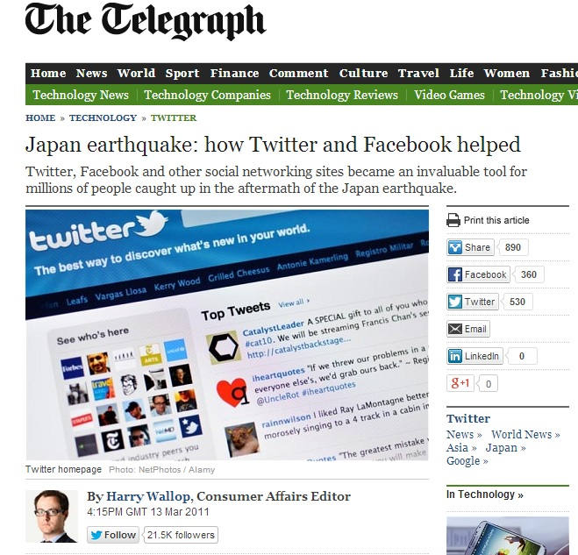
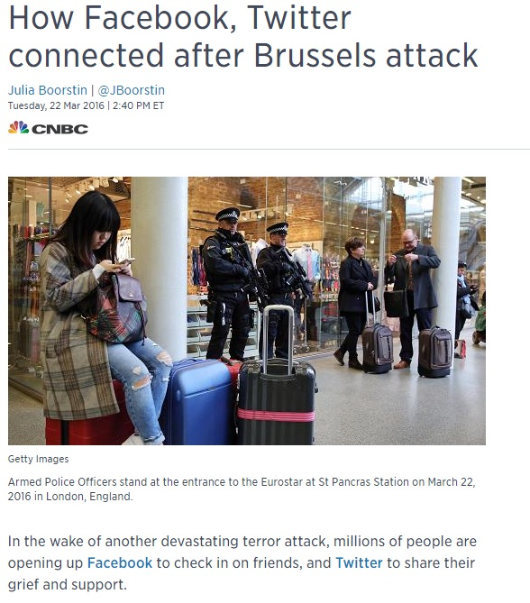
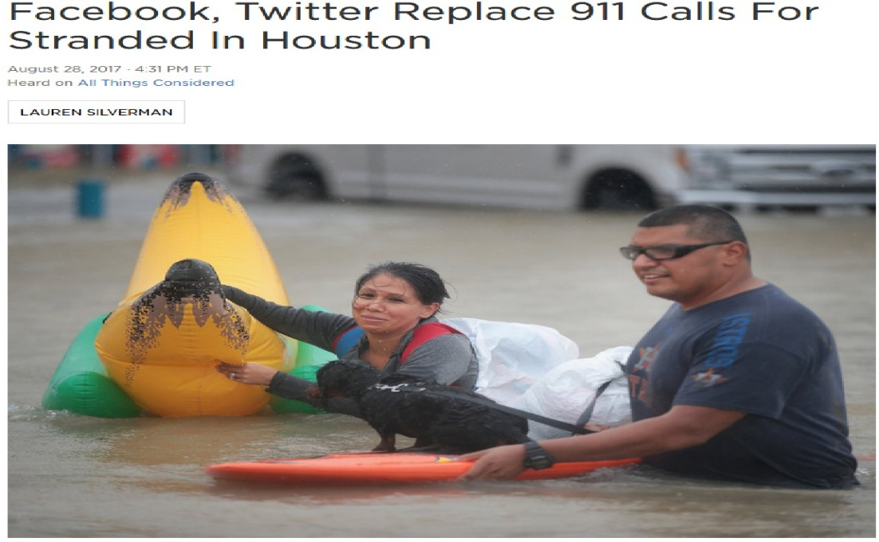
Use of Twitter during calamities
Broad Objective: Improve utilization of OSNs (Twitter) in the post-disaster scenario, through retrieval of useful information.

Slide 4
Sample Tweets
Situational Tweets (SA)
Hyderabad blasts helpline nos +91 9391351543, 9963857749, 9440379926 Avoid making calls unless necessary
15,000 tourists stranded due to landslide in Uttarakhand
Typhoon now making landfall in eastern samar, with winds of 175 to 210 kph
Objective
Impersonal
Assertive
Non-Situational Tweets (NSA)
Extremely sad day my prayers to the victims and their families affected by the Hyderabad blast.
There was a shooting at an elementary school. I’m loosing all faith in humanity
Thoughts/prayers for everyone in the path of #typhoon hope lessons from #haiyan will save lives
Subjective
Personal
Opinionated
Emotion
Information Content of SA Tweets
Infrastructure damage
Missing/ trapped people
Injured/ dead people
Shelter and service
…
Information Content of NSA Tweets
Opinion
Sentiment
Event Analysis
Communal (Attacking Religious communities)
…

Slide 5
Sample Tweets
Mixed Tweets (SA + NSA)
ayyo! not again! :( Blasts in Hyderabad, 7 Killed: TV REPORTS.
oh no !! unconﬁrmed reports that the incident in #newtown #ct may be a school shooting. police on the way
may god save d rest!58 dead, over 58,000 trapped as rain batters Uttarakhand, UP.....
5-6% mixed tweets
Fragmentation
Focus on end-markers (!, ?, .)
Separate SA/NSA components

Slide 6
Talk Overview
To identify situational tweets and summarize information during crises [Extending the framework to regional languages]
To identify sub-events and summarize information at diﬀerent levels of granularity [Satisfying needs of different stakeholders]
To generate abstractive summaries during disaster
To analyze non-situational tweets [Characterizing and countering communal tweets]

Slide 7
Situational tweets
Classification
Humanitarian Category Detection
Tweet
Stream
Sub-event Identification
Real-Time Summarization
Fragmentation
Classification
Handling fast changing actionable information
Non-situational tweets
Analyzing Communal tweet

Slide 8
Classification
A simple approach is to use vocabulary of the event to develop a classifier [Verma 2011]
Problem: It will become an event dependent classifier i.e. we can’t use it over other kinds of events
Challenge: To develop a classifier which can capture features which remain same across different disaster events
Observation: People follow certain traits in posting different kinds of tweets
Those features/signals can be captured to develop an event independent classifier
S. Verma, S. Vieweg, W. J. Corvey, L. Palen, J. H. Martin, M. Palmer, A. Schram, and K. M. Anderson. Natural Language Processing to the Rescue? Extracting “Situational Awareness” Tweets During Mass Emergency. In Proc. AAAI ICWSM, 2011

Slide 9
Classification: proposed features
Count of numerals urgent blood required at omni hospital please contact 8096369999 040 67369999 | Presence of Intensifiers Blasts - sadly, one of the very, very few things that put us on world news!
Presence of wh-words Why don’t you submit your coalgate scam money to disaster | Presence of Exclamations RT @DavaS12: RIP all you Angels ! #sandyhook http://t.co/yrGA39Pc
Count of personal pronouns its just few km frm my place n i cant reach my people | Presence of Question Marks another school shooting? what kind of sick mentality is this?? #blast
Presence of Modal Verbs #HyderabadBlasts we're talking abt it we will forget this in few days.it should not end here.we should find out | Count of Subjective Words [MPQA] Beautiful, stupid, coward, …
Presence of Religious terms Hindu, Muslim, Allah | Count of non-situational Words (condemn, donate, sympathize) Pm condemns hyderabad blast

Slide 10
Dataset
Events considered:
School Shooting in Sandy Hook elementary school (SHshoot)
Typhoon Hagupit in Philippines (THagupit)
Two bomb blasts in Hyderabad, India (HDblast)
Devastating floods and landslides in Uttarakhand, India (UFlood)
Tweets collected on keyword-based matching
Consider 5000 English tweets in chronological order
Future events:
Earthquake in Nepal and parts of India (NEquake)
Harda train derailment (HDerail)

Slide 11
Classification results: Experimental settings
Gold standard
Random sampling of 1000 tweets
Three annotators independently annotate these tweets
Majority verdict is taken for determining the class of tweets(unanimous agreement in 82% cases)
~500 SA and NSA tweets per event
Performance evaluation
In-domain accuracy: train and test over same disaster event
Cross-domain accuracy: train and test events are different
Baseline [Bag of Words (BOW)]
Frequency of unigrams
Frequency of bigrams
POS tags
Count of subjective words
Presence of personal pronouns

Slide 12
Classification results
EVENTS | HDBlast |  | UFlood |  | SHShoot |  | THagupit
 | BOW | PRO | BOW | PRO | BOW | PRO | BOW | PRO
HDBlast | 86.89 | 84.26 | 73.65 | 78.22 | 86.68 | 89.58 | 77.26 | 82.33
UFlood | 81.85 | 82.45 | 84.98 | 79.60 | 85.53 | 89.81 | 81.33 | 81.45
SHShoot | 82.21 | 83.05 | 75.05 | 79.85 | 93.17 | 90.04 | 78.36 | 80.24
THagupit | 73.55 | 77.28 | 65.57 | 75.64 | 71.87 | 86.45 | 87.73 | 85.86
Result
Proposed features perform better for cross-domain scenario
Cover 30% more situational tweets compared to BOW model in cross-domain setting
Fragmentation phase helps to improve accuracy ~4-5%

Slide 13
Situational tweets
Classification
Humanitarian Category Detection
Tweet
Stream
Sub-event Identification
Real-Time Summarization
Fragmentation
Classification
Handling fast changing actionable information
Non-situational tweets
Analyzing Communal tweet

Slide 14
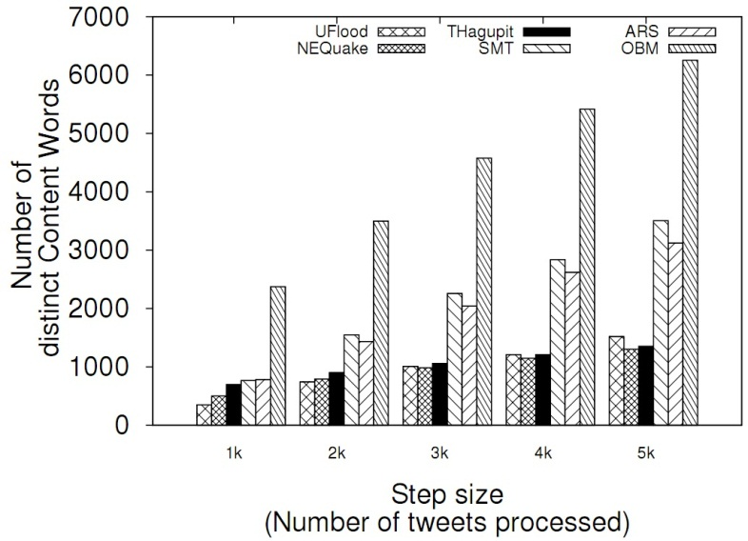
Summarizing situational updates
Some particular types of words play an important role in disaster
Consider specific types of terms (Content words)
Numerals (number of casualties, helpline nos.)
Nouns (names of places, important context words like people, hospital)
Main Verbs (killed, injured, stranded etc.)
Objective:
maximize the coverage of these content words in final summary

Slide 15
Summarizing situational updates
ILP based solution
max(∑_{i=1…n} x_{i} + ∑_{j=1…m} Score(j).y_{j})
x_{i}, y_{j} binary variable
x_{i} tweet indicator, y_{j} content word indicator
Score(j) = tf-idf score
Constraints
∑_{i=1…n} x_{i *} Length(i) ≤ L
Length(i) = number of words in tweet i
L = required summary word length limit
∑_{i ∈ Tj} x_{i} ≥ y_{j} j = [1 … m]
Tj = set of tweets containing content word j
y_{j}=1=> at least one tweet covering y_{j} is picked
∑_{j ∈ Ci} y_{j} ≥ | Ci | * x_{i}
i = [1 … n]
C_{i} = set of content words present in tweet i
x_{i}=1=> all content words in tweet i are selected

Slide 16
Summarization results: Experimental settings
Baselines
NAVTS: Focus only on specific pos-tags --- noun, adjective and verbs [Socialcom 2013 (Khan et al)]
Sumblr: Real-time cluster-based tweet stream summarization algorithm [SIGIR 2013 (Shou et al)]
APSAL: Affinity clustering based disaster tweet summarization technique [ACL 2015 (Kedzie et al)]
TSum4Act: Disaster specific summarization technique based on LDA, NER [PAKDD 2015 (Nguyen et al)]
Experimental setting
Summarize at two breakpoints at 2k, and 5k tweets
Generate a gold standard summary of 250 words at each breakpoint

Slide 17
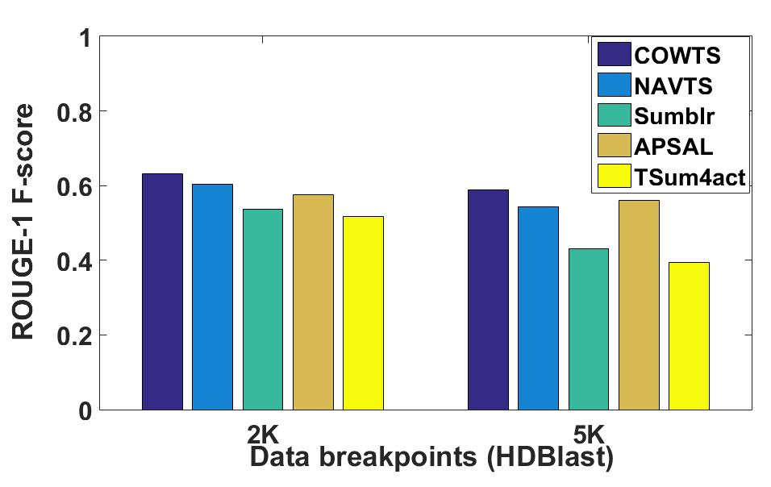
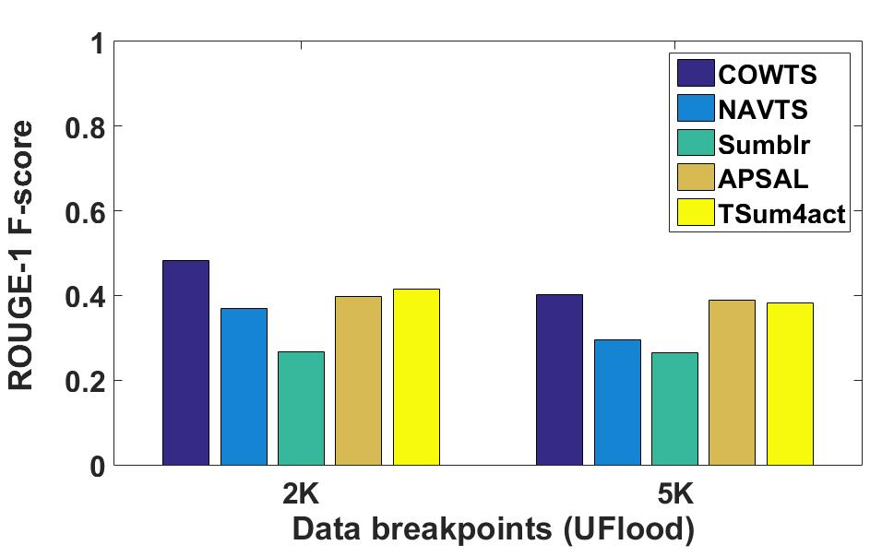
Summarization results
If number of clusters increases, determining importance of different clusters becomes difficult [Sumblr,TSum4act]
Salient-update resolves that issue through some supervised approach [APSAL]
Numerals play better role compared to adjectives [NAVTS] in disaster scenario [COWTS]
Classification step helps to improve the coverage of summarization step (10-12%)

Slide 18
Situational tweets
Classification
Humanitarian Category Detection
Tweet
Stream
Sub-event Identification
Real-Time Summarization (Hindi)
Fragmentation
Classification (Hindi)
Handling fast changing actionable information
Non-situational tweets
Analyzing Communal tweet

Slide 19
Utility of Hindi Tweets
Hindi tweets can be useful in two ways
Contain new situational information not available in English tweets [Exclusive]
Contain same information but Hindi tweet was posted earlier [Earlier]
Consider distinct situational tweets posted in Hindi and English over same time span for NEquake and HDerail events
 | Exclusive | Earlier
NEquake | 21.43% | 14.29%
HDerail | 15.45% | 8.43%

Slide 20
Classification results: Hindi Tweets
Gold standard
Random sampling of 500 tweets
Three annotators independently annotate these tweets
Majority verdict is taken for determining the class of tweets(unanimous agreement in 87% cases)
281 and 120 SA tweets for NEquake and HDerail events
Performance
EVENTS | NEquake |  | HDerail
 | BOW | PRO | BOW | PRO
NEquake | 85.41 | 81.30 | 69.19 | 72.22
HDerail | 74.37 | 77.93 | 74.83 | 74.22

Slide 21
Summarization results: Hindi Tweet
Baselines
NAVTS
Sumblr
APSAL
Event | ROUGE-1 F-score
 | COWTS | NAVTS | Sumblr | APSAL
NEquake | 0.5694 | 0.4700 | 0.3588 | 0.5539
HDerail | 0.6833 | 0.6146 | 0.5495 | 0.6717

Slide 22
Observations and Roadmap
Low level lexical features are helpful for classification
Content words are helpful for summarization
Situational information consists of humanitarian categories like ‘infrastructure’, ‘missing’, ‘shelter’ etc. [Natural disasters]
Each of these categories contains information from multiple dimensions. [Infrastructure --- ‘road block’, ‘building damage’, ‘airport operations’]
Publications
Koustav Rudra, Subham Ghosh, Pawan Goyal, Niloy Ganguly, and Saptarshi Ghosh. 2015. Extracting Situational Information from Microblogs during Disaster Events: A Classiﬁcation-Summarization Approach. In Proc. ACM CIKM.
Koustav Rudra, Niloy Ganguly, Pawan Goyal, and Saptarshi Ghosh. Extracting and Summarizing Situational Information from the Twitter Social Media during Disasters. ACM TWEB, 2018.

Slide 23
Situational tweets
Classification
Humanitarian Category Detection
Tweet
Stream
Sub-event Identification
Real-Time Summarization
Fragmentation
Classification
Handling fast changing actionable information
Non-situational tweets
Analyzing Communal tweet

Slide 24
Humanitarian Category Detection
Situational tweets contain various sort of information
Infrastructure and utilities
Injured or dead people
Missing, trapped, or found people
Displaced people
Shelter and supplies
Caution and advice
Volunteer or professional services
Animal management
Unigrams, bigrams, numerals, hashtags, verbnet etc. used as features [AIDR framework]
Sub-event detection and Summarization can be performed over individual classes
Muhammad Imran, Carlos Castillo, Ji Lucas, Patrick Meier, and Sarah Vieweg. AIDR: Artiﬁcial intelligence for disaster response. In Proceedings of the companion publication of the 23rd international conference on World wide web companion, pages 159–162, 2014.
Notes:
UN OCHA

Slide 25
Situational tweets
Classification
Humanitarian Category Detection
Tweet
Stream
Sub-event Identification
Real-Time Summarization
Fragmentation
Classification
Handling fast changing actionable information
Non-situational tweets
Analyzing Communal tweet

Slide 26
Dataset
Nepal Earthquake [25th – 27th April, 2015]
Infrastructure damage
Missing or trapped people
Shelter and supplies
Volunteer service
Typhoon Hagupit [6th – 8th December, 2014]
Infrastructure damage
Caution and advice
Displaced people
Volunteer service
Pakistan Flood [7th-8th September, 2014]
Infrastructure damage
Missing or Trapped people
Volunteer service
12 instances
12 instances
6 instances

Slide 27
Sub-event identification
Objective: to capture small-scale sub-events such as ‘power outage’, ‘bridge closure’ etc.
sub-event as a combination of a noun and a verb where noun represents a concept and verb represents an event
Category | Sub-event phrases
Infrastructure | ‘airport shut’, ‘road crack’, ‘tower collapse’, ‘service affect’
Missing | ‘family stuck’, ‘tourist strand’, ‘contact number’, ‘database track’
Shelter | ‘material sent’, ‘relief provide’, `medicine dispatch’, ‘aircraft deploy’
Noun-Verb association
According to China media buildings toppled in Tibet

Slide 28
Sub-event identification
Ranking sub-events
Compute Szymkiewicz-Simpson overlap score between noun(N) and verb(E).
Score(N,E) = |X∩Y|/min(|X|,|Y|), X : set of tweets containing N, Y: set of tweets containing E
Problem
Does not discriminate between heavily and rarely occurring sub-events
Discounting factor [Pantel 2002]
Δ(N,E) = |X∩Y|/(1 + |X∩Y|) * min(|X|,|Y|)/(1 + min(|X|,|Y|))
Weight(N,E) = Score(N,E) * Δ(N,E)
Patrick Pantel and Dekang Lin. Discovering word senses from text. In Proc. ACM SIGKDD, pages 613–619, 2002.

Slide 29
Sub-event results
Baselines
COS-clustering [Abhik 2013]
SOM-clustering [Pohl 2015]
LDA-clustering [Blei 2003]
BTM-clustering [Yan 2013]
Performance evaluation
Evaluation using crowdsourcing [CrowdFlower]
Evaluation using gold standard sub-events (formed as noun-verb pairs)
Evaluation using crowdsourcing
Which of the five methods identifies least number of irrelevant sub-events? [A sub-event is irrelevant if it is a random selection of words/terms from tweets.]
Which of the five methods identifies sub-events most useful for crisis responders to understand the situation/ take actions in the disaster region?
Which of the five methods is able to provide a clear situational overview (through the identified sub-events) of the disaster situation stated above?

Slide 30
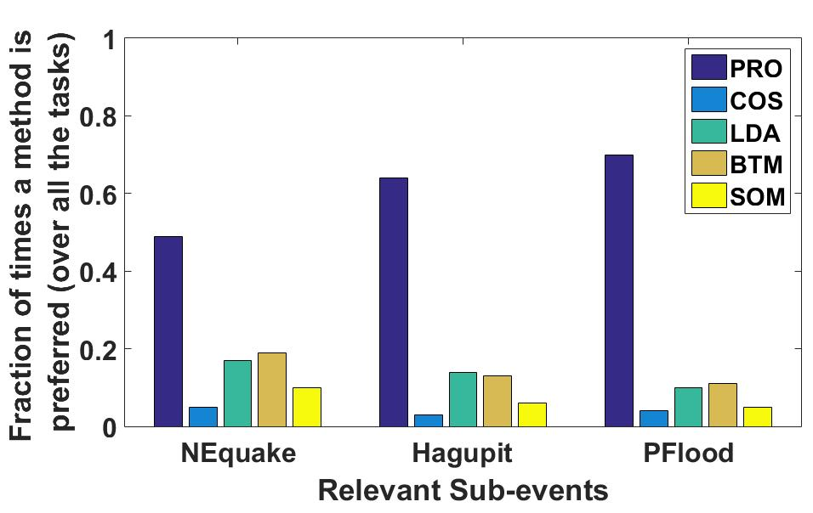
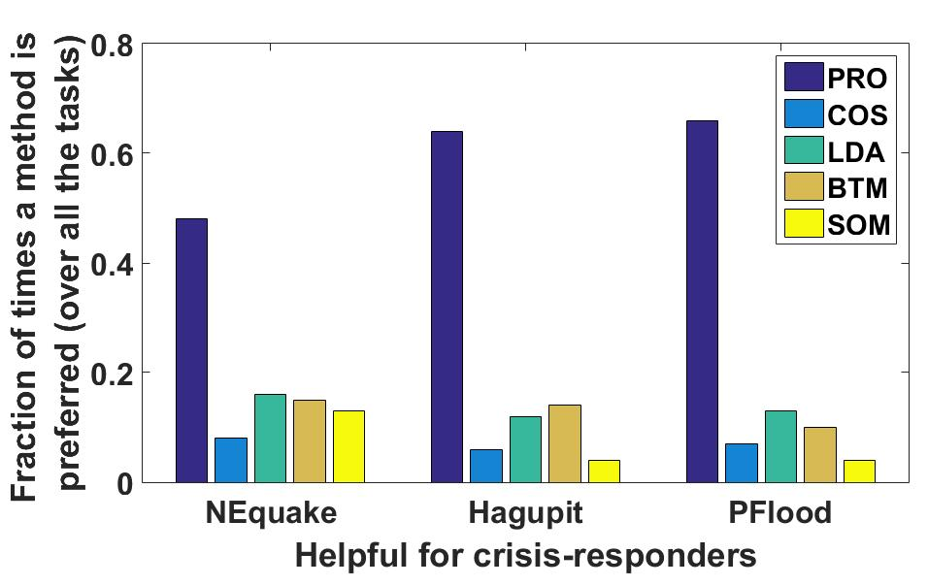
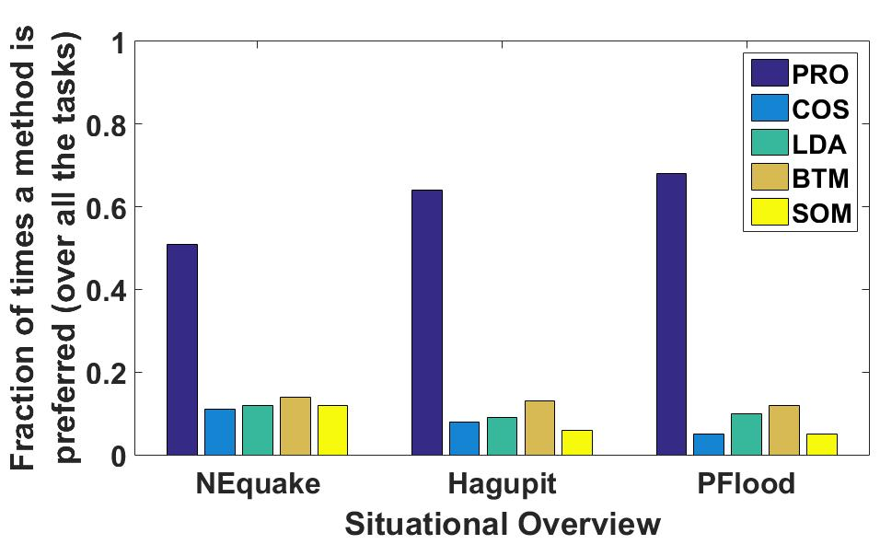
Sub-event results
Total 30 tasks
Each task is evaluated by 15 workers
Method which gets most votes is chosen as winner of a task
Evaluation using gold-standard sub-events
 | P | R | F
Infrastructure | 0.52 | 0.87 | 0.65
Missing | 0.78 | 0.87 | 0.82
Shelter | 0.77 | 0.96 | 0.89
Volunteer | 0.63 | 0.79 | 0.69
 | P | R | F
Infrastructure | 0.75 | 0.81 | 0.78
Missing | 0.67 | 0.87 | 0.75
Shelter | 0.58 | 0.84 | 0.68
Volunteer | 0.75 | 0.85 | 0.80
 | P | R | F
Infrastructure | 0.69 | 0.75 | 0.71
Missing | 0.73 | 0.91 | 0.81
Volunteer | 0.67 | 0.94 | 0.81
NEquake
Hagupit
PFlood

Slide 31
Situational tweets
Classification
Humanitarian Category Detection
Tweet
Stream
Sub-event Identification
Real-Time Perspective based Summarization
Fragmentation
Classification
Handling fast changing actionable information
Non-situational tweets
Analyzing Communal tweet

Slide 32
Perspective based summarization
Parameters
Content words: Nouns, numerals, verbs, locations
Sub-events: Noun-Verb pairs
Humanitarian Category information (CL(i))
Objective
maximize the coverage of these content words, sub-events in final summary

Slide 33
Perspective based summarization: Model
ILP based solution
max(λ₁∑_{i=1…n} ICL(CL(i)).x_{i} + λ₂ ∑_{j=1…m} Cscore(j).y_{j}
+ λ₃∑_{k=1…p} Sscore(k).z_{k})
x_{i}, y_{j} , z_{k} binary variable
x_{i} tweet indicator, y_{j} content word, z_{k} sub-event indicator
Cscore(j) = tf-idf score
Sscore(k) = Sub-event weight
λ_{1,} λ_{2,} λ₃ tuning parameter [λ₁ + λ₂ + λ₃] = 1
Constraints
∑_{i=1…n} x_{i *} Length(i) ≤ L
Length(i) = number of words in tweet i
L = required summary word length limit
∑_{i ∈ Tj} x_{i} ≥ y_{j} j = [1 … m]
Tj = set of tweets containing content word j
y_{j}=1=> at least one tweet covering y_{j} is picked
∑_{j ∈ Ci} y_{j} ≥ | Ci | * x_{i} i = [1 … n]
C_{i} = set of content words present in tweet i
x_{i}=1=> all content words in tweet i are selected
∑_{i ∈ TCLa} x_{i} ≥ δ a = [1 … q]
q = total number of categories
TCL_{a} = set of tweets present in category a
Select at least δ tweets from each category

Slide 34
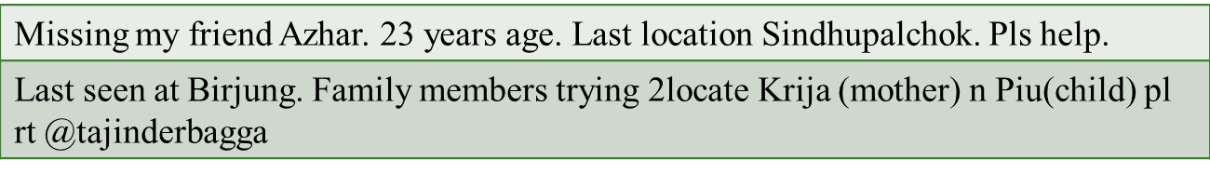
Perspective based summarization: Use-cases
High level summarization
Set importance of each class
Provide uniform weight to each class
Humanitarian category specific summarization
Importance of focused category is 1, others 0
Missing person summarization
Importance of missing class is 1
Content words – name, relation

Slide 35
Sample summary
All ﬂights canceled as airport closes down after quake.
Reporter Kathmandu airport closed following 6.7 aftershock no planes allowed to land.
Kathmandu airport reopened.
Nepal quake photos show historic buildings reduced to rubble as survivor search continues.
Death toll in the earthquake in Nepal exceeded 2 thousand people

Slide 36
Summarization results
Baselines
COWTS: Real-time disaster specific ILP based summarization algorithm
APSAL: Affinity clustering based disaster tweet summarization technique [ACL 2015]
TSum4act: Disaster specific summarization technique based on LDA, NER [PAKDD 2015]
Experimental setting
Summarize at category / high level
Generate a gold standard summary of 200 words for each day and each category [category level]
Generate gold standard summary of 200 words for each day [High level]
Evaluation
Evaluation using ground-truth summaries
Evaluation using Crowdsourcing

Slide 37
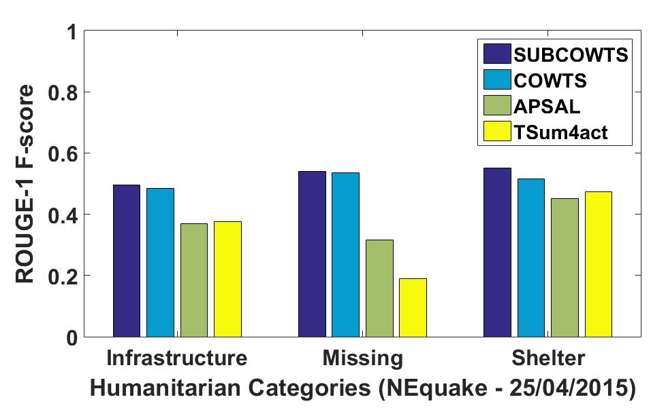
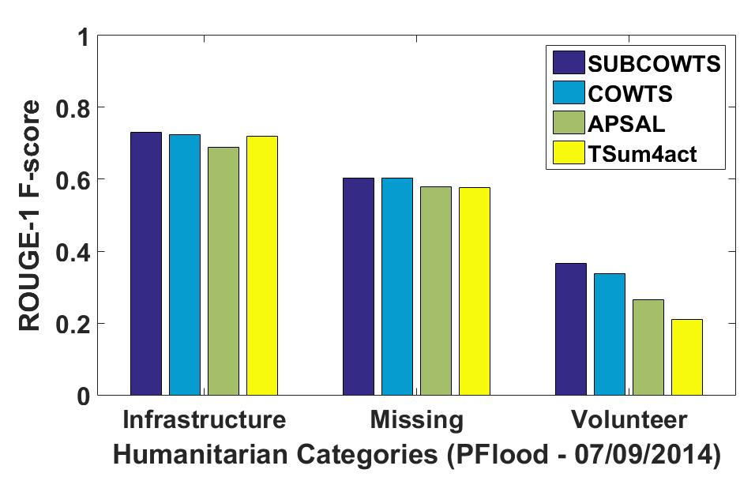
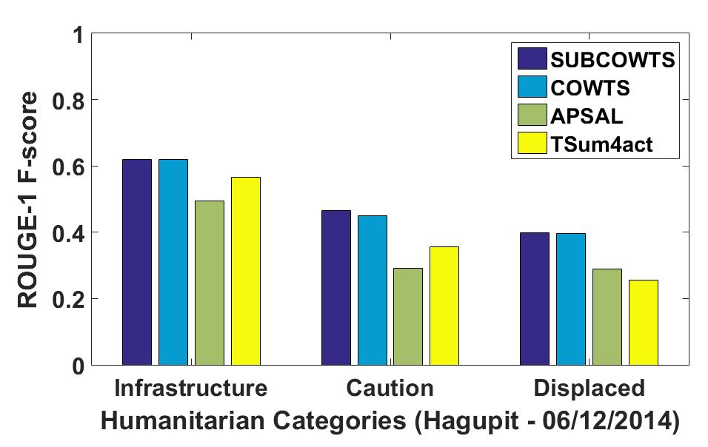
Summarization results: Category level
.
Sub-events play a key role in information coverage
Overall achieves 6-30% improvement

Slide 38
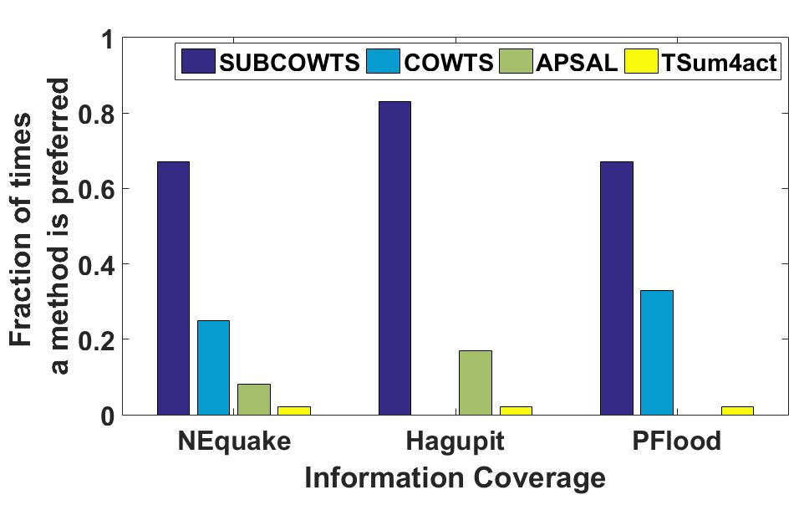
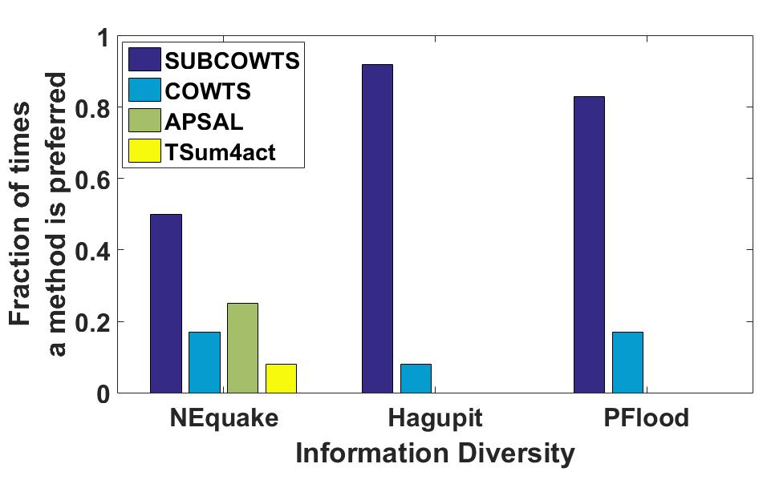
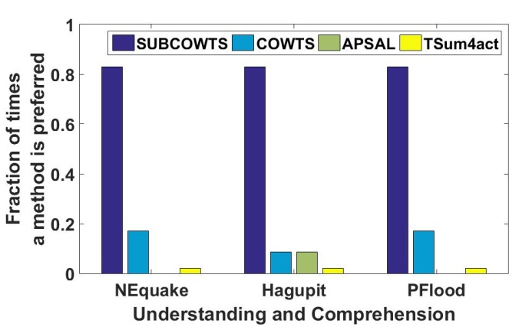
Summarization results: Category level
Evaluation using crowdsourcing
Overall, which method in your opinion has the best information coverage?
Overall, which method provides the most diverse information?
Overall, which summary helps you quickly understand and comprehend the situation?
Overall, do you prefer summaries with highlighted topics or without them?
Highlighted sub-events help in the comprehension process [90% cases]

Slide 39
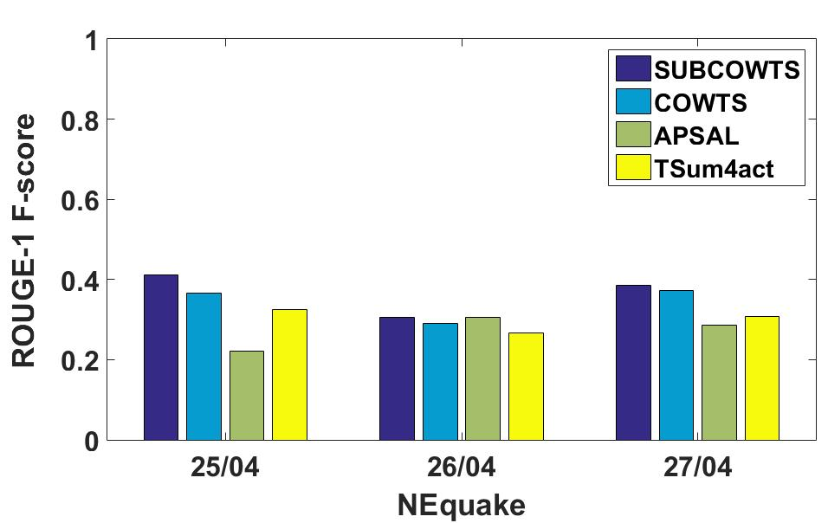
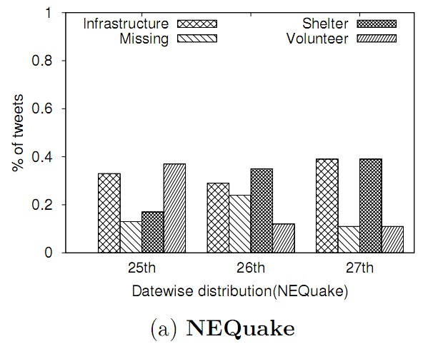
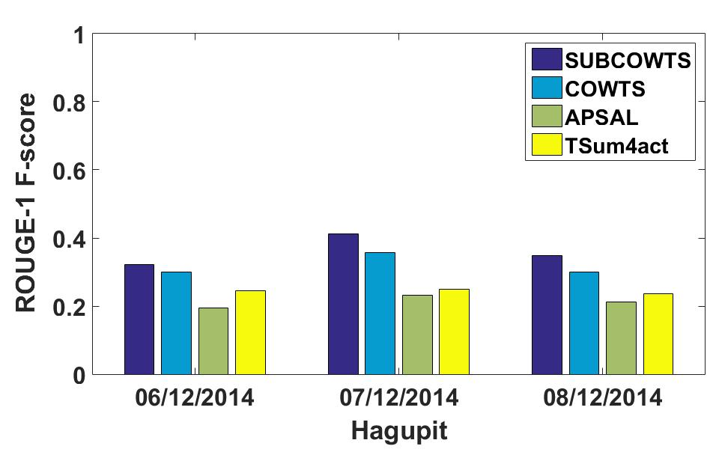
Summarization results: High level
.
Classes, Sub-events play a key role in information coverage
Overall achieves 13-45% improvement
Humanitarian categories help in comprehension
Importance of classes varies over day

Slide 40
Summarization results: Missing person
Ground-truth
NEquake --- 30 words (25th April), 305 words (26th April), 130 words (27th April)
PFlood --- 110 words (7th September), 80 words (8th September)
Performance (Recall score)
25th Apr | 1
26th Apr | 0.82
27th Apr | 0.87
7th Sep | 0.81
8th Sep | 0.83
PFlood
NEquake
Problems
Spelling mistakes
Short hand expressions
Ex – My bro is missing

Slide 41
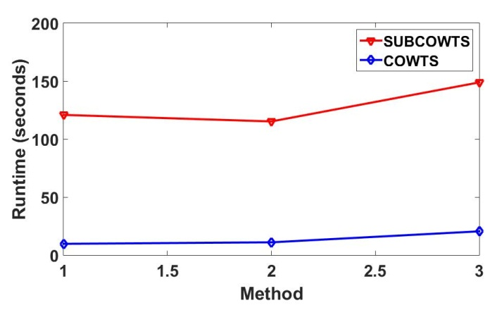
Observations and Roadmap
Noun-verb pair based sub-events are easy to comprehend
Small scale sub-events, Humanitarian categories are helpful for summarization
Sub-event detection is time consuming
Combine information from multiple tweets => Abstractive summarization
Publications
Koustav Rudra, Siddhartha Banerjee, Niloy Ganguly, Pawan Goyal, Muhammad Imran, Prasenjit Mitra. Summarizing Situational and Topical Information during Crises. The Fourth International Workshop on Social Web for Disaster Management, 2016 (Colocated with CIKM 2016)
Koustav Rudra, Pawan Goyal, Niloy Ganguly, Prasenjit Mitra, Muhammad Imran. Identifying sub-events and Summarizing information during Crisis. (SIGIR 2018)

Slide 42
Situational tweets
Classification
Humanitarian Category Detection
Tweet
Stream
Sub-event Identification
Real-Time Abstractive Summarization
Fragmentation
Classification
Handling fast changing actionable information
Non-situational tweets
Analyzing Communal tweet

Slide 43
Objective
Reducing redundancies in final summary
Combining information from related tweets
​Dharara Tower built in 1832 collapses in Kathmandu during earthquake.
Historic Dharara Tower Collapses in Kathmandu after 7.9 Earthquake.
Dharara tower built in 1832 collapses in Kathmandu after 7.9 earthquake

Slide 44
Dharara Tower built in 1832 collapses in Kathmandu during earthquake.
Historic Dharara Tower Collapses in Kathmandu after 7.9 Earthquake.
historic|dharara
dharara|tower
tower|built
built|in
tower|collapses
in|1832
1832|collapses
7.9|earthquake
after|7.9
kathmandu|after
collapses|in
during|earthquake
kathmandu|during
in|kathmandu

Slide 45
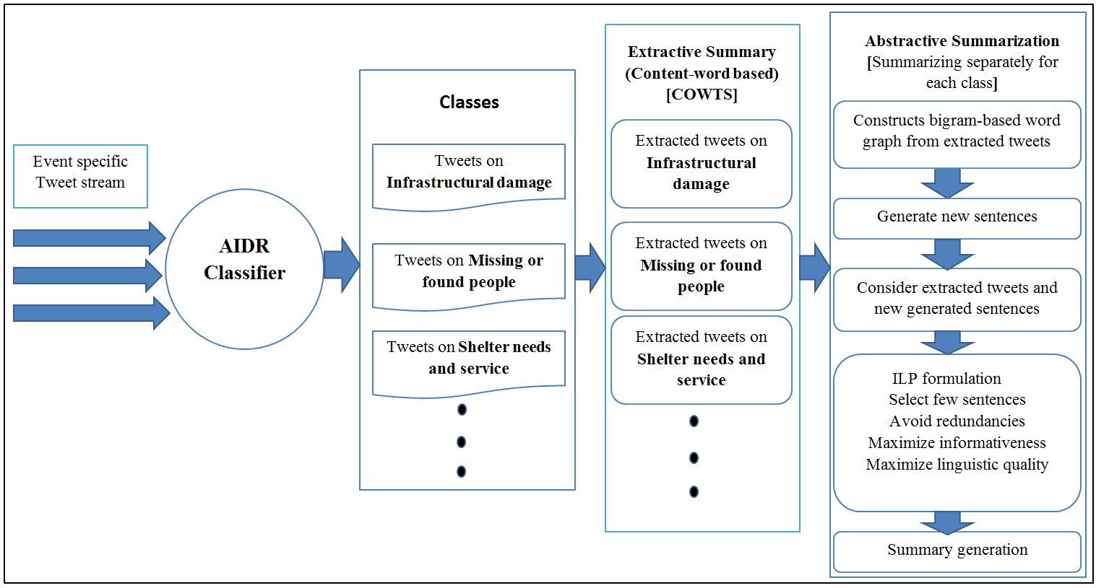
Summarization flowchart

Slide 46
ILP based formulation
Parameters
Score of sentences/generated paths (I(s))
Textrank/ Centroid score [tweet-paths]
Machine confidence score [tweets]
Linguistic quality(LQ(s))
Trigram language model
LQ(s) = 1/(1-ll(w₁,w₂,…,w_{q}))
ll(w₁,w₂,…,w_{q}) = 1/Llog₂∏^{q}_{t =3} P(w_{t}|w_{t-2}w_{t-1})

Slide 47
ILP based solution
Model
max(∑_{i=1…n} I(i).LQ(i).x_{i} + ∑_{j=1…m} Score(j). y_{j})
x_{i}, y_{j} binary variable
x_{i} tweet / tweet-path indicator, y_{j} content word indicator
Score(j) = tf-idf word of j
Constraints
∑_{i=1…n} x_{i *} Length(i) ≤ L
Length(i) = number of words in tweet i
L = required summary word length limit
∑_{i ∈ Tj} x_{i} ≥ y_{j} j = [1 … m]
T_{j} = set of tweets and paths where content word j is present
If y_{j} is selected then at least one tweet covering that word is also selected
∑_{j ∈ Ci} y_{j} ≥ | Ci | * x_{i} i = [1 … n]
C_{i} = set of content words present in tweet and path i
x_{i}=1=> all content words in tweet / path i are selected

Slide 48
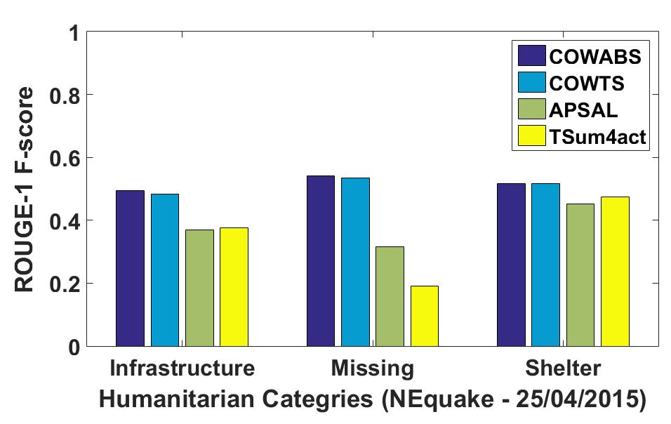
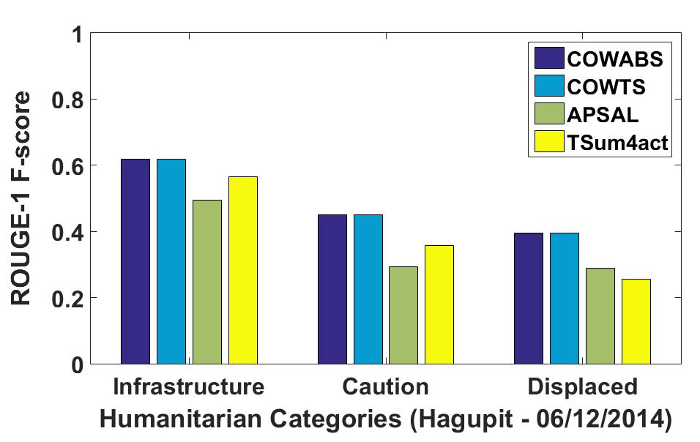
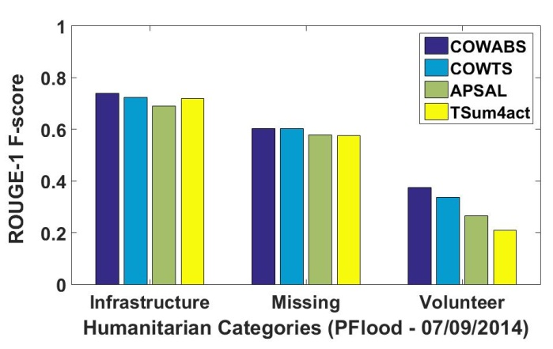
Experimental Results
Baselines
COWTS: Real-time disaster specific ILP based summarization algorithm
APSAL: Affinity clustering based disaster tweet summarization technique [ACL 2015]
TSum4Act: Disaster specific summarization technique based on LDA, NER [PAKDD 2015]
Better than APSAL and TSum4act in 87% and 90% cases
Improvement over COWTS by 1-2%
Running time increases linearly compared to COWTS
Publication
Koustav Rudra, Siddhartha Banerjee, Niloy Ganguly, Pawan Goyal, Muhammad Imran, Prasenjit Mitra. Summarizing Situational Tweets in Crisis Scenario. ACM Hypertext 2016

Slide 49
Situational tweets
Classification
Humanitarian Category Detection
Tweet
Stream
Sub-event Identification
Real-Time Summarization
Fragmentation
Classification
Handling fast changing actionable information
Non-situational tweets
Analyzing Communal tweet

Slide 50
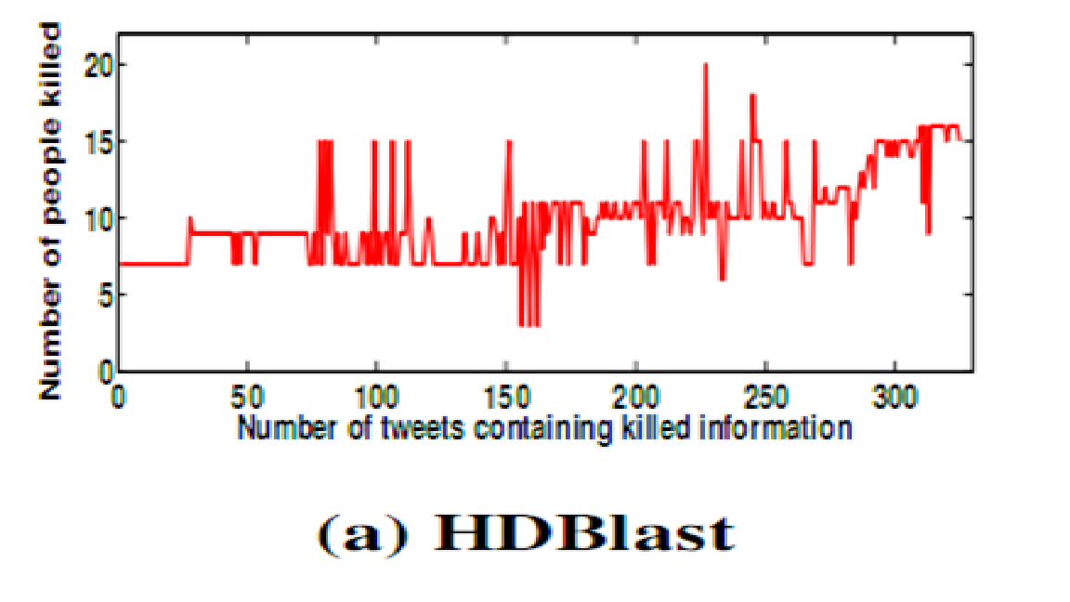
Frequently changing numerals
Time | Tweet
14:13:55 | seven killed in hyderabad blast [url]
14:16:18 | at least 15 feared dead in hyderabad blast
14:19:01 | 10 killed in hyderabad blast more photos
14:20:56 | hyderabad blast, 7 people are feared dead and 67 others are missing
Information is not stable and also not monotonically increasing
Some of these information may be rumors!
Associating numerals with keywords
Consider particular main verbs like killed, injured, died etc.
Identify numerals directly modify the main verbs
Numerals modify the main verb through direct object
15 people killed 50 injured in Hyderabad blast
Killed is modified by 15 via people[direct object]
Problem: PM visits blasts sites in Hyderabad, three days after two powerful bombs killed
Killed is modified by bomb[direct object]
Numerals modify the main verb through direct object and that direct object is a living entity
Obtain 95% precision compared to three word based window approach (63%)

Slide 51
Situational tweets
Classification
Humanitarian Category Detection
Tweet
Stream
Sub-event Identification
Real-Time Summarization
Fragmentation
Classification
Handling fast changing actionable information
Non-situational tweets
Analyzing Communal tweet

Slide 52
Communal tweets
F**k these Missionaries who are scavenging frm whatever’s left after the #NepalEarthquake Hav some shame & humanity. | Christian
#HillaryClinton’s reply when asked if war on terror is a war on “radical Islam” #DemDebate | Muslim
Who made kashir the heaven? they r Kashmiri Pandits, Muslims made it Hell. | Muslim
Slaughter. Like shooting ﬁsh in barrel. Now tell me what should be done with radical Muslims ? | Muslim
Non-situational (Communal) tweets are posted in many languages ---
English
Devanagari
Romanized
Code-mixed
Yeh allah, hope everybody is safe.
I must say that in ch****n ko jinda goli mar dena chahiye.

Slide 53
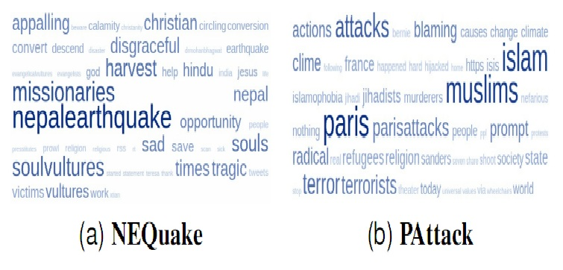
Identifying communal tweets
A simple approach is to use vocabulary of the event to develop a classifier [Burnap 2015]
Past tweet history of users can be used to develop a classifier [Magdy 2016]
Observation: People follow certain traits in posting different kinds of tweets
Those features/signals can be captured to develop an event independent classifier
Peter Burnap and Matthew Leighton Williams. Cyber hate speech on twitter: An application of machine classiﬁcation and statistical modeling for policy and decision making. Policy and Internet, 7:223–242, 2015
Walid Magdy, Kareem Darwish, Norah Abokhodair, Afshin Rahimi, and Timothy Baldwin. # isisisnotislam or# deportallmuslims?: Predicting unspoken views. Web Science, pages 95–106. ACM, 2016

Slide 54
Classification of Communal tweets: Features
Feature | Explanation
Presence of communal slang phrases | Some words are not slang words itself but when they are combined with some races or religions it turns out to be a slang (e.g., ‘m*** pig’, ‘radical islam).
Presence of negated religious phrases | phrases containing religious terms like ‘god’, ‘jesus’ sometimes contain negated/slang terms (e.g., ‘b*****d missionaries’).
Presence of communal hashtags | Some hashtags are explicitly used to curse a religious community (e.g., ‘#SoulVultures’, ‘#evangelicalvultures’).
Religious sarcasm | Why do all the Muslim guys barking endian endian?? If u dnt knw hw to write english jst dnt write.. #GurdaspurAttack
Proposed a rule based classifier: presence of any one of these features indicate communal tweet

Slide 55
Dataset
Event | #tweets | #distinct users
Nepal earthquake (NEquake) | 5,05,077 | 3,26,536
Kashmir flood (KFlood) | 14,922 | 8,367
Gurudaspur attack (GShoot) | 53,807 | 29,293
Paris attack (PAttack) | 6,48,800 | 5,77,888
California shooting (CShoot) | 2,93,483 | 1,64,276
Gold standard
Random sampling of 4000 tweets
Three annotators independently annotate these tweets
Majority verdict is taken for determining the class of tweets (unanimous agreement in 81% cases)
We obtain 247, 112, 203, 201, 152 communal tweets for five events respectively
Randomly sample same number of non-communal tweets from rest of the set
First three datasets used for training the classifier and learning the tweet pattern

Slide 56
Classification accuracy
Train | Test
 | NEquake |  | KFlood |  | GShoot
 | BUR | USR | BUR | USR | BUR | USR
NEquake | 0.86 | 0.73 | 0.50 | 0.62 | 0.46 | 0.59
KFlood | 0.56 | 0.59 | 0.83 | 0.64 | 0.62 | 0.56
GShoot | 0.50 | 0.55 | 0.54 | 0.59 | 0.79 | 0.58
Proposed Approach
Problem of the proposed approach:
If communal tweets are posted in a sarcastic way
Terrorists hav no religion but they hav beard
Huh, its a Muslim behind California attack
Event | Recall | F-score | Acc
NEquake | .90 | .93 | 0.93
KFlood | .96 | .94 | 0.94
GShoot | .87 | .91 | 0.91
PAttack | .98 | .95 | 0.95
CShoot | .96 | .93 | 0.93

Slide 57
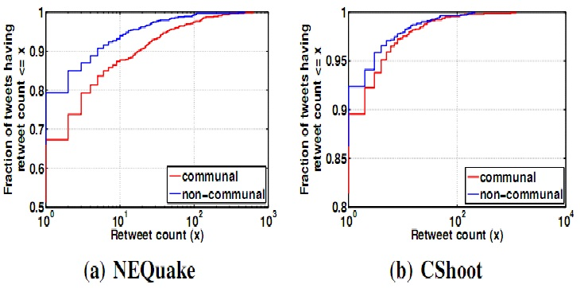
Communal tweets: Popularity
Communal tweets are retweeted more compared to random non-situational tweets

Slide 58
Communal users: Classes
Initiators
Users who originally publish tweets on Twitter (Originator of a Tweet).
Propagators
Users who Retweet or copy other user's (initiators) tweets.
Who are involved?
Common users: having < 5000 followers
Popular users: having >= 10000 followers

Slide 59
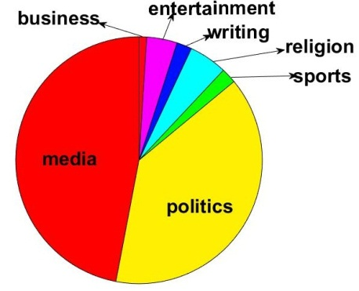
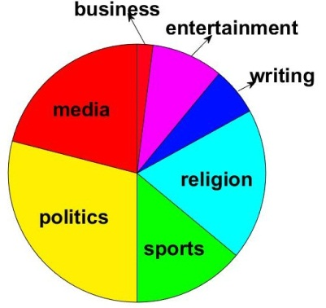
Communal users: Topical interest
popular
common
Most frequent words in the bio
Communal | Non-communal
Hindu, Media, Muslim, Religion, Politics | Indian, Lover, Fan, Music, Life

Slide 60
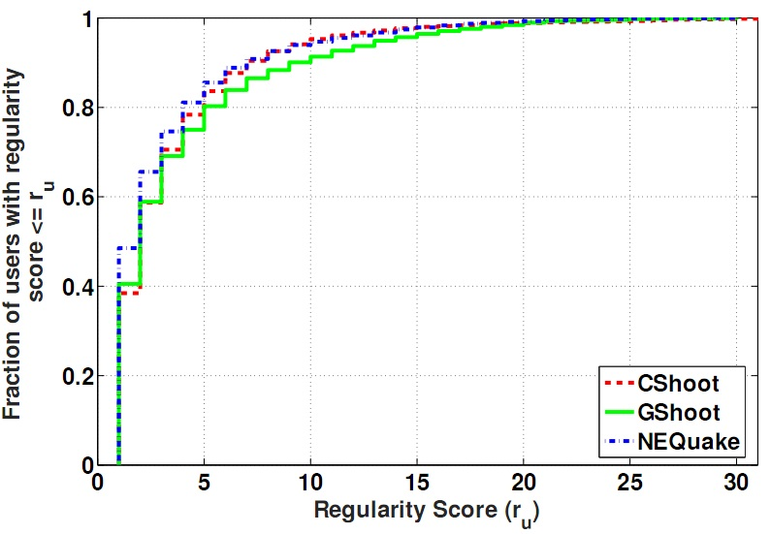
Communal users: Behaviour
Collect tweets of communal users over a period of 30 days
V_{u}[i] = 1, user u posted a communal tweet on d+i where i = [-15,15]
Regularity score (r_{u}) = ∑_{i = -15}¹⁵ V_{u}[i]
Around 10% users post communal tweets in regular fashion

Slide 61
Communal users: Interaction
DENSITY: Fraction of links present in the network
RECIPROCITY: Fraction of users who are mutual friends, i.e. both u->v & v->u are present
EVENT | USER GROUP | MENTION NETOWRK |  | FOLLOW NETWORK
 |  | Reciprocity | Density | Reciprocity | Density
Nepal Earthquake | Communal | 4.20% | 0.0037 | 25.05% | 0.0099
 | Non-Communal | 3.31% | 0.0002 | 16.88% | 0.0007
Gurdaspur Shootout | Communal | 4.74% | 0.0047 | 26.14% | 0.0133
 | Non-Communal | 3.78% | 0.0012 | 16.92% | 0.0038
Communal users form a strong social connection among themselves

Slide 62
Countering communal tweets
Anti-communal tweets
Sad commentary of our times that people bring religion even into the devastating #NepalEarthquake
Won’t Hindus remember Shiva or Hanuman in this crisis? So what’s wrong if Christians remember Jesus?
Saddened to know abt #GurdaspurAttack, pls avoid politics on terror. Act fast, whatever be religion of terrorists.
Identification: Features
anti-communal hashtags – ‘#RespectAllReligion’, ‘#MuslimsAreNotTerrorist’, ‘#NothingToDoWithIslam’
Anti-communal collocations – `has no religion’, ‘terrorism defies religion’
Multiple religious terms – ‘WTF people are trying to save their life & this MORONs Tweeting Hindu christian muslim #earthquake #NepalEarthquake’
Evaluation
Annotate 2000 tweets / datasets
Obtain 196 anti-communal tweets
Baseline – Bag-of-Words
In-domain accuracy (0.75)
Cross-domain accuracy (0.64)
Event | Recall | F-score
NEquake | .88 | .86
GShoot | .97 | .77
PAttack | 1 | .88

Slide 63
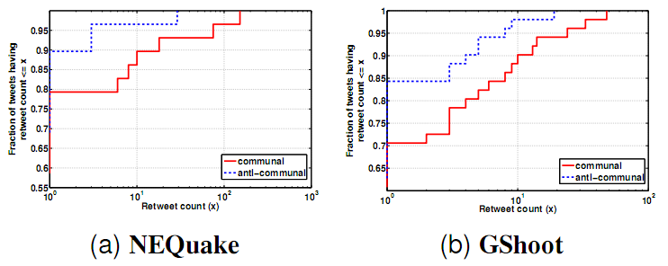
Anti-communal tweets: Properties
Popularity of anti-communal tweets
Anti-communal tweets are less popular compared to communal ones
Popularity distribution of users is same as communal tweets
Challenges –
Promoting such contents
Interaction among communal and anti-communal contents
Publications
Koustav Rudra, Ashish Sharma, Niloy Ganguly, Saptarshi Ghosh. Characterizing communal microblogs during disaster events. ASONAM 2016
Koustav Rudra, Ashish Sharma, Niloy Ganguly, Saptarshi Ghosh. Characterizing and Countering Communal Microblogs during Disaster Events. IEEE Transactions on Computational Social Systems, 2018

Slide 64
Conclusion
Low level lexical features can help in the identification of situational / communal tweets
Specific POS tags help in the summarization
Related noun-verb pairs represent sub-events in a comprehensible way
Vernacular languages (Hindi) provide useful information during crisis
Communal tweets are posted by common and popular users
Hindi tweets are preferred to express negative sentiments, slangs.
Anti-communal tweets provide an effective way to counter adverse effects of communal tweets

Slide 65
Future directions
Extending classification-summarization framework to regional languages
Developing Twitter specific NLP tools
Developing an exhaustive corpus / dictionary
Handling false information / rumours
Handling epidemics
Incorporating importance of Humanitarian categories
Extracting information from other social medias
Promoting anti-communal tweets

Slide 66
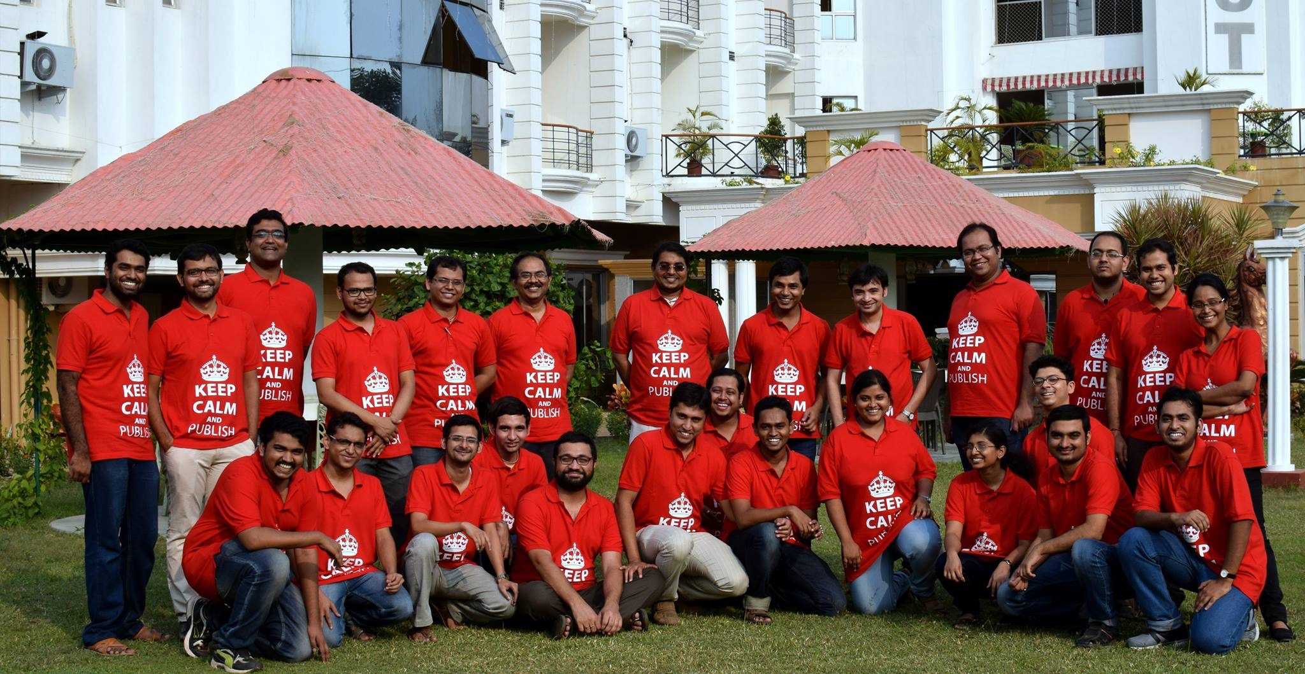
CNeRG, CSE Dept, IIT Kharagpur

Slide 67
Publications
Conferences
Koustav Rudra, Subham Ghosh, Niloy Ganguly, Pawan Goyal, Saptarshi Ghosh. Extracting Situational Information from Microblogs during Disaster Events: a Classification-Summarization Approach. ACM CIKM 2015
Koustav Rudra, Siddhartha Banerjee, Niloy Ganguly, Pawan Goyal, Muhammad Imran, Prasenjit Mitra. Summarizing Situational Tweets in Crisis Scenario. ACM Hypertext 2016
Koustav Rudra, Ashish Sharma, Niloy Ganguly, Saptarshi Ghosh. Characterizing communal microblogs during disaster events. ASONAM 2016
Rafiya Begum, Kalika Bali, Monojit Choudhury, Koustav Rudra, Niloy Ganguly. Functions of Code-Switching in Tweets: An Annotation Scheme and Some Initial Experiments. LREC 2016
Koustav Rudra, Shruti Rijhwani, Rafiya Begum, Kalika Bali, Monojit Choudhury, Niloy Ganguly. Understanding Language Preference for Expression of Opinion and Sentiment: What do Hindi-English Speakers do on Twitter? EMNLP 2016
Koustav Rudra, Pawan Goyal, Niloy Ganguly, Prasenjit Mitra, Muhammad Imran. Identifying sub-events and Summarizing information during Crisis. SIGIR 2018

Slide 68
Publications
Journals
Koustav Rudra, Niloy Ganguly, Pawan Goyal, Saptarshi Ghosh. Extracting and Summarizing Situational Information from the Twitter Social Media during Disasters, ACM TWEB, 2018
Koustav Rudra, Ashish Sharma, Niloy Ganguly, Saptarshi Ghosh. Characterizing and Countering Communal Microblogs during Disaster Events, IEEE Transactions on Computational Social Systems, 2018
Koustav Rudra, Ashish Sharma, Niloy Ganguly, Muhammad Imran. Classifying and Summarizing Information from Microblogs during Epidemics, Special Issue on “Exploitation of Social Media for Emergency Relief and Preparedness” in the journal Information Systems Frontiers (Springer), 2018
Koustav Rudra, Ashish Sharma, Kalika Bali, Monojit Choudhury, Niloy Ganguly. Identifying and Analyzing different Aspects of English-Hindi Code-Switching in Twitter (communicated)

Slide 69
Publications
Workshops
Anirban Sen, Koustav Rudra, Saptarshi Ghosh. Extracting Situational Awareness from Microblogs during Disaster Events. Social Networking Workshop, Comsnets 2015
Prabhat Agarwal, Ashish Sharma, Jeenu Grover, Mayank Sikka, Koustav Rudra, Monojit Choudhury. I may talk in English but gaali toh Hindi mein hi denge : A study of English-Hindi Code-Switching and Swearing Pattern on Social Networks. Social Networking Workshop, Comsnets 2016
Koustav Rudra, Siddhartha Banerjee, Niloy Ganguly, Pawan Goyal, Muhammad Imran, Prasenjit Mitra. Summarizing Situational and Topical Information during Crises. The Fourth International Workshop on Social Web for Disaster Management, 2016 (Colocated with CIKM 2016)

Slide 70


