Slide 1



Modeling Cross-linguistic
Relationships Across
Consonant Inventories:
A Complex Network Approach

Slide 2
Sabda Bramha: Sound is Eternity
sabda-brahma su-durbodham
pranendriya-mano-mayam
ananta-param gambhiram
durvigahyam samudra-vat
  Sound is eternal and as well very difficult to comprehend. It manifests within the life air, the senses, and the mind. It is unlimited and unfathomable, just like the ocean

Slide 3
Signals and Symbols
Several living organisms can produce sound
  They emit sound signals to communicate
  These signals are mapped to certain symbols (meanings) in the brain
  E.g., mating calls, danger alarms

Slide 4
Human Communication
Human beings also produce sound signals
Unlike other organisms, they can concatenate these sounds to produce new messages – Language
Language is one of the primary cause/effect of human intelligence

Slide 5
Human Speech Sounds
Human speech sounds are called phonemes – the smallest unit of a language
Phonemes are characterized by certain distinctive features like
    Place of articulation
    Manner of articulation
    Phonation

Slide 6
Types of Phoneme
Vowels
    /a/, /e/, /u/ …
Consonants
    /p/, /t/, /k/ …
Dipthongs
    /au/, /iu/ …

Slide 7
Choice of Phonemes
How a language chooses a set of phonemes in order to build its sound inventory?
Is the process arbitrary?
    Certainly Not
What are the forces affecting this choice?

Slide 8
Forces of Choice
A Linguistic System
/a/
/a/
Speaker
Listener / Learner
Desires “ease of articulation”
Desires “perceptual contrast” / “ease of learnability”
The forces shaping the choice are opposing – Hence there is a non-trivial solution

Slide 9
Vowels: A Solved Mystery
Languages choose vowels based only on maximal perceptual contrast.
For instance if a language has three vowels then in more than 95% of the cases they are /a/,/i/ and /u/.
/a/
Maximally Distinct
Maximally Distinct
/i/
/u/
Maximally Distinct

Slide 10
Consonants: A Jigsaw puzzle
Research: From 1929 – Date
No single satisfactory explanation of the organization of the consonant inventories
      The set of features that characterize consonants is much larger than that of vowels
      No single force is sufficient to explain this organization
      Rather a complex interplay of forces goes on in shaping these inventories

Slide 11
Principle of Occurrence
PlaNet – “Phoneme Language Network”
  A bipartite network N=(V_{L},V_{C},E)
  V_{L} : Nodes representing languages of the world
  V_{C} : Nodes representing consonants
  E : Set of edges which run between V_{L} and V_{C}
      There is an edge e Є E between two nodes v_{l} Є V_{L} and v_{c} Є V_{C} if the consonant c occurs in language l.
v_{l1}
v_{l2}
v_{l3}
v_{l4}
v_{c1}
v_{c2}
v_{c3}
v_{c4}

Slide 12
Construction of PlaNet
Data Source : UCLA Phonological Inventory Database (UPSID)
Number of nodes in V_{L} is 317
Number of nodes in V_{C} is 541
Number of edges is 7022

Slide 13
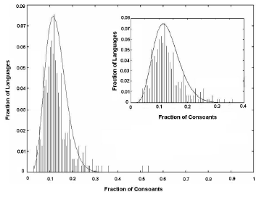
Degree Distribution of PlaNet
DD of the nodes of V_{L}
An asymmetric β-distribution peaking at 21
  Most of the languages in UPSID tend to have a consonant
  inventory size of 21

Slide 14
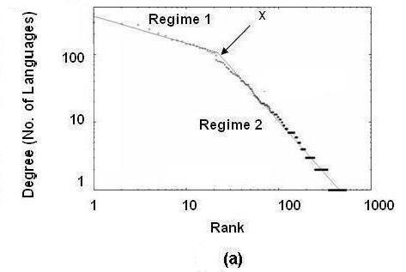
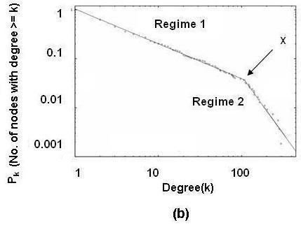

Degree Distribution of PlaNet: A Two Regime Power Law
Rank versus degree of the nodes in V_{C}
DD of the nodes in V_{C}

Slide 15
Two Regime Power Law:
An Explanation
Power Law:
  Languages preferentially choose consonants they have a tendency to choose a consonant which has been already chosen by many other languages.
Two Regime:
  Hypothesis: The typical distribution of the consonant inventory size over languages coupled with the principle of preferential attachment enforces the two distinct regimes to appear in the power law curves.

Slide 16
Why the Break??
Average consonant inventory size in UPSID is 21
  Principle of preferential attachment: The first 21 consonants (most frequent) are more preferred by languages than the rest. Hence the transition.
The break shifts as the average inventory size is shifted.

Slide 17
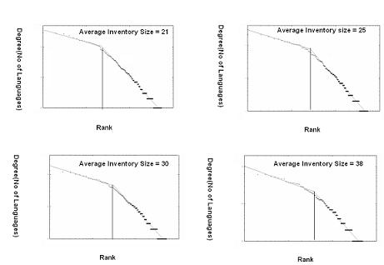
Support Experiment
Shift the inventory size form 21 to 25, 30 and 38 by neglecting the contribution of the consonant inventory size less than 15, 20 and 25 respectively.
Break at 25
Break at 21
Break at 37
Break at 30

Slide 18
Simplified Theoretical Explanation
Assumption:
  Inventory size of all languages is fixed at 21.
  Consonants are organized in a hierarchy of preference
Model:
  A language traverses the hierarchy of consonants
  At each step decides with a probability p whether to choose the current consonant.

Slide 19


Simplified Theoretical Explanation
Analysis:
  Probability of choosing any one of the first 21 consonants is p (since languages must traverse through the first 21 consonants regardless of whether the previous consonants are chosen or not)
  22nd consonant is chosen only if 0, 1, 2 or at most 20 but not all 21 consonants are chosen
  In general

Slide 20
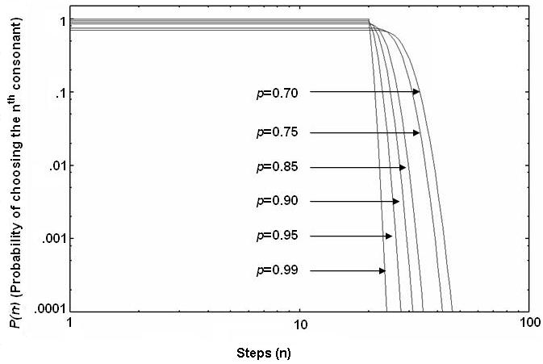
Simplified Theoretical Explanation
The plots for the function P(n) different values of p

Slide 21

The Synthesis Model (PlaNet_{syn})
Initialization
  Degree distribution of the nodes in V_{L} is known. V_{L}={L₁,L₂,…,L₃₁₇} with degrees (consonant inventory size) {k₁,k₂,…,k₃₁₇}
  Nodes in V_{C} are unlabelled.
Algorithm
  At every time step a node L_{j} (j = 1 to 317) from V_{L} tries to attach itself to a node i Є V_{C} (to which L_{j} is not already connected) with a probability Pr(i) given by
  where k_{i} is the current degree of the node i and V_{j} is the set of nodes in V_{C} to which L_{j} is not already connected and ε is the model parameter that inserts some randomness in the model
  The above step is repeated until all L_{j} Є V_{L} gets connected to exactly k_{j} nodes in V_{C}

Slide 22
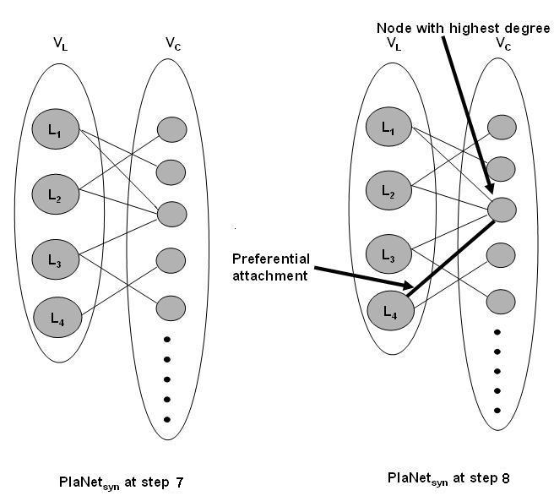
The Mechanism in Illustration

Slide 23
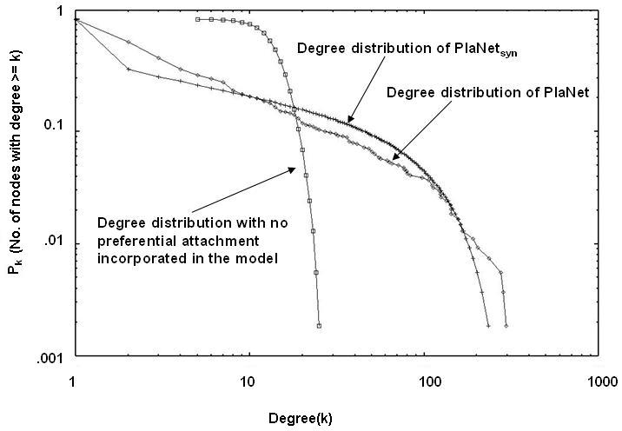
Simulation Results
For PlaNet_{syn} ε = 0.0701 and the results are averaged over 100 runs

Slide 24
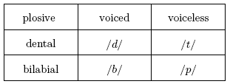
Principle of Co-occurrence
Consonants tend to co-occur in groups or communities
The observed property can be explained by principle of feature economy
  Languages tend to maximize the combinatorial possibilities of a few distinctive features in order to produce a large number of consonants.
If a language has in its inventory
Then it will also tend to have

Slide 25
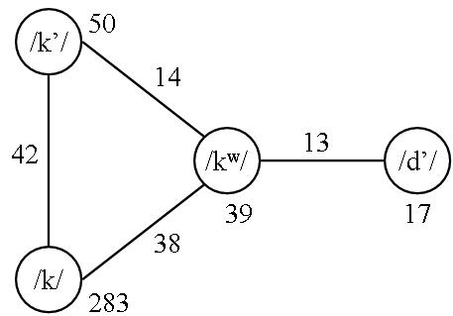
Studies of this Co-occurrence
PhoNet – “Phoneme Phoneme Network”
  A weighted network N=(V_{C},E)
  V_{C} : Nodes representing consonants
  E : Set of edges which run between the nodes in V_{C}
    There is an edge e Є E between two nodes v_{c1} ,v_{c2} Є V_{C} if the consonant c₁ and c₂ co-occur in a language. The number of languages in which c₁ and c₂ co-occurs defines the edge-weight of e. The number of languages in which c₁ occurs defines the node-weight of v_{c1}.

Slide 26
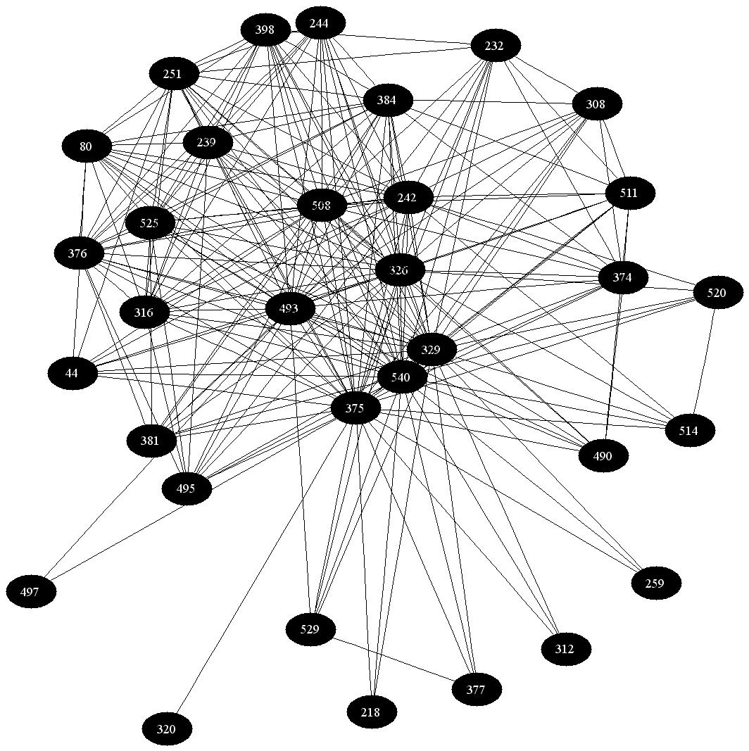
Construction of PhoNet
Data Source : UCLA Phonological Inventory Database (UPSID)
Number of nodes in V_{C} is 541
Number of edges is 34012
PhoNet

Slide 27
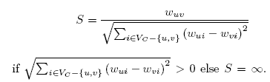
Communities in PhoNet
Modified Radicchi et al. algorithm
Basis
  Edges running between communities are unlikely to belong to short-loops because to complete this loop there needs to be another edge running between these two communities and such edges are rare
Modification for Weighted Networks
  Rather than considering triangles, whether or not the weights on the edges of this triangle are comparable is to be considered. If they are, then the group of consonants co-occur highly else it is not so.
  Measure strength S for each edge in PhoNet where S is,
  Remove edges with S less than a threshold η

Slide 28
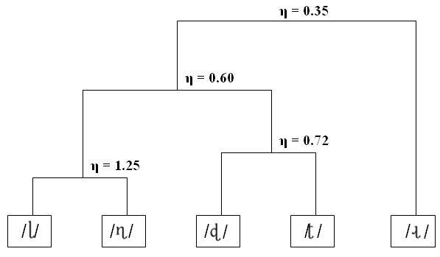
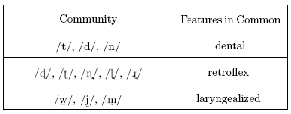
The Consonant Communities
The formation of the retroflex community as η decreases
Three different communities

Slide 29


Evaluation of the Communities
Occurrence Ratio: , where N is the number of consonants (ranked by their frequency of occurrence) in a community C, M is the number of consonants that occur in a language L and R_{top} is the rank of the highest ranking consonant (If a high-ranking consonant is present it is not necessary that the low-ranking should be present; but if a low ranker is present then it is expected that the high ranker must be present)
Average Occurrence Ratio: , where L_{occur} is the number of languages where at least one of the members of C has occurred

Slide 30
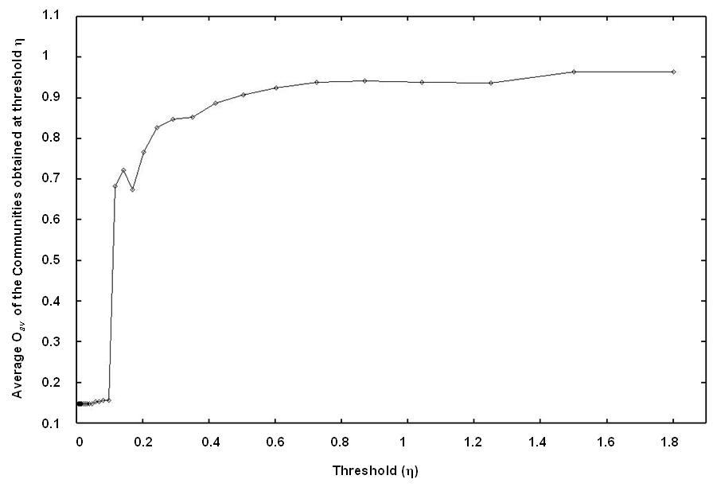
Evaluation of the Communities
O_{av} > 0.8
η > 0.3
Consonants show patterns of co-occurrence 80% or more of the world’s languages

Slide 31

The Binding Force of the Communities: Feature Economy
Feature Entropy: The idea is borrowed from information theory
For a community C of size N, let there be p_{f} consonants having a particular feature f and q_{f} other consonants lacking f – probability that a consonant chosen from C has f is p_{f} /N and that it does have f is q_{f} /N or (1- p_{f} /N)
Feature entropy can be therefore defined as
    where F is the set of all features present in the consonants in C
Essentially the number of bits needed to transmit C through a channel.

Slide 32
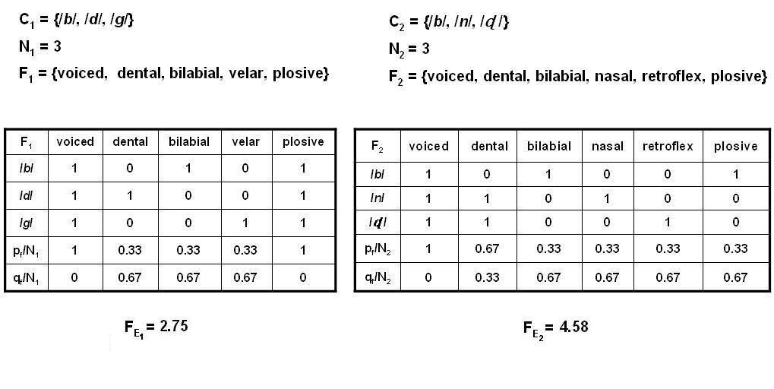
For Instance
Lower F_{E} -> C economizes on the number of features
Higher F_{E} -> C does not economize on the number of features

Slide 33
Comparison with Random PhoNet (PhoNet_{rand})
Construction of PhoNet_{rand}
  For each consonant c let the frequency of occurrence in be denoted by f_{c}. Let there be 317 bins each corresponding to a language in UPSID. f_{c} bins are then chosen uniformly at random and the consonant c is packed into these bins. Thus the consonant inventories of the 317 languages corresponding to the bins are generated. Construct PhoNet_{rand} from these new consonant inventories similarly as PhoNet.
  Cluster by the PhoNet_{rand} method proposed earlier

Slide 34
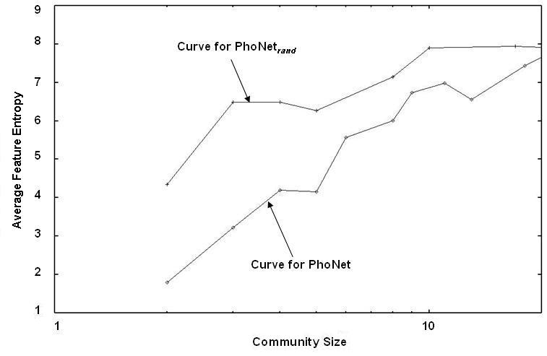
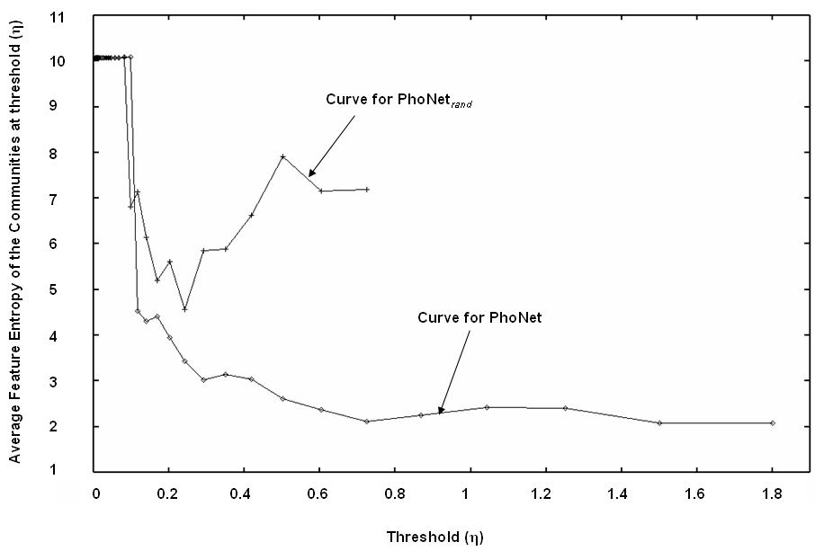
Comparison with Random PhoNet (PhoNet_{rand})
Average feature entropy of the communities of a particular size versus the community size (in log scale)
Communities would
not have emerged if
inventories had evolved
just by chance
Average feature entropy of the communities at a threshold η versus the threshold η

Slide 35
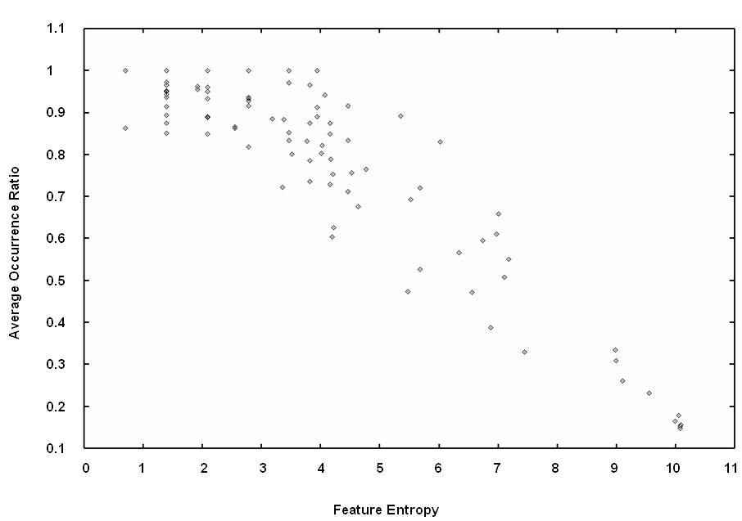
Occurrence Ratio and
Feature Entropy
O_{av} > 0.7
F_{E} ≤ 4
The consonant communities that maximize feature economy tend to occur more frequently in the languages of the world.

Slide 36
The Future
The quantification of Feature Economy can help in understanding the interplay of the forces like
  Perceptual Contrast (will tend to increase feature economy by increasing the number of distinctive features required for better perception)
  Ease of Learnability (will tend to decrease feature economy by decreasing the number of distinctive features to be learnt)

Slide 37
Implications to Language Evolution
N speakers communicating with two consonants /k/ and /g/.
Each speaker have l descendant
m of them speak /k/ and the rest n of them speak /g/
After i generations there will be ml^{i} /k/ speakers and nl^{i} /g/ speakers. Now if
If m > n then ml^{i} >> nl^{i} (something similar to the phenomenon of preferential attachment)
How the initial disparity (m > n) comes is still to be explored (maybe phonetic reasons)

Slide 38
Thanks

