Slide 1
Design of a Robust Search Algorithm for P2P Networks
  Niloy Ganguly, Geoffrey Canright, Andreas Deutsch
  Indian Institute of Social Welfare and Business Management, Kolkata
  Telenor Research and Development, Norway
  Center for High Performance Computing, Technical University
  Dresden, Germany

Slide 2
Talk Overview
Problem Definition
Design Overview
Experimental Results

Slide 3
Talk Overview
Problem Definition
Search in p2p Network
Immune Inspiration
Cellular Automata Design
Experimental Results
Theoretical Explanation

Slide 4
Unstructured Peer to Peer Networks
Each Network consists of peers (a, b, c, ..).
Peers host data (1, 2, 3, …)
5
a
4
b
1
a
2
b
3
4
d
6
d
5
e
e
2
c
3
c
g
7
g
7
1
6
f
f
Structured Network
Unstructured Network

Slide 5
Unstructured Networks
5
a
4
b
Searching in unstructured networks –
Non-deterministic Algorithms
Flooding, random walk
6?
3
d
6
e
2
c
6!!!
6?
6?
g
7
6?
1
6?
f
6?
Unstructured Network

Slide 6
Solution
Our ImmuneSearch algorithm
1. Packet movement guided by Immune System inspired concept of packet proliferation and mutation.
2. Topology evolution of the network to provide some structure (semi – structure) in the network speeding up the search process
Topology evolution speeds up search algorithm as we conduct more and more search operation (the network develops memory!)

Slide 7
Immune Inspiration
Immune search algorithm
Message proliferation/mutation + Topology evolution (memory formation)
Similarity (message, searched item)
Interaction between message and searched item
P2p Network
Query Message
Searched Item
Human Body
Antibody
Antigen

Slide 8
Talk Overview
Problem Definition
Design Overview
Representing network by a 2-dimensional grid
Data and query distribution
Algorithms
Experimental Results

Slide 9
Mapping an unstructured network to a
2-dimensional grid
Network = (peers, neighborhood)
5
a
4
b
5
4
3
d
a
b
6
e
2
c
1
2
3
f
c
d
g
7
1
7
6
f
g
e
Peers host data

Slide 10
Query and Data Distribution
Query/Data
– 10-bit strings
– 1024 unique queries/data (tokens)
– Distribution based on Zipf’s law
power law - frequency of occurrence
of a token T α 1/r, rank of the token
eg. Most popular word = 1000 times
2nd most popular word = 500 times
3rd most popular word = 333 times
– Each node host one data item (information profile) and one query item (search profile)
5
4
a
b
1
2
3
1001001001
f
c
d
7
6
1001001001?
g
e

Slide 11
Algorithm
Query Initiation – Start a search by flooding k query message packets to the neighborhood
Query Processing – Compare query message with data.
Report a match if hamming distance(message,data) ≤ 1
Query Forwarding – Forward the message to the neighbors
Topology Evolution – Change the neighborhoods of the peer
a
b
a
b
5
5
4
4
6?
6?
1
2
3
1
2
3
f
c
d
f
c
d
6?
7
6
7
6
g
6!
g
e
e
Query Initiation
Query Processing

Slide 12
Query forwarding
Proliferation/Mutation
Produce N message copies of the single message. (Mutate one bit with prob. β)
Spread the messages to the neighboring nodes
original
1010110011
1010010011
5
4
N = 3
b
a
mutated
1
2
3
f
c
d
N = 8 · S,
where S = sim(PI,M)/d
and S ≥ Threshold
7
6
g
e

Slide 13

Topology Evolution
Aim
Cluster Similar Nodes (Similar in Information and Search Profile)
Initiator node
Movement Depends on
The Distance from the user node
Amount of Matching
Age
visited node

Slide 14
Talk Overview
Problem Definition
Design Overview
Experimental Results
Experiment Search
Processes
Metrics & Fairness Criteria
Stable Condition
Transient Condition

Slide 15
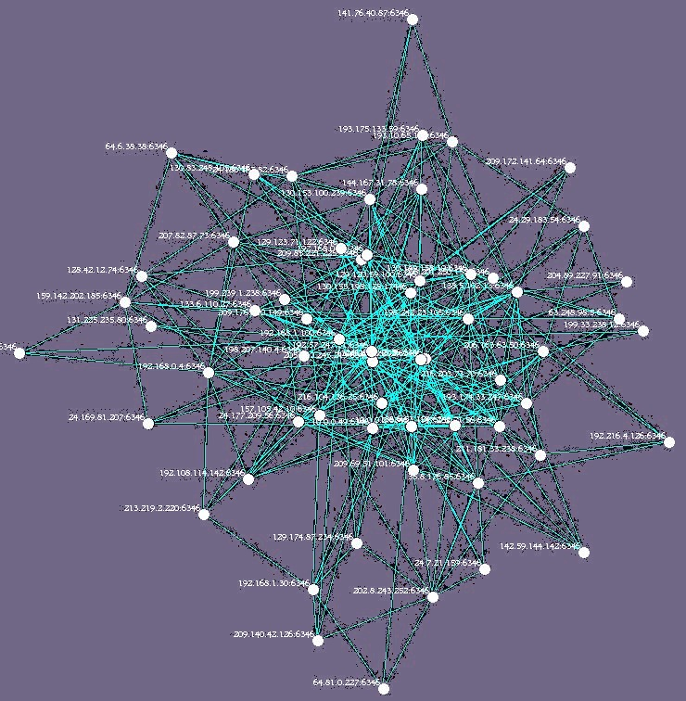
Experiment Search
Calculate the number of search items
found after 50 time steps from initiation of a search. Average the result over 100 searches (a generation).
Grid has 100 x 100 nodes

Slide 16
Processes
1. Immune Search Algorithm
Immune Search Algorithm without Topology evolution
2. Proliferation₁ – Threshold (d – 1)
3. Proliferation₂ – Threshold (d – 2)
4. Random Walk
5. Flooding

Slide 17
Metrics
1. Search efficiency
No of search items found within 50 time steps from initiation of search
2. Cost per item
No of message packets needed to search one item
Clustering
Amount of clustering of similar peers
Time Step - A time step is the period within which all the nodes operate once in a random sequence

Slide 18
Fairness Criteria
The processes (Proliferation₁,random walk, flooding) work with same average number of packets.
Since flooding produces a lot of packets, it is stopped once it produces the average number of packets as Proliferation₁.
ImmuneSearch and Proliferation₁ has same threshold level, but ImmuneSearch produces more packets due to topology evolution.
ImmuneSearch and Proliferation₂ produces roughly same average number of packets.

Slide 19
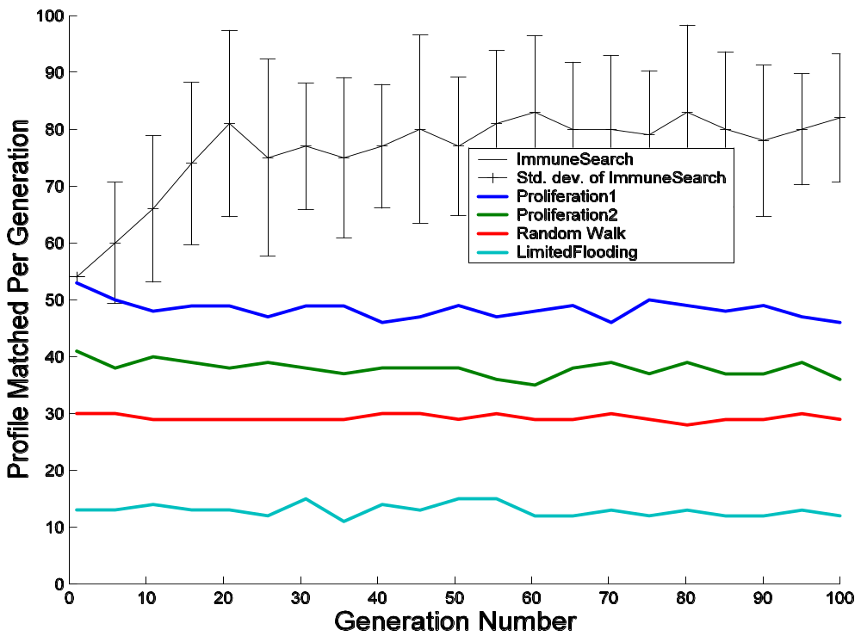
Stable Condition
Search Efficiency and Cost Regulation

Slide 20
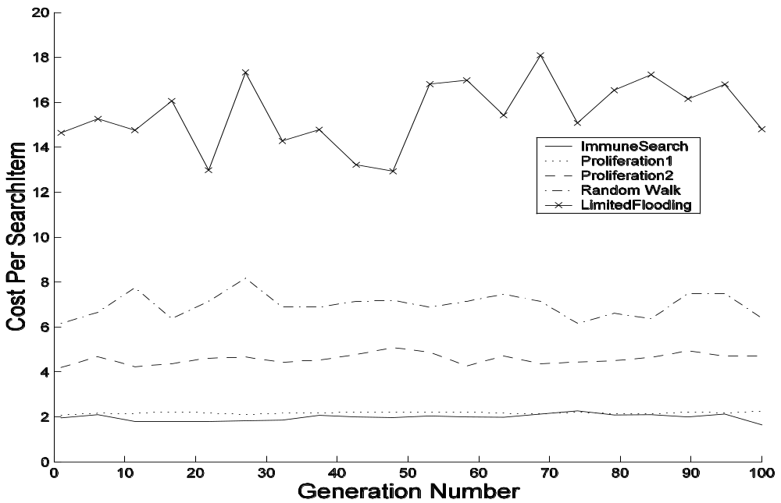
Stable Condition
Search Efficiency and Cost Regulation
Excellent cost regulation, number of messages required by Proliferation is virtually constant in spite of varying search output

Slide 21
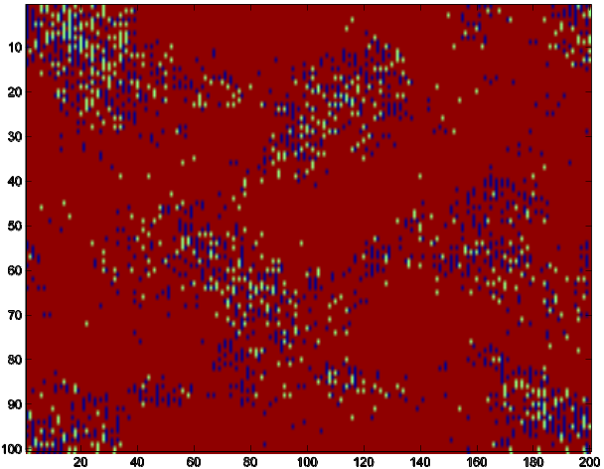
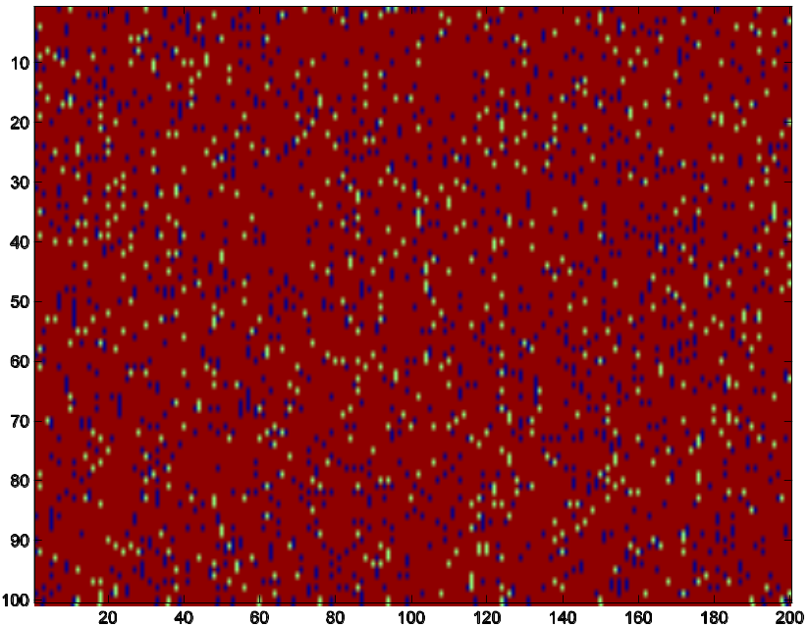
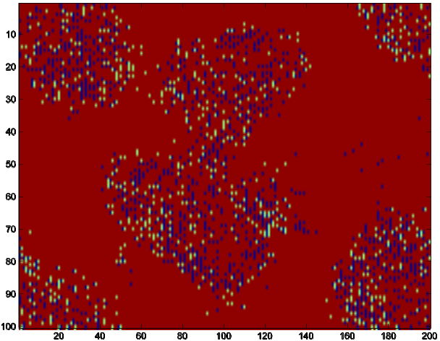
Stable Condition
Clustering
Generation 3
Generation 0
Most frequent information.
Search Profile – yellow.
Information Profile – blue
Generation 24

Slide 22
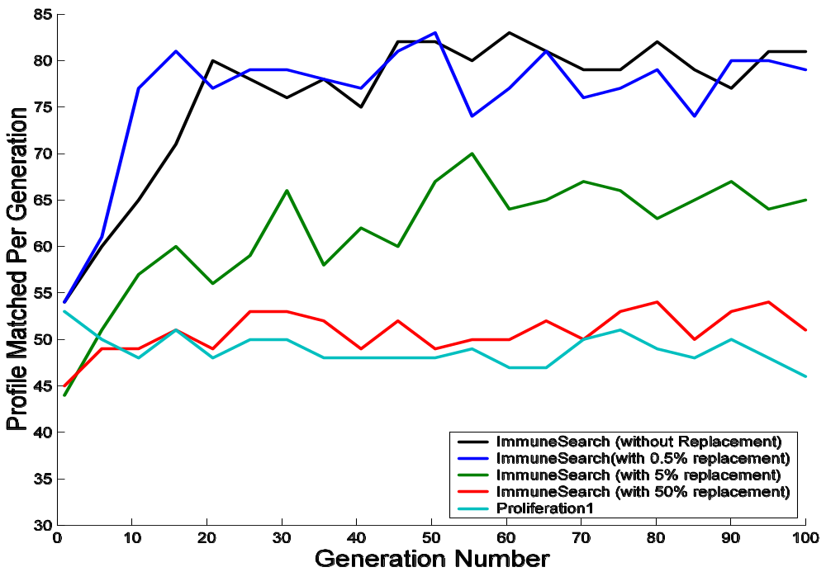
Transient Condition
Search Efficiency
-- Without replacemnt
-- 0.5% replacement
-- 5% replacement
-- 50 % replacement
-- Proliferation₁

Slide 23
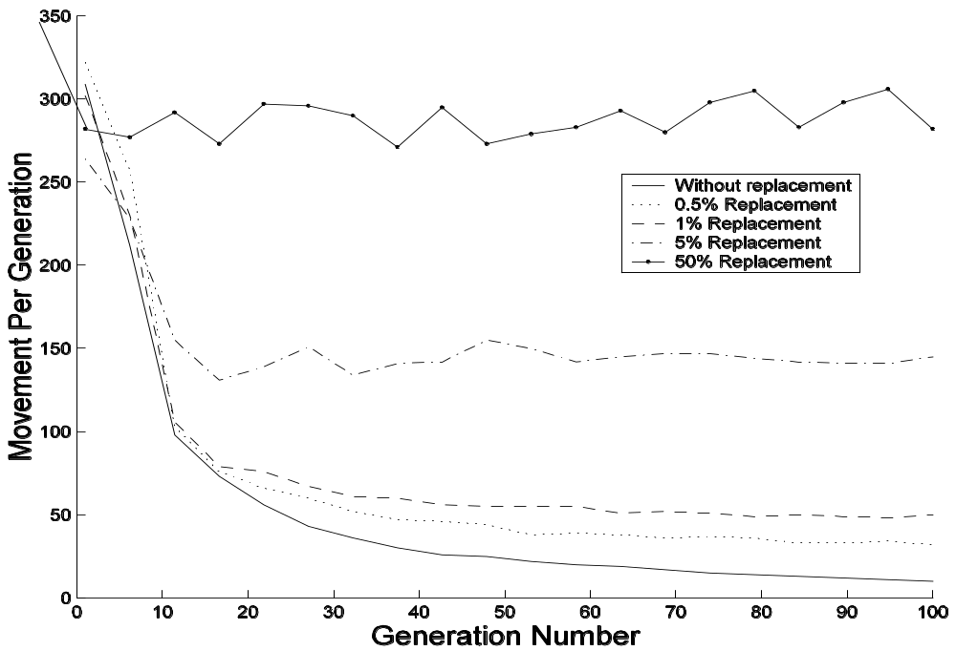
Transient Condition
Search Efficiency

Slide 24
Summary
ImmueSearch algorithm produces 2.5 times more search output than random walk.
ImmueSearch algorithm has a distinct learning phase.
The algorithm is stable even when peers constantly leave the system.
Simple proliferation/mutation is also better than random walk.
Proliferation/mutation has a special cost regulatory function inbuilt.
Higher proliferation rate necessarily doesn’t mean higher search output.

Slide 25
Limitation
The work is done on grid – it should be tested on other type of networks (power-law graph, random graph).
The profiles (data) are too simplistic, it should be made more realistic.

Slide 26

Thank you

