Slide 1
Search in Unstructured Networks
  Niloy Ganguly, Andreas Deutsch
  Center for High Performance Computing
  Technical University
  Dresden, Germany

Slide 2
Unstructured Networks
Each Network consists of peers.
Peers host data
5
a
4
b
1
a
2
b
3
4
d
6
d
e
5
2
e
c
3
c
g
7
g
7
1
6
f
f
Structured Network
Unstructured Network

Slide 3
Unstructured Networks
Searching in unstructured networks –
Non-deterministic Algorithms
Flooding, random walk
Our algorithms – packet proliferation and mutation
5
a
4
b
6?
3
d
6
e
2
c
6!!!
6?
6?
g
7
6?
1
6?
f
6?
Unstructured Network

Slide 4
Unstructured Networks
Searching in unstructured networks –
Non-deterministic Algorithms
Flooding, random walk
Our algorithms – packet proliferation and mutation
5
a
4
b
3
d
6
e
2
c
g
7
1
f
Unstructured Network

Slide 5
Model Definition
Topology
Data and query distribution
Algorithms
Metrics

Slide 6
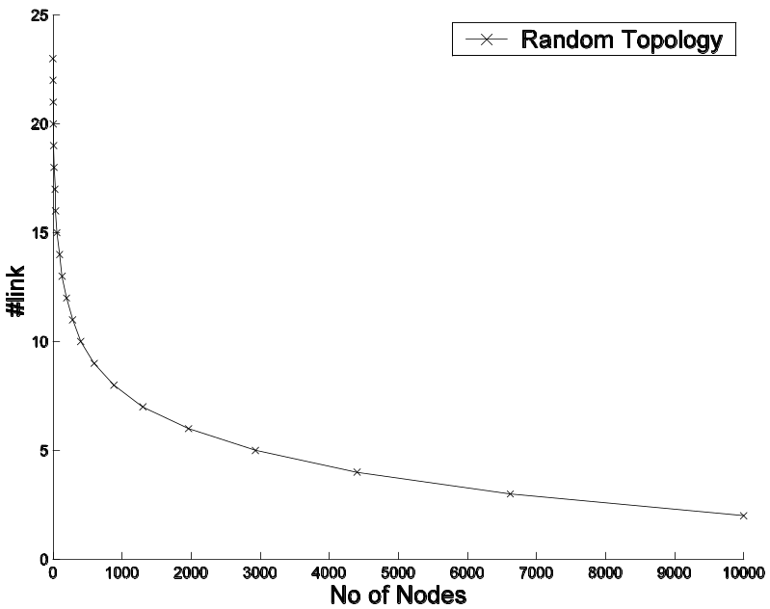
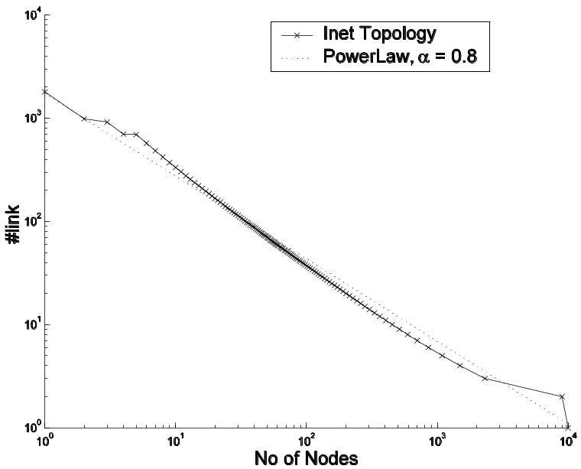
Topology Definition
Random Graph
Power-law graph
# link
# link
No of nodes
No of nodes
No of Nodes = 10000, Mean Indegree ≈ 4
No of Nodes = 10000, Mean Indegree ≈ 4
Random Topology – BRITE
Power-law graph - INET

Slide 7
Query/Data Distribution
Query/Data
– 10 bit strings
– 1024 unique queries/data (tokens) – Distributed based on Zipf’s Law
power law - frequency of occurrence of a token T α 1/r, rank of the token

Slide 8
Algorithms
Query Initiation Algorithm – Start a search by flooding k query message packets to the neighborhood
Query Processing Algorithm – Compare query message with data. Report a match if message = data.
Query Forwarding Algorithm – Forward the message to the neighbors

Slide 9
Forwarding Algorithms
Proliferation/Mutation Algorithms
Simple Proliferation/Mutation Algorithm (PM)
Restricted Proliferation/Mutation Algorithm (RPM)
Random Walk Algorithms
Simple Random Walk Algorithm (RW)
Restricted Random Walk Algorithm (RRW)
High Degree Restricted Random Walk Algorithm (HDRRW)

Slide 10
Proliferation/Mutation Algorithms
Simple Proliferation/Mutation Algorithm (PM)
Produce N messages from the single message. (Mutate one bit with prob. β)
Spread them to the neighboring nodes
a
b
d
e
N = 3
c
g
f

Slide 11
Proliferation/Mutation Algorithms
Restricted Proliferation/Mutation Algorithm (RPM)
Produce N messages from the single message. (Mutate one bit with prob. β)
Spread them to the neighboring nodes if free
a
b
d
e
N = 3
c
g
f

Slide 12
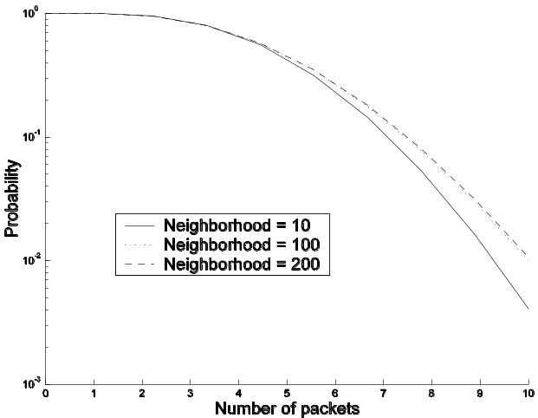
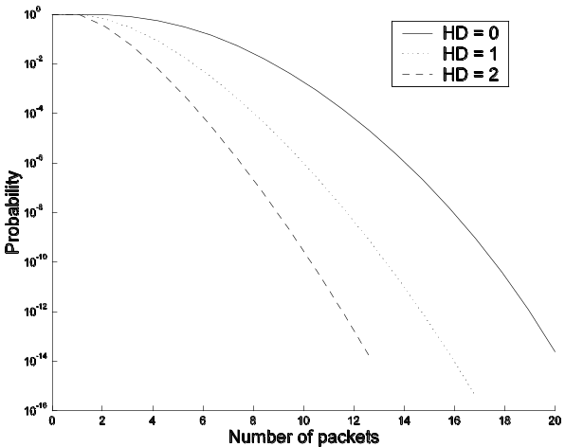
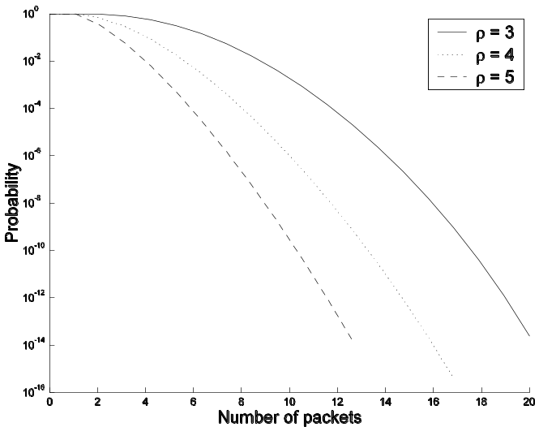
Proliferation Controlling Function
Production of N messages depends on
a. Proliferation constant (ρ)
b. Hamming distance between message and data
c. Always ≥ 1 and ≤ no of neighbors
Probability
10⁻³ 10⁻² 10⁻¹ 10⁰
Probability
10⁻³ 10⁻² 10⁻¹ 10⁰
0 1 2 3 4 5 6 7 8 9 10
Number of packets
0 2 4 6 8 10 12 14 16 18 20
Number of packets
b
a

Slide 13
Random Walk Algorithms
Simple Random Walk Algorithm (RW)
Forward the message to a randomly selected neighbor
a
b
d
e
c
g
f

Slide 14
Random Walk Algorithms
Restricted Random Walk Algorithm (RRW)
Forward the message to a randomly selected free neighbor
a
b
d
e
c
g
f

Slide 15
Random Walk Algorithms
High Degree Restricted Random Walk Algorithm (HDRRW)
Forward the message to the free neighbor which has highest number of neighbors
a
b
d
e
c
g
f

Slide 16
Metrics
1. Search efficiency
No of search items found within 50 time steps from initiation of search
2. Network coverage efficiency
No of time steps required to cover the entire network
3. Cost per item
No of message packets needed to search one item
Time Step - A time step is the period within which all the nodes operate once in a random sequence

Slide 17
Experiments
Experiment Coverage – Calculate time taken to cover the entire network after initiation of a search from a randomly selected initial node. Repeated for 500 such searches.
Experiment TimeStep - Calculate the number of search items
found after 50 time steps from initiation of a search. Average the result over 100 searches (a generation).

Slide 18
Fairness Criteria
Comparing a random walk algorithm with a proliferation algorithm (RW and PM)
Both processes work with same average number of packets.
Comparing between two proliferation/mutation algorithm (PM and RPM)
Both processes have same proliferation constant and same number of message packets initially

Slide 19
Experimental Results
Experiment Coverage
Comparison Between PM/RPM and RW/RRW
Comparison Between RPM and RRW on Different Topologies
Effect of mutation on power-law network
Experiment TimeStep
Search Efficiency and Cost Regulation

Slide 20
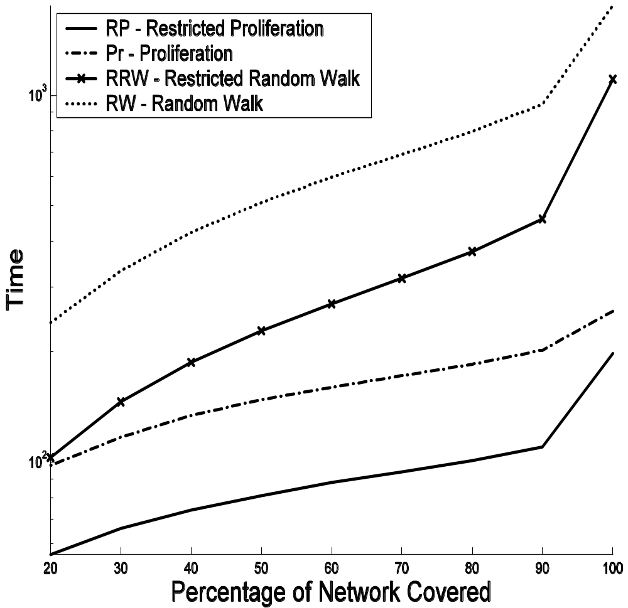
Experimental Result -1
Comparison Between PM/RPM and RW/RRW
Results on grid
Experiment Coverage with ρ = 3
Network coverage time RW > RRW > PM > RPM

Slide 21
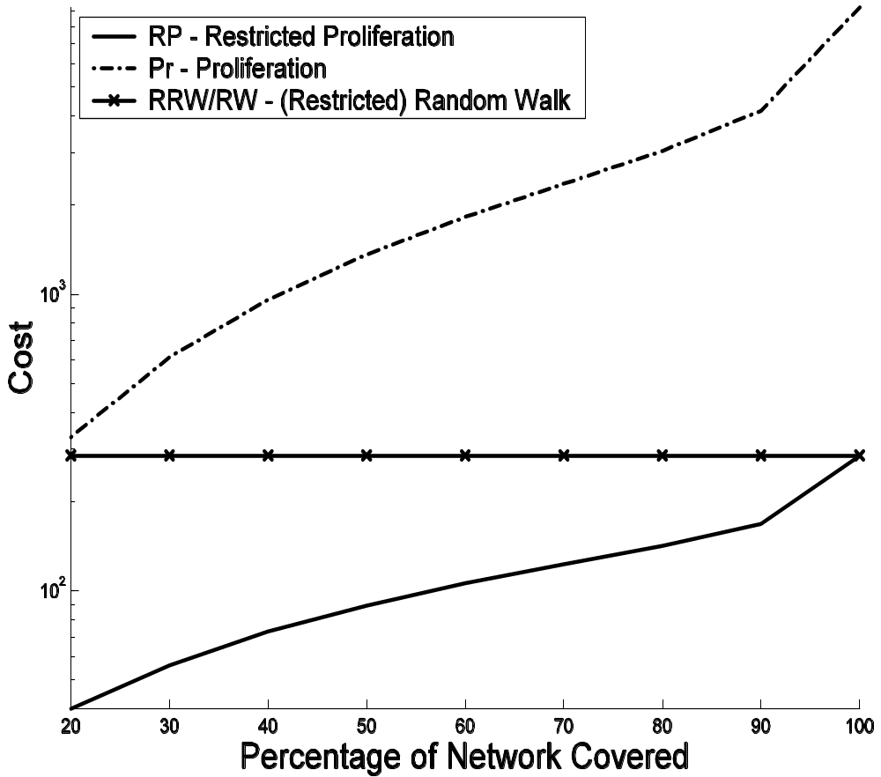
Experimental Result -1
Comparison Between PM/RPM and RW/RRW
Results on grid
Experiment Coverage with ρ = 3
Network coverage time RW > RRW > PM > RPM
Cost PM 10 times more than RPM

Slide 22
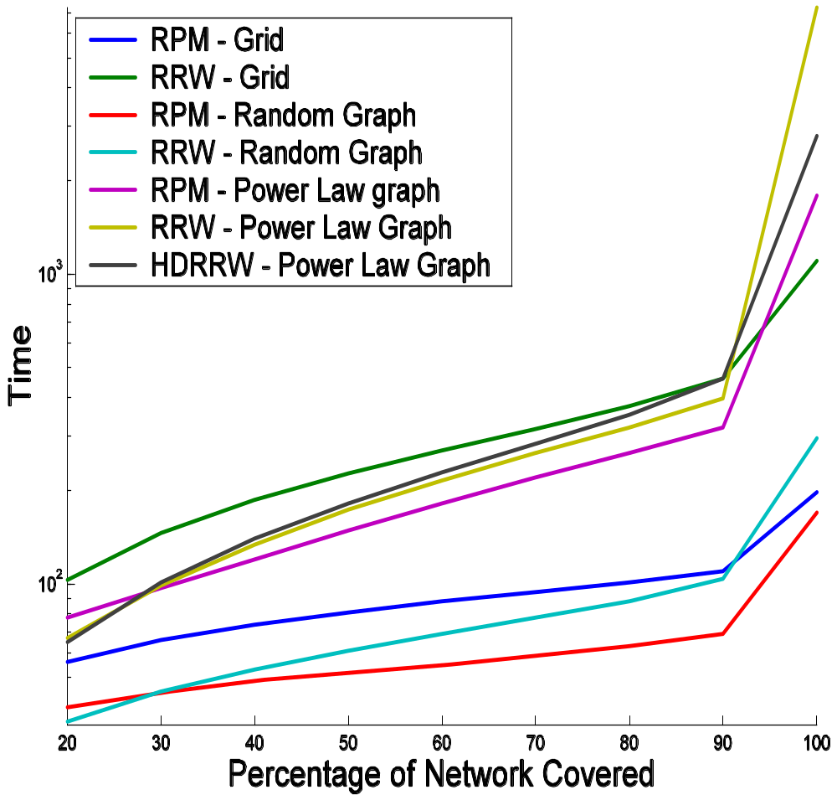
Experimental Result -2
Comparison Between RPM and RRW on Different Topologies
Experiment Coverage
Network coverage time RRW > RPM
Network coverage time power-law Network > random network
HDRRW is better than RRW, however only slightly

Slide 23
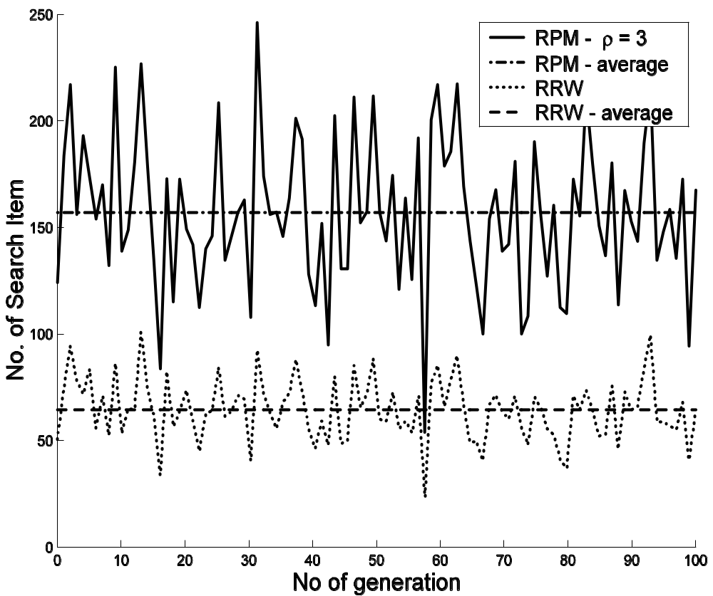
Experimental Result -3
Search Efficiency and Cost Regulation
Experiment TimeStep on random network
Spanning over 100 generations
Search efficiency of RPM is 2.5 times better than RRW

Slide 24
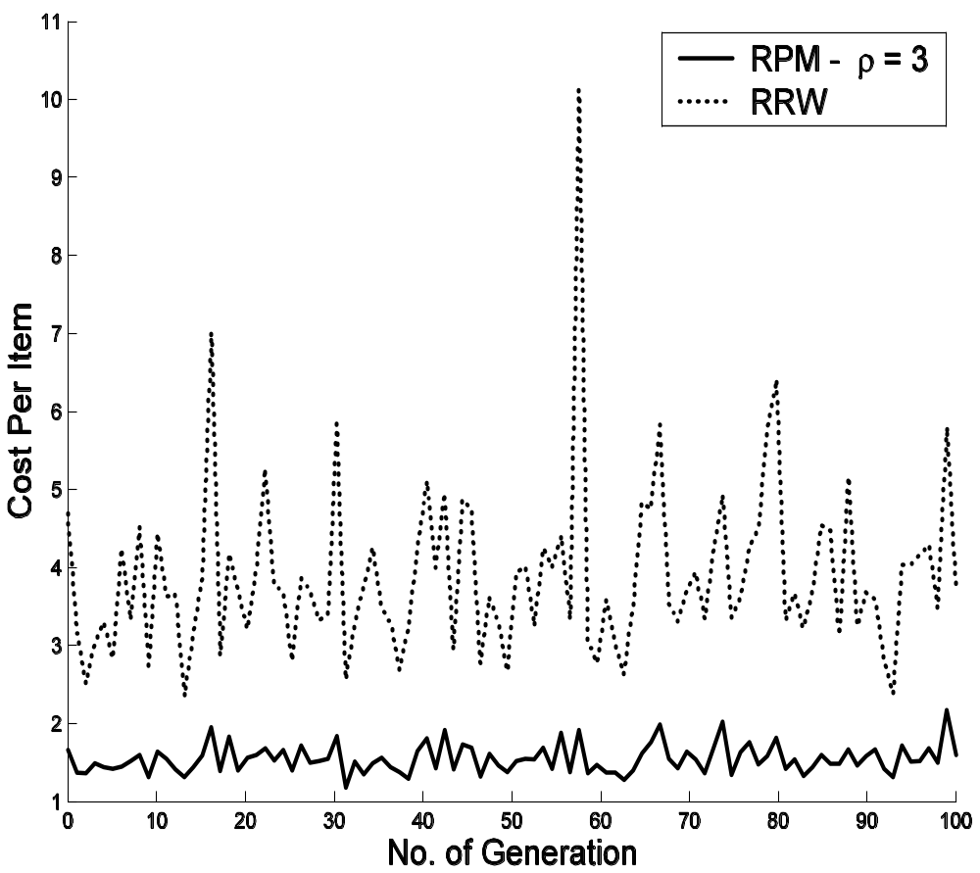
Experimental Result -3
Search Efficiency and Cost Regulation
Experiment TimeStep on random network
Spanning over 100 generations
Excellent cost regulation, number of messages required by RPM is virtually constant in spite of varying search output

Slide 25
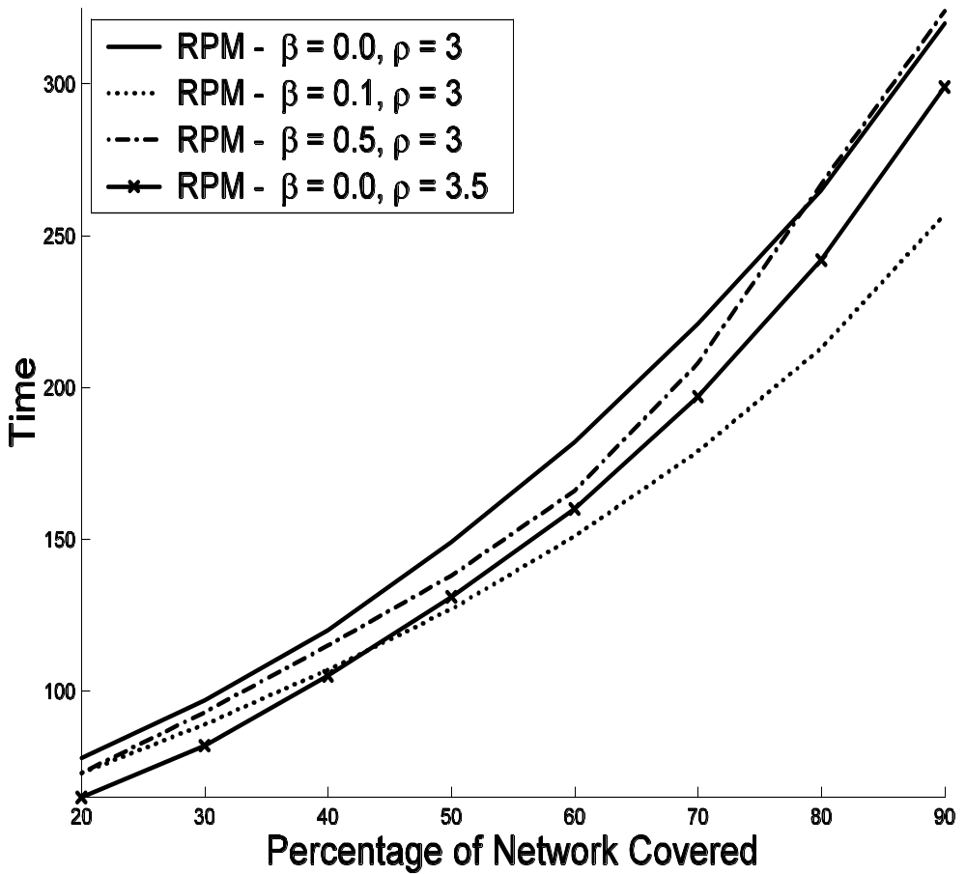
Experimental Result -4
Effect of mutation on power-law network
Experiment Coverage on power-law network
RPM β = 0.1 and ρ = 3 works best, better than even ρ = 3.5
Cost of RPM (β = 0.1 and ρ = 3) and (ρ = 3.5) is same
Combination of proli/mutation has better effect than proliferation
However, higher mutation doesn’t improve the efficiency

Slide 26
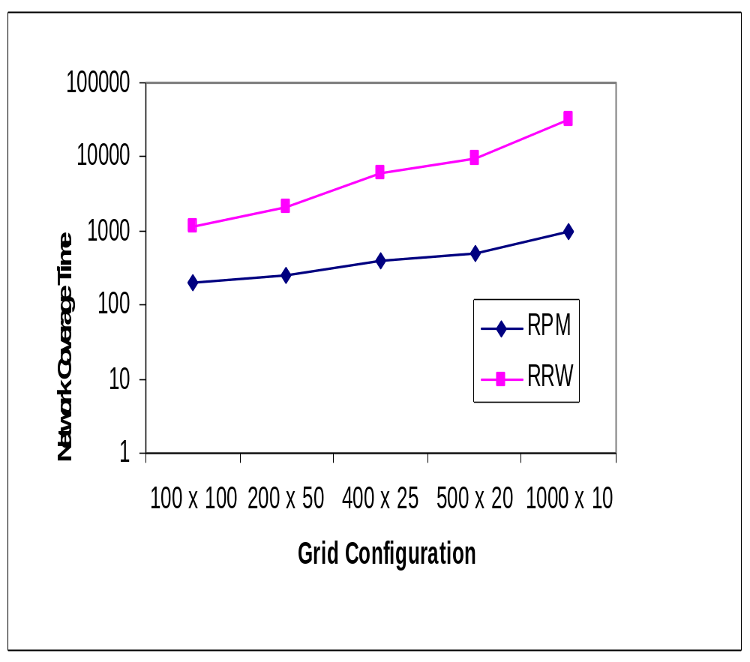
Experimental Result -5
Scalability –Scalability with respect to shape
Experiment Coverage on grid
Different grid shapes –
100 x 100, 200 x 50, 400 x 25, 500 x 20, 1000 x 10
RPM coverage time increases from 198 to 951 ( ≈ 5 times)
RRW coverage time increases from 1105 to 31025 ( ≈ 30 times)

Slide 27
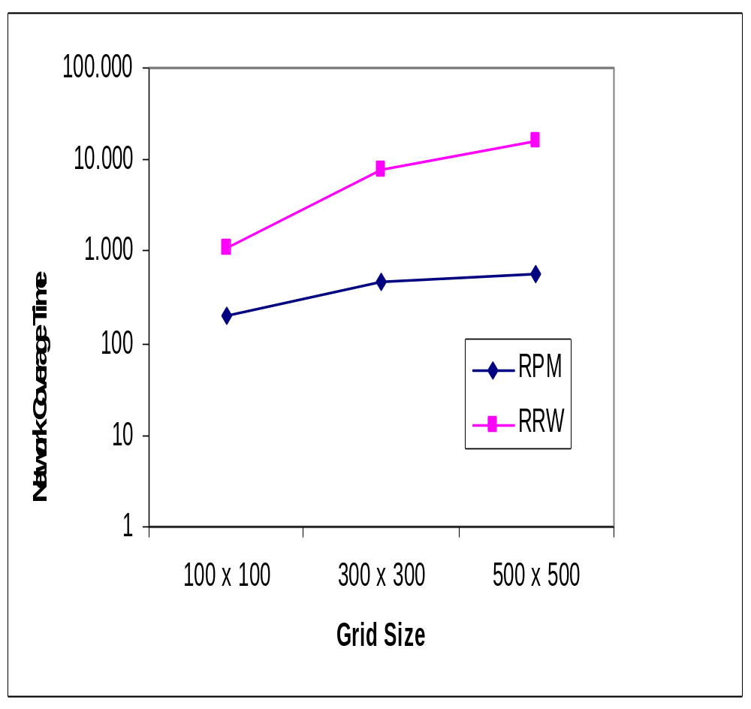
Experimental Result -5
Scalability –Scalability with respect to size
Experiment coverage on grid
Different Grid sizes –
100 x 100, 300 x 300, 500 x 500
The increase in network coverage time
RPM < log (increase of number of nodes) [198 → 586]
RRW ≈ increase of number of nodes [1105 → 16161]

Slide 28
Summary
Restricted proliferation/mutation (random walk) is better than simple proliferation/mutation (random walk).
Both network coverage and search output is much better in restricted proliferation/mutation than restricted random walk
Proliferation has special cost regulatory function inbuilt
Mutation helps in enhancing coverage in power-law network, but it should be properly regulated
The proliferation/mutation scheme is extremely scalable

Slide 29


Thank you
Köszönöm
dank
merci
Dhanyabad
Danke
Grazie
Takk

Slide 30
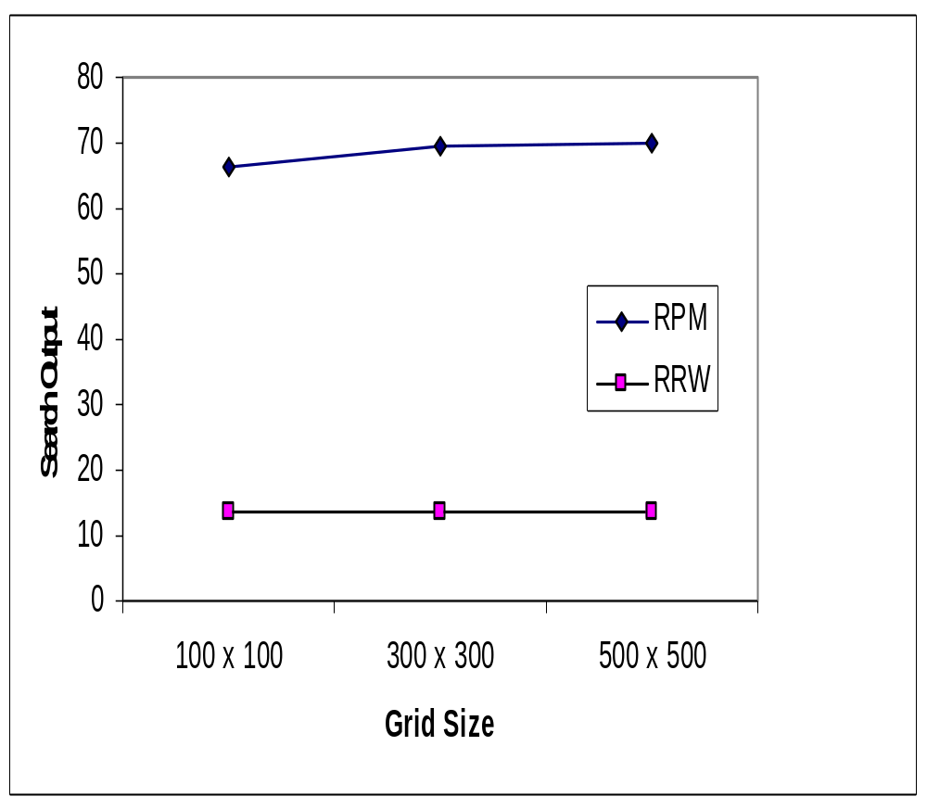
Experimental Result -5
Scalability –Scalability with respect to size
Experiment TimeStep on grid
Different grid sizes –
100 x 100, 300 x 300, 500 x 500
Both for RPM and RRW, the search output remains constant

Slide 31
Experimental Result -1
Comparison Between PM/RPM and RW/RRW
Results on grid
Experiment Coverage with ρ = 3
Network coverage time RW > RRW > PM > RPM

Slide 32
Experimental Result -1
Comparison Between PM/RPM and RW/RRW
Results on grid
Experiment Coverage with ρ = 3
Network coverage time RW > RRW > PM > RPM
Cost PM 10 times more than RPM

Slide 33
Experimental Result -2
Comparison Between RPM and RRW on Different Topologies
Experiment Coverage
Network coverage time RRW > RPM
Network coverage time power-law Network > grid > random network
HDRRW is better than RRW, however only slightly

Slide 34
Experimental Result -3
Search Efficiency and Cost Regulation
Experiment TimeStep on random network
Spanning over 100 generations
Search efficiency of RPM is 2.5 times better than RRW

Slide 35
Experimental Result -3
Search Efficiency and Cost Regulation
Experiment TimeStep on random network
Spanning over 100 generations
Excellent cost regulation, number of messages required by RPM is virtually constant in spite of varying search output

Slide 36
Experimental Result -4
Effect of mutation on power-law network
Experiment Coverage on power-law network
RPM β = 0.1 and ρ = 3 works best, better than even ρ = 3.5
However, higher mutation doesn’t improve the efficiency

Slide 37
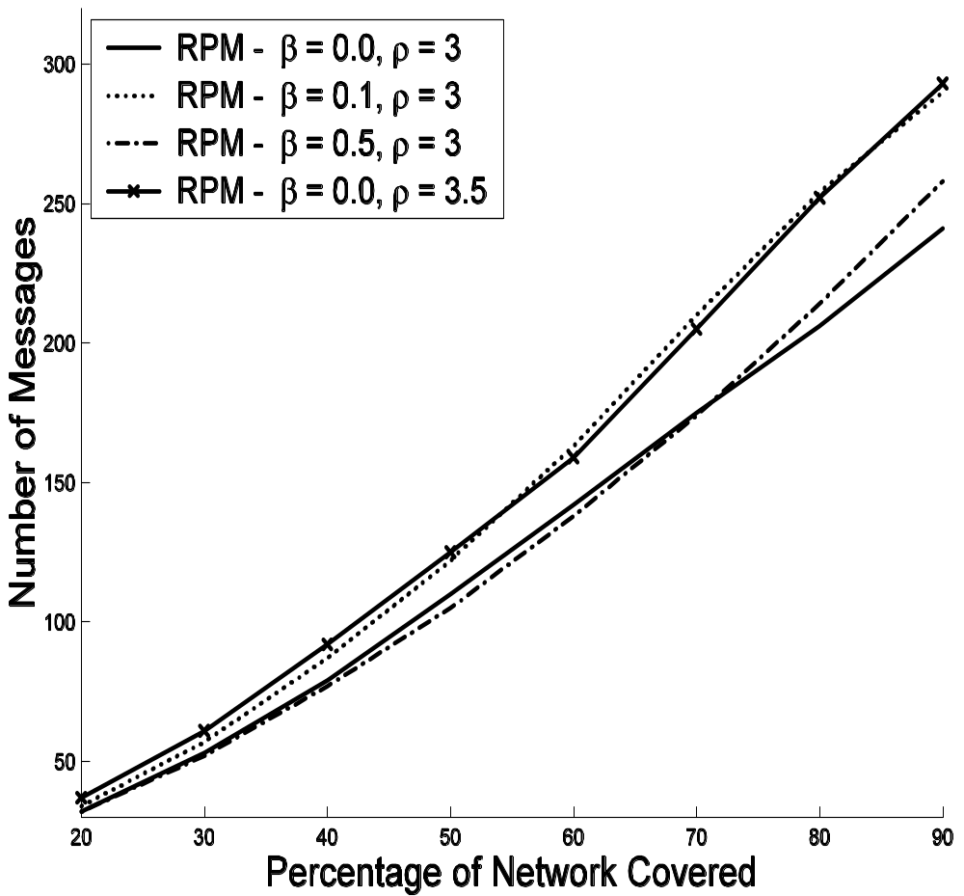
Experimental Result -4
Effect of mutation on power-law network
Experiment Coverage on power-law network
RPM β = 0.1 and ρ = 3 works best, better than even ρ = 3.5
Cost of RPM (β = 0.1 and ρ = 3) and (ρ = 3.5) is same
Combination of proli/mutation has better effect than proliferation

Slide 38
Experimental Result -5
Scalability –Scalability with respect to shape
Experiment Coverage on grid
Different grid shapes –
100 x 100, 200 x 50, 400 x 25, 500 x 20, 1000 x 10
RPM coverage time increases from 198 to 951 ( ≈ 5 times)
RRW coverage time increases from 1105 to 31025 ( ≈ 30 times)

Slide 39
Experimental Result -5
Scalability –Scalability with respect to size
Experiment coverage on grid
Different Grid sizes –
100 x 100, 300 x 300, 500 x 500
The increase in network coverage time
RPM < log (increase of number of nodes) [198 → 586]
RRW ≈ increase of number of nodes [1105 → 16161]

