Slide 1
Analyzing Network Coverage in Unstructured P2P Networks : A Complex Network Approach
Joydeep Chandra, Santosh Shaw and Niloy Ganguly
Department of Computer Science & Engineering,
Indian Institute of Technology, Kharagpur,
India.

Slide 2
Background
Most used search and query mechanism in Unstructured P2P Networks is
  Flooding (or selective flooding) like BFS, k-BFS
    Gnutella, Kazaa (Use TTL based flood)
Thus query and search performance depends on
  Topology of the network.
  The network coverage of the peers achieved through flooding.
Drawbacks
  Message Redundancy
  Wastage of precious bandwidth
Our Claim
  Analyzing topological behavior can help
    Develop new insights on flooding.
    Build specialized flood-oriented topologies.

Slide 3
Objectives
Analyze the topological behavior of the networks.
  Based on the given degree distribution of the networks
    Derive the network coverage of the peers that use TTL-based flooding
  Observe the impact of topology on the coverage and redundancy of the peers in the network.
Apply the developed concepts on real p2p networks
  Propose necessary topological modifications to improve search efficiency through flooding.
    Validate the proposed measures on simulated p2p networks.

Slide 4
Methodology
Derive a basic model for network coverage in TTL-2 networks
  Based on the work of Newman et. al. of finding neighborhood distribution in large networks
  Assumptions
    Given the degree distribution of the networks
    Many real p2p networks like Gnutella uses TTL-2 based flood for searching
      TTL-3 is used for rare searches
Refine the basic model for more accurate results
Based on derived results, propose suitable modifications to Gnutella protocol.
  To reduce message redundancy and message complexity.
Validate the models and protocols using simulations.
  Implemented a thread based simulated Gnutella with all basic features.

Slide 5
Network Coverage : Basic Model
Based on derivations by Newman et. al. for neighbor distribution in large graphs.
Assumptions
  The degree distribution p_{k} of the network is known.
  TTL-2 coverage of a node is the sum of its first and second neighbors.
  The probability that two neighbors of a node are themselves connected is almost zero.
Source Node
First Neighbors
Second Neighbors
A hypothetical network for Basic Model

Slide 6
Network Coverage : Basic Model
The degree distribution can be represented using a generating function as
  G₀(x) = p₀ + p₁x + p₂x² + p₃x³ + …
  Coefficient of x^{i} represents the probability that
    A randomly selected node will have degree i.
Thus G₀^{ʹ}(1) = 1p₁ + 2p₂ + 3p₃ + … = ↑z (say)
  Represents the average degree of the nodes in network
Probability that a randomly selected edge leads to a node of excess degree k-1 = kp_{k}/(Σjp_{j})= kp_{k}/↑z
Corresponding generating function
G₁(x) = (Σkp_{k}x^{k-1})/↑z = G₀^{ʹ}(x)/ G₀^{ʹ}(1)
According to power-law property distribution for number of outgoing edges for k independent nodes = [G₁(x) ]^{k}
So Second Neighbor distribution of a random node = p_{k}[G₁(x) ]^{k} = G0(G1(x)) = S(x) (say)

Slide 7
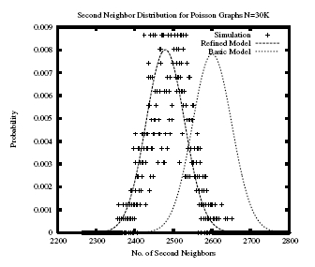
Network Coverage : Basic Model
From previous derivations we get
  Distribution of first neighbors of a peer = G₀(x)
  Distribution of second neighbors of a peer = S(x)
Thus total network coverage of a peer C(x) =G₀(x) · S(x)
Expected TTL-2 coverage of the network = ↑c= C ^{ʹ}(1)
Observations
Does not reflect the actual network coverage
Does not capture the actual topology of the real networks
Gives the maximum expected coverage

Slide 8
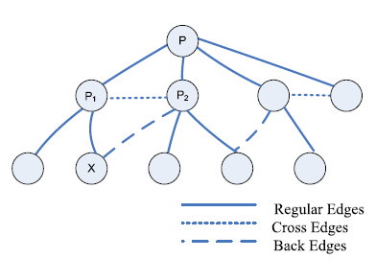
Limitations of the basic model
Reflects correct behavior only when neighbors of a source node does not form cycles among themselves.
  But actually real p2p networks behave like social networks
    Many short length cycles are present
Ignores the presence of edges that causes short length cycles
  We name them as Cross and Back Edges
More accurate models need to be developed that captures the effect of these edges.

Slide 9
Network Coverage: Refined Model
Assumptions
Degree Distribution, p_{k} of the network is known.
The actual TTL-2 network coverage of a peer is the number of unique nodes reached by a TTL-2 flood message.
  All the first neighbors of a node are always unique.
  So, the objective is to find the number of unique second neighbors
The back and cross edge probability, b and c, of the nodes in the network
  Based on simulation results we observed that for networks, the back and cross edges of a node depend on its degree k.
  We have later derived models for back and cross edge distributions of nodes, based on their degree k, for various networks.

Slide 10
Network Coverage: Refined Model
Major steps of the refined model
We derived the distribution of number of non-cross edges of a node with k first neighbors (Γ_{k}(x)= Γ_{k,0} + Γ_{k,1}x + Γ_{k,2}x² + … )
Then we derived the distribution that out t non-cross edges, the number of edges that leads to unique nodes (say Q_{t}(x)) without being back-edge.
The distribution of the actual number of unique peers to which k first neighbors of a peer connect, A_{k}(x)=Σ_{t} Γ_{k,t}Q_{t}(x)
The distribution for unique second neighbors for any random peer is
  Ŝ(x) = Σp_{k} A_{k}(x)
The distribution for total coverage of the network is
  Ĉ(x) = G₀(x)· Ŝ(x)

Slide 11
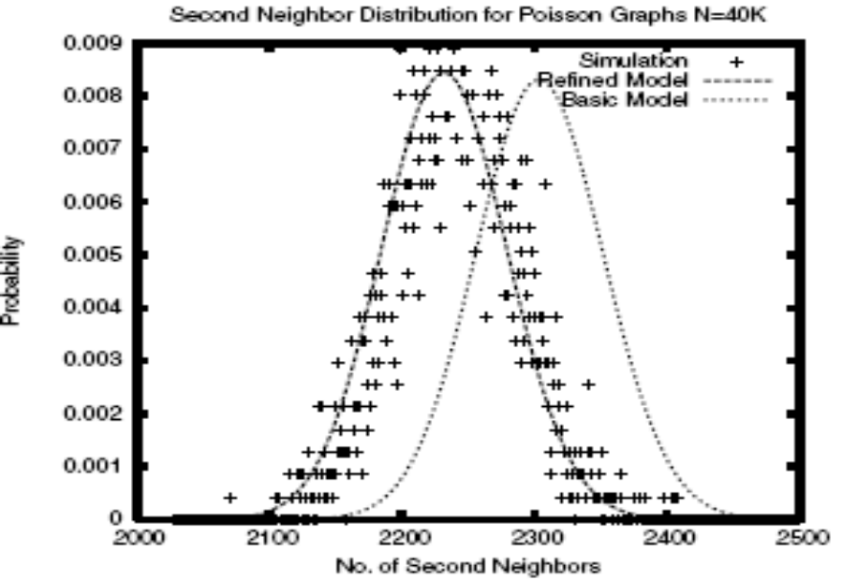
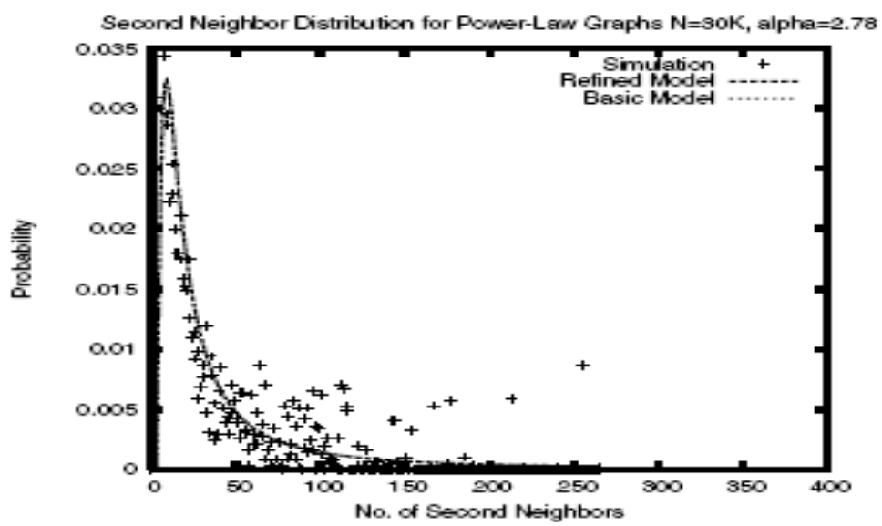
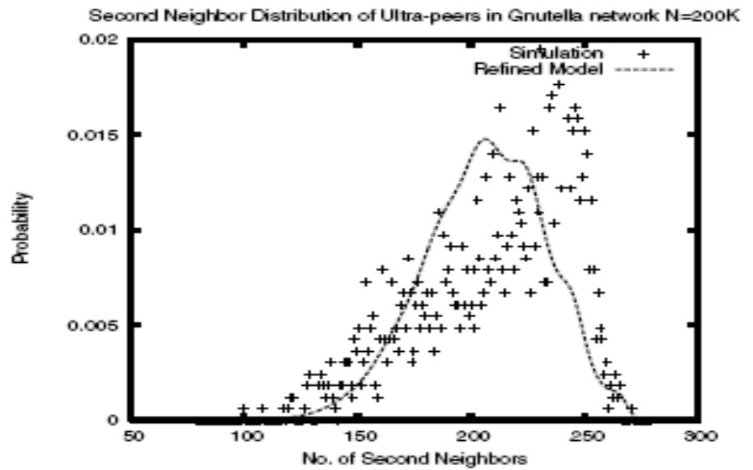
Key Observations : Refined Model
The refined model, models the network coverage of the peers more accurately as compared to the basic model.
The refined model accurately models the network coverage of the peers in a Poisson network for a fixed back/cross edge probability.
However, for random networks with arbitrary degree distribution, the model needs to be improved further.

Slide 12
Topological Behavior of Gnutella
Based on these observations, we propose a protocol (HPC5) to reduce back/cross edges during bootstrapping.
Topology
  Two tier overlay n/w
    Ultra peers & leaf peers
Basic Search Technique
  Limited flood based search query
    TTL(2) for normal searches, TTL(3) for rare searches
  Dynamic Querying
    An ultra-peer incrementally forwards a query in 3 steps (TTL(1), TTL(2) & TTL(3)) depending upon response
  Query Routing Protocol (QRP)
    Leaf peer creates a hash table of all its files and sends it to neighboring ultra-peers.
The super-peers form high number of cross and back edges
  Thus, flooding can lead to huge traffic redundancy.

Slide 13
Objectives
Propose a completely distributed topology generation mechanism that is
  Efficient
    Provides better search efficiency
  Scalable
    Generates less number of redundant messages
  Compatible with existing unstructured p2p networks.
    Our proposed mechanism works on any unstructured topology like , Gnutella, Kazaa etc.
      We mainly focus on Gnutella.

Slide 14
HPC5 :Handshake Protocol for Cycle-5 networks
Basic Considerations
  Each peer maintains a list of its 1st and 2nd ultra-peer neighbors.
  Each ultra-peer exchanges the list of 1st neighbors periodically with its 1st neighbors.
  Each peer sends the 1st neighbor list to its leaf peers.

Slide 15
HPC5
A peer A sends a connection request to a peer B such that
  B is not in A’s 1st or 2nd neighbor set
B replies back with
  List of 1st neighbors
  a neighborhood acceptance/rejection message
    Rejection is sent when the maximum connection limit is reached
1
2
Connection Request
A
B
List of 1st neighbors
Acceptance/Rejection

Slide 16
HPC5
If B rejects A, then A records B’s neighbors and closes connection.
If B accepts, A checks at-least one common peer between A’s 2nd neighbor and B’s 1st neighbor
  If no common peer found, then A adds B as neighbor
  Else A sends reject connection to B
1
2
Connection Request
A
B
List of 1st neighbors
Acceptance/Rejection
Reject
Check for common peers in 2nd neighbor set of A and 1st neighbor set of B

Slide 17
Simulations
Performance Metrics
  Message Complexity : Average number of messages required to discover a peer in the overlay network.
  Network Coverage : The number of unique peers explored during query propagation in limited flooding.
We plotted for message complexity and network coverage against size of network.
The ultra and leaf peer ratio (U/L) are same as in Gnutella networks

Slide 18
Simulation Parameters
Property | Gnutella | Simulated Gnutella
No. of peers | 2000k | 100k
Ultra peer ratio | 15-16% of total peers | 15% of total peers
Average Diameter of ultra layer | 6-7 | 4-5
Maximum connections | Ultra-ultra 32 Ultra-leaf 30 Leaf-ultra 3 | Ultra-ultra 32 Ultra-leaf 30 Leaf-ultra 3
Average Connections | d_{uu} : 25-26 d_{ul} : 20-22 d_{lu} : 3-4 | d_{uu} : 22-23 d_{ul} : 17-18 d_{lu} : 3

Slide 19
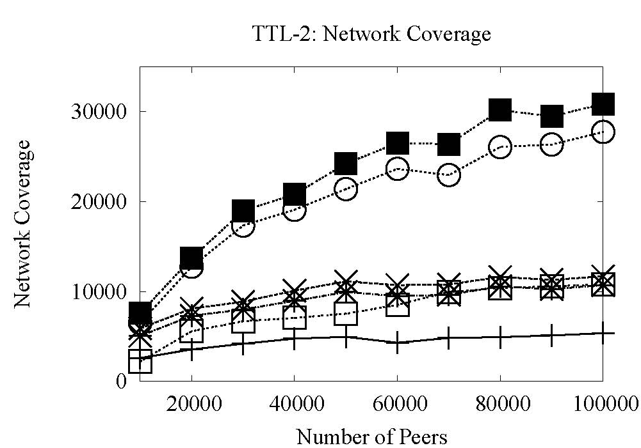
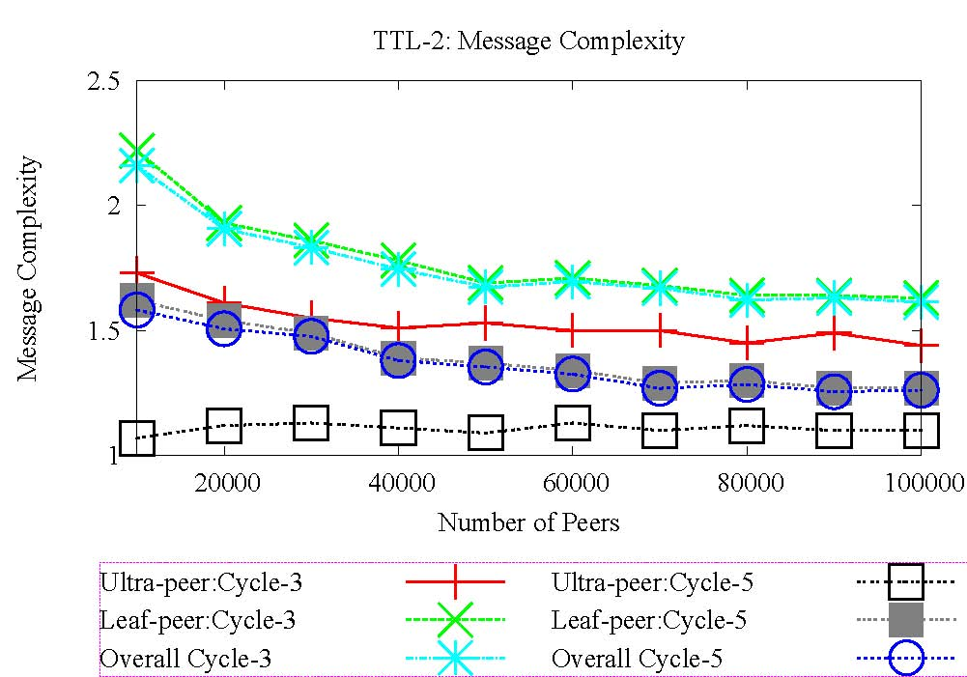
Search Performance TTL(2) without QRP
For cycle-5 network coverage is 10% more in ultra-peers than cycle-3 networks.
For cycle-5 message complexity is almost 30% less than cycle-3 networks

Slide 20
Conclusion
We derived suitable models to quantify the coverage of peers in networks that perform TTL-2 searches.
  Reflected a relation between the topology and the achievable search performance.
The derived model provided an insight of
  The top0logical impact of network coverage and message complexity in Gnutella.
Proposed a modified bootstrap protocol for Gnutella that
  Shows improved network coverage
  Improves the message complexity.

Slide 21
Future Works
Develop suitable models for deriving back and cross edges.
Propose distributed methods to classify back and cross edges.
Thank you
Danke Schoen
niloy@cse.iitkgp.ernet.in

