Slide 1

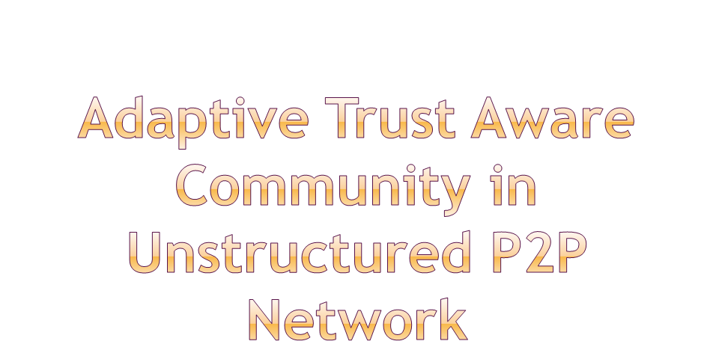
Presented by:
Dr. Niloy Ganguly
Department of Computer Science, IIT Kharagpur.
Co-authors – Ujjwal Sarkar, Subrata Nandi

Slide 2
Introduction
Motivation
Simulation Environment
Algorithm
Result Analysis
Conclusion
Reference

Slide 3

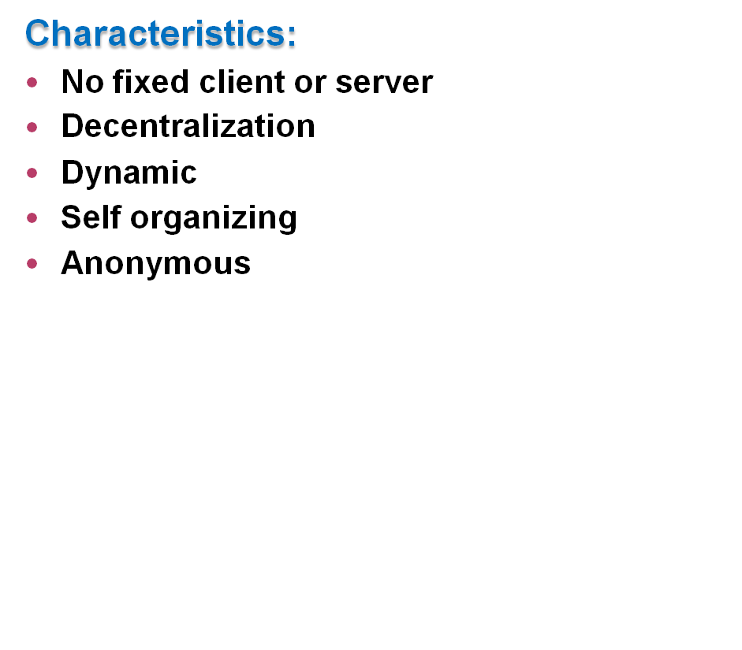
A cooperative resource sharing environment.
Efficient sharing of computer resources and services by direct exchange between systems.
Virtual overlay on the top of existing network with own routing mechanism.
Structured or unstructured topology.

Slide 4
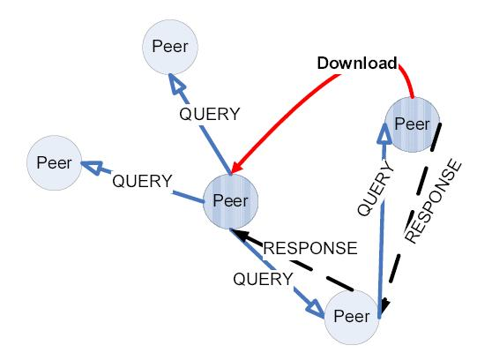
Gnutella
Decentralized, unstructured, content sharing P2P network.
Open system architecture.
Uses flooding to locate resource.
Popular contents are replicated.
Power law topology.
Courtesy: Lua, Crowcroft, IEEE Comm. 04
Notes:
Goal : To share files in cooperative fashion .

Slide 5
Free Riding
Security Threats in P2P Network
Poor search scalability

Slide 6
1)Free Riding
Manifestation of tragedy of commons
      70% of users share no file.
      1% of hosts answer nearly 50% of all queries.
      25% users account for 99% of all queries.
Indicates peers are heterogeneous entities.
The system goal differs from individual goal.
( Ref: E. Adar, “Free Riding on Gnutella”, First Monday, September 2000)
( Ref: M. Ripeanu, “Peer-to-peer architecture case study: Gnutella network”,P2P Computing ’01)
Solution: To provide incentive to upload files.

Slide 7
Fake Content distribution
(Ref: J. SchÄafer, “P2P networks security”, ICIMP '08 )
Malicious File Upload → e.g. VBS.Gnutella.worm
(Ref: Ernesto Damiani, “A reputation-based approach for choosing reliable resources in P2P N/W”, CCS '02)
White washing
(Ref: Michal Feldman, “Free-riding and white washing in P2P system”, PINS '04)
Solution: Download from trusted source

Slide 8
Trust is probability that resource provider will provide authentic files.
Computed based on transaction history.
Direct trust and Recommendation trust.
Challenges:
Decentralized and scalable.
Cope up with transient nature of P2P.
Robust against various threat models.
Types: 1) Centralized Reputation based trust management
      used in Ebay, amazon.com
2) Distributed Reputation based scheme
      used in P2P network.

Slide 9

Allows resource requester to compute trust rating of the resource provider.
Types
    Gossip based e.g. XREP, Eigen Trust
    via Topology Adaptation e.g. APT, RC-ATP. A natural choice for unstructured topology
Limitation of existing trust management scheme
  Heavy weight: High computational cost, message and storage overhead.
  Lack effective mechanism to disseminate trust information.
  Presence of dynamicity (churning) is not taken in amount.

Slide 10
Flooding
      BFS with limited TTL
Random walker
      A blind search
via Topology adaptation
      Semantic community
      efficient
      Iterative deepening

Slide 11




P2P overlay
Trust management
Semantic Communities

Slide 12

Motivation
Both search quality and efficiency equally important.
Existing trust management schemes are heavyweight.
No work carried out to use topology adaptation to combat inauthentic downloading as well as to improve search scalability.
To incorporate incentives and punishment mechanism to combat free riding and fake content distribution. Nodes get central position as a reward.
Trust aware community is proposed to address above issues

Slide 13
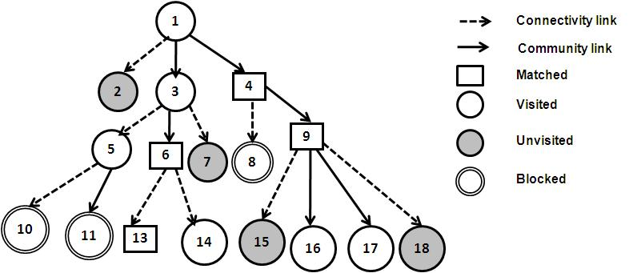
What is Trust Aware Community?
An overlay network of trusted peers.
Neighbors are selected based on trust and content similarity.
Evolving search strategy.

Slide 14




What is Trust Aware Community?
An overlay network of trusted peers.
Neighbors are selected based on trust and content similarity.
Evolving search strategy.
P2P overlay
Trust aware community

Slide 15


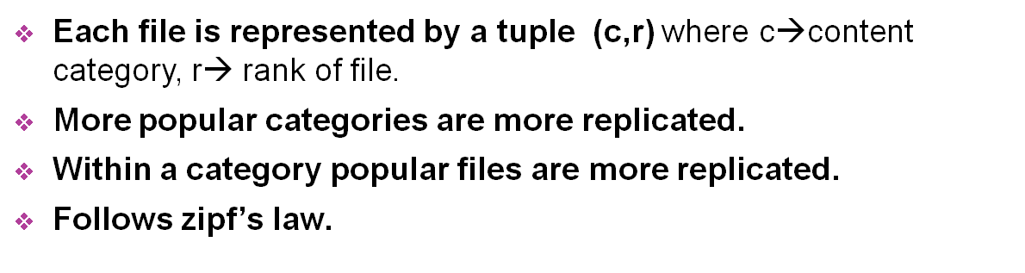
is
(Ref. Kamvar, “Simulating a P2P file-sharing network”, P2P and Grid Computing ’02)

Slide 16
Use Poison distribution to calculate number of queries each peer issues.
A peer issues queries for files not present in its own categories.
Model A: Malicious peers provides good files probabilistically.
Model B: Malicious peers provides fake file only when it gains sufficient community edges.

Slide 17
Network learn trust through search.
Five basic modules
  Search/ Forward
  Response selection and download
  Update trust
  4. Check trust
  5. Rewire topology

Slide 18

1)Search/Forward
  Uses Directed BFS which evolves to DFS as network connectivity increases using parameter
  Queries are disseminated through trusted neighbors,
among trusted neighbors matching community members are preferred.
  Queries forwarded by malicious peers are dropped.
2) Response selection:
  Response are sorted based on trust rating of source peers.
  If trust rating of source is not available in local db, recommendation is sought via trust query.

Slide 19
BF Search tree illustrating search initiated by peer 1.
Uses TTL limited modified BFS which evolves to DFS as network connectivity increases.
Queries are disseminated through trusted neighbors,
among trusted neighbors matching community members are preferred.
Queries forwarded by mal. peers are dropped.

Slide 20
3) Topology adaptation:
After successful download a peer probabilistically attempt to form link with resource provider.
Requires approval of resource provider.
If trust rating of source is negative, existing community edge is removed unconditionally.
Controlled by parameter edge limit and degree of rewiring.

Slide 21
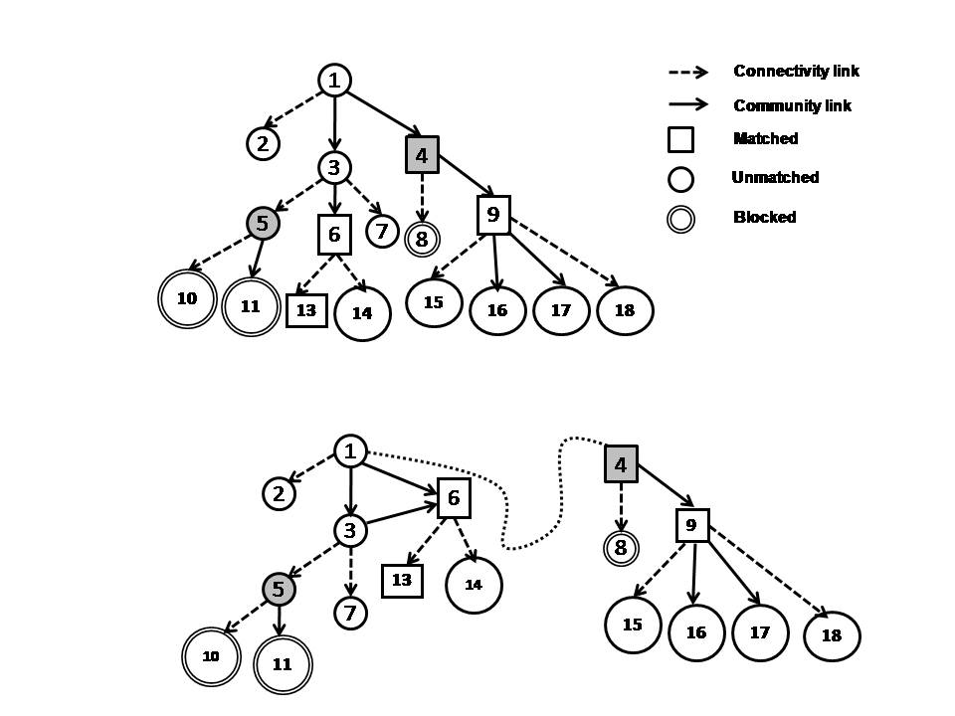
Figure illustrates topology adaptation. Mal. nodes are shaded in grey.

Slide 22
4) Trust Updating:
LRU structure used to remember past transactions with other peers.
After each download of file from peer ‘j’ , peer ‘i’ changes
by +/ - 1, where be # of successful transaction.
Normalized value of be trust score of peer ‘j’ as per peer ‘i’
local history.
5) Trust Query:
A TTL limited DFS to seek recommendation from neighbors.
Query is propagated at each hop through a trusted neighbor
Uses iterative deepening.

Slide 23


1) Search QoS related metrics:
Attempt Ratio (AR): It is the probability of downloading a file in the first attempt.
Let P be the total number of attempts to download an authentic file, then attempt ratio is defined as AR=1/P*100 or zero, if it fails to download authentic file.
Effective Attempt Ratio (EAR): Let P(i) be the total number of attempts made by peer ‘i’ to download an authentic file.
Then
where M and N be the number of good and malicious peers
Query miss ratio (QMR): Fraction of total search failures in a single generation.

Slide 24

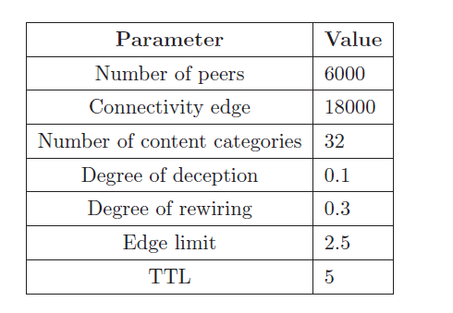
2) Topology related metrics
Largest connected component (LCC): Fraction of total peers in largest connected component sharing a particular content category.
Relative increase in connectivity (RIC):
where N be total # of peers
Simulation parameters

Slide 25
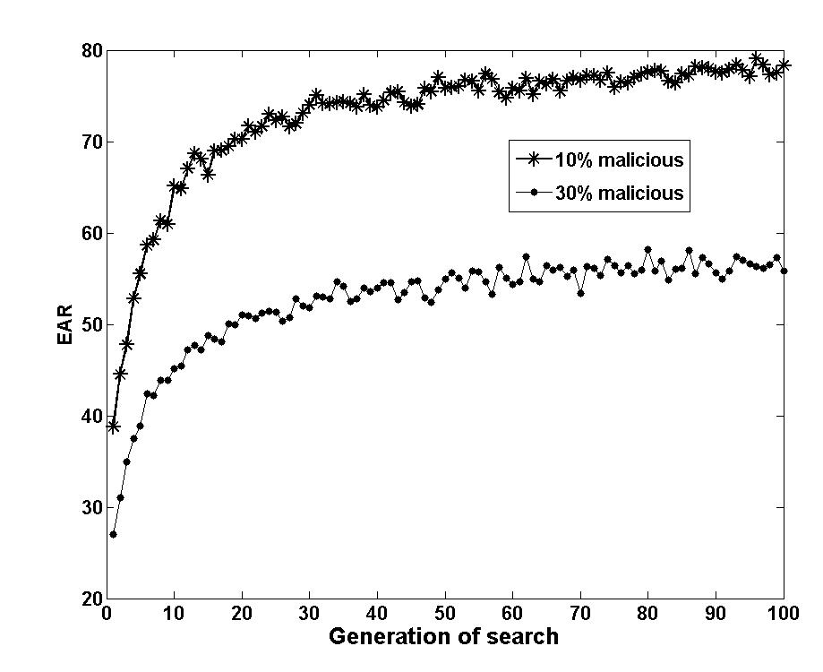
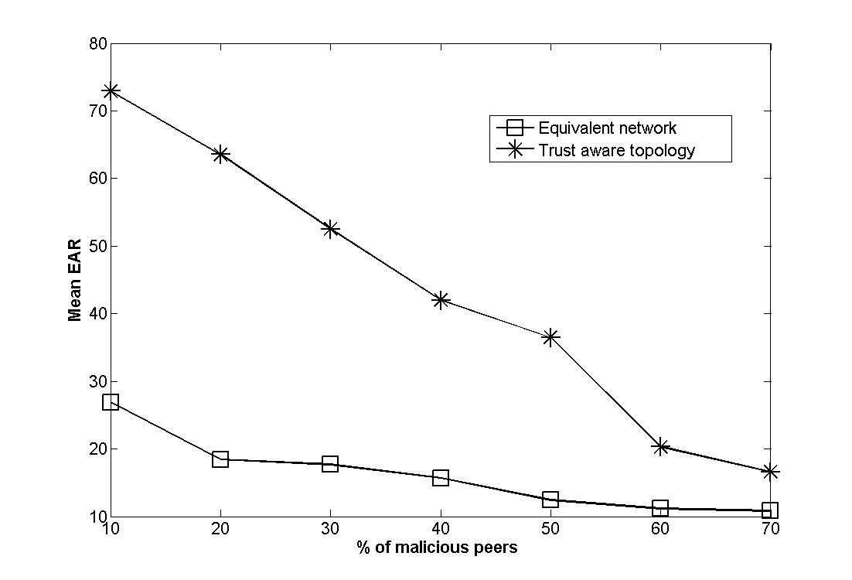
Fig illustrating search quality
Comparison with an equivalent network

Slide 26
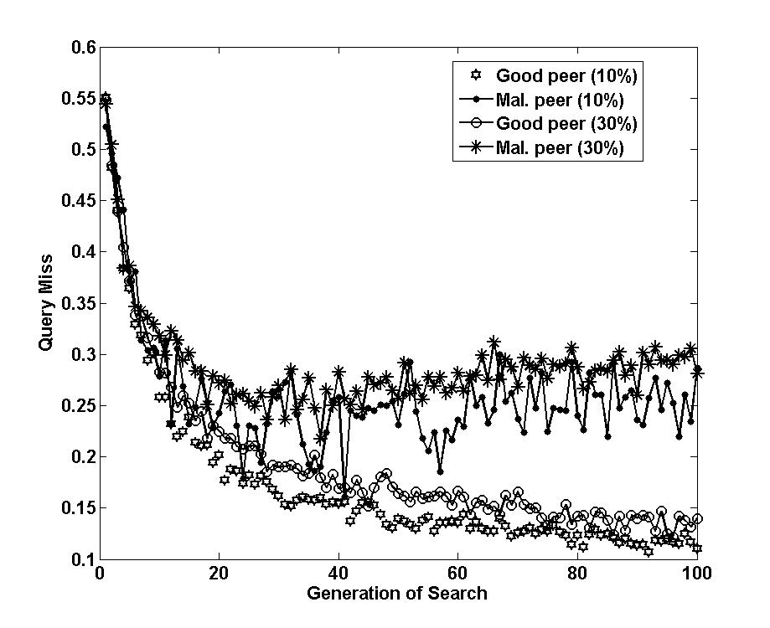
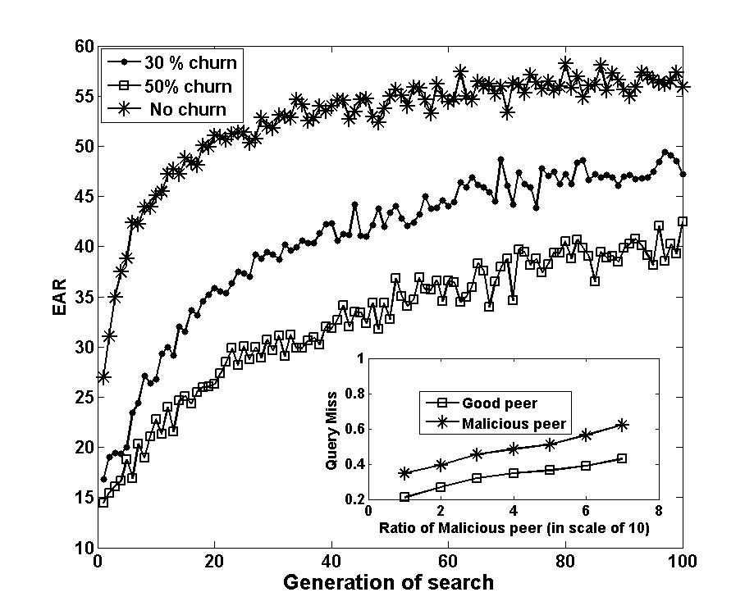
Fig. illustrating Search efficiency
Performance under node churn

Slide 27
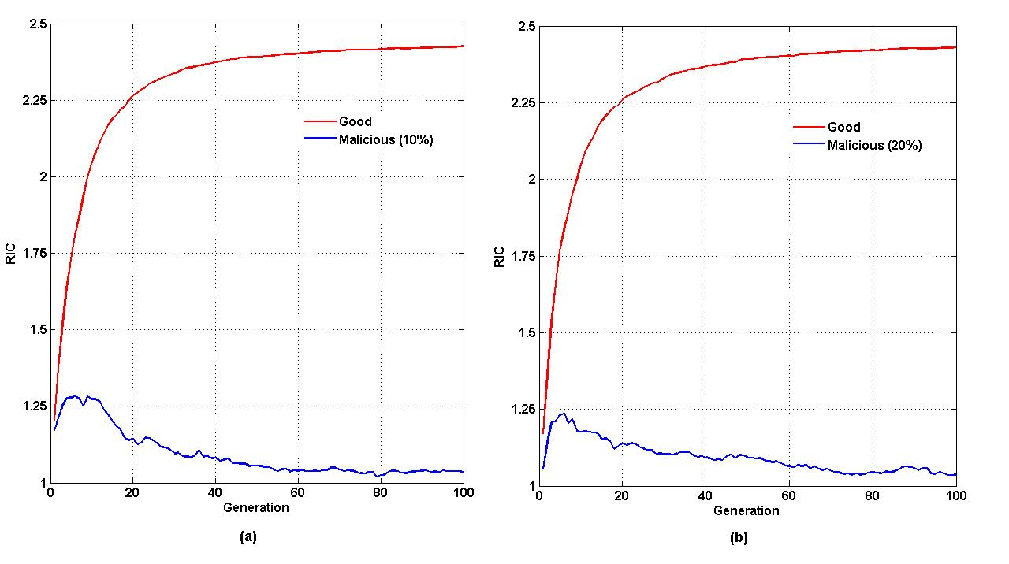
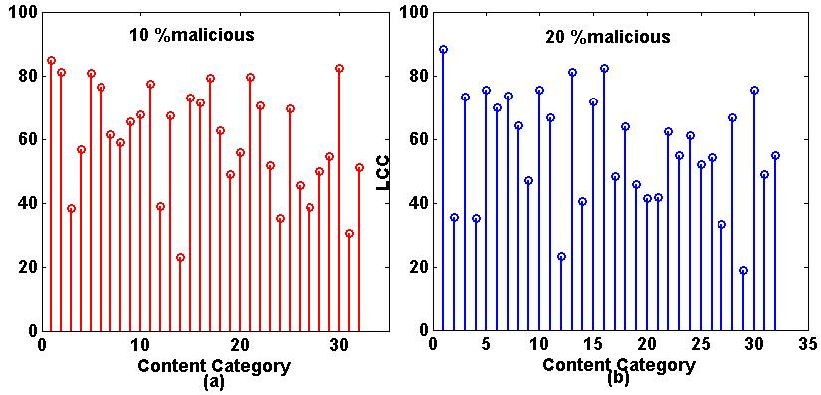
Figures Illustrating goodness of community formation

Slide 28
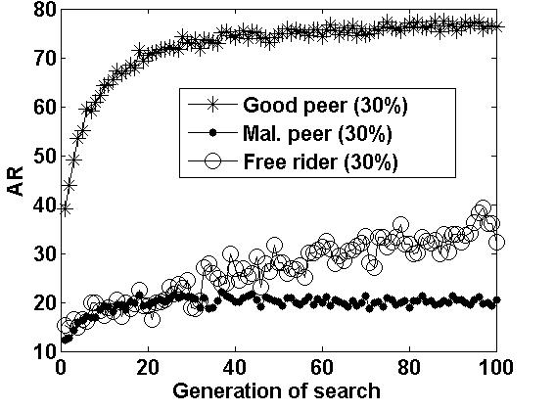
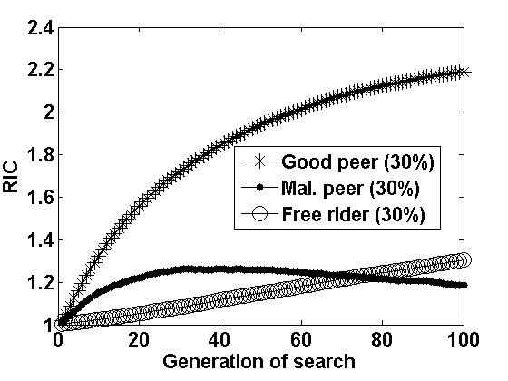
Attempt Ratio
Relative increase in connectivity
Performance of free rider

Slide 29
Eigen trust:
Fraction of response is high for good peers when percentage of malicious peers is ~80. Trust aware topology can withstand up to 60 %.
Eigen trust is computationally intensive.
Eigen value converges only in static network and suffers from Byzantine consensus problem.
APT/RC-ATP:
Trust aware topology is scalable , but RC-ATP not.
Fraction of authentic response is 100 % for good peers. with 10 % malicious peers.
RC-ATP not evaluated with higher percentage of malicious peers.
Use flooding to locate files. Trust aware community use evolving search.

Slide 30
Trust aware community combats fake download, free riding and poor search scalability.
It is scalable and light weight.
Incorporates incentives and punishment mechanism.
White washing is not considered.
Not tested in real network data.

Slide 31
Ernesto Damiani, De Capitani di Vimercati, Stefano Paraboschi. “A Reputation based Approach for Choosing Reliable Resources Peer to Peer Networks”, Proceedings of the 9th ACM conference on Computer and communications security, 2002.
Eytan Adar and Bernardo A. Huberman. “Free Riding on Gnutella”, First Monday 5, October 2000.
Michal Feldman, Christos Papadimitriou, John Chuang, Ion Stoica. “Free-Riding and Whitewashing in Peer-to-Peer Systems”, SIGCOMM-04 Workshop, August-September, 2004.
Matei Ripeanu. “Peer-to-peer architecture case study: Gnutella Network”, Proceedings of First International Conference on Peer-to-Peer Computing, 2001.
A. Abdul-Rahman and Stephen Hailes. “A Distributed Trust Model”, Proceedings of the 1997 workshop on New security paradigms, Pages: 48-60, 1998.
Sepandar D. Kamvar, Mario T. Schlosser, Hector Garcia-molina. “The Eigen Trust Algorithm for Reputation Management in P2P Networks”, In Proceedings of the Twelfth International World Wide Web Conference, 2003.

Slide 32
Tyson Condie, Sepandar D. Kamvar, Hector Garcia-Molina. “Adaptive Peer-To-Peer Topologies”, Proceedings of the Fourth International Conference on Peer-to-Peer Computing, 2004.
Huirong Tian, Shihong Zou, Wendong Wang, Shiduan Cheng. “Constructing efficient peer-to-peer overlay topologies by adaptive connection establishment”, Computer Communications Volume 29, Issue 17, 8 November 2006.
Kevin Walsh, Emin Gun Sirer. “Fighting Peer-to-Peer SPAM and Decoys with Object Reputation”, P2PECON Workshop, Philadelphia,Pennsylvania, USA, August 2005.
Kunwadee Sripanidkulchai, Bruce Maggs, Hui Zhang. “Efficient Content Location Using Interest-Based Locality in Peer-to-Peer Systems”, INFOCOM 2003.
Vicent Cholvi, Pascal Felber. “Efficient Search in Unstructured Peer-to-Peer Networks”, European Transactions on Telecommunications: Special Issue on P2P Networking and P2P Services, 2004.
Tathagata Das, Subrata Nandiy and Niloy Ganguly. “Community Formation and Search in P2P: A Robust and Self-Adjusting Algorithm”, IAMCOM 2009, held with COMSNET 2009.

Slide 33
Liangmin Guo, Shoubao Yang, Leitao Guo, Kai Shen, Weina Lu. “Trust-aware Adaptive P2P Overlay Topology Based on Superpeer-partition”, Proceedings of the Sixth International Conference on Grid and Cooperative Computing, 2007.
Mario T. Schlosser, Tyson E.Condie, Ar D. Kamvar. “Simulating a P2P file-sharing network”, First Workshop on Semantics in P2P and Grid Computing, 2002.
A. Crespo, H. Garcia-Molina. “Semantic Overlay Networks for P2P Systems”, Technical report, Computer Science Department, Stanford University, 2002.
S. Saroiu, P. K. Gummadi, S. D. Gribble. A. “A Measurement Study of Peer-to-Peer File Sharing Systems”, Proceedings of Multimedia Computing and Networking, 2002.

Slide 34

Dynamics On and Of Complex Networks
Applications to Biology, Computer Science, and the Social Sciences
Ganguly, Niloy; Deutsch, Andreas; Mukherjee, Animesh (Eds.)
A Birkhäuser book
Workshop – 23rd September, Warwick

Slide 35
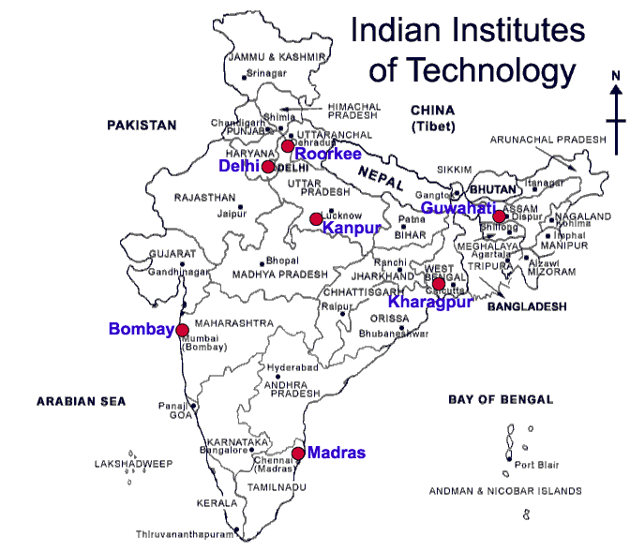
Thank you

Slide 36
Thank You

