Slide 1
Brief Announcement : Measuring Robustness of Superpeer Topologies
Niloy Ganguly
Department of Computer Science & Engineering
Indian Institute of Technology, Kharagpur
Kharagpur 721302

Slide 2
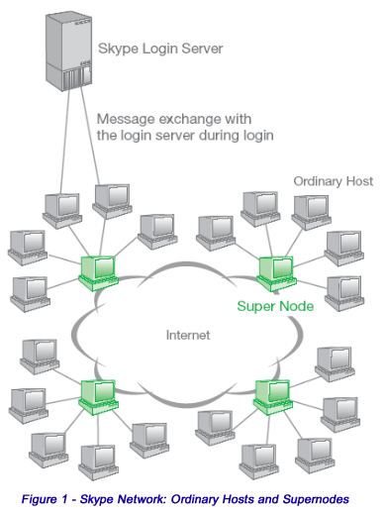
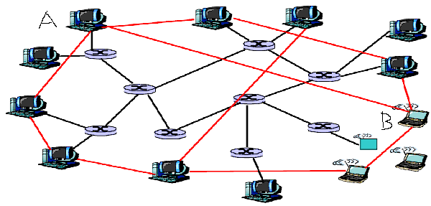
Peer to peer and overlay network
An overlay network is built on top of physical network
Nodes are connected by virtual or logical links
Underlying physical network becomes unimportant
Interested in the complex graph structure of overlay

Slide 3
Dynamicity of overlay networks
Peers in the p2p system leave network randomly without any central coordination
Important peers are targeted for attack
  Makes overlay structures highly dynamic in nature
  Frequently it partitions the network into smaller fragments
  Communication between peers become impossible

Slide 4
Problem definition
  Development of an analytical framework to investigate the stability of the p2p networks against the dynamic behavior of peers
  Modeling of Overlay topologies
    pure p2p networks, superpeer networks, commercially used networks like Gnutella
    Peer dynamics
      churn, attack
p_{k} specifies the fraction of nodes having degree k
q_{k} probability of survival of a node of degree k after the disrupting event

Slide 5
Stability Metric:
Percolation Threshold
Initially all the nodes in the network are connected
Forms a single giant component
Size of the giant component is the order of the network size
Giant component carries the structural properties of the entire network
Nodes in the network are connected and form a single giant component

Slide 6
Stability Metric:
Percolation Threshold
f fraction of nodes removed
Initial single connected component
Giant component still exists

Slide 7
Stability Metric:
Percolation Threshold
f_{c} fraction of nodes removed
f fraction of nodes removed
Initial single connected component
The entire graph breaks into smaller fragments
Giant component still exists
Therefore f_{c} =1-q_{c} becomes the percolation threshold

Slide 8
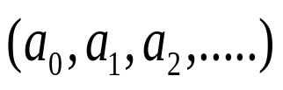
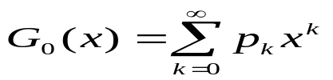

Development of analytical framework
Generating function:
  Formal power series whose coefficients encode information
  Here encode information about a sequence
  Used to understand different properties of the graph
  generates probability distribution of the vertex degrees.
  Average degree

Slide 9
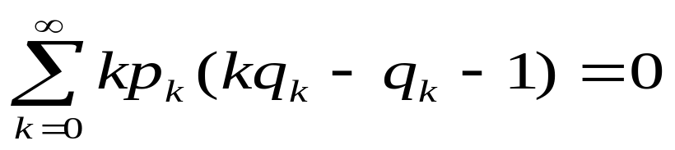
Development of analytical framework
Generating function:
  Formal power series whose coefficients encode information
  Here encode information about a sequence
  With the help of generating function, we derive the following critical condition for the stability of giant component
Degree distribution
Peer dynamics

Slide 10
Peer Movement : Churn and attack
  Degree independent node failure
    Probability of removal of a node is constant & degree independent
      q_{k}=q
  Deterministic attack
    Nodes having high degrees are progressively removed
      q_{k}=0 when k>kmax
      0< q_{k}< 1 when k=kmax
      q_{k}=1 when k<kmax

Slide 11
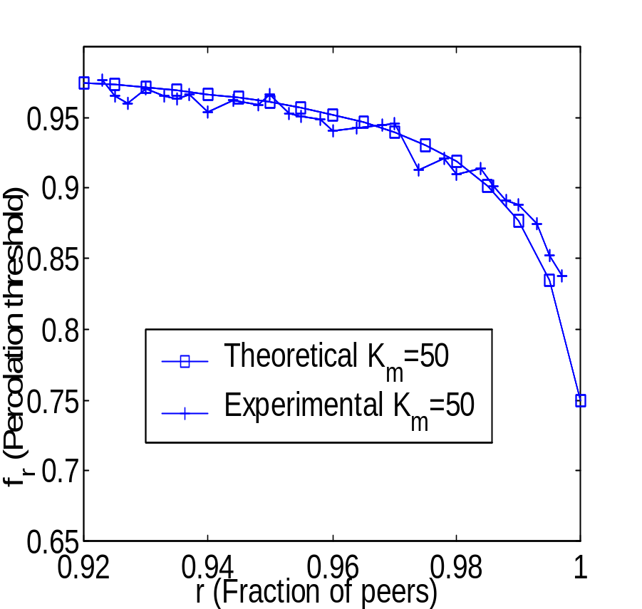
Stability of superpeer networks against churn
Superpeer networks are quite robust against churn.
There is a sharp fall of fr when fraction of superpeers is less than 3%

Slide 12
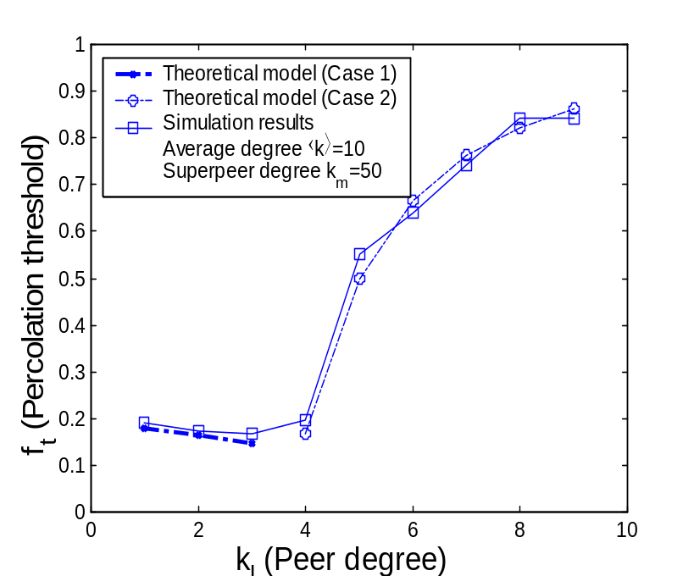
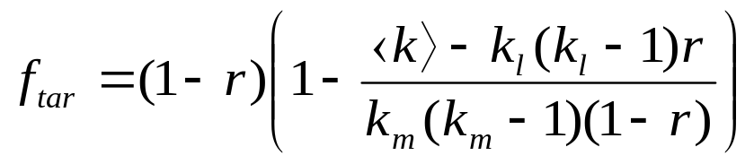
Stability of superpeer networks against deterministic attack
Two different cases may arise
Case 1:
  Removal of a fraction of high degree nodes are sufficient to breakdown the network
Case 2:
  Removal of all the high degree nodes are not sufficient to breakdown the network
  Have to remove a fraction of low degree nodes

Slide 13
Stability of superpeer networks against deterministic attack
Two different cases may arise
Case 1:
  Removal of a fraction of high degree nodes are sufficient to breakdown the network
Case 2:
  Removal of all the high degree nodes are not sufficient to breakdown the network
  Have to remove a fraction of low degree nodes
Interesting observation in case 1
  Stability decreases with increasing value of peers – counterintuitive

Slide 14
Conclusion
Contribution of our work
  Development of general framework to analyze the stability of superpeer networks
  Modeling the dynamic behavior of the peers using degree independent failure as well as attack.
  Comparative study between theoretical and simulation results to show the effectiveness of our theoretical model.
  Future work
  Perform the experiments and analysis on more realistic network

Slide 15

Thank you

