Slide 1
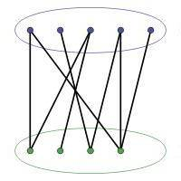
Growth models of Bipartite Networks
Niloy Ganguly
Department of Computer Science & Engineering
Indian Institute of Technology, Kharagpur
Kharagpur 721302

Slide 2
Contents of the presentation
Introduction to Bipartite network (BNW) and BNW growth
Why BNWs ?
Classes of Growth Models
  Sequential attachment growth model (SA)
  Parallel attachment with replacement growth model (PA_{WR})
  parallel attachment without replacement growth model (PA_{WOR})
One-mode Projection
Model verification
Conclusions and future works

Slide 3
Contents of the presentation
Introduction to Bipartite network (BNW) and BNW growth
Why BNWs ?
Classes of Growth Models
  Sequential attachment growth model (SA)
  Parallel attachment with replacement growth model (PA_{WR})
  parallel attachment without replacement growth model (PA_{WOR})
One-mode Projection
Model verification
Conclusions and future works

Slide 4
Bipartite network (BNW)
Two disjoint sets of nodes, namely “TOP” set and “BOTTOM” set
No edge between the co-members of the sets
Edges - interactions among the nodes of two sets
Top Set
Bottom Set

Slide 5
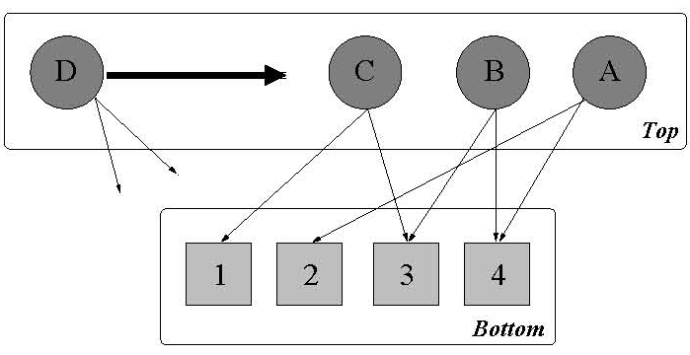
BNW growth
One top node is introduced at each time step
Top nodes enter the system with µ edges ( 1≤ µ)
Each top node can bring m new bottom nodes (1≤ m <µ). If m=0, the bottom set is fixed.
Edges are attached randomly or preferentially

Slide 6
Contents of the presentation
Introduction to Bipartite network (BNW) and BNW growth
Why BNWs ?
Classes of Growth Models
  Sequential attachment growth model (SA)
  Parallel attachment with replacement growth model (PA_{WR})
  parallel attachment without replacement growth model (PA_{WOR})
One-mode Projection
Model verification
Conclusions and future works

Slide 7
Many real world examples
Many real systems can be abstracted as BNWs
  Biological networks
  Social networks
  Technological networks
  Linguistic Networks

Slide 8
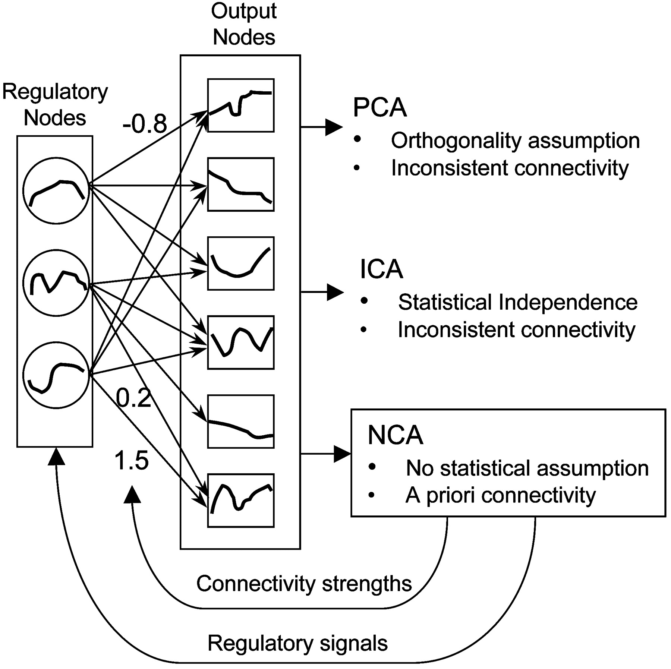
A regulatory system network
The output data are driven by regulatory signals through a bipartite network
Liao J. C. et.al. PNAS 2003;100:15522-15527

Slide 9
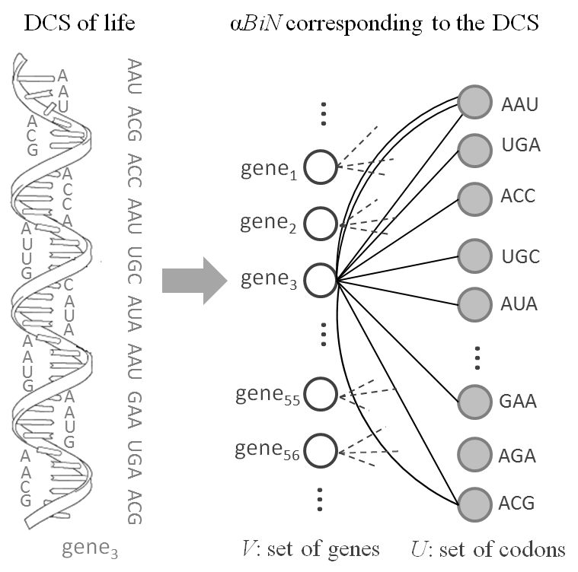
Codon Gene Network

Slide 10
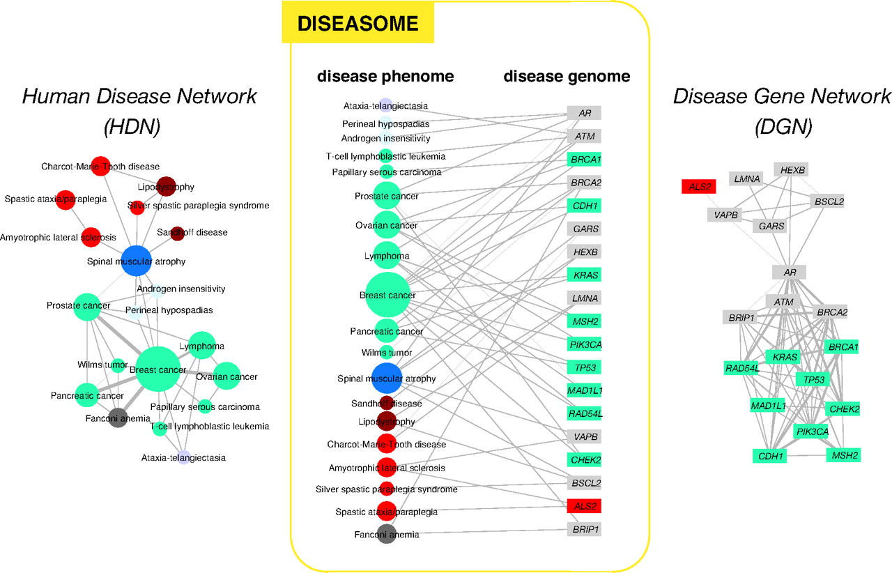
Disease Genome Network
Goh K. et.al. PNAS 2007;104:8685-8690

Slide 11
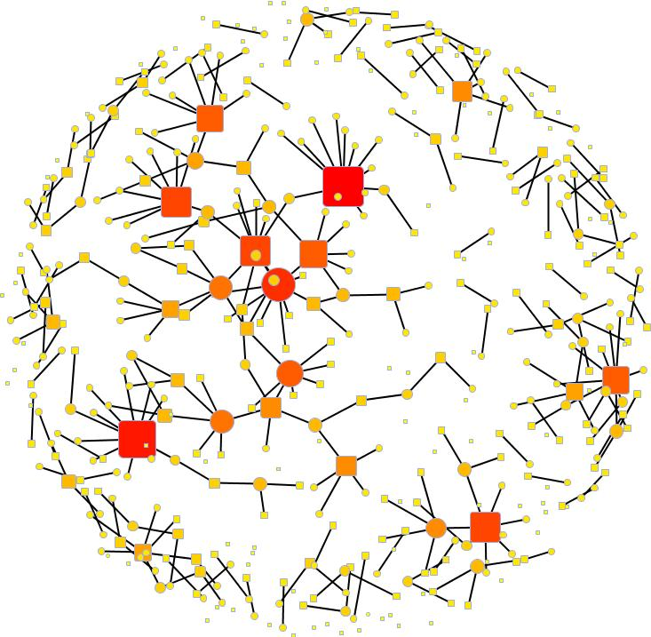
People Project Network
Bipartite network of people and projects funded by the UK eScience initiatives
The people are circles and the projects are squares.
The color and size of the nodes indicates degree; redder and bigger nodes have more connections than smaller and yellower nodes

Slide 12
Phoneme Language Network
The Structure of the Phoneme-Language Networks (PlaNet)
/θ/
L₁
/ŋ/
L₂
/m/
Consonants
Languages
L₃
/d/
/s/
L₄
/p/

Slide 13
And many others…….
Protein-protein complex network
Movie-actor network
Article-author network
Board-director network
City-people network
Word-sentence network
Bank-company network

Slide 14
Contents of the presentation
Introduction to Bipartite network (BNW) and BNW growth
Why BNWs ?
Classes of Growth Models
  Sequential attachment growth model (SA)
  Parallel attachment with replacement growth model (PA_{WR})
  parallel attachment without replacement growth model (PA_{WOR})
One-mode Projection
Model verification
Conclusions and future works

Slide 15
Two broad categories
Both partitions grow with time
Empirical and analytical studies are available
Ramasco J. J., Dorogovtsev S. N. and Pastor-Satorras R., Phys. Rev. E, 70 (036106) 2004.
Only one partition grows and other remains fixed
Couple of empirical studies but no analytical research

Slide 16
Two broad categories
Both partitions grow with time
Empirical and analytical studies are available
Ramasco J. J., Dorogovtsev S. N. and Pastor-Satorras R., Phys. Rev. E, 70 (036106) 2004.
Only one partition grows and other remains fixed
Couple of empirical studies but no analytical research
with many real examples: Protein protein complex
network, Station train network, Phoneme language
network etc….

Slide 17
BNW growth with the set of bottom nodes fixed
Fixed number of bottom nodes (N)
One top node is introduced at each time step
Top nodes enter with µ edges
Edges get attached preferentially

Slide 18
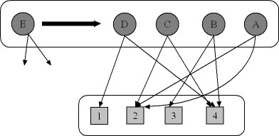


Attachment Kernel
µ edges are going to get attached to the bottom nodes preferentially
Attachment of an edge depends on the current degree of a bottom node (k)
(k + €)
γ is the preferentiality parameter
Random attachment when γ = 0

Slide 19
Attachment Kernel
µ edges are going to get attached to the bottom nodes preferentially
Attachment of an edge depends on the current degree of a bottom node (k)
Referred to as the attachment probability or the attachment kernel
γ is the preferentiality parameter
Random attachment when γ = 0

Slide 20
Contents of the presentation
Introduction to Bipartite network (BNW) and BNW growth
Why BNWs ?
Classes of Growth Models
  Sequential attachment growth model (SA)
  Parallel attachment with replacement growth model (PA_{WR})
  parallel attachment without replacement growth model (PA_{WOR})
One-mode Projection
Model verification
Conclusions and future works

Slide 21
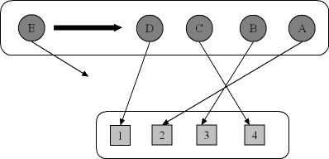
Sequential attachment model
µ = 1
Total number of edges = Total time (t)
Example: Language - Webpage

Slide 22


Bottom node degree distribution
Attachment probability :
Notations:
- # of bottom nodes
- time or # of top nodes
- preferentiality parameter
- bottom node degree
- degree probability
distribution at time t
Markov chain model of the growth:
No asymptotic behavior – the degree continuously increases

Slide 23

Bottom node degree distribution
Attachment probability :
Notations:
- # of bottom nodes
- time or # of top nodes
- preferentiality parameter
- bottom node degree
- degree probability
distribution at time t
Markov chain model of the growth:
Degree distribution function

Slide 24


Approximated parallel attachment solution
Attachment probability :
Degree distribution function
Approaches to Beta– distribution
f(x,α,β) for
C =

Slide 25
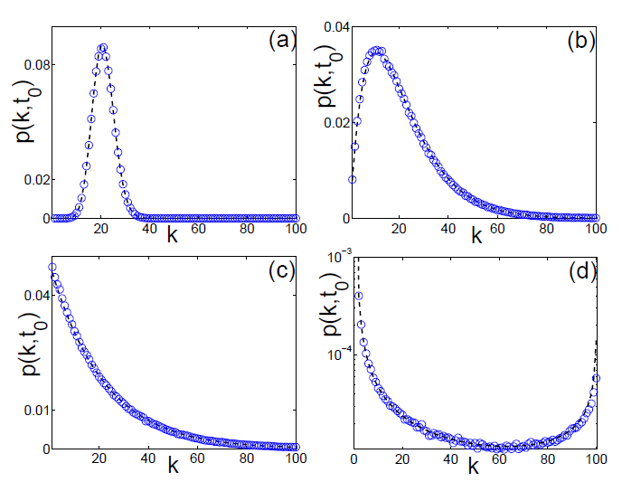
Four regimes
The four possible regimes of degree distributions depending on .
(a) , (b) (c) (d)

Slide 26
Contents of the presentation
Introduction to Bipartite network (BNW) and BNW growth
Why BNWs ?
Classes of Growth Models
  Sequential attachment growth model (SA)
  Parallel attachment with replacement growth model (PA_{WR})
  parallel attachment without replacement growth model (PA_{WOR})
One-mode Projection
Model verification
Conclusions and future works

Slide 27
Parallel attachment with replacement model (PA_{WR})
µ ≥ 1
Total number of edges = µt
Example: Codon – Gene

Slide 28


Exact solution of PA_{WR}
For random attachment, we can derive the attachment probability as
Attachment probability of edges to a bottom node
of degree k at time t
Notes:
The probability at time t of a node of degree k of receiving i new edges in the next time step

Slide 29
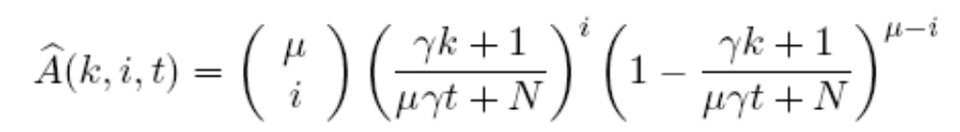
Exact solution of PA_{WR}
For random attachment, we can derive the attachment probability as
Attachment probability of edges to a bottom node
of degree k at time t
Introducing preferentiality in the model
Notes:
The probability at time t of a node of degree k of receiving i new edges in the next time step

Slide 30
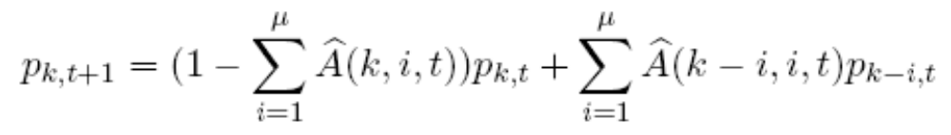
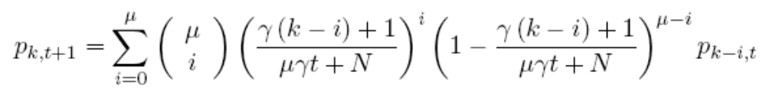
Exact solution of PA_{WR}
Recurrence relation for bottom node degree distribution
Notes:
The probability at time t of a node of degree k of receiving i new edges in the next time step

Slide 31
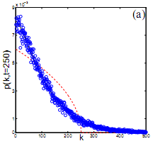
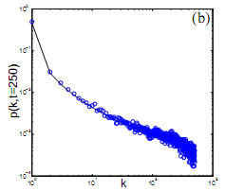
Exactness of exact solution of PA_{WR}
Probability of having degree k
Probability of having degree k
Degree(k)
Degree(k)
N = 20, t = 250, µ = 40, γ = 1
γ = 16
Solid black curve –> Exact solution
Symbols –> Simulation
Dashed red curve –> Approximation
Approximation fails but exact solution does well

Slide 32
Observations on PA_{WR}
Degree distribution curve is not monotonically
decreasing for γ = 1
Two maxima in bottom node degree distribution
plots

Slide 33
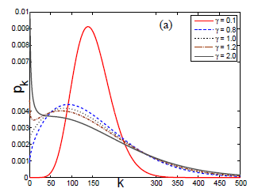
Observation - I
Degree distribution curve is not monotonically decreasing for γ = 1
Probability of having degree k
Degree(k)
N = 50, µ = 50

Slide 34
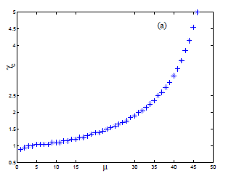
Observation - I
Degree distribution curve is not monotonically decreasing for γ = 1
Probability of having degree k
Critical γ
µ
Degree(k)
Critical γ vs. µ: N = 10
N = 50, µ = 50
Critical γ – The value of γ for which distribution become monotonically decreasing with mode at zero

Slide 35
Contents of the presentation
Introduction to Bipartite network (BNW) and BNW growth
Why BNWs ?
Classes of Growth Models
  Sequential attachment growth model (SA)
  Parallel attachment with replacement growth model (PA_{WR})
  parallel attachment without replacement growth model (PA_{WOR})
One-mode Projection
Model verification
Conclusions and future works

Slide 36
Parallel attachment without replacement (PA_{WOR})
µ ≥ 1
Total number of edges = µt
No parallel edge
Example:
Language - Phoneme

Slide 37

PA_{WOR} Model - I
µ edges connect one by one to µ distinct bottom nodes
After attachment of every edge attachment kernel changes as
Theoretical analysis is almost intractable
W is the subset of bottom nodes already chosen by the current top node

Slide 38
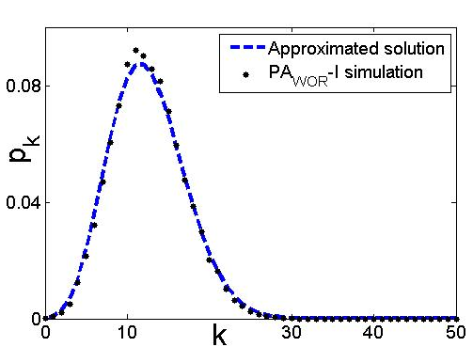
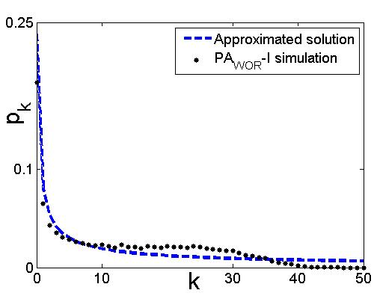
Degree distribution for PA_{WOR} Model - I
Probability of having degree k
Probability of having degree k
Degree(k)
Degree(k)
N = 20, t = 50, µ = 5, γ = 0.1
γ = 3

Slide 39
Degree distribution for PA_{WOR} Model - I
Probability of having degree k
Probability of having degree k
Degree(k)
Degree(k)
N = 20, t = 50, µ = 5, γ = 0.1
γ = 3
Approximated solution is very close to Model-I

Slide 40
PA_{WOR} Model - II
A subset of µ nodes is selected from N bottom nodes preferentially. ^{N}C_{μ} sets
Attachment of edges depends on the sum of degrees of member nodes
Each of the selected µ bottom nodes get attached through one edge with the top node

Slide 41

Attachment kernel for subset
Attachment kernel for µ member subset
- time or # of top nodes
- preferentiality parameter
- A µ member subset of bottom nodes
- degree of the i^{th} member node
Notes:
The probability at time t of a node of degree k of receiving i new edges in the next time step

Slide 42
Attachment kernel for subset
Attachment kernel for µ member subset
- time or # of top nodes
- preferentiality parameter
- A µ member subset of bottom nodes
- degree of the i^{th} member node
We need attachment probability for individual bottom node
Notes:
The probability at time t of a node of degree k of receiving i new edges in the next time step

Slide 43


Attachment probability for a single node
Attachment probability for a bottom node is sum of the attachment probabilities of all container subsets
Any specific bottom node (b) is member of number of subsets
Among those subsets any other bottom node except b has membership in number of subsets
Sum of degrees of all nodes is
Notes:
The probability at time t of a node of degree k of receiving i new edges in the next time step

Slide 44
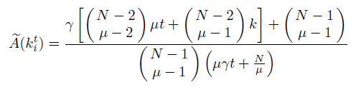

Attachment probability for a single node
Attachment probability for bottom nodes
Notes:
The probability at time t of a node of degree k of receiving i new edges in the next time step

Slide 45

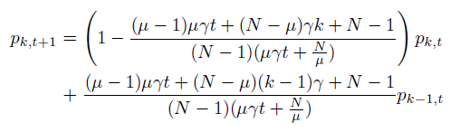
Bottom node degree distribution
Markov chain model of the growth:
Notes:
The probability at time t of a node of degree k of receiving i new edges in the next time step

Slide 46
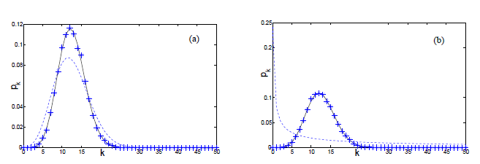
Degree distribution for PA_{WOR} Model - II
Probability of having degree k
Probability of having degree k
Degree(k)
Degree(k)
N = 20, t = 50, µ = 5, γ = 0.1
γ = 3
dotted lines for approximated parallel attachment model

Slide 47
Degree distribution for PA_{WOR} Model - II
Probability of having degree k
Probability of having degree k
Degree(k)
Degree(k)
N = 20, t = 50, µ = 5, γ = 0.1
γ = 3
dotted lines for approximated parallel attachment model
Only skewed binomial distributions are observed
Extra randomness in the model

Slide 48
Contents of the presentation
Introduction to Bipartite network (BNW) and BNW growth
Why BNWs ?
Classes of Growth Models
  Sequential attachment growth model (SA)
  Parallel attachment with replacement growth model (PA_{WR})
  parallel attachment without replacement growth model (PA_{WOR})
One-mode Projection
Model verification
Conclusions and future works

Slide 49
One mode projection of bottom
Goh K. et.al. PNAS 2007;104:8685-8690

Slide 50
Degree of the nodes in One-mode
Easy to calculate if each node v in growing partition enters with exactly μ (> 1) edges
Consider a node u in the non-growing partition having degree k
u is connected to k nodes in the growing partition and each of these k nodes are in turn connected to μ-1 other nodes in the non-growing partition
Hence degree q=k(μ-1)

Slide 51
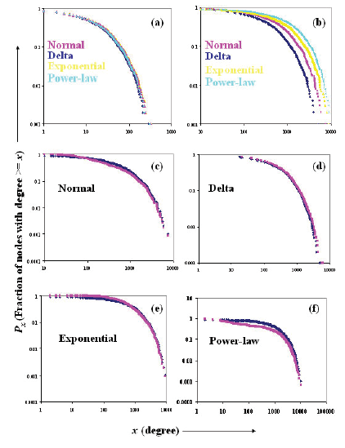
What if μ is not fixed??
μ
One-Mode
Networks
Bipartite
Networks

Slide 52
What if μ is not fixed??
The degree of the TOP nodes for any real-world networks is not fixed → not all genes made up of the same no. of codons and not all languages are composed of the same number of phonemes
Relax the assumption that the size of the consonant inventories is a constant (μ)
Assume these sizes to be random variables being sampled from a distribution f_{d}
It is easy to show that, while the one-mode degree (q) for a node u is dependent on f_{d}, its bipartite n/w degree (k) is not (the kernel of attachment roughly remains the same)

Slide 53

Analysis of Degree Distribution
Assume that the k nodes in TOP partition to which a BOTTOM node u is connected to have degrees
The probability that u is connected to a node of degree d₁ is d₁f_{d1}, d₂ is d₂f_{d2}, …, d_{k} is d_{k}f_{dk}
The normalized probability that u is connected to nodes of degree d₁, d₂, … d_{k} is

Slide 54


Analysis of Degree Distribution
F_{k}(q): The probability that node u having degree k in the bipartite network ends up as a node having degree q in the one-mode projection
Now add up these probabilities for all values of k weighted by the probability of finding a node of degree k in the bipartite network

Slide 55
Analysis of Degree Distribution
Assumption: d₁d₂…d_{k} = μ^{k} (i.e., AM~GM which holds when the variance is low)
F_{k}(q): Sum of k random variables each sampled from f_{d} → How is the sum of these k random variables distributed?
The distribution of this sum can be easily obtained by iterative convolution of f_{d} for k times

Slide 56




Analysis of Degree Distribution
If f_{d} varies as a Normal Distribution N(μ, σ²)
If f_{d} varies as a Delta function δ(d, μ)
If f_{d} varies as an Exponential function E(λ=1/μ)
If f_{d} varies as Power-law function (power = –λ)

Slide 57
Results of the Analysis
Bipartite
Networks
One-Mode
Networks
N = 1000,
t = 1000,
γ= 2,
μ=22

Slide 58
Contents of the presentation
Introduction to Bipartite network (BNW) and BNW growth
Why BNWs ?
Classes of Growth Models
  Sequential attachment growth model
  Parallel attachment with replacement growth model
  parallel attachment without replacement growth model
One-mode Projection
Model verification
Conclusions and future works

Slide 59



Experimental Setup
Consider models of PA_{WR} and PA_{WOR} – I
Simulate the BNW growth to synthesize the real world BNW for several values of γ
Error
real distribution
simulated distribution
t Number of top nodes in real world BNW
Minimum error gives the best fitted γ and bottom node degree distribution

Slide 60
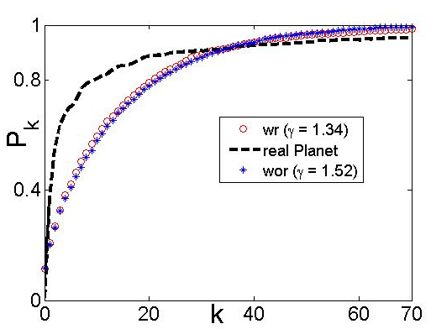
Phoneme-Language Network
Top – Language
Fixed bottom - Phoneme
N – 541 (phonemes)
t – 317 (language)
µ – 22
E_{WOR} = 0.113062928
E_{WR} = 0.109411487
Data - UCLA Phonological Segment Inventory Database (UPSID)

Slide 61
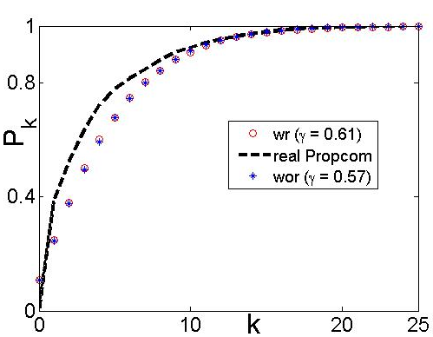
Protein-Protein Complex Network
Top – Protein Complex
Fixed bottom – Protein
N – 959 (protein)
t – 488 (protein-complex)
µ – 9
E_{WOR} = 0.075977328
E_{WR} = 0.073801462
Data – Yeast protein complex data from
http://yeast-complexes.embl.de/complexview.pl?rm=home

Slide 62
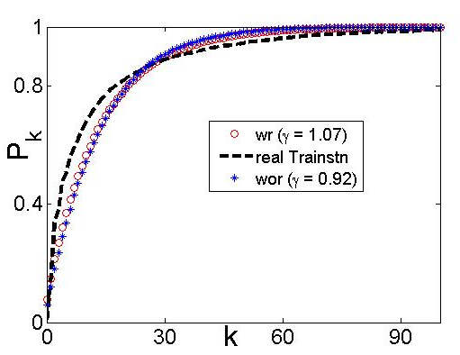
Station-Train Network
Top – Train
Fixed bottom – Station
N – 2764 (Station)
t – 1377 (Train)
µ – 26
E_{WOR} = 0.034344613
E_{WR} = 0.034138636
Data – Indian Railway data from http://www.indianrail.gov.in

Slide 63
Contents of the presentation
Introduction to Bipartite network (BNW) and BNW growth
Why BNWs ?
Classes of Growth Models
  Sequential attachment growth model
  Parallel attachment with replacement growth model
  parallel attachment without replacement growth model
One-mode Projection
Model verification
Conclusions and future works

Slide 64
Conclusions and Future works
The dynamics of BNWs where one of the partitions is fixed and finite over time is different from those where both the partitions grow unboundedly.
  While the former approaches a β–distribution, the latter results in a power-law in the asymptotic limits
Many real-world systems can be modeled as BNWs with one partition fixed (e.g., Phoneme-Language N/w, Protein-Protein Complex N/w, Train-Station N/w)
The growth dynamics of these n/ws can be suitably explained through simple preferential attachment based models coupled with a tunable parameter controlling the amount of preferentiality/randomness of the growth process.
The degree distribution of one-mode projection onto the BOTTOM nodes depends on how the TOP node degrees are distributed in the BNW

Slide 65
Conclusions and Future works
Future works include
  Deriving closed form solutions for PA_{WR} and PA_{WOR} models. Understanding their (non)equivalence.
  Exploring the dynamics of the models for non-linear kernels, i.e., the attachment probability is proportional to k^{α} where α < 1 refers to sub-linear kernels and α > 1 to super-linear kernels
  Analytically deriving other structural properties of the one-mode like clustering coefficient, assortativity etc.

Slide 66
Collaborators
Animesh Mukherjee, Abyayananda Maity – IIT Kharagpur
Monojit Choudhury – Microsoft Research India
Fernando Peruani – CEA, Sacalay, France
Andreas Deutsch, Lutz Brusch – TU Dresden, Germany
Notes:
Picture would be good

Slide 67
Contributing literature
F. Peruani, M. Choudhury, A. Mukherjee, and N. Ganguly. Emergence of a non-scaling degree distribution in bipartite networks: A numerical and analytical study. Europhys. Lett., 79:28001, 2007.
M. Choudhury, N. Ganguly, A. Maiti, A. Mukherjee, L. Brusch, A. Deutsch, and F. Peruani. Modeling discrete combinatorial systems as alphabetic bipartite networks: Theory and applications. (communicated to “Physical Review E”).
A. Mukherjee, M. Choudhury and N. Ganguly. Analyzing the Degree Distribution of the One-mode Projection of Alphabetic Bipartite Networks (α-- BiNs) (communicated to “Europhys. Lett.”).
Notes:
Picture would be good

Slide 68

Dynamics On and Of Complex Networks
Applications to Biology, Computer Science, and the Social Sciences
Series: Modeling and Simulation in Science, Engineering and Technology
Ganguly, Niloy; Deutsch, Andreas; Mukherjee, Animesh (Eds.)
A Birkhäuser book
Workshop – 23rd September, Warwick

Slide 69

Dziękuję

Slide 71
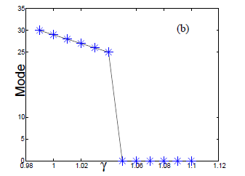
Observation - I
Degree distribution curve is not monotonically decreasing for γ = 1
Probability of having degree k
Degree(k)
Mode vs. γ
N = 50, t = 100, µ = 50

Slide 72
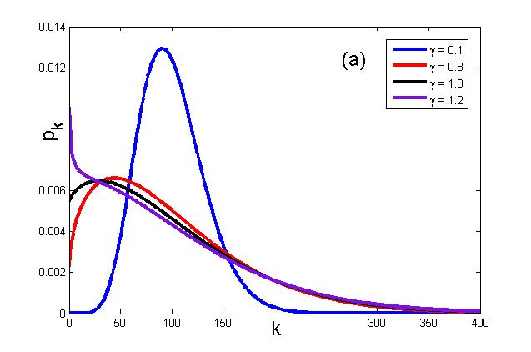
Observation - I
Degree distribution curve is not monotonically decreasing for γ = 1
Probability of having degree k
Degree(k)
Mode vs. γ
N = 50, t = 100, µ = 50
Mode changes abruptly, but there is no abruptness in the model

Slide 73
Observation – I cont.
Critical γ – The value of γ for which distribution become
monotonically decreasing with mode at zero

Slide 74
Observation – I cont.
Critical γ – The value of γ for which distribution become
monotonically decreasing with mode at zero
Critical γ
µ
Critical γ vs. µ: N = 10, t = 50

Slide 75
Observation – I cont.
Critical γ – The value of γ for which distribution become
monotonically decreasing with mode at zero
Critical γ
µ
Critical γ vs. µ: N = 10, t = 50
Critical γ is directly proportional to µ in exponential manner

Slide 76
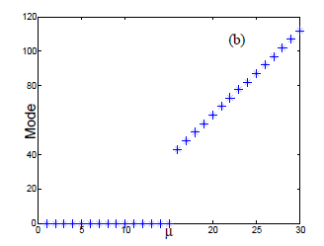
Observation – I cont.
Critical γ – The value of γ for which distribution become
monotonically decreasing with mode at zero
Critical γ
µ
µ
Critical γ vs. µ: N = 10, t = 50
Mode vs. µ: γ = 1.2, at µ = 16 mode becomes zero
Critical γ is directly proportional to µ in exponential manner

Slide 77
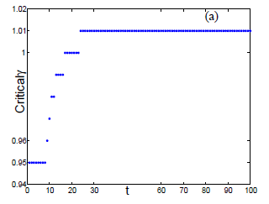
Observation – I cont.
Critical γ
Time (t)
Critical γ vs. time: N = 10, µ = 5

Slide 78
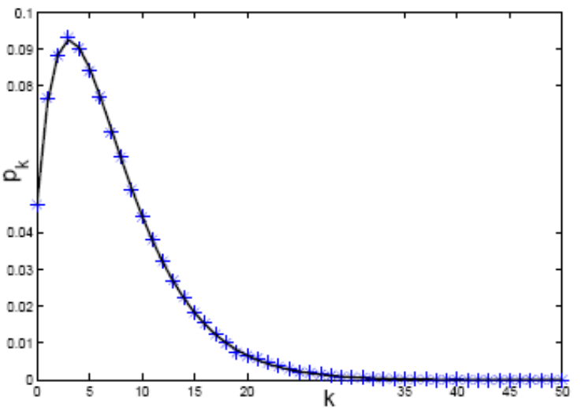
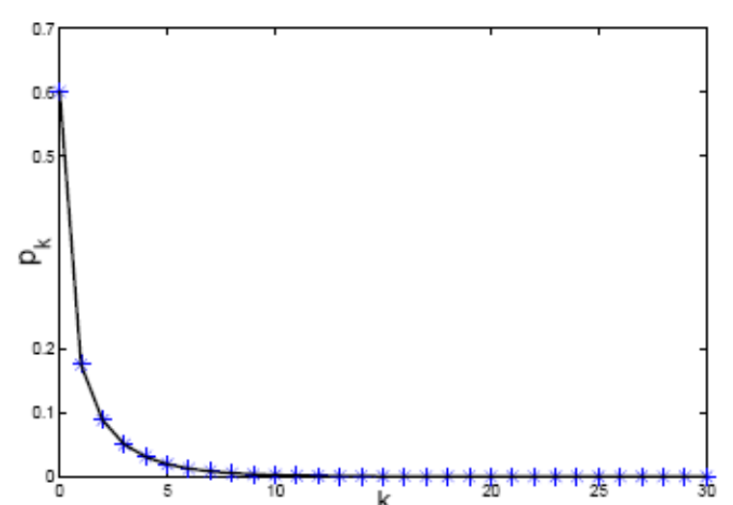
Degree distribution for PA_{WR}
Solid line - recursive function
Symbols - simulation
(a)
(b)
Probability of having degree k
Probability of having degree k
Degree(k)
Degree(k)
N = 100, µ = 7, γ = 0.5, t = 100
N = 100, µ = 1, γ = 2.5, t = 100
Both simulation have been taken as average over 1000 run

Slide 79
Observation – I cont.
Critical γ
Time (t)
Critical γ vs. time: N = 10, µ = 5
Critical γ has a stationary value

Slide 80
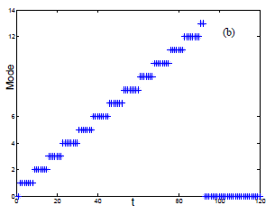
Observation – I cont.
Critical γ
Mode
Time (t)
Time (t)
Critical γ vs. time: N = 10, µ = 5
Mode vs. time: N = 10, µ = 8, γ = 1.03
At t = 92 mode becomes zero
Critical γ has a stationary value

Slide 81
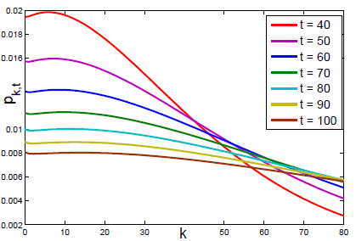
Observation – I cont.
Mode
Probability of having degree k after time t
Degree(k)
Time (t)
Degree distribution after seven time stamp
Mode vs. time: N = 10, µ = 8, γ = 1.03
At t = 92 mode becomes zero
Critical γ has a stationary value

Slide 82
Observation – I cont.
Mode
Probability of having degree k after time t
Degree(k)
Time (t)
Degree distribution after seven time stamp
Mode vs. time: N = 10, µ = 8, γ = 1.03
At t = 92 mode becomes zero
Mode changes abruptly, but there is no abruptness in the model

Slide 83
Observation - II
Two maxima in bottom node degree distribution plots
Probability of having degree k
Degree(k)
N = 10, t = 100, µ = 15

Slide 84
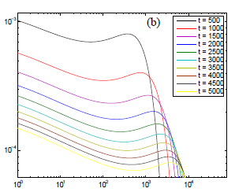
Observation - II
Two maxima in bottom node degree distribution plots
Probability of having degree k
Probability of having degree k
Degree(k)
Degree(k)
N = 10, t = 100, µ = 15
Distribution with different time for γ = 1.2 in log-log scale

Slide 85
Observation - II
Two maxima in bottom node degree distribution plots
Probability of having degree k
Probability of having degree k
Degree(k)
Degree(k)
N = 10, t = 100, µ = 15
Distribution with different time for γ = 1.2 in log-log scale
Two maxima are not from initial effect

Slide 86
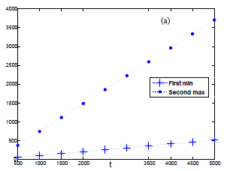
Observation – II cont.
Min \ Max degree
Time(t)
First min and second max degree over time for N = 10, µ = 15, γ = 1.2

Slide 87
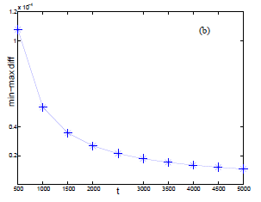
Observation – II cont.
Prob diff of Min, Max degree
Min \ Max degree
Time(t)
Time(t)
First min and second max degree over time for N = 10, µ = 15, γ = 1.2
Difference between first min and second max probability

Slide 88
Observation – II cont.
Prob diff of Min, Max degree
Min \ Max degree
Time(t)
Time(t)
First min and second max degree over time for N = 10, µ = 15, γ = 1.2
Difference between first min and second max probability
Probability difference may get a non-zero value asymptotically

