Slide 1
Spreading on networks: a topographic view
Niloy Ganguly
IIT Kharagpur
IMSc Workshop on
Modeling Infectious Diseases
September 4-6, 2006

Slide 2

Spreading on networks: a topographic view
Niloy Ganguly
IIT Kharagpur
IMSc Workshop on
Modeling Infectious Diseases
September 4-6, 2006

Slide 3
Introduction
Motivation
    We want to understand spreading, of things that can proliferate (diseases, gossip, rumors, innovation, …), over networks (biological, social, ...)
Basic ideas
    The ability of a network node to spread infections is captured by how ‘central’ the node is.
    We show that the ‘smooth’ definition of centrality (eigenvector centrality or EVC), and the resulting ‘topographic’ view of the network provides a systematic understanding of spreading.

Slide 4
Introduction
General assumptions
    We consider undirected (symmetric) networks.
    Spreading model considered is the SI model. Each node is assigned one of two possible states: Susceptible or Infected.
    Infections travel over the links of the network, and an infected node can infect any or all of its uninfected network neighbors, with probability p per unit time.

Slide 5
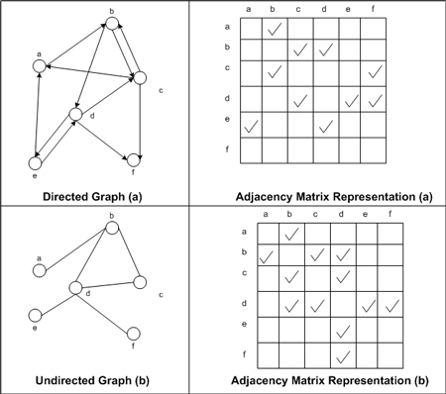
Introduction
General assumptions
    We consider undirected (symmetric) networks.
    Spreading model considered is the SI model. Each node is assigned one of two possible states: Susceptible or Infected.
    Infections travel over the links of the network, and an infected node can infect any or all of its uninfected network neighbors, with probability p per unit time.

Slide 6
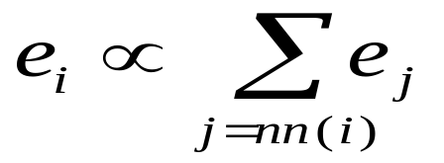
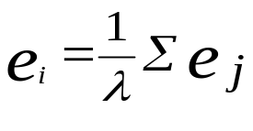

Eigenvector centrality
Let node i have centrality e_{i}
i’s centrality depends on that of its nearest neighbors
Rearrange:
A is the adjacency matrix, non-negative; e is the positive definite eigenvector corresponding to the dominant (largest) eigenvalue λ

Slide 7
Eigenvector centrality and topography
Eigenvector centrality (EVC), in words: Your own centrality is proportional to your neighbors’ centrality (summed over neighbors)
  A node becomes rich only if its neighbors are rich
Because of this, EVC is ‘smooth’ over the network ➔ a topographic picture makes sense (where EVC
= ‘height’).
We resolve the network into distinct ‘regions’—where each region is a ‘mountain’, identified by its local maximum (of the EVC).

Slide 8
Small network example
Regions of the network
A node finds which region it belongs to by following a steepest-ascent path to a unique ‘peak’ node.

Slide 9
The topographic view
We call the peak node of a region its ’Center’
EVC
Here is a ’bridge link’

Slide 10
Basic intuition about spreading
Eigenvector centrality (EVC) is a good measure of a node’s spreading power
Reason:
Spreading power should be based not only on how many neighbors you have, but on how well connected they are
This is (in words) just like EVC
Outcome : Because EVC is smooth, we can develop a topographic view of spreading

Slide 11
Consequences of our basic assumption about spreading
Diffusion has a tendency to run upwards
Center
Spreading is faster towards neighbor- hoods of higher spreading power
EVC
Infected node
Neighborhood of infected node

Slide 12
Consequences of our basic assumption about spreading
Diffusion has a tendency to run upwards
Eventually, the spreading infection reaches the Center node (‘peak’) of the region
This is where the infection rate is at its maximum (recall high centrality ≈ high spreading power)
Center
EVC

Slide 13
Consequences of our basic assumption about spreading
Diffusion subsequently move downwards
Center
After reaching the Center, the infection spreads outwards in all directions, since there is no ‘preferred’ direction
The whole region is saturated by the infection (at a steadily decreasing rate, as it moves ‘downhill’)
Spreading between regions depends on height and location of the bridge/’valley in between the two regions
EVC

Slide 14
Consequences of our basic assumption about spreading
Relationship between EVC and S curve
h_{new}(t)
Point where center
node is infected
The average EVC score of all newly infected nodes (in a time step)
t
Classical S curve — cumulative number of infected nodes
t
Takeoff point in S curve
Stages of a S curve -
(1) innovators, (2) early adopters, (3) early majority, (4) late majority, and (5) laggards.
t

Slide 15
Consequences of our basic assumption about spreading
Relationship between EVC and S curve
NB: this comparison is based on a one-region picture. Cumulative infection curve for the whole network depends on the relative timing of takeoffs for different regions, which in turn depends on how well or poorly the regions are connected to one another—can be hard to predict.
Classical S curve — cumulative number of infected nodes
t
Takeoff point in S curve
Stages of a S curve -
(1) innovators, (2) early adopters, (3) early majority, (4) late majority, and (5) laggards.
t

Slide 16
Consequences of our basic assumption about spreading
Prediction
Based on the above qualitative arguments we state the following predictions:
Each region has an S curve
The number of takeoffs/plateaux will be not more than the number of regions in the network
For each region, growth will at first (typically) be slow
For each region, initial growth will be towards higher EVC
For each region, when the infection reaches the neighborhood of high centrality, growth takes off
For each region, the most central node will be infected at, or after, the S curve takeoff—but not before
For each region, the final stage of growth (saturation) will be characterized by low centrality

Slide 17
Testing the predictions
We want to test our predictions by simulations on several real networks:
      Gnutella network snapshot 2001; one region
      Gnutella network snapshot 2001; two regions
      SFI collaboration network; three regions
      several other empirically-measured social networks (not shown here)

Slide 18
Testing the predictions
We use the SI model for our simulations
      Each link is given the same probability p for transmitting the infection (per unit time) to an uninfected neighbor
      (It is straightforward to allow for varying p over links, by calculating EVC from a suitably weighted adjacency matrix)
      We ran each simulation to network saturation
      Typically, we ran many simulations for each network and for each value of p

Slide 19
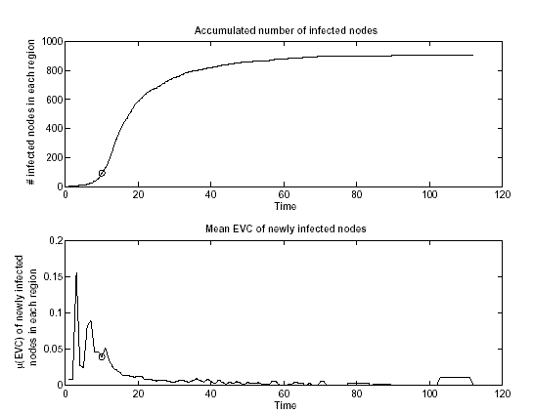
Testing the predictions - Simulation
Gnutella network — Single region case
S curve
Most central node
is infected
Centrality

Slide 20
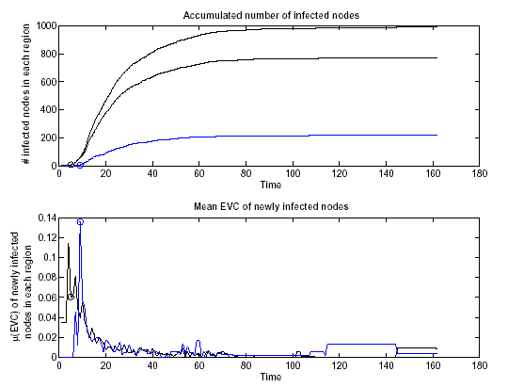
Testing the predictions - Simulation
Gnutella network — Two regions case
S curve
Each region displays individual S curves
Both regions have similar takeoffs
⇒ Sum S curve behaves as one!
Centrality

Slide 21
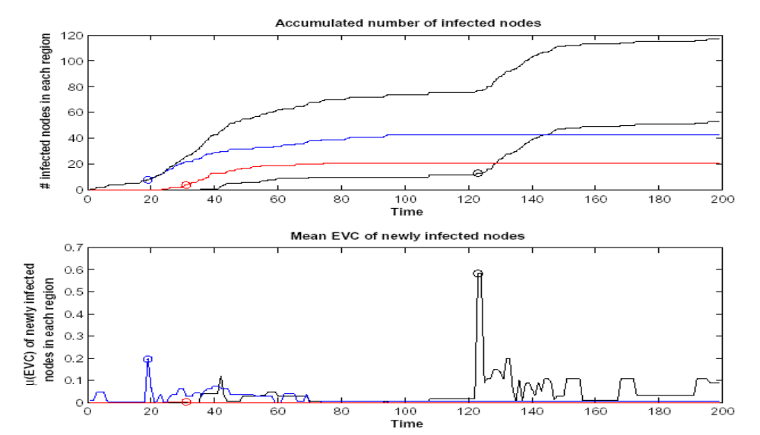
Testing the predictions - Simulation
SFI collaboration network — Three regions case
S curve
Infected a random start node
Each region displays an S curve
⇒ Sum S curve shows clearly two take offs
Centrality

Slide 22
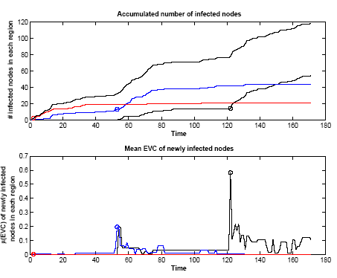
Testing the predictions - Simulation
SFI collaboration network — Three regions case
S curve
Infected a random start node
Each region displays an S curve
⇒ Sum S curve shows clearly three take offs
Centrality

Slide 23
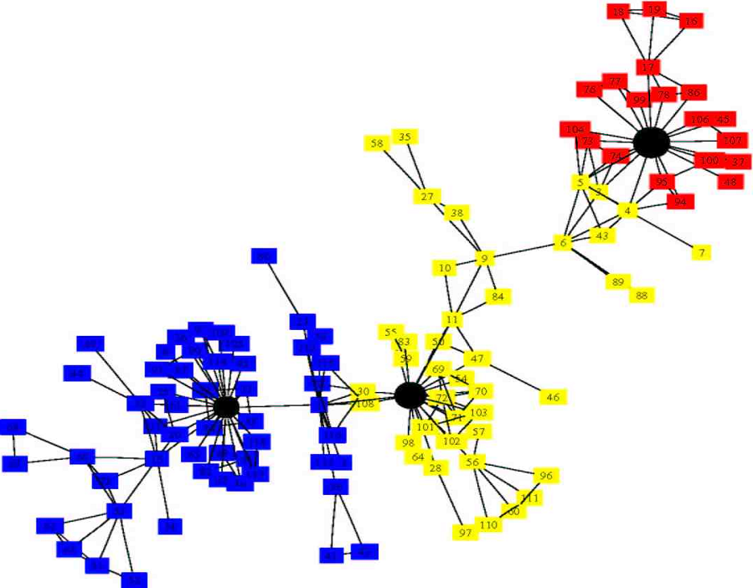
Explaining the Simulation
SFI network – A 2D layout
The 3 regions are connected in a chain
Premature takeoffs for ‘blue’ and ‘black’ S curves
Red S curve
Black S curve
Blue S curve

Slide 24
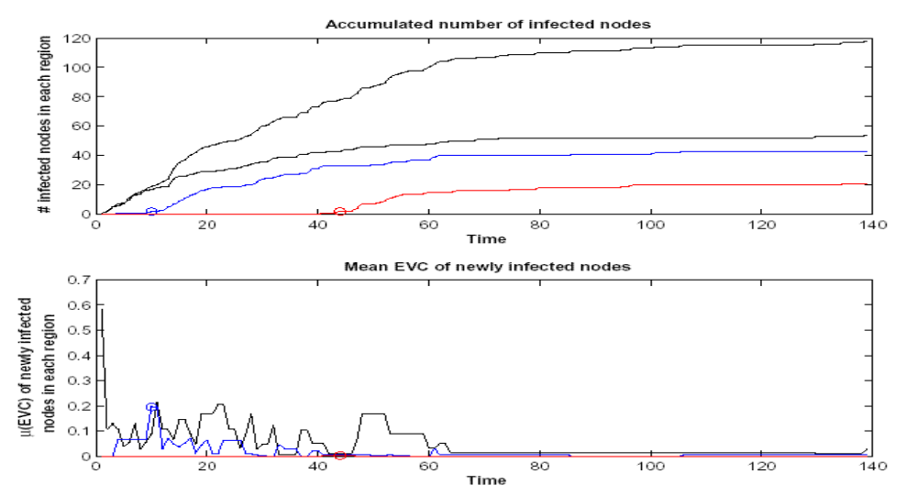
Testing the predictions - Simulation
SFI collaboration network — Three regions case
(Note much faster saturation)
S curve
Infected the most central node first
Black region takes off immediately
Blue comes after, red is last
⇒ Sum S curve behaves as one!
Centrality

Slide 25
Mathematical Analysis
Define spreading power of a node
  Show that it is roughly equivalent to EVC (Eigen Vector Centrality) of that node.
Exact equations for propagation of an infection, from an arbitrary starting node.
  Show that this is equivalent if we use the evolution technique to calculate Eigen vector

Slide 26
Summary
The regions analysis offers a neighborhood picture—having a spatial resolution which is between the microscopic (one-node) and the whole-graph views
The simulations strongly support the predictions we get from our topographic picture
Some mathematical support for this picture is provided
Our analysis is useful for:
    Predicting behavior of epidemic spreading
    Network design and/or modification
      both to help (useful info), or to hinder (diseases, etc) spreading

Slide 27
Problem of Design and Improvement of Network
Design or modification of the network may be to
satisfy two opposite goals
Prevent the spreading of harmful information (virus)
Help spreading
First we concentrate on the second problem (Help spreading)
Try to modify the multiple region network to single region.

Slide 28
Improve spreading
Techniques are quite simple
  Add more links between the regions.
  Connect the centers of the region

Slide 29
Improve spreading
Techniques are quite simple
  Add more links between the regions.
  Connect the centers of the region

Slide 30
Improve spreading
Techniques are quite simple
  Add more links between the regions.
  Connect the centers of the region

Slide 31
Improve spreading
Techniques are quite simple
  Add more links between the regions.
  Connect the centers of the region

Slide 32
Improve spreading
Techniques are quite simple
  Add more links between the regions.
  Connect the centers of the region
Experiments conducted to test this approach

Slide 33
Improve spreading
Joining center guarantees single region topology
  Centers of different regions eventually merges to single region.
Tested using SFI
  Connect three centers of the graph pair wise.
  Results a single region
  Run 1000 spreading simulation with p=0.1.
We incorporate two variations in our experiment.
In one test, we start from a random node (a).
In another test, we used a start node located close to the highest EVC center(b).

Slide 34
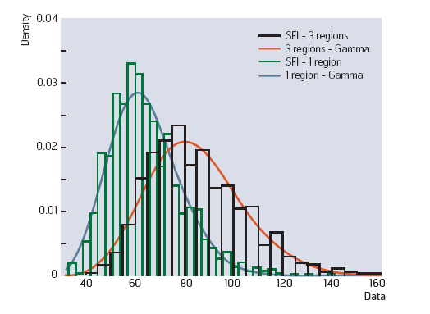
Results (Improve spreading)
Starting at random node

Slide 35
Results (Improve spreading)
 | Random Start Node | High EVC Start Node
Original Graph | 83.8 | 68.9
Connect Centers | 64.0 | 56.0
Choosing a strategic location (b) gives 18% reduction of average saturation time.
Improving topology, without controlling the start node (a) gives almost 24% reduction.

Slide 36
Measures to prevent spreading
Complicated than helping case
  We build network to facilitate communication
  Approach should be incremental change of the network
Two types of inoculation techniques are considered
  inoculation of nodes
  inoculation of links
The techniques can be
Inoculate the Centers and a small neighborhood around them.
Find a ring of nodes surrounding each Center and inoculate it.
Inoculate bridge links
Inoculate nodes at the end of bridge links

Slide 37
Measures to prevent spreading
The techniques can be
Inoculate the Centers and a small neighborhood around them.
Find a ring of nodes surrounding each Center and inoculate it.
Inoculate bridge links
Inoculate nodes at the end of bridge links

Slide 38
Measures to prevent spreading
The techniques can be
Inoculate the Centers and a small neighborhood around them.
Find a ring of nodes surrounding each Center and inoculate it.
Inoculate bridge links
Inoculate nodes at the end of bridge links

Slide 39
Measures to prevent spreading
The techniques can be
Inoculate the Centers and a small neighborhood around them.
Find a ring of nodes surrounding each Center and inoculate it.
Inoculate bridge links
Inoculate nodes at the end of bridge links

Slide 40



Measures to prevent spreading
We have tested technique 1 and 3 with the experiments on SFI network .
For technique 3 (bridge link removal), we use two strategies
  Removal of k bridge links between each region pair
    That have lowest EVC
    That have highest EVC
We define “link EVC” as the arithmetic mean of the EVC values of the end nodes.
  Referred as height of the link.
We have tested for k=1 and k=3

Slide 41
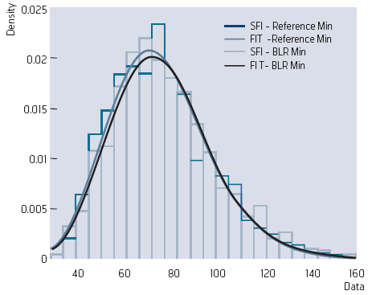
Results (Technique 3)
Removing links with lowest EVC

Slide 42
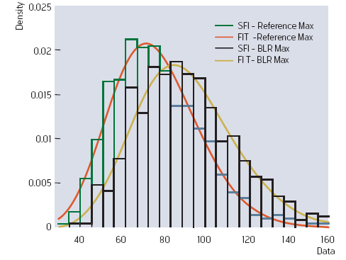
Results (Technique 3)
Removing links with lowest EVC

Slide 43
Results (Technique 3)
Removing links with lowest EVC
Significant observations
  Effect of removing the three lowest EVC bridge links is negligible.
  But significant retardation of saturation time as a result of removing the top three bridge links.

Slide 44
Results (Technique 3)
 | K = 1 | K = 3
Reference | 82.9 | 83.3
Remove random | 84.3 | 87.1
Remove lowest | 84.4 | 85.8
Remove highest | 87.7 | 96.5
Removing highest bridges has a significantly larger retarding effect than removing the lowest.
The effect of removing lowest bridges is almost same as random.

Slide 45
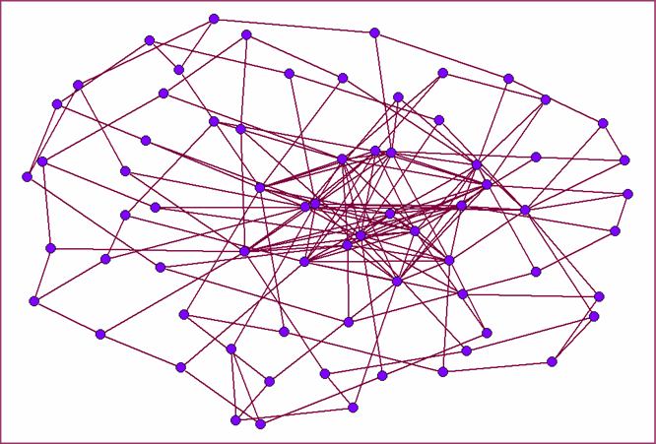
Search in distributed networks
Merge the search space into one hill with suitable replication of data

Slide 46
Contribution and Future Work
A fundamental measure to quantify spreading power
The measure is based upon neighborhood information
More thorough comparison with other measures are required
The coalescing of hills can be used for varied applications

Slide 47

Publications
Roles in networks
Science of Computer Programming, 2004
Spreading on networks: a topographic view
In Proceedings of the European Conference on Complex Systems, November 2005.

