Slide 1
Design of An On-Chip Test Pattern Generator Without Prohibited Pattern Set (PPS)
Niloy Ganguly Biplab K Sikdar P Pal Chaudhuri
Presented by
Niloy Ganguly
Indian Institute of Social Welfare and Business Management. Calcutta 700 073
Email : niloy@ppc.becs.ac.in

Slide 2
The Coverage
Introduction and Overview
Cellular Automata Preliminaries
Proposed Design of TPG
Experimental Results
Concluding Remarks

Slide 3
Problem Definitions
Prohibited Pattern Set (PPS) – A set of patterns input of which sents the system into an unstable state.
Example : Toggle State of a flip flop
Design a TPG with the following features
  It avoids the generation of such PPS
  It maintains the randomness and fault coverage of a Pseudo Random Pattern Generator
  Side by side it doesn’t add to any hardware cost

Slide 4
Problem Definitions
Non Max Length GF(2) Cellular Automata is employed to obtain the design criteria
Design the CA in such a way so that it has large cycles free from PPS
Design a TPG with the following features
  It avoids the generation of such PPS
  It maintains the randomness and fault coverage of a Pseudo Random Pattern Generator
  Side by side it doesn’t add to any hardware cost

Slide 5
Cellular Automata Machine
A powerful computing and modeling tool
50’s - J von Nuemann 80’s - Wolfram
A CA consists of an array of cells
A CA cell is essentially a memory element (D Flip flop) with some combinational logic - an XOR and/or XNOR Gate (additive)
Clock
CL
Flip - Flop
Q
D
From
left neighbor
Combinational logic
From
right neighbor

Slide 6
Cellular Automata Machine
A powerful computing and modeling tool
The cell is updated at every clock cycle
The state of the cell is dictated by the immediate neighbors
Typically termed as Two State Three neighborhood Cellular Automata
Clock
CL
Flip - Flop
Q
D
From
left neighbor
Combinational logic
From
right neighbor

Slide 7
GF(2) Cellular Automata
The operation of XOR and XNOR rules can be conceived as mod two multiplication and addition
The operations thus can be mapped to operations of Galois Field(2) giving rise to GF(2) Cellular Automata.
The CA is characterized by a T matrix which is essentially the dependency matrix
1 0 0 0 0
0 1 1 0 0
T = 0 1 1 1 0 F = [1 0 1 0 1]
0 0 0 1 1
0 0 0 0 1

Slide 8
GF(2) Cellular Automata
For 3-neighborhood CA, we have a band matrix
An XNOR CA is characterized by a inversion vector F indicating the cells where XNOR operation has been performed
1 0 0 0 0
0 1 1 0 0
T = 0 1 1 1 0 F = [1 0 1 0 1]
0 0 0 1 1
0 0 0 0 1

Slide 9
State Transition Behavior
Group CA - All states lie on some Cycle
13
5
6
0
7
12
2
8
Our TPG Design is based on this type of CA
9
15
3
14
1
4
Non Maximum Length CA
11
10
3
6
11
2
5
13
9
0
1
10
12
15
14
4
8
7
Maximum Length CA

Slide 10
State Transition Behavior
Additive variant of Group CA
Equal Length CA
8
7
6
5
10
1
12
11
Our TPG Design is based on this type of CA
13
14
15
0
3
4
9
2
Non Group CA : Cyclic/ Non cyclic and Non Reachable States
5
10
4
11
2
13
3
12
15
14
7
6
0
1
8
9

Slide 11
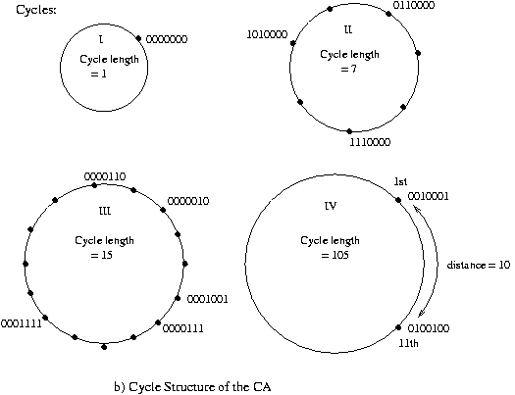
Overview of Design
Given PPS
0000110
0000010
0001001
0000111
PPS = 0001111
0010100
1101101
1011001
0100100
0010001
Choose a Non Maxlength CA

Slide 12
Overview of Design
Criterion for choosing Non-Max Length CA
Large cycle of length close to a Max length Cycle
All members of PPS fall in smaller cycles
Redundant Cycle(RC)
Choose a Non Maxlength CA
Target Cycle(TC)

Slide 13
Overview of Design
Criterion for choosing Non-Max Length CA
Large cycle of length close to a Max length Cycle
All members of PPS fall in smaller cycles
Redundant Cycle(RC)
Dmax
  In Practical Situation all members of PPS don’t fall in RC.
  Then Sacrifice a small part of TC
Target Cycle(TC)

Slide 14
Design of TPG without PPS
C1: Find n-cell CA having RCs and TC
C2: Let most of the members of PPS fall in RC
C3: Find Dmax in TC to avoid remaining PPS
Acceptable Criteria
TC ≥ 2^{n-1} for n > 16
TC ≥ .75 x 2^{n} for n ≤16
Dmax 10% of TC

Slide 15
Method of selecting RC
Design Simplification :
Form CA with 2 RCs besides the all zero cycle
Value of RCs to form big TC
CA Size n 7
Divide n = n1 + n2 7 = 4 + 3
n1 and n2 are mutually prime
Cycle Length RC1 = 2^{n1} –1 15
Cycle Length RC2 = 2^{n2} –1 7
Cycle Length TC = 2^{n1} –1 x 2^{n2} –1 105

Slide 16
Selection of n1 and n2
Each RC forms a vector subspace
Evolve strategy to partition PPS in two vector subspace
Randomly partition PPS into two sets S1 and S2
Calculate rank of S1(r1) and S2(r2)
Select a partition where
  r1 + r2 ≈ n
  r1 and r2 are mutually prime
  The acceptable criterion of TC is met
Set n1 = r1 and n2 = r2
T matrix can be designed with maximum member of PPS falling in smaller cycles

Slide 17
Heuristic to Design the TPG
Problem
Since a CA forms a Band Matrix all linear transform is not supported by CA
Randomly Synthesize a non-maximal length group CA
Method - illustrated in paper
CA Toolkit - http://ppc.becs.ac.in
Maximum member of PPS falls in RCs
Find Dmax of rest of PPS covered by TC
Select CA with acceptable criteria

Slide 18
Heuristic to Design the TPG
Acceptable Criteria
Dmax – 10% of TC
Randomly Synthesize a non-maximal length group CA
Method - illustrated in paper
CA Toolkit - http://ppc.becs.ac.in
Maximum member of PPS falls in RCs
Find Dmax of rest of PPS covered by TC
Select CA with acceptable criteria

Slide 19
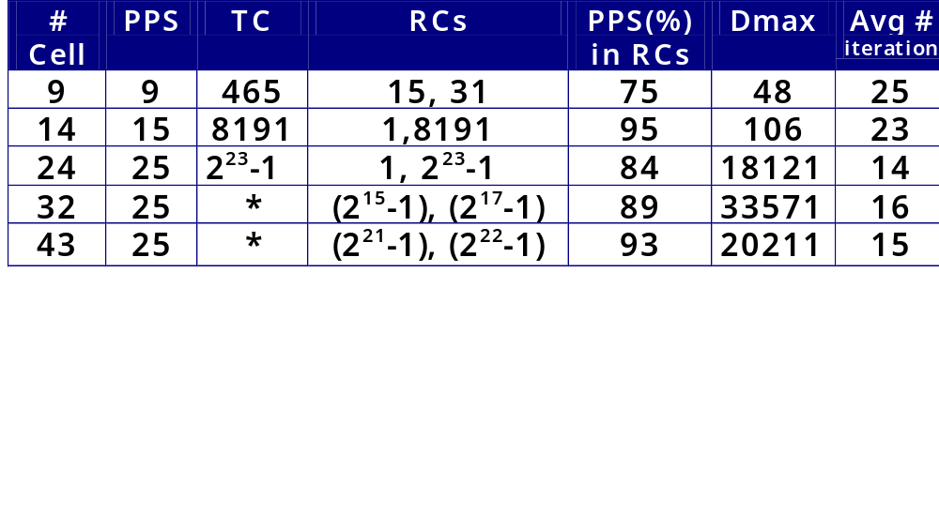
Experimental Observation-I
Real data of PPS is not available
PPS randomly generated, no. of prohibited patterns assumed 25
For a particular n, 10 different PPS are considered
* Indicates that the cycle length approx. 2^{n} – 2^{n/2}

Slide 20
Experimental Observations -II
Study of randomness property
Platform used is DiehardC
Compared with corresponding maximal length CA
Random Test | n=24 Max TPG | n=32 Max TPG | n=48 Max TPG
Overlap Sum | pass pass | pass pass | pass pass
3D Sphere | pass pass | pass pass | fail fail
B’day Spacing | fail fail | fail fail | fail fail
Overlap 5-permut | fail fail | fail fail | pass pass
DNA | fail fail | fail fail | pass fail
Squeeze | fail pass | fail fail | pass fail

Slide 21
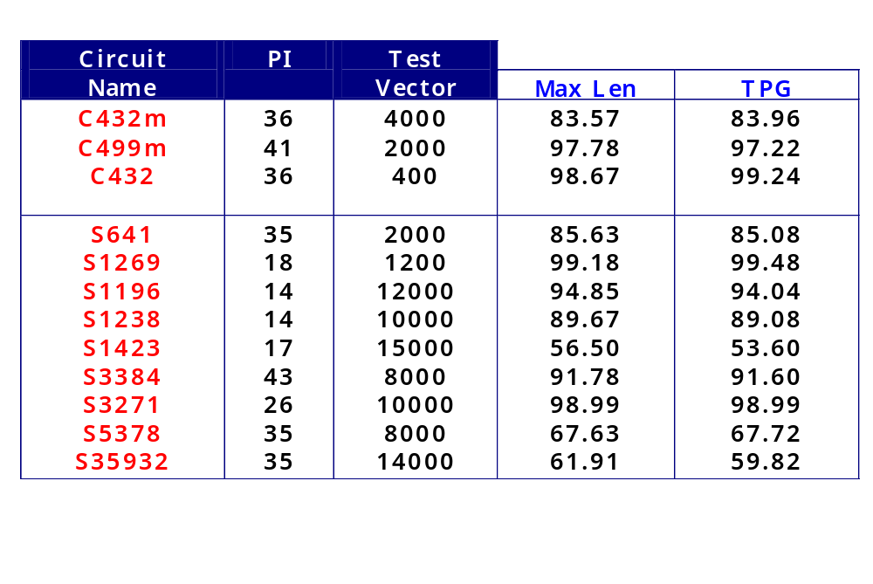
Experimental Observations -III
Fault coverage of the proposed design (Compared with MaxLength CA)
Fault Simulator used : Cadence `verifault’

Slide 22
Conclusion
Based on analytical framework of CA theory, the real life problem of PPS is addressed
Solution does not incur extra overhead
Fault efficiency of the TPG is as good as the existing designs

Slide 23
Thank you
Niloy Ganguly

