Slide 1
Cellular Automata Machine For Pattern Recognition
Pradipta Maji¹ Niloy Ganguly ²
Sourav Saha¹ Anup K Roy¹ P Pal Chaudhuri ¹
¹ Department of Computer Science & Technology ,
Bengal Engineering College ( D . U ) , Howrah ,
West Bengal , India 711103
²Department of Business Administration ,
Indian Institute of Social Welfare and Business Management , Calcutta ,
West Bengal , India 700073

Slide 2
The Problem
Pattern Recognition - Study how machines can learn to distinguish patterns of interest
Conventional Approach - Compares input patterns with each of the stored patterns learn
A
B
C …
Z
A
Comic Sans MS
Bookman Old Style
CA Research Group (BECDU)

Slide 3
The Problem
A
A
B
Grid by Grid Comparison
A
B
C …
Z
A
Comic Sans MS
Bookman
old Style
CA Research Group (BECDU)

Slide 4
The Problem
A
A
B
Grid by Grid Comparison
0 0 1 0
0 0 1 0
0 1 1 1
1 0 0 1
1 0 0 1
0 1 1 0
0 1 1 0
0 1 1 0
1 0 0 1
1 0 0 1
No of Mismatch = 3
CA Research Group (BECDU)

Slide 5
The Problem
A
A
B
Grid by Grid Comparison
0 0 1 0
0 0 1 0
0 1 1 1
1 0 0 1
1 0 0 1
No of Mismatch = 9
1 1 1 0
0 1 0 1
0 1 1 1
0 1 0 1
1 1 1 0
CA Research Group (BECDU)

Slide 6

The Problem
Time to recognize a pattern - Proportional to the number of stored patterns ( Too costly with the increase of number of patterns stored )
Solution - Associative Memory Modeling
CA Research Group (BECDU)

Slide 7
The Problem
Time to recognize a pattern - Proportional to the number of stored patterns ( Too costly with the increase of number of patterns stored )
Solution - Associative Memory Modeling
Transient
A
B
A
A
A
Transient
A
C
Transient
A
A
CA Research Group (BECDU)

Slide 8
Associative Memory
Entire state space - Divided into some pivotal points.
State close to pivot - Associated with that pivot.
Time to recognize pattern-Independent of number of stored patterns.
Transient
A
B
A
A
A
Transient
A
C
Transient
A
A
CA Research Group (BECDU)

Slide 9
Associative Memory
Two Phase : Learning and Detection
Time to learn is higher
Driving a car
Difficult to learn but once learnt it becomes natural
Transient
A
B
A
A
A
Transient
A
C
Transient
A
A
CA Research Group (BECDU)

Slide 10
Associative Memory (Hopfield Net)
Densely connected Network - Problems to implement in Hardware
Transient
A
B
A
A
A
Transient
A
C
Transient
A
A
Solution - Cellular Automata (Sparsely connected machine) - Ideally suitable for VLSI application
CA Research Group (BECDU)

Slide 11
Cellular Automata
VLSI Domain
India under Prof. P Pal Chaudhuri
Late 80’s - Work at Indian Institute of Technology Kharagpur
Late 90’s - Work at Bengal Engineering College Deemed University, Calcutta
Book - Additive Cellular Automata Vol I, IEEE Press
CA Research Group (BECDU)

Slide 12
Cellular Automata
A computational Model with discrete cells updated synchronously
………..
0/1
Clock
output
2 - State 3-Neighborhood CA Cell
Input
Combinational Logic
From Left Neighbor
From Right Neighbor
CA Research Group (BECDU)

Slide 13
Cellular Automata
Combinational Logic can be of 256 types
each type is called a rule
Each cell can have 256 different rules
………..
98
236
226
107
4 cell CA with different rules at each cell
CA Research Group (BECDU)

Slide 14
State Transition Diagram
3
6
11
2
5
13
9
0
1
10
12
15
14
4
8
7
13
5
6
7
12
2
8
0
9
15
3
14
1
4
11
10
CA Research Group (BECDU)

Slide 15
Generalized Multiple Attractor CA
Transient
A
B
A
A
A
Transient
A
C
Transient
A
A
The State Space of GMACA – Models an Associative Memory
1101
0100
1000
0111
1100
1001
1010
0001
0011
1011
0110
0101
0010
Rule vector:
<202,168,218,42>
1110
0000
P1 attractor-1
CA Research Group (BECDU)
P2 atractor-2
1111

Slide 16
Generalized Multiple Attractor CA
The state transition diagram breaks into disjoint attractor basin
Each attractor basin of CA should contain one and only one pattern to be learnt in its attractor cycle
The hamming distance of each state with its attractor is less than that of other attractors.
Pivot Points
1101
0100
1000
0111
Dist =3
1100
1001
1010
Dist =1
0001
0011
1011
0110
0101
0010
Rule vector:
<202,168,218,42>
1110
0000
P1 attractor-1
CA Research Group (BECDU)
P2 atractor-2
1111

Slide 17
Synthesis of GMACA Reverse Engineering Technique
Phase I: Random Generation of a set of directed Graph
Patterns to be learnt P1 = 0000 P2 = 1111
Number of bits of noise = 1
1
1110
1011
1101
0100
1000
0001
0111
Basin 1
Basin 2
0010
0
1111
0000
CA Research Group (BECDU)

Slide 18
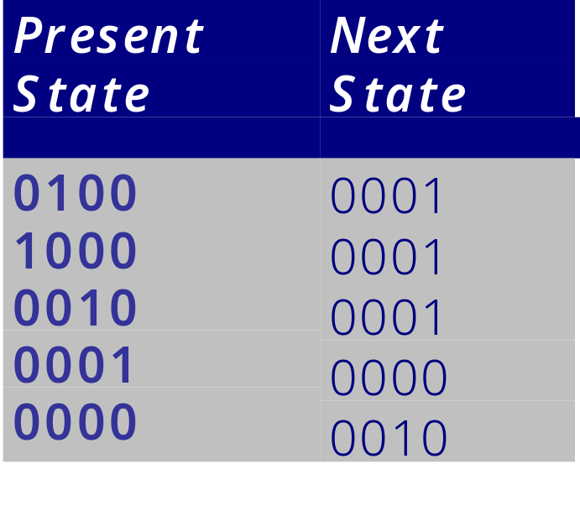
Synthesis of GMACA Reverse Engineering Technique
Phase II: State transition table from Graph
0100
1000
0001
Basin 1
0010
0000
CA Research Group (BECDU)

Slide 19
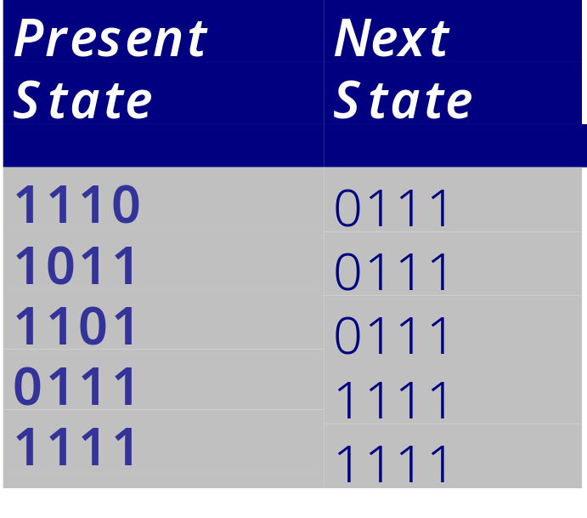
Synthesis of GMACA Reverse Engineering Technique
Phase II: State transition table from Graph
1110
1011
1101
0111
Basin 2
1111
CA Research Group (BECDU)

Slide 20
Synthesis of GMACA Reverse Engineering Technique
Phase III: GMACA rule vector from State transition table
Basin 1
Basin 2
CA Research Group (BECDU)

Slide 21
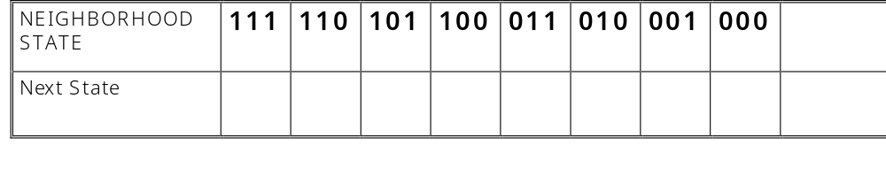
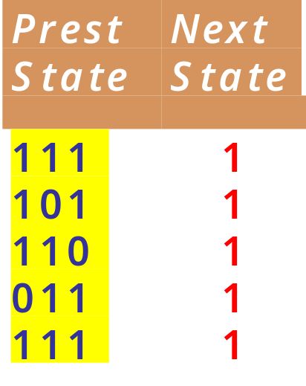
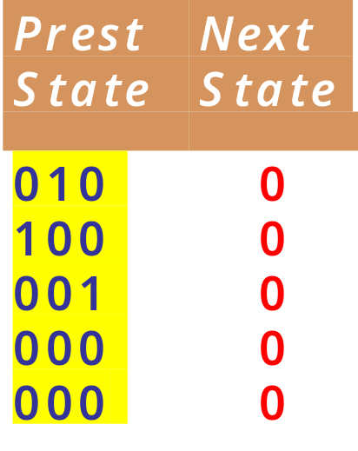
Synthesis of GMACA Reverse Engineering Technique
Phase III: GMACA rule vector from State transition table
Basin 1
Basin 2
CA Research Group (BECDU)

Slide 22
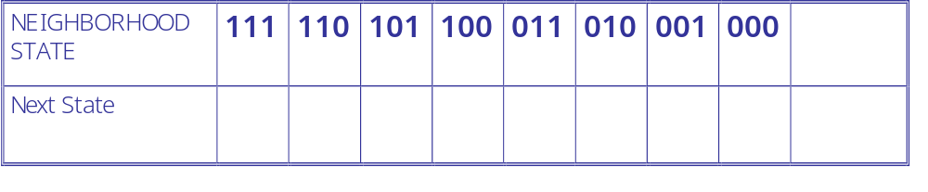
Synthesis of GMACA Reverse Engineering Technique
Phase III: GMACA rule vector from State transition table
Rule 232
1
1
1
0
1
0
0
0
Basin 1
Basin 2
111
1
010
0
101
1
100
0
110
1
001
0
011
1
000
0
111
1
000
0
CA Research Group (BECDU)

Slide 23
Synthesis of GMACA Reverse Engineering Technique
Phase III: GMACA rule vector from State transition table
Collision
0/1?
Basin 1
Basin 2
000
0
000
1
CA Research Group (BECDU)

Slide 24
Synthesis of GMACA Reverse Engineering Technique
Phase III: GMACA rule vector from State transition table
Collision
0/1?
Less the number of collision better the design.
Design Objective :
Design GMACA so that there is minimum number of collision during rule formation
Simulated Annealing to attain the design
CA Research Group (BECDU)

Slide 25
Simulated Annealing Program Mutation Technique - 1
Objective Reduce Collision
Increment of Cycle Length
1110
1101
0111
1110
1101
0111
1011
1011
1111
1111
Cycle Length = 1
Cycle Length = 2

Slide 26
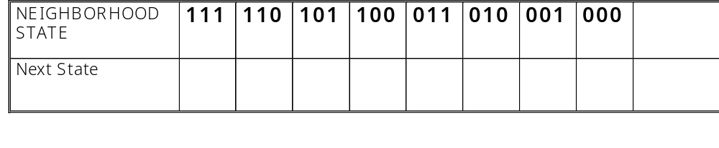
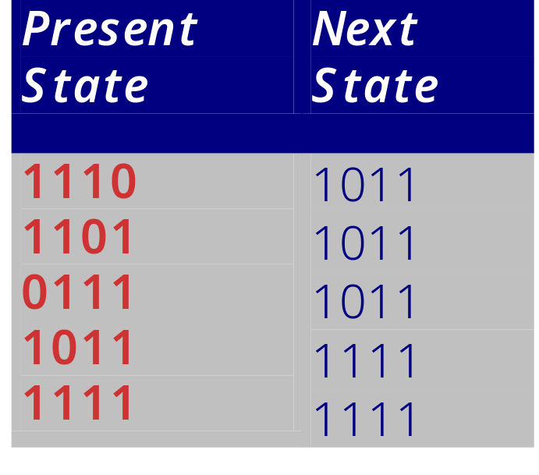
Simulated Annealing Program Increment of Cycle Length
0/1?
0
1
*
0
*
*
*
1110
1101
0111
1011
111
0
1111
Cycle Length = 1
111
1

Slide 27
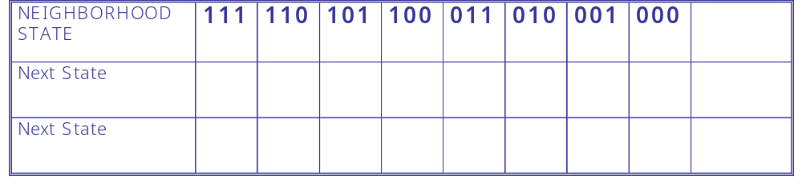

Simulated Annealing Program Increment of Cycle Length
0/1?
0
1
*
0
*
*
*
0
0
1
*
0
*
*
*
1110
1101
0111
111
0
1011
1111
111
0
Cycle Length = 2

Slide 28
Simulated Annealing Program Mutation Technique - 2
Reduction of Cycle Length
1110
1101
1011
1110
1101
1011
1111
0111
1111
0111
Cycle Length = 4
Cycle Length = 3

Slide 29
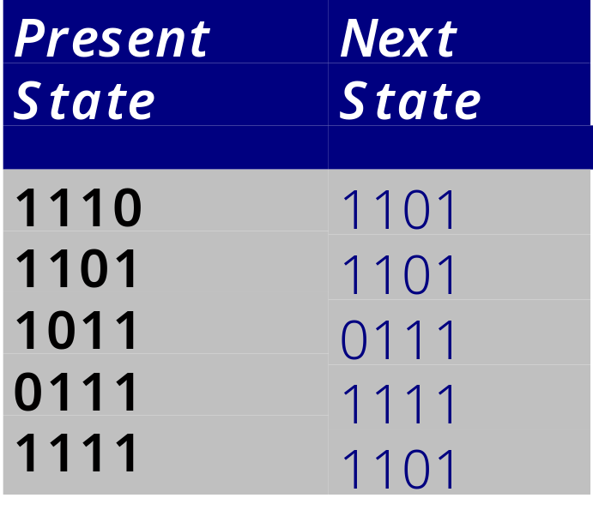
Simulated Annealing Program Decrement of Cycle Length
0/1?
0
0
*
1
*
*
*
1110
1101
1011
1111
0111
111
1
Cycle Length = 4
111
0

Slide 30

Simulated Annealing Program Decrement of Cycle Length
0/1?
0
1
*
0
*
*
*
1
0
1
*
0
*
*
*
1110
1101
1011
1111
0111
111
1
Cycle Length = 3
111
1

Slide 31
Performance of GMACA Based Pattern Recognizer
Memorizing Capacity
Evolution Time
Identification / Recognition Complexity

Slide 32
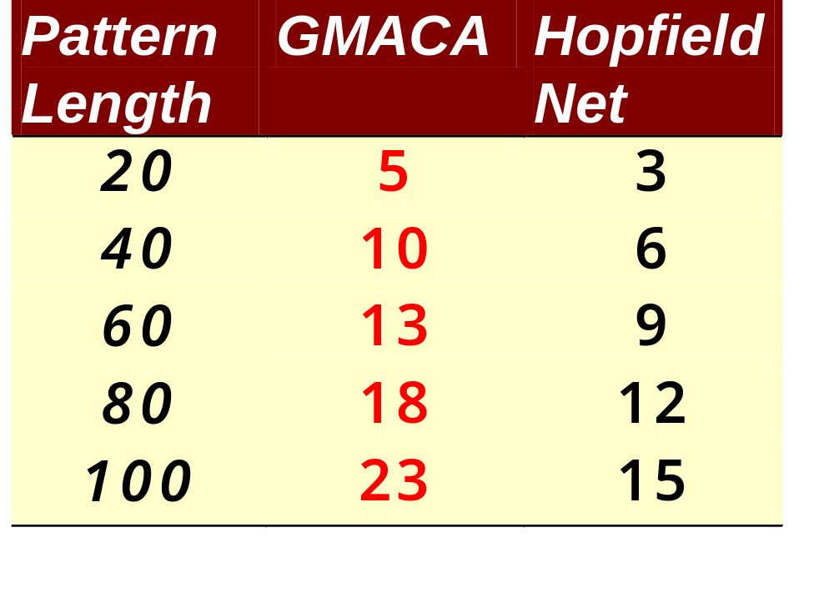
Memorizing Capacity
Conclusion : GMACA have much higher capacity than Hopfield Net

Slide 33
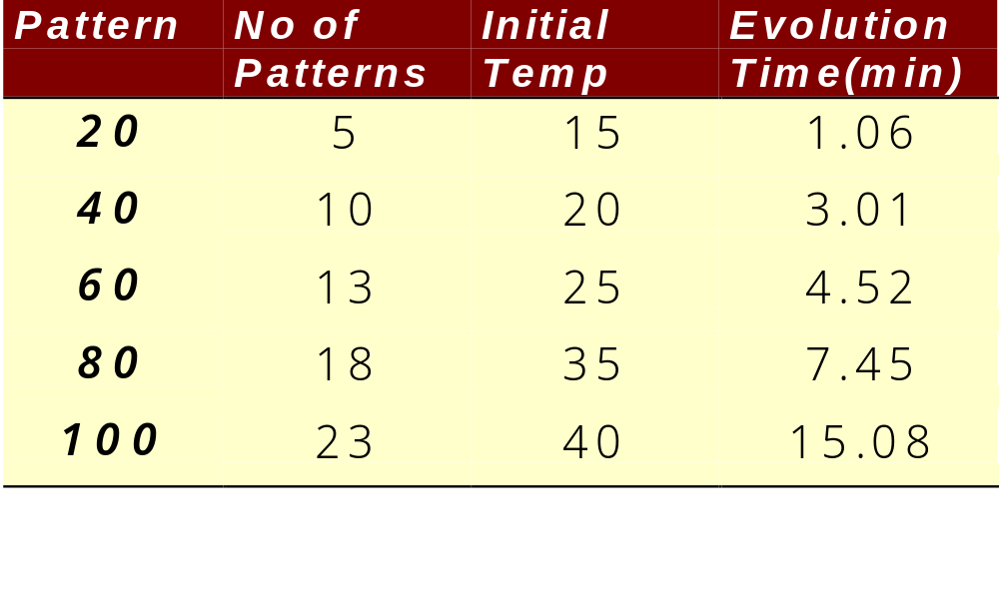
Evolution Time

Slide 34
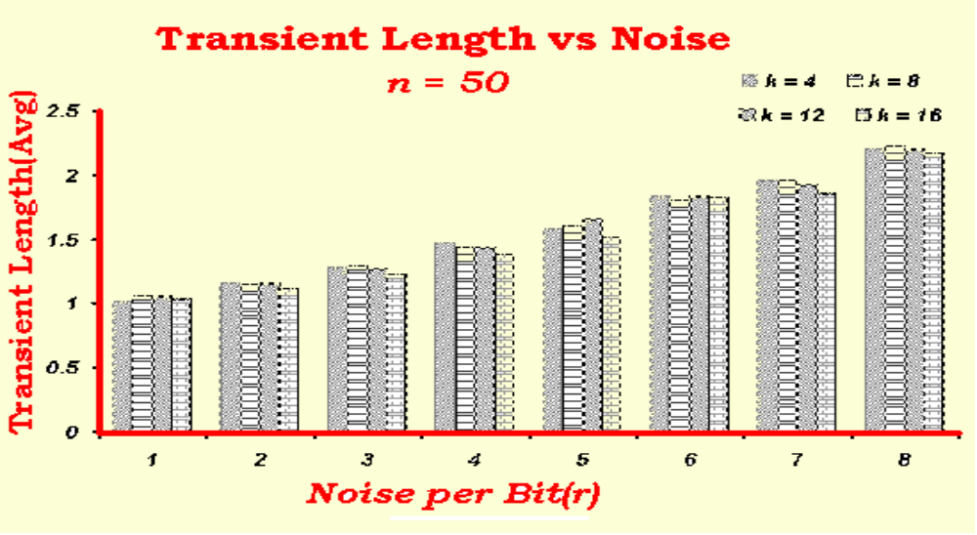
Identification / Recognition Complexity
Cost of Computation for Recognition / Identification - Constant

Slide 35
Achievements
1.Cellular Automata - A powerful machine in designing the pattern recognition tool
2.Storage Capacity of CA - Higher than Hopfield Net
3.A clever reverse engineering technique is employed to design Cellular Automata based Associative Memory

Slide 36
Publications
Study of Non-Linear Cellular Automata For Pattern Recognition To be published in IEEE Transaction, Man, Machine and Cybernetics, Part - B
Generalized Multiple Attractor Cellular Automata(GMACA) Model for Associative Memory Niloy Ganguly, Pradipta Maji, Biplab k Sikdar and P Pal Chaudhuri To be published in International Journal for Pattern Recognition and Artificial Intelligence
Error Correcting Capability of Cellular Automata Based Associative Memory, IEEE Transaction, Man, Machine and Cybernetics, Part - A

Slide 37
Thank you
Niloy Ganguly
n_ganguly@hotmail.com
http://ppc.becs.ac.in

