Slide 1
Analytical Insights into Immune Search
  Niloy Ganguly
  Center for High Performance Computing
  Technical University
  Dresden, Germany

Slide 2
Talk Overview
Experimental Results
Report of the updated version
Theoretical Insights

Slide 3
Unstructured Networks
Searching in unstructured networks –
Non-deterministic Algorithms
Flooding, random walk
Our algorithms – packet proliferation and mutation (dropped for the time being, although we have some ideas)
5
a
4
b
3
d
6
e
2
c
g
7
1
f
Unstructured Network

Slide 4
Model Definition
Topology (Uniform random, powerlaw
topology)
Data and query distribution(realistic)
Algorithms
Metrics (updated)

Slide 5
Forwarding Algorithms
Proliferation/Mutation Algorithms
Simple Proliferation Algorithm (P)
Restricted Proliferation Algorithm (RP)
Random Walk Algorithms
Simple Random Walk Algorithm (RW)
Restricted Random Walk Algorithm (RRW)
High Degree Restricted Random Walk Algorithm (HDRRW)

Slide 6
Proliferation Algorithms
Simple Proliferation Algorithm (P)
Produce N messages from the single message.
Spread them to the neighboring nodes
a
b
d
e
N = 3
c
g
f

Slide 7
Proliferation Algorithms
Restricted Proliferation Algorithm (RP)
Produce N messages from the single message.
Spread them to the neighboring nodes if free
a
b
d
e
N = 3
c
g
f

Slide 8
Proliferation Controlling Function
Proliferate more when content and query packets are similar
Affinity-driven proliferation

Slide 9
Metrics
1. Network coverage efficiency
No of time steps required to cover the entire network
2. Average Cost
No of message packets (average over each time step) needed to cover a network
3. Cost per item composite (new)
  No of message packets + no of lookahead needed to cover a network
Follow Fairness criteria - All processes work with same average number of packets.

Slide 10
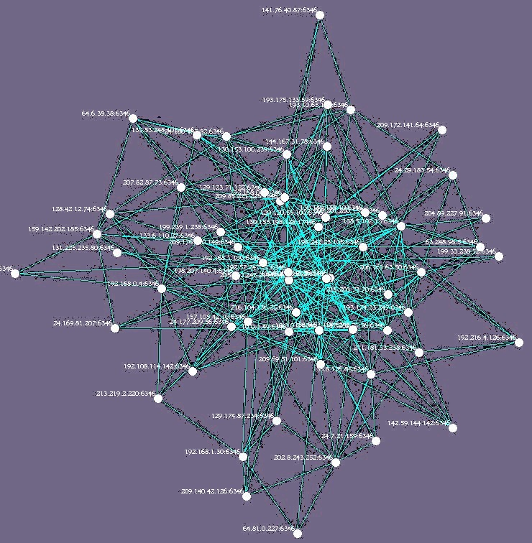
Experiment
Experiment Coverage – Calculate time taken to cover the entire network after initiation of a search from a randomly selected initial node. Repeated for 500 such searches.

Slide 11
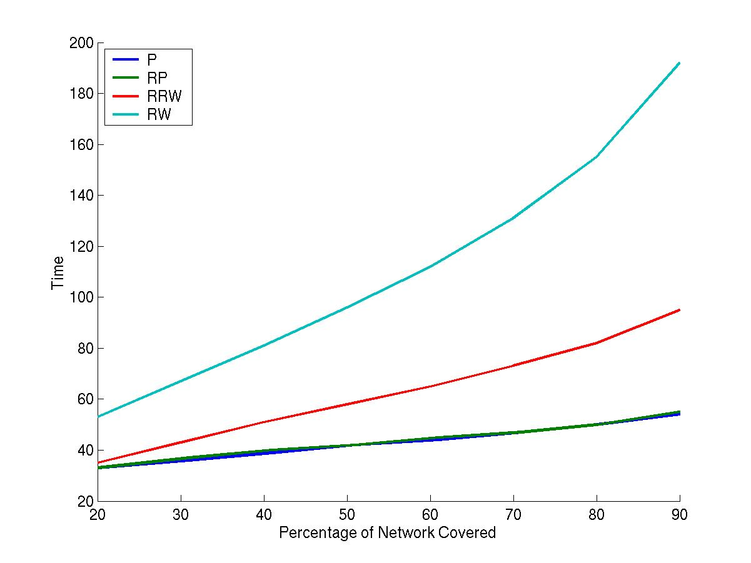
Performance of Different Schemes
----- P
----- RP
----- RRW
----- RW
20 40 60 80 100 120 140 160 180 200
Time
20 30 40 50 60 70 80 90
Percentage of Network Covered

Slide 12
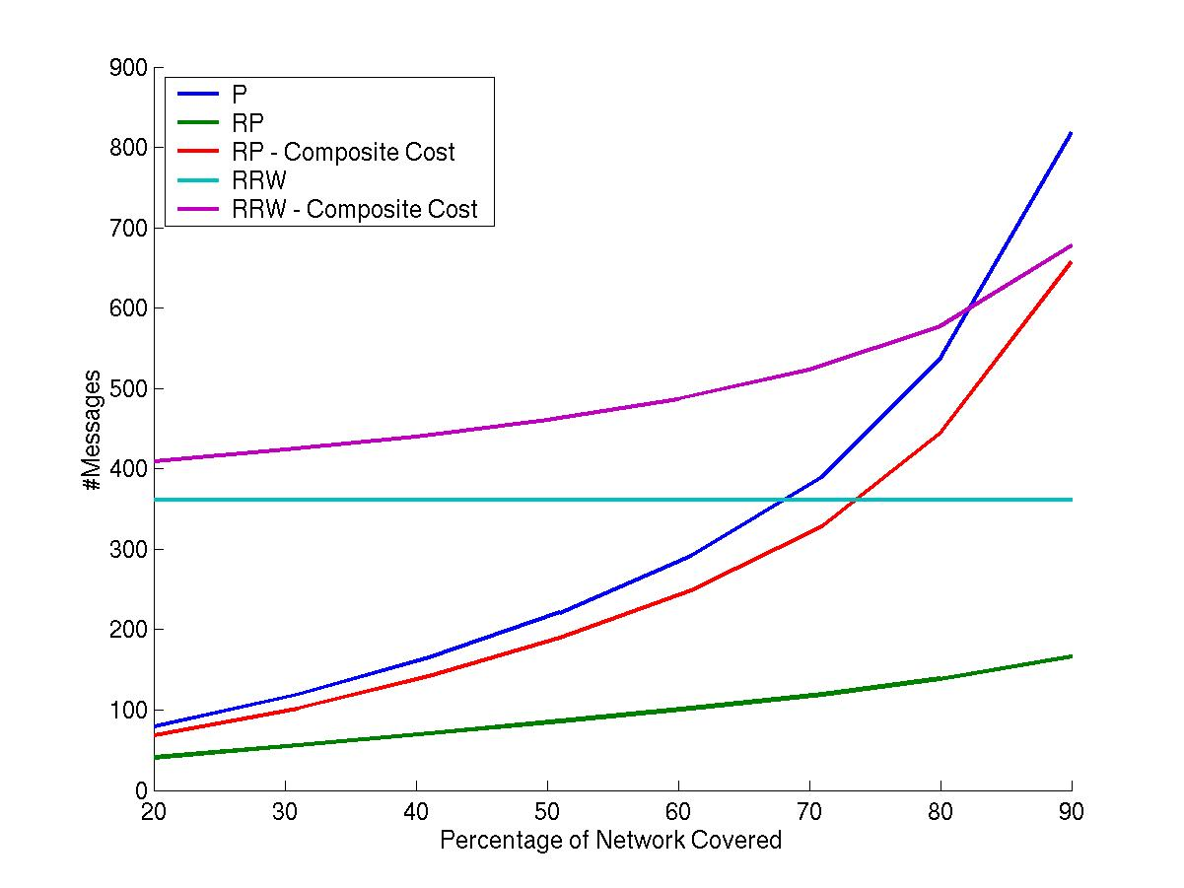
Cost Incurred By Different Schemes
900
----- P
----- RP
----- RP – Composite Cost
----- RRW
----- RRW – Composite Cost
800
700
600
500
#Cost
400
Time
300
200
100
0
20 30 40 50 60 70 80 90
Percentage of Network Covered

Slide 13
Theoretical Insights
Theoretical reasoning
Objectives
1. Explain experimental results
2. Optimize design parameters
Two approaches
    Continuous models
    Discrete models

Slide 14
Explain the result of the graph through continuous model
----- P
----- RP
----- RRW
----- RW
20 40 60 80 100 120 140 160 180 200
Time
20 30 40 50 60 70 80 90
Percentage of Network Covered

Slide 15
Modeling Random Walk and Proliferation
Representing them by continuous models
Random Walk = Diffusion
Proliferation = Reaction-Diffusion System
(Diffusion + Addition of New Materials)
(We don’t consider restricted random walk for our analysis)

Slide 16
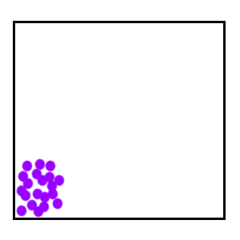
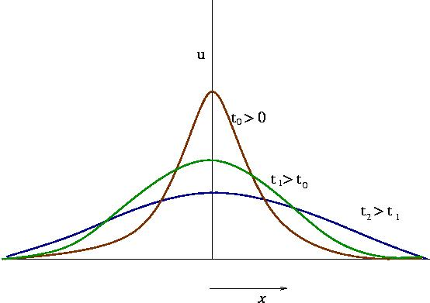
Diffusion
Random Walk = Diffusion

Slide 17
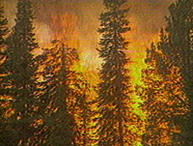
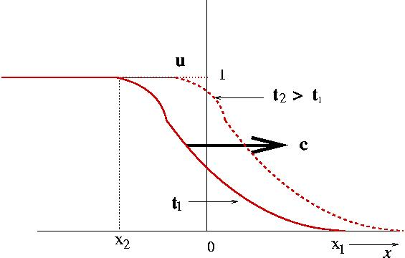
Reaction-Diffusion
Proliferation = Reaction-Diffusion System
(Diffusion + Addition of New Materials)

Slide 18
Calculate Speed of the processes
Assumption : If we can calculate the speed in which the concentration is spreading, we can directly relate it with the network coverage time.
coverage = speed x time

Slide 19
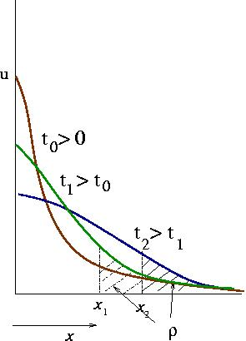
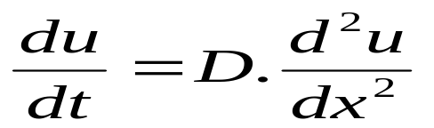
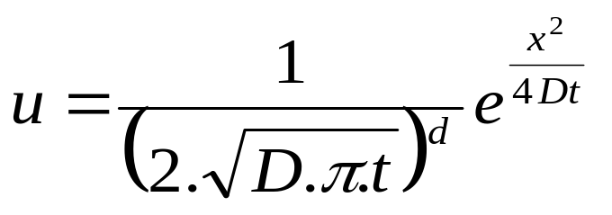
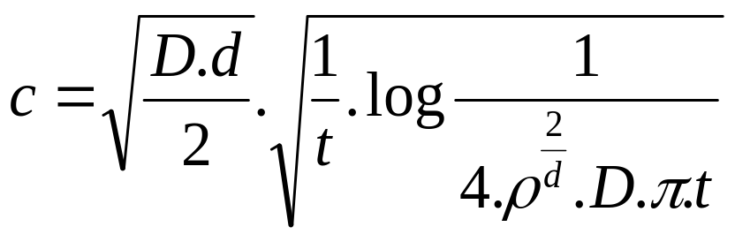
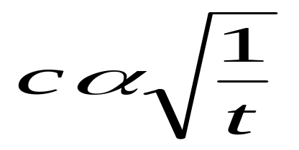
Calculating Speed of Diffusion
Calculate Speed of a finite density ρ
Diffusion Equation
pdf of a concentration u
Speed (c) of a concentration ρ

Slide 20
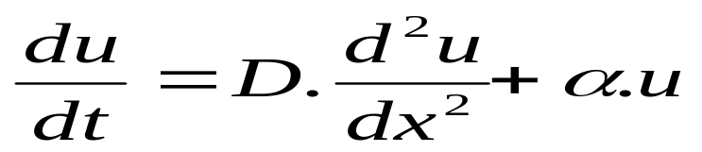
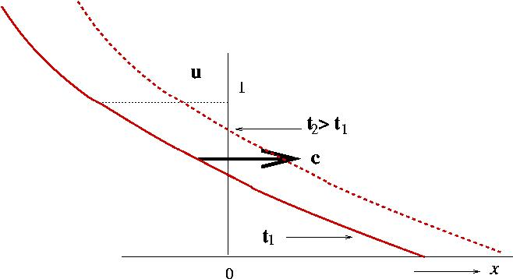
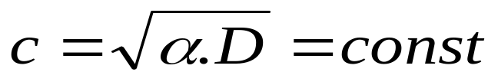
Calculating Speed of Reaction-Diffusion
Proliferation – Each time α fraction of concentration is added to the system
Reaction- Diffusion Equation:

Slide 21
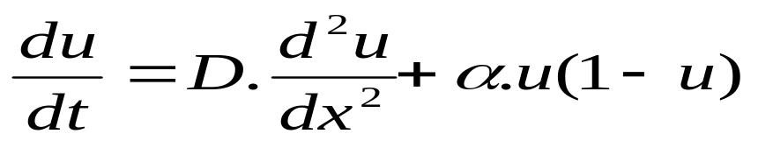
Calculating Speed of Reaction-Diffusion
Restricted Proliferation – Follows logistic population growth model. F(u) = α.u(1-u)
Reaction- Diffusion Equation:

Slide 22
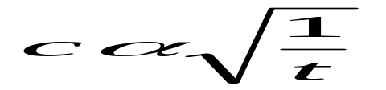
Conclusion derived from analysis
coverage = speed x time
For Diffusion
Coverage become difficult with time.
For Proliferation
c = const
Coverage rate is const over time
----- P
----- RP
----- RRW
----- RW
20 40 60 80 100 120 140 160 180 200
Time
20 30 40 50 60 70 80 90
Percentage of Network Covered

Slide 23
Conclusion derived from analysis
This analysis helps to explain the results of our experiment.
However, doesn’t help us to improve our design.
We don’t get any insights regarding improvement of our design

Slide 24
Our Design Objective
Fast coverage of nodes.
Minimum usage of message packets.
Can we quantify Fast and Minimum (what exactly does it mean?)
or
At least can we express it qualitatively in terms of message movement

Slide 25
A Simple Experiment
Objective – To measure coverage speed of different algorithms
Random walk of packets all starting from the same nodes
Proliferation of packets after starting from a central node
Random walk of packets starting from different nodes

Slide 26
A Simple Experiment
Objective – To measure coverage speed of different algorithms
Slowest
Fastest
Least Collision, each individual particle has its own zone to explore

Slide 27
Desired output
Have proliferation in such a way, so that
each individual
packets have just enough place to explore
without overlapping with others
Minimum – Use as few packets as possible so that each packet has individual area to explore without colliding with other packets.
Fast - Fastest possible under the above restriction of minimum.

Slide 28
N-Random Walkers
(All starting from same point)
Three Periods
Period 1 : At the start, when all the walkers are close to each other, they demonstrate a flooding behavior.
Period 2 : (Intermediate state) There is still considerable collision, however each packet has some place to explore.
Period 3 : All the random walkers are far away from each other and the system behave as if comprising of N independent random walkers

Slide 29
N-Random Walkers – No. of nodes covered
3-dimensional lattice
No of nodes covered Lasts till
Period 1 t^{d} t = log N
Period 2 t^{d/2} t = N²
Period 3 N.t
(t – nodes covered by a single random walker)

Slide 30
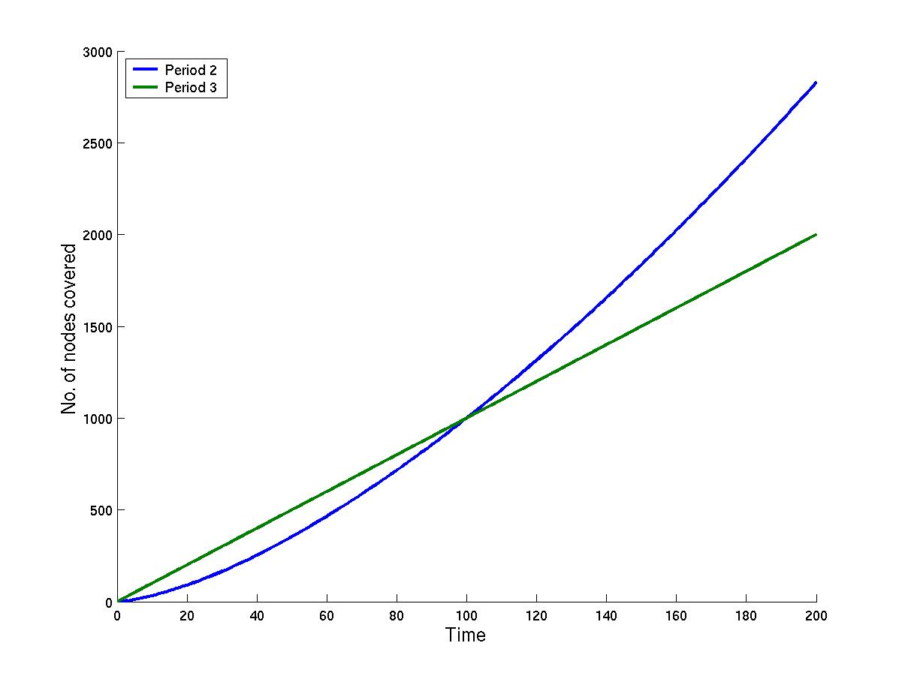
Phase Transformation between Period 2 and Period 3
The n random walkers cover nodes according to the
formula of Period 2 or
Period 3, whichever is
smaller.
Period 2 = t^{d/2}
Period 3 = N.t
3000
---- Period 2
---- Period 3
N = 10
2500
2000
No of nodes covered
1500
1000
500
20 40 60 80 100 120 140 160 180 200
Time

Slide 31
Phase Transformation between Period 2 and Period 3
Phase Transformation between
Period 2 and Period 3
occurs, when
t^{d/2} > N.t
So, N determines the phase transformation
Let d = 3
N = t^{3/2}/t = t^{1/2} i.e.
t_{transform} = N²
3000
---- Period 2
---- Period 3
N = 10
2500
2000
No of nodes covered
1500
1000
500
20 40 60 80 100 120 140 160 180 200
Time

Slide 32
Optimum Point and our aim
3000
Our Aim
Can we keep our proliferation
scheme always at optimum
point
---- Period 2
---- Period 3
N = 10
2500
2000
Unexplored area
No of nodes covered
1500
1000
Collision
500
Optimum Point
20 40 60 80 100 120 140 160 180 200
Time

Slide 33
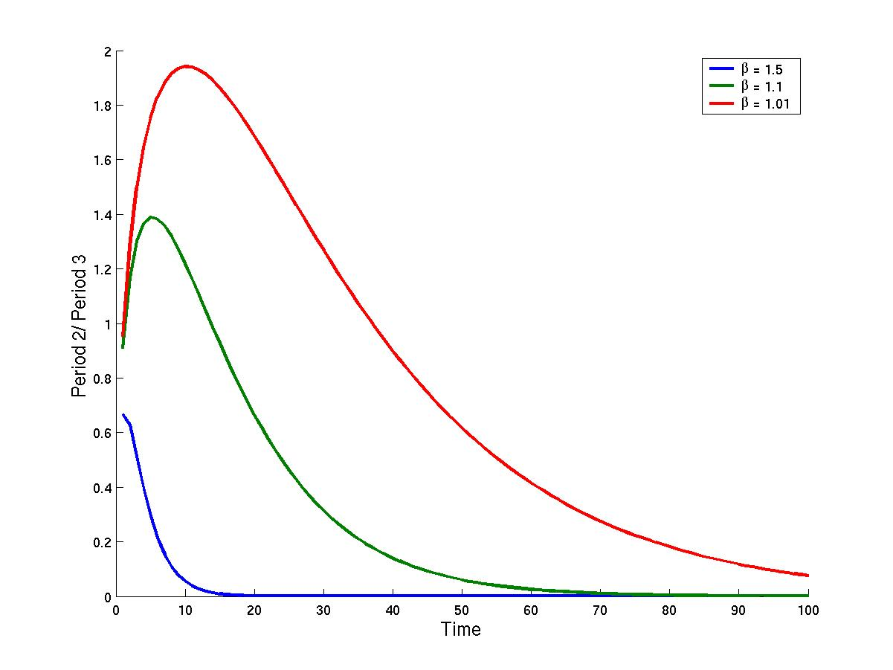
Equation for Proliferation in Period 2 and Period 3
Period 2 = t^{d/2}
Period 3 = (α+1)^{t} . N_{proli}.t
N
Let (1+α) = β be constant
And N_{proli} = 1,
Then how should the system behave?
---- β = 1.5
---- β = 1.1
---- β = 1.01
Period 3
Period 2
10 20 30 40 50 60 70 80 90 100
Time

Slide 34
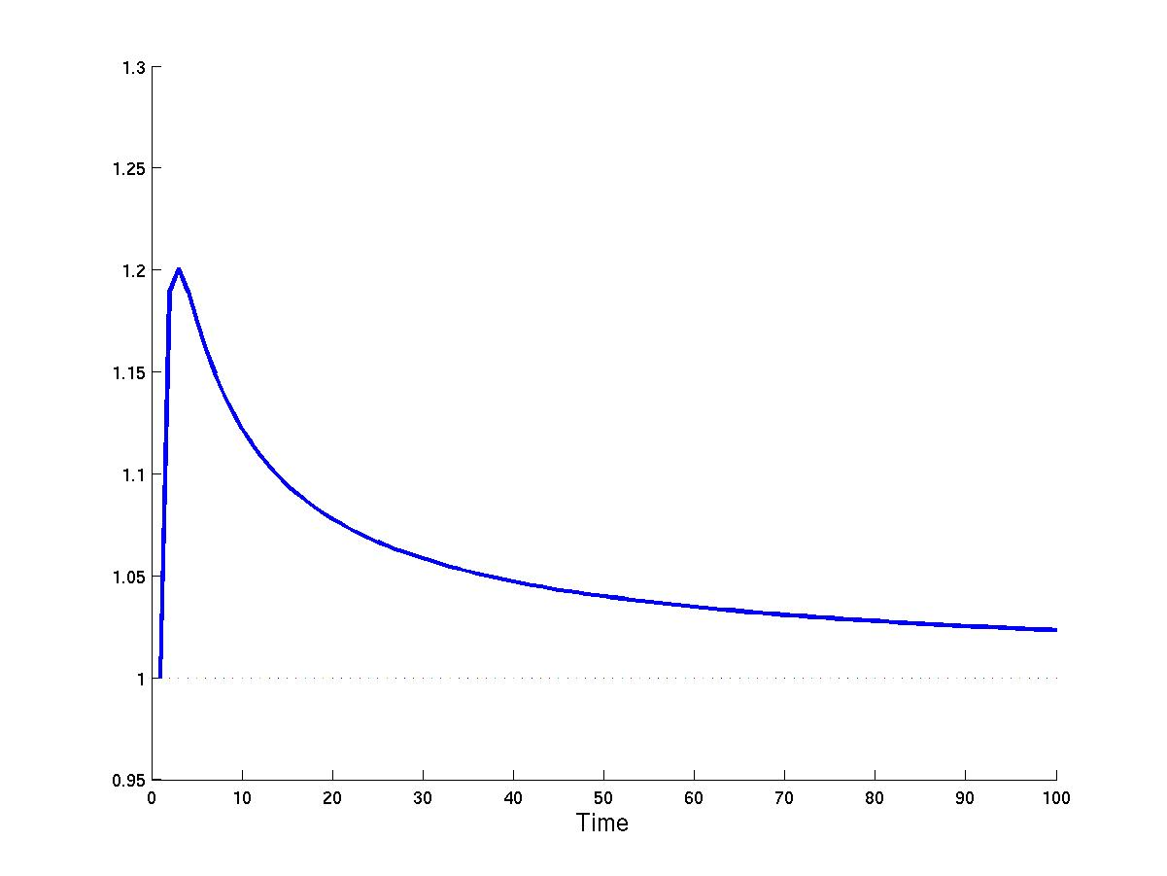
Optimum value of β
Optimum value of β such that the system always stays at the conjuction between Period 2 and Period 3
Period 2 = t^{d/2}
Period 3 = (α+1)^{t} . N_{proli}.t
t^{3/2} = β^{t} . N_{proli}.t
β = (t/ N_{proli}²)^{(1/2t)}
tends to 1, exponential growth of packet is restricted.
1.3
1.2
Value of β
1.1
1
0.95
10 20 30 40 50 60 70 80 90 100
Time

Slide 35
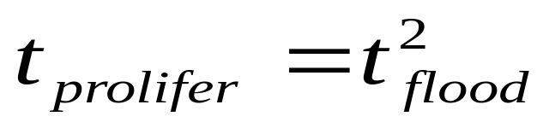
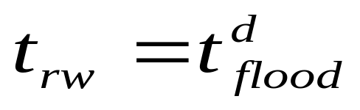
Conclusion
The theoretical limit of fast is defined .
The coverage time for proliferation
The coverage time for random walk
Fairness redefined
Spreading as much as you can as long as there is no collision
Awaiting Simulation verification

Slide 36
Summary
Extensive experiments done to test the robustness of our proposition
Theoretical work undertaken to find the reason behind the robustness
Theoretical work is pointing towards newer direction of research.

Slide 37

Thank you
Special Thanks to the Bios group for many hours of discussions

