Slide 1
Cellular Automata Evolution : Theory and Applications in Pattern Recognition and Classification
Niloy Ganguly

Slide 2
Aim of the Dissertation
Additive CA – An important modeling tool
Extremely interesting state transition behavior
Can mimic complex operations
Problem – How to find the exact CA rules which will model a particular application
This thesis builds up the general framework and applies it to the special application of Pattern Recognition

Slide 3
Coverage
Additive Cellular Automata (CA) ?
Analysis
Synthesis
Evolution
Pattern Recognition/Classification
  Associative Machine
  Pattern Classifier
  Classifying Prohibited Pattern Sets for VLSI Testing
Associative Memory – More general class of CA

Slide 4
Cellular Automata
50’s - J von Nuemann
80’s - Wolfram
Work round the world
America - Santafe Institute of Complexity Study
Europe - Stephen Bandini, Bastein Chopard
VLSI Domain
India under Prof. P.Pal.Chaudhuri
Late 80’s - Work at IIT KGP
Late 90’s - Work at BECDU
Book - Additive Cellular Automata Vol I

Slide 5
Cellular Automata
A computational Model with discrete cells updated synchronously
………..
0/1
Clock
output
2 - State 3-Neighborhood CA Cell
Input
Combinational Logic
From Left Neighbor
From Right Neighbor

Slide 6
Cellular Automata
Combinational Logic can be of 256 types
each type is called a rule
Each cell can have 256 different rules
………..
Clock
CLK
D
Q
2 - State 3-Neighborhood CA Cell
Combinational Logic
From Left Neighbor
From Right Neighbor

Slide 7
Cellular Automata
Combinational Logic can be of 256 types
each type is called a rule
Each cell can have 256 different rules
………..
98
236
226
107
4 cell CA with different rules at each cell

Slide 8
CA - State Transition
0
0
1
1
3
98
236
226
107
0
1
1
1
7
98
236
226
107
2
0
0
1
0

Slide 9
State Transition Diagram
5
10
4
11
3
12
2
13
15
14
6
7
0
1
9
8
13
5
6
7
12
2
8
0
9
15
3
14
1
4
11
10

Slide 10
Additive Cellular Automata
Combinational Logic can be of 15 types
Each cell can have 15 different rules
………..
i-1
i
i+1
XNOR /
XOR

Slide 11
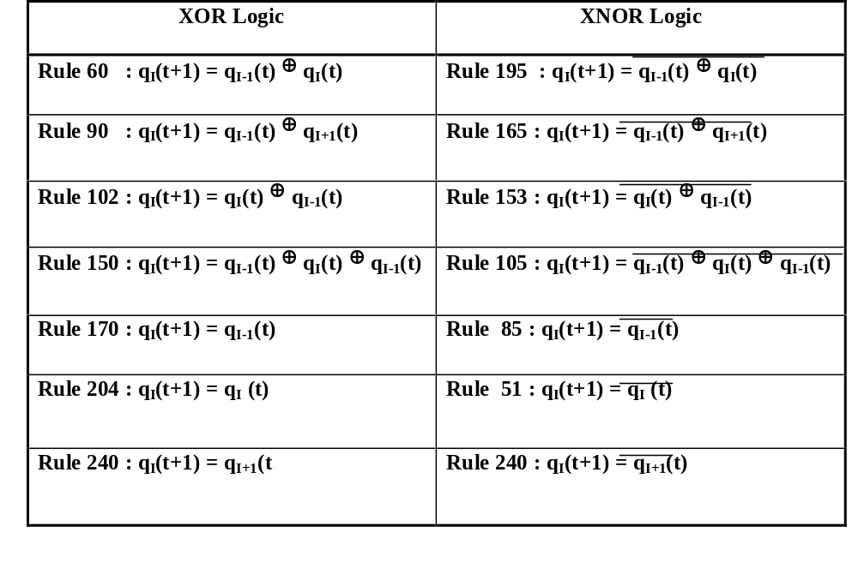
Additive Cellular Automata
15

Slide 12
Additive Cellular Automata
1 0 0 0
1 1 0 0
0 1 1 1
0 0 0 1
60
102
150
204
T =
Linear CA
1 0 0 0
1 0 1 0
0 0 1 0
0 0 0 1
60
165
51
204
T =
0 1 1 0
Additive CA
F =

Slide 13
Additive Cellular Automata - Analysis
60
102
150
204
CA Rules
13
5
6
7
12
2
8
0
9
15
3
14
1
4
Cycle Structure
11
10

Slide 14
Additive Cellular Automata - Analysis
60
102
150
204
CA Rules
Cycle Structure and Depth
5
10
4
11
3
12
2
13
15
14
6
7
0
1
9
8

Slide 15
Linear Cellular Automata - Analysis
204
102
204
102
90
CA Rules
1 0 0 0 0
0 1 1 0 0
0 0 1 0 0
0 0 0 1 1
0 0 0 1 0
T =
Elementary Divisor – (irreducible polynomial)^{p}
Primary Cycles (odd) – 1, 3.
Secondary Cycles 2^{p} .k – (2, 4 ..), (6, 12, ..).
Characteristic Polynomial
(x + 1) . (x +1)² . (x² +x + 1)
PFCS, PCS
[1(1), 1(1)]
x [1(1), 1(3)]
= [4(1), 2(2), 4(3), 2(6)]
x [1(1), 1(1),1(2)]

Slide 16
Additive Cellular Automata - Analysis
51
153
204
153
165
1 0 0 0 0
0 1 1 0 0
0 0 1 0 0
0 0 0 1 1
0 0 0 1 0
T =
F =
1 1 0 1 1
CS = [2(4), 2(12))]
Similarity between ACA and LCA
The cycle structure of an Additive CA differs from its Linear Counterpart only if the characteristic polynomial contains a (x +1) factor.

Slide 17
Additive Cellular Automata - Analysis
Compute the cycle structure of LCA.
Characteristic Polynomial - (x + 1) . (x +1)² . (x² +x + 1)
CS = [4(1), 2(2), 4(3), 2(6)]
If factor (x+1)^{p} is present
Check the nature of F vector.
If F vector belongs to Null Space of (x+1)^{p} (here (x +1)² ),
then merge all the cycles k to 2^{p}.k (here p = 2)
k = 1
4 x 1 + 2 x 2 = 8 = 2(4),
k = 3
4 x 3 + 2 x 6 = 24 = 2(12)
Null Space
(T + I)^{p} . F = 0, (T + I)^{p-1} . F ≠ 0

Slide 18
Additive Cellular Automata - Synthesis
CS = [4(1), 2(2), 4(3), 2(6)]
204
102
204
102
90
Steps – Linear Cellular Automata
Express the CS as product of 2 PFCS [1(1), 3(1), 2(2)] x [1(1),1(3)]
Express PFCS as product of PCS (1,1)¹ x (1,1)² x (1,3)¹
Construct the elementary divisor of each PCS. (x+1). (x+1)². (x²+x+1) - characteristic polynomial.
Corresponding to each individual elementary divisor construct a submatrix and join the submatrix by placing them in Block Diagonal Form
[1 ] 0 0 0 0
0 |1 1| 0 0
0 |0 1| 0 0
0 0 0 |1 1|
0 0 0 |1 0|
(x+1)
[1(1), 1(1), 1(2)]
T =
(x+1)²
(x²+x+1)

Slide 19
Additive Cellular Automata - Synthesis
CS = [2(4), 2(12))]
51
153
204
153
165
Steps – Additive Cellular Automata
Synthesis of T Matrix
Synthesis of F Vector
Synthesis of T Matrix
Find the corresponding linear cycle structure from the additive cycle structure.
CS = [2(4), 2(12))]
CS = [4(1), 2(2), 4(3), 2(6)]
Synthesize the T Matrix
Synthesis of F Vector – Probabilistic approach, Randomly pick a F vector and check whether it falls in the respective Null Space

Slide 20
Linear Cellular Automata - Evolution
General Framework for CA evolution.
1. Form Population of (say) 50 CA
98
236
226
107
4 cell CA needs 32 bit chromosome
11100010
2. Arrange the chromosomes with respect to their fitness value
3. Select 10 best solution
5. Crossover between solutions and form 35 new solutions
1110001000
0.8
….
….
….
…
1000001001
0.7
1110001000
1000011000
4. Mutate 5 best chromosome
32
40
1110001000
1110011000
1000001000
32
48
24

Slide 21
Linear Cellular Automata - Evolution
General Framework for CA evolution.
1. Form Population of (say) 50 CA
98
236
226
107
4 cell CA needs 32 bit chromosome
11100010
1110001000
0.8
….
….
….
….
Population of 50 chromosomes at Generation 0
1100011010
0.5
1110011100
0.95
….
….
….
….
Population of 50 chromosomes at Generation 1
1100000010
0.75

Slide 22
Linear Cellular Automata - Evolution
General Framework for CA evolution.
1. Form Population of (say) 50 CA
98
236
226
107
4 cell CA needs 32 bit chromosome
11100010
Problem – Huge search space 4 cell CA – search space = 2³²
100 cell CA – search space = 2⁸⁰⁰ !!!
For linear CA 100 cell CA – search space = 2³⁰⁰ !!!
Solution – Analytically reduce the search space. Identify a subclass of CA fit for the particular job and evolve it.
Subclass – Group CA, Max-length CA, LCA with same characteristic polynomial

Slide 23
Multiple Attractor Cellular Automata (MACA)
Special class of Linear CA
Characteristic polynomial x^{n-m}(1+x)^{m}
Min. Polynomial x^{d} (1+x) d - depth
01000
01010
10100
10110
01001
01011
10101
10111
11100
11110
11111
11101
00010
Basin
00001
00000
00011
10010
10000
01100
01110
01101
01111
10011
10001
11000
11010
11001
11011
00100
00111
00110
00101

Slide 24
MACA - Evolution
Select 10 best solution
Crossover between solutions and form 35 new solutions
1110001000
0.8
….
….
….
…
1000001001
0.7
1110001000
1000011000
Mutate 5 best chromosome
32
40
1110001000
1110011000
1000001000
32
48
24
Problem in using conventional genetic algorithm to arrive at the correct configuration of MACA
Same rules in different sequence doesn’t produce the MACA
90
60
150
90
60
150
90
90
MACA
Not an MACA
Not an MACA

Slide 25
MACA - Evolution
A special methodology of Genetic Algorithm is used
Consideration - After mutation and cross-over, the resultant is also a MACA
Pseudo Chromosome Format is introduced
All members of chromosomes has the characteristic polynomial x^{n-m} (1+x)^{m}
The characteristic polynomial of all MACA is x^{n-m} (1+x)^{m}

Slide 26
MACA - Evolution
Char Poly = x³(1+x)²
Distribute the factors - x² (1+x) x (1+x)
Resultant Matrix T
1
1
0
0
0
x²
1
1
1
0
0
T =
0
0
1
0
0
(1 + x)
0
0
1
0
0
x
0
0
0
0
1
(1 + x)
2
0
-1
1
-1
Pseudo Chromosome Format
2
0
-1
1
-1

Slide 27
MACA - Evolution
Each x^{d} is represented by d followed by d -1 zeros
Each (1+x) represented by -1
1
1
0
0
0
x²
1
1
1
0
0
T =
0
0
1
0
0
(1 + x)
0
0
1
0
0
x
0
0
0
0
1
(1 + x)
2
0
-1
1
-1
Pseudo Chromosome Format
2
0
-1
1
-1

Slide 28
MACA - Evolution Crossover Technique
2
2
0
0
-1
-1
3
3
0
0
0
-1
1
-1
2
0
MACA - 1
2
0
-1
2
0
-1
1
-1
3
0
0
-1
1
-1
3
0
0
MACA - 2
2
0
-1
3
0
-1
1
-1
3
0
0
d followed by d-1 zero
2
0
-1
2
0
-1
1
-1
3
0
0
2
0
-1
2
0
-1
1
-1
3
0
0
MACA

Slide 29
MACA - Evolution Mutation Technique
3
0
0
-1
3
0
0
-1
1
1
MACA - 1
3
0
0
-1
3
-1
0
1
1
d followed by d-1 zero
3
3
0
0
0
0
-1
-1
1
1
-1
-1
3
3
0
0
0
0
1
1
Mutated MACA

Slide 30
Multiple Attractor Cellular Automata - Applications
  Associative Memory Model Pattern Classifier
A
B
C …
Z
A
Comic Sans MS
Bookman Old Style
Conventional Approach - Compares input patterns with each of the stored patterns learn

Slide 31
The Problem
A
A
B
Grid by Grid Comparison
A
B
C …
Z
A
Comic Sans MS
Bookman
old Style

Slide 32
The Problem
A
A
B
Grid by Grid Comparison
0 0 1 0
0 0 1 0
0 1 1 1
1 0 0 1
1 0 0 1
0 1 1 0
0 1 1 0
0 1 1 0
1 0 0 1
1 0 0 1
No of Mismatch = 3

Slide 33
The Problem
A
A
B
Grid by Grid Comparison
0 0 1 0
0 0 1 0
0 1 1 1
1 0 0 1
1 0 0 1
No of Mismatch = 9
1 1 1 0
0 1 0 1
0 1 1 1
0 1 0 1
1 1 1 0

Slide 34
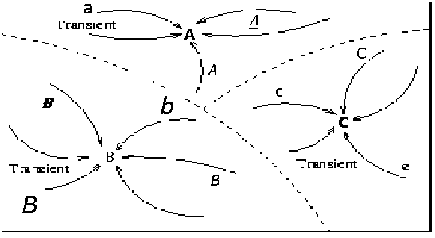
Associative Memory
Time to recognize a pattern - Proportional to the number of stored patterns ( Too costly with the increase of number of patterns stored )
Solution - Associative Memory Modeling
Entire state space - Divided into some pivotal points.
State close to pivot - Associated with that pivot.
Time to recognize pattern - Independent of number of stored patterns.

Slide 35
Associative Memory
Time to recognize a pattern - Proportional to the number of stored patterns ( Too costly with the increase of number of patterns stored )
Solution - Associative Memory Modeling
Two Phase : Learning and Detection
Time to learn is higher Driving a car
Difficult to learn but once learnt it becomes natural
Densely connected Network - Problems to implement in Hardware
Solution - Cellular Automata (Sparsely connected machine) - Ideally suitable for VLSI application

Slide 36
MACA as Associative Memory
MACA – Can be made to act as an Associative Memory
A
B
C
D
Hamming Hash Family - Patterns close to each other is more likely to fall in the same basin
What follows – (for example) Different variations of A falls in same attractor basin

Slide 37
Performance – Memorizing Capacity
Given a set of patterns to be learned – P1, P2, ….Pk,
Evolve an MACA which can classify the patterns in different attractor basin
Capacity – Theoretical
Capacity – Experimental
Hopfield Network
Pattern Size (n)
10
9
8
2
3
8
14
15
20
13
13
50
25
24
90
34
33
100
36
37

Slide 38
Performance – Recognition Capacity
Recognition Capacity - The machine can identify 90% of all the patterns which are within one hamming distance from pivot point.
The recognition capacity can be made perfect by using multiple MACA each classifying the same set of patterns.

Slide 39








Pattern Classification
Classifying Several Related Patterns into one class
Another
Vehicle !!
Vehicle

Slide 40
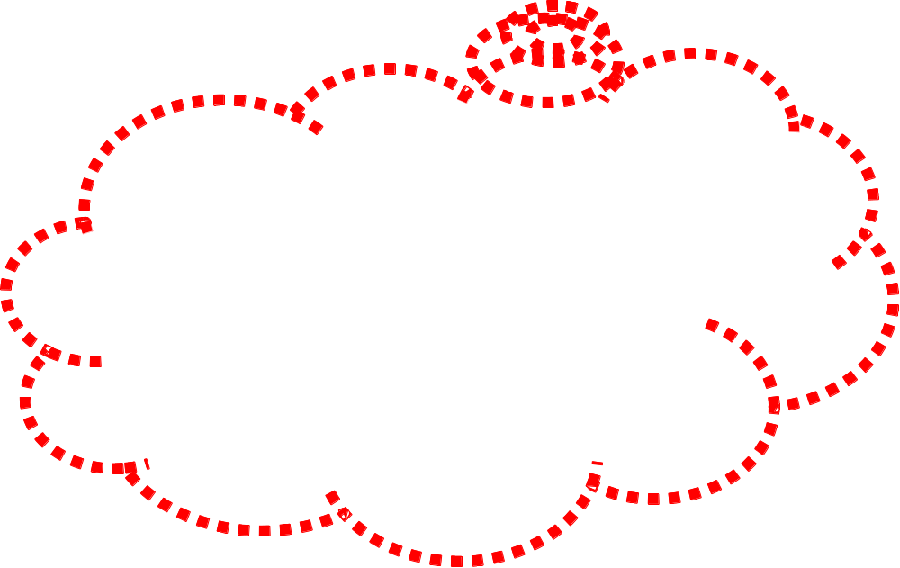








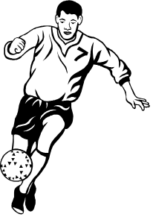

Pattern Classification
Human Brain

Slide 41
Pattern Classification
MACA - A NATURAL CLASSIFIER.
11
10
Class I
01
Class II
00
MACA Based Classification Strategy for Two Class Classifier

Slide 42
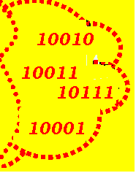
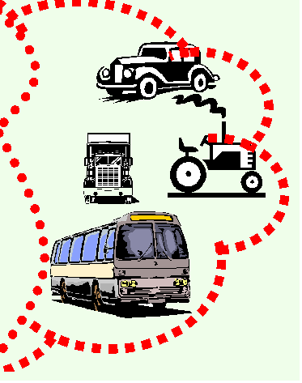
Pattern Classification
MACA - A NATURAL CLASSIFIER.
Closeness is measured in terms of hamming distance
Forms Natural Cluster
MACA Based Classification Strategy for Two Class Classifier

Slide 43
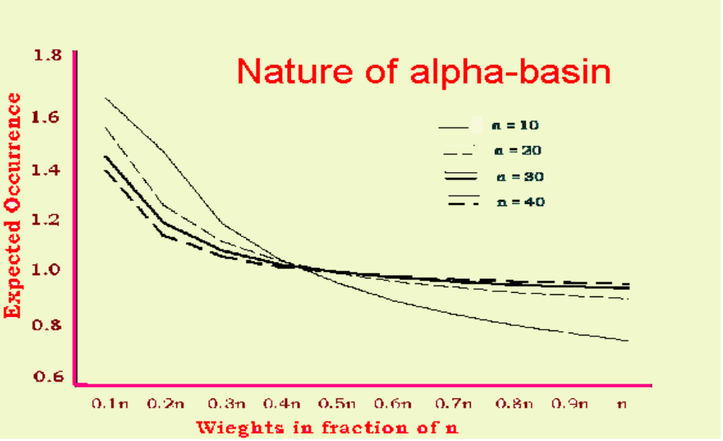
Pattern Classification
MACA - A NATURAL CLASSIFIER.
MACA Based Classification Strategy for Two Class Classifier

Slide 44
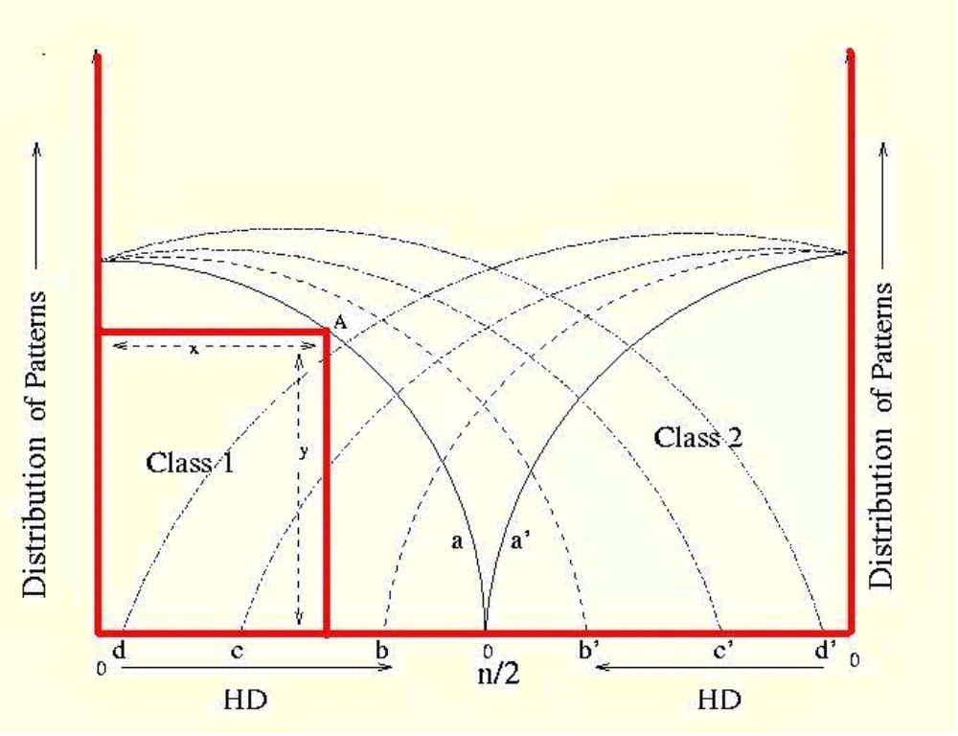
Experimental Results
b
b’
c
c’
a
a’
Distribution of patterns in class 1 and class2

Slide 45
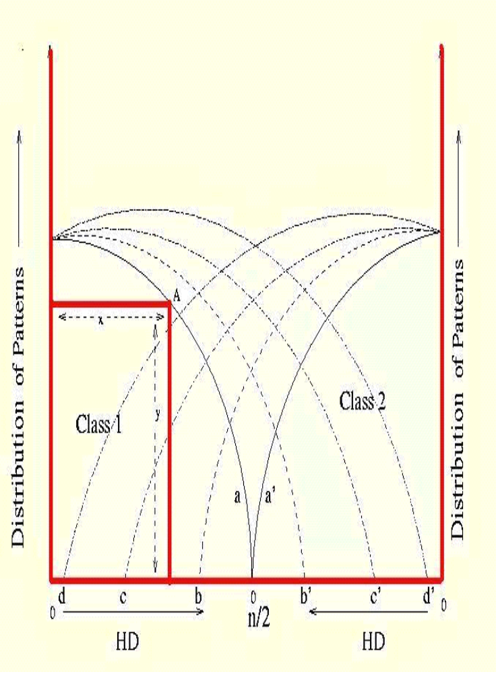
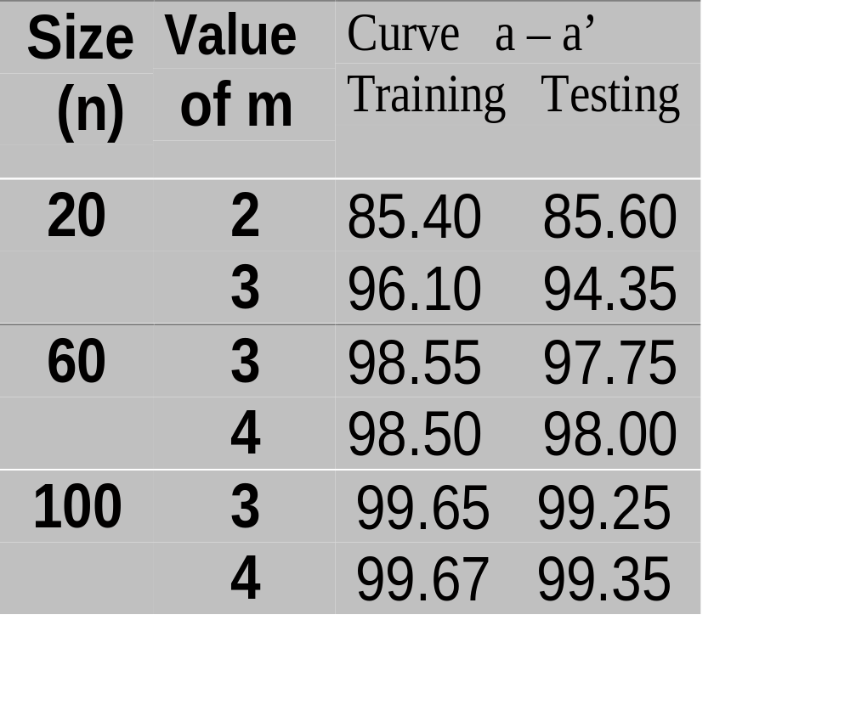
Experimental Results
a
a’

Slide 46
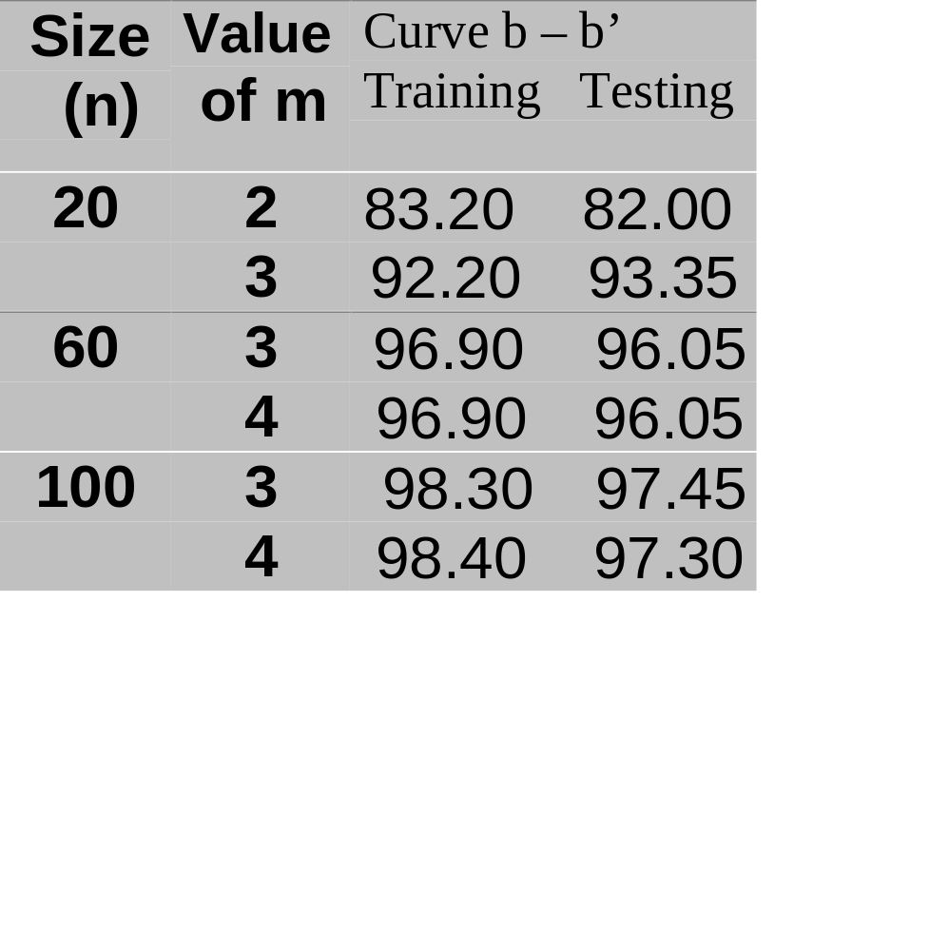
Experimental Results
b
b’

Slide 47
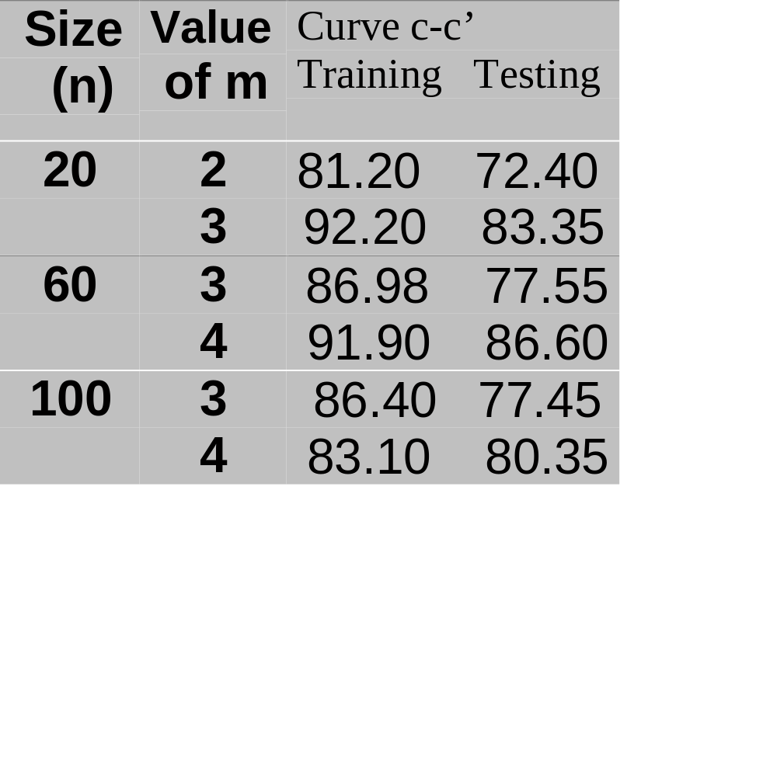
Experimental Results
c
c’

Slide 48
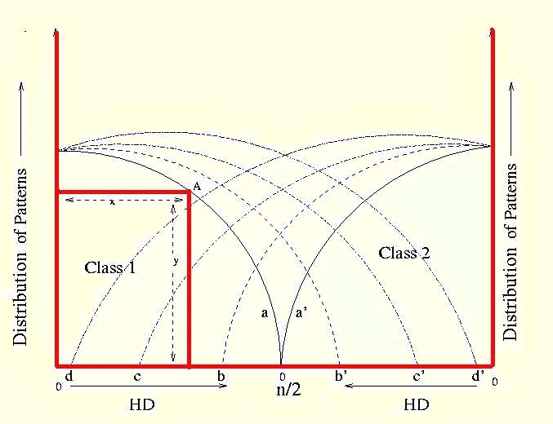
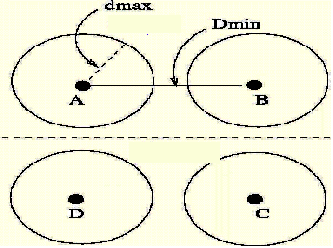
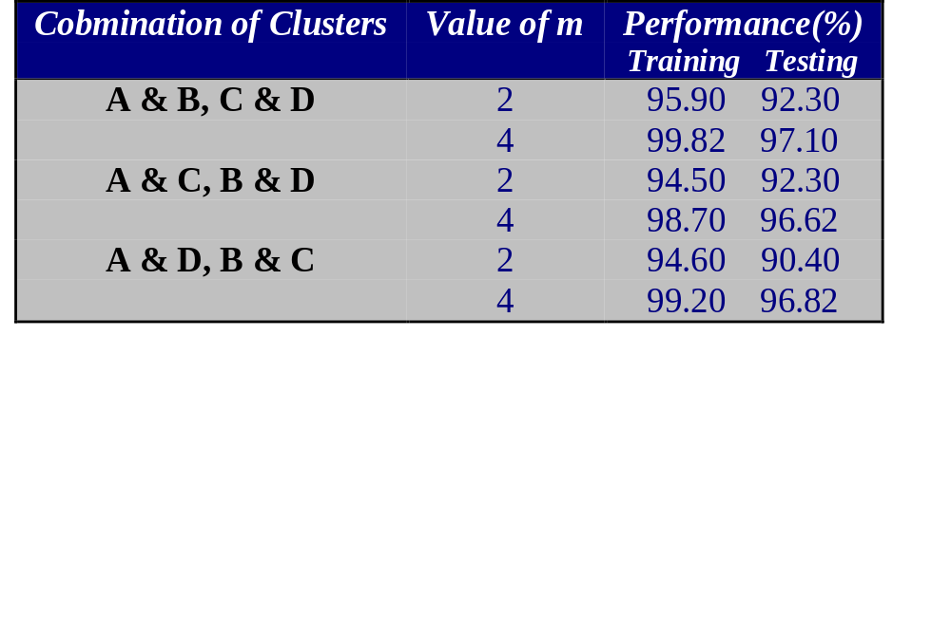
Experimental Results
Clusters Detection by two class classifier
Class 1
Class 2
d
d’

Slide 49
Prohibited Pattern Set
Prohibited Pattern Set (PPS) – A set of patterns input of which sents the system into an unstable state.
Example : Toggle State of a flip flop
Design a TPG with the following features
  It avoids the generation of such PPS
  It maintains the randomness and fault coverage of a Pseudo Random Pattern Generator
  Side by side it doesn’t add to any hardware cost

Slide 50
Problem Definitions
Non Max Length GF(2) Cellular Automata is employed to obtain the design criteria
Design the CA in such a way so that it has large cycles free from PPS
PPS can be of two types
  Prohibited Random Patterns – Small number of patterns
  Prohibited Functions – some combination of Primary Input can be detrimental

Slide 51
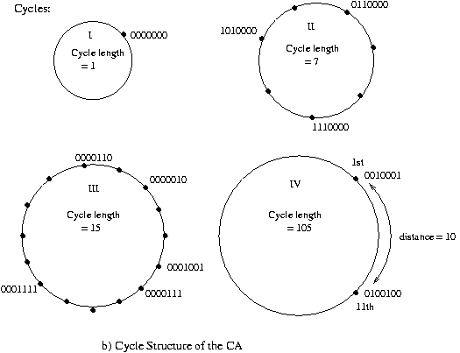
Overview of Design
Given PPS
0000110 0000010 0001001 0000111 0001111 0010100
1101101 1011001 0100100
0010001
Evolve a Non Maxlength CA
Redundant Cycle(RC)
Criterion for choosing Non-Max Length CA
Large cycle of length close to a Max length Cycle
Most members of PPS fall in smaller cycles
Dmax
Same Evolution Framework as before, population is built on group CA only
Target Cycle(TC)

Slide 52
Experimental Observation-I
Real data of PPS is not available
PPS randomly generated, no. of prohibited patterns assumed 10, 15
For a particular n, 10 different PPS are considered
PPS = 10
PPS = 15
#cell
TC
FreeSpace
TC
FreeSpace
8
217
59.76
225
44.14
14
15841
55.02
15841
41.00
17
131071
57.78
82677
34.80
19
458745
57.70
458745
45.70
22
4063201
65.62
3138051
42.65

Slide 53
Experimental Observations -II
Study of randomness property
Platform used is DiehardC
Compared with corresponding maximal length CA
Random Test | n=24 Max TPG | n=32 Max TPG | n=48 Max TPG
Overlap Sum | pass pass | pass pass | pass pass
3D Sphere | pass pass | pass pass | fail fail
B’day Spacing | fail fail | fail fail | fail fail
Overlap 5-permut | fail fail | fail fail | pass pass
DNA | fail fail | fail fail | pass fail
Squeeze | fail pass | fail fail | pass fail

Slide 54
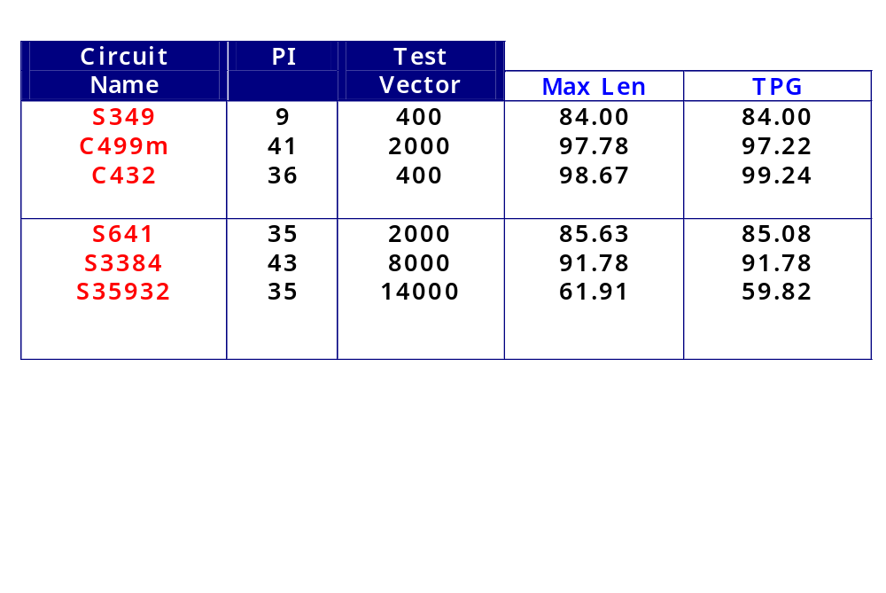
Experimental Observations -III
Fault coverage of the proposed design (Compared with MaxLength CA)
Fault Simulator used : Cadence `verifault’

Slide 55
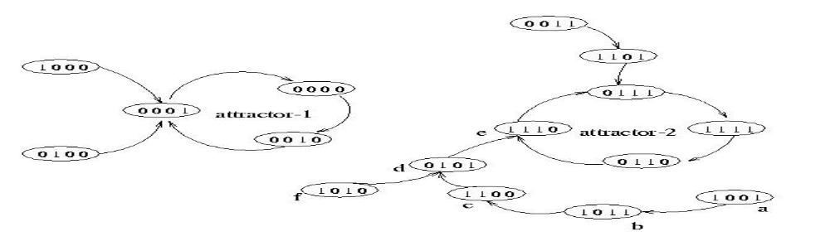
Generalized Multiple Attractor CA
The State Space of GMACA – Models an Associative Memory
Associative Memory and Non-Linear CA

Slide 56
Generalized Multiple Attractor CA
The state transition diagram breaks into disjoint attractor basin
Each attractor basin of CA should contain one and only one pattern to be learnt in its attractor cycle
The hamming distance of each state with its attractor is lesser than that of other attractors.
Pivot Points
Dist =1
Dist =3

Slide 57
GMACA Evolution
Fitness Function
If P_{j} does not belongs to any attractor cycle after
Maximum Iteration L_{max}
Fitness Function (F) = 0
P_{j}
L_{max=4}

Slide 58
GMACA Evolution
Fitness Function
If P_{j} does not belongs to any attractor cycle after
Maximum Iteration L_{max}
Fitness Function (F) = 0
Desired Pivot Point
else
Fitness Function: F = [1 - HD(P_{i} - P_{j})/N]
P_{j}

Slide 59
GMACA Evolution
Fitness Function
Average fitness of 30 randomly chosen state

Slide 60
Performance
Capacity – MACA
Capacity – GMACA
Hopfield Network
Pattern Size (n)
10
8
4
2
2
4
5
7
15
10
4
25
15
6
35
19
8
45
23
10
Observation : GMACA have much higher capacity than Hopfield Net

Slide 61
Comments
Memorizing Capacity of GMACA - Higher than Hopfield Net but less than MACA
Genetic Algorithm and Reverse Engineering Techniques is employed innovatively
Recognition Capacity higher than MACA
Rules lie in the edge of chaos

Slide 62
Major Contributions
Analysis
Synthesis
Evolution
Pattern Recognition

Slide 63
Thank you

