Slide 1
Are Proliferation Techniques more efficient than Random Walk with respect to the fast coverage of networks?
  Niloy Ganguly, Andreas Deutsch
  Center for High Performance Computing
  Technical University
  Dresden, Germany

Slide 2
Talk Overview
Problem Definition
Experimental Results
Theoretical Abstraction

Slide 3
Networks
Network = (peers, neighborhood)
5
a
4
b
a
b
c
3
2
5
7
d
6
e
2
c
d
e
f
4
1
5
g
7
g
1
f
7
Peer host data –
  no connection between data and peer.
  not possible to devise a deterministic function to reach from a particular peer to a particular data

Slide 4
Unstructured Networks
Searching in unstructured networks –
Non-deterministic Algorithms
Flooding, random walk
Our algorithms – packet proliferation and mutation
5
a
4
b
6?
3
d
6
e
2
c
6!!!
6?
6?
g
7
6?
1
6?
f
6?
Unstructured Network

Slide 5
Model Definition
Topology
Data and query distribution
Algorithms
Metrics

Slide 6
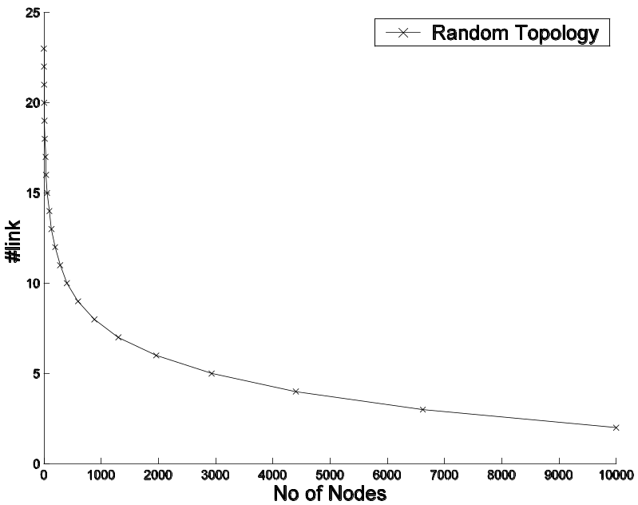
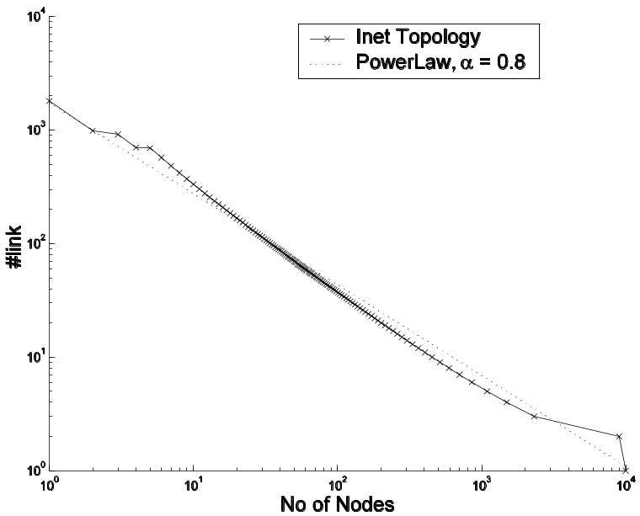
Topology Definition
Random Graph
Power-law graph
No of Nodes = 10000, Mean Indegree ≈ 4
No of Nodes = 10000, Mean Indegree ≈ 4
Grid
No of Nodes = 10000, Mean Indegree = 4

Slide 7
Query/Data Distribution
Query/Data
– 10 bit strings
– 1024 unique queries/data (tokens) – Distributed based on Zipf’s Law
power law - frequency of occurrence of a token T α 1/r, rank of the token
a
b
d
e
1001001001
c
g
f

Slide 8
Forwarding Algorithms
Proliferation/Mutation Algorithms
Simple Proliferation/Mutation Algorithm (PM)
Restricted Proliferation/Mutation Algorithm (RPM)
Random Walk Algorithms
Simple Random Walk Algorithm (RW)
Restricted Random Walk Algorithm (RRW)
High Degree Restricted Random Walk Algorithm (HDRRW)

Slide 9
Proliferation/Mutation Algorithms
Simple Proliferation/Mutation Algorithm (PM)
Produce N messages from the single message. (Mutate one bit with prob. β)
Spread them to the neighboring nodes
a
b
d
e
N = 3
c
g
f

Slide 10
Proliferation/Mutation Algorithms
Restricted Proliferation/Mutation Algorithm (RPM)
Produce N messages from the single message. (Mutate one bit with prob. β)
Spread them to the neighboring nodes if free
a
b
d
e
N = 3
c
g
f

Slide 11
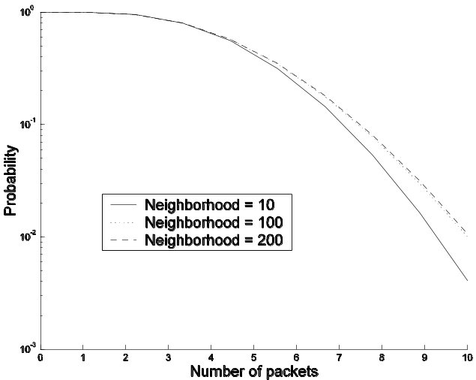
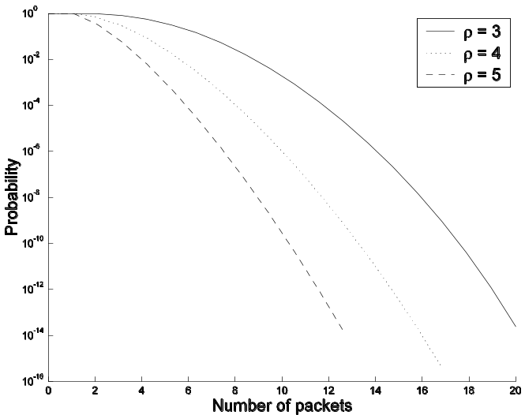
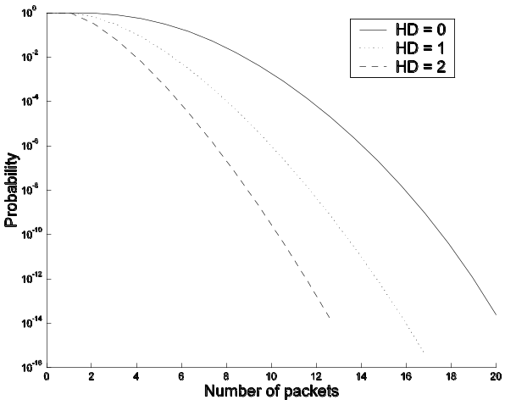
Proliferation Controlling Function
Production of N messages depends on
a. Proliferation constant (ρ)
b. Hamming distance between message and data
c. Always ≥ 1 and ≤ no of neighbors
a
b

Slide 12
Random Walk Algorithms
Simple Random Walk Algorithm (RW)
Forward the message to a randomly selected neighbor
a
b
d
e
c
g
f

Slide 13
Random Walk Algorithms
Restricted Random Walk Algorithm (RRW)
Forward the message to a randomly selected free neighbor
a
b
d
e
c
g
f

Slide 14
Random Walk Algorithms
High Degree Restricted Random Walk Algorithm (HDRRW)
Forward the message to the free neighbor which has highest number of neighbors
a
b
d
e
c
g
f

Slide 15
Metrics and Experiment
Network coverage efficiency
No of time steps required to cover the entire network
Time Step - A time step is the period within which all the nodes operate once in a random sequence
Experiment Coverage – Calculate time taken to cover the entire network after initiation of a search from a randomly selected initial node. Repeated for 500 such searches.

Slide 16
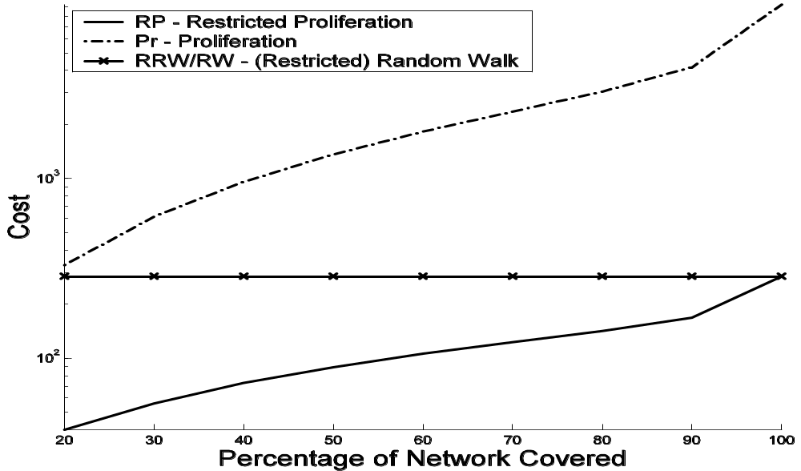
Fairness Criteria
Comparing a random walk algorithm with a proliferation algorithm (RRW and RPM)
Both processes work with same average number of packets.
RRW
RPM

Slide 17
Forwarding Algorithms
Proliferation/Mutation Algorithms
Simple Proliferation/Mutation Algorithm (PM)
Restricted Proliferation/Mutation Algorithm (RPM)
Random Walk Algorithms
Simple Random Walk Algorithm (RW)
Restricted Random Walk Algorithm (RRW)
High Degree Restricted Random Walk Algorithm (HDRRW)

Slide 18
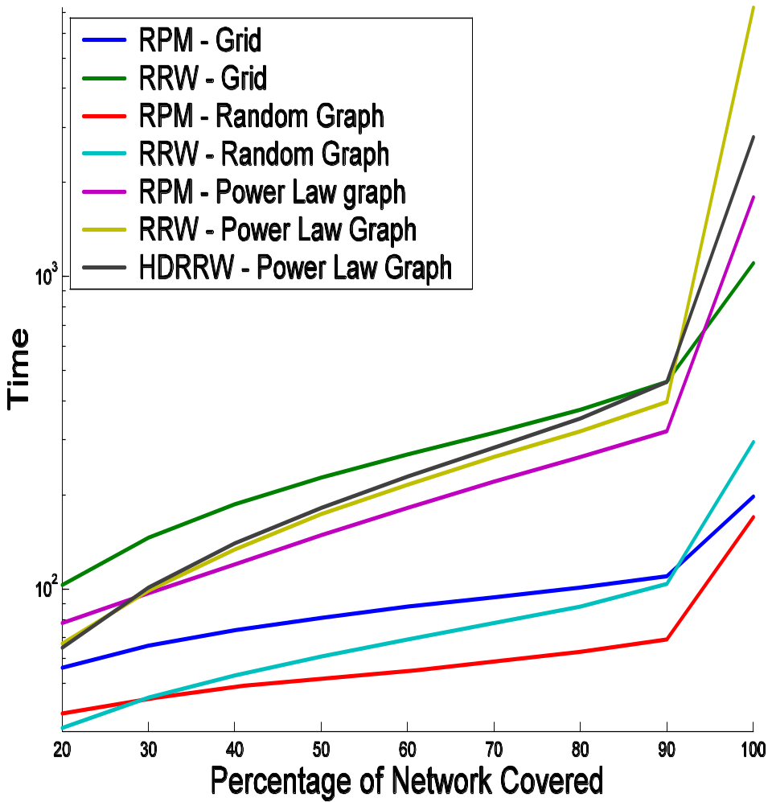
Experimental Result
Comparison Between RPM and RRW on Different Topologies
Experiment Coverage
Network coverage time RRW > RPM
Network coverage time power-law Network > grid > random network
HDRRW is better than RRW, however only slightly

Slide 19
Defining the REAL Problem
Why do Proliferation work better than random walk ?
Can we theoretically answer?
A first attempt
Make the problem simpler.
Consider only grid topology

Slide 20
Compare the two systems?
Random Walk
x
K (= 4) random walk
What is the time taken to cover all the nodes in the
network? (with some confidence level?)

Slide 21
Compare the two systems?
Proliferation
K’ (= 2) initial messages.
At every time step, increase message packets by α factor.
So at
t = 1, K ’(1+ α)
t = 2, K ’(1+ α)²
t = n, K ’(1+ α)^{n}
x
K ’ + K ’(1+ α) + K ’(1+ α)² + ……+ K ’(1+ α)^{n} = K .(n + 1)
K ’ = K .(n + 1). α / ((1+ α)^{n+1} - 1 )

Slide 22
Compare the two systems?
Proliferation
K’ (= 2) initial messages.
At every time step, increase message packets by α factor.
So at
t = 1, K ’(1+ α)
t = 2, K ’(1+ α)²
t = n, K ’(1+ α)^{n}
So what is the time taken to cover the network????

