Slide 1
Analyzing the Vulnerability of Superpeer Networks Against Churn and Attack
Niloy Ganguly
Department of Computer Science & Engineering
Indian Institute of Technology, Kharagpur
Kharagpur 721302

Slide 2


Poster - Developing Analytical Framework to Measure Stability of P2P Networks, ACM Sigcomm 2006 Pisa, Italy
Brief Abstract - Measuring Robustness of Superpeer Topologies, PODC 2007
How stable are large superpeer networks against attack? The Seventh IEEE Conference on Peer-to-Peer Computing, 2007
Full paper - Analyzing the Vulnerability of the Superpeer Networks Against Attack, ACM CCS, 14th ACM Conference on Computer and Communications Security, Alexandria, USA, 29 October - 2 Nov, 2007.

Slide 3
Client/Server architecture
Server
Client
Client
Internet
Client
Client
Servers: Provide services.
Clients : Request services from servers
Very successful architecture
  WWW (HTTP), FTP, Web services, etc.

Slide 4
Client/Server architecture
Limitations
Scalability : Hard to achieve
Poor fault tolerance : Single point of failure
Administration : Highly required

Slide 5
Peer to Peer architecture
Node
Node
Node
Internet
Node
Node
All peers act as both clients and servers i.e. Servent (SERVer+cliENT)
  Provide and consume data
  Any node can initiate a connection
No centralized data source
  “The ultimate form of democracy on the Internet”
File sharing and other applications like IP telephony, distributed storage, publish subscribe system etc

Slide 6
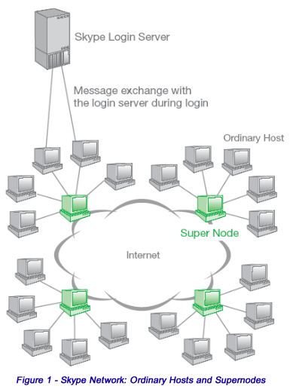
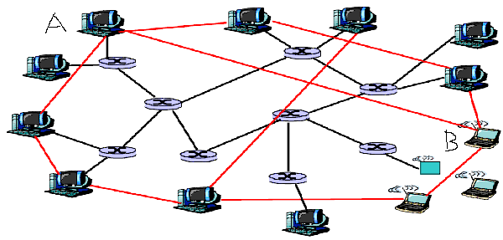
Peer to peer and overlay network
An overlay network is built on top of physical network
Nodes are connected by virtual or logical links
Underlying physical network becomes unimportant
Interested in the complex graph structure of overlay

Slide 7
Dynamicity of overlay networks
Peers in the p2p system leave network randomly without any central coordination (user churn)
Important peers are targeted for attack
  DoS attack drown important nodes in fastidious computation
    Fail to provide services to other peers
  Importance of a node is defined by centrality measures
    Like degree centrality, betweenness centraliy etc

Slide 8
Dynamicity of overlay networks
Peers in the p2p system leave network randomly without any central coordination (user churn)
Important peers are targeted for attack
  Makes overlay structures highly dynamic in nature
  Frequently it partitions the network into smaller fragments
  Communication between peers become impossible

Slide 9
Problem definition
Investigating stability of the networks against the churn and attack
Network Topology + Dynamicity = How (long) stable
Developing an analytical framework
Examining the impact of different structural parameters upon stability
  Peer contribution
  degree of peers, superpeers
  their individual fractions

Slide 10
Steps followed to analyze
Modeling of
  Overlay topologies
    pure p2p networks, superpeer networks, hybrid networks
  Various kinds of failures and attacks
Defining stability metric
Developing the analytical framework
Validation through simulation
Understanding impact of structural parameters

Slide 11
Modeling overlay topologies
Topologies are modeled by various random graphs characterized by degree distribution p_{k}
  Fraction of nodes having degree k
Examples:
Erdos-Renyi graph
Scale free network
Superpeer networks

Slide 12
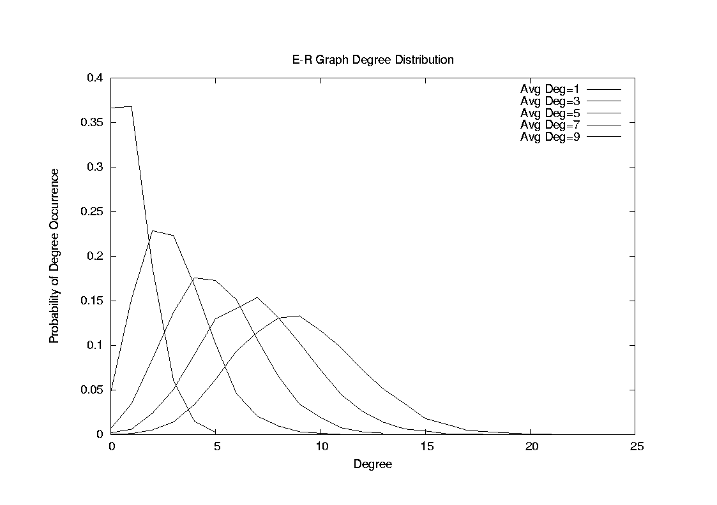
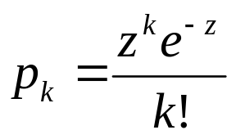
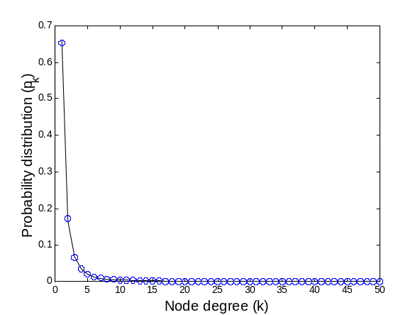
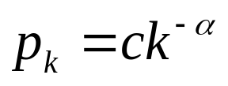
Modeling overlay topologies:
E-R graph, scale free networks
Erdos-Renyi graph
  Degree distribution follows Poisson distribution.
Scale free network
  Degree distribution follows power law distribution
Average degree

Slide 13



Modeling overlay topologies: Superpeer networks
Superpeer networks emerge as most widely used network
  Small fraction of nodes are superpeers and rest are peers
  KaZaA adopted this kind of topology
  Can be modeled using bimodal degree distribution
  Mathematically if
  otherwise
Superpeer Node
Peer node

Slide 14
Modeling peer dynamics
We propose a generalized model for peer dynamics
Probability of removal of a node having degree k is
f_{k} α k^{γ}, γ models peer dynamics
By changing the value of γ, we can obtain various peer dynamics like
  random failure, degree dependent failure
  deterministic and degree dependent attack
qk models the probability of survival of a node of degree k after the disrupting event
  qk=1-fk

Slide 15
Generalized model for peer dynamics
γ = 0 (degree independent failure)
  Probability of removal of a node (f_{k}) is constant & degree independent i.e. qk=q
γ < 0 (degree dependent failure)
  Probability of removal of a node (f_{k}) is inversely proportional to the degree of that node (1/k)
  Peers having lower connectivity or bandwidth are less stable because they enter and leave network frequently
γ > 0 (Attack)
  Peers with high degrees are targeted.

Slide 16
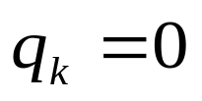

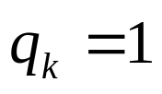

Modeling: Attack
Deterministic attack
  Nodes having high degrees are progressively removed
    qk=0 when k>kmax
    0< qk< 1 when k=kmax
    qk=1 when k<kmax
Degree dependent attack
  Nodes having high degrees are likely to be removed
  Probability of removal of node having degree k

Slide 17
Stability Metric:
Percolation Threshold
Initially all the nodes in the network are connected
Forms a single giant component
Size of the giant component is the order of the network size
Giant component carries the structural properties of the entire network
Nodes in the network are connected and form a single giant component

Slide 18
Stability Metric:
Percolation Threshold
f fraction of nodes removed
Initial single connected component
Giant component still exists

Slide 19
Stability Metric:
Percolation Threshold
f_{c} fraction of nodes removed
f fraction of nodes removed
Initial single connected component
The entire graph breaks into smaller fragments
Giant component still exists
Therefore f_{c} =1-q_{c} becomes the percolation threshold

Slide 20
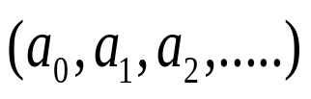
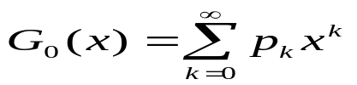

Development of the analytical framework
Generating function:
  Formal power series whose coefficients encode information
  Here encode information about a sequence
  Used to understand different properties of the graph
  generates probability distribution of the vertex degrees.
  Average degree

Slide 21
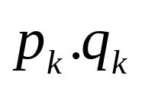

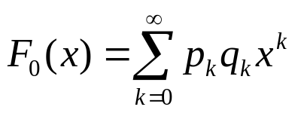
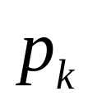
Development of the analytical framework
specifies the probability of a node having degree k to be present in the network after f_{k} = (1-q_{k}) fraction of nodes removed.
becomes the corresponding generating function.
(1-q_{k}) fraction of nodes removed

Slide 22
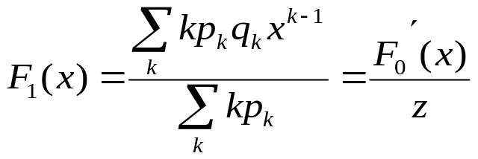
Development of the analytical framework
specifies the probability of a node having degree k to be present in the network after (1-q_{k}) fraction of nodes removed.
becomes the corresponding generating function.
Distribution of the outgoing edges of first neighbor of a randomly chosen node
Random node
First neighbor

Slide 23

Development of the analytical framework
H₁(x) generates the distribution of the size of the components that are reached through random edge
H₁(x) satisfies the following condition

Slide 24

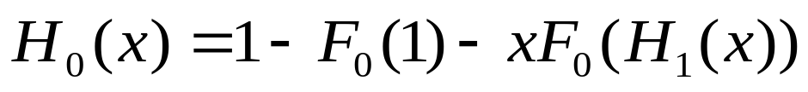
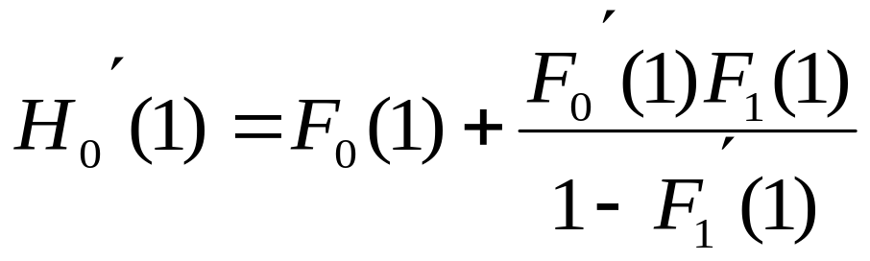
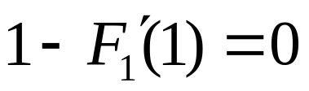
Development of the analytical framework
generates distribution for the component size to which a randomly selected node belongs to
Average size of the components
Average component size becomes infinity when

Slide 25
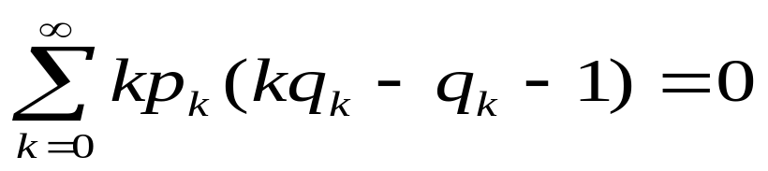
Development of the analytical framework
Average component size becomes infinity when
With the help of generating function, we derive the following critical condition for the stability of giant component
The critical condition is applicable
  For any kind of topology (modeled by p_{k})
  Undergoing any kind of dynamics (modeled by 1-q_{k})
Degree distribution
Peer dynamics

Slide 26
Stability metric: simulation
The theory is developed based on the concept of infinite graph
At percolation point
  theoretically ‘infinite’ size graph reduces to the ‘finite’ size components
In practice we work on finite graph
  cannot simulate the phenomenon directly
We approximate the percolation phenomenon on finite graph with the help of condensation theory

Slide 27
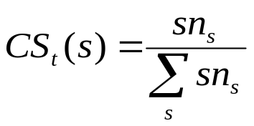

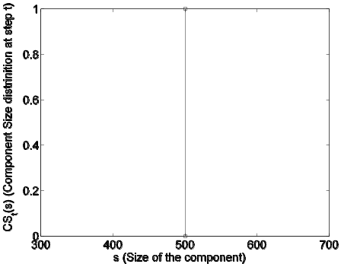
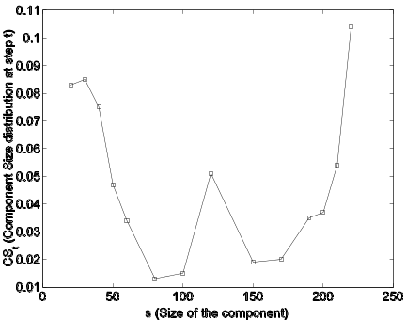
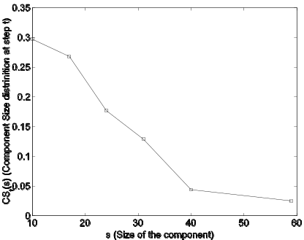
How to determine percolation point during simulation?
Let s denotes the size of a component and n_{s} determines the number of components of size s at time t
At each timestep t a fraction of nodes is removed from the network
Calculate component size distribution
If becomes monotonically decreasing function at the time t
  t becomes percolation point
Initial condition (t=1)
Intermediate condition (t=5)
Percolation point (t=10)

Slide 28
Outline of the results
Networks under consideration | Disrupting events
Superpeer networks (Characterized by bimodal degree distribution ) | Degree independent failure or random failure
 | Degree dependent failure
 | Degree dependent attack
 | Deterministic attack (special case of degree dependent attack ??)

Slide 29
Outline of the results
Networks under consideration | Disrupting events
Superpeer networks (Characterized by bimodal degree distribution ) | Degree independent failure or random failure
 | Degree dependent failure
 | Degree dependent attack
 | Deterministic attack (special case of degree dependent attack ??)

Slide 30
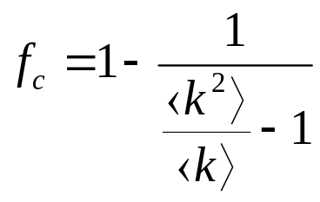
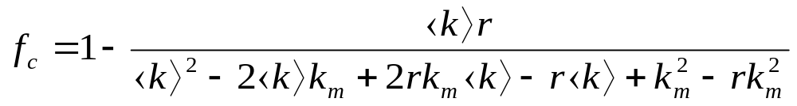
Stability against various failures
Degree independent random failure :
Percolation threshold
For superpeer networks
Average degree of the network
Superpeer degree
Fraction of peers

Slide 31

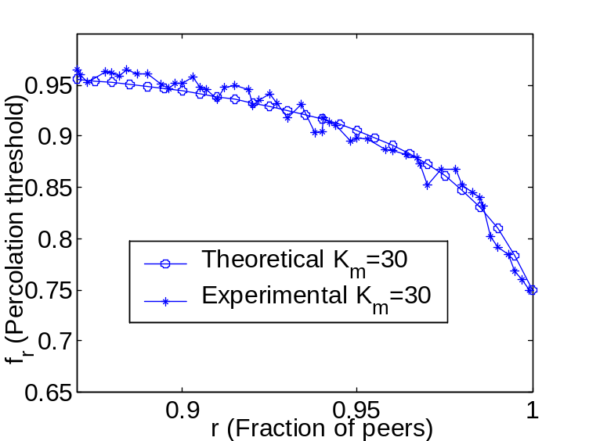
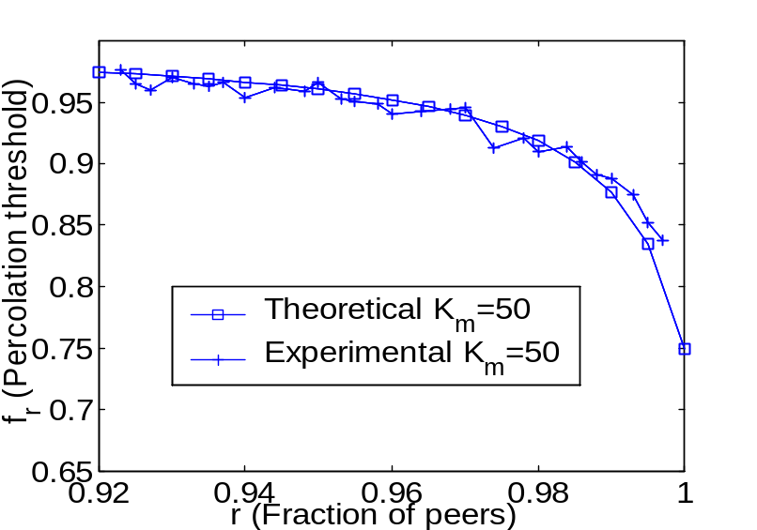
Stability against random failure
(superpeer networks)
Comparative study between theoretical and experimental results
We keep average degree fixed

Slide 32
Stability against random failure
(superpeer networks)
Comparative study between theoretical and experimental results
Increase of the fraction of superpeers (specially above 15% to 20%) increases stability of the network

Slide 33
Stability against random failure
(superpeer networks)
Comparative study between theoretical and experimental results
There is a sharp fall of f_{c} when fraction of superpeers is less than 5%

Slide 34
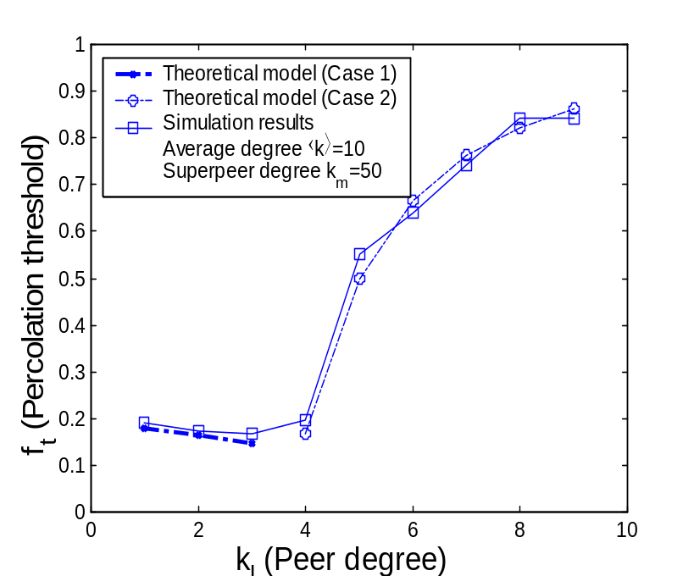
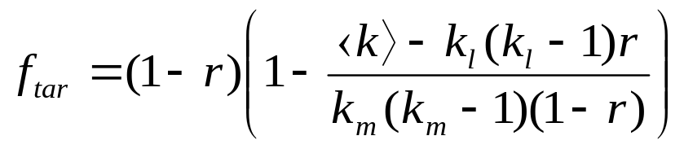
Stability of superpeer networks against deterministic attack
Two different cases may arise
Case 1:
  Removal of a fraction of high degree nodes are sufficient to breakdown the network
Case 2:
  Removal of all the high degree nodes are not sufficient to breakdown the network
  Have to remove a fraction of low degree nodes

Slide 35
Stability of superpeer networks against deterministic attack
Two different cases may arise
Case 1:
  Removal of a fraction of high degree nodes are sufficient to breakdown the network
Case 2:
  Removal of all the high degree nodes are not sufficient to breakdown the network
  Have to remove a fraction of low degree nodes
Interesting observation in case 1
  Stability decreases with increasing value of peers – counterintuitive

Slide 36


Peer contribution
Controls the total bandwidth contributed by the peers
  Determines the amount of influence superpeer nodes exert on the network
Peer contribution
where is the average degree
We investigate the impact of peer contribution upon the stability of the network

Slide 37
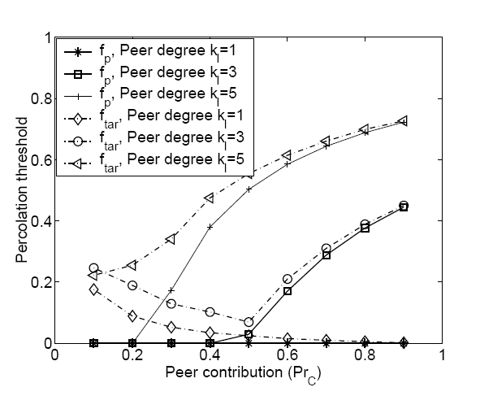

Impact of peer contribution for deterministic attack
The influence of high degree peers increases with the increase of peer contribution
This becomes more eminent as peer contribution

Slide 38


Impact of peer contribution for deterministic attack
Stability of the networks ( ) having peer contribution
primarily depends upon the stability of peer ( )

Slide 39
Impact of peer contribution for deterministic attack
Stability of the network increases with peer contribution for peer degree kl=3,5
Gradually reduces with peer contribution for peer degree kl=1

Slide 40


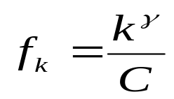
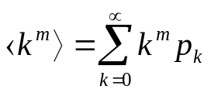
Stability of superpeer networks against degree dependent attack
Probability of removal of a node is directly proportional to its degree
  Hence
Calculation of normalizing constant C
Minimum value
This yields an inequality

Slide 41

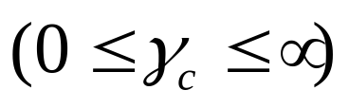
Stability of superpeer networks against degree dependent attack
Probability of removal of a node is directly proportional to its degree
  Hence
Calculation of normalizing constant C
Minimum value
The solution set of the above inequality can be
  either bounded
  or unbounded

Slide 42
Degree dependent attack:
Impact of solution set
Three situations may arise
  Removal of all the superpeers along with a fraction of peers – Case 2 of deterministic attack
  Removal of only a fraction of superpeer – Case 1 of deterministic attack
  Removal of some fraction of peers and superpeers

Slide 43


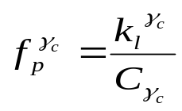



Degree dependent attack:
Impact of solution set
Three situations may arise
  Case 2 of deterministic attack
    Networks having bounded solution set
    If ,
  Case 1 of deterministic attack
    Networks having unbounded solution set
    If ,
  Degree Dependent attack is a generalized case of deterministic attack

Slide 44

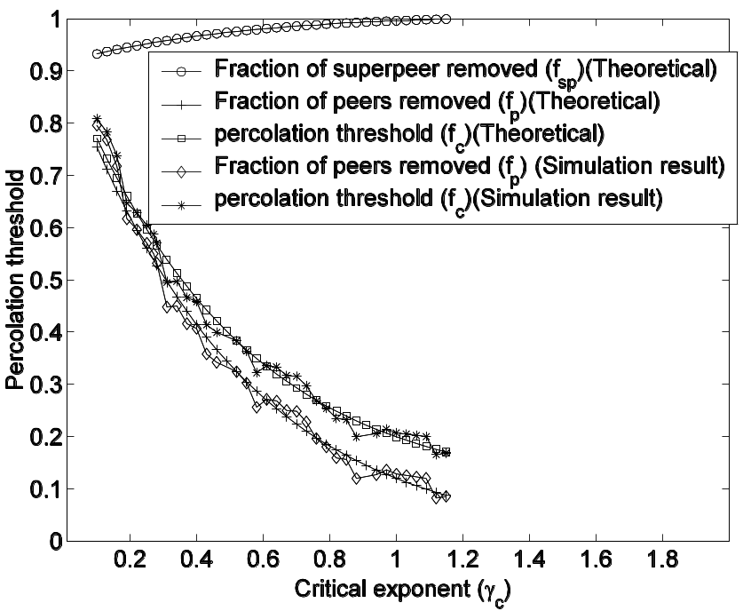


Impact of critical exponent γ_{c} Validation through simulation
Bounded solution set with
Removal of any combination of where disintegrates the network
At , all superpeer need to be removed along with a fraction of peers
Performed simulation on graphs with N=5000 and 500 cases
Good agreement between theoretical and simulation results
Case Study :
Superpeer network with
k_{l}=3, km=25, ⟨k⟩=5

Slide 45
Summarization of the results
Random failure
  Stability increases with superpeer degree and its fraction
  Drastic fall of the stability when fraction of superpeers is less than 5%
In deterministic attack, networks having small peer degrees are very much vulnerable
Increase in peer degree improves stability
    Superpeer degree is less important here!
In degree dependent attack,
  Stability condition provides the critical exponent
    Amount of peers and superpeers required to be removed is dependent upon
  More general kind of attack

Slide 46
Conclusion
Contribution of our work
  Development of general framework to analyze the stability of superpeer networks
  Modeling the dynamic behavior of the peers using degree independent failure as well as attack.
  Comparative study between theoretical and simulation results to show the effectiveness of our theoretical model.
  Future work
  Perform the experiments and analysis on more realistic network

Slide 47
Limitations
We have not considered the change in the degree distribution in the network due to disrupting events
Assumed that nodes are turned OFF during disrupting events
Topological change in the network should be included in the theory

Slide 48
Node removal procedure
Original networks
All the nodes are ON

Slide 49
Node removal procedure
ON nodes
OFF nodes
Nodes to be removed are turned OFF

Slide 50
Node removal procedure
Degrees of the neighboring nodes remain unchanged
There is no topological change in the network

Slide 51

Thank you

