Slide 1
How do the superpeer networks emerge?
Niloy Ganguly, Bivas Mitra
Department of Computer Science & Engineering
Indian Institute of Technology, Kharagpur, India

Slide 2
Introduction: Peer to Peer architecture
Node
Node
Node
Internet
Node
Node
All peers act as both clients and servers
  Any node can initiate a connection
  Provide and consume data
No centralized data source

Slide 3
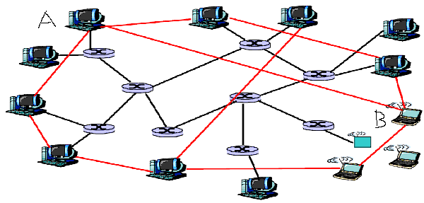
Introduction: P2p overlay network
Physical link
Overlay edge
An overlay network is built on top of physical network
Nodes are connected by virtual or logical links
Search and information flow follows overlay structure
  Underlying physical network becomes unimportant

Slide 4



Introduction : Superpeer networks
Topology of the overlay networks are modeled by degree distribution p_{k}
  p_{k} specifies the fraction of nodes having degree k
Superpeer network (Gnutella 0.6, KaZaA, Skype) emerges as most widely used network
  Small fraction of nodes are superpeers and rest are peers
  Can be modeled using bimodal degree distribution
  Mathematically if
  otherwise
superpeers
peers
r=fraction of peers
k_{l}=peer degree
k_{m}=superpeer degree

Slide 5
Introduction : Motivation
Formation of the superpeer networks
  Bootstrapping of incoming nodes
  Churn of peers
  Restructuring of links

Slide 6
Introduction : Bootstrapping
Servent programs perform the bootstrapping function
Some of the popular Gnutella 0.6 servents are Limewire, Mutella, Gnucleus, Gtk-gnucleus
At the time of joining, each peer tries to establish a link with some online node of the p2p network.
The selection of the online node influences the structure of the network.

Slide 7
Introduction : Bootstrapping
Detecting the online nodes
  Word of mouth
  Servent cache
  Use of GWebCache server
GWebcache works as a distributed repository for maintaining the information of online peers
Primary goal of servent program
  bootstrapping function
  and Gwebcache updation
When a new peer joins the Gnutella network, it retrieves the host list from one or more of these GWebCaches.
  selects ‘good’ online nodes from the GWebCache

Slide 8
Introduction : Bootstrapping
Limewire and Gnucleus maintain a list of superpeers and give priority to hosts in this list during connection initiation.
Study shows that in Gnutella 0.6 network 74-77% Limewire client, 19-20% Bearshare and 4-6% others.
Limewire’s and Bearshare’s superpeers prefer to serve 30 and 45 leaf peers respectively
  whereas both try to maintain around 30 neighbors in the superpeer layer of the overlay.
Most leaf peers are connected to 3 ultrapeers or fewer

Slide 9
Question
Why bootstrapping protocol results superpeer networks?
Literature shows that preferential attachment of nodes results scale free network
  Inclusion of the ‘fitness’ and ‘rewiring of links’ does not changes the nature
But superpeer networks exhibit bimodal degree distribution
Finite Bandwidth – power-law with exponential cut-off!!

Slide 10
Outline of the presentation
Development of an analytical framework to explain the appearance of bimodal network
Modeling the bootstrapping protocols
  Define ‘goodness’ of a node
  Incorporate the ‘finiteness’ of bandwidth
Comparative study of the theoretical and simulation results
Computation of the amount of superpeers in the network
  Investigating the effect of various parameters
Effect of churn
Study of the Gnutella network in light of the developed formalism
Conclusion

Slide 11
Modeling the bootstrapping protocols
Each node joins the network with
  Node weight (processing power, storage space etc)
  Finite bandwidth (determines the cutoff degree)
‘Goodness’ of a node is defined by the ‘node weight’ and current ‘node degree’
We model bootstrapping phenomena by node attachment rules
Probability of attachment of a new node with an online node is proportional to the node weight and node degree

Slide 12
Modeling the bootstrapping protocols : Concept of cutoff degree
Cutoff degree of a node is k_{c}
k_{c}=5
k_{c}=5
Allowed to take incoming links
k_{c}=5
Not allowed to take incoming links

Slide 13
Modeling the bootstrapping protocols : Concept of cutoff degree
Two different assumptions
Simple : All the nodes join with same cutoff degree k_{c}
Realistic : Nodes join with individual cutoff degree.
  q_{kc(j)} fraction of nodes joins with cutoff degree kc(j).

Slide 14
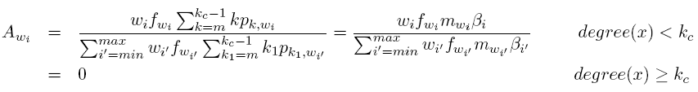

Modeling the bootstrapping protocols
Probability that an incoming nodes has weight w_{i} is f_{wi}
Let set_{i} denotes the set of nodes in the network with weight w_{i}.
Probability that an online node x with weight w_{i} will receive a new link
w₁
w₂
w₃
denotes the fraction of nodes in set_{i}, that have reached their cutoff degree k_{c}

Slide 15


Development of the analytical framework
We compute , the fraction of k degree nodes in
Sum it over all weights w
Joining of a node with degree m results
  the shift in the k degree nodes to (k+1)
  The shift in the (k-1) degree nodes to k
Number of nodes of degree k at t+1
Number of nodes of degree (k-1) at t
Number of nodes of degree k at t
influx
outflux

Slide 16


Development of the analytical framework
The amount of decrease in the number of k degree nodes due to outflux
The amount of increase in the number of k degree nodes due to influx
Change in the number of k degree nodes in

Slide 17



Development of the analytical framework
Rate equations
For m < k < kc
For k = m
For k = kc

Slide 18
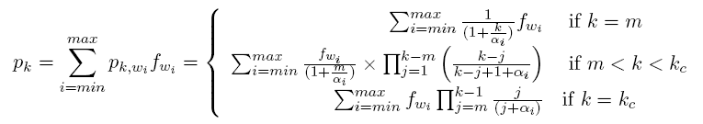

Development of the analytical framework
This results the degree distribution of the emerging network
where

Slide 19
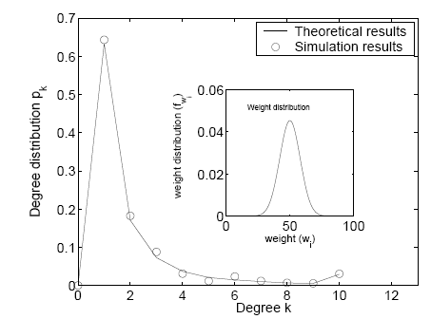
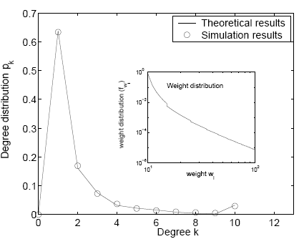
Validation through simulation
Stochastic simulation
Nodes join with weight w (10 ≤ w ≤ 100)
Two different weight distribution f_{w}
  Normal and power law
Total number of nodes 5000 and 500 realizations
Important observation
  Emergence of superpeer nodes p_{kc} at degree k_{c} (Irrespective of the weight distribution)

Slide 20
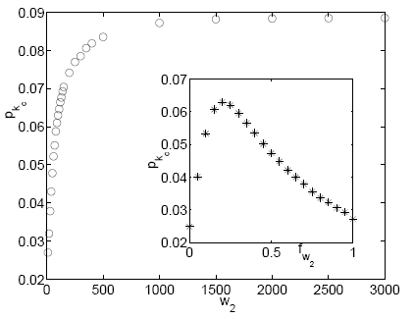
Important results
Impact of node weight
Consider a bimodal weight distribution
  nodes join with two weights w₁ and w₂ with individual fraction fw₁ and fw₂.
We take w₁=10, fw₁=0.8. w₂ varied from 10 to 3000.
Observations (1)
Initial increase in w₂ increases the amount of superpeers (p_{kc}) rapidly.
After a certain threshold, p_{kc} stabilizes
pkc*
Observations (2) - Inset
Initial increase in fw₂ increases p_{kc}.
After reaching maximum value (pkc*), pkc decreases
Existence of optimum fw₂ (fw₂*)
fw₂*

Slide 21
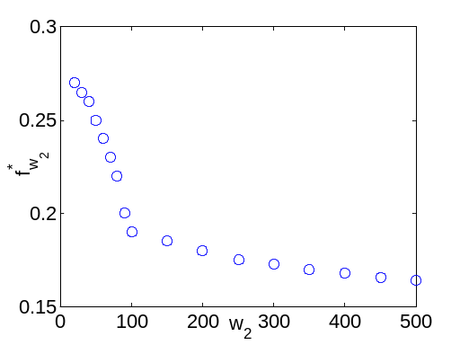
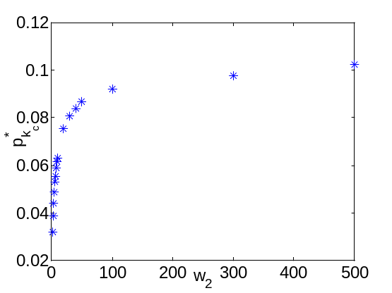
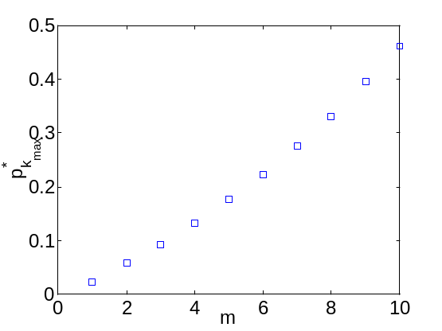
Important results
Impact of node weight
Increase in node weight w₂ decrease fw₂*.
Increase in w₂ increases the corresponding pkc*
Increase in m increases pkc* when w2 → ∞
Proper updation of GWebcache is important
Presence of too much high weighted nodes may be detrimental
High weighted nodes may increase the fraction of superpeers only upto a level

Slide 22
How bootstrapping protocol affects the p2p services
Modifying bootstrapping protocols
  probability of connecting only high degree online nodes is r
  probability of connecting with online nodes based upon both its weight and degree is (1-r)
Two important network parameters that affect the p2p services
  diameter of the network
    Reducing the diameter of the network improves the p2p search
  Amount of superpeers in the network
    Increasing the amount of superpeers results fast downloading of files
We investigate, how r regulates the diameter and amount of superpeers

Slide 23
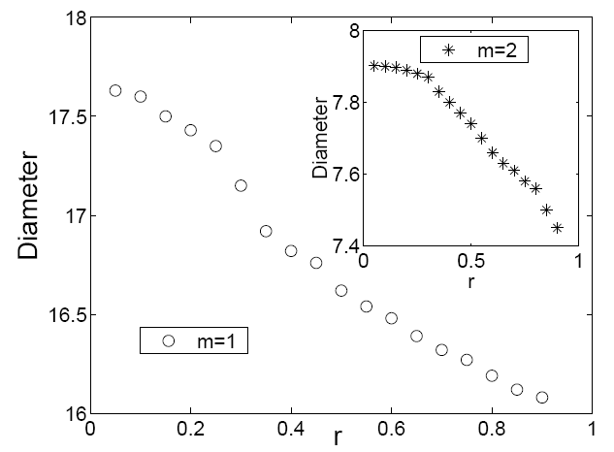
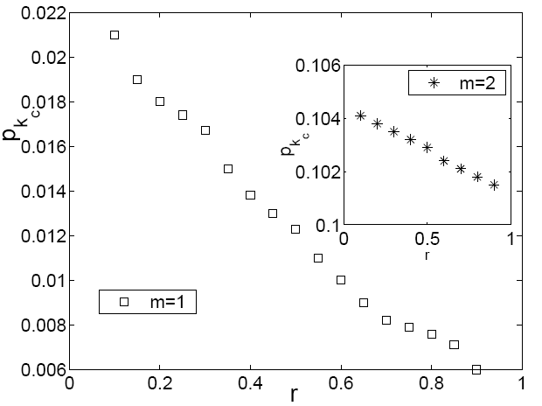
How bootstrapping protocol affects the p2p services
Increase in r slowly reduces the diameter of the network
Increase in r slowly reduces the amount of superpeers in the network
By properly selecting the online nodes from the GWebcache during bootstrapping may improve different p2p services.

Slide 24


Development of analytical framework : nodes join with individual cutoff degree
Assumption
Probability that node j joins with
cutoff degree kc(j) is q_{kc(j)} ; kc(min) ≤ kc(j) ≤ kc(max)
weight w_{j} is fw_{j}
Probability that an online node of weight w_{i} receives a new link from the incoming peer
Where
implies the fraction of nodes in set_{wi} capable of accepting new links
S_{k,wi} is the fraction of k degree nodes in set_{wi} whose cutoff degree is greater than k
  hence capable of taking new links

Slide 25

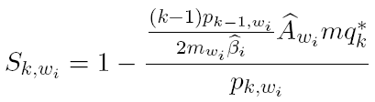
Development of analytical framework : nodes join with individual cutoff degree
Based on the behavior of S_{k,wi}, formulation of rate equation is done in two parts
  Part A : m ≤ k < kc(min) : S_{k,wi} trivially becomes 1
    Rate equations are similar to fixed cutoff degree
  Part B : kc(min) ≤ k ≤ kc(max) : a fraction of nodes reach to their cutoff degree and stop taking new links
    Calculation of S_{k,wi} becomes nontrivial
Rate equation for k=kc(min)

Slide 26
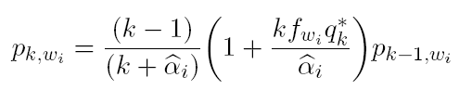



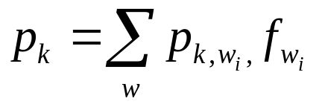
Development of analytical framework : nodes join with individual cutoff degree
Substituting S_{k,wi} and rearranging results
where
Generalization yields for
Degree distribution of the network

Slide 27
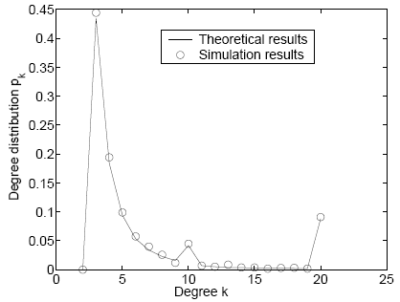
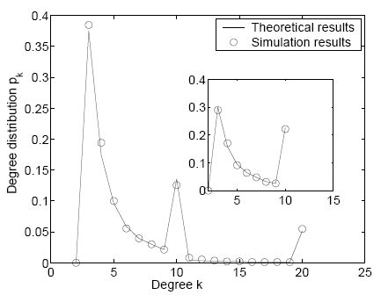
Validation through simulation
Case 1: Fraction of nodes joined with cutoff degree 3, 10 and 20 are 0.5, 0.1 and 0.4.
Total amount of superpeers (degree ≥ 10) 0.1472
Case 2: Fraction of nodes joined with cutoff degree 3, 10 and 20 are 0.5, 0.3 and 0.2 (superpeers 0.2158)
Inset: shows 50% of nodes joined with cutoff 3 and rest joined with cutof 10. (superpeers : 0.2761)

Slide 28
Interesting observation
Results show that instead of joining through multiple high bandwidth connections
  Using single (or few) bandwidth increases the amount of superpeers
In Gnutella, bootstrapping protocols can be properly modified to restrict the maximum node degree
  This may increase the amount of superpeers

Slide 29
Case study : Gnutella
Experiment performed based on the real world network data
Gnutella network snapshot obtained from the Multimedia and Internetworking research group, University of Oregon, USA (2004).
Size of the network 1,31,869 nodes
We theoretically compute the degree distribution of the network, validate it through simulation
  Perform a comparative study of the gnutella snapshot and the theoretical/simulation results

Slide 30
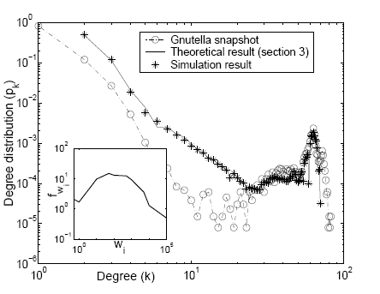
Case study : Gnutella
Inset shows the weight distribution
weight of a node is determined as
  The amount of shared file it possesses
  Inverse of search latency (indicates processing power)
Servents connect with 3 online nodes
  m=3
Observations
Good agreement of theoretical model and data
Some minor deviation specially for the low degree nodes
  In reality, nodes join with variable initial connectivity (m)
  Finite size of the GWebCache
  Rewiring of the existing links

Slide 31
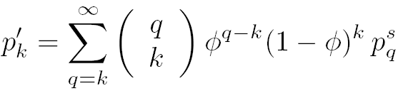

Effect of peer churn
In addition to the bootstrapping, peer churn has an important impact on the topology
Peer churn can be modeled as the removal of nodes from the network
In p2p, highly connected nodes are more stable
  In churn, probability of removal of a node is inversely proportional to the degree of the node.
According to our theory, if the initial degree distribution is pk and probability of removal of a node is f_{k}, then degree distribution after removal of the nodes [B. Mitra et al PRE 2008]
Where

Slide 32
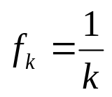
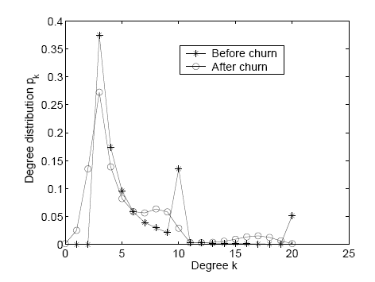
Effect of peer churn
In peer churn
In simulation, we consider a network where fraction of nodes join with cutoff degrees 3, 10 and 20 is 0.5, 0.3 and 0.2.
Total percentage of nodes of nodes removed in peer churn is 21%
Observations : In face of heavy churn, bimodality of the network is still maintained
However, disappearence of old modes and emergence of new modes .

Slide 33
Conclusion
Our formalism have shown that interplay of
  finite bandwidth of nodes,
  their weight and
  current degree
  results superpeer networks
We have calculated the amount of superpeers in the network
We have shown that resource of a machine can be exploited only upto a point
  Putting many high resource machines in the network can in fact be detrimental
Rigorous analysis lead to some suggestions to the network engineers which they may use to improve the servent program.

Slide 34
References
1. P. Karbhari, M. Ammar, A. Dhamdhere, H. Raj, G. Riley and E.
Zegura, “Bootstrapping in Gnutella: A Measurement Study'', In PAM,
April 2004.
2. P. Saroiu, K. Gummadi, S. D. Gribble, “A measurement study of peer to-peer file sharing systems'', In Proceedings of Multimedia Computing and Networking (MMCN) 2002, January 2002
3. G. Bianconi and A.-L. Barabasi, “Competition and multiscaling
in evolving networks'', Europhys. Lett. 54, 436– 442, 2001.
4. “Gnutella sanpshpt'', http://mirage.cs.uoregon.edu/P2P/info.cgi".
5. G. Pandurangan, P. Raghavan, and E. Upfal, “Building
Low-Diameter P2P Networks'', IEEE Journal on Selected Areas in
Communications, Vol. 21, pp. 995-1002, Aug. 2003.

Slide 35
Thank you

