Slide 1
Stability analysis of peer to peer networks
Niloy Ganguly
Department of Computer Science & Engineering
Indian Institute of Technology, Kharagpur
Kharagpur 721302

Slide 2
Complex Network Research Group
Use various ideas of complex networks to model large technological networks – peer-to-peer networks.
Language modeling
Distributed mobile networks
Theoretical development of complex network
niloy@cse.iitkgp.ernet.in Department of Computer Science, IIT Kharagpur, India

Slide 3
Complex Network Research Group
Overlay Management
Searching unstructured networks (IFIP Networks, PPSN, HIPC, Sigcomm (poster), PRL (submitted)).
Understanding behavior of phonemes. (ACL, EACL, Colling, ACS)
Distributed mobile networks (IEEE JSAC (submitted))
Understanding Bi-partite Networks (EPL,PRE(submitted))
niloy@cse.iitkgp.ernet.in Department of Computer Science, IIT Kharagpur, India

Slide 4
Group Activities
Graduate level course – Complex Network
Workshops organized at European Conference of Complex Systems
Published Book volume named “Dynamics on and of Complex Network”
Collaboration with a number of national and international Institutions/Organizations
Projects from government, private companies (DST, DIT, Vodafone, Indo-German, STIC-Asie)
http://cse-web.iitkgp.ernet.in/~cnerg/

Slide 5




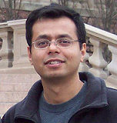
External Collaborators
Technical University Dresden, Germany
Telenor, Norway
CEA, Sacalay, France
Microsoft Research India, Bangalore
University of Duke, USA

Slide 6
Stability analysis of peer to peer networks
Niloy Ganguly
Department of Computer Science & Engineering
Indian Institute of Technology, Kharagpur
Kharagpur 721302

Slide 7
Selected Publications
Generalized theory for node disruption in finite-size complex networks, Physical Review E, 78, 026115, 2008.
Stability analysis of peer to peer against churn. Pramana, Journal of physics, Vol. 71, (No.2), August 2008.
Analyzing the Vulnerability of the Superpeer Networks Against Attack, ACM CCS, 14th ACM Conference on Computer and Communications Security, Alexandria, USA, 29 October - 2 Nov, 2007.
How stable are large superpeer networks against attack? The Seventh IEEE Conference on Peer-to-Peer Computing, 2007
Brief Abstract - Measuring Robustness of Superpeer Topologies, PODC 2007
Poster - Developing Analytical Framework to Measure Stability of P2P Networks, ACM Sigcomm 2006 Pisa, Italy
Department of Computer Science, IIT Kharagpur, India

Slide 8
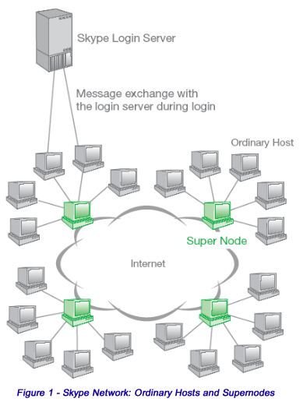
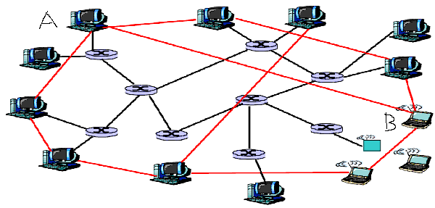
Peer to peer and overlay network
An overlay network is built on top of physical network
Nodes are connected by virtual or logical links
Underlying physical network becomes unimportant
Interested in the complex graph structure of overlay
Department of Computer Science, IIT Kharagpur, India

Slide 9
Dynamicity of overlay networks
Peers in the p2p system leave network randomly without any central coordination (peer churn)
Important peers are targeted for attack
  Makes overlay structures highly dynamic in nature
  Frequently it partitions the network into smaller fragments
  Communication between peers become impossible
Department of Computer Science, IIT Kharagpur, India

Slide 10
Problem definition
Investigating stability of the peer to peer networks against the churn and attack
Developing an analytical framework for finite as well as infinite size networks
Impact of churn and attack upon the network topology
Examining the impact of different structural parameters upon stability
  Size of the network
  degree of peers, superpeers
  their individual fractions
Department of Computer Science, IIT Kharagpur, India

Slide 11
Steps followed to analyze
Modeling of
  Overlay topologies
    pure p2p networks, superpeer networks, hybrid networks
  Various kinds of churn and attacks
Computing the topological deformation due to failure and attack
Defining stability metric
Developing the analytical framework for stability analysis
Validation through simulation
Understanding the impact of structural parameters
Department of Computer Science, IIT Kharagpur, India

Slide 12
Modeling overlay topologies
Topologies are modeled by various random graphs characterized by degree distribution p_{k}
  Fraction of nodes having degree k
Examples:
Erdos-Renyi graph
Scale free network
Superpeer networks
Department of Computer Science, IIT Kharagpur, India

Slide 13
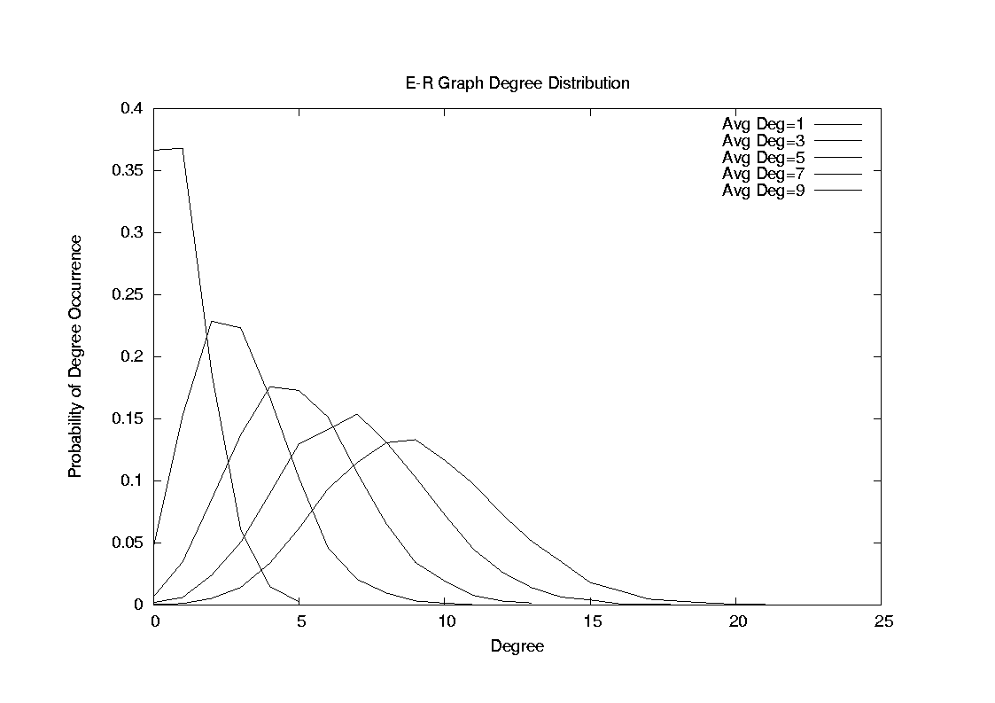
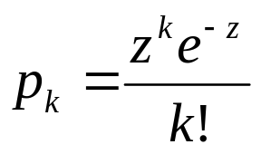
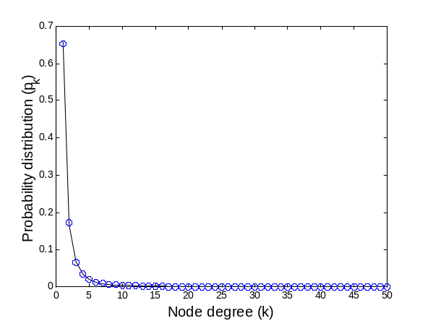
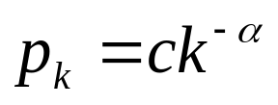
Modeling overlay topologies:
E-R graph, scale free networks
Erdos-Renyi graph
  Degree distribution follows Poisson distribution.
Scale free network
  Degree distribution follows power law distribution
Average degree
Department of Computer Science, IIT Kharagpur, India

Slide 14



Modeling: Superpeer networks
Superpeer network (KaZaA, Skype) - small fraction of nodes are superpeers and rest are peers
  Modeled using bimodal degree distribution
    r = fraction of peers
    k_{l} = peer degree
    k_{m} = superpeer degree
  p _{kl} = r
  p _{km} = (1-r)
Department of Computer Science, IIT Kharagpur, India

Slide 15
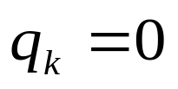

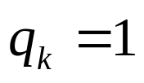
Modeling: Attack
f_{k} probability of removal of a node of degree k after the disrupting event
Deterministic attack
  Nodes having high degrees are progressively removed
    f_{k}=1 when k>k_{max}
    0< f_{k}< 1 when k=k_{max}
    f_{k}=0 when k<k_{max}
Degree dependent attack
  Nodes having high degrees are likely to be removed
  Probability of removal of node having degree k is proportional to k^{γ}
Department of Computer Science, IIT Kharagpur, India

Slide 16
Deformation of the network due to node removal
Removal of a node along with its adjacent links changes the degrees of its neighbors
  Hence changes the topology of the network
Let initial degree distribution of the network be p_{k}
Probability of removal of a node having degree k is f_{k}
We represent the new degree distribution p_{k}’ as a function of p_{k} and f_{k}
Department of Computer Science, IIT Kharagpur, India

Slide 17
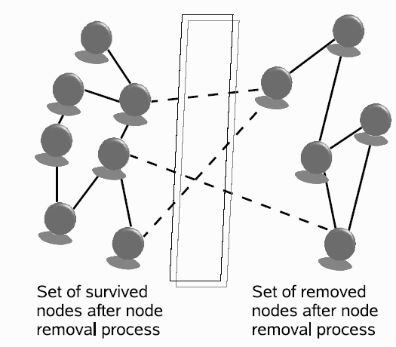
Deformation of the network due to node removal
In this diagram, left node set denotes the survived nodes (N∑p_{k}(1-f_{k})) and right node set denotes the removed nodes (N∑p_{k}f_{k})
The change in the degree distribution is due to the edges removed from the left set
We calculate the number of edges connecting left and right set (E)
Department of Computer Science, IIT Kharagpur, India

Slide 18
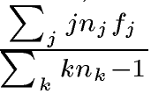

Deformation of the network due to node removal
The total number of tips in the surviving node set is
The probability of finding a random tip that is going to be removed is
The ‘-1’ signifies that a tip cannot
connect to itself.
The total number of edges running between two subset
Department of Computer Science, IIT Kharagpur, India

Slide 19

Deformation of the network due to node removal
Probability of finding an edge in the surviving (left) subset that is connected to a node of removed (right) subset
Department of Computer Science, IIT Kharagpur, India

Slide 20
Deformation of the network due to node removal
Removal of a node reduces the degree of the survived nodes
Node having degree > k becomes a node having degree k by losing one or more edges
Probability that a survived node will lose one edge becomes
Department of Computer Science, IIT Kharagpur, India

Slide 21


Deformation of the network due to node removal
Probability of finding a node having degree k (p_{k}’) after removal of nodes following f_{k}, depends upon
Probability that nodes having degree k, k+1, k+2 … will lose 0, 1, 2, etc edges respectively to become a node having degree k
Probability that nodes having degree k, k+1, k+2 … will sustain k number of edges with them
Hence
Where denotes the fraction of nodes in the survived (left) node set having degree q
Department of Computer Science, IIT Kharagpur, India

Slide 22
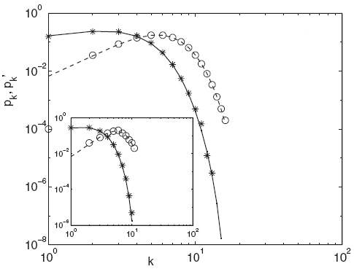
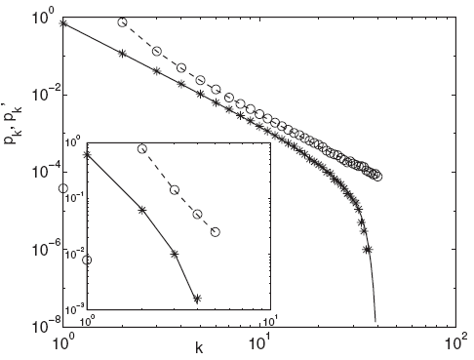



Deformation of the network due to node removal
Degree distribution of the Poisson and power law networks after the attack of the form
Main figure shows for N=10⁵ and inset shows for N=50.
Department of Computer Science, IIT Kharagpur, India

Slide 23
Stability Metric:
Percolation Threshold
Initially all the nodes in the network are connected
Forms a single component
Size of the giant component is the order of the network size
Giant component carries the structural properties of the entire network
Nodes in the network are connected and form a single component
Department of Computer Science, IIT Kharagpur, India

Slide 24
Stability Metric:
Percolation Threshold
f fraction of nodes removed
Initial single connected component
Giant component still exists
Department of Computer Science, IIT Kharagpur, India

Slide 25
Stability Metric:
Percolation Threshold
f_{c} fraction of nodes removed
f fraction of nodes removed
Initial single connected component
The entire graph breaks into smaller fragments
Giant component still exists
Therefore f_{c} becomes the percolation threshold
Department of Computer Science, IIT Kharagpur, India

Slide 26


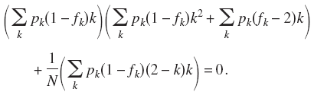
Percolation threshold
Percolation condition of a network having degree distribution p_{k} can be given as
After removal of f_{k} fraction of nodes, if the degree distribution of the network becomes pk’, then the condition for percolation becomes
Which leads to the following critical condition for percolation
Department of Computer Science, IIT Kharagpur, India

Slide 27


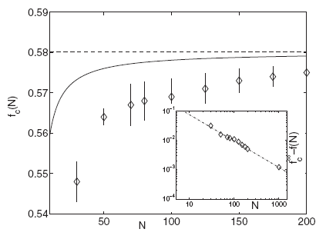
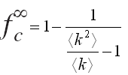
Percolation threshold for finite size network
The percolation threshold for random failure in the network of size N
where the percolation threshold of infinite network
Experimental validation
for E-R networks
Our equation shows the impact of network size N on the percolation threshold.
Department of Computer Science, IIT Kharagpur, India

Slide 28


Percolation threshold for infinite size network
In infinite network , the critical condition for percolation reduces to
Degree distribution Peer dynamics
The critical condition is applicable
  For any kind of topology (modeled by p_{k})
  Undergoing any kind of dynamics (modeled by 1-q_{k})
Department of Computer Science, IIT Kharagpur, India

Slide 29
Outline of the results
Networks under consideration | Disrupting events
Superpeer networks (Characterized by bimodal degree distribution ) | Degree independent failure or random failure
 | Degree dependent failure
 | Degree dependent attack
 | Deterministic attack (special case of degree dependent attack ??)
Department of Computer Science, IIT Kharagpur, India

Slide 30
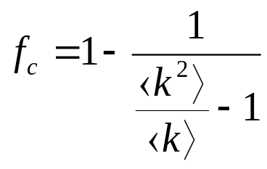
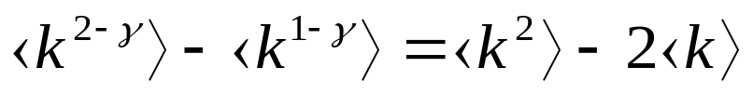
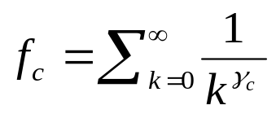

Stability against various failures
Degree independent random failure :
Percolation threshold
Degree dependent random failure :
Critical condition for percolation becomes
Thus critical fraction of node removed becomes
  where which satisfies the above equation
Department of Computer Science, IIT Kharagpur, India

Slide 31
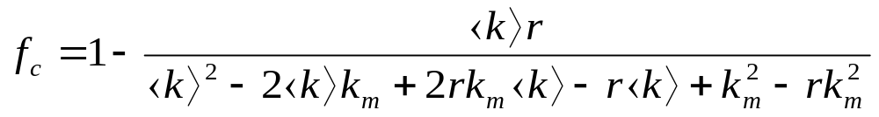
Stability against random failure
For superpeer networks
Average degree of the network
Superpeer degree
Fraction of peers
Department of Computer Science, IIT Kharagpur, India

Slide 32

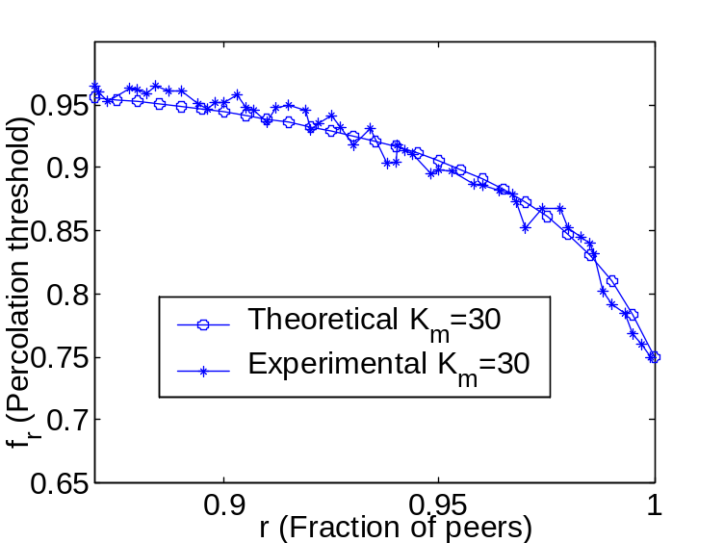
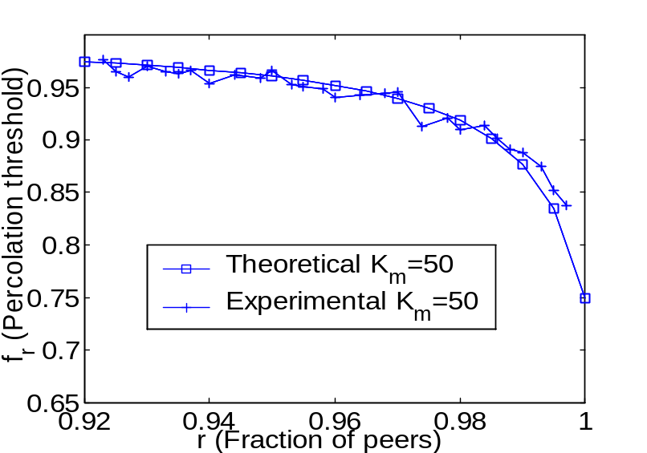
Stability against random failure
(superpeer networks)
Comparative study between theoretical and experimental results
We keep average degree fixed
Department of Computer Science, IIT Kharagpur, India

Slide 33
Stability against random failure
(superpeer networks)
Comparative study between theoretical and experimental results
Increase of the fraction of superpeers (specially above 15% to 20%) increases stability of the network
Department of Computer Science, IIT Kharagpur, India

Slide 34
Stability against random failure
(superpeer networks)
Comparative study between theoretical and experimental results
There is a sharp fall of f_{c} when fraction of superpeers is less than 5%
Department of Computer Science, IIT Kharagpur, India

Slide 35

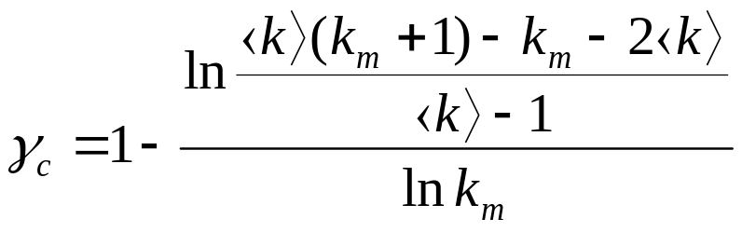
Stability against degree dependent failure (superpeer networks)
In this case, the value of critical exponent which percolates the network
Average degree of the network
Superpeer degree
Department of Computer Science, IIT Kharagpur, India

Slide 36
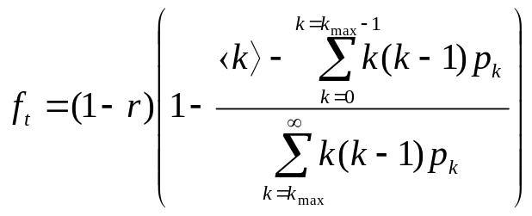
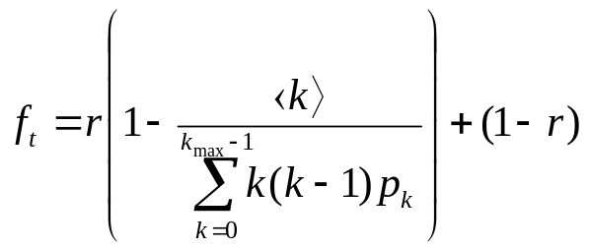
Stability against deterministic attack
  Case 1
  Removal of a fraction of high degree nodes is sufficient to breakdown the network
  Percolation threshold
Case 2
Removal of all the high degree nodes is not sufficient to breakdown the network. Have to remove a fraction of low degree nodes
  Percolation threshold
Department of Computer Science, IIT Kharagpur, India

Slide 37
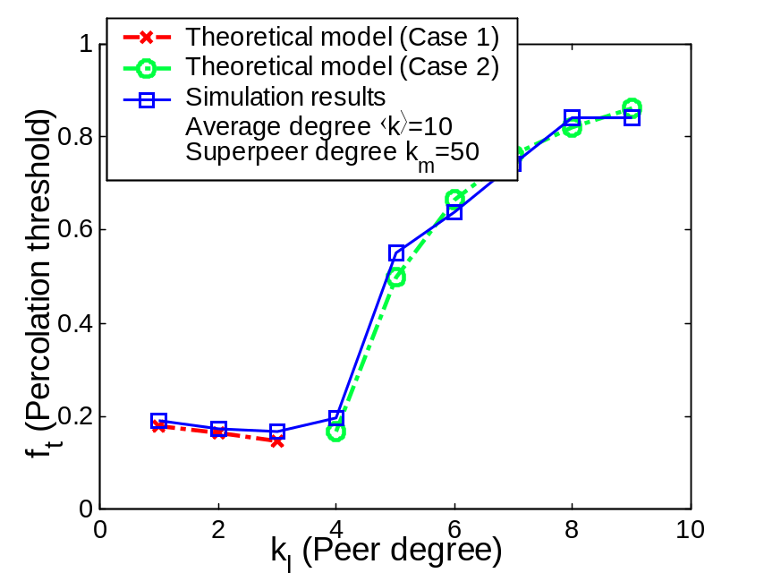
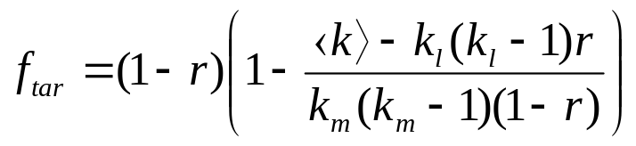
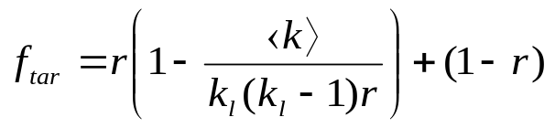
Stability against deterministic attack (superpeer networks)
Case 1:
  Removal of a fraction of superpeers is sufficient to breakdown the network
Case 2:
  Removal of all the superpeers is not sufficient to breakdown the network
  Have to remove a fraction of peers nodes.
Fraction of superpeers in the network
Department of Computer Science, IIT Kharagpur, India

Slide 38
Stability of superpeer networks against deterministic attack
Two different cases may arise
Case 1:
  Removal of a fraction of high degree nodes are sufficient to breakdown the network
Case 2:
  Removal of all the high degree nodes are not sufficient to breakdown the network
  Have to remove a fraction of low degree nodes
Interesting observation in case 1
  Stability decreases with increasing value of peers – counterintuitive
Department of Computer Science, IIT Kharagpur, India

Slide 39

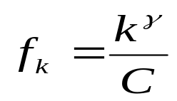

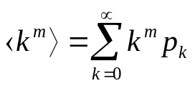
Stability of superpeer networks against degree dependent attack
Probability of removal of a node is directly proportional to its degree
Calculation of normalizing constant C
Maximum value = 1
  Hence minimum value of
This yields an inequality
Critical condition
Department of Computer Science, IIT Kharagpur, India

Slide 40

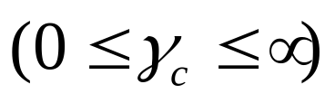
Stability of superpeer networks against degree dependent attack
Probability of removal of a node is directly proportional to its degree
Calculation of normalizing constant C
Maximum value ₌ ₁
  Hence minimum value of
The solution set of the above inequality can be
  either bounded
  or unbounded
Department of Computer Science, IIT Kharagpur, India

Slide 41
Degree dependent attack:
Impact of solution set
Three situations may arise
  Removal of all the superpeers along with a fraction of peers – Case 2 of deterministic attack
  Removal of only a fraction of superpeer – Case 1 of deterministic attack
  Removal of some fraction of peers and superpeers
Department of Computer Science, IIT Kharagpur, India

Slide 42


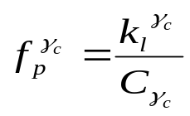



Degree dependent attack:
Impact of solution set
Three situations may arise
  Case 2 of deterministic attack
    Networks having bounded solution set
    If ,
  Case 1 of deterministic attack
    Networks having unbounded solution set
    If ,
  Degree Dependent attack is a generalized case of deterministic attack
Department of Computer Science, IIT Kharagpur, India

Slide 43
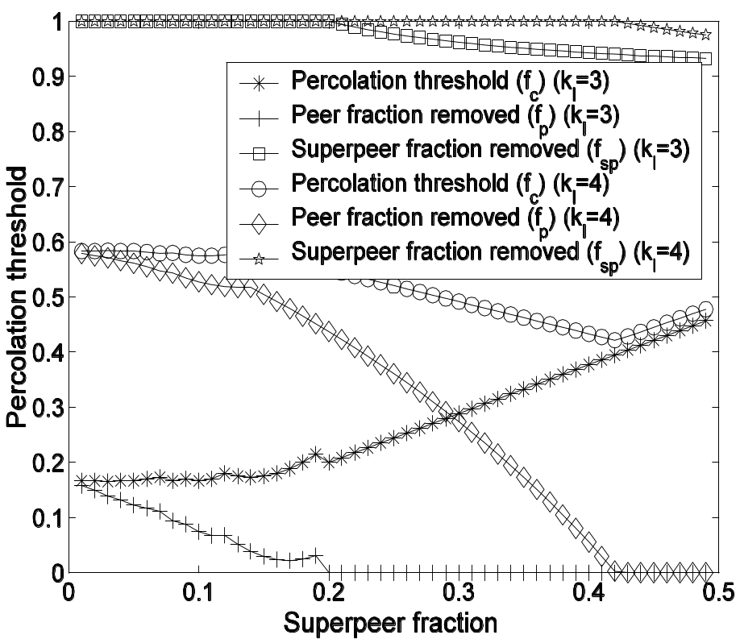
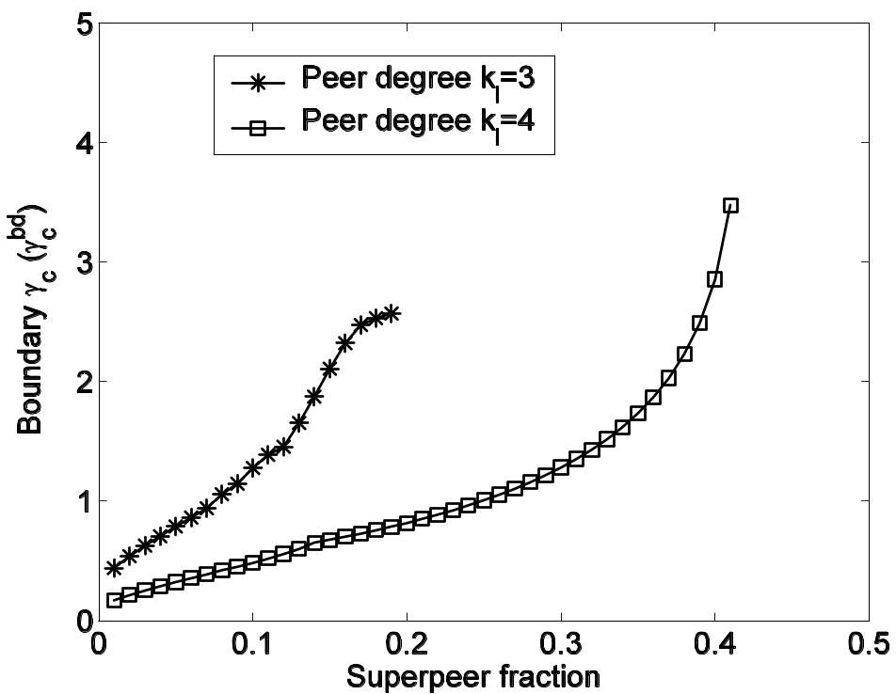
Degree dependent attack:
Impact of solution set
Three situations may arise
  Case 2 of deterministic attack
    Networks having bounded solution set
    If ,
  Case 1 of deterministic attack
    Networks having unbounded solution set
    If ,
  Degree Dependent attack is a generalized case of deterministic attack
Department of Computer Science, IIT Kharagpur, India

Slide 44
Summarization of the results
Network size has a profound impact upon the stability of the network
  Our theory is capable in capturing both infinite and finite size networks
Random failure
  Drastic fall of the stability when fraction of superpeers is less than 5%
In deterministic attack, networks having small peer degrees are very much vulnerable
Increase in peer degree improves stability
    Superpeer degree is less important here!
In degree dependent attack,
  Stability condition provides the critical exponent
    Amount of peers and superpeers required to be removed is dependent upon
Department of Computer Science, IIT Kharagpur, India

Slide 45
Conclusion
Contribution of our work
Development of general framework to analyze the stability of finite
as well as infinite size networks
  Modeling the dynamic behavior of the peers using degree independent failure as well as attack.
  Comparative study between theoretical and simulation results to show the effectiveness of our theoretical model.
  Work in progress
  Correlated Network, Networks with same assortative coefficient, identify networks with equal robustness
Department of Computer Science, IIT Kharagpur, India

Slide 46
Conclusion
Contribution of our work
Development of general framework to analyze the stability of finite
as well as infinite size networks
  Modeling the dynamic behavior of the peers using degree independent failure as well as attack.
  Comparative study between theoretical and simulation results to show the effectiveness of our theoretical model.
  Future work
  Perform the experiments and analysis on more realistic network
Department of Computer Science, IIT Kharagpur, India

Slide 47

Thank you
Department of Computer Science, IIT Kharagpur, India

Slide 48
Stability Analysis - Talk overview
Introduction and problem definition
Modeling peer to peer networks and various kinds of failures and attacks
Development of analytical framework for stability analysis
Validation of the framework with the help of simulation
Impact of network size and other structural parameters upon network vulnerability
Conclusion
Department of Computer Science, IIT Kharagpur, India

