Slide 1
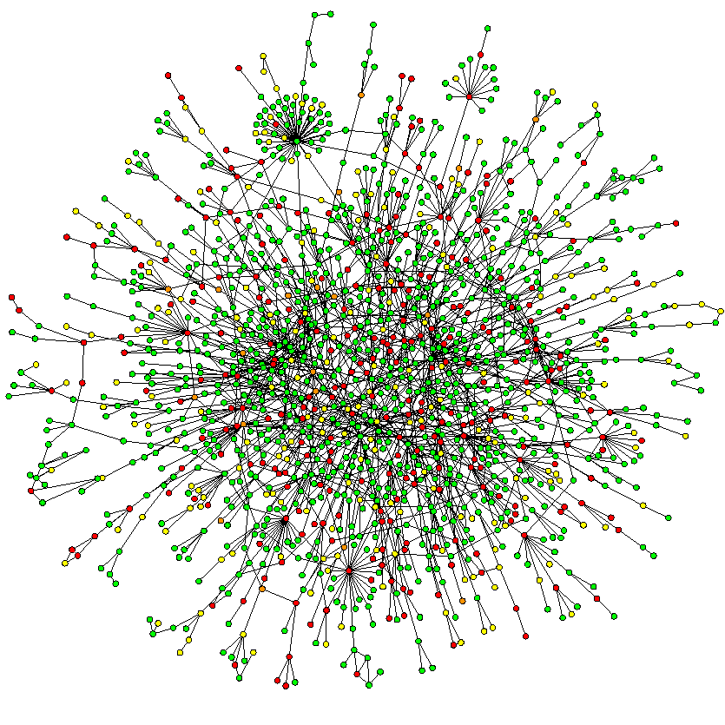
Research Scopes in Complex Network
Niloy Ganguly

Slide 2
Complex System
Non-trivial properties and patterns emerging from the interaction of a large number of simple entities
Self-organization: The process through which these patterns evolve without any external intervention or central control
Emergent Property or Emergent Behavior: The pattern that emerges due to self-organization

Slide 3





Complex System to Complex Network
Statistical Mechanics
Statistics
Studied under
Uses
Complex Network
Complex Systems
Modeled as
Engi-neering
Studied under
Uses
Graph Theory

Slide 4
Complex Network Theory
Handy toolbox for modeling Complex Systems
Marriage of Graph theory and Statistics
Complex because:
  Non-trivial topology
  Difficult to specify completely
  Usually large (in terms of nodes and edges)
Provides insight into the nature and evolution of the system being modeled

Slide 5
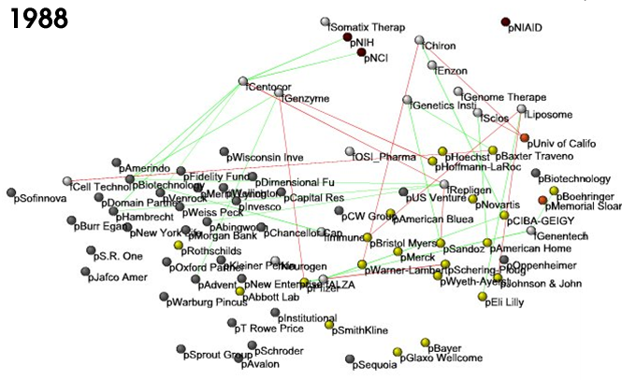
Business ties in US biotech-industry
Nodes: companies: investment
pharma
research labs
public
biotechnology
Links: financial
R&D collaborations
http://ecclectic.ss.uci.edu/~drwhite/Movie

Slide 6
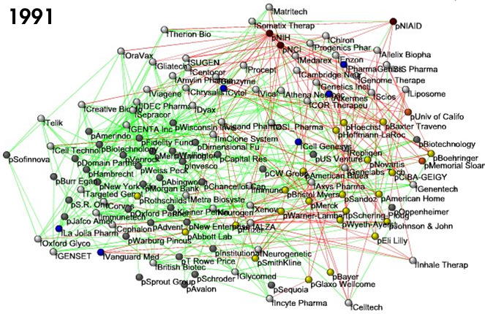
Business ties in US biotech-industry
Nodes: companies: investment
pharma
research labs
public
biotechnology
Links: financial
R&D collaborations
http://ecclectic.ss.uci.edu/~drwhite/Movie

Slide 7
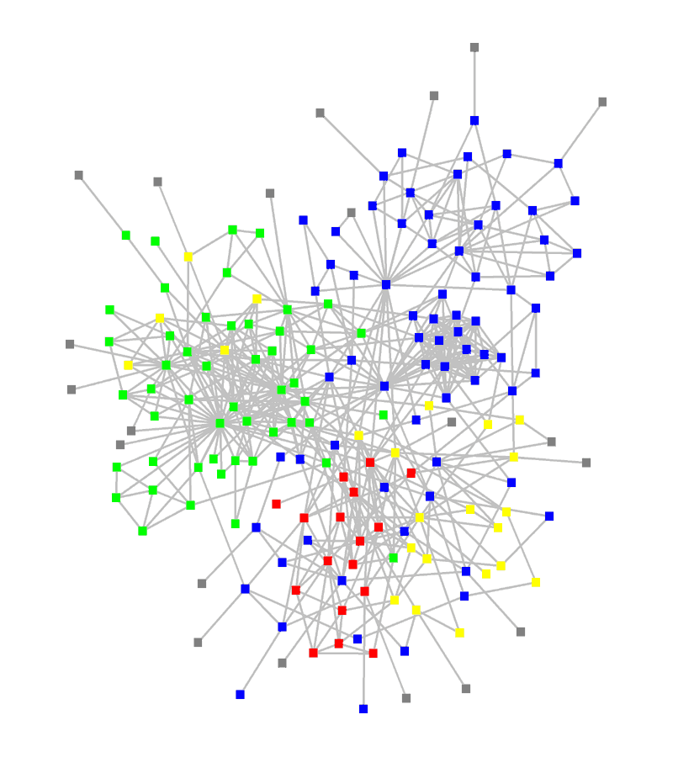
Structure of an organization
Red, blue, or green: departments
Yellow: consultants
Grey: external experts
www.orgnet.com

Slide 8
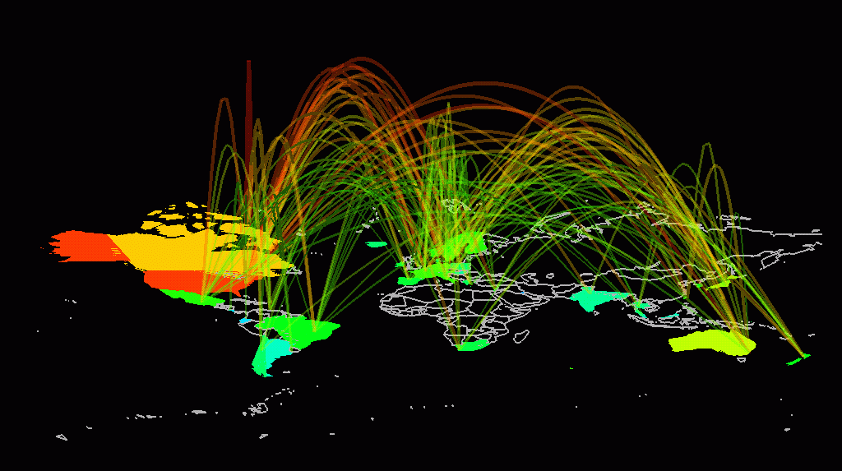
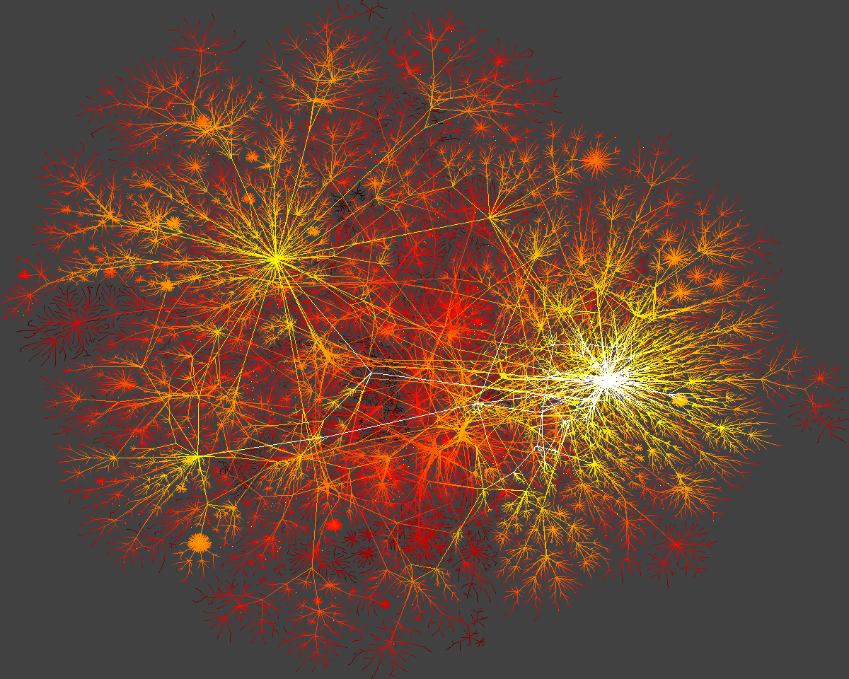
Internet

Slide 9
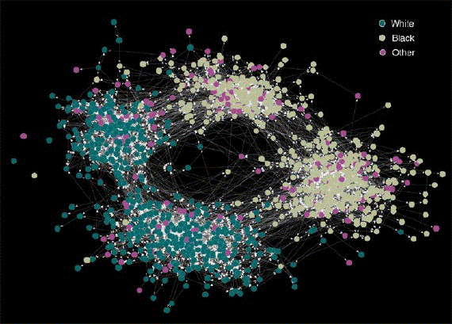
Friendship Network

Slide 10
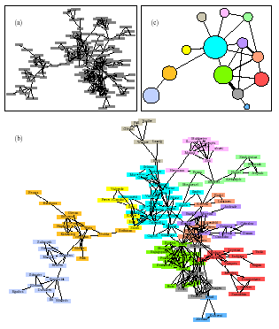
Network Collaboration Network

Slide 11

Swedish sex-web
Nodes: people (Females; Males)
Links: sexual relationships
4781 Swedes; 18-74;
59% response rate.
Liljeros et al. Nature 2001

Slide 12
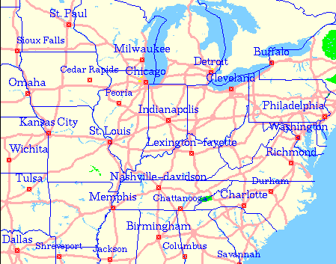
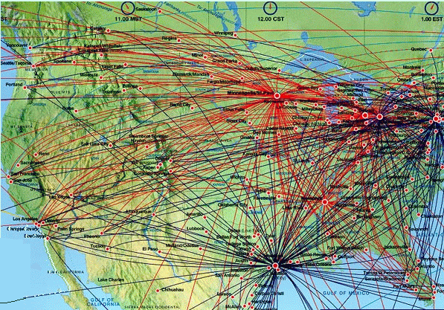
Road and Airlines Network
-

Slide 13
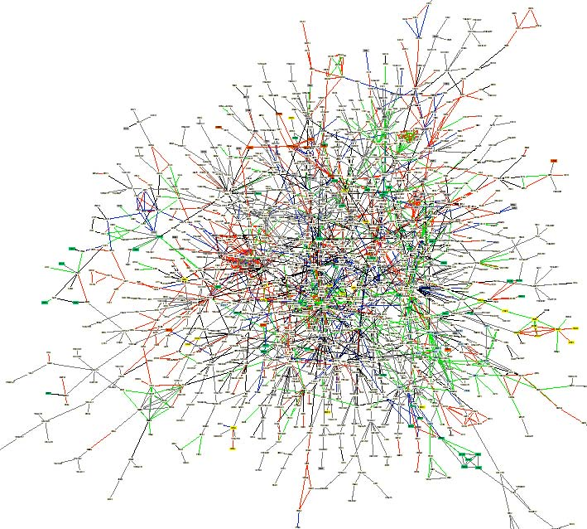
Yeast protein-protein interaction network

Slide 14
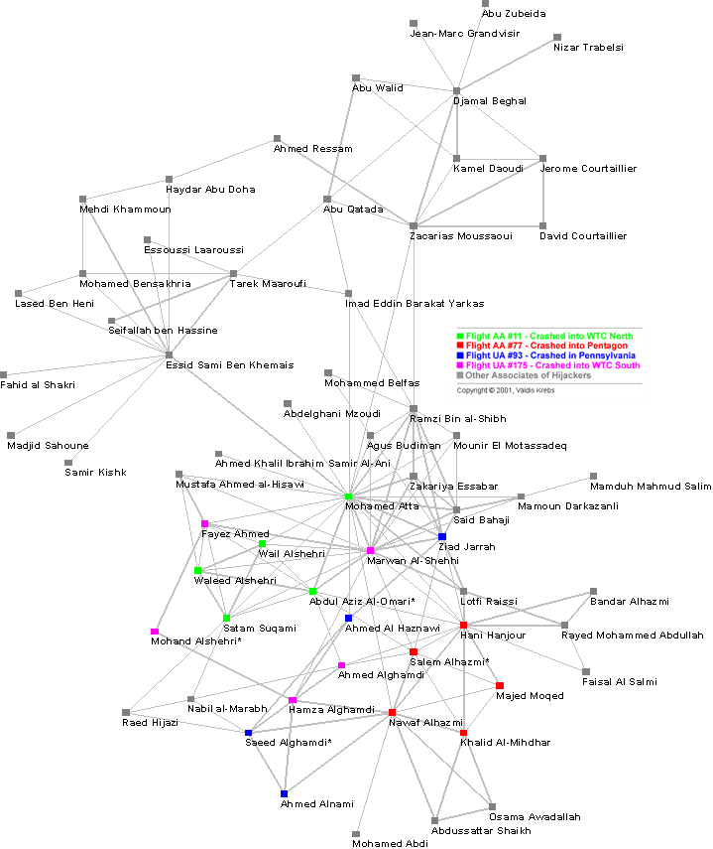
9-11 Terrorist Network

Slide 15
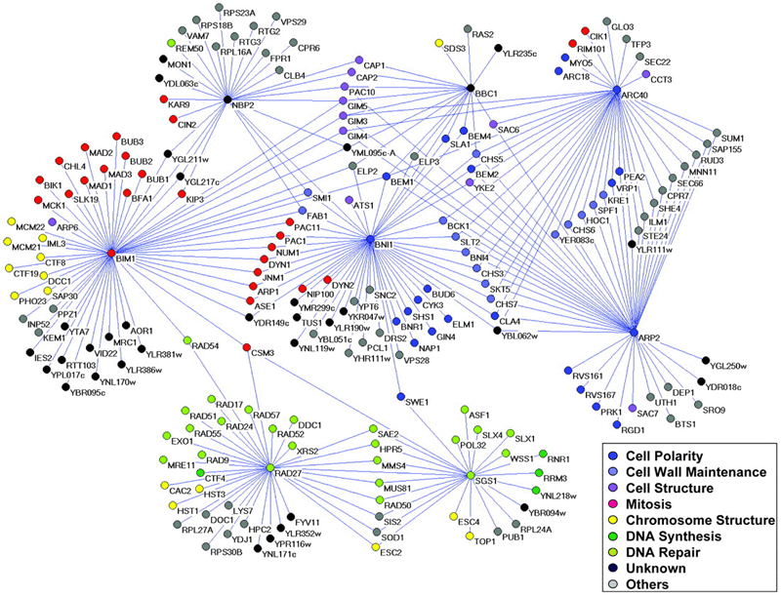
Genetic interaction network

Slide 16
What Questions can be asked
Does these networks display some symmetry?
Are these networks creation of intelligent objects or they have emerged?
How have these networks emerged?
What are the underlying simple rules leading to their complex formation?

Slide 17
What Questions can be asked
Can we predict some outcomes/ make statements about the health of the system represented by the network
Are these networks robust against failure
Does these networks help in information flow
How can we engineer (build) such network, (engineering complex systems).

Slide 18
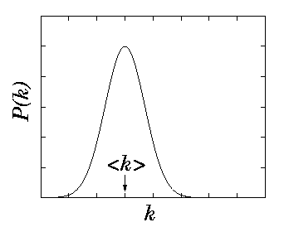
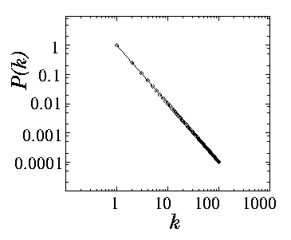
Symmetry
Poisson distribution
Power Law distribution
Exponential Network
Scale free Network

Slide 19
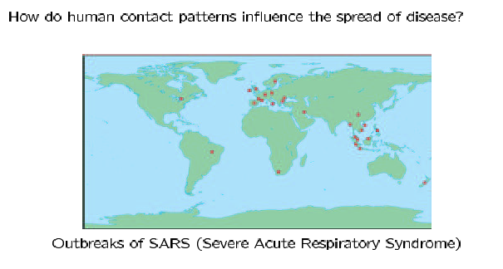
The Small World Effect

Slide 20
The Small World Effect
Even in very large social networks, the average distance between nodes is usually quite short.
Milgram’s small world experiment:
Target individual in Boston
Initial senders in Omaha, Nebraska
Each sender was asked to forward a packet to a friend who was closer to the target
Friends asked to do the same
Result: Average of ‘six degrees’ of separation.
S. Milgram, The small world problem, Psych. Today, 2 (1967), pp. 60-67.

Slide 21
9-11 Terrorist (?) Network
How to conduct investigation

Slide 22

Swedish sex-web
Nodes: people (Females; Males)
Links: sexual relationships
Internet
Robust against random failure
Vulnerable against attack
4781 Swedes; 18-74;
59% response rate.
Liljeros et al. Nature 2001

Slide 23
Some Interesting Research Areas
Language domain
  Consonants (Language) Networks
  Word network
  Language evolution
Social Network domain
  Collaboration Networks
  Friendship network
Biological Network domain
  Protein-protein interaction
  Gene regulatory network
Technological networks domain
  Delay Tolerant Network
  Internet
  Peer-to-Peer Network

Slide 24
Peer to Peer networks
in the context of complex networks

Slide 25
Peer to Peer architecture
Limitations of client server achitecture
Scalability : Hard to achieve
Poor fault tolerance : Single point of failure
Administration : Highly required
Server
Client
Client
Internet
Client
Client
Node
Peer to Peer networks
Node
Node
Internet
Node
Node
No centralized data source
File sharing and other applications like IP telephony, distributed storage, publish subscribe system etc
All peers act as both clients and servers
  Provide and consume data
  Any node can initiate a connection

Slide 26
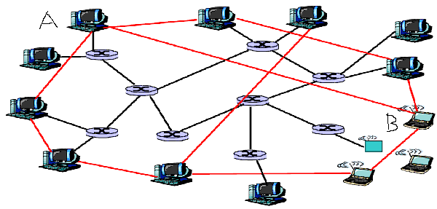
Overlay networks
Physical link
Overlay edge
An overlay network is built on top of physical network
Nodes are connected by virtual or logical links
Search and information flow follows overlay structure which makes underlying physical network unimportant

Slide 27
Why overlay networks are Complex?
This large number of computers are connected in overlay networks
Dynamics in the network
  Peers in the p2p system leave network randomly without any central coordination
Network Evolution
  Peers join the network by establishing a link with some existing node of the p2p network.
Dynamics of overlay network makes the network complex in nature

Slide 28
Why overlay networks are Complex?
The most important process in P2P networks is the search.
In a search process there exists an inherent tradeoff between utilization of bandwidth and QOS i.e. latency.
The increasing popularity and rapidly growing size of P2P networks in recent years gives rise to some non trivial issues such as overlay congestion, flash crowd, free-riding.
Main challenge is to design fast, scalable as well as resource efficient search strategies.

Slide 29
Complex Network Research Group at IIT Kharagpur

Slide 30
Group Activities
5 full time Research scholars
Several students are attached
Workshop organized at European Conference of Complex Systems, Dresden, Germany
Publishing Book volume named “Dynamics on and of Complex Network”
Collaboration with a number of national and international Institutions/Organizations
Several research publications.
Projects from government, private companies
http://cse-web.iitkgp.ernet.in/~cnerg/

Slide 31




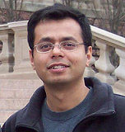
External Collaborators
Technical University Dresden, Germany
Telenor, Norway
Complex System Institute Paris, France
Microsoft Research India, Bangalore
University of Duke, USA

Slide 32
Thank You

