Slide 1
Self Regulated Search in Unstructured Peer-to-Peer Networks
Niloy Ganguly
Department of Computer Science and Engineering
IIT Kharagpur

Slide 2
Talk Overview
Peer to peer networks and autonomic computing
Search in peer to peer networks
Algorithms proposed
  Regulated message Passing
  Evolving semi-structured networks
Conclusion

Slide 3
Autonomic Computing
Autonomic Computing - analogy to the human autonomic nervous system.
Nature-inspired Computing
Initiative started by IBM in 2001.
Aim is to create self-managing systems to overcome their rapidly growing complexity and to enable their further growth.

Slide 4

Functional Areas
Role of human operator not to control the system directly instead define general policies and rules that serve as an input for the self-management process.

Slide 5
Functional Areas
Self-configuring
  adaptation to IT system changes, such as new nodes becoming available or going offline
Self-optimising
  tuning resources and load balancing
Self-protecting
  guard against damage from attacks or failures
Self-healing
  recovery from, or work around, failed components

Slide 6
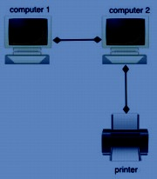
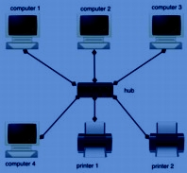
Peer To Peer Network
Most Direct Method of Connecting Computers
  Simple
  Inexpensive
  No Boss
  No Regulation

Slide 7
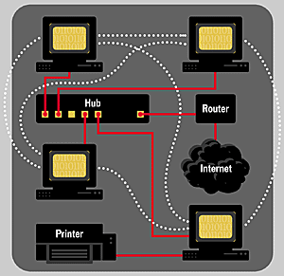
Peer To Peer Network
PCs at the edge of the network are called “Peers”
Peers can retrieve objects directly from each other
Advantages of a P2P Network
A large collection of peers may be available for content distribution--sometimes millions!
User takes advantage of the network’s currently available resources.

Slide 8
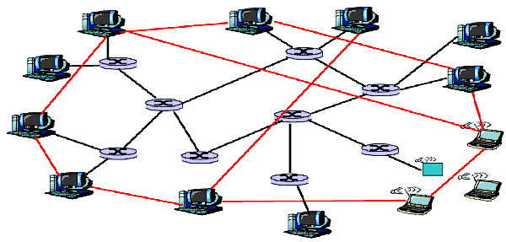
Peer-to-Peer Systems

Slide 9
Unstructured P2P and Autonomic Computing
Unstructured P2P – No rule exists for data placement and overlay topology is arbitrary. Ex : Gnutella
Self-organizing
Self-configuring
  adaptation to IT system changes, such as new nodes becoming available or going offline
Self-optimising
  tuning resources and load balancing (connectivity according to the type of connection used)
Self-protecting
  guard against damage from attacks or failures
Self-healing
  recovery from, or work around, failed components (performance degradation due to failure quickly recovered)

Slide 10
Search in Unstructured P2P
Non-deterministic Algorithms -
Random walk, Flooding
5
a
4
b
6?
3
d
6
e
2
c
6!!!
6?
6?
g
7
6?
1
6?
f
6?
Random walk

Slide 11
Search in Unstructured P2P
Problems in basic search schemes
  Flooding is fast.
  Random walk is efficient.
Objective
  Design a search scheme which is
    Fast i.e. reduces query response time.
    Efficient i.e uses minimum query packets.
Strategy
  Regulated message Passing
  Evolving semi-structured networks

Slide 12
Immune Inspired Message Forwarding Algorithms
Proliferation/Mutation Algorithms
Simple Proliferation Algorithm (P)
Restricted Proliferation Algorithm (RP)
Random Walk Algorithms
Simple Random Walk Algorithm (RW)
Restricted Random Walk Algorithm (RRW)

Slide 13
Proliferation/Mutation Algorithms
Simple Proliferation/Mutation Algorithm (PM)
Produce N messages from the single message. (Mutate one bit with prob. β)
Spread them to the neighbouring nodes
a
b
Mutated
d
e
N = 3
c
g
f

Slide 14
Proliferation/Mutation Algorithms
Restricted Proliferation/Mutation Algorithm (RPM)
Produce N messages from the single message. (Mutate one bit with prob. β)
Spread them to the neighbouring nodes if free
a
b
d
e
N = 3
c
g
f

Slide 15
Proliferation Controlling Strategy
Proliferate more when content and query packets are similar
Affinity-driven proliferation

Slide 16
Immunity Inspired Search
Affinity-governed proliferation based search algorithm
Message proliferation
Similarity (message, searched item)
Interaction between message and searched item
P2p Network
Query Message
Searched Item
Human Body
Antibody
Antigen

Slide 17
Evaluation Metrics
1. Network coverage efficiency
No of time steps required to cover the entire network
2. Average Cost
No of message packets (average over each time step) needed to cover a network
Follow Fairness criteria - All processes work with same average number of packets.

Slide 18
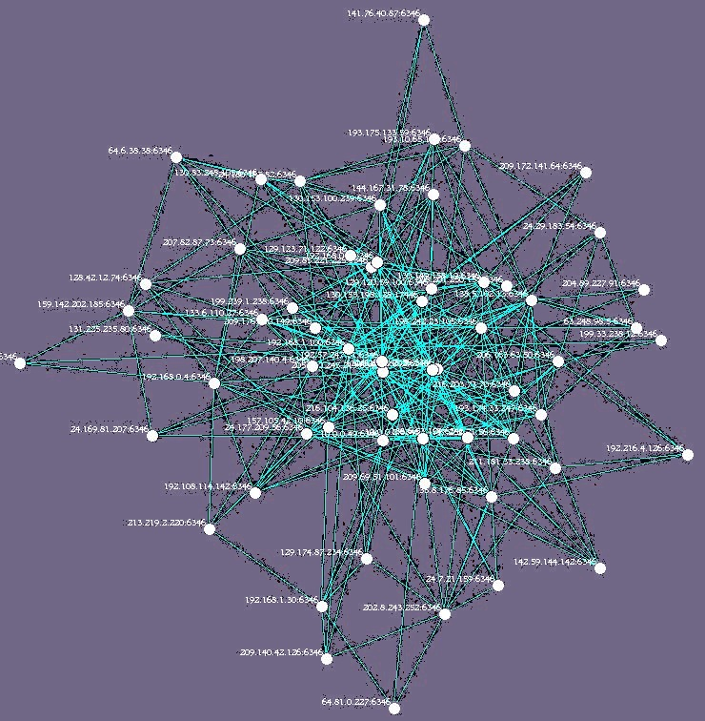
Experiment
Experiment Coverage – Calculate time taken to cover the entire
network after initiation of a search from a randomly selected initial
node. Repeated for 500 such searches.

Slide 19
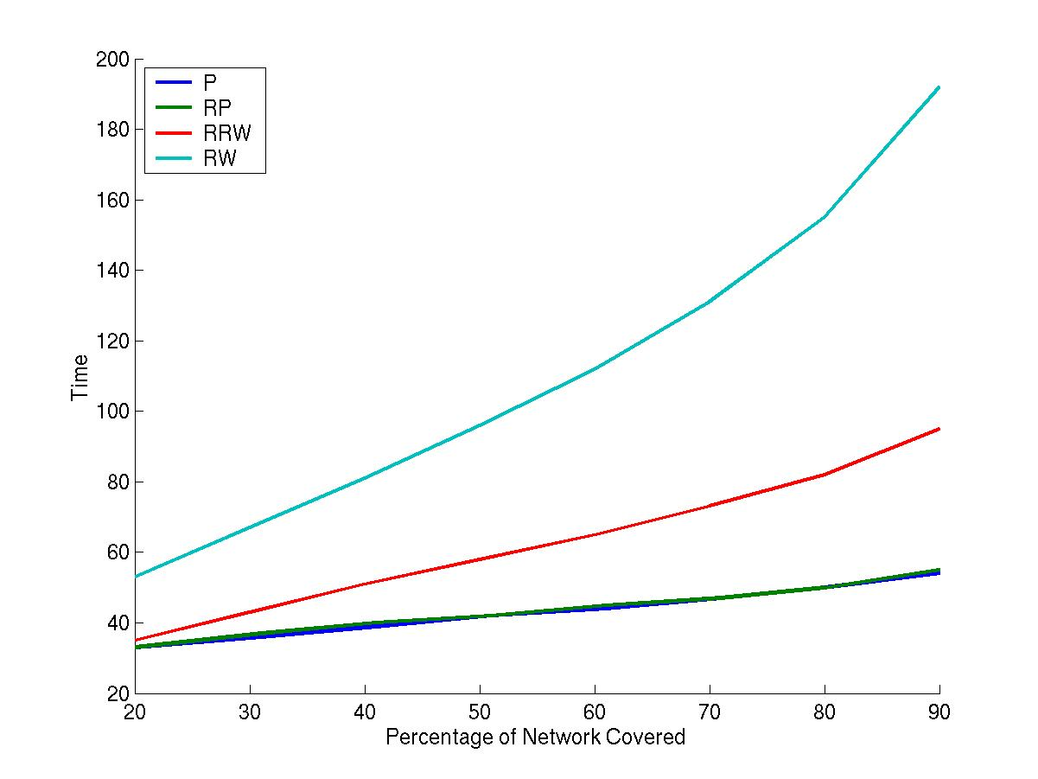
Performance of Different Schemes
----- P
----- RP
----- RRW
----- RW
20 40 60 80 100 120 140 160 180 200
Time
20 30 40 50 60 70 80 90
Percentage of Network Covered

Slide 20
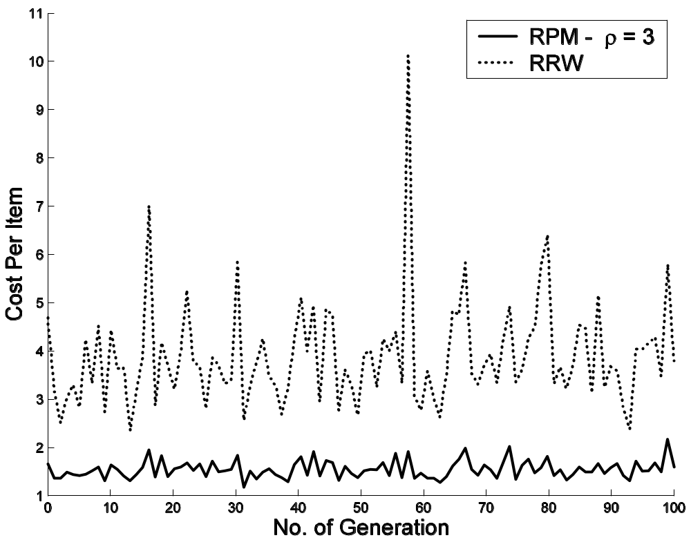
Search Efficiency and Cost Regulation
1 Generation = 100 search attempts

Slide 21
Result Summary
Proliferation is better than random walk
Proliferation is performing at par with restricted proliferation except producing large number of packets
If the item is present in more number then more packets are produced.

Slide 22
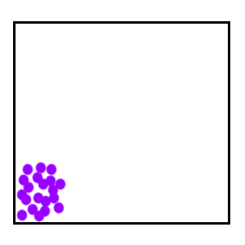
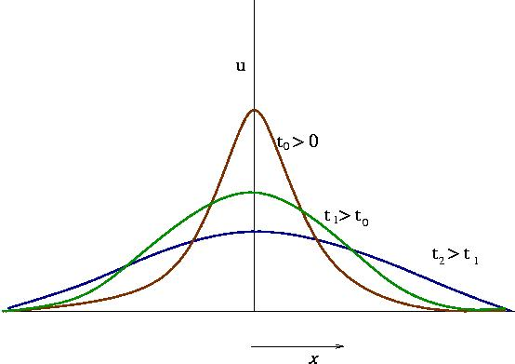
From Nature to Nature - Analytical Insights
Random Walk = Diffusion

Slide 23
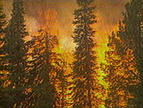
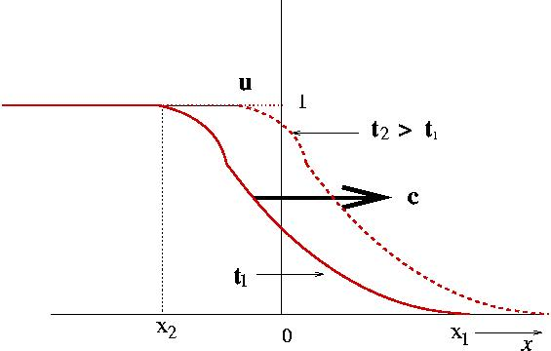
Analytical Insights
Proliferation = Reaction-Diffusion System
(Diffusion + Addition of New Materials)

Slide 24
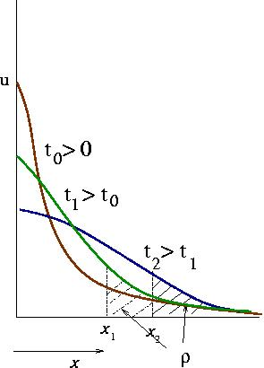
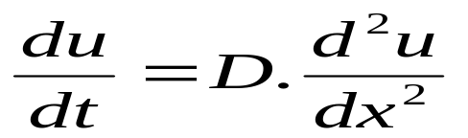
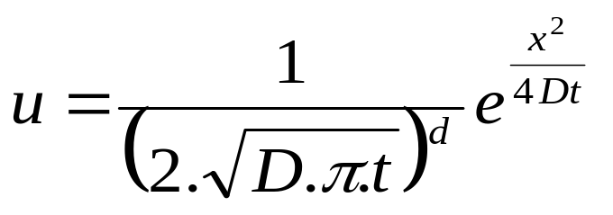
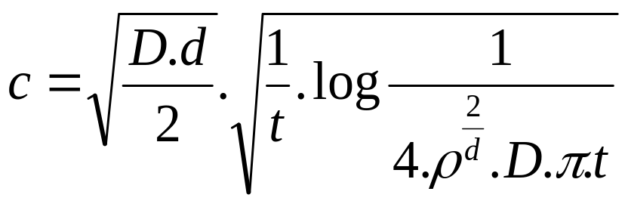
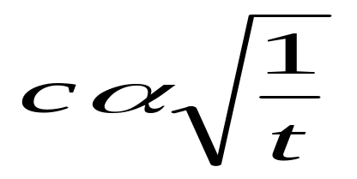
Calculating Speed of Diffusion
Calculate Speed of a finite density ρ
Diffusion Equation
pdf of a concentration u
Speed (c) of a concentration ρ

Slide 25

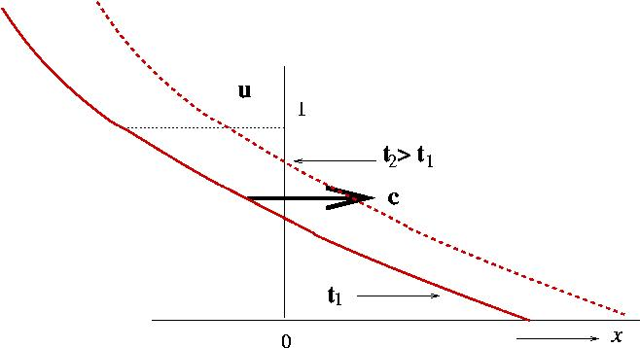
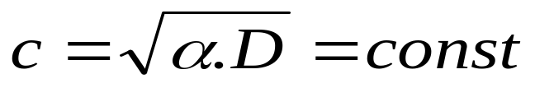
Calculating Speed of Reaction-Diffusion
Proliferation – Each time α fraction of concentration is added to the system
Reaction- Diffusion Equation:

Slide 26
Result Summary and realizations
Proliferation is better than random walk
Proliferation is performing at par with restricted proliferation except producing large number of packets

Slide 27
Result Summary and realizations
Fast coverage of nodes.
Minimum usage of message packets.
Can we quantify Fast and Minimum (what exactly does it mean?)
or
At least can we express it qualitatively in terms of message movement

Slide 28
Self Regulating Proliferation
Have proliferation in such a way, so that
each individual
packets have just enough place to explore
without overlapping with others
Minimum – Use as few packets as possible so that each
packet has individual area to explore without colliding with other packets.
Fast - Fastest possible under the above restriction of
minimum.

Slide 29
Distinct Regimes in
Random Walk Spread
Regime1 : At the start, when all the N walkers are close to each other, they demonstrate a flooding behavior.
Regime 2 : (Intermediate state) There is still considerable collision, however each packet has some place to explore.
Regime 3 : All the random walkers are far away from each other and the system behave as if comprising of N independent random walkers

Slide 30
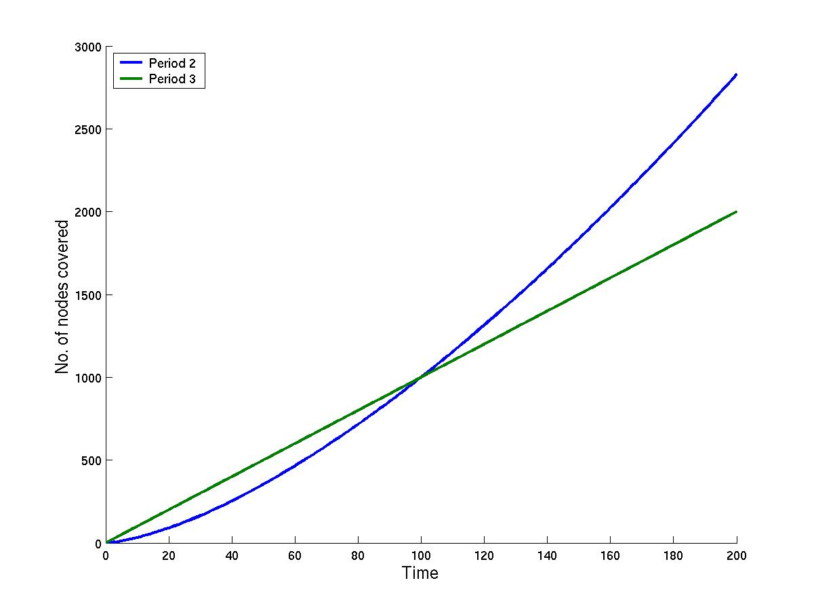
Optimum Point and our aim
3000
---- Period 2
---- Period 3
N = 10
2500
2000
No of nodes covered
Unexplored area
1500
1000
Collision
500
Can we regulate
proliferation
scheme so that system
always remains at the
optimum point
Optimum Point
20 40 60 80 100 120 140 160 180 200
Time

Slide 31
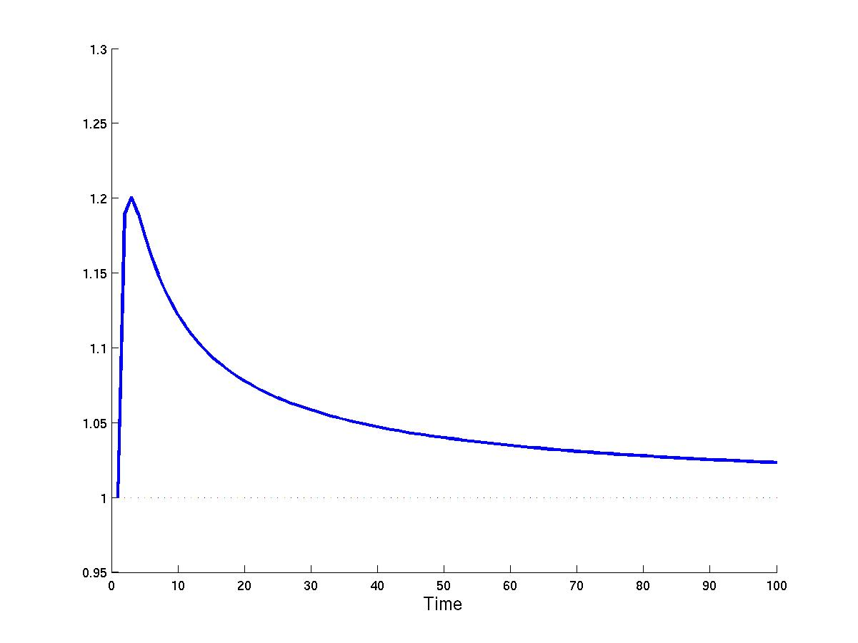
Optimum proliferation rate β
Optimum value of β such that the system always stays at the conjuction between Period 2 and Period 3
Period 2 = t^{d/2}
Period 3 = (α+1)^{t} . N_{proli}.t
t^{3/2} = β^{t} . N_{proli}.t
β = (t/ N_{proli}²)^{(1/2t)}
tends to 1, exponential growth of packet is restricted.
1.3
1.2
Value of β
1.1
1
0.95
10 20 30 40 50 60 70 80 90 100
Time

Slide 32
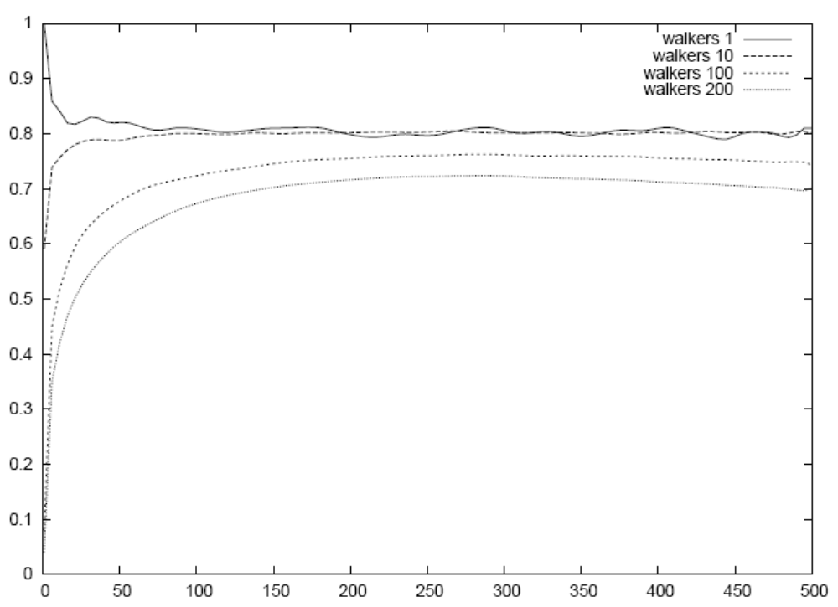
Results (No Proliferation)
R_{distvist_walker} – Number of distinct visits per walker
R_{distvist_walker}
Regime 3
Regime 2
Regime 1
Time

Slide 33
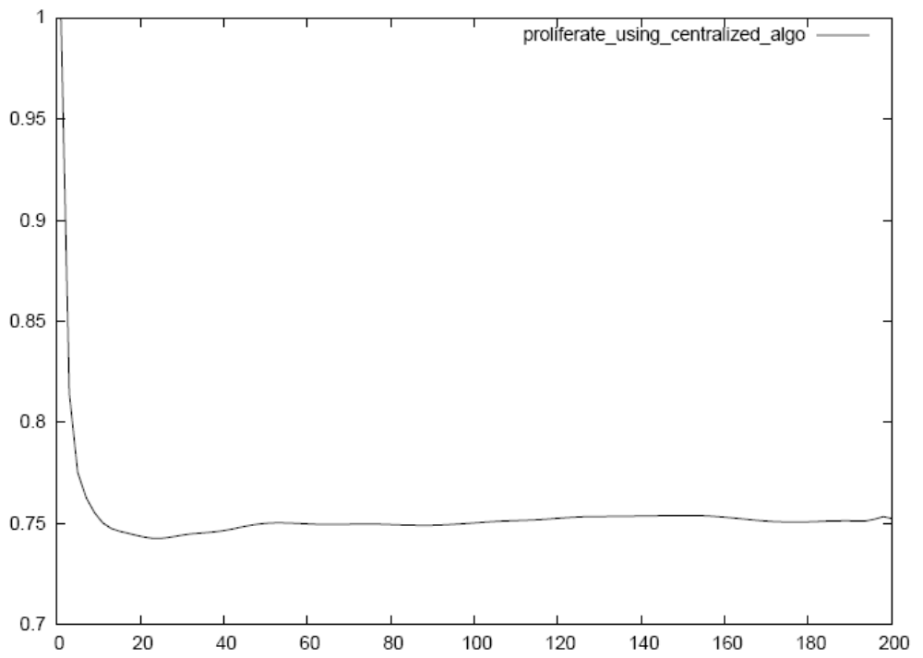
Results (Regulated Proliferation)
Regulated proliferation with optimal β
R_{distvist_walker}
Time

Slide 34
Evolving semi-structured networks Community Formation
Profile based community is formed by rearranging the Topology
Aim - Cluster Similar Nodes (Similar in Information and Search Profile)
Algorithm - Move nodes similar to user node closer to the user by rewiring links.

Slide 35
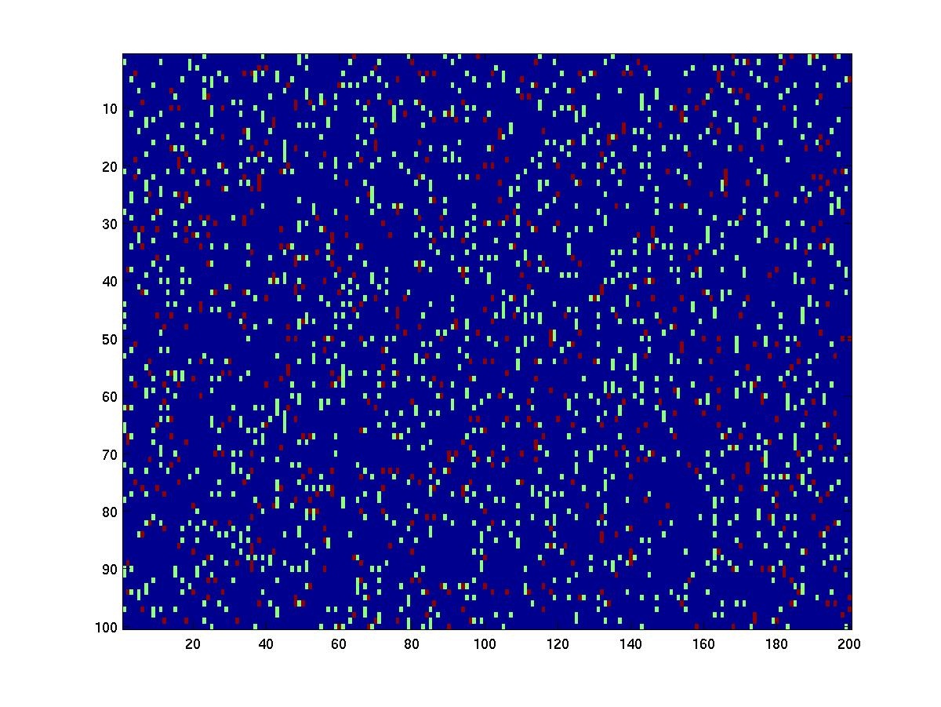
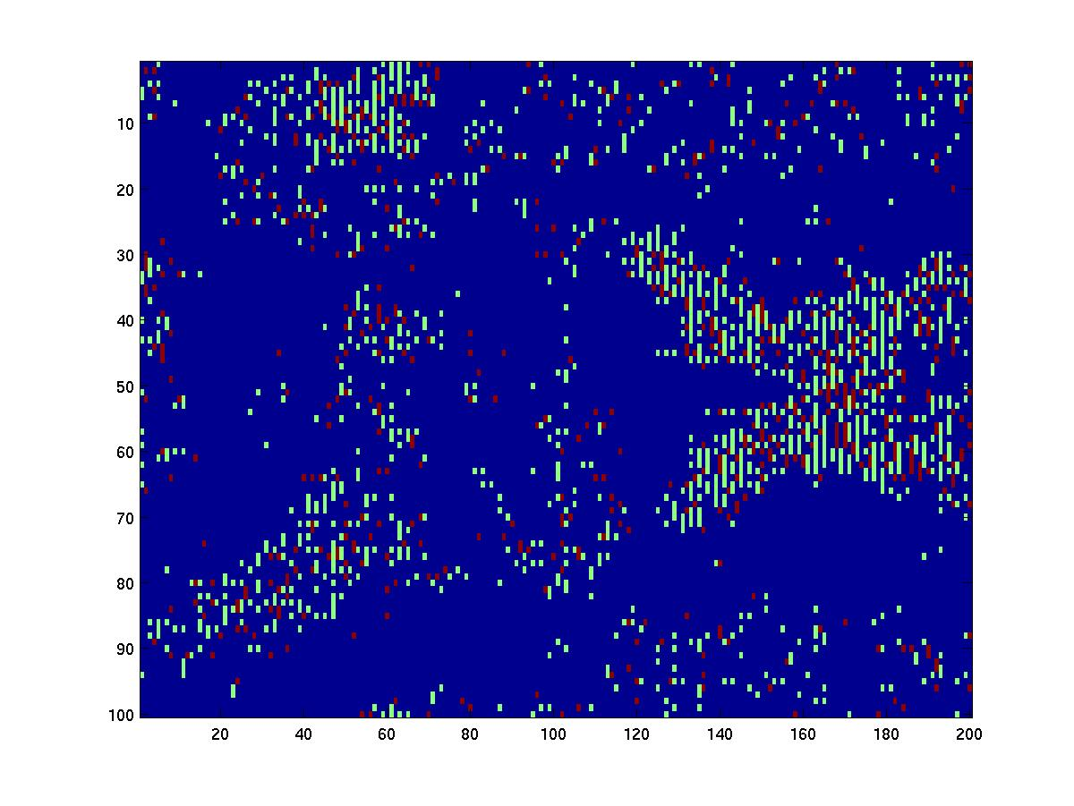
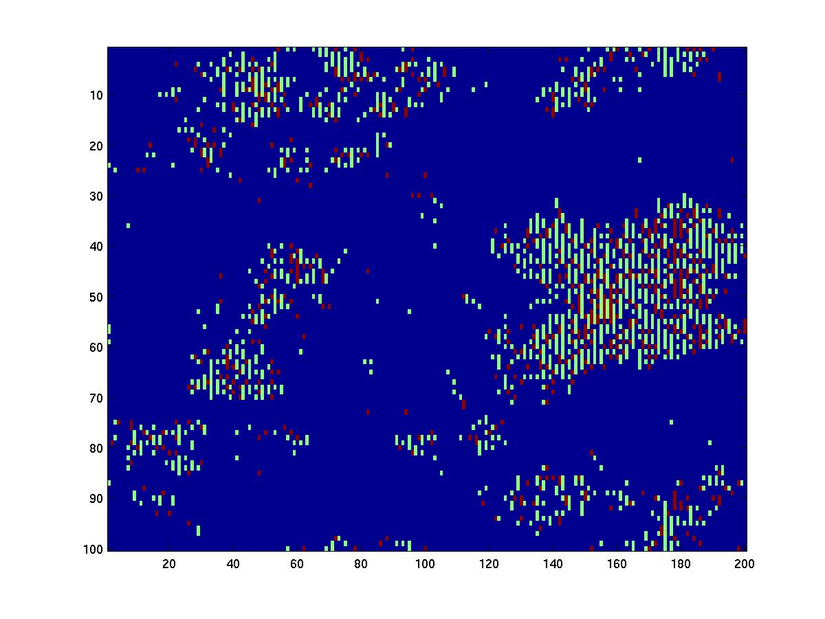
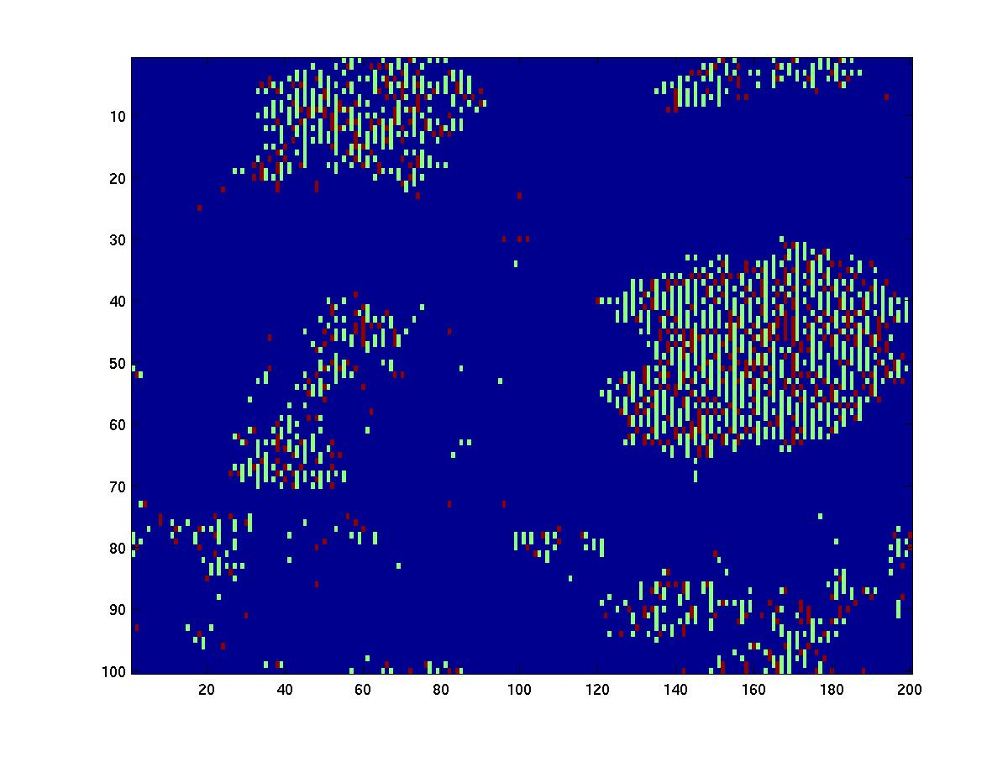
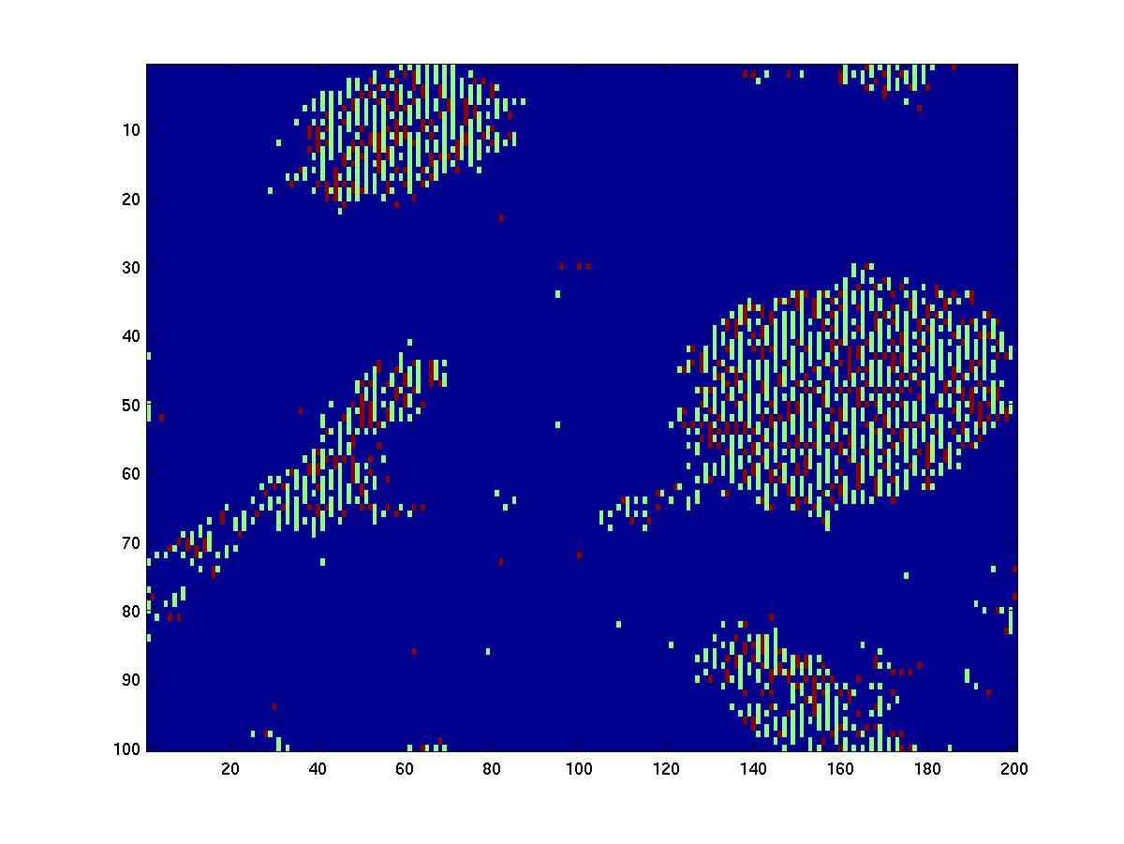
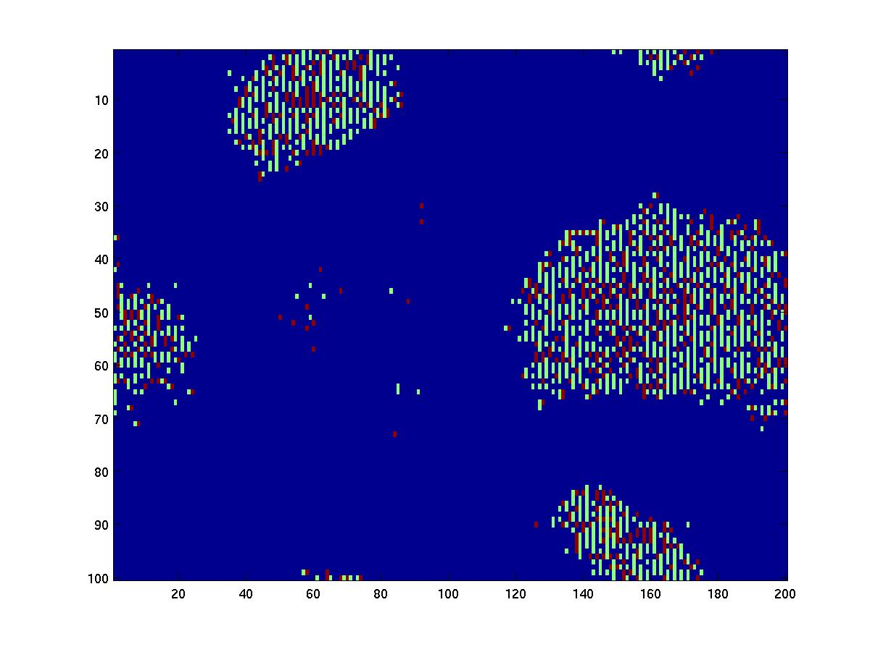
Topology Evolution Snapshots

Slide 36
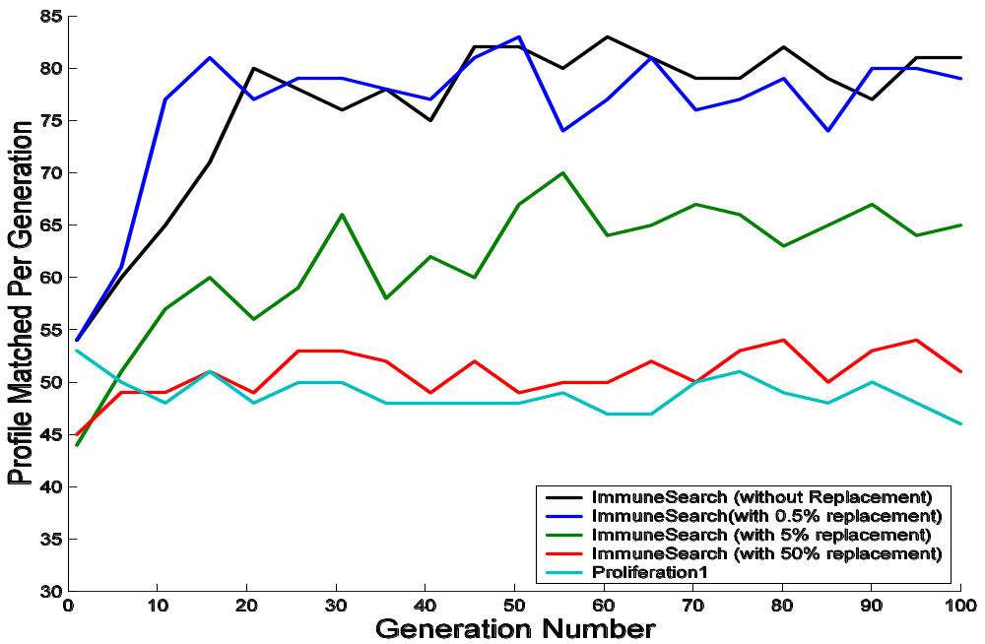
Transient Condition Search Efficiency
-- Without replacemnt
-- 0.5% replacement
-- 5% replacement
-- 50 % replacement
-- Proliferation₁

Slide 37
Conclusion
Different ongoing activity on optimizing peer to peer networks
  Search
  Topology Management
  Growth

Slide 38
References
www.facweb.iitkgp.ernet.in/~niloy
Design Of An Efficient Search Algorithm For P2P Networks Using Concepts From Natural Immune Systems. In PPSN VIII: The 8th International Conference on Parallel Problem Solving from Nature, Birmingham, UK, 18-22 September 2004.
Design and analysis of a bio-inspired search algorithm for peer to peer networks. In post proceedings of the workshop SELF-STAR: Self-* Properties in Complex Information Systems, 2005.
.Design Patterns from Biology for Distributed Computing ACM Transaction of Autonomous and Adaptive Systems Vol 1 Issue 1 (September 2006).

