Slide 1

Using Mobile Phones to Write in Air

Slide 2
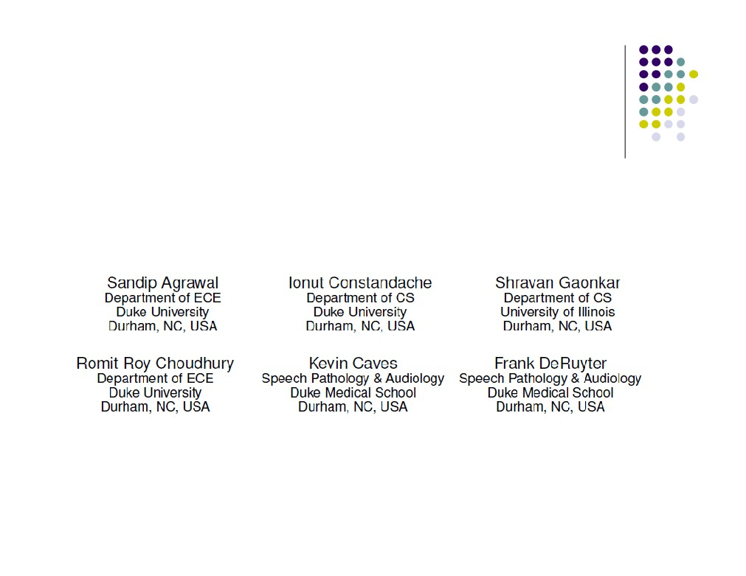
Who and Where?
● Systems Networking Research Group
Duke University, Durham, NC, 2009 - 2011

Slide 3

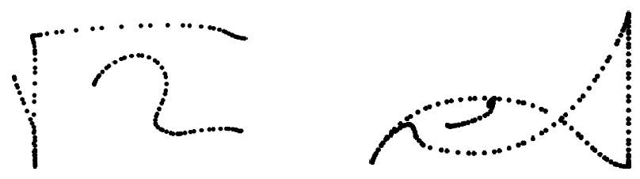

Introduction/motivation:
What was the main problem addressed?
● MOTIVATION:
● Phones and sensors allow for people-centric apps. Can write in the air.
● MAIN POBLEM:
● Alternative input method using accelerometer for text and drawing by writing in the air - use mobile phone to write in the air

Slide 4

Introduction/motivation:
What was the main problem addressed?
● WHY IMPORTANT:
● Assistive technology - Allow people with disabilities to use
● Don’t have to type, frees your other hand and your eyes to watch what’s around you.
● Writing English alphabets/words in real-time with
commodity phones has been an unexplored problem.  http://www.youtube.com/watch?v=Nvu2hwMFkMs

Slide 5
Introduction/motivation:
Why is this problem solved important?
● VISION:
● PhonePoint Pen (P3) establishes feasibility and justifies longer-term research commitment
● Write short messages, draw simple diagrams  Use cases
● Assistive technology for impaired patients  Equations and sketching
● Emergency operations and first responders  Write message on top of picture

Slide 6

Related Work:
Vision based gesture recognition
● Use cameras to track object’s 3D movements  TinyMotion
● Uses built-in cell phone camera to detect simple movements.
● No character or word detection.
● Microsoft Research TechFest: Write in The Air (2009)
● Character, but no word detection.
● http://www.youtube.com/watch?v=WmiGtt0v9CE

Slide 7
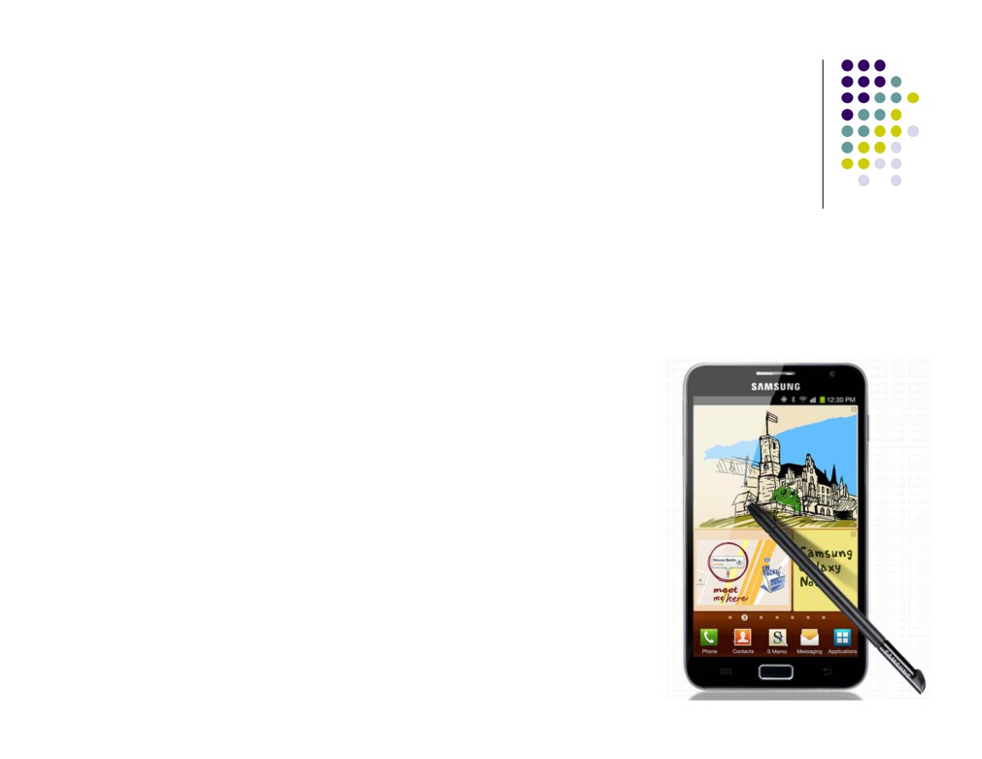
Related Work:
Stylus-based sketch recognition
● Draw sketches on a pad or Tablet PC using a stylus
● SketchREAD
● Electronic Cocktail Napkin
● Unistrokes - single-stroke characters  Graffiti - single-stroke characters  Pen-touch based Tablet PCs
● Can relocate pen
● Visual reference
● Samsung Galaxy Note (5”, 8”, 10”)

Slide 8
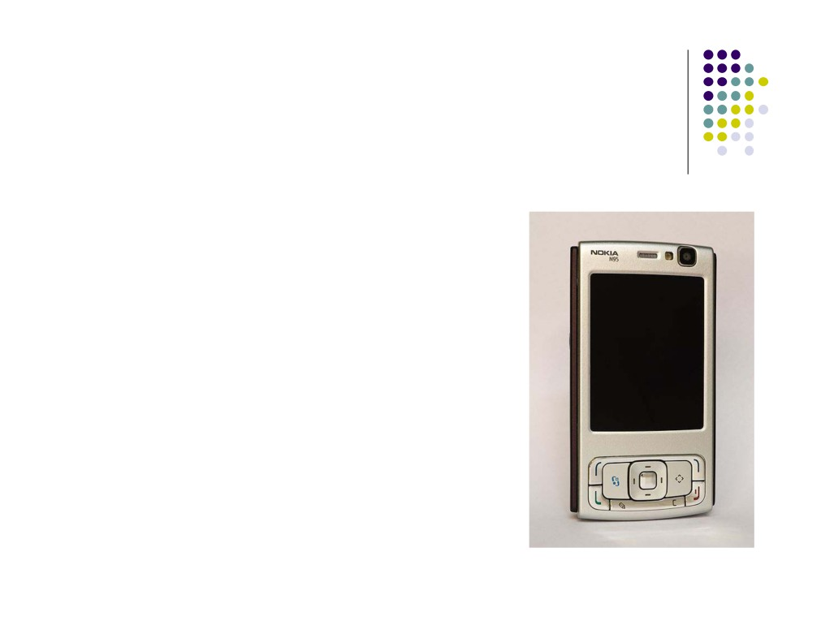
Methodology:
Overview/Summary of approach/design
● Nokia N95 phone (2007)
● Symbian OS
● Experiments with
● 10 CS and Engineering students
● Novice (<10 chars)
● Trained (>26 chars)
● 5 patients from Duke University Hospital

Slide 9
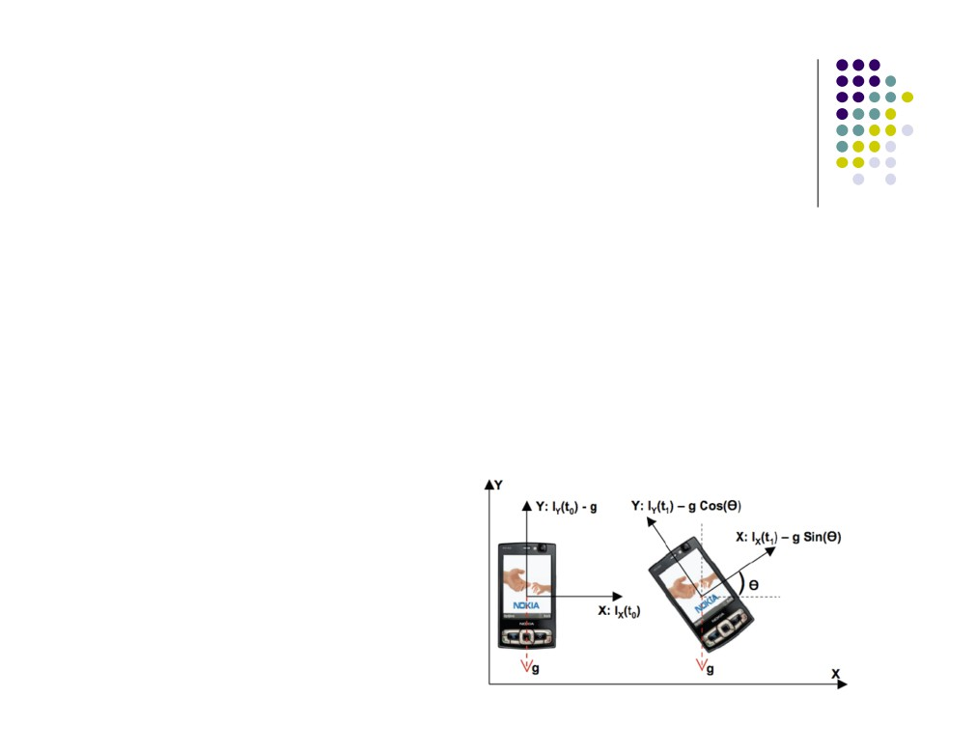
Methodology:
Core Challenges - Rotation Gyroscope
ISSUE:
● Nokia N95: cannot detect rotation
3-axis accelerometer X, Y, Z, no gyroscope
● Can’t tell difference between linear movements and rotation using just the accelerometer.

Slide 10
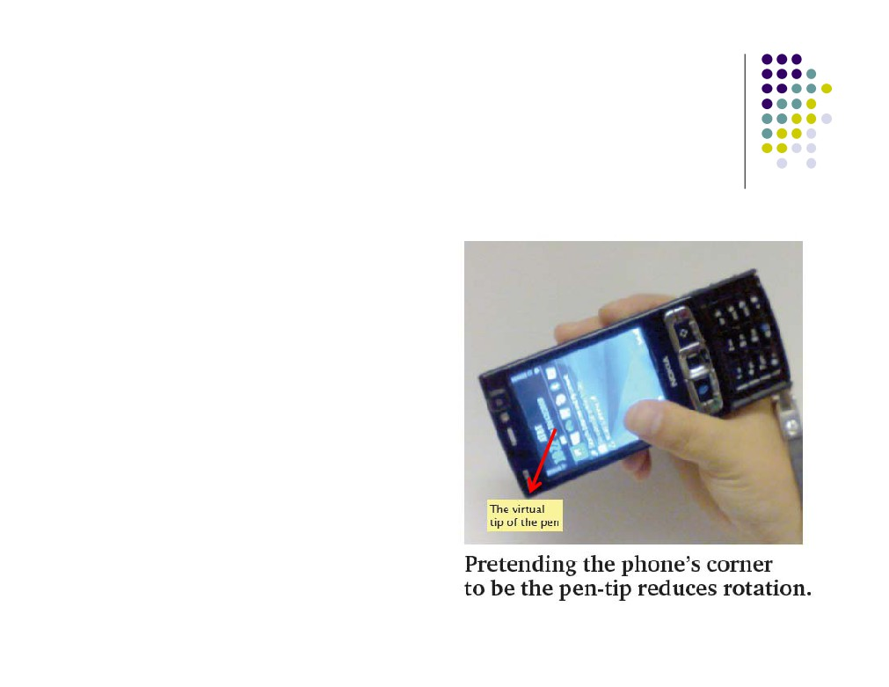
Methodology:
Core Challenges - Rotation Gyroscope
APPROACH:
● Hold like pen or blackboard eraser
● Pause between strokes

Slide 11
Methodology:
Core Challenges - Background Vibration
ISSUE:
● Jitter from natural hand vibrations
● Measurement errors from accelerometer APPROACH:
● Noise-reduction
● Smooth with moving average over last 7 readings  Drop data under threshold, <= 0.5m/s2 = noise

Slide 12
Methodology:
Core Challenges - Computing Displacement
ISSUE:
● Phone movement can introduce errors as integrating from Acceleration to velocity to displacement.
APPROACH:
● Reset velocity to zero if previous accelerometer readings below threshold (noise)

Slide 13
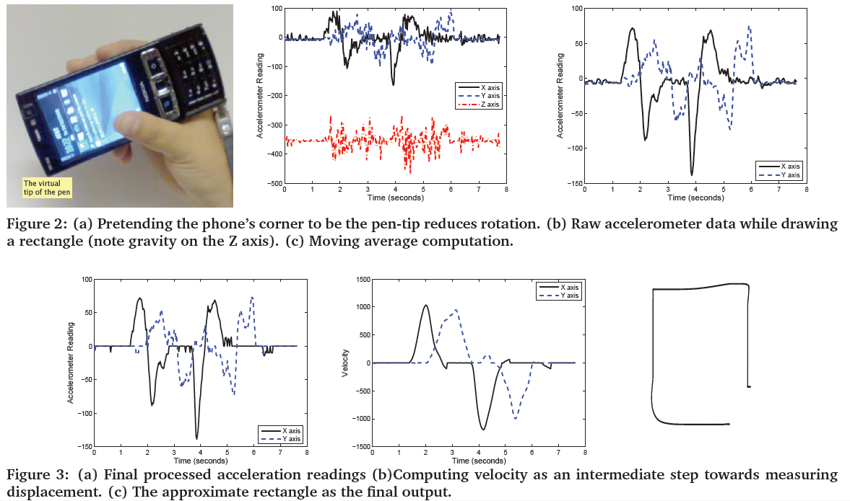

Slide 14

Methodology:
Core Challenges - “A” v. Triangle
ISSUE:
/
+
\
+
= A … or a triangle?
APPROACH:
● Watch for “lifting of the pen”
● Monitor data, but don’t include in final output

Slide 15
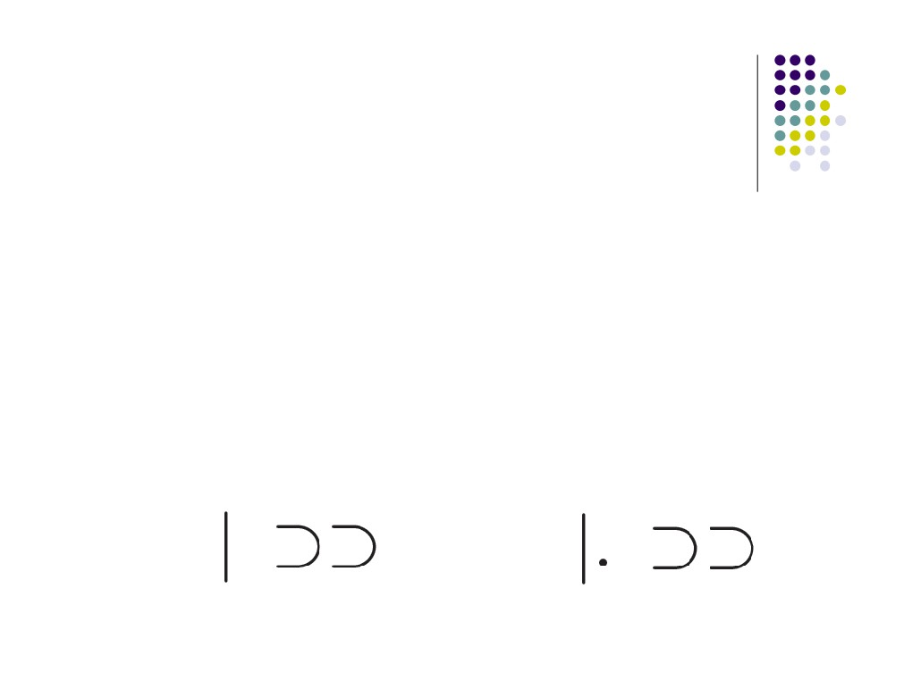
Methodology:
Core Challenges - Character Transitions
ISSUE:
● Can’t tell difference between B and 13 same set gestures cause ambiguities
APPROACH:
● Use delimiter between characters - dot or pause
B =
13 =

Slide 16
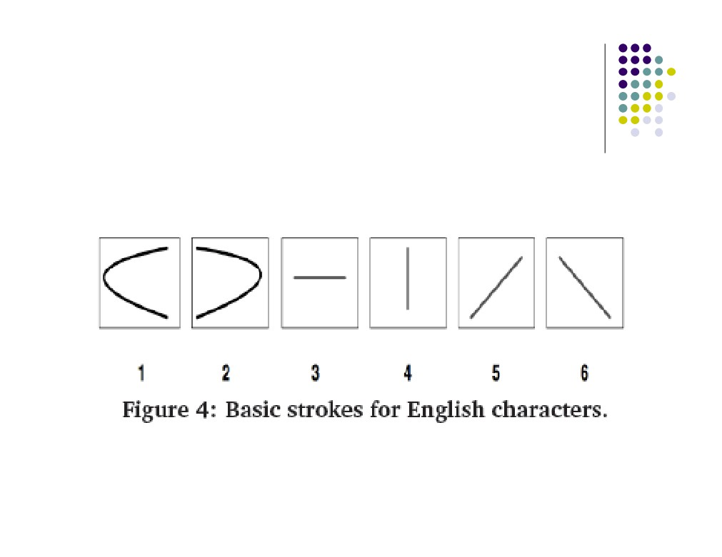
Methodology:
Gesture Stroke Detection primitives

Slide 17
Methodology:
Character Recognition
● Stroke grammar using decision tree
● D and P - start same, but then can turn into N  O and S - same strokes
● X and Y - same strokes
● O and 0 - cannot tell difference

Slide 18
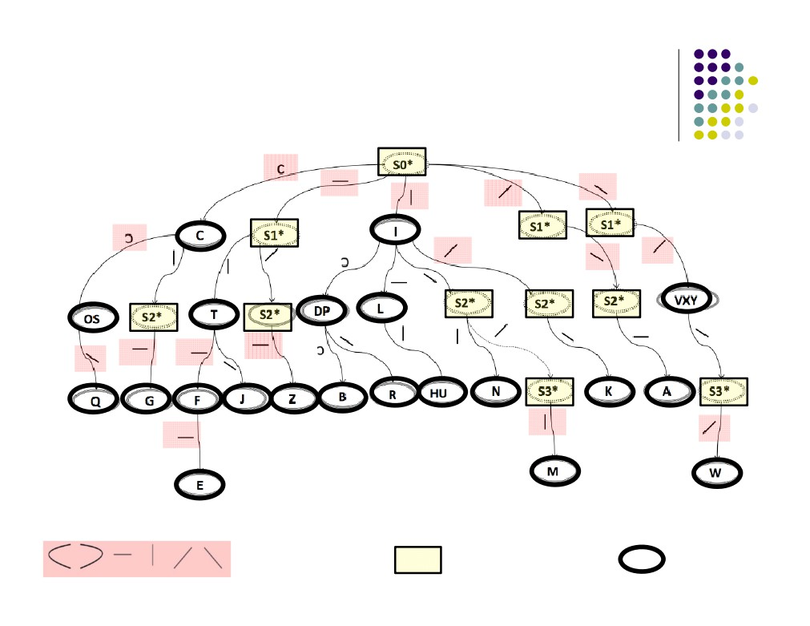
Methodology:
Stroke grammar for English alphabets and digits
Single gesture
Intermediate state
Final state

Slide 19
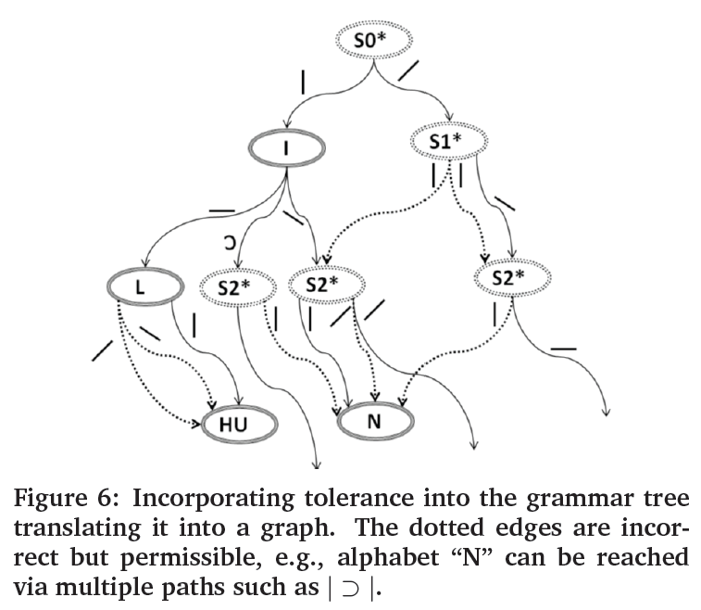

Slide 20
Methodology:
Word Recognition
● Examples: B and 13, H and IT
● Look at sequence of previous and next strokes  Infer previous character when see start of new char
● Watch for move back to left position
● Have user pause or draw dot to delimit characters

Slide 21
Methodology:
P3-Aware Spelling Correction
● Distance for correction (replace # chars)
● MQM edit distance of 1 with MOM, MAM, MUM.
● P3 confuses Q with O but hardly confuses Q with A or U, can suggest MOM with high confidence.
● NIET - could be NET or MET
● Edit distances of 1 and 2,
● P3 confuses “M” as “NI” > probability than “E” as “IE”. could predict user intended MET with reasonably high probability

Slide 22
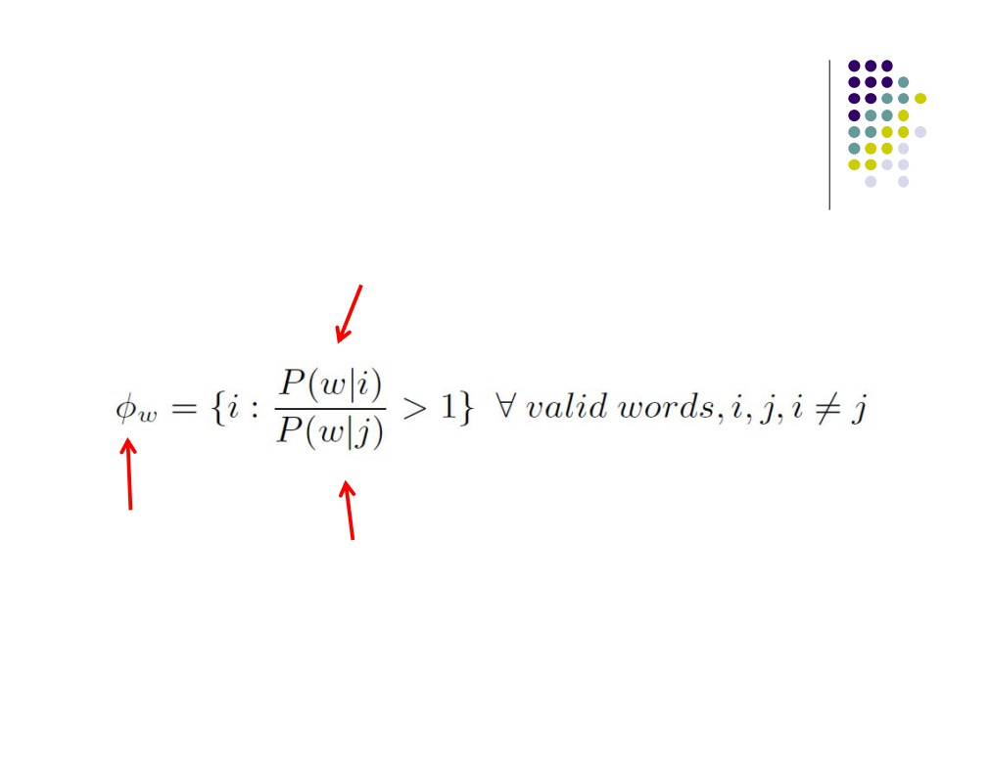
Methodology:
P3-Aware Spelling Correction
Probability of valid word i
Corrected word
Probability of valid word j

Slide 23
Methodology:
Assumptions and limitations of this work
● Speed of writing = 3:02 sec/letter on average  Repositioning pen for long words and drawing  Cursive handwriting (continuous movement)  Can’t write AND move at same time  Users were CS majors, but can train others  Investigate “greater algorithmic sophistication” for gesture recognition (Bayesian Networks and Hidden Markov Models)

Slide 24
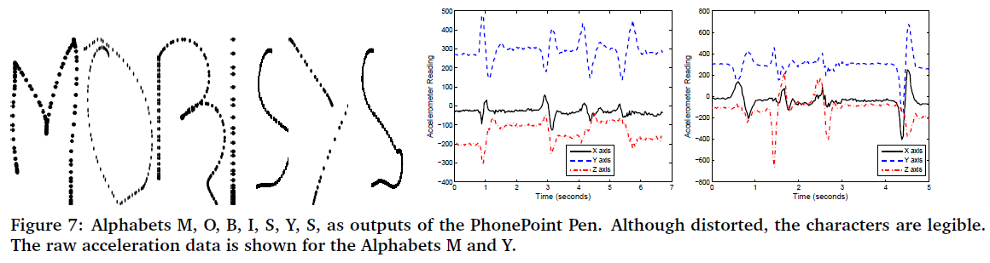
Results:

Slide 25
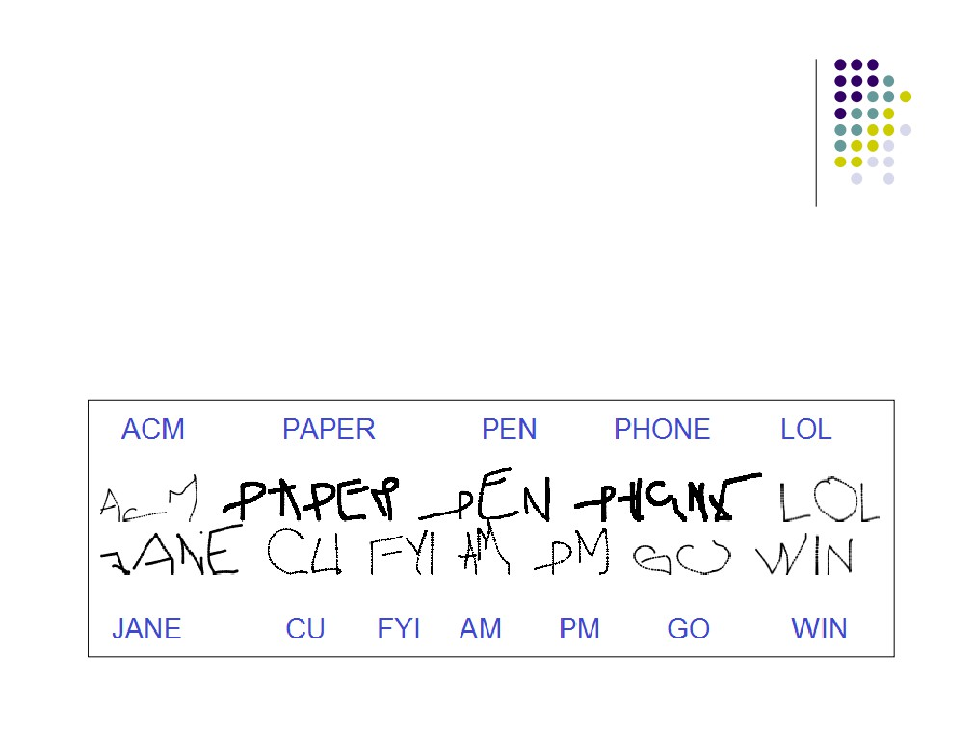
Results:
● English characters identified with average accuracy of 91:9% … but
● Slow: speed = 3.02 sec

Slide 26
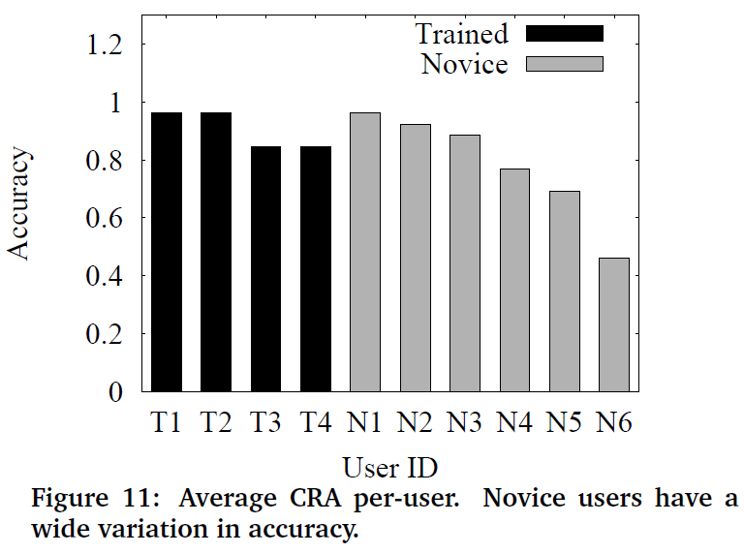
Results:

Slide 27
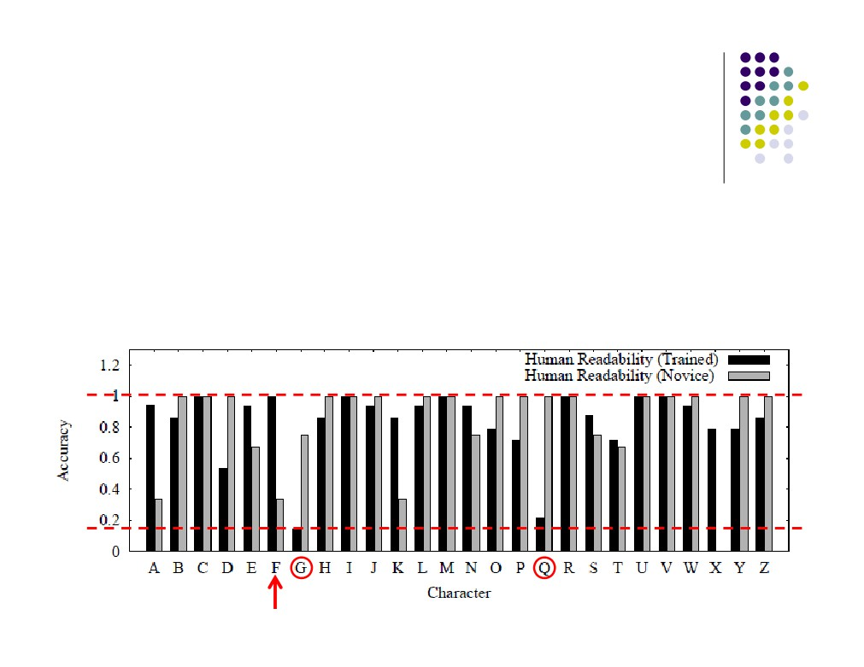
Results:
Human Readability Accuracy (HRA)
Average readability
● Trained writers: 83%  Novice writers:85:4%

Slide 28
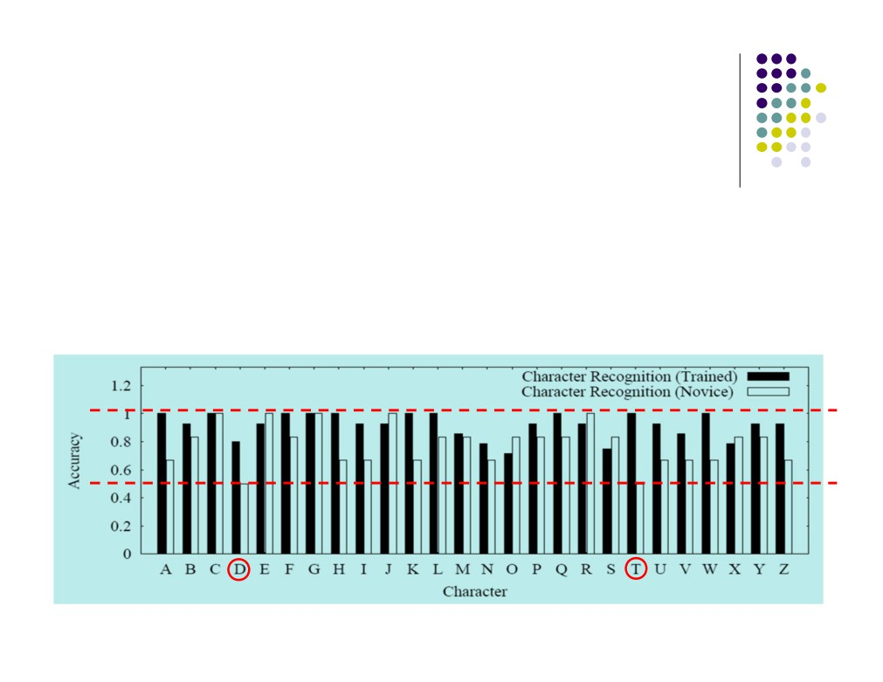
Results:
Character Recognition Accuracy (CRA)
Average character recognition (stroke grammar)  Trained writers: 91:9%
● Novice writers: 78:2%

Slide 29
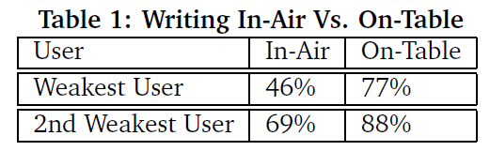
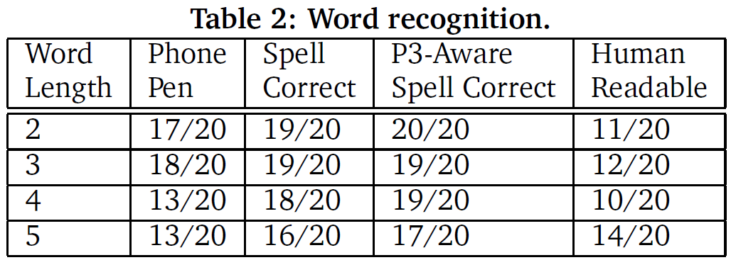

Slide 30
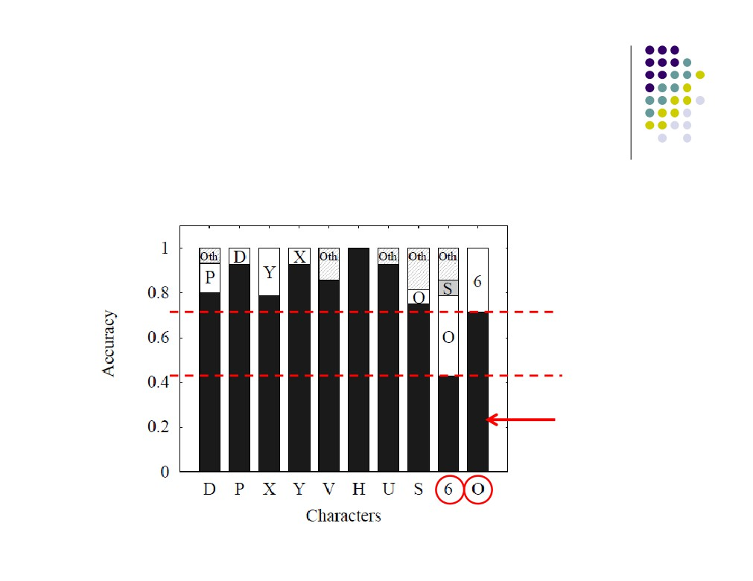
Results:
Character disambiguation
Common set of strokes causes confusion
correct

Slide 31
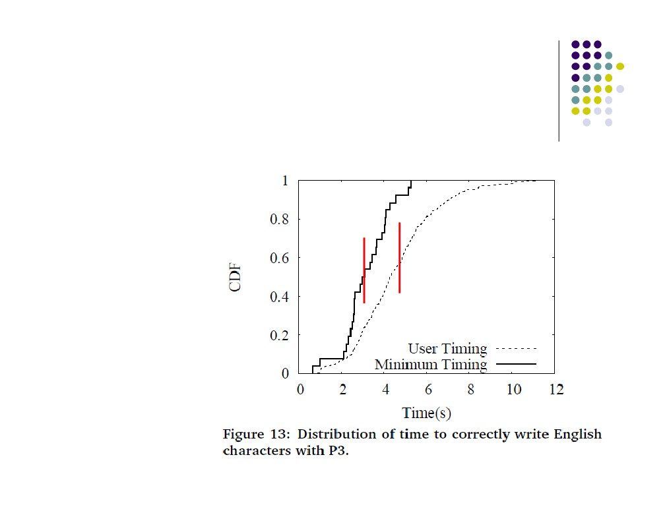
Results:
Median time to correctly write character
● 4.3 sec (all)
● 3.02 sec (min)

Slide 32
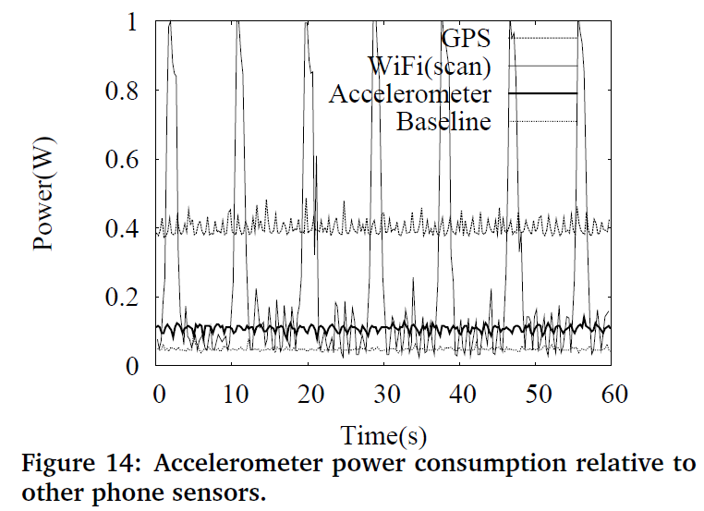
Results:

Slide 33
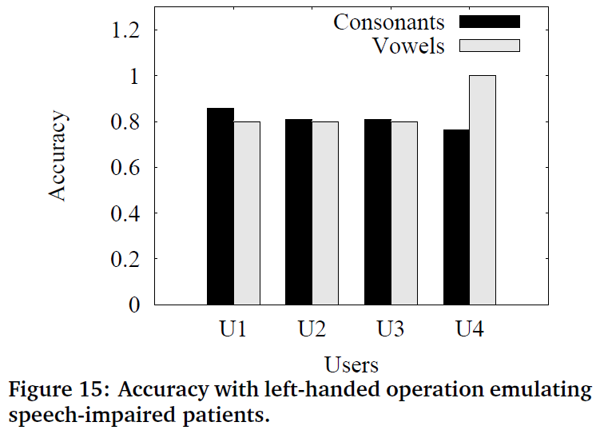
Results:

Slide 34
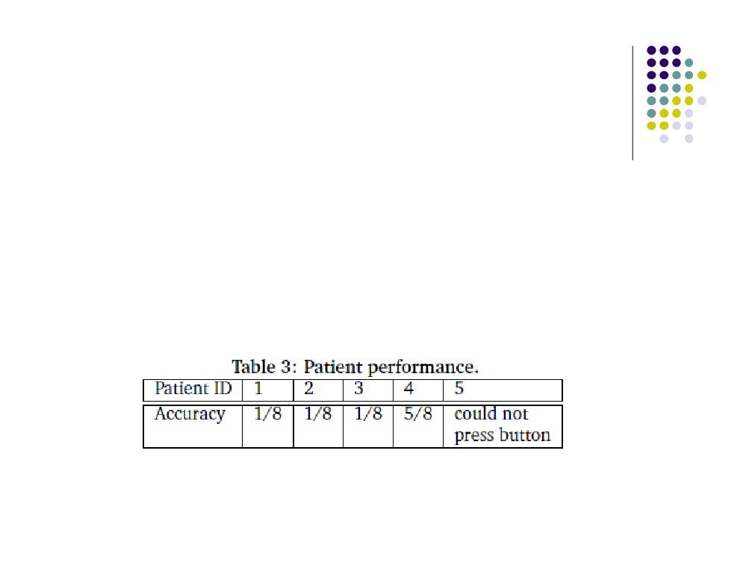
Results:
Hospital Patients
● Only 5 patients
● Cognitive disorders and motor impairments  Write 8 random letters
● Not allowed to observe patients  Problem pressing button
● Suggestions from doctors: Try left-hand to emulate speech-impaired patients.

Slide 35

Discussions/Conclusions/Future Work
● Not extensive, only 10 students, 5 patients  Prototype, shows possibilities
● Improve prototype, new user-experience “that complements keyboards and touch-screens.”
● Integrate gyroscope in next PhonePoint Pen
● TEDxDuke - Vansh Muttreja on the Virtual White Board - A New Way of Remote Collaboration
● http://www.youtube.com/watch?v=vmyXJzkfevY

Slide 36
Discussions/Conclusions/Future Work
● Some other ideas
● Use back camera to optically track movement?  Write in the air
● Geo-location
● Augmented reality

Slide 37

References
● PhonePen Video
http://www.youtube.com/watch?v=Nvu2hwMFkMs
● Systems Networking Research Group (at Duke University) http://synrg.ee.duke.edu
● LiveMove Pro: Advanced Motion Recognition http://www.ailive.net/liveMovePro.html
● Zhen WANG - uWave
http://www.owlnet.rice.edu/~zw3/projects_uWave.html  Nokia N95
http://en.wikipedia.org/wiki/Nokia_N95  Symbian mobile operating system http://en.wikipedia.org/wiki/Symbian_OS

Slide 38

References
● Leap Motion Controller
https://www.leapmotion.com/
● Magic : Write This Down in Air into your iPhone (using a magnet) http://www.youtube.com/watch?v=W89cpE9gFMg
● Writing in the Air for Google Glass (MessagEase)
http://www.youtube.com/watch?v=wfmlNuPwmS0  Bayesian network
http://en.wikipedia.org/wiki/Bayesian_network  Heuristic
http://en.wikipedia.org/wiki/Heuristic

Slide 39
Questions?

