Slide 1

Energy Consumption in Mobile Phones: A Measurement Study and Implications for Network Applications
REF:Balasubramanian, Niranjan, Aruna Balasubramanian, and Arun Venkataramani. "Energy consumption in mobile phones: a measurement study and implications for network applications.", 9th ACM SIGCOMM
Notes:
08/03/14

Slide 2
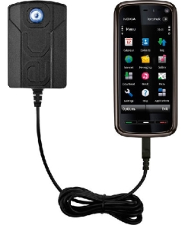
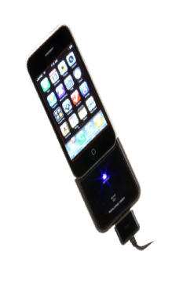

Motivation
Network applications increasingly popular in mobile phones
  50% of phones sold in the US are 3G/2.5G enabled
  60% of smart phones worldwide are WiFi enabled
Network applications are huge power drain and can considerably reduce battery life
How can we reduce network energy cost in phones?
Notes:
08/03/14

Slide 3
Contributions
  Measurement study over 3G, 2.5G and WiFi
    Energy depends on traffic pattern, not just data size
  3G incurs a disproportionately large overhead
  Design TailEnder protocol to amortize 3G overhead
    Energy reduced by 40% for common applications including email and web search
Notes:
08/03/14

Slide 4
Outline
Measurement study
TailEnder Design
Evaluation
Notes:
08/03/14

Slide 5
3G/2.5G Power consumption (1 of 2)
Power profile of a device corresponding to network activity
Transfer
Power
Time
Ramp
Tail
Notes:
08/03/14
Instead of releasing the aquired state imediately, it moves to an intermediate state before moving to the idle state
Our focus is not to study the trade-off of the tail time, but rather given the tail time how can reduce it.

Slide 6
3G/2.5G Power consumption (2 of 2)
Ramp energy: To create a dedicated channel
Transfer energy: For data transmission
Tail energy: To reduce signaling overhead and latency
  Tail time is a trade-off between energy and latency [Chuah02, Lee04]
The tail time is set by the operator to reduce latency. Devices do not have control over it.
Notes:
08/03/14
Instead of releasing the aquired state imediately, it moves to an intermediate state before moving to the idle state
Our focus is not to study the trade-off of the tail time, but rather given the tail time how can reduce it.

Slide 7
WiFi Power consumption
Network power consumption due to
  Scan/Association
  Transfer
Notes:
08/03/14
The focus of this work is not to investigate the power save techniques, but instead to compare WiFi set up overhead with cellular set up overhead

Slide 8
Measurement goals
What fraction of energy is consumed for data transmission versus overhead?
How does energy consumption vary with application workloads for cellular and WiFi technologies?
Notes:
08/03/14

Slide 9
Measurement set up
Devices: 4 Nokia N95 phones
  Enabled with AT&T 3G, GSM EDGE (2.5G) and 802.11b
Experiments: Upload/Download data
  Varying sizes (1 to 1000K)
  Varying inter-transfer times (1 to 30 second)
Environment:
  4 cities, static/mobile, varying time of day
Notes:
08/03/14

Slide 10
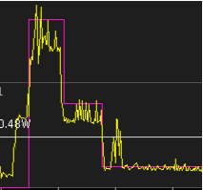
Power measurement tool
Nokia energy profiler software
  Idle power accounted for in the measurement
Power profile of an example network transfers
Notes:
08/03/14

Slide 11
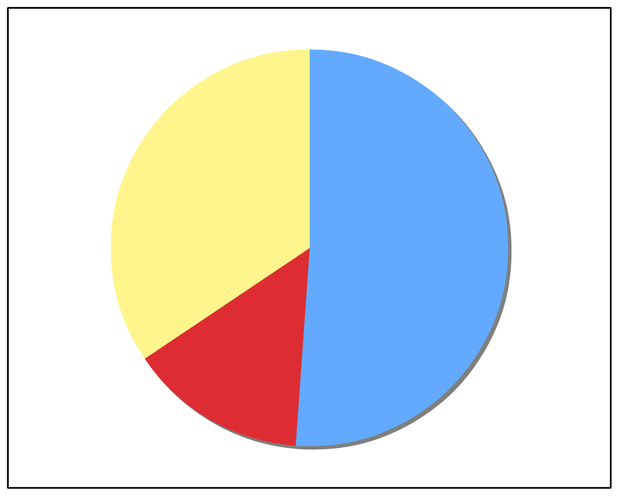
3G Energy Distribution for a 100K download
Total energy= 14.8J
Data
Transfer
(32%)
Tail time = 13s
Tail energy = 7.3J
Tail (52%)
Ramp
(14%)
Notes:
08/03/14
Just an example point in our measurement, it represents the size of a typical web download

Slide 12
100K download: GSM and WiFi
GSM
  Data transfer = 74%
  Tail energy= 25%
WiFi
  Data transfer = 32%
  Scan/Associate = 68%
Notes:
08/03/14

Slide 13
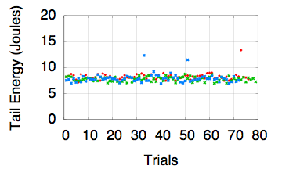
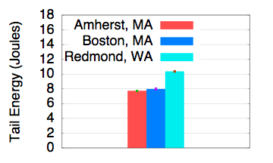
More analysis of the 3G Tail
Over varied data sizes, days and network conditions
At different locations
Experiments over three days
Notes:
08/03/14
The plot here shows that the Tail energy measurements are very consistent. They do not vary across different data sizes, or network conditions.
The measurements show that tail energy can vary depending on the location. As seen in this plot, tail energy in Redmond is much higher than the tail energy in Amherst. However, at the same locations we still note that the tail energy is consistent as shown by the small standard deviation.
Add smething to describe what the Trials

Slide 14
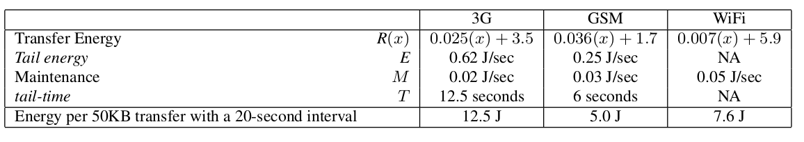
Energy model derived from the measurement study
R(x) denotes the sum of the Ramp energy and the
transfer energy to send x bytes
E denotes the Tail energy.
For WiFi, R(x) to denotes the sum of the
transfer energy and the energy for scanning and as-
sociation
Notes:
08/03/14

Slide 15
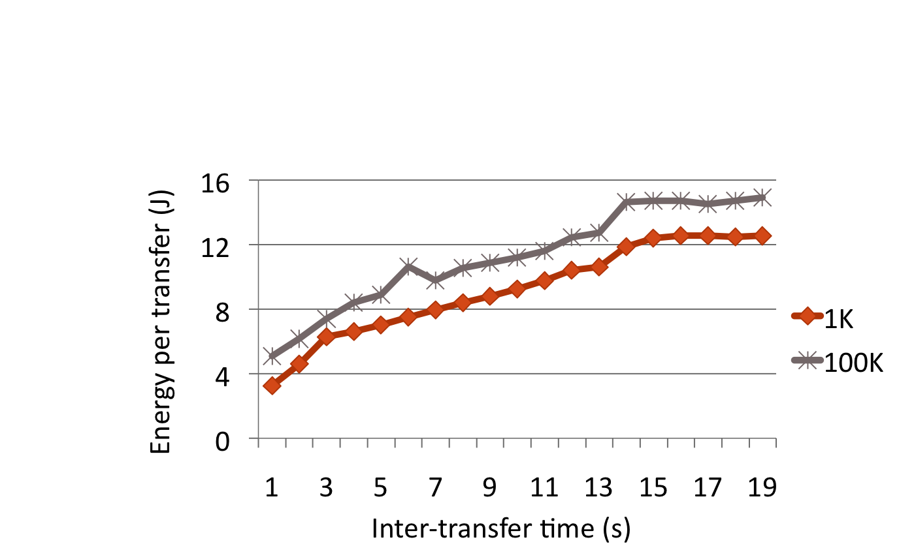
3G: Varying inter-transfer time
This result has huge implications for application design!!
Decreasing inter-transfer time reduces energy
Sending more data requires less energy!
Notes:
08/03/14
Tail energy can be amortized by reducing inter-transfer time

Slide 16
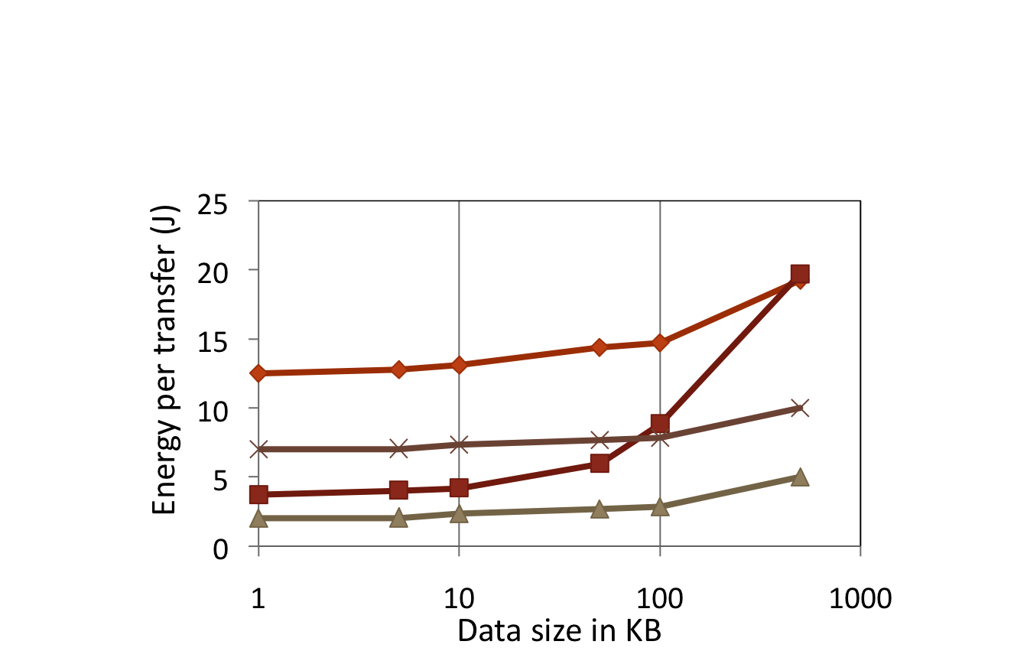



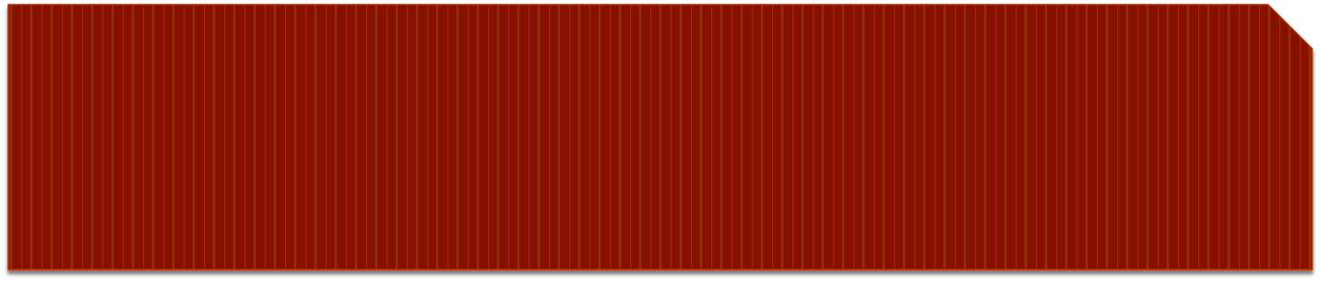
Comparison: Varying data sizes
3G
GSM
WiFi + SA
WiFi
In the paper:
Present model for 3G, GSM and WiFi energy as a function of data size and inter-transfer time
WiFi energy cost lowest without scan and associate
3G most energy inefficient
Notes:
08/03/14
Move label to match the line

Slide 17
Outline
Measurement study
TailEnder design
Evaluation
Notes:
08/03/14

Slide 18
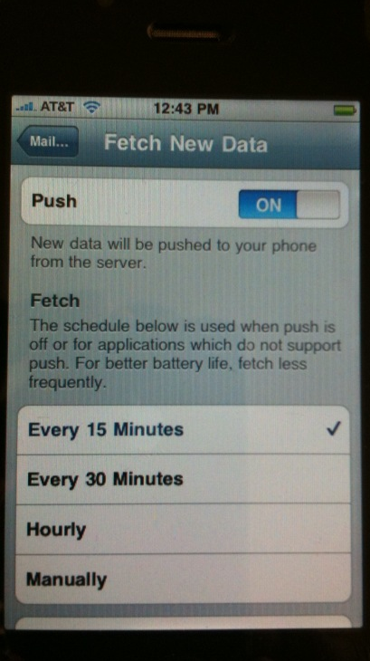
TailEnder
Observation: Several applications can
  Tolerate delays: Email, Newsfeeds
  Prefetch: Web search
Implication: Exploiting prefetching and delay tolerance can decrease time between transfers
Notes:
08/03/14

Slide 19
Exploiting delay tolerance
Default behaviour
ε
T
ε
T
Power
Total = 2T + 2ε
Time
r₁
r₂
TailEnder
Total = T + 2ε
Power
ε
ε
T
delay tolerance
How can we schedule requests such that the time in the high power state is minimized?
r₁
r₂
Time
r₁
r₂
Notes:
08/03/14

Slide 20
TailEnder scheduling
Online problem: No knowledge of future requests
Power
ε
T
Time
r_{i}
r_{j}
r_{j}
Send
immediately
??
Defer
Notes:
08/03/14
Add another request?

Slide 21
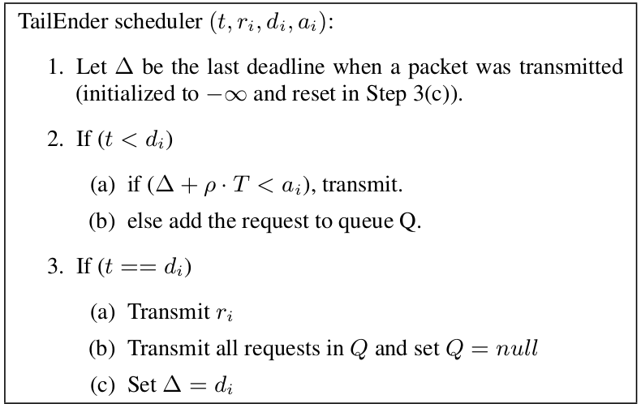
TailEnder algorithm
TailEnder is within 2x of the optimal offline algorithm
No online algorithm can do better than 1.62x
Notes:
08/03/14
Row in [0,1]

Slide 22
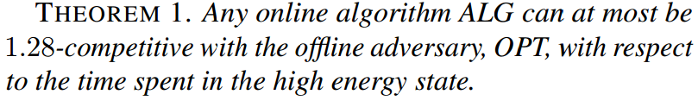
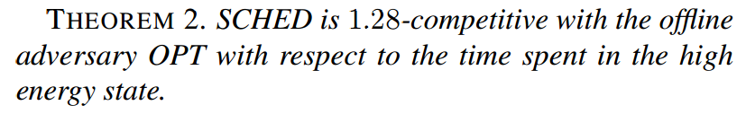
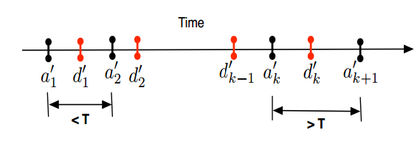
THEOREM 2. SCHED is 1.28-competitive with the offline
adversary OPT with respect to the time THEOREM 2. SCHED is 1.28-competitive with the offline
adversary OPT with respect to the time spent in the high
energy state. spent in the high
energy state.
08/03/14
Notes:
08/03/14

Slide 23
Outline
Measurement study
TailEnder Design
  Application that are delay tolerant
  Application that can prefetch
Evaluation
Notes:
08/03/14

Slide 24
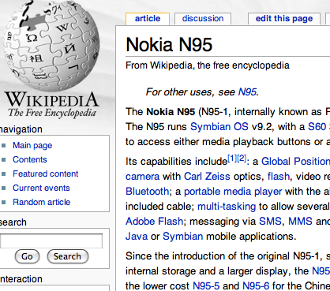
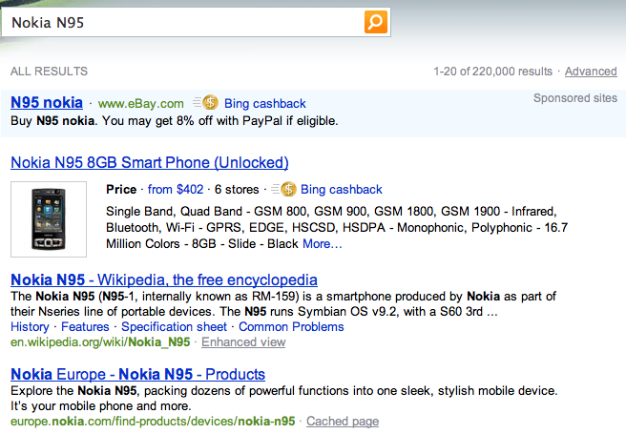


TailEnder for web search
Current web search model
  Idea: Prefetch web pages.
  Challenge: Prefetching is not free!
Notes:
08/03/14

Slide 25

Expected fraction of energy savings if top k documents are pre-fetched:
k be the number of prefetched documents,prefetched in
the decreasing rank order.
p(k) be the probability that a user requests a document with rank k.
E is the Tail energy
R(k) be the energy required to receive k documents.
TE is the total energy required to receive a document.
TE = energy to (receive the list of snippets + request for a document
from the snippet + receive the document)
Notes:
08/03/14

Slide 26
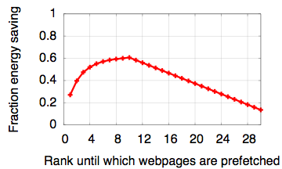
How many web pages to prefetch?
Analyzed web logs of 8 million queries
  Computed the probability of click at each web page rank
TailEnder prefetches the top 10 web pages per query
Notes:
08/03/14

Slide 27
Outline
Measurement study
TailEnder Design
Evaluation
Notes:
08/03/14

Slide 28
Applications
Email:
  Data from 3 users over a 1 week period
  Extract email time stamp and size
Web search:
  Click logs from a sample of 1000 queries
  Extract web page request time and size
Notes:
08/03/14

Slide 29
Evaluation
Methodology
  Model-driven simulation
  Emulation on the phones
Baseline
  Default algorithm that schedules every requests when it arrives
Notes:
08/03/14
Arbitrarily subotimal?

Slide 30
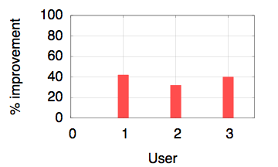
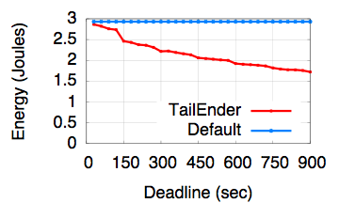
Model-driven evaluation: Email
With delay tolerance = 10 minutes
For increasing delay tolerance
TailEnder nearly halves the energy consumption for a 15 minute delay tolerance. (Over GSM, improvement is only 25%)
Notes:
08/03/14

Slide 31
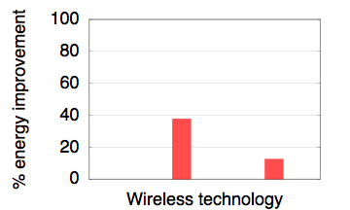
Model-driven evaluation: Web search
GSM
3G
Notes:
08/03/14

Slide 32
Conclusions and Future work
Large overhead in 3G has non-intuitive implications for application design.
TailEnder amortizes 3G overhead to significantly reduce energy for common applications
Future work
Leverage multiple technologies for energy benefits in the presence of different application requirements
Leverage cross-application opportunities
Notes:
08/03/14
Optimize power and performance using multiple technologies
Sophisticated application requirements

