Slide 1

Location Privacy
Location privacy in mobile systems: A personalized Anonymization Model
Burga Gedik, Ling Liu

Slide 2
Location privacy threats
An adversary learns the locations that a subjected visited as well as the times of visit.
Can receive clues about private information such as political affiliations, medical problems.
If a subject is identified at any point, her complete movement can be exposed.

Slide 3
K-anonymity
Originally introduced in the context of relational data privacy research.
In context of LBS, refers to k-anonymous usage of location information
  A subject is considered k-anonymous with respect to location information if this location information is indistinguishable from the location information of at least k-1 other subjects.
  The adversary will have uncertainty in matching the mobile node to a location-identity association
  The uncertainty increases with increasing value of k.

Slide 4
Overview
To ensure that a subject is k-anonymous one can perturb the location information by replacing relatively large spatial region or by delaying the message long enough.
May result in poor quality of service.
Allow personalization: Enable each node to specify
    minimum level of anonymity it desires
    maximum temporal and spatial resolutions
Efficient message perturbation engine
  Cliquecloak: spatio-temporal cloaking

Slide 5
Personalized location k-anonymity
Assumptions
  LBS system consists of mobile nodes, wireless networks, anonymity servers and LBS servers.
  Source of location information : GPS receiver in vehicle (includes time information as well)
  Nodes communicate with third party LBS servers through anonymity servers.
Each node specifies anonymity level (k value), spatial tolerance and temporal tolerance.

Slide 6
Spatial cloaking: Degree of location anonymity maintained by decreasing the location accuracy through enlarging the exposed spatial area such that there are k-1 mobile nodes present in the area.
Temporal cloaking: Location anonymity achieved by delaying the message until k nodes have visited the area located by message sender.

Slide 7
Set up
S: Set of messages received from the mobile nodes.
a message in set S is denoted by
m_{s} = <u_{id} , r_{no} , {t,x,y}, k, {d_{t} , d_{x} , d_{y}}>
(u_{id} , r_{no}) sender's identifier and message reference number pair
L(m_{s}) → {t,x,y} (spatio-temporal location point)
K → anonymity level. (k=1 anonymity not required)
{d_{t} , d_{x} , d_{y}} → tolerances

Slide 8
Set up
Let Φ(v,d)= [v-d,v+d]
Spatio-temporal Constraint box of message m_{s} denoted by B_{cn}(m_{s})
Φ(m_{s}.x , m_{s}.d_{x}), Φ(m_{s}.y , m_{s}.d_{y}) , Φ(m_{s}.t , m_{s}.d_{t})
Denote the set of perturbed (anonymized) messages as T
message in T denoted by
m_{t} <u_{id} , r_{no} ,{X: [x_{s} ,x_{e} ], Y: [y_{s} ,y_{e} ], T: [t_{s} ,t_{e}]},C>
Spatio-temporal cloaking box of a perturbed message
B_{cl}(m_{t}) -> (m_{t}.X:[x_{s} ,x_{e} ], m_{t}.Y:[y_{s} ,y_{e} ], m_{t}.I:[t_{s} ,t_{e} ])

Slide 9
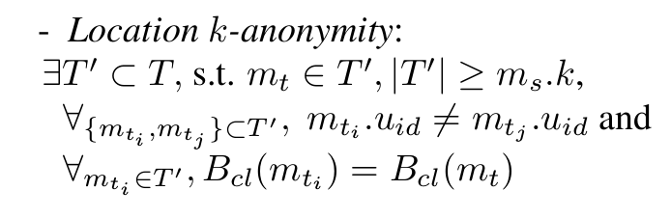
Basic propertiesthat must hold
  Spatio-temporal Containment
  Spatio-temporal Resolution
  Content Preservation

Slide 10
Message perturbation engine
Zoom-in
Detection
Perturbation
Expiration

Slide 11
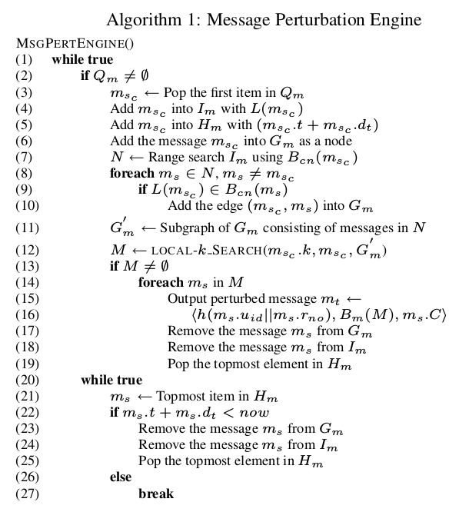
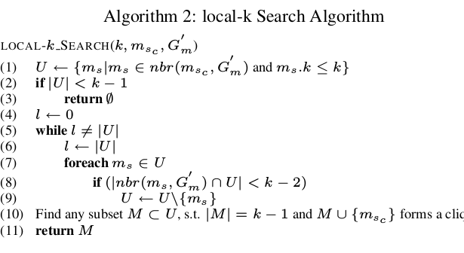

Slide 12
Data structures
Message Queue (FIFO): collects messages sent from the mobile node
Multi-dimensional index: contains a 3D point L(m_{s}) as key and m_{s} as data.
Expiration heap: A mean heap sorted based on the deadline of the messages

Slide 13
Constraint graph
An undirected graph represented by G(S,E)
S is the set of vertices, each representing a message received at the message perturbation engine
edge e = (m_{si} , m_{sj} ) ∈ E between two vertices m_{si} and m_{sj} , if and only if the following conditions hold:
(i) L(m_{si}) ∈ B_{cn} (m_{sj} ),
(ii) L(m_{sj}) ∈ B_{cn} (m_{si} ),
(iii) m_{si} .u_{id} = m_{sj} .u_{id}
m_{t} is a valid perturbed message of m_{s} if there exists an l-clique in the constraint grapg such that l>=m_{s}.k

Slide 14
Cliquecloak theorem
Let M = {m _{s1} , m_{s2} , . . . , m_{sl} } be a set of messages in S. For each message m_{si} in M , we define m_{ti} = m_{si}.u_{id} ,m_{si}.r_{no} , B_{m}(M ), m_{si}.C . Then m_{ti} ,1 ≤ i ≤ l, is a valid perturbed format of m s i if and only if the set M of messages form an l-clique in the constraint graph G(S, E) with the additional condition that for any message m_{si} in S, we have m_{si}.k ≤ l (i.e. m_{si} ’s user specified k value is not larger than the cardinality of the set M )

Slide 15
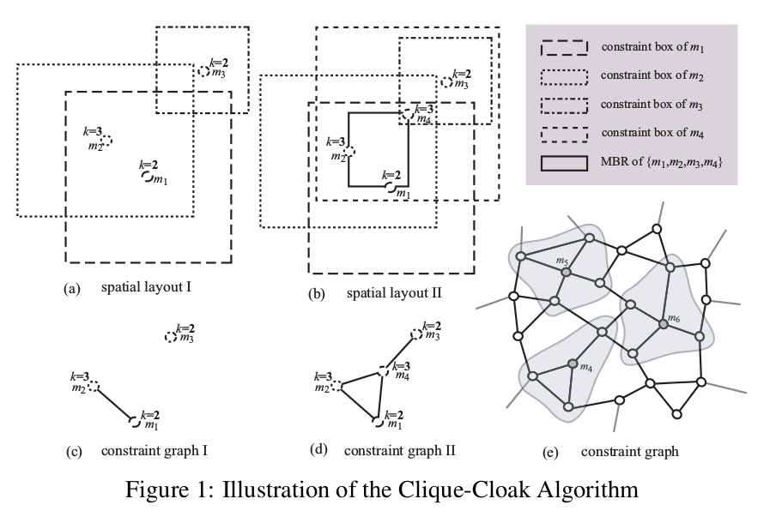

Slide 16
Optimizations
Neighbor_k instead of local_k
Deferred Cliquecloak vs Immediate Cliquecloak

Slide 17
Evaluation metrics
Success rate : defined over a set S' ⊂ S of messages as the percentage of messages that are successfully anonymized .
Relative anonymity level : measure of the level of anonymity provided by the cloaking algorithm, normalized by the level of anonymity required by the messages.
Relative spatial resolution : measure of the spatial resolution provided by the cloaking algorithm, normalized by the minimum acceptable spatial resolution de-fined by the spatial tolerances
Relative temporal resolution : measure of the temporal resolution provided by the cloaking algorithm, normalized by the minimum acceptable temporal resolution de-
fined by the temporal tolerances

Slide 18
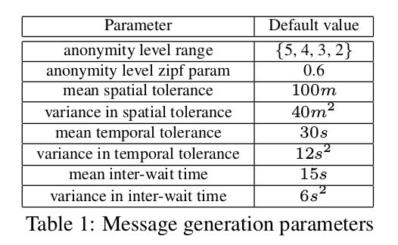
Experiments
Success rate
Spatio-temporal resoluton
Each message specifies an anonymity level (k value) from the list {5,4,3,2}

Slide 19
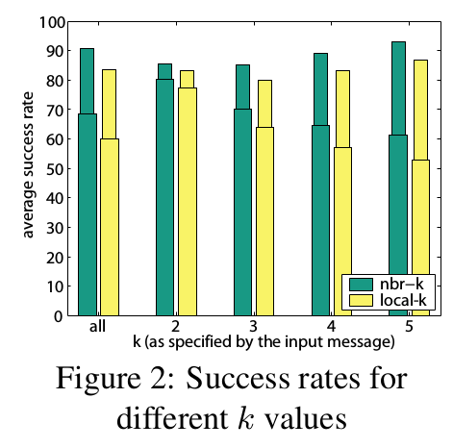
Success Rate
Best average success rate achieved is around 70%
Success rate for messages with k=2 is around 30% higher than the success rate for messages with k=5

Slide 20
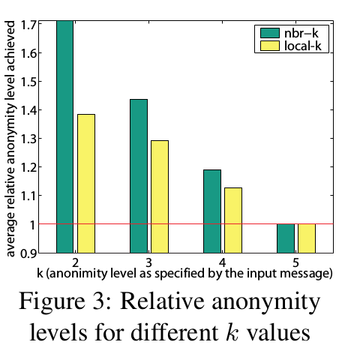
Relative anonymity level
Nbr-k shows relative anonymity level of 1.7 for k=2.
For local-k the value is 1.4

Slide 21
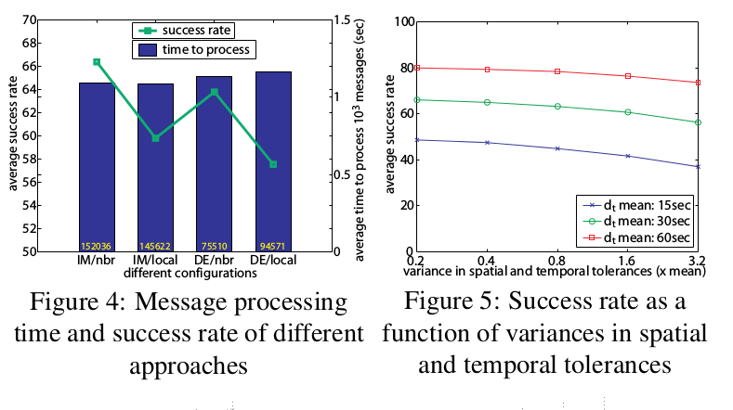
Message processing time

Slide 22
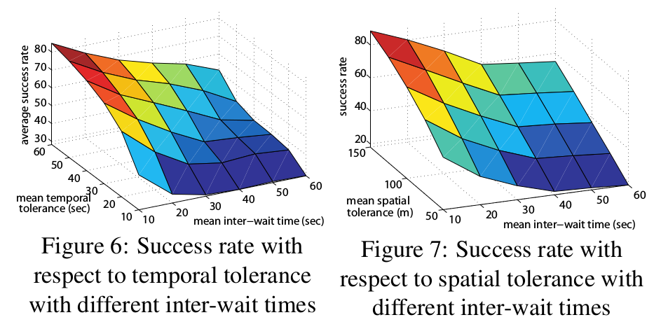
success rate vs spatial and temporal tolerances

Slide 23
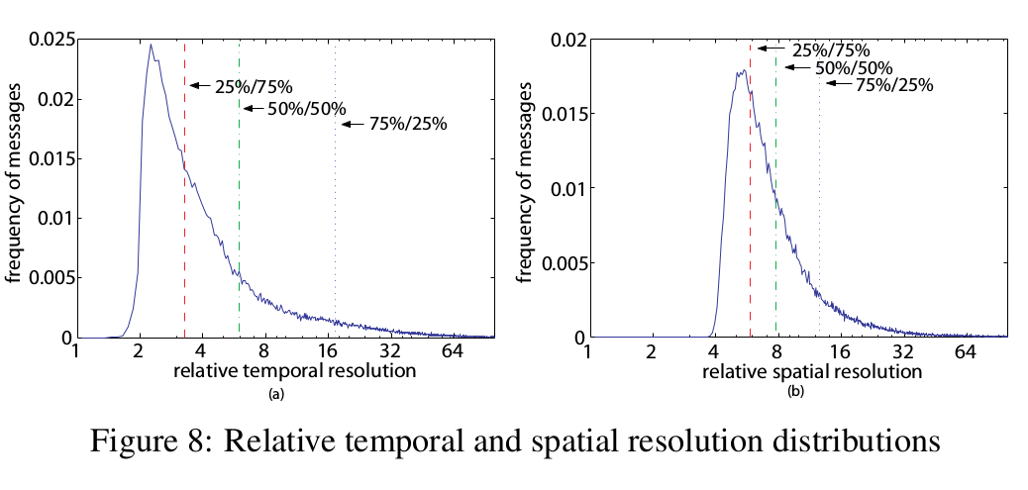
Relative temporal and spatial resolution distribution

Slide 24
THANK YOU

