Slide 1
Mood Sensing

Slide 2


Mood
We need to explicitly communicate the mood

Slide 3
Affective Computing (Mood and Emotion)
Audio/Video-based
(AffectAura, EmotionSense)
Biometric-based
(Skin conductivity,
Temperature, Pulse rate)
Captures expressions
Power hungry
Slightly invasive
Highly temporal
High cost of deployment
Hassle

Slide 4
Can your mobile phone infer your mood?
From already-available, low-power information?*
* No audio/video sensing, no body-instrumentation

Slide 5
Mobile devices have many sensors
Senses the physical world
Aim to implement automatic mood sensors
Automatically shares the mood with the close friends and family
Share in social network
Important application
Video / music recommendation (based on the view’s mood)
Parent may cheer up the son

Slide 6

Mood is…
… a strong social signal
Drives communications
Drives interactions
Drives activity patterns
… a persistent long-lasting state
Lasts hours or days
Emotion lasts seconds or minutes

Slide 7
Key idea
Smartphone has a rich information
With whom we communicate
What application we use
People use their smartphone differently
Depending on the mood

Slide 8
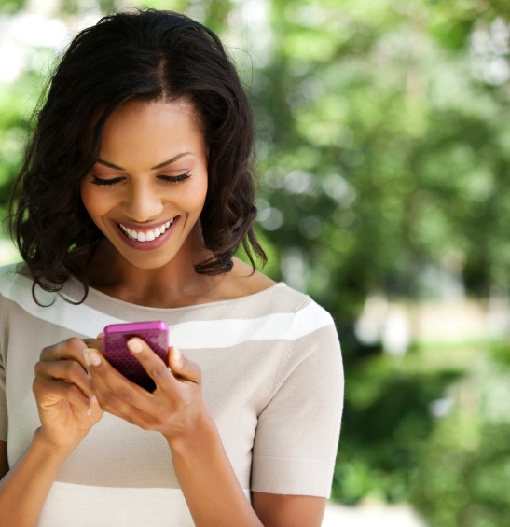
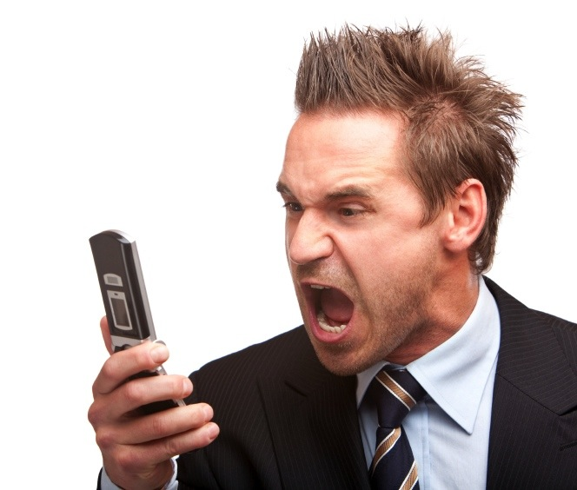
How is the user communicating?
Maybe people text more when they’re happy and call more when they are angry
Call mom when sad
Longer text messages

Slide 9
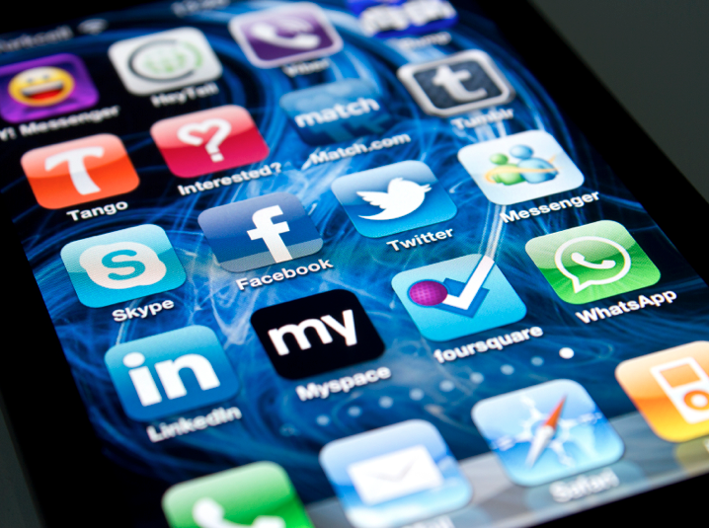
What apps is the user using?
Social applications
Games
Web Browser

Slide 10
Proposed approach
Doesn’t require extra hardware/sensors
Microphone/camera

Slide 11
MoodScope ∈ Affective Computing
Usage Trace-based
(MoodScope)
Passive, Continuous
How to model mood?
Audio/Video-based
Captures expressions
Power hungry
Slightly invasive
Biometric-based
Very direct, Fine-grained
High cost of deployment

Slide 12
Outline
User study with 32 participants
Focus group discussion to learn how mood plays a role in device interaction
2 months field study reports
Daily smartphone usage log
Self reported mood data
Based on the collected users’ data
Build statistical mood models
Infer participants mood from the smartphone usage pattern

Slide 13
Mood inference engine
Infer mood of a user based on his smartphone usage history
Two components
Phone
Cloud

Slide 14
Resource-friendly Implementation
Phone
Cloud
Inferred Mood
Mood Model
Mood Model
Current Usage
Model Training
Mood Inputs/
Usage Logs
Mood and Usage History

Slide 15
Mood model
How can we make mood measurable
Philological research
Models
Dimensional
Discrete
Meaning oriented
Appraisal theory
etc
etc

Slide 16
Discrete model
Ekman presented six basic emotions (anger, surprise, happiness, disgust, sadness and fear)
Extensions

Slide 17
Dimensional
Emotional state is point in a continuous dimensional space
Uni-dimensional model has one dimension
PANAS (positive and negative affect scale )
Multi-dimensional
Two to three dimensions
PAD (Pleasure, Activity, Dominance)
Circumplex mood model
Small number of dimensions to describe and measure mood

Slide 18


Circumplex model (Russell 1980)
depressed
nervous
calm
excited
sad
stressed
bored
attentive
relaxed
happy

Slide 19
Mood is…
… a persistent long-lasting state
Lasts hours or days
Emotion lasts seconds or minutes
… a strong social signal
Drives communications
Drives interactions
Drives activity patterns
… a strong social signal
Drives communications
Drives interactions
Drives activity patterns

Slide 20
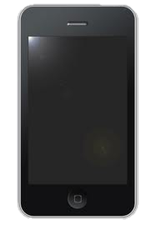
f ( ) = mood
usage
Smartphone usage and mood are related.
We don’t know which one causes which.
But we know there’s some relationship there.
We believe that we can train a machine to recognize mood from smartphone usage. This is the crux of MoodScope.

Slide 21
User study: Pre-study focus group
Two part
Impact of mood changes on smartphone usage
Usage of different application,
Communicate different people
Participant’s opinion on mood sharing
With whom she could share mood
How to publish mood
etc

Slide 22
Field study
Collected real world data from 32 participants over 2 months
Study the correlation between mood and smartphone intersection
Involves two software
Mood journaling application
Background logger

Slide 23
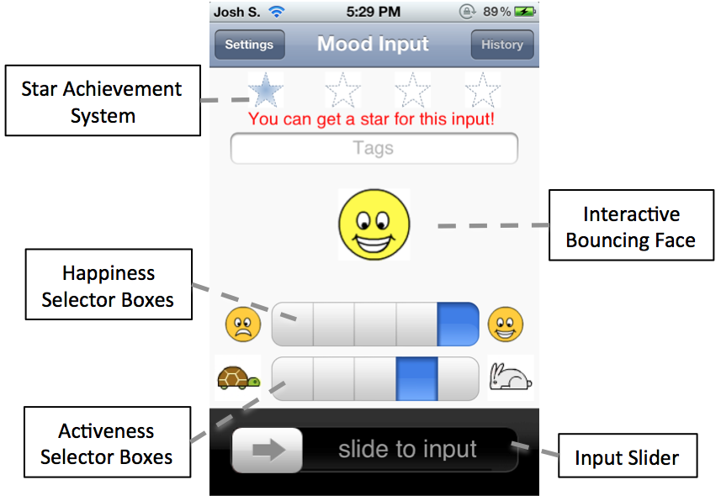
Mood Journaling App
Report use’s mood
Five options
User input 4 times a day
User-base
32 users aged between 18 and 29
11 females

Slide 24
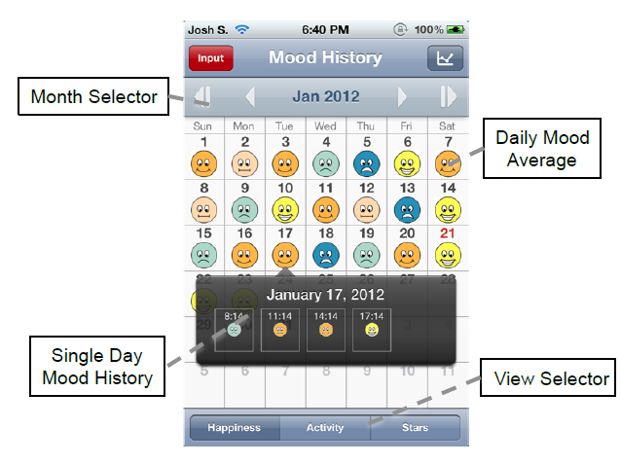
History

Slide 25
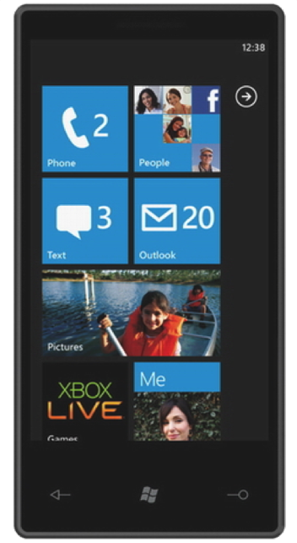
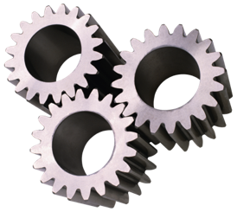
iPhone Livelab Logger
Logger collects participants smartphone interactions
To link with collected mood
Operates in background
No user intervention
Data is archived to server/cloud
Gather relevant information for feature table

Slide 26
iPhone Livelab Logger
Web history
Phone call history
Sms history
Email history
Location history
App usage

Slide 27
iPhone Livelab Logger
Web history
Phone call history
Sms history
Email history
Location history
App usage
Runs as shell
Hash private data
Uploads logs to our server nightly

Slide 28
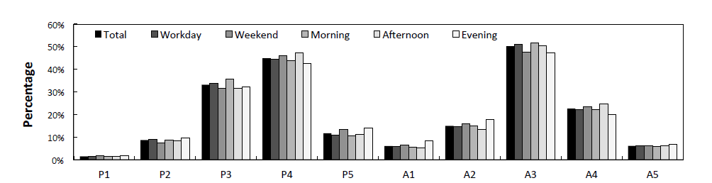
Quantitatively understand user response to mood journalism system
Five level scores P1-P5, A1-A5
Response rate
Mood persistence
Very displeased

Slide 29
Inference
Detect a mood pattern
Validate with only 60 days of data
Wide range of candidate usage data
Low computational resources

Slide 30
Design of model
Crux of the model
Ability to predict user’s mood
Supervised ML
How user’s mood can be inferred from usage log analysis
Tasks
Construction of daily mood sample
Usage log feature table

Slide 31


Daily Mood Averages
Mood changing slow over time
Take the average over a day
Separate pleasure, activeness dimension
Sixty (Pleasure-Activity) pairs for each user
Σ( )
_______________
4

Slide 32
Usage record
Build feature table on the usage records collected by logger
Focus on two categories
Social interaction
Routine activity

Slide 33
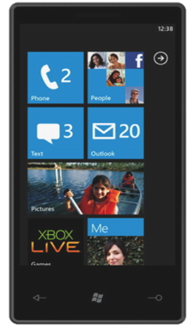

Social interaction
Communication
SMS
Email
Phone Calls
To whom?
# words in messages, mail
Length/Duration call
Consider “Top 10” Histograms
How many phone calls were made to #1? #2? … #10?
How much time was spent on calls to #1? #2? … #10?
?
?
Creates 6 social interactions, 10 dimensional histogram in feature table

Slide 34
Routine activity
Usage Activity
Applications usage
Websites visited
Location History
Usage of 10 most frequent app, webpages
Which (app/site/location)?
# instances
Cluster the locations => approx location
Count user visit to each approx location
Duration of time an application was used

Slide 35
Routine activity
Group applications by (12) type (build in, communication, game, entertainment etc)
Application usage by each user
Application duration
12 dimensional vector

Slide 36
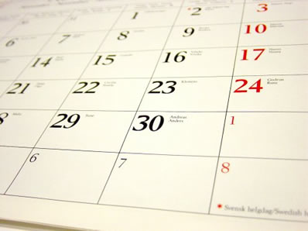
Previous Mood Time series component
Use previous 2 pleasure-activity pairs of mood labels

Slide 37
Data Type | Histogram by: | Dimensions
Email contacts | # Messages | 10
 | # Characters | 10
SMS contacts | # Messages | 10
 | # Characters | 10
Phone call contacts | # Calls | 10
 | Call Duration | 10
Website domains | # Visits | 10
Location Clusters | # Visits | 10
Apps | # App launches | 10
 | App Duration | 10
Categories of Apps | # App launches | 12
 | App Duration | 12
Previous Pleasure and Activeness Averages | N/A | 4

Slide 38
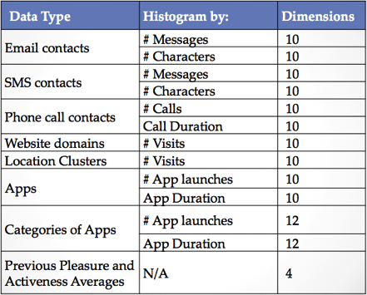

Model Design
??
Usage record
Label: Mood average
Multi-Linear Regression
Minimize Mean Squared Error
Leave-One-Out Cross-Validation
Regression on each mood dimension (pleasure /activeness)
Cross validation
Train with 59 samples

Slide 39
Sequential Forward selection
Subset Feature Selection during training
Pick subset Y features that gives best regression
Greedy approach
Y starts with empty set
Add feature x to Y that minimizes the mean error
Stops when reaches local minimum

Slide 40
Sequential Feature Selection
SFS chose 16.3 features per user
Some users use 5, some 32
(Each line is a different user)

Slide 41
Personalized mood model
Multi-linear regression on each user data individually
Average Mean square error: 0.075, SD: 0.05
Minimum: 0.002, maximum: 0.176
On average 93.1% of daily pleasure averages and 92.7% activeness averages have error under 0.25

Slide 42
All user mood model
Personalized model reports high accuracy
Require individual tanning for long time
One size fits all mood model
Attempts to reduce the amount of training
Created from aggregate of all user’s data
Results
Performs well for few user
Minimum error 0.069
Average 0.296 (SD: 0.175)
Maximum: 0.79
66% of pleasure estimates have square error under 0.25

Slide 43
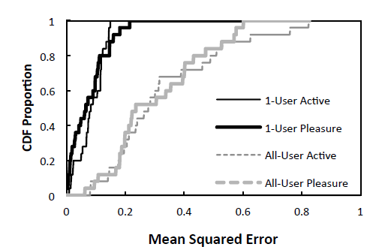

Slide 44
Hybrid model
Ideal mood model
Blend together personalized (high accuracy)
All user model (no user training)
Approach
Combines small amount of user specific training data
Large amount of data from general user population
Objective function
Reduce the error (personalized data, data sourced from rest of the population)

Slide 45
Personalized Training
All-user model accuracy
Notes:
But if we start from the all-user model and slowly add personalized data, we can have a nice hybridized training.

Slide 46
Personalized/All-user Hybrid Training

Slide 47
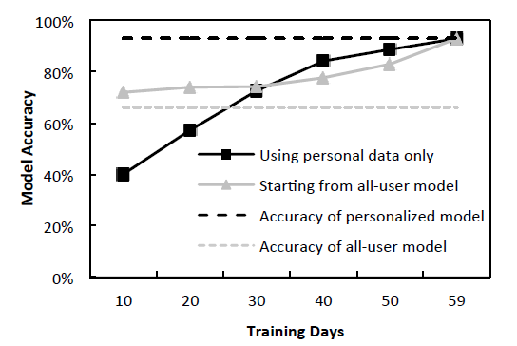

Slide 48
Mood inference engine
Infer mood of a user based on his smartphone usage history
Two components
Phone
Cloud

Slide 49
Resource-friendly Implementation
Phone
Cloud
Inferred Mood
Mood Model
Mood Model
Current Usage
Model Training
Mood Inputs/
Usage Logs
Mood and Usage History
Notes:
But training is expensive

Slide 50
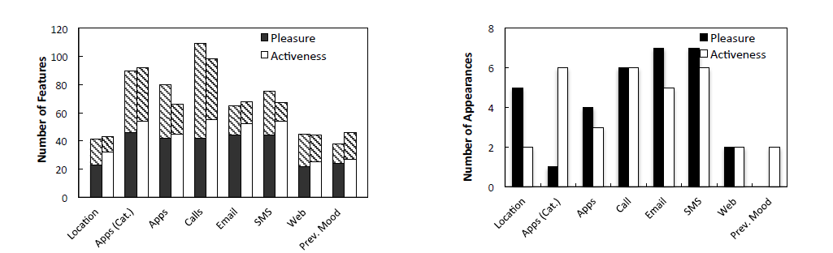

Slide 51
Discriminative Features

