Slide 1

Wardriving
7/29/2004
The “Bad Karma Gang”

Slide 2
Agenda
Introduction to Wardriving
The Tools of Wardriving
Wardriving Green Lake

Slide 3
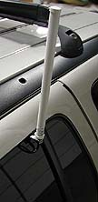
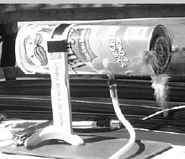
What is War Driving?
Definition:
  Driving through a neighborhood with a wireless-enabled notebook computer in search for wireless access points (APs)
Purpose:
  Analyze Wireless LANs & show which APs are open
Product:
  Wireless Access Point Map
Origin:
  “War dialing”

Slide 4
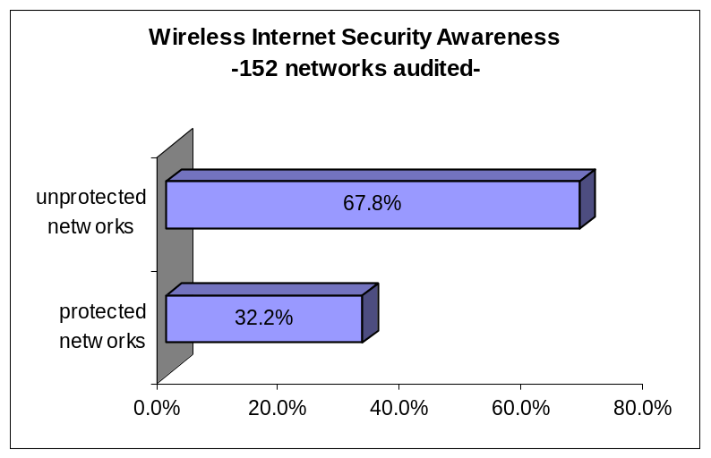
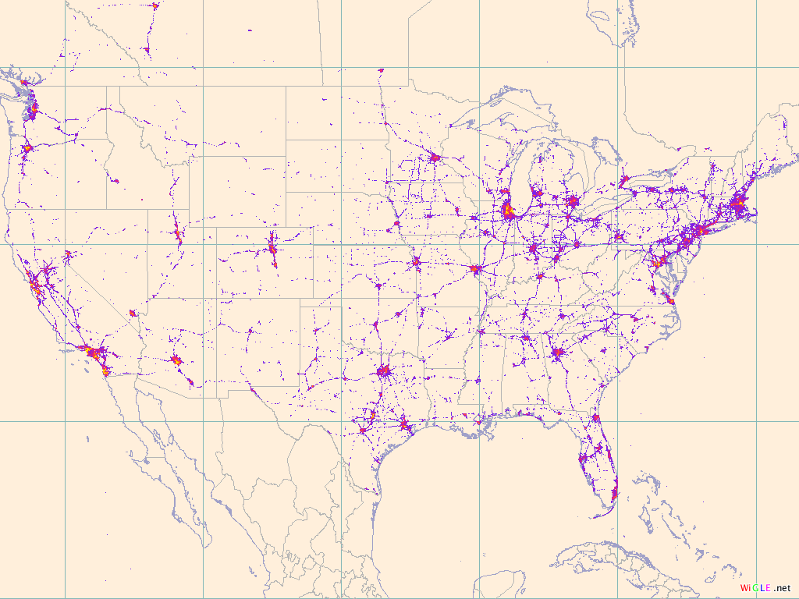
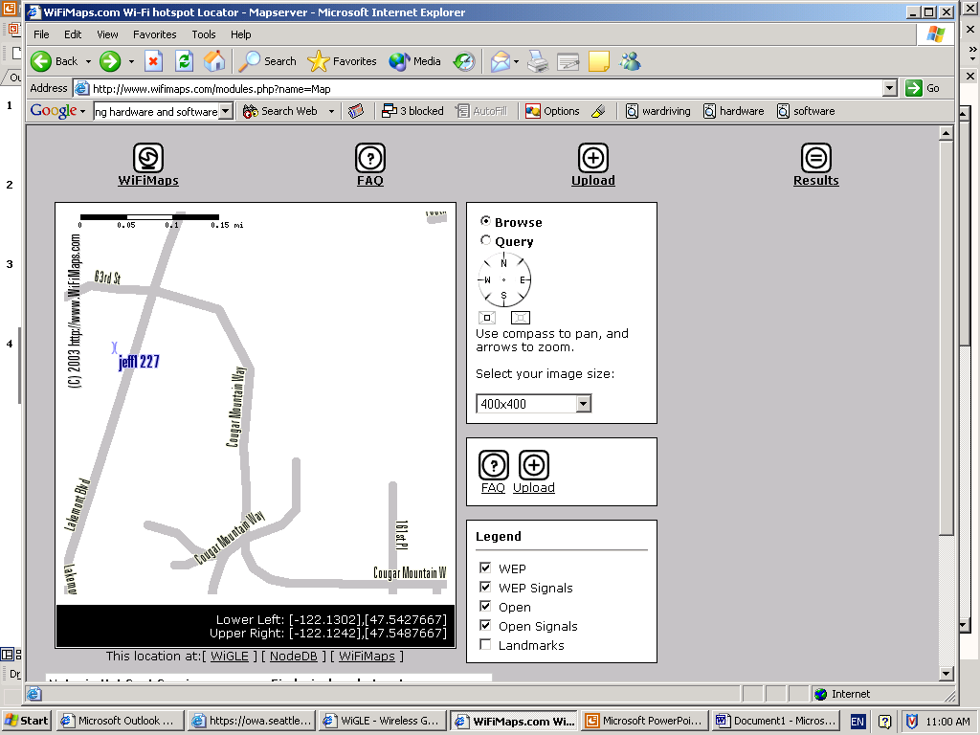
Some Results of War Driving
Wireless Access Point Maps
Nowel & Budge
-Source: Wigle.Net-
WWWD4 (World Wide War Drive)
  June 12-19 , 2004
  300,000 APs submitted worldwide
Access point
Nui’s House
WiGLE
-WiFiMaps.com-

Slide 5
Legal Background
Activity | Legality | Law
Scan access points | Not illegal
Intentional access of a computer without authorization | Illegal | Computer Fraud and Abuse Act
Alteration of communication on ISP network without authorization | Illegal | Electronic Communications Protection Act
Interception of communications as they’re going through the air | Illegal | Wiretap Act
Notes:
Computer Fraud and Abuse Act -
prohibits intentional access of a computer without authorization
Electronic Communications Protection Act prohibits alteration of communication on ISP network without authorization
Wiretap Act - prohibits interception of communications as they’re going through the air. Probalby not violation to pick up unencrypted WiFi communications
Theft of services
Trespass
http://cfp2004.org/blogs/wardriving/archives/000056.html

Slide 6
Anatomy of a Hack
(Hacking Exposed 4th Edition)
War driving Process
Footprinting
Address range,
namespace acquisition
Scanning
Find promising
points of entry
Enumeration
Find user accounts
and poorly protected shares
Gaining Access
Informed attempts
to access target
Escalating Privilege
Gain complete
control of system
Pilfering
Gain access to
trusted systems
Covering Tracks
Hide system privileges
Creating Back Doors
Ensure ability to
regain access at will
Denial of Service
Create ability to disable target
Legal
Illegal

Slide 7
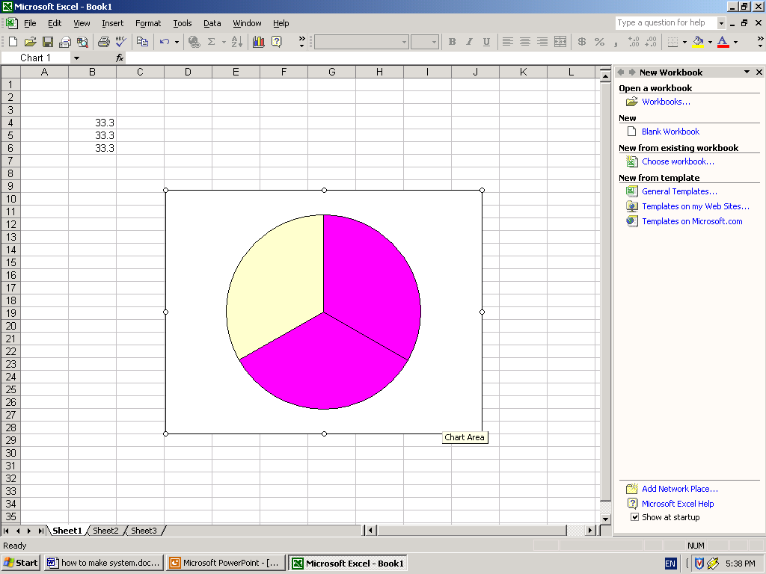
Possible Risks
War driving = not illegal
Beyond war driving = illegal
  Encryption key cracking
  Free internet access
  Identity exposure and theft
  Network resource utilization
  Data theft
  Denial-of-service
  Other hacking activities
Availability
Confidentiality
Integrity

Slide 8
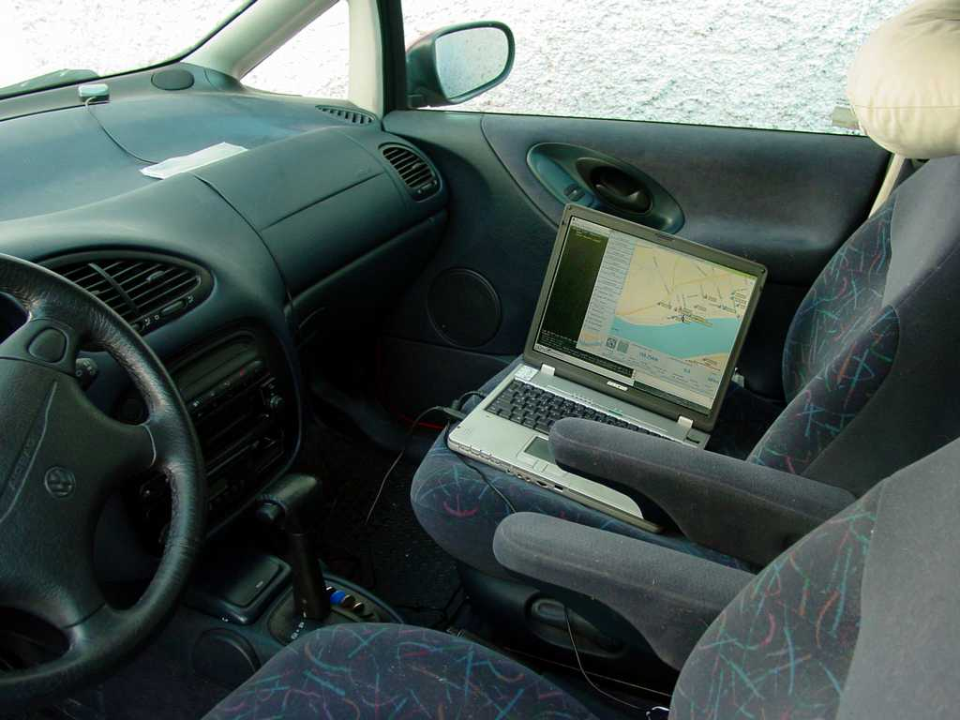
Typical Wardriving Setup
GPS Mouse
Notebook computer
802.11 network sniffing software (e.g. Netstumbler)
GPS Software
Display
Text to speech software
"new network found. ssid is thd-wireless. channel 6. network open."
Power Cable

Slide 9
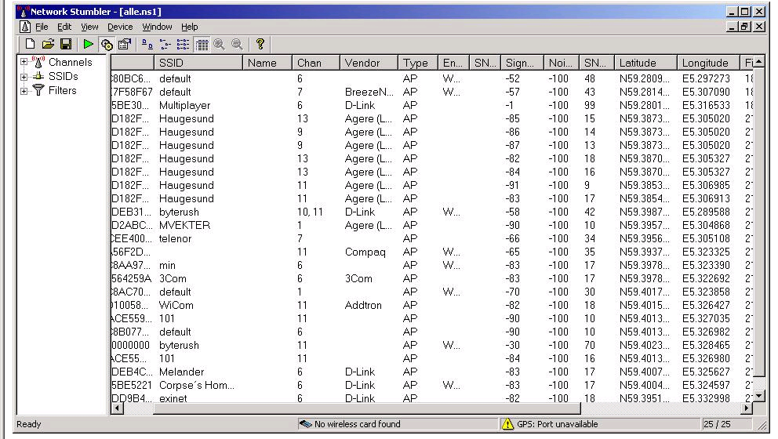
Netstumbler Screenshot

Slide 10
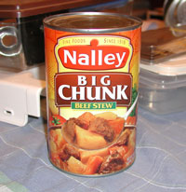
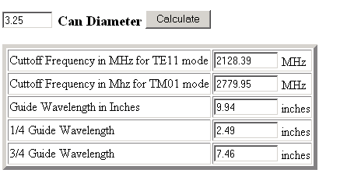

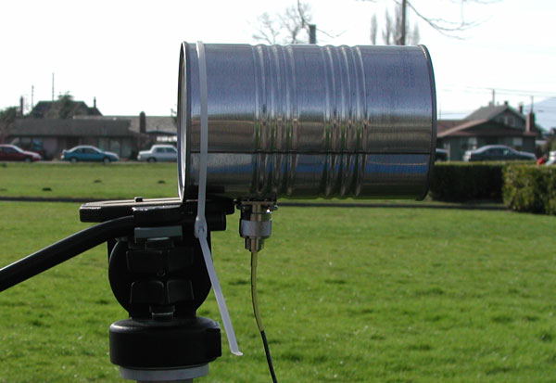
For the thrifty and adventurous wardriver…
Build a “Cantenna”
http://www.turnpoint.net/wireless/cantennahowto.html

Slide 11
Protection of Wireless Networks
Use Wired Equivalency Privacy (WEP)
Network card encrypts “payload” using RC4 cipher
Receiving station decrypts upon arrival
Only works between 802.11 stations.
No longer applies once payload enters wired side of network
Users should change default password and Service Set Identifier
Users should change keys often
Physically locate access point to avoid “spilling” signal off premises
Install hardware or software firewall
Use passwords for sensitive folders and files
Users should perform wardriving test
Notes:
Job title: associate prof.
Campus address
Social security #
Work phone
Husband’s name
Social

Slide 12
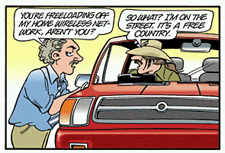
Experiment: War Driving Seattle
* Doonesbury, December, 2002.

Slide 13
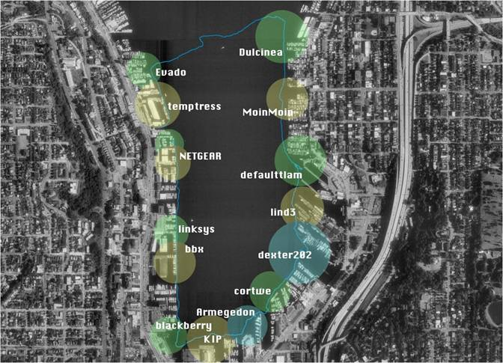
Wardriving: Been there, done that?
* “War Kayaking”, Summer, 2003.

Slide 14
War Driving Experiments

Slide 15
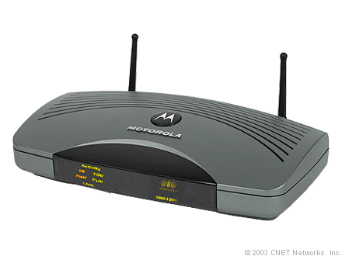
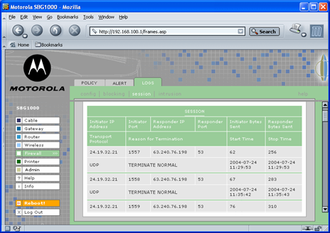
Experiment 1: Open door
Opened SBG1000 wireless Internet gateway
Meant to disable 16 bit encryption
Discovered traffic in logs when home computers off

Slide 16



Experiment 2: Tools of the trade
+
+
=
Access

Slide 17
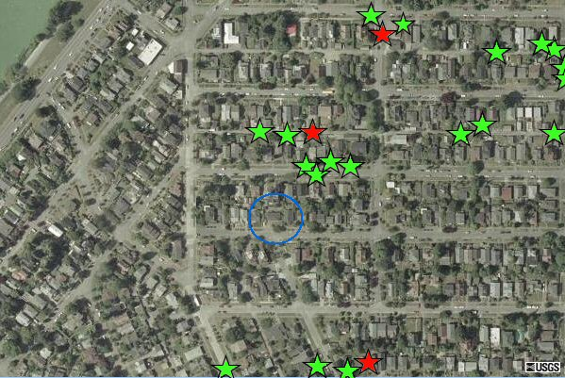
Results: Access Gained
My house

Slide 18
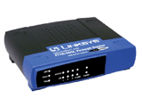
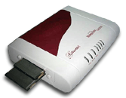
Results
29 Available networks in 2 short hours
All available from parked car on crowded streets
Colorful names for wireless routers
  hotstuff, red libre, eatshitanddie
  most use manufacturer name
Only 3 required a key of any kind

Slide 19
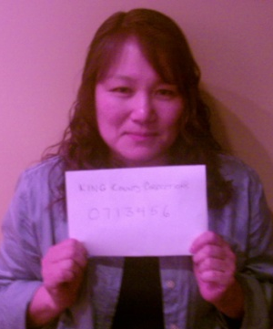
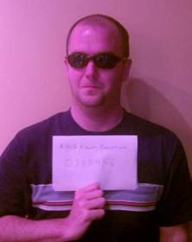
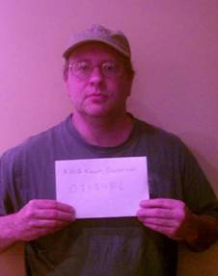
Discussion
The “Bad Karma Gang”
-Social Engineer Alumni Relations-

