Slide 1
Content Distribution through WiFi Network
Presented By
Sourav Kumar Dandapat
VDA-VII

Slide 2
Background and Motivation
Internet traffic is increasing in exponential rate
A significant part of the Internet traffic is due to wireless Internet.
In year 2010, 34% of overall Internet traffic was due to wireless Internet
It has been predicted by year 2014 traffic due to wireless Internet will exceed 50% of overall traffic.
It has been also predicted that demand of data will increase 40 times in next 5 years.

Slide 3
Cont..
We can use under-utilized resources like cell-towers, WiMax, WiFi APs for offloading 3G traffics
Use local memory for hosting files and existing technology to access those files
What will be the most suitable technology to use?

Slide 4
What can a user get from this?
We can categorize our Internet usage in two broad categories
Personal file accessing (like mail, Facebook)
Popular file accessing (movie, songs, sports)
We can not provide personal’s file without connecting Internet, so our basic goal is to distribute popular files through WiFi network

Slide 5
How much of users’ request can be satisfied?
How many files can be distributed through local memory?
Memory Limitation
However, there is a fantastic statistics about popularity of files
Popularity of files follows power law (I tube, you tube, everybody tubes, IMC 2007)
So hosting fewer popular file, we can satisfy a large number of requests from user.

Slide 6
Problem Definition
Let us assume there are n APs, and every AP can hosts up to m files (assuming file size is same for all files). Using this system, how many files we can offer so that a traveler can download a file of his desire between his source and destination.
Max no of files that can be hosted=nXm

Slide 7
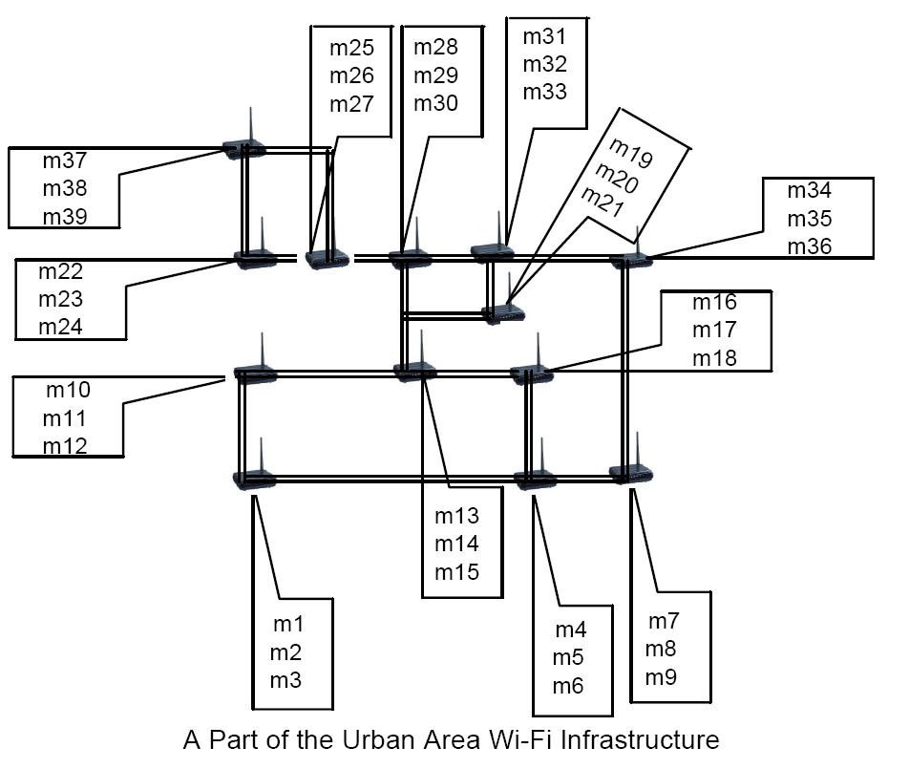

Slide 8
Easy problem needs to be solved first
Let us concentrate on distributing a single file
Let us assume that every AP can hosts m chunks of similar size, now the question is which AP should host which chunks
i^{th} chunk must be executed before i+1 ^{th} chunk is executed.

Slide 9
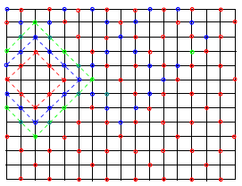
A simple case study

Slide 10
What can we do for a general graph?
Vertex cover problem- It finds out a minimum sub graph or set (say S) so that for every edge at least one of its vertex belongs to S.
Vertex cover problem is a NP-Complete problem. So optimal solutions can not be obtained in polynomial time.
There might be a number of solutions
ILP can be used to get the solutions
How vertex cover can be used to decide chunk distribution?

Slide 11
Maps to a standard Algorithm
K-hop vertex cover- We can extend the normal vertex cover definition to k-hop vertex cover.
In k-hop vertex cover problem needs to ensure that for any k-hop path in the graph, at least one node of this path belongs to set S.

Slide 12
Solution
Chunk 1 placement- S¹₁ S¹₂ S¹₃ S¹₄ S¹₅
Chunk 2 placement- S²₁ S²₂ S²₃ S²₄ S²₅
Chunk 3 placement- S³₁ S³₂ S³₃ S³₄ S³₅
Chunk 4 placement- S⁴₁ S⁴₂ S⁴₃ S⁴₄ S⁴₅
Chunk 1 placement- S⁵₁ S⁵₂ S⁵₃ S⁵₄ S⁵₅
How does S^{i}_{j} looks? {n1, n2, n3, …}
What is the final solution?

Slide 13
Thank You!!!

