Slide 1
Self-stabilizing
Distributed Systems
Sukumar Ghosh
Professor, Department of Computer Science
University of Iowa

Slide 2
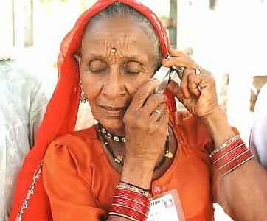
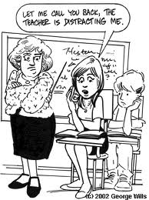
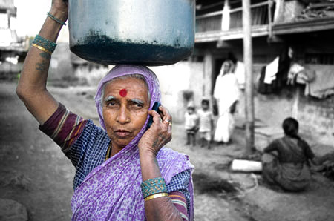


Introduction
2

Slide 3
Failures and Perturbations
Fact 1. All modern distributed systems are dynamic.
Fact 2. Failures and perturbations are a part of such
distributed systems.

Slide 4
Classification of failures
Crash failure
Security failure
Omission failure
Temporal failure
Byzantine failure
Transient failure
Software failure
Environmental perturbations

Slide 5
Classifying fault-tolerance
Masking tolerance.
Application runs as it is. The failure does not have a visible impact. All properties (both liveness & safety) continue to hold.
Non-masking tolerance.
Safety property is temporarily affected, but not liveness.
Example 1. Clocks lose synchronization, but recover soon thereafter.
Example 2. Multiple processes temporarily enter their critical sections, but thereafter, the normal behavior is restored.
Backward error-recovery vs. forward error-recovery

Slide 6
Backward vs. forward error recovery
Backward error recovery
When safety property is violated, the computation rolls back and resumes from a previous correct state.
time
rollback
Forward error recovery
Computation does not care about getting the history right, but moves on, as long as eventually the safety property is restored.
True for self-stabilizing systems.

Slide 7
So, what is self-stabilization?
Technique for spontaneous healing after transient failure or perturbation.
Non-masking tolerance (Forward error recovery).
Guarantees eventual safety following failures.
Feasibility demonstrated by Dijkstra in his Communications of the ACM 1974 article

Slide 8
Why Self-stabilizing systems?
It is nice to have the ability of spontaneous recovery from any initial configuration to a legitimate configuration. It implies that no initialization is ever required. Such systems can be deployed ad hoc, and are guaranteed to function properly in bounded time. Such systems restore their functionality without any extra intervention.

Slide 9
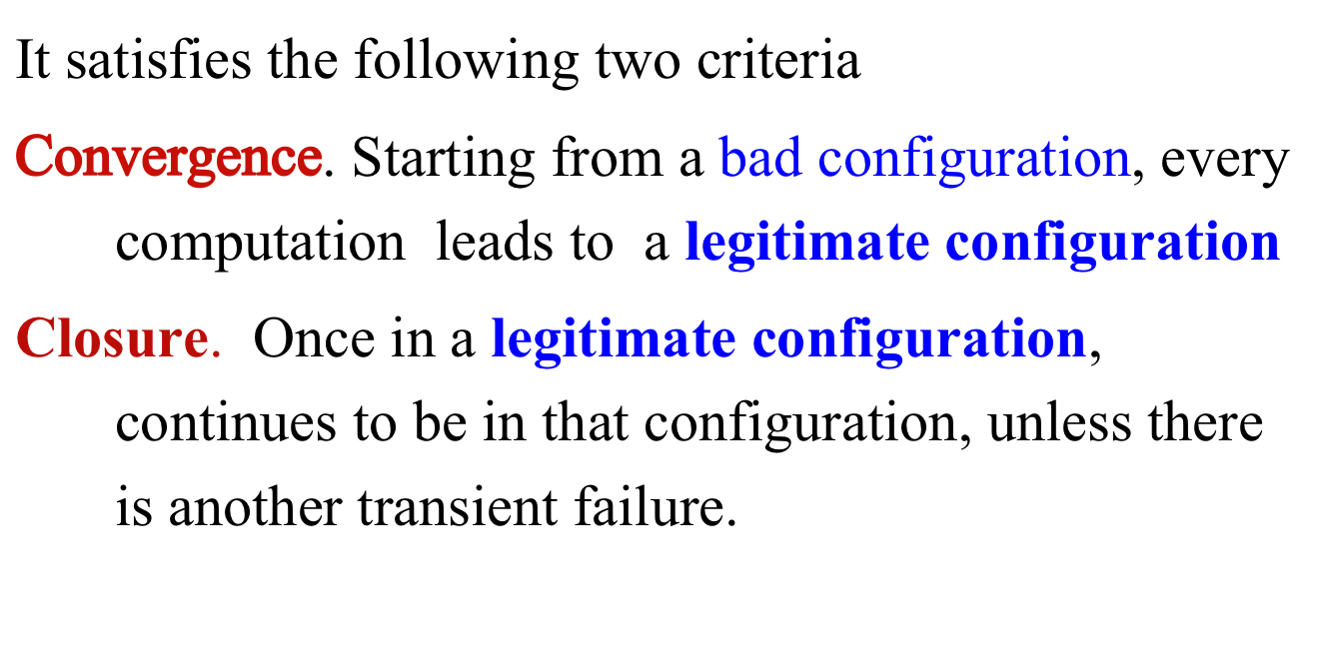
Two properties

Slide 10
Self-stabilizing systems
State space
legal

Slide 11
Example 1:
Self-stabilizing mutual exclusion on a ring (Dijkstra 1974)
N-1
0
1
2
6
7
3
4
5
Consider a unidirectional ring of processes.
In the legal configuration, exactly one token
will circulate in the network

Slide 12
Stabilizing mutual exclusion on a ring
0
The state of process j is x[j] ∈ {0, 1, 2, K-1}. (Also, K > N)
{Process 0} repeat x[0] = x[N-1]→ x[0] := x[0] + 1 mod K forever
{Process j > 0} repeat x[j] ≠ x[j -1] → x[j] := x[j-1] forever
(TOKEN = ENABLED GUARD)
Hand-execute this first, before proceeding further.
Start the system from an arbitrary initial configuration

Slide 13
Stabilizing mutual exclusion on a ring
(N=6, K=7)
0
2
5
4
6
0
2
2
5
5
6
0
2
3
3
5
6
6
2
{Process 0} repeat x[0] = x[N-1]→ x[0] := x[0] + 1 mod K forever
{Process j > 0} repeat x[j] ≠ x[j -1] → x[j] := x[j-1] forever

Slide 14
Outline of Correctness Proof
(Absence of deadlock). If no process j>0 has an enabled guard then
x[0]=x[1]=x[2]= … x[N-1]. But it means that the guard of process 0 is enabled.
(Proof of Closure) In a legal configuration, if a process executes an action,
then its own guard is disabled, and its successor’s guard becomes enabled.
So, the number of tokens (= enabled guards) remains unchanged.
It means that if the system is already in a good configuration, it remains so
(unless, of course a failure occurs)

Slide 15
Correctness Proof (continued)
Proof of Convergence
Let x be one of the “missing states” in the system.
Processes 1..N-1 acquire their states from their left neighbor
Eventually process 0 attains the state x (liveness)
Thereafter, all processes attain the state x before process 0 becomes enabled again. This is a legal configuration (only process 0 has a token)
Thus the system is guaranteed to recover from a bad configuration to a good configuration

Slide 16
To disprove
To prove that a given algorithm is not self-stabilizing to L, it is
sufficient to show that. either
there exists a deadlock configuration, or
(2) there exists a cycle of illegal configurations (≠L) in the history
of the computation, or
(3) The systems stabilizes to a configuration L‘≠ L

Slide 17
Exercise
Consider a completely connected network of n processes numbered
0, 1, …, n-1. Each process i has a variable L(i) that is initialized to i.
The goal of the system is to make the values of all L(i)’s identical:
For this, each process i executes the following algorithm:
repeat
∃j ∈ neighbor (i): L(i) ≠ L(j) → L(i) := L(j)
forever
Question: Is the algorithm self-stabilizing?

Slide 18
Example 2: Clock phase synchronization
0
System of n clocks ticking at the same rate.
Each clock is 3-valued, i,e it ticks as 0, 1, 2, 0, 1, 2…
A failure may arbitrarily alter the clock phases.
The clocks phases need to stabilize, i.e.
they need to return to the same phase. .
Design an algorithm for this.
1
2
3
n-1

Slide 19
The algorithm
∀k: c[k] ∈ {0.1.2}
Clock phase synchronization
{Program for each clock}
(c[k] = phase of clock k, initially arbitrary)
repeat
R1. ∃j: j∈ N(i) :: c[j] = c[i] +1 mod 3 →
c[i] := c[i] + 2 mod 3
R2. ∀j: j∈N(i) :: c[j] ≠ c[i] +1 mod 3 →
c[i] := c[i] + 1 mod 3
forever
First, verify that it “appears to be” correct.
Work out a few examples.
0
1
2
3
n-1

Slide 20
Why does it work?
0
1
2
n-1
Let D = d[0] + d[1] + d[2] + … + d[n-1]
d[i] = 0 if no arrow points towards clock i;
= i + 1 if a ← points towards clock i;
= n – I if a → points towards clock i;
= 1 if both → and ← point towards
clock i.
By definition, D ≥ 0.
Also, D decreases after every step in the system. So the number of arrows must reduce to 0.
0
2
2
2
0
1
1
0
1
1
2
2
2
2
2
Understand the game of arrows

Slide 21
Exercise
Why 3-valued clocks? What happened for larger clocks?
Will the algorithm work for a ring topology? Why or why not?

Slide 22
Example 3:
Self-stabilizing spanning tree
Problem description
Given a connected graph G = (V,E) and a root r, design an algorithm for maintaining a spanning tree in presence of transient failures that may corrupt the local states of processes (and hence the spanning tree) .
Let n = |V|

Slide 23
Different scenarios
⁰
⁰
¹
¹
¹
Parent(2) is corrupted
²
²
⁴
⁵
²
⁴
³
³
⁴
⁵
³
⁵

Slide 24
Different scenarios
⁰
⁰
¹
¹
¹
¹
²
⁴
²
²
⁵
²
⁴
⁵
³
⁴
³
³
⁵
⁵
⁵
⁴
The distance variable L(3) is corrupted

Slide 25
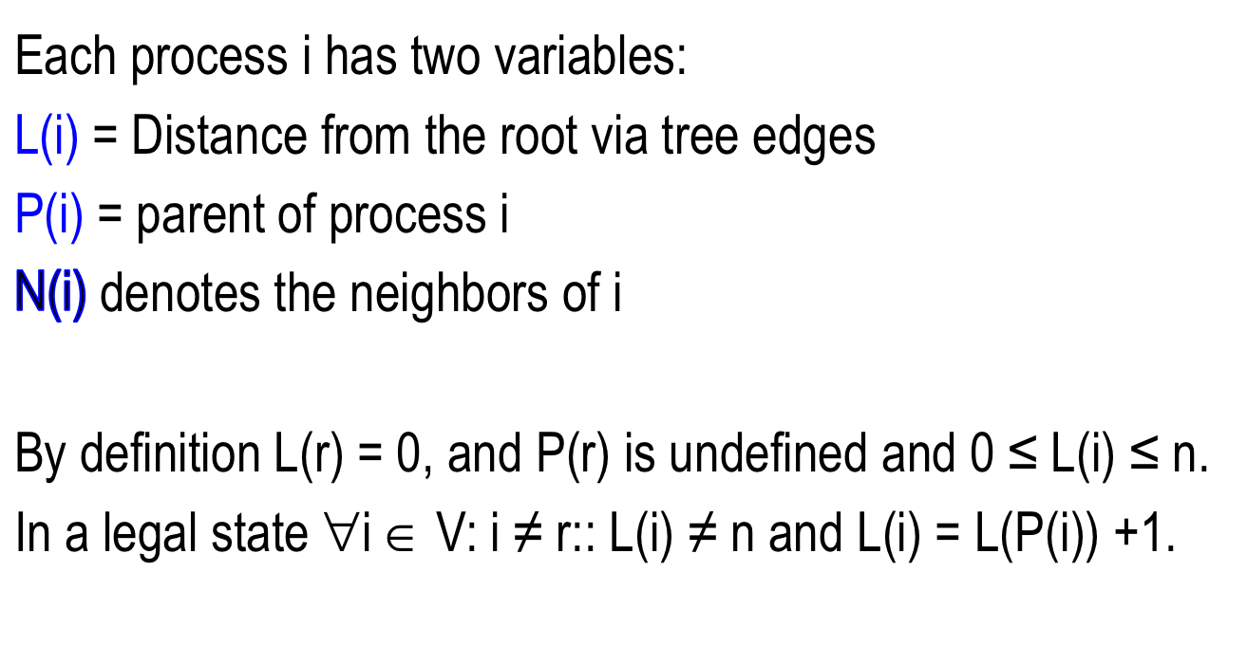
Definitions

Slide 26
The algorithm
repeat
R1. (L(i) ≠ n) ∧ (L(i) ≠ L(P(i)) +1)
∧ (L(P(i)) ≠ n) → L(i) :=L(P(i) + 1
R2. (L(i) ≠ n)∧(L(P(i))=n) → L(i):=n
R3. (L(i) =n) ∧ (∃k ∈ N(i):L(k)<n-1) → L(i) :=L(k)+1; P(i):=k
forever
0
⁰
1
¹
P(2) is corrupted
2
²
⁴
5
3
4
³
⁵
The blue labels denote
the values of L

Slide 27
Proof of stabilization
Define an edge from i to P(i) to be well-formed, when L(i) ≠ n, L(P(i)) ≠ n and L(i) = L(P(i)) +1.
In any configuration, the well-formed edges form a spanning forest. Delete all edges that are not well-formed. Each tree T(k) in the forest is identified by k, the lowest value of L in that tree.

Slide 28
Example
In the sample graph shown earlier, the original spanning tree is decomposed into two well-formed trees
T(0) = {0, 1}
T(2) = {2, 3, 4, 5}
Let F(k) denote the number of T(k)’s in the forest.
Define a tuple F= (F(0), F(1), F(2) …, F(n)).
For the sample graph, F = (1, 0, 1, 0, 0, 0) after node 2’s has a transient failure.

Slide 29
Proof of stabilization
Minimum F = (1,0,0,0,0,0) {legal configuration}
Maximum F = (1, n-1, 0, 0, 0, 0) (considering lexicographic order)
With each action of the algorithm, F decreases lexicographically. Verify the claim!
This proves that eventually F becomes (1,0,0,0,0,0) and the spanning tree stabilizes.
What is an upper bound time complexity of this algorithm?

Slide 30
Conclusion
Classical self-stabilization does not allow the codes to
be corrupted. Can we do anything about it?
The fault-containment problem
The concept of transient fault is now quite relaxed.
Such failures now include
-- perturbations (like node mobility in WSN)
-- change in environment
-- change in the scale of systems,
-- change in user demand of resources
The tools for tolerating these are varied, and still evolving.

Slide 31
Questions?

Slide 32
Applications
Concepts similar to stabilization are present in the networking area for quite some time. Wireless sensor networks have given us a new platform.
Many examples of systems that recover from limited perturbations. These mostly characterize a few self-healing and self-organizing systems.
The University of Iowa
Notes:
Link-state routing is stabilizing, but distance-vector routing is not).

Slide 33


Pursuer Evader Games
In a disaster zone, rescuers (pursuers) try to track hot spots (evaders) using sensor networks. How soon can the pursuers catch the evader
(Arora, Demirbas, Gouda 2003)
The University of Iowa

Slide 34
Pursuer Evader Games
Evader is omniscient;
Strategy of evader is unknown
Pursuer can only see state of nearest node;
Pursuer moves faster than evader
Design a program for nodes and pursuer so that itr can catch evader (despite the occurrence of faults)
The University of Iowa

Slide 35
Main idea
A balanced tree (DFS) is continuously maintained with the evader as the root. The pursuer climbs “up the tree” to reach the evader.
The University of Iowa

