Slide 1
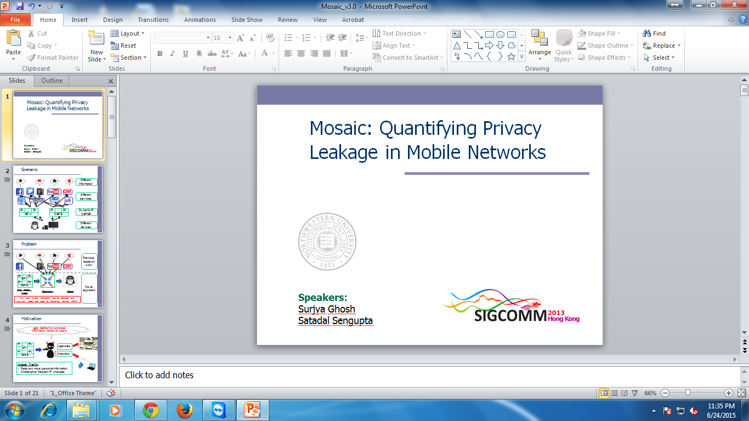
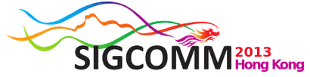
Mosaic: Quantifying Privacy Leakage in Mobile Networks
Institution | Authors
Northwestern University | Ning Xia Aleksandar Kuzmanovic
Narus Inc. | Han Hee Song Yong Liao Marios Iliofotou Antonio Nucci
University of Minnesota | Zhi-Li Zhang

Slide 2
Outline
Scenario
Problem
Motivation
Challenges
Datasets
Methodology – Overview
Methodology – Details
Traffic Attribution
Construction of User Mosaic
Quantifying Privacy Leakage
Counter-measures
Conclusion

Slide 3













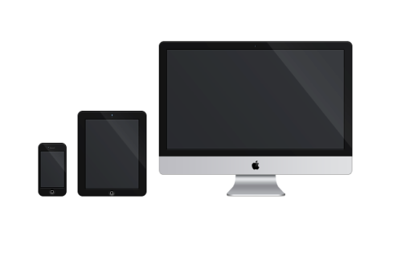

Scenario
Different information
Different services
IP₁
…
IP_{K}
IP₁
…
IP_{K}
Dynamic IP,
CSP/ISP
ISP A
CSP B
Different
devices

Slide 4

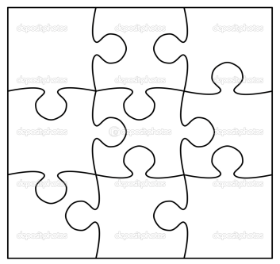

Problem
Previous research work
IP₁
…
IP_{K}
Novel approach
ISP A
IP₁
…
IP_{K}
CSP B
Input packet
traces
Tessellation
Mosaic
How much private information can be obtained and expanded about end users by monitoring network traffic?

Slide 5


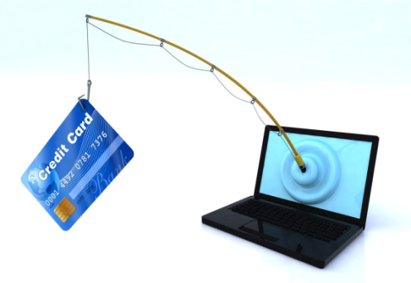
Motivation
Aim: Gathering complete information about all users
IP₁
…
IP_{K}
Agencies
ISP A
IP₁
…
IP_{K}
Hackers
CSP B
Mobile Traffic:
Relevant: more personal information
Challenging: frequent IP changes

Slide 6
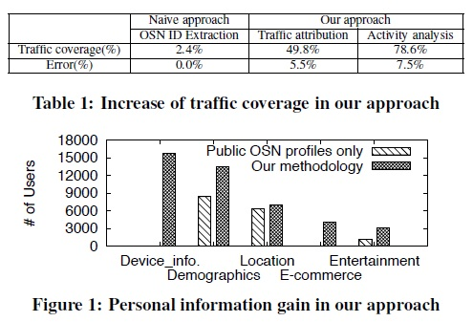
Goals
First, is it feasible to utilize users’ OSN activities to extract and attribute users’ digital footprints to individual OSN users?
Second, if the answer to the first question is affirmative, then how much and what type of information can be gleaned from the data, assisted and corroborated by whatever public information about the users available on the Web?

Slide 7



Challenges
How to track users when they hop over different IPs?
Sessions:
Flows (5-tuple) are grouped into sessions
IP1
time
Traffic Markers:
Identifiers in the traffic that can be used to differentiate users
IP2
time
IP3
time
With Traffic Markers, it is possible to
connect the users’ true identities to their sessions.

Slide 8
Datasets
Dataset | Source | Description
3h-Dataset | CSP-A | Complete payload
9h-Dataset | CSP-A | Only HTTP headers
Ground Truth Dataset | CSP-B | Payload & RADIUS info.
3h-Dataset: main dataset for most experiments
9h-Dataset: for quantifying privacy leakage
Ground Truth Dataset: for evaluation of session attribution
RADIUS: provide session owners

Slide 9


Methodology Overview
Tessellation
IP₁
…
IP_{K}
ISP A
Via
traffic markers
IP₁
…
IP_{K}
CSP B
Traffic attribution
Via activity fingerprinting
Mapping from
sessions to users
Network data analysis
Mosaic construction
Web crawling
Combine information from both network data and OSN profiles to infer the user mosaic.

Slide 10
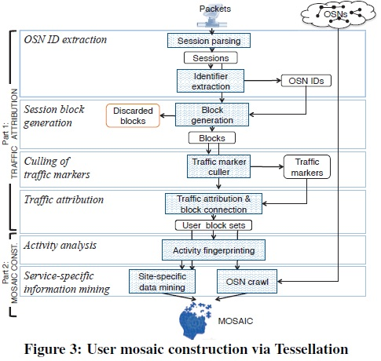
Flow Chart

Slide 11
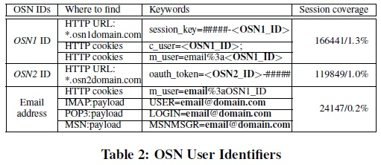
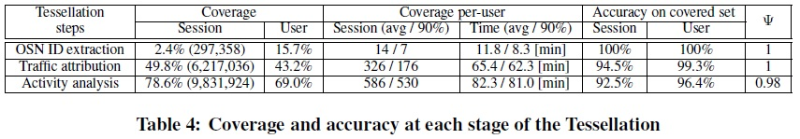
Traffic attribution via OSN credentials

Slide 12
Traffic Attribution via Traffic Markers
Traffic Markers:
Identifiers in the traffic to differentiate users
Key/value pairs from HTTP header
User IDs, device IDs or sessions IDs
Domain | Keywords | Category | Source
osn1.com | c_user=<OSN1_ID> | OSN User ID | Cookies
osn2.com | oauth_token=<OSN2_ID>-## | OSN User ID | HTTP header
admob.com | X-Admob-ISU | Advertising | HTTP header
pandora.com | user_id | User ID | Cookies
google.com | sid | Session ID | Cookies
How can traffic markers be selected and evaluated
from network data?

Slide 13
Traffic Attribution via Traffic Markers
OSN IDs as Anchors:
The most popular user identifiers among all services
Linked to user public profiles
OSN | Source | Session Coverage
OSN1 ID | HTTP URL and cookies | 1.3%
OSN2 ID | HTTP header | 1.0%
Top 2 OSN providers
from North America
Only 2.3% sessions contain OSN IDs
OSN IDs can be used as anchors, but their coverage on sessions is too small

Slide 14
Traffic Attribution via Traffic Markers
Block Generation: Group Sessions into Blocks
OSN ID
Other sessions?
Session interval δ
Depends on the CSP
δ=60 seconds in our study
≥δ
IP
time
IP 1
Block
Session group on the same IP within a short period of time
Traffic markers shared by the same block
Block
IP
time
IP 1
99K session blocks generated from the 12M sessions

Slide 15
Traffic Attribution via Traffic Markers
Culling the Traffic Markers: OSN IDs are not enough
Uniqueness: Can the traffic marker differentiate between users?
Persistency: How long does a traffic marker remain the same?
Uniqueness = 1
No two users will share the same google.com#sid value
Persistency ~= 1
The value of Google.com#sid remains the same for the same user nearly all the observation duration
OSN1 ID
mydas.mobi
#mac-id
mobclix.com
#uid
mobclix.com
#u
google.com
#sid
pandora.com
#user_id
craigslist.org
#cl_b
Traffic markers
625 traffic markers are picked: uniqueness = 1, persistency > 0.9

Slide 16
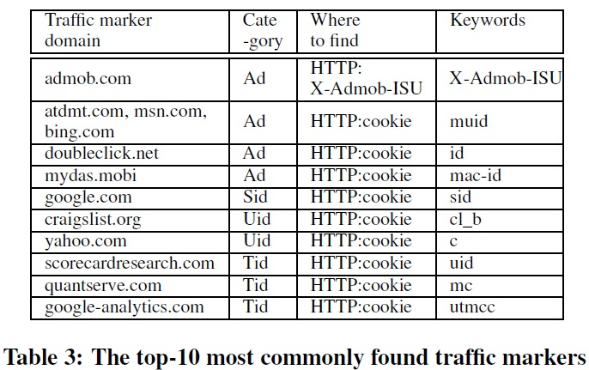
Traffic Attribution via Traffic Markers

Slide 17
Traffic Attribution via Activity Fingerprinting
What if a session block has no traffic markers?
Assumption (Activity Fingerprinting):
Users can be identified from the DNS names of their favorite services
DNS names:
Extracted 54,000 distinct DNS names
Classified into 21 classes
Service classes | Service providers
Search | bing, google, yahoo
Chat | skype, mtalk.googl.com
Dating | plentyoffish, date
E-commerce | amazon, ebay
Email | google, hotmail, yahoo
News | msnbc, ew, cnn
Picture | Flickr, picasa
… | …
Activity Fingerprinting:
Favorite (top-k) DNS names as the user’s “fingerprint”

Slide 18

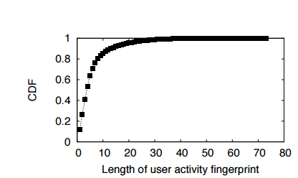
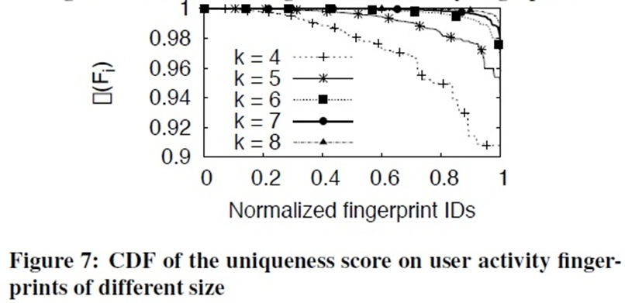
Traffic Attribution via Activity Fingerprinting
Fi : Top k DNS names from user as “activity fingerprint”
| | : Length of Fingerprint
Probability of erroneous user association is at most 2% for k=5

Slide 19
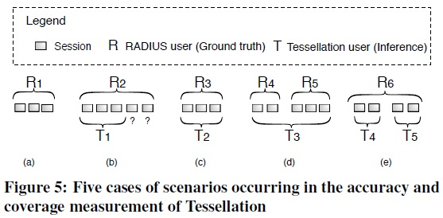
Traffic Attribution Evaluation
Coverage = -----------------------
= -------------------
identified
sessions/users
correctly identified
sessions/users
Accuracy on
Covered Set
total
sessions/users
total identified
sessions/users

Slide 20
Traffic Attribution Evaluation
Evaluation Results

Slide 21
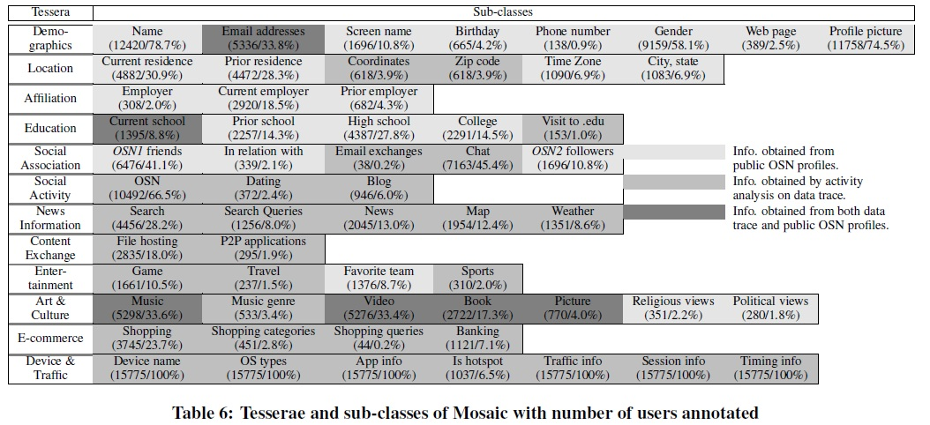
Construction of User Mosaic

Slide 22
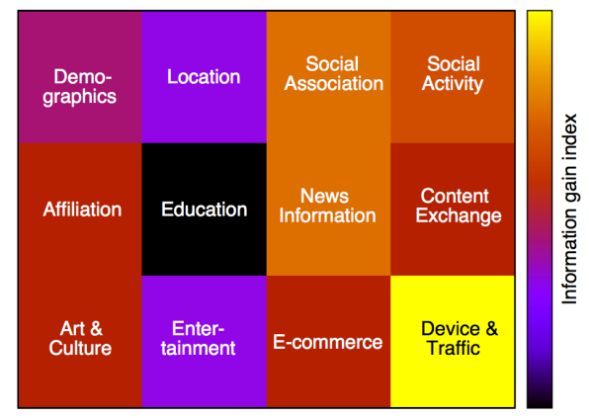
Construction of User Mosaic
Mosaic of Real User
Sub-classes:
Residence, coordinates, city, state, and etc.
Least gain
Most gain
MOSAIC with 12 information classes (tesserae):
Information (Education, affiliation and etc.) from OSN profiles
Information (Locations, devices and etc.) from users’ network data

Slide 23
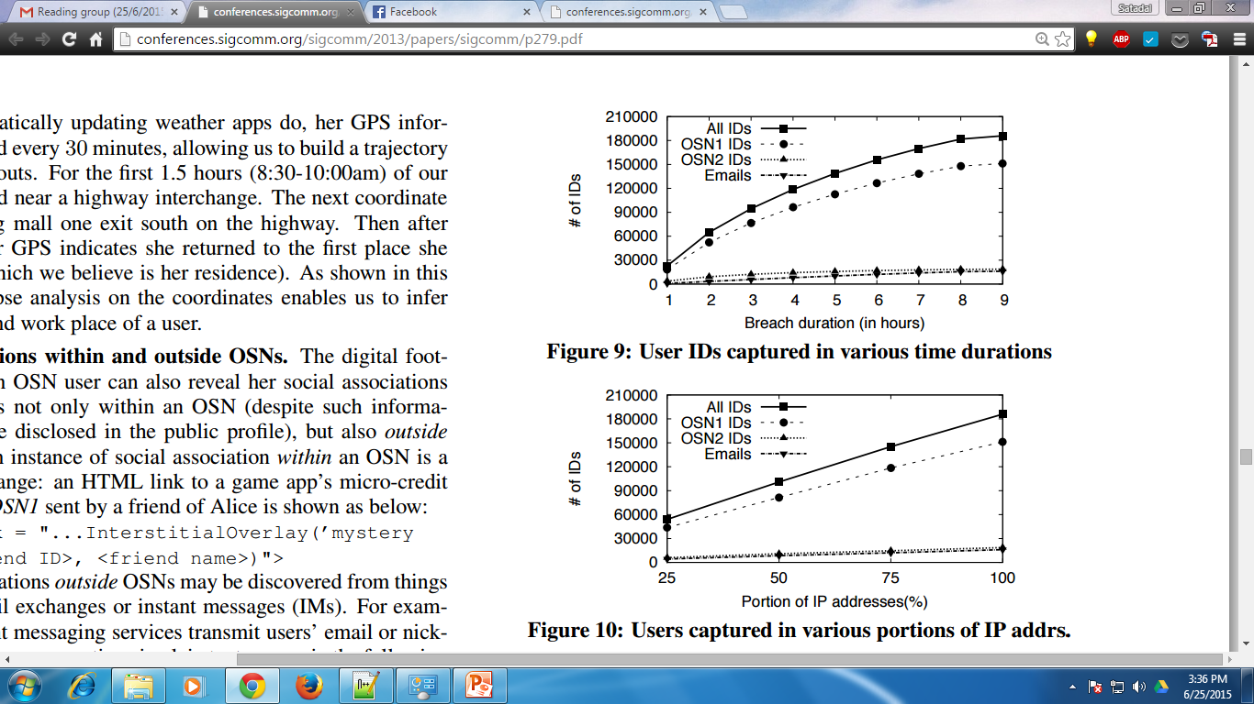
Quantifying Privacy Leakage
User IDs captured in various time duration
Users captured in various portions of IP addresses

Slide 24
Quantifying Privacy Leakage
Leakage from OSN profiles vs. from Network Data
OSN profiles provide static user information (education, interests)
Analysis on network data provides real-time activities and locations
Information from both sides can corroborate to each other
Information from OSN profiles and network data can complete and corroborate each other

Slide 25
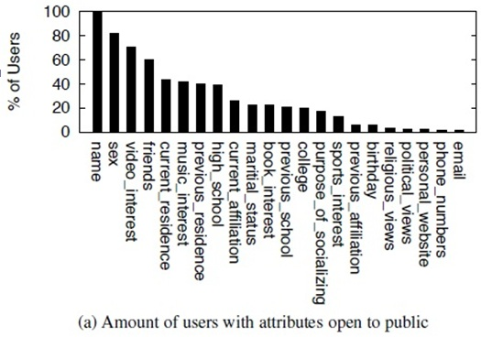
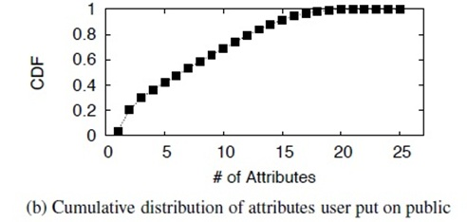
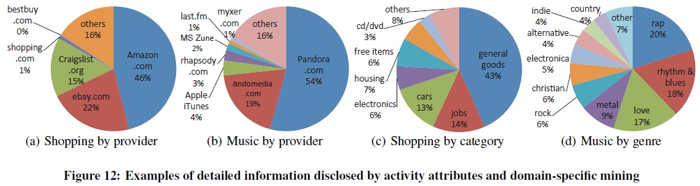
Comparison of Information Disclosed on OSNs vs. Leaked in the Network Data

Slide 26
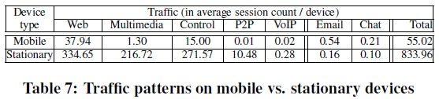
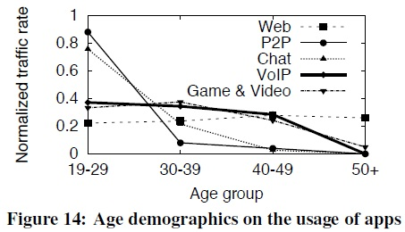
Other Usages of Tessellation: Examples
Traffic breakdown among devices and apps.
Age demographics of app usage.

Slide 27
Preventing User Privacy Leakage
The usage of unique user/device identifiers should be carefully limited, and those identifiers should be strongly encrypted whenever it is necessary to transfer them in network traffic.
Tracking cookies and HTTP session identifiers, which are commonly used in today’s Web services, should be encrypted or frequently updated.
The public profiles of OSN users should have certain attributes to be carefully obfuscated so it is hard for someone to link them together with the information in network traffic.
A service provider, such as an OSN, should have mechanisms to enforce third parties involved in the service, such as individual app developers, to obey its privacy guidelines.
Protect
traffic markers
Restrict
3rd parties
Protect
user profiles

Slide 28
Conclusions
Prevalence in the use of OSNs leaves users’ true identities available in the network.
Tracking techniques used by mobile apps and services make trafﬁc attribution easier.
Sessions can be labeled with network users’ true identities, even without any identity leaks.
Various types of information can be gleaned to paint rich digital Mosaic about users.

Slide 29


Slide 30
Backup

Slide 31

Traffic Attribution via Traffic Markers
Traffic Attribution: Connecting the Dots
Tessellation User T_{i}
( )
IP 1
Same OSN ID
IP 2
Same traffic marker
IP 3
Traffic markers are the key in attributing sessions to the same user over different IP addresses

