Slide 1

Precise Indooro
(Spot localization using PHY Layer information
Mobisys' 12

Slide 2

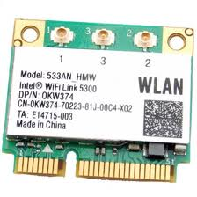
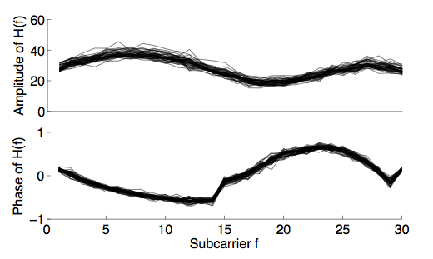
Fingerprinting Wireless Channel
802.11 a/g/n implements OFDM
  Wideband channel divided into subcarriers
  Intel 5300 card exports frequency response per subcarrier
1 2 3 4 5 6 7 8 9 10 39 48
Frequency subcarriers

Slide 3
Is WiFi Channel Amenable to Localization?
Two key hypotheses need to hold:
Temporal
  Channel responses at a given location may vary over time
  However, variations must exhibit a pattern – a signature
1.
2.
Spatial
  Channel responses at different locations need to be different

Slide 4
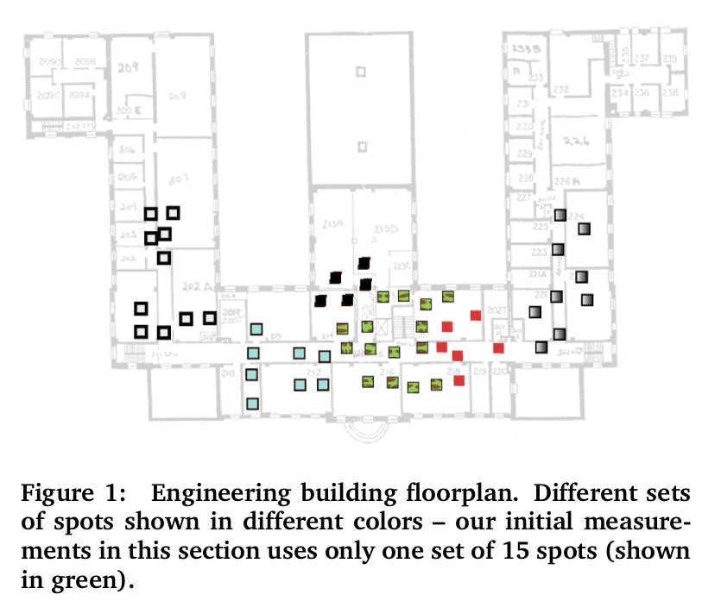
Experimental methodology

Slide 5
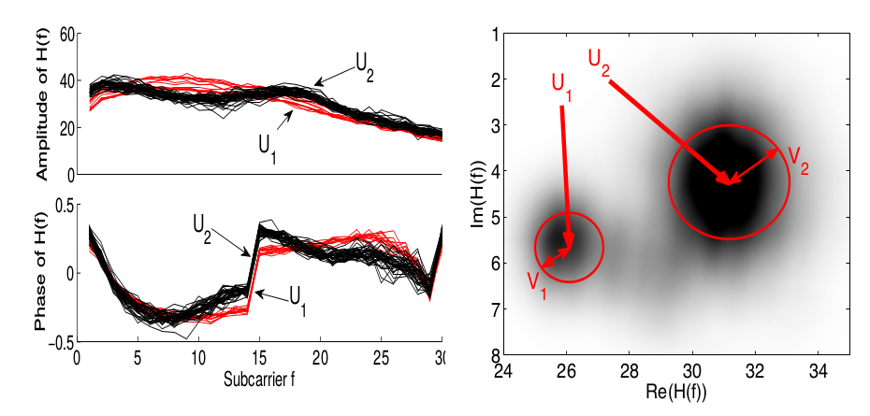
Variation over Time
Measured channel response at different times
Observe: Frequency responses often clustered at a location

Slide 6
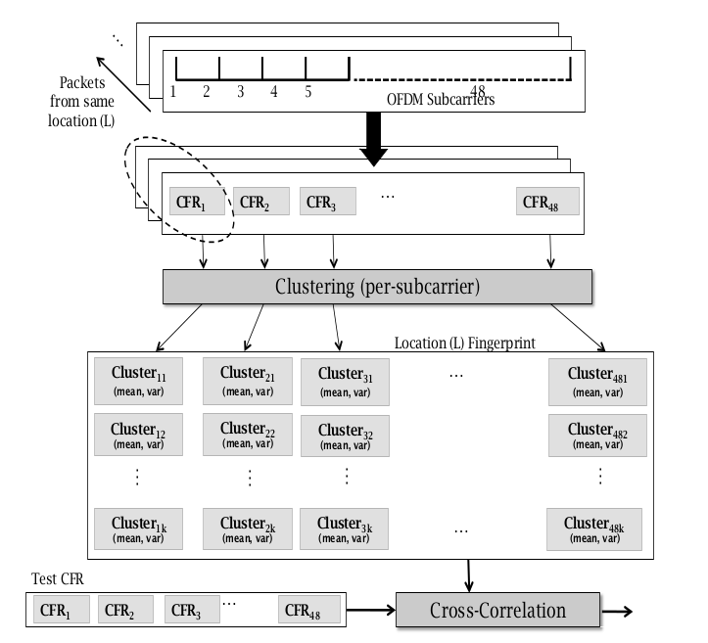
Overview

Slide 7
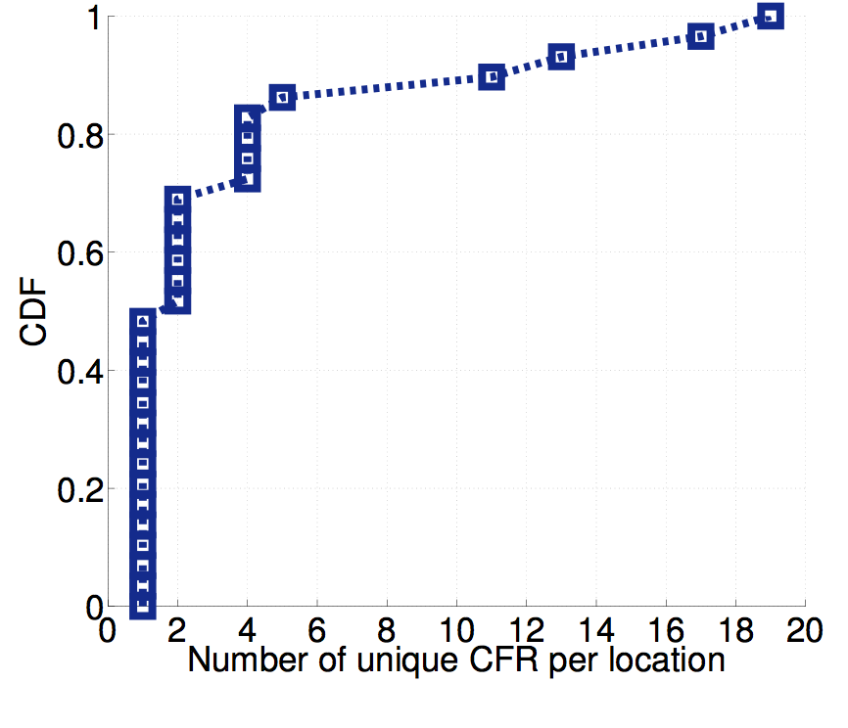
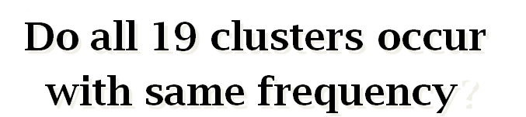
How Many Clusters per Location?

Slide 8
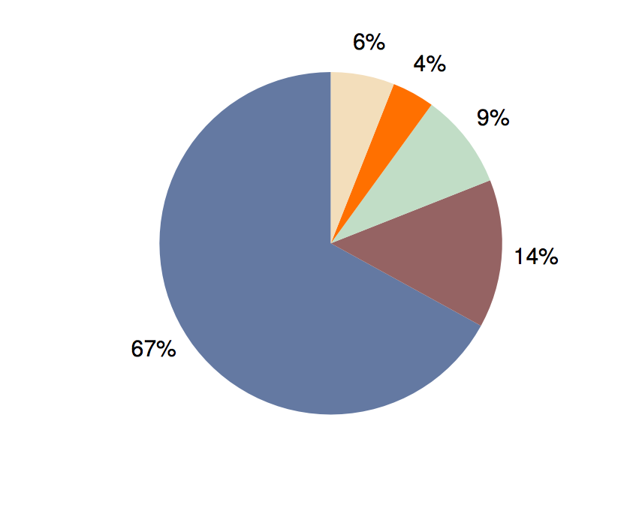
Cluster Occurrence Frequency
others
4th
3rd
Most frequent
2nd
3 to 4 clusters heavily dominate, need to learn these signatures

Slide 9
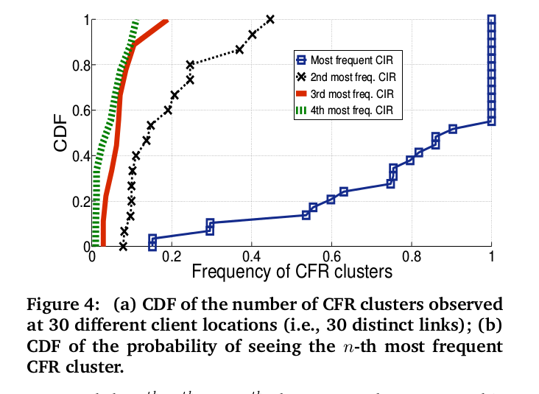

Slide 10
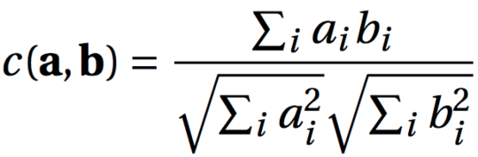
Impact of environmental changes
Measure the cross-correlation of CFR observed with and without the change

Slide 11
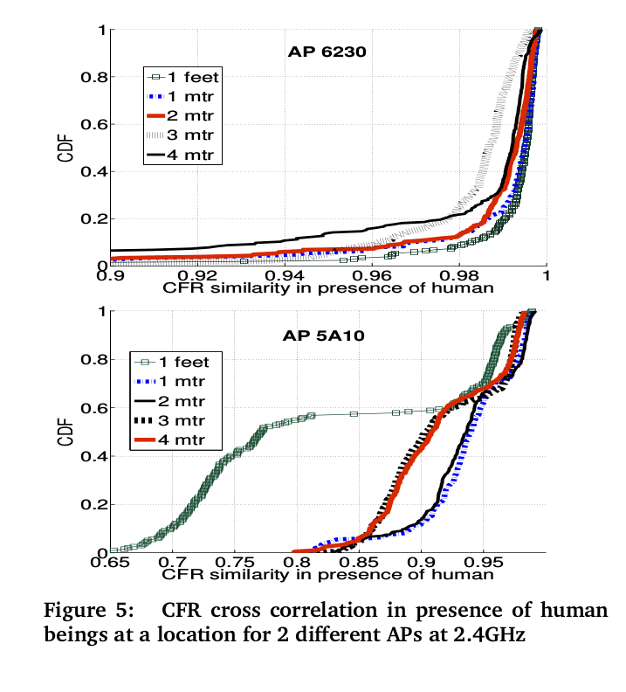
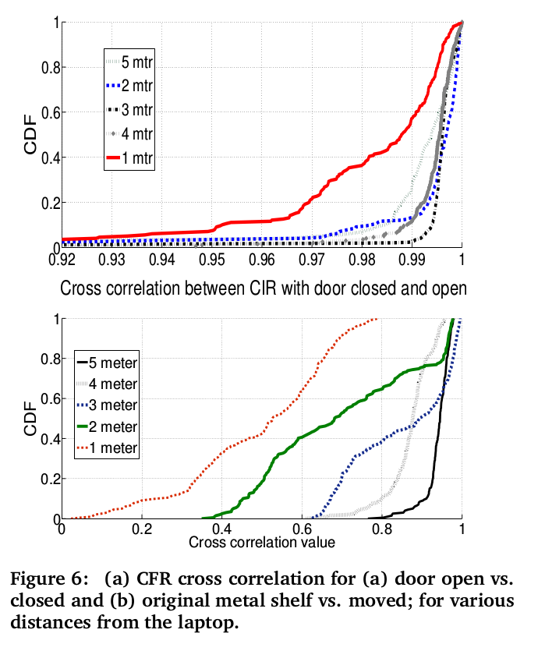
Impact of environmental changes

Slide 12
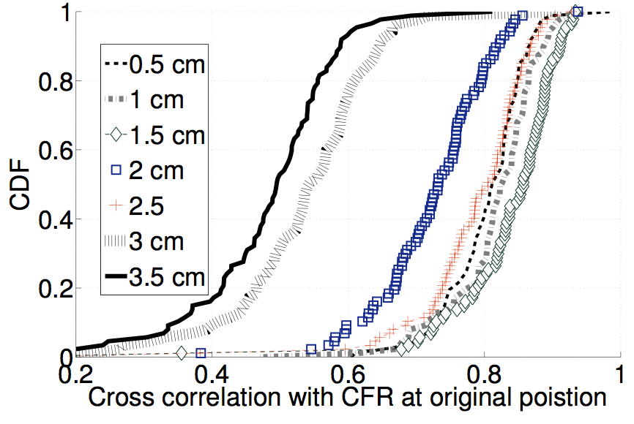
What is the Size of a Location?
Localization granularity depends on size
  RSSI changes in orders of several meters (hence, unsuitable)
3 cm apart
2 cm apart
Cross correlation with signature at reference location

Slide 13
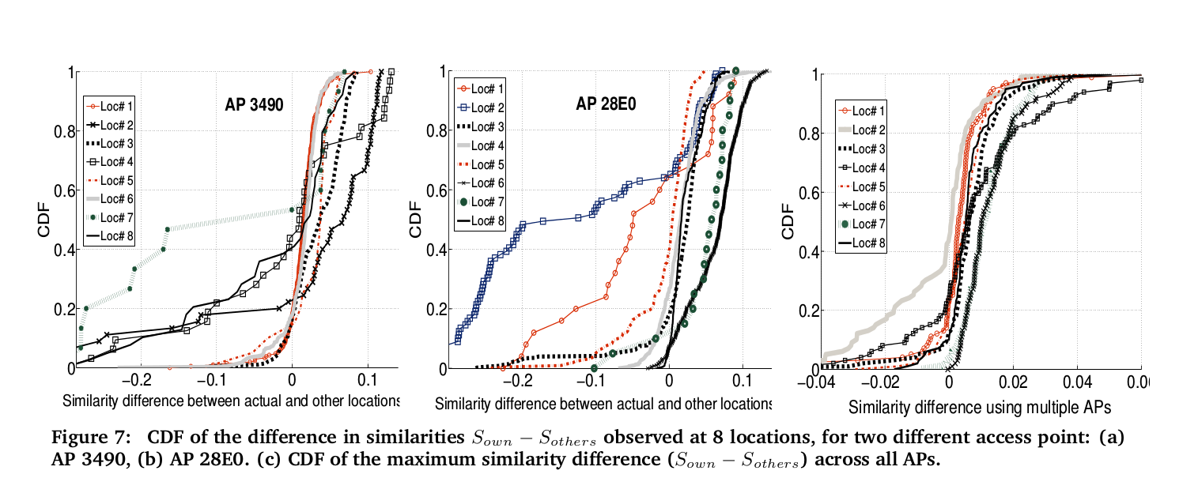
CFR structure varies from one location to another

Slide 14
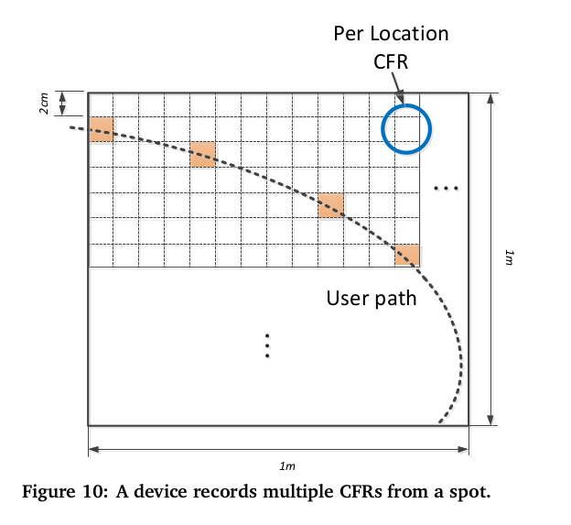
Pixels (locations) and spots

Slide 15

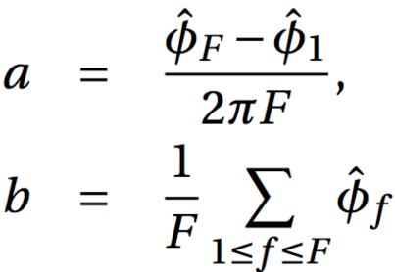
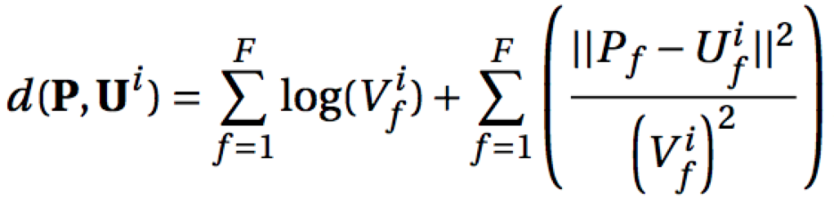
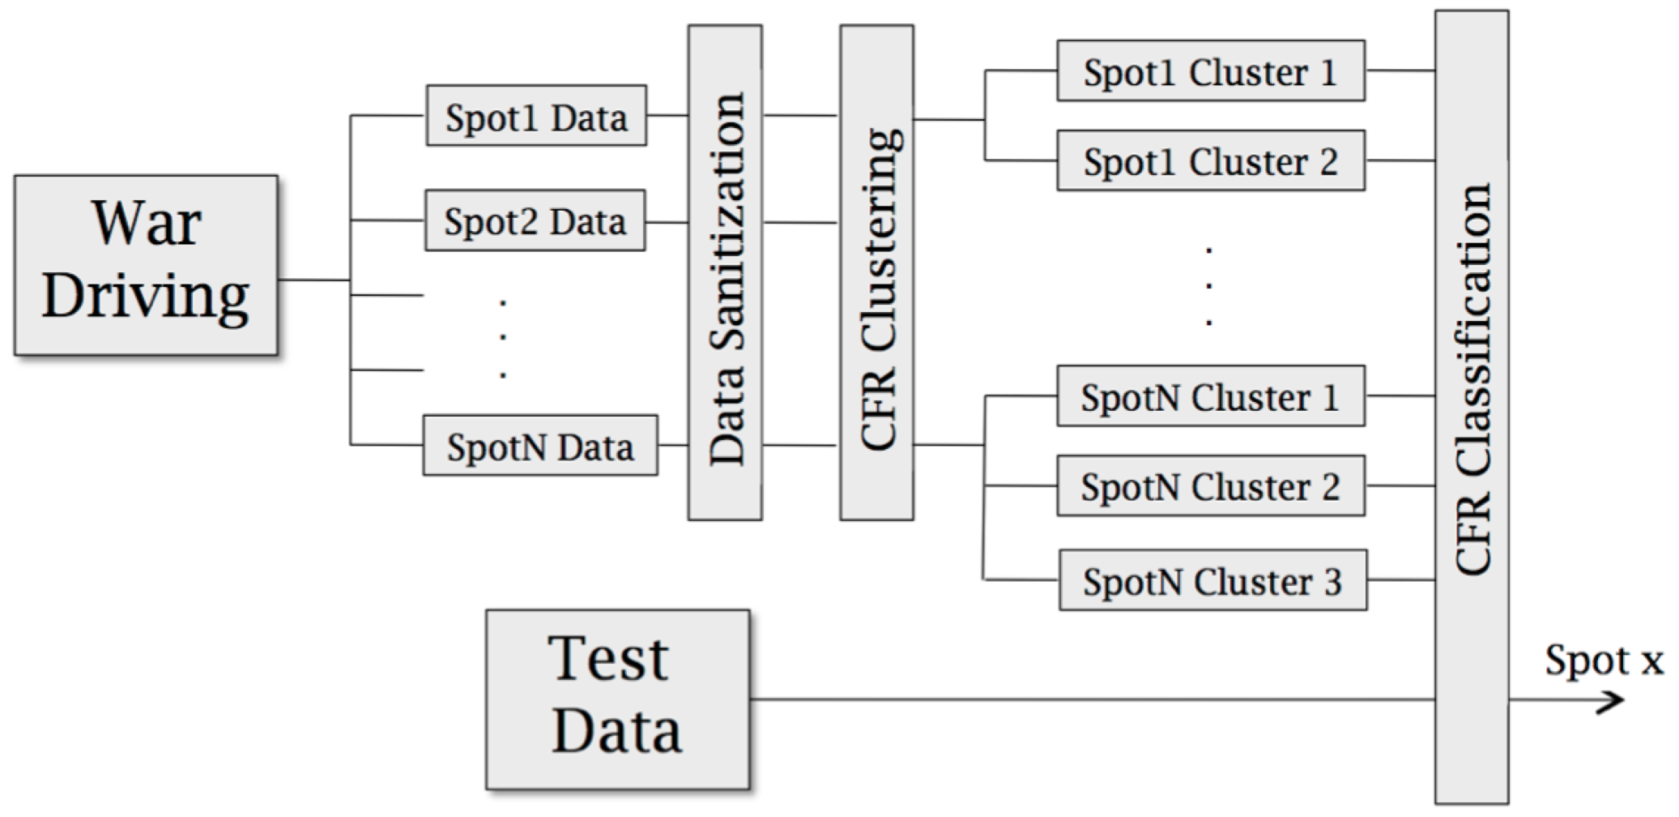

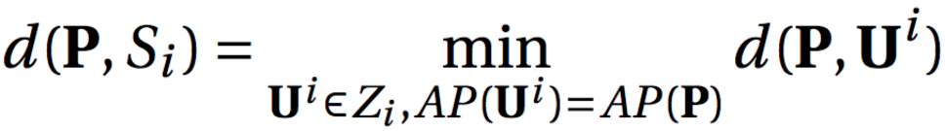
Architecture and Modeling
Parameters: (w_{K, UK, VK)}
Variational Inference (Infer.NET)
Test data

Slide 16
Data sanitization
CFRs received at a location cannot be directly used for calibration.
Unknown phase and time lag can distort CFR.
We need to make sure that every the measurement includes same values of phase and time lag.

Slide 17

Modeling channel response
Model the noise as complex Gaussian noise.
Model the channel response as a random vector with
Gaussian mixture distribution.
Channel response is assumed to be drawn from one
of the representative CFR clusters chosen at random for
each packet.
Each CFR cluster is modeled as a complex Gaussian
random vector with mean Ui and variance Vi.
Probability that packet P belongs to CFR cluster
with mean Ui

Slide 18
Applying logarithm and remove constants
to derive the loglikelihood distance metric.

Slide 19
Clustering algorithm
Each location is a gaussian mixture distribution with
k clusters with means and variances Uk and Vk
Wk the probability that an observed packet belongs to
a particular cluster k.
Uk,Vk and wk are the three parameters.
Paremeters estimated using variational
Bayesian inference.

Slide 20
Classification algorithm
Pinloc calculates macro location based on Wifi SSIDs
and shortlists the spots within this macro location.
Candidate set C
Define the distance between a given packet P and a
spot Si as

Slide 21
PinLoc Evaluation
Evaluated PinLoc (with existing building WiFi) at:
  Duke museum
  ECE building
  Café (during lunch)
Roomba calibrates
  4m each spot
  Testing next day
  Compare with Horus (best RSSI based scheme)

Slide 22
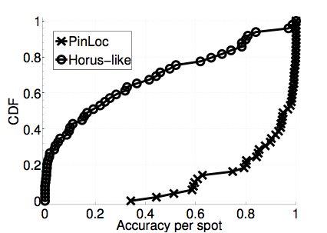
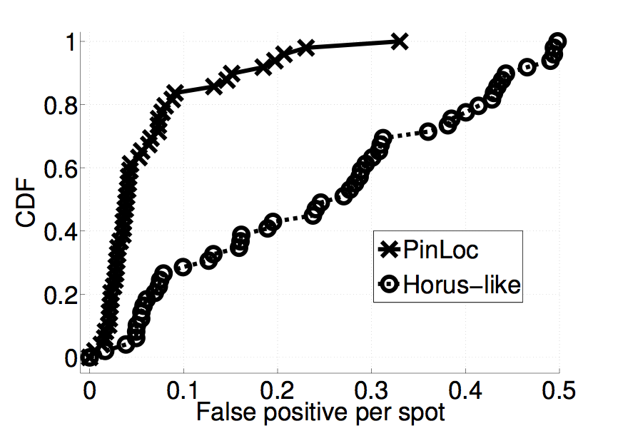
Performance
90% mean accuracy, 6% false positives
WiFi RSSI is not rich enough, performs poorly - 20% accuracy
accuracy per spot

Slide 23
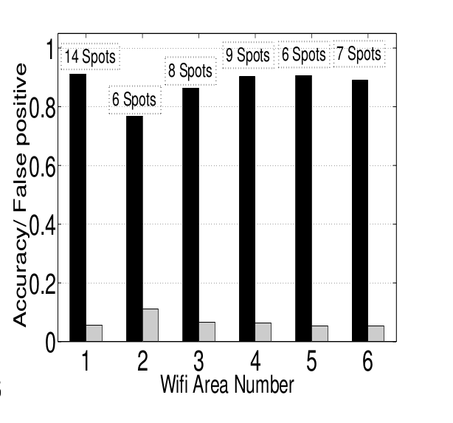
Accuracy on a per-Wifi macro location

Slide 24
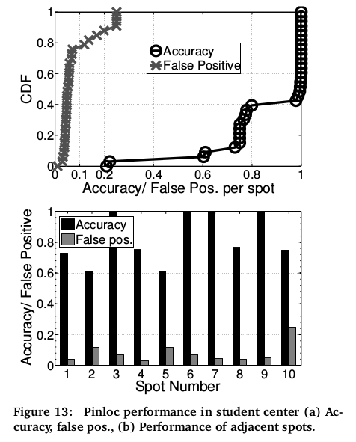
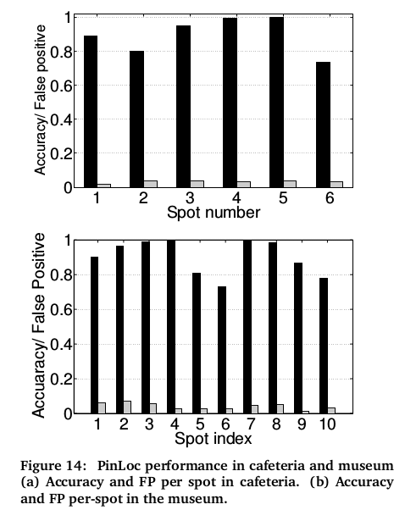
Performance

Slide 25
Impact of Parameters
number of test packets
number of Aps
war-driving
mobility
old training data

Slide 26
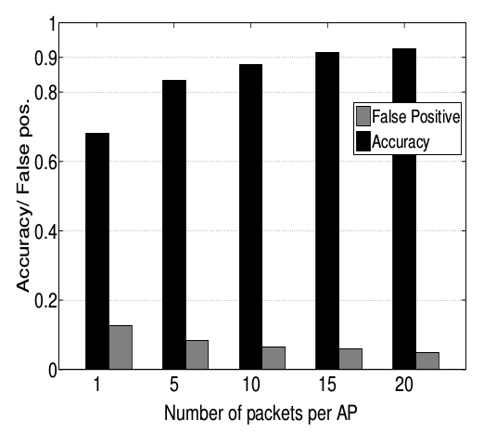
Impact of number of test packets
With 10 packets per AP, mean accuracy
is 89% (7% false positives)
With 1 packet the mean accuracy
reduces
to 68%(14% false positives)
Single reading may randomly match
with an incorrect spot.

Slide 27
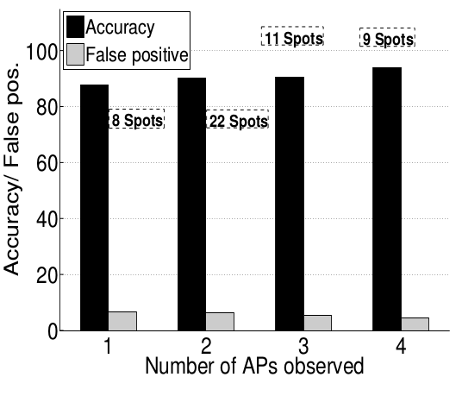
Impact of the number of APs
Even with single AP visible the mean
accuracy is over 85%
(below 7% false positives )
Significant improvement as other Wi-fi
based localization method need at
least 3 Aps.

Slide 28
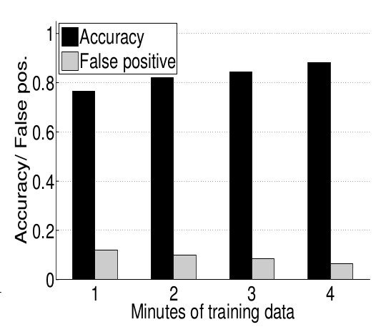
Impact of war-driving
Short wardriving records fewer
CFRs incurring the possibility of
overlooking important ones.
Reasonable performance observed
even for 1 minute of wardriving

Slide 29
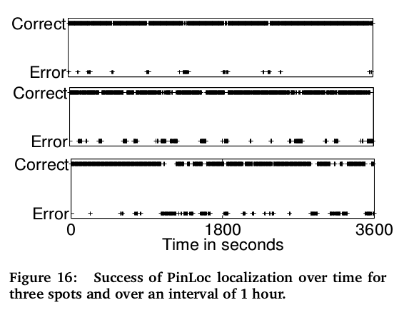
Impact of mobility
Cafeteria scenerio
Time interval – 1hr
Mean accuracy – 85% (7% false positives)
Time instants of failure are short and
evenly distributed.

Slide 30
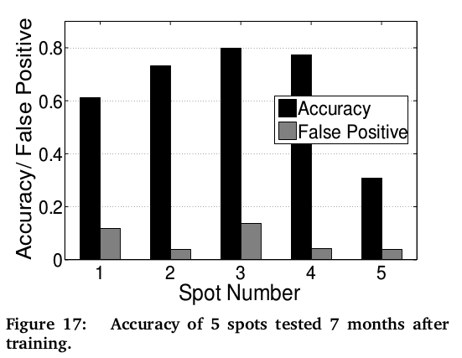
Impact of old training data
Need fresh rounds of wardriving for
spots affected by significant
environmental changes.
With 5 spots observed after 7 months
median accuracy of 73% found

