Slide 1

ANDROID OS Architecture

Slide 2
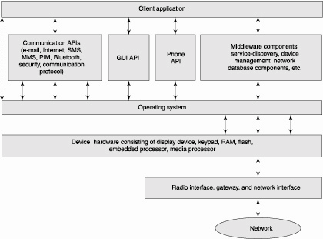
Mobile Computing Architectural Layers
Notes:
"CALL_PLACED",
"BAD_NUMBER",
"PHONE_IN_USE",
"BLOCKED_NUMBER"

Slide 3
Smartphone OS
Symbian
Windows Mobile
RIM Blackberry OS
Apple iOS
Google Android
Palm WebOS
Windows Phone 7

Slide 4
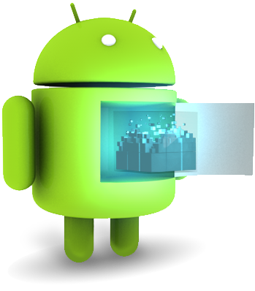
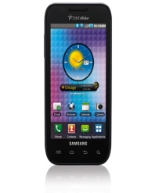

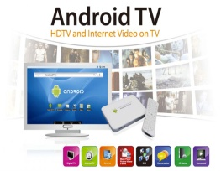
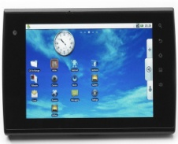
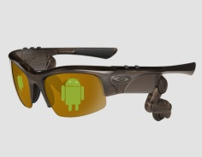
Android … What?
Android is a Linux-based platform for mobile devices …
Operating System
Middleware
Applications
Software Development Kit (SDK)
Which kind of mobile devices … (examples)
?
SMARTPHONES
TABLETS
EREADERS
ANDROID TV
GOOGLE GLASSES

Slide 5
WHAT IS ANDROID?
Android is a software stack for mobile devices that includes an operating system, middleware and key applications.
Google Inc. purchased the initial developer of the software, Android Inc., in 2005.
Android’s mobile operating system is based on the Linux kernel. Google and other members of the Open Handset Alliance collaborated on Android’s development and release. The Android Open Source Project (AOSP) is tasked with the maintenance and further development of Android.
Android was listed as the best-selling Smartphone platform world-wide in Q4 2010 by Canalys (wikipedia.org)

Slide 6
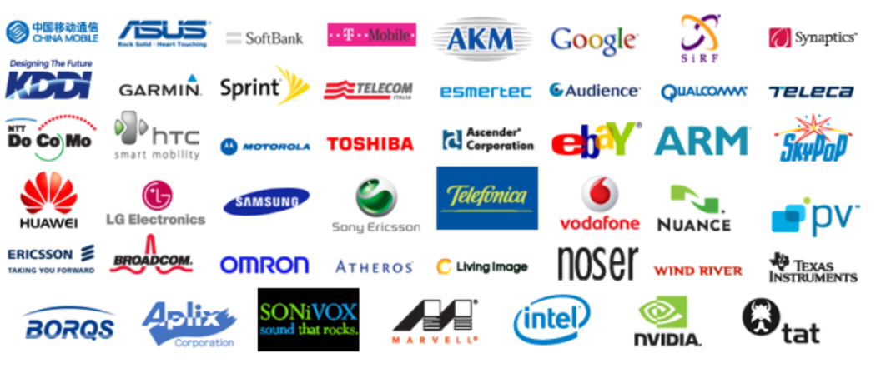
Open Handset Alliance (OHA)
It's a consortium of several companies

Slide 7
Android … What?
Fastest growing mobile OS
Over 300,000 Android activations a day
Android overtook iOS as the dominant OS in US during 2H 2010
First phone launched HTC G1 in 2008
Currently an OS of choice for Motorola, HTC, Samsung, Sony Ericsson, among others
Software updates every few months

Slide 8
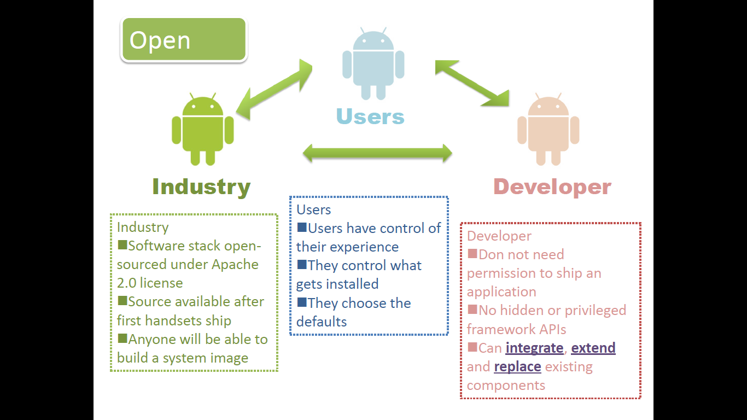

Slide 9
Android … When?
2005
Google buys Android from the Android Inch
Open Handset Alliance (OHA) created for open standards for mobile devices. Partners of OHA: Google, Motorola, Samsung, Vodafone, T-Mobile, etc
Android 1.0 Released
The first Android smartphone: G1 HTC-Dream
Android 1.1 Released
Android 1.5 (CupCake) Released
2006
2007
2008
2009
Time

Slide 10


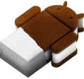
Android … When?
Android 1.6 (Donut) Released
Android 2.0 (Eclair) Released
Android 2.2 (Froyo) Released
Android 2.3 (Gingerbread) Released
Android 3.0 (Honeycomb) Released
(First version for devices with larger screens such as tablets)
Android 4.0 (Ice-Cream Sandwich) Released. (It merges the 3.x tab centric design and the v2.x phone based design into a single version.)
2008
2009
2010
2011
2012
Time

Slide 11
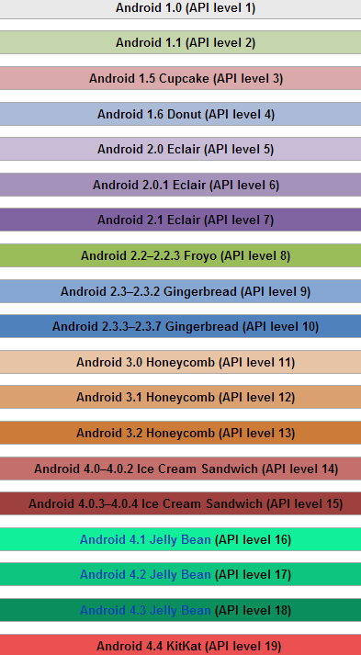


Android … When?
Android 4.2 (Jelly Bean) Released
Gesture Mode for Accessibility
Improved browser performance
Easy data-sharing through NFC
Improved camera and face recognition
functionalities
…
Android 4.4 (KitKat) Released
Clock no longer shows bold hours,
all digits are thin.
Wireless printing capability
Public API for developing and
managing text messaging clients
New framework for UI transitions
.....
2012
2013
Time

Slide 12

Latest Android Version
Android Lollipop
5.0 (Nov. 2014) – 5.1.1(Apr. 2015)
Features (5.1.1)
Ability to join Wi-Fi networks and control paired Bluetooth devices from quick settings
Official support for multiple SIM cards
Device protection: if a device is lost or stolen it will remain locked until the owner signs into their Google account, even if the device is reset to factory settings.
High-definition voice calls
Improvements to the notification priority system

Slide 13
Android – At a Glance
Software stack for mobile devices
incl. OS, middleware and key applications
Open source – source code is open and contributions are welcome
Application framework enabling reuse/replacement of apps
Dalvik virtual machine optimized for mobile
Integrated browser based on webkit
Optimized graphics – 2D graphics library, 3D based on OPEN GL ES
SQLite for data storage
Media support (MPEG4, H.264, MP3, AAC, JPG, PNG,…)
Support for radio interfaces, Bluetooth, WiFi, Camera, GPS, accelerometer
Software Development Kit (SDK)
Preinstalled applications from Google (GMS)
Gmail, Maps, Search, Voice Search, Youtube

Slide 14

ARCHITECTURE
OF
ANDROID

Slide 15

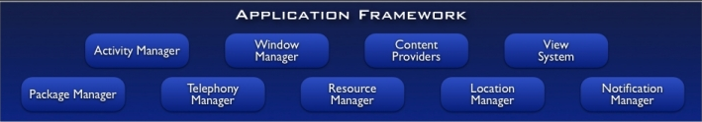
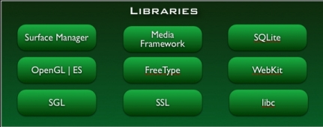
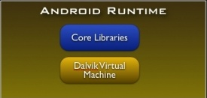
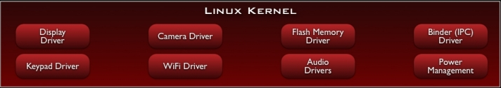
Notes:
SGL – Scalable Graphics Library – Low-Level Graphics Library – compatible with 2D standards
Open-GL- 3D

Slide 16
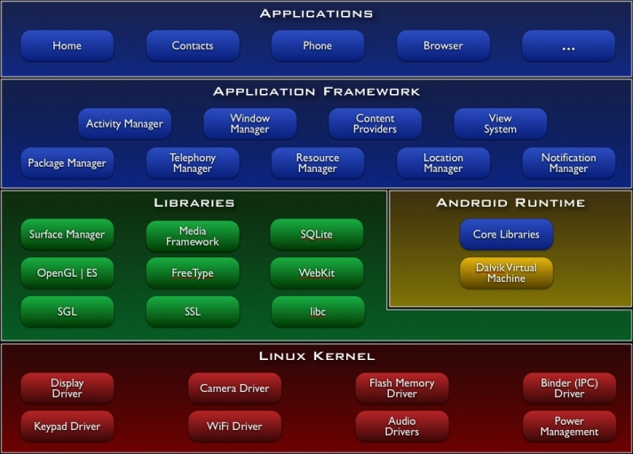
The Android Architecture
}
Stack
Architecture
Open Source Architecture
(Apache/MIT License v. 2.0)
Business-friendly License

Slide 17
Software Stack
Linux kernel
Libraries
Android run time
core libraries
Dalvik virtual machine
application layer
application protocol

Slide 18
The Android Architecture
Built on top of Linux kernel (v. 2.6-3.0)
Advantages:
Portability (i.e. easy to compile on different harwdare architectures)
Security (e.g. secure multi-process environment)
Power Management

Slide 19
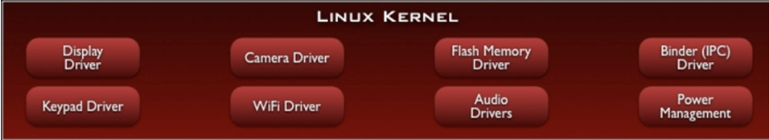
Linux version 2.6.x for core system services.
Provides proven driver model.
Provides memory management, process management, security model, networking and lot of core OS infrastructure

Slide 20
The Android Architecture
Native Libraries
(C/C++ code)
Graphics (Surface Manager)
Multimedia (Media Framework)
Database DBMS (SQLite)
Font Management (FreeType)
WebKit
C libraries (Bionic)
….

Slide 21
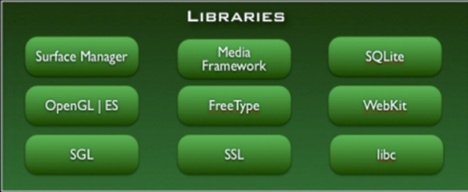
Libc:c standard library
SSL: Secure Socket Layer
Surface Manager:
responsible for
composing different
drawing surfaces onto the
screen.
OpenGL|ES : 3D Image Engine
SGL : 2D image Engine.
Hence we can combine 3D and 2D graphics in the same application.
Media Framework : Core part of the android multimedia.➔ MPEG4,H264,MP3,AAC…..
FreeType: To render the fonts.
WebKit:open source browser engine. Helps to work well on small screen.
SQLite: Embedded Database

Slide 22
The Android Architecture
Dalvik Virtual Machine (VM)
Novel Java Virtual Machine implementation (not using the Oracle JVM)
Open License (Oracle JVM is not open!)
Optimized for memory-constrained devices
Faster than Oracle JVM
….

Slide 23
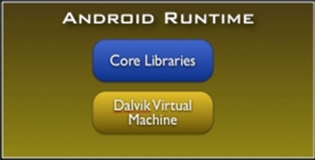
Android runtime meet the needs of running in an embedded environment ,i.e., where is limited battery, limited
Memory and limited CPU.
CORE LIBRARIES:
Java Programming Language
contains all the collection classes, utilities, IO..all these utilities which you come across and expect to use.
DALVIK VIRTUAL MACHINE:
Java based license free VM
Optimization for low memory requirements.
DVM runs .dex files (byte codes) that converts during built time.
➔ more efficient and run very well on small processors.
➔structure are designed to be shared across processes due to which multiple instance of DVM running on device at the same time one in several processes

Slide 24
The Android Architecture
Application Libraries
(Core Components of Android)
Activity Manager
Packet Manager
Telephony Manager
Location Manager
Contents Provider
Notification Manager
….

Slide 25
VM
A set of registers
A Stack (optional)
An execution environment
A garbage collected heap
A constant pool
A method storage area
An Instruction set

Slide 26
Dalvik VM
All applications written in Java are converted to the dalvik executable .dex
Every android app runs its own process, with its own instance of the dalvik virtual machine
Not a traditional JVM, but a custom VM designed to run multiple instances efficiently on a single device
VM uses linux kernel to handle low-level functionality incl. security, threading, process and memory management

Slide 27
Dalvik Java Virtual Machine (JVM)
Java Source
Code
Java Source
Code
Java Standard Edition
Java
Compiler
Java
Compiler
Java Byte
Code
Java Byte
Code
Dex
Compiler
Stack-based
byte-code
Dalvik Byte
Code
Register-based
byte-code
Java Virtual Machine (JVM)
Dalvik Virtual Machine (VM)
Notes:
Dalvik is an open source VM created by Dan Bornstein. VM’s can be of two types, Register based or Stack based. While the JVM (Java Virtual Machine) is stack based Dalvik is Register based. Android application runtime must support a diverse set of devices and that applications must be sandboxed for security, performance, and reliability, a virtual machine seems like an obvious choice. Register based VM’s will avoid unnecessary memory access and consume instructions efficiently. Every Android application will be running its own process, with its own instance of the Dalvik VM. Dalvik is made in a way so that a device can run multiple VMs efficiently. The Dalvik VM executes files in the Dalvik Executable (.dex) format which is optimized for very low memory. It relies on the underlying Linux kernel for low level memory management. If you are aware of Java then this should be comprehensible. The Java source code of the applications are converted to class files. But the change is that Dalvik will use the “dx” tool to convert class files into “dex” files. Major difference would be a class file will have one class while dex file would have multiple classes. Dalvik is a Just in Time compiler. Compilation is done when the program is running. This is in stark contrast to ART which uses Ahead of time compilation (AOT). JVM along with the .NET framework uses JIT as well.

Slide 28
The Android Architecture
Applications
(Written in Java code)
Android Play Store
Entertainment
Productivity
Personalization
Education
Geo-communication
….

Slide 29
Advantages of Android:
Excellent software/application support
Thousands of Apps (free) to download online
Frequent OS updates (for improving performance)
Android phones can also function as a router to share Internet.
Multitasking
Disadvantages of Android:
No standardization of application quality
Generally power-hungry
Difficult to modify
Virus applications

Slide 30
APPs - Fundamental

Slide 31
Applications
All apps (native and 3rd party) are written using the same APIs and run on the same run time executable
All apps have APIs for hardware access, location-based services, support for background services, map-based activities, 2D and 3D graphics.
App Widgets are miniature app views that can be embedded in other apps like Home Screen

Slide 32
Application Fundamentals
Activities
application presentation layer
Services
invisible components, update data sources, visible activities, trigger notifications
perform regular processing even when app is not active or invisible
Content Providers
shareable data store
Intents
message passing framework
broadcast messages system wide, for an action to be performed
Broadcast receivers
consume intent broadcasts
lets app listen for intents matching a specific criteria like location
Notifications
Toast notification
Status Bar Notification
Dialog notification

Slide 33
Application Framework
Rich, extensible set of Views
apps can include lists, grids, text boxes, buttons, web browser
Content Providers
allows data access from other applications or share own data
Resource Manager
access to localized strings, graphics, layout files
Notification Manager
enables custom alerts to be displayed in status bar
Activity Manager
Manages lifecycle of applications and provides navigation backstack

Slide 34
Client apps
Developed using the Android SDK and installed on user devices
Compiled Java code, with data and resource – bundled by Android Asset Packaging tool (AAPT) into Android package or .apk
All applications have Android Manifest file in its root directory
provides essential information about app
Could be installed directly on phone, but necessary to be distributed thru Market

Slide 35
Web Apps
An alternative to standalone apps
Developed using web standards and accessed through browser – nothing to install on devices
Mixing client and web apps is also possible – Client apps can embed web pages using “Webview” in Android app

Slide 36
END

Slide 37
NETWORK CONNECTIVITY:
It supports wireless communications using
GSM mobile-phone technology
3G
802.11 Wi-Fi networks

Slide 38
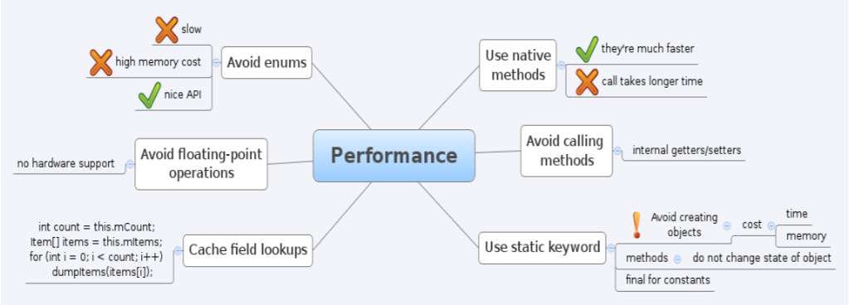
PERFORMANCE:

Slide 39
What is a Intent
Intent is basically a message that is passed between components (such as Activities, Services, Broadcast Receivers, and Content Providers). So, it is almost equivalent to parameters passed to API calls. The fundamental differences between API calls and intents’ way of invoking components are:
API calls are synchronous while intent-based invocations are asynchronous.
API calls are compile time binding while intent-based calls are run-time binding. Of course, Intents can be made to work exactly like API calls by using what are called explicit intents, which will be explained later. But more often than not, implicit intents are the way to go and that is what is explained here.
One component that wants to invoke another has to only express its’ intent to do a job. And any other component that exists and has claimed that it can do such a job through intent-filters, is invoked by the android platform to accomplish the job. This means, both the components are not aware of each other’s existence and can still work together to give the desired result for the end-user.
This invisible connection between components is achieved through the combination of intents, intent-filters and the android platform.
This leads to huge possibilities like:
Mix and match or rather plug and play of components at runtime.
Replacing the inbuilt android applications with custom developed applications.
Component level reuse within and across applications.
Service orientation to the most granular level, if I may say.
Here is additional description about intent, almost formal.

Slide 40
What is a Intent
This invisible connection between components is achieved through the combination of intents, intent-filters and the android platform.
This leads to huge possibilities like:
Mix and match or rather plug and play of components at runtime.
Replacing the inbuilt android applications with custom developed applications.
Component level reuse within and across applications. Service orientation to the most granular level, if I may say. Here is additional description about intent, almost formal.

