Slide 1
Freenet
Ubiquitous Computing - Assignment
Guided By:
Prof. Niloy Ganguly
Department of Computer Science and Engineering
Submitted By:
  Parin Deepak Cheda
  Ravi Niranjan
  Sarthak Jain

Slide 2

Freenet is a decentralized, censorship-resistant distributed data store originally designed by Ian Clarke.
According to Clarke,
  Freenet aims to provide freedom of speech through a peer-to-peer network
  with strong protection of anonymity; as part of supporting its users' freedom,
  Freenet is free and open source software.
Freenet works by pooling the contributed bandwidth and storage space of member computers to allow users to anonymously publish or retrieve various kinds of information.

Slide 3
Characteristics
Designed to provide extensive protection from hostile attack
  from both inside and out by addressing information privacy and survivability issues
Based around the P2P environment, which is inherently unreliable and untrustworthy
  assume that all participants in the network could potentially be malicious or their peer could fail without warning.
implements a self-organizing routing mechanism over a decentralized structure
  This algorithm dynamically creates a centralized/decentralized network..

Slide 4
Characteristics..
The network learns
  it route queries in a better fashion from local not global knowledge
  Achieves this by using file keys and sub-dividing the key space to partition the location of the stored files across the network
FreeNet therefore provides a good example of how the various technologies discussed so far can be used within a innovative system: It addresses:
  P2P
  Security (and Privacy)
  Scalability
  Decentralized networks

Slide 5
Technical Design
  Distributed storage and caching of data
  Network
  Protocol
  Keys

Slide 6
Distributed storage and caching of data
Unlike other P2P networks, Freenet not only transmits data between nodes but actually stores them, working as a huge distributed cache.
To achieve this, each node allocates some amount of disk space to store data; this is configurable by the node operator, but is typically several GB (or more).
Files on Freenet are typically split into multiple small blocks, with additional blocks added to provide redundancy. Each block is handled independently, meaning that a single file may have parts stored on many different nodes.
Information flow in Freenet is different from networks like eMule or BitTorrent:
  A user wishing to share a file or update a freesite "inserts" the file "to the network"
  After "insertion" is finished, the publisher is free to shut down his node, since the file is stored in the network. It will remain available for other users whether the original publishing node is online or not. No one node is responsible for the content; instead, it is replicated to several different nodes.
Advantages: high reliability and anonymity.
  Information remains available even if the publisher node goes offline,
  And is anonymously spread over many hosting nodes as encrypted blocks, not entire files. Freenet is also not affected by the typical BitTorrent problem, a lack of "seeds", or full copies of a file or torrent.
Disadvantage:
  no one node is responsible for any chunk of data.
  While users can insert data into the network, there is no way to delete data.

Slide 7
Network
The network consists of a number of nodes that pass messages among themselves.
Typically, a host computer on the network runs the software that acts as a node, and it connects to other hosts running that same software to form a large distributed network of peer nodes.
Some nodes are end user nodes, from which documents are requested and presented to human users. Other nodes serve only to route data.
It is not possible for a node to rate another node except by its capacity to insert and fetch data associated with a key.
This is unlike most other P2P networks where node administrators can employ a ratio system, where users have to share a certain amount of content before they can download.
Each node knows only its neighbors. Each message is routed through the network by passing from neighbor to neighbor until it reaches its destination. As each node passes a message to a neighbor, it does not know or care whether the neighbor will forward the message to another node, or is the final destination or original source of the message. This is intended to protect the anonymity of users and publishers.
Each node maintains a data store containing documents associated with keys, and a routing table associating nodes with records of their performance in retrieving different keys.

Slide 8
Protocol
The Freenet protocol uses a key-based routing protocol, similar to distributed hash tables.
File Keys: are used to route storage or retrieval requests onto the Freenet network
  File keys are constructed from either user or the file itself (discussed later).
Routing Tables: each peer has a routing table
  Stores file keys and location of key (i.e. on connected peers) e.g. see next slide

Slide 9
P1
1. Create Key e.g. from SSK + descriptive String
2. Ask Next Node
P2
3. (a) Check Local Store
(b) Check routing Table and find peer with closest key
4. Ask Next node
Routing Table
File Key – Peer ID (p4)
File Key – Peer ID (p5)
File Key – Peer ID(p3)
…
P3
P4
P5

Slide 10
Searching/Requesting
Searching: peers try and intelligently route requests
  Peers ask neighbours (like Gnutella) BUT …
  Peers do not forward request to all peers
  They find the closest key to the one supplied in their local routing table and pass the request only to this peer - intelligent routing (subdividing keyspace)
  At each hop keys are compared and request is passed to the closest matching peer And so on…

Slide 11
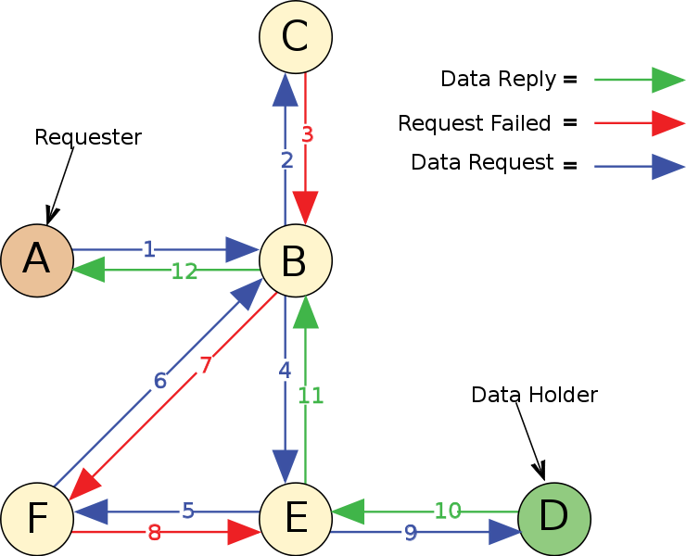
Request Sequence

Slide 12
Example Key Mapping
X/2-X
0-X/2
X-Y
Y-N
0-X

Slide 13
Updating Routing Tables
if a peer forwards the request to a peer that can retrieve the data
  then the address of the upstream peer (which contains or is closer to the data), is included in the reply.
This peer uses this information to update its local routing table to include the peer that has a more direct route to the data.
Then, when a similar request is issued again the peer can more effectively send the request to a node that is closer to the data.

Slide 14
Adaptive behaviour?
Dynamic algorithm used by Freenet to update its knowledge is analogous to the way humans reinforce decisions based on prior experiences.
Remember the Milgrim experiment?
Milgrim noted that 25% of all requests went through the same person (the local shopkeeper). The people in this experiment used their experience of the local inhabitants to attempt to forward the letter to the best person who could help it reach its destination.
the local shopkeeper was a good choice because he knew a number of out-of-town people and therefore could help the letter get closer to its destination.
If this experiment were repeated using the same people, then surely the word would spread quickly within Omaha that the shopkeeper is a good place to forward the letter to and subsequently, the success rate and efficiency would improve - people in Omaha would learn to route better !
This is what Freenet does -> adapts routing tables based on prior experiences

Slide 15
Comparison
Gnutella: a user searches the network by broadcasting its request to every node within a given TTL.
Napster: on the other hand, uses a central database that contains the locations of all files on the network.
Gnutella, in its basic form, is inefficient and Napster, also in its simplest form, is simply not scalable and is subject to attack due the the centralization of its file indexing.
However, both matured into using multiple caching servers in order to be able to scale the network
  Resulting in a centralized/decentralized topology
But the Freenet Approach …
Such caching services (I.e. super peers or Napster indexes) form the basic building block of the Freenet network
  each peer contains a routing table
The key difference is that Freenet peers do not store locations of files rather they contain file keys that indicate the direction in the key space where the file is likely to be stored and file keys are used to route the query to the stored file - but there are many different types of keys …

Slide 16
Keys
Three types of keys:
Keyword-Signed Keys (KSK): the simplest of Freenet keys
  derived directly from a descriptive string that the user chooses for the file
Signed-Subspace Keys (SSK): are used to create a subspace
  to define ownership
  or to make pointers to a file or a collection of files.
Content-Hash Keys (CHK): used for low-level data storage
  obtained by hashing the contents of the data to be stored.

Slide 17
KSK Keys
Descriptive String
Deterministically
Generate
i.e. string always creates the same key
Public
Key
Private
Key
Hash
Digitally
Sign
Keyword
Signed
Keys (KSK)
Derived from short
File description.
KSK
File

Slide 18
KSK Keys
Key Generation:
  derived from a descriptive string in a deterministic manner
  Therefore same key pair gets created for the same key
  Change the string a new key gets generated and therefore a new file gets created
  Create the same key, old file gets overwritten
Ownership:
  None -> file is owned only by descriptive string

Slide 19
Signed Subspace
SSK Keys
Private
Key
Public
Key
Description
Sign
Hash
Hash
XOR
File
Hash
Signed Subspace
Keys (SSK)

Slide 20
SSK Keys
Key Generation:
  derived from subspace key pair + description
  Unique within this sub-domain (I.e. the key subspace)
Ownership:
  Creates a read-only file system for all users
  Only owners of the subspace can over-write the files within the subspace i.e. need private subspace key to generate the correct signature.

Slide 21

File to Store
CHK Keys
SHA-1
Secure Hashing
Content Hash
Key (CHK)
File GUID
(Direct reference to
file contents
- used for comparisons)

Slide 22
CHK Keys
Key Generation:
  derived directly from the contents of the file
Ownership:
  None -> normally associated with a subspace to define ownership

Slide 23
Analogies for Keys
Three types of keys:
Keyword-Signed Keys (KSK):
  Like filenames on a file system
  But analogous to having all files in one directory
Signed-Subspace Keys (SSK):
  Can contain collections of filenames
  Analogous to using (multiple level) directories
Content-Hash Keys (CHK):
  Like inodes on a file system I.e. a pointer to the file on disk

Slide 24
The use of Keys
Keyword-Signed Keys (KSK) and Signed-Subspace Keys (SSK):
  used to create a user view of the file
  E.g. a description or a subspace
Content-Hash Keys (CHK):
  used to verify file – for file version control, integrity etc

Slide 25
Distribution of keys within the Keyspace
Key Generation:
  ALL keys use hash functions to create final key value
  Hash functions have a good avalanche effect
  Therefore input has no correlation with output
  So, 2 very similar files will create two completely different hash keys (CHKs)
  Therefore, similar files will be put in completely different parts of the network (remember the routing?)

Slide 26
Properties of key Distribution
Does this random behaviour matter?
No, it helps the file distribution across the network
  Imagine an experiment -> all data may be quite similar (e.g. peoples faces, star characteristics etc.)
  But the Freenet keys will create quasi-random keys from these files
  Ensures even (random) distribution across ALL peers within the network.

Slide 27
Thank You

