Slide 1

Scalable, decentralized object locations and routing for large p2p systems

Slide 2
Outline
Introduction
  Design of Pastry
Pastry Node State
  Routing Table
  Neighborhood Set
  Leaf Set
Routing Algorithm and Performance
Self Adaptation
  Node Arrival
  Node Departure
Locality
Arbitrary Node Failure
Experimental Results
Applications with Pastry
Conclusion

Slide 3
Introduction
Self organizing overlay network of nodes
Pastry offers the following capability
  Each node has a unique id(nodeId)
  Given a message and a key, the message can be routed to the node with nodeId closest to the key
  Expected number of routing steps = O(log N), N is the number of nodes in the pastry
  At each step application specific computations may be preformed
Pastry takes into account the network locality and seeks to minimize the distance travelled

Slide 4
Design of Pastry
Each node has a 128 bit identifier (nodeId)
  Id assigned randomly when a node joins
  nodeIds have a random distribution
Message with a key routed to the node with nodeId closest to key in [log_{2b}N] + 1 steps
  Here b is a network configuration parameter typically 2, 3
Message delivery is guaranteed unless |L|/2 nodes with consecutive nodeId fail simultaneously
  |L| is a configuration parameter

Slide 5
Design of Pastry cont…
When routing the message M with a key K, K is considered a number with base 2^{b}
At each step of routing message M is sent to a node that has a nodeId such that it shares with K a prefix that is at least 1 bit longer than what is shared by the current node
The information maintained by each node is described later

Slide 6
Pastry Node State
Each node maintains
  A routing table, R
  A neighborhood set, M
  A leaf set, L
Routing table R and leaf set L are used in the routing algorithm described later
Neighborhood set M is used to maintain locality properties

Slide 7
Routing Table (R)
Let each nodeId have X bits, then the routing table has X/b rows
  X/b is of the order of log_{2b}N
The routing table has 2^{b} – 1 entries for each row
Let R[m, n] denote the entry in row m and column n of the routing table
  R[m, n] refers to a node whose nodeId has m bits same as the present node and value of its (m+1)^{th} bit is n
Choice of b in the configuration parameter provides a trade off
  Increasing b decreases the number of steps for routing but increases the size of the routing table

Slide 8
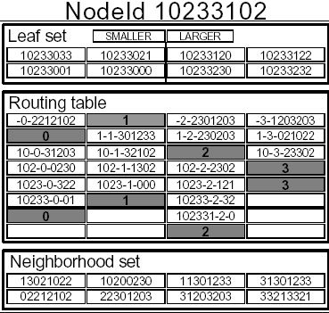
Routing Table Example
This is an example of a routing table (taken from the original paper that talks about Pastry)
The different row and column entries are shown
NodeId = 10233102, b = 2, l = 8 and all numbers are in base 4
It also shows the leaf set, neighborhood set for the same node

Slide 9
Neighborhood Set M
Neighborhood set contains the |M| nodeIds and their IPs such that they are closest to the node
Closeness is measured according to a proximity metric
Proximity metric can be:
  Number of IP routing hops
  Geographical distance
  Round trip time
  It is assumed to follow the triangle inequality

Slide 10
Leaf Set L
It contains |L|/2 nodes with numerically closest larger nodeIds
And |L|/2 nodes with numerically closest smaller nodeIds
Leaf set is used during message routing
Typical values of |L| and |M| are 2^{b} or 2*2^{b}

Slide 11
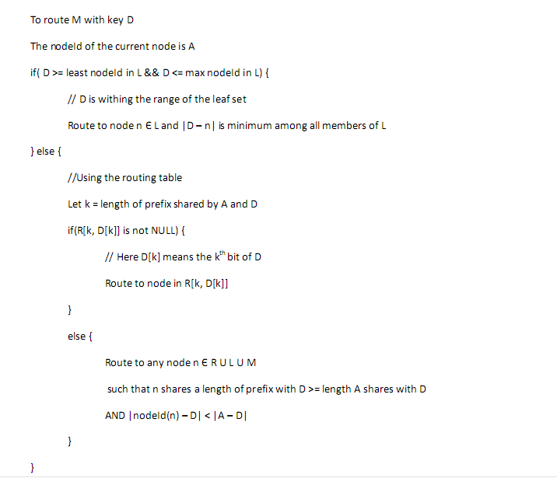
Routing Algorithm

Slide 12
Routing Performance
Routing can happen in 3 ways
  If D is within the range of leaf set
    In this case the destination is one hop away
  Else If the routing table entry is referred to
    In this case D shares a common prefix of length that is at least 1 greater than the length of the previous common prefix at each step, so number of steps ~ O(log_{2b}N)
  Else if the routing table entry if NULL
    This is an extremely rare case
    Analysis show if |L| = 2^{b} the probability is 0.02
    And if |L| = 2*2^{b} the probability is 0.006
    In this case with high probability there is only one additional step
If simultaneous nodes fail the worst case number of routing steps can grow to O(N)

Slide 13
Self Adaptation
Pastry is a self organizing network
It is unaffected to a large extent by node arrivals and departures
To enable this it must alter the node states with node arrivals and departures

Slide 14
Node Arrivals
Let us assume node n joins with nodeId X
  We assume that X knows one node A in the network
  A is assumed to be in proximity of X
X sends special “join” message to A with key X
So A routes the message to the node with nodeId closest to X
Each node on the path sends its state to X
X builds its state based on the states it receives
The ways for building R, M and L for X are described below

Slide 15
Building the Routing Table R
Let the path of routing of “join” message be X→ A → B → C → ….. → Z
The first row of X is the first row of A
  As A does not share any common prefix with X
The second row of X is the second row of B
  As B shares prefix of size one with X
The third row of X is the third row of C
  As C shares prefix of size two with X
And so on…

Slide 16
Building the Neighborhood Set M
The neighborhood Set of X is built using the neighborhood Set of A
The neighborhood Set of X is initialized with the neighborhood set of A
X can then request the neighborhood sets of the individual members to make any modifications necessary
  If any member from the requested neighborhood set is found to be at a closer distance it replaces a member at a larger distance in M

Slide 17
Building the Leaf Set L
Let the path of routing of “join” message be X→ A → B → C → ….. → Z
The leaf set of X is build using the leaf set of Z
Let the leaf set of Z in increasing order of nodeId be
  a₁, a₂, a₃, …. , a_{|L|}
X and Z lie between a_{(|L|/2 -1)} and a_{(|L|/2+1)}
  So Z is inserted between these nodes and one of a₁ and a_{|L|} is removed so that properties of L still holds

Slide 18
Node Departure
A node is considered failed when its immediate neighbors can no longer communicate with it
A node referred in either L, M or R can fail
In each of the 3 cases: L, M or R needs to be updated accordingly
The ways these are updated is described below for each of the 3 cases

Slide 19
Node Departure in L
If a node in leaf set fails the node asks the extreme valued nodeId on the side where the node has failed for its neighborhood set
  Let the neighborhood set of the extreme node be L’
A part of L’ will overlap with L
The first nodeId that is not present in L but present in L’ after the overlap is added in L
  Before adding the node it is verified that the node is alive by contacting it

Slide 20
Node Departure in R
If a node has failed in the m^{th} row and n^{th} of R then any other node in the m^{th} row is contacted and its entry in R[m, n] is added
If no node in m^{th} row is alive then we move on to (m+1)^{th} row and copy its R[m, n] and so on…
  If a valid live node exists it is extremely likely that we will find one

Slide 21
Node Departure from M
Neighborhood Set is not used for routing
Still it is important to keep this list up to date as it plays an important role in exchanging information about nearby nodes
Each member of M is periodically contacted
  If it does not respond it needs to be replaced
  This is done by asking other members of M for their neighborhood sets and updating accordingly

Slide 22
Locality
The nodes in the routing table R are close to the node with respect to the proximity metrics
  It is assumed that the triangle inequality law holds for the proximity metrics
Let us assume that the nodes in the routing tables of the present nodes are close
  We then prove that when a node joins the nodes in its routing table are also close to it
When a new node X joins it knows a current node A
  It is assumed that A is close to X

Slide 23
Locality cont…
As the first row of routing table of A is copied to the new routing table these nodes are close to X (because A is close to X)
The next row is copied from B
  The average distance grows exponentially with each row, as the number of nodes to choose from decreases exponentially
  So the average distance of first row nodes of B from B is exponentially larger than the distance between A and B
  So the distance of X from first row elements of B is of the same order as the distance of B from the elements
The same argument holds from C, D…
  So the nodes in routing table of X are close to X

Slide 24
Locality among k Nodes
In some Pastry-based applications, object is replicated on k nodes on its route (during insertion)
In prefix-base routing: goal is to reach any of k numerically closest nodes that has a copy of object
Here it is possible to miss nearby nodes with different prefix
Here due to properties of the routing table one reaches a close node that stores the object with high probability

Slide 25
Arbitrary Node Failure
When a node continues to be responsive but behaves incorrectly or maliciously
In such a case repeated queries will fail as each time we take the same route
This is solved using randomized routing
  If a number of nodes are satisfying a routing condition then one can randomly choose one of them
  One can also be slightly biased towards a closer node instead of being completely biased

Slide 26
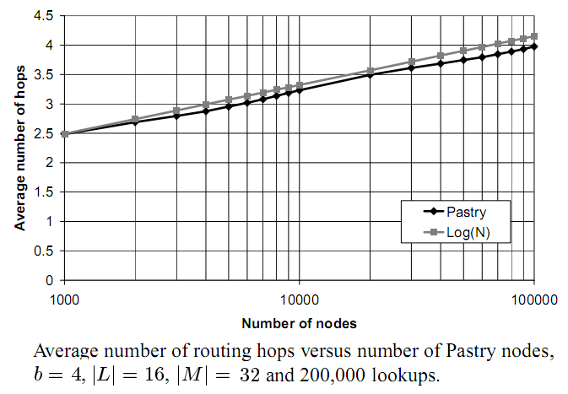
Experimental Results
Number of hops has been shown to vary as log(N)

Slide 27
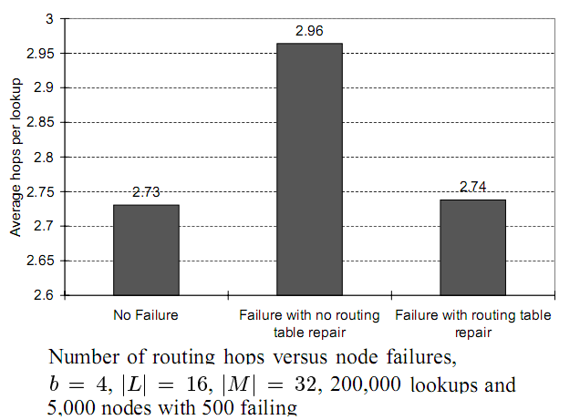
Experimental Results
Average number of hops when nodes fail
  It is observed that with routing table repair the average number of hops with nodes failing and nodes not failing remain approximately the same

Slide 28
Applications using Pastry
PAST: It is a distributed file system implemented on top of Pastry
SCRIBE: It is a decentralized publish/subscribe system that uses Pastry for its underlying route management and host lookup

Slide 29
Conclusion
Pastry is a p2p content location and routing system
It performs relatively unaffected even with relatively large number of node failures
Results with up to 100,000 nodes show that the system is efficient and scales well
It can be used as a building block for varied internet applications
  Examples are file sharing, Global file storage, group communications and naming systems

Slide 30
References
ROWSTRON,A. AND DRUSCHEL,P. 2001. Pastry: Scalable, distributed object location and routing for large-scale peer-to-peer systems. In Proceedings of IFIP/ACMMiddleware.Heidelberg, Germany
http://en.wikipedia.org/wiki/Pastry_(DHT)
A Survey of Peer-to-Peer Content Distribution Technologies, STEPHANOS AND ROUTSELLIS-THEOTOKIS AND DIOMIDIS SPINELLIS
http://research.microsoft.com/en-us/um/people/antr/pastry/

