Slide 1
Tapestry
GTK Devaroy (07CS1012)
Kintali Bala Kishan (07CS1024)
G Rahul (07CS3009)

Slide 2
Introduction
Tapestry is a distributed hash table which provides a decentralized object location, routing, and multicasting infrastructure for distributed applications.
It is composed of a peer-to-peer overlay network offering efficient, scalable, self-repairing, location-aware routing to nearby resources.
It also allows applications to implement multicasting in the overlay network.

Slide 3
Similarities With The Other Overlay Networks
Key-based routing similar to Chord, Pastry
Similar guarantees to Chord, Pastry
  Log_{b}N routing hops (b is the base parameter)
  bLog_{b}N state on each node
  O(Log_{b}²N) messages on insert
Locality-based routing tables similar to Pastry

Slide 4
What sets Tapestry above the rest of the structured overlay p2p networks?

Slide 5
Decentralized Object Location and Routing: DOLR
The core of Tapestry
Routes messages to endpoints
  Both Nodes and Objects
Virtualizes resources
  objects are known by name, not location

Slide 6
DOLR Identifiers
ID Space for both nodes and endpoints (objects): 160-bit values with a globally defined radix (e.g. hexadecimal to give 40-digit IDs)
Each node is randomly assigned a nodeID
Each endpoint is assigned a Globally Unique IDentifier (GUID) from the same ID space
Typically done using SHA-1
Applications can also have IDs (application specific), which are used to select an appropriate process on each node for delivery

Slide 7
DOLR API
PublishObject(O_{G}, A_{id})
UnpublishObject(O_{G}, A_{id})
RouteToObject(O_{G}, A_{id})
RouteToNode(N, A_{id}, Exact)

Slide 8
Node State
Each node stores a neighbor map similar to Pastry
  Each level stores neighbors that match a prefix up to a certain position in the ID
  Invariant: If there is a hole in the routing table, there is no such node in the network
For redundancy, backup neighbor links are stored
  Currently 2
Each node also stores backpointers that point to nodes that point to it
Creates a routing mesh of neighbors

Slide 9
Routing Mesh
Each identifier is mapped to a live node called the root
If a node's nodeID is G, then it is the root else use the routing table's nodeIDs and IP addresses to find the nodes neighbors
At each hop a message is progressively routed closer to G by incremental suffix routing
Neighbor map has multiple levels where each level contains links to nodes matching to a certain digit position in the ID

Slide 10
Routing Mesh (cont.)
The primary i^{th} entry in the j^{th} level is the ID and location of the closest node that begins with prefix (N, j-1)+i
  Level 1 has links to nodes that have nothing in common, level 2 has the first digit in common, etc.
So, the routing takes approximately log_{B}N hops in a network of size N and IDs of base B (hex: B=16)
If an exact ID can not be found, the routing table will route to the closest matching node.
For fault tolerance, nodes keep c secondary links such that the routing table has size c * B * log_{B}N

Slide 11
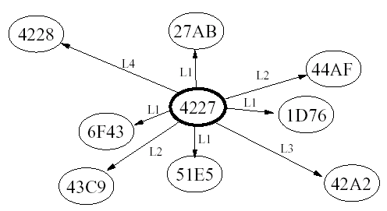
Routing Mesh

Slide 12
Routing
Every ID is mapped to a root
An ID’s root is either the node where nodeID = ID or the “closest” node to which that ID routes
Uses prefix routing (like Pastry)
  Lookup for 42AD: 4*** => 42** => 42A* => 42AD
If there is an empty neighbor entry, then use surrogate routing
  Route to the next highest (if no entry for 42**, try 43**)

Slide 13
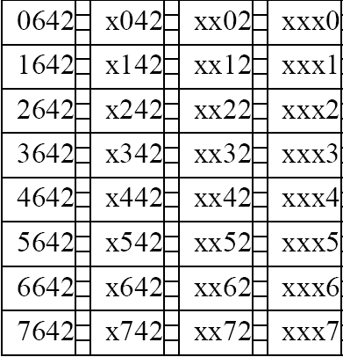
Routing Table Of A Node

Slide 14
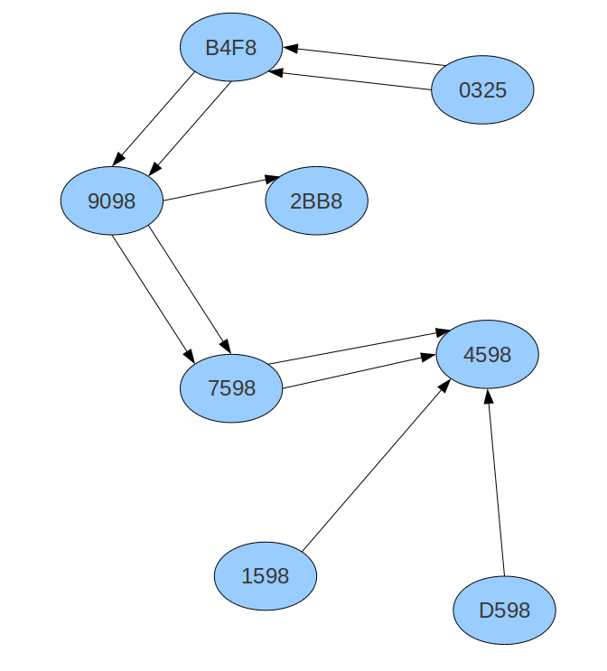
Routing From Node 0325 to Node 4598:

Slide 15
Fault Tolerance
Tapestry has the ability to detect, circumvent and recover from failures
In Tapestry, faults are detected and circumvented by the previous hop router, minimizing the effect a fault has on the overall system
Failures can occur due to:
  server outages(those due to high load and hardware/softwarefailures)
  link failures (router hardware and software faults)
  neighbor table corruption at the server
  failure of intermediate nodes.

Slide 16
Fault Tolerance Routing
Each entry table has two backup-ids(backup neighbours) apart from the primary neighbour
The Primary and back-up ID's are chosen based on RTT(Round Trip Time) to the neighbours
Whenever the Primary-ID fails, the backup ID's are initiated and a stream of control messages is passed to the failed primary neighbour to see if it is repaired
If the primary is repaired, then it is re-initiated
If the failed node is not repaired within a timeout interval, then the Secondary Neighbour is made primary and a new secondary node is brought in

Slide 17
Object Publication
A node sends a publish message towards the root of the object
At each hop, nodes store pointers to the source node
  Data remains at source. Exploit locality without replication (such as in Pastry, Freenet)
  With replicas, the pointers are stored in sorted order of network latency
Soft State – must periodically republish

Slide 18
Object Location
Client sends message towards object’s root
Each hop checks its list of pointers
  If there is a match, the message is forwarded directly to the object’s location
  Else, the message is routed towards the object’s root
Because pointers are sorted by proximity, each object lookup is directed to the closest copy of the data

Slide 19
Use of Mesh for Object Location
Getting Locality in the mesh.
Objects belong to root sharing same ID

Slide 20
Node Insertions
A insertion for new node N must accomplish the following:
  All nodes that have null entries for N need to be alerted of N’s presence
    Acknowledged mulitcast from the “root” node of N’s ID to visit all nodes with the common prefix
  N may become the new root for some objects. Move those pointers during the mulitcast
  N must build its routing table
    All nodes contacted during mulitcast contact N and become its neighbor set
    Iterative nearest neighbor search based on neighbor set
  Nodes near N might want to use N in their routing tables as an optimization
    Also done during iterative search

Slide 21
Node Deletions
Voluntary
  Backpointer nodes are notified, which fix their routing tables and republish objects
Involuntary
  Periodic heartbeats: detection of failed link initiates mesh repair (to clean up routing tables)
  Soft state publishing: object pointers go away if not republished (to clean up object pointers)

Slide 22
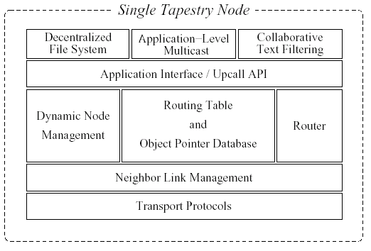
Tapestry Architecture
Prototype implemented using Java
OceanStore, etc
deliver(), forward(), route(), etc.
Tier 0/1: Routing, Object Location
Connection Mgmt
TCP, UDP

Slide 23
Benefits
Simple Fault Handling
Scalable
Exploiting Locality
Proportional Route

Slide 24
Limitations
Root Node Vulnerability
Global Knowledge
Lack of Ability to Adapt

Slide 25
Applications
Tapestry can be used to deploy large-scale applications!
  Oceanstore: a global-scale, highly available storage utility
  Bayeux: an efficient self-organizing application-level multicast system

