Slide 1

Content Addressable Network
CAN

Slide 2
The CAN is essentially a distributed Internet-scale hash table that maps file names to their location in the network by supporting insertion, lookup, and deletion of the key, value pairs in the table.
What is CAN?

Slide 3
Overview of the basic structure of CAN
Each node of CAN stores
A part of (referred to as 'zone') hash table
Information about small number of adjacent
zones in the hash table.
Request to insert, lookup, or delete a particular node are routed through intermediate zones to the node that maintains the zone containing the key

Slide 4
Design of CAN
Concept of d- dimensional coordinate system to store (key, value) pairs.
At any time the entire coordinate space is partition dynamically among the node such that each of the nodes owns a distinct zone within the overall space.
Nodes in CAN self-organize into overlay network that represents this virtual coordinate space.
The zone of the hash table of which the node is responsible for is represented by a segment of this coordinate space.
Any key k is mapped to a point p in this coordinate space using a uniform function.
A (k,v) pair is then stored at the node which is responsible for the zone within which point p lies.
To retrieve point p the key k is mapped onto point p by the same hash function and the retrieve the corresponding value from that point.
If point P is not owned by requesting node or immediate neighbors, the request must be routed through CAN infrastructure until it find the node whose zone contain point P.

Slide 5
Incorporating new nodes to CAN
Each time a node joins the existing zone is split into two halves, one of which is assigned to the new node.
Splitting of zones by well known ordering dimensions.
Lets take an example to understand how the splitting is done. Here we take 2-d space
The first node takes whole of the space.
Next node which arrives is split along x axis
And then a zone is found which has to be split for the next node that arrives and is split along y axis in two halves.
And for next node a zone is found again which has to be split and is split along x axis
This will continue till the nodes continue arrive.
This can be represented graphically as ...(next slide)

Slide 6
Partitioning of the CAN space as 5 nodes join in succession
0
01
1
11
110
111
00
10

Slide 7
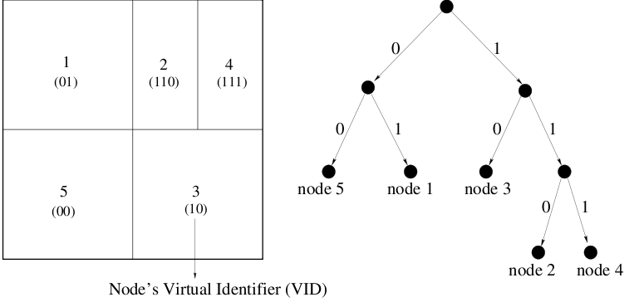
Concept of Binary “Partition tree”
Figure below depicts the concept.
Root is split into two nodes edges labeled 0 and 1
A edge is labeled '0' if it is in the lower half of the coordinate space and other half
is labeled '1'
Intermediate nodes don't exist, they are partitioned
Left figure denotes VID which is just the binary number which is number labeled on
the edges from the root to the node in which we are interested
For example for node 4 VID is '111' ,for node 2 the path is '10' which is its VID

Slide 8
Summary of the node arrival
First a new node must find a new node existing already in CAN.
Secondly using CAN routing mechanism, it must find a node whose zone will be
split.
Finally, the neighbors of split zone must be notified so that routing can include new node

Slide 9
Finding a zone
First a new node identify any node by discovering its IP address
Randomly choose a point P
Send a join request destined for P.
This message is sent int CAN via any existing Can node
Each CAN node the uses the CAN routing mechanism to forward the join request message to next node until it reaches the node the zone of which contains P
Divide the Zone into two halves
Lower half of the zone is held by the parent (splitting node) and other half by the child (new node)
One is assigned '0' and the '1' based on the rule discussed previously. (binary tree)
The parent node appends '0' to its existing VID and child node appends '1' to the parent's original VID

Slide 10
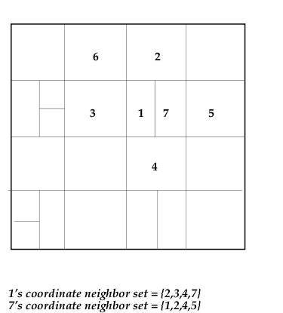
Joining to Routing
Once the new node joins it learns the IP addresses of its coordinate neighbor's set.
Two nodes are neighbors if their coordinate span overlap along d-1 dimensions and abut along 1 dimension

Slide 11
Joining to Routing continued.........
The new node's neighbor set is subset of the its parent's neighbors set plus the parent itself
Parent's neighbors set is also updated accordingly
All nodes send a message to inform about the the update which took place and all other nodes update their neighbors set accordingly.
For a d-dimensional space, O(d) are only affected by a node insertion.

Slide 12
Routing in CAN
Routing in CAN follows straight line path from source to destination coordinates
Every node in CAN maintains a routing table
The table holds the IP and VIDs of each of its neighbor in the coordinate space
A CAN message includes the destination coordinates.
A node routes the message using the its coordinate neighbor set towards the destination using simple greedy forwarding to neighbors closet to destination coordinates
For d-dimensional space partitioned into n equal zones we have
=> Average routing path length is (d/4)(n^{1/d})
If one or more neighbors of a node crashes then since there are many path to destination ,the node route through next best available path.

Slide 13

Routing
y
d-dimensional space with n zones
2 zones are neighbor if d-1 dim overlap
Routing path of length:
Algorithm:
  Choose the neighbor nearest to the destination
(x , y)
Peer
Q(x ,y)
Query/
Resource
Q(x ,y)
key

Slide 14
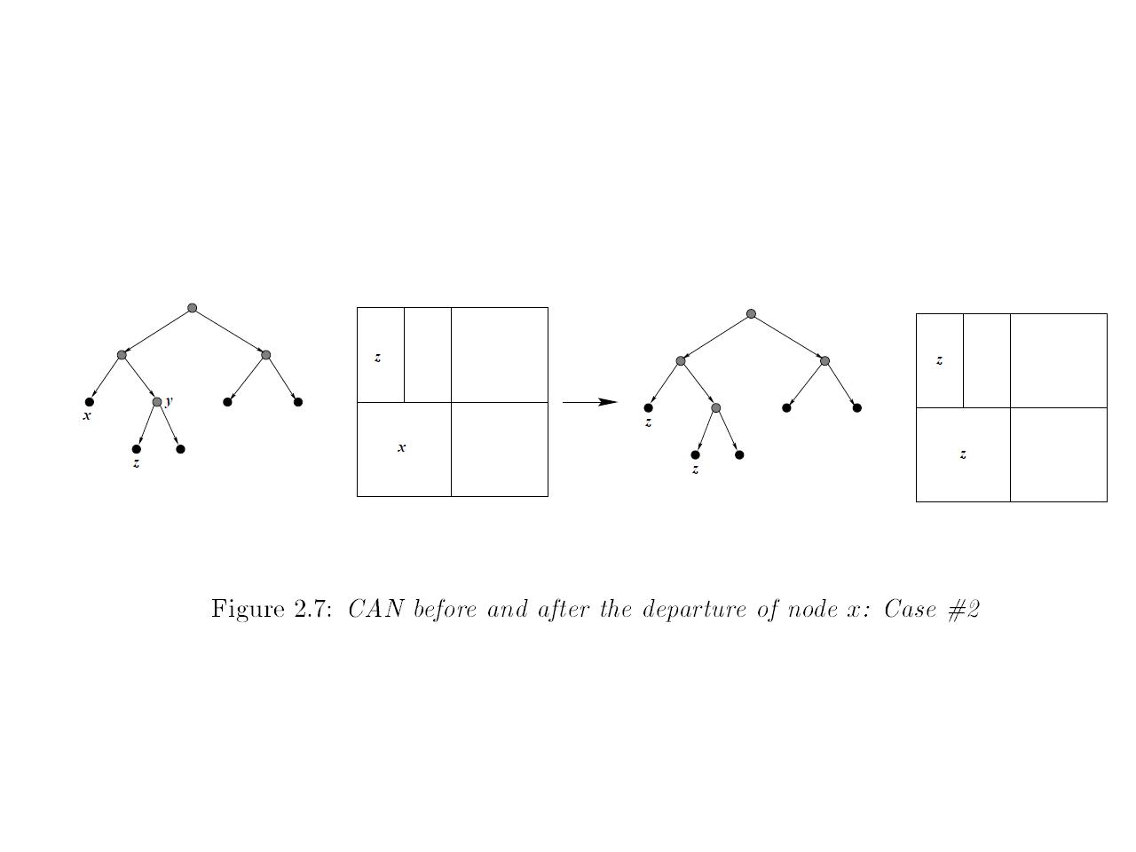
Node Departure
To handle a node departing, the CAN must:
  Identify a node is departing.
  Have the departing node's zone merged or taken-over by a neighbouring node known as Takeover node .
  Update the routing tables across the network.

Slide 15
Recovery Algorithm
Detecting a node's departure can be done, for instance, via heartbeat messages that periodically broadcast routing table information between neighbours. After a predetermined period of silence from a neighbour, that neighbouring node is determined as failed and is considered a departing node. Alternatively, a node that is willingly departing may broadcast such a notice to its neighbours.
After departing node identified, its zone must be either merged or taken-over. First the departed node's zone is analyzed to determine whether a neighbouring node's zone can merge with the departed node's zone to form a valid zone. For e.g., a zone in a 2d coordinate space must be square or rectangle and cannot be L-shaped. The validation test may cycle through neighbouring zones to determine if a successful merge can occur. If one of the potential merges is deemed a valid merge, the zones are then merged. If none of the potential merges are deemed valid, then the neighbouring node with the smallest zone takes over control of the departing node's zone. After a take-over, the take-over node may periodically attempt to merge its additionally controlled zones with respective neighbouring zones.

Slide 16
Zone reassignment
3
1
1
3
2
4
2
4
Partition tree
Zoning

Slide 17
Zone reassignment
3
1
1
3
4
4
Partition tree
Zoning

Slide 18
Zone reassignment
2
1
1
2
4
4
Partition tree
Zoning

Slide 19
Maintenance
Use zone takeover in case of failure or leaving of a node
Send your neighbor table to neighbors to inform that you are alive at discrete time interval t
If your neighbor does not send alive in time t, takeover its zone
Zone reassignment is needed

