Slide 1
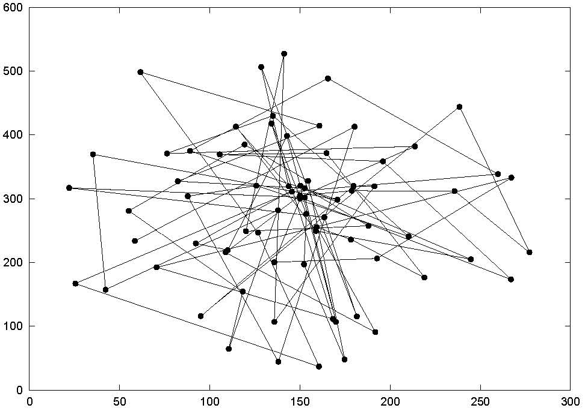
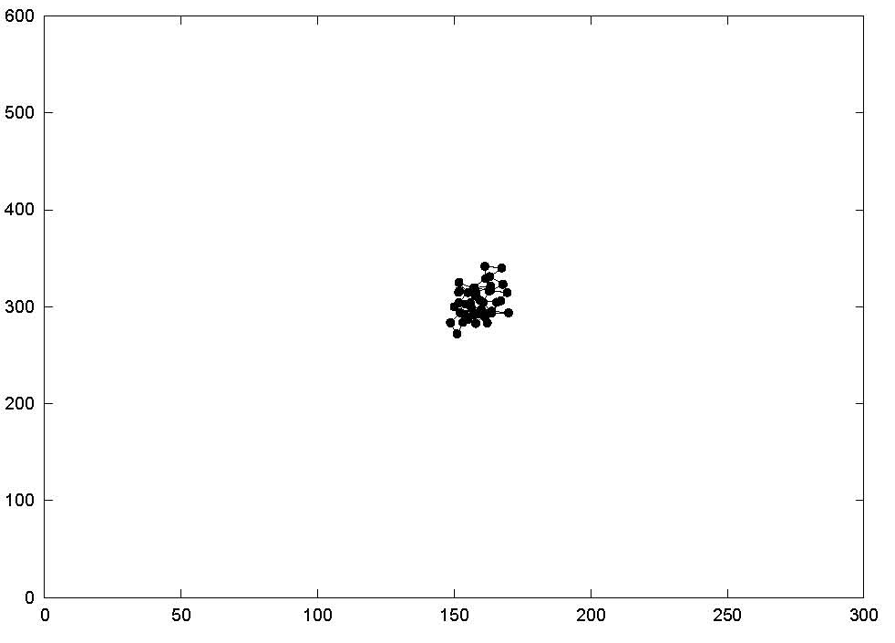
Random Walk Mobility
Figure 1: Traveling pattern of an MN using the 2-D Random Walk Mobility Model (time).
Figure 2: Traveling pattern of an MN using the 2-D Random Walk Mobility Model (distance).

Slide 2
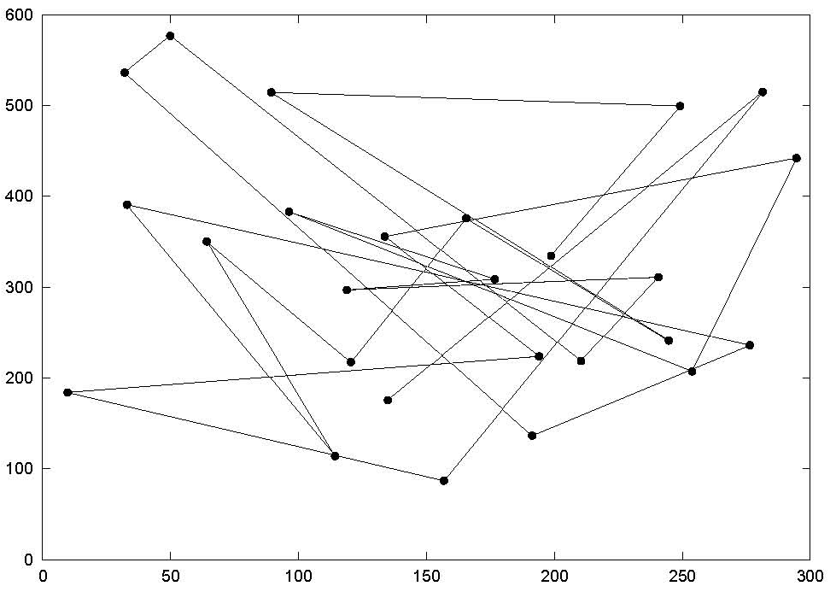
Random Waypoint Mobility
Figure 3: Traveling pattern of an MN using the Random Waypoint Mobility Model.

Slide 3
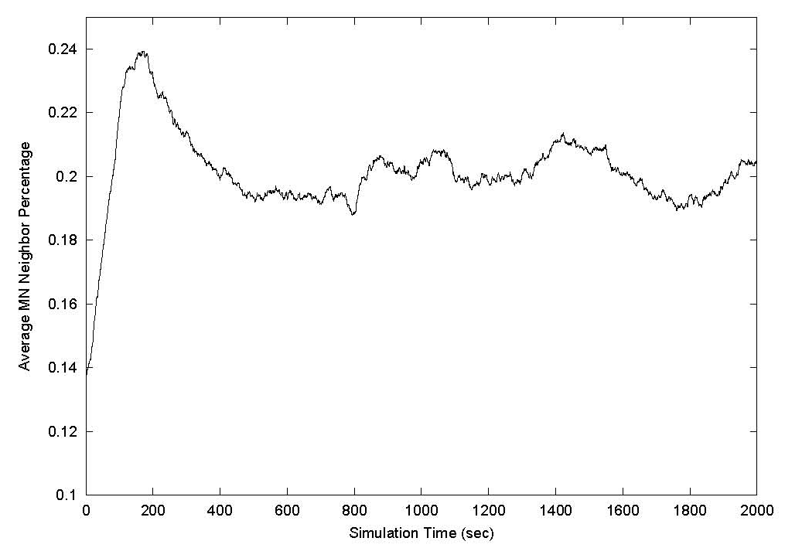
Random Waypoint Mobility
Figure 4: Average neighbor percentage vs. time.

Slide 4
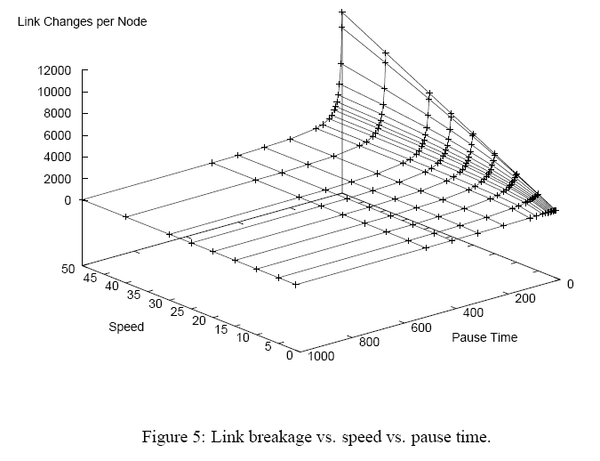
Random Waypoint Mobility

Slide 5
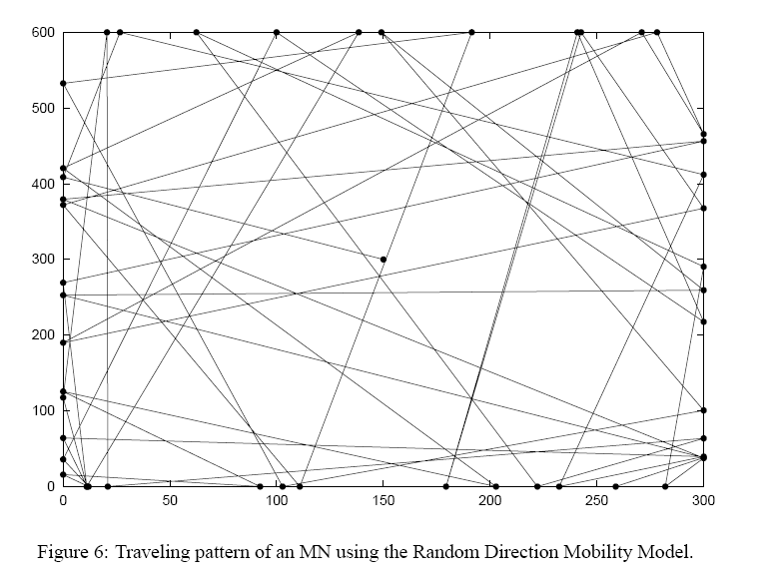
Random Direction Mobility

Slide 6
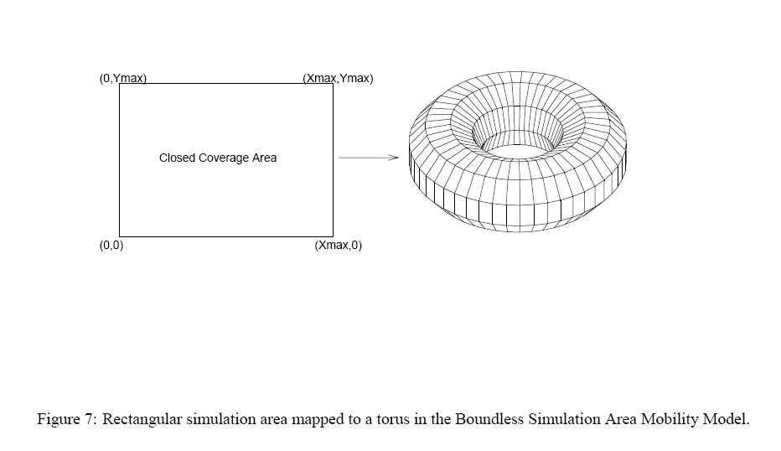
A Boundless Simulation Area

Slide 7
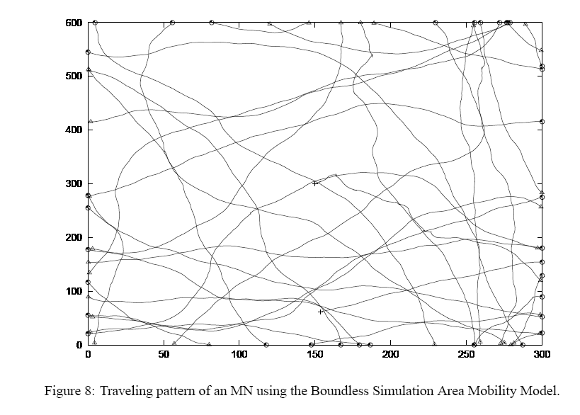

Slide 8
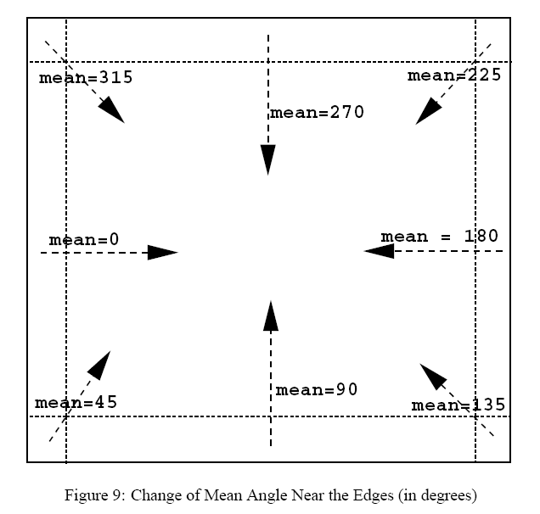

Slide 9
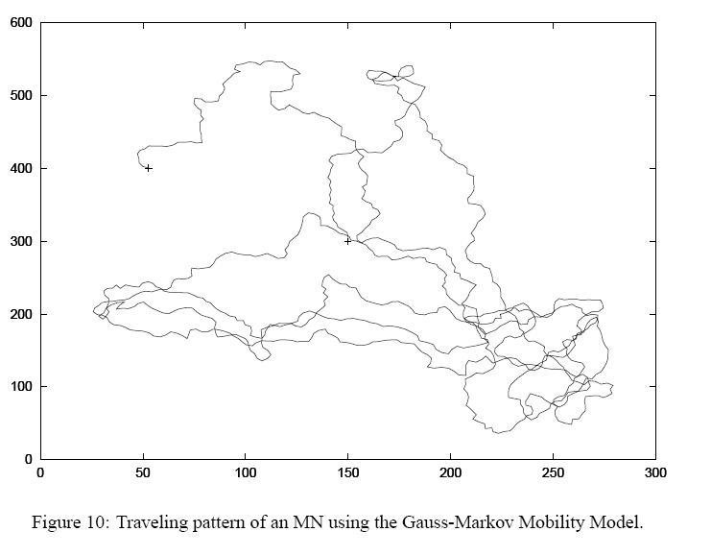

Slide 10
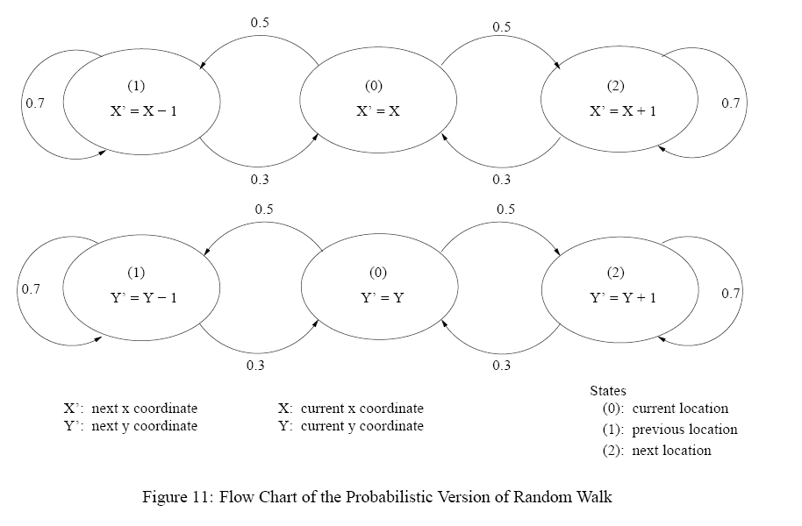
Random Walk

Slide 11
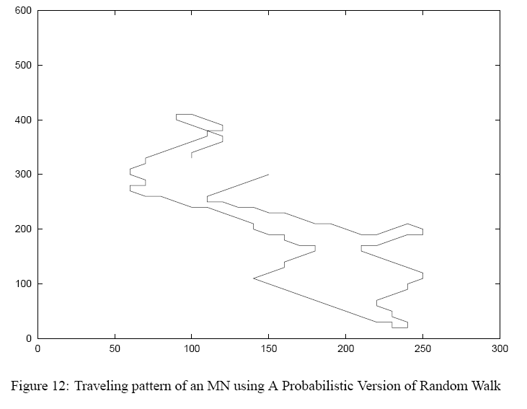
Probabilistic Random Walk

Slide 12
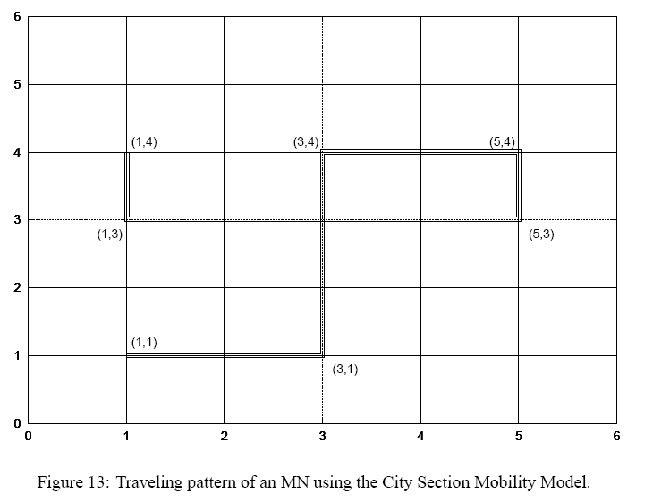
City Section

Slide 13
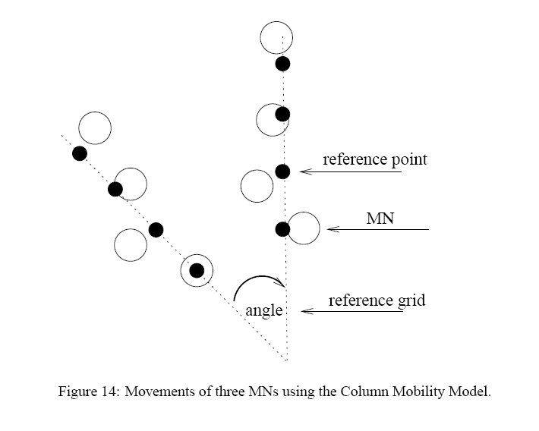
Column Mobility

Slide 14
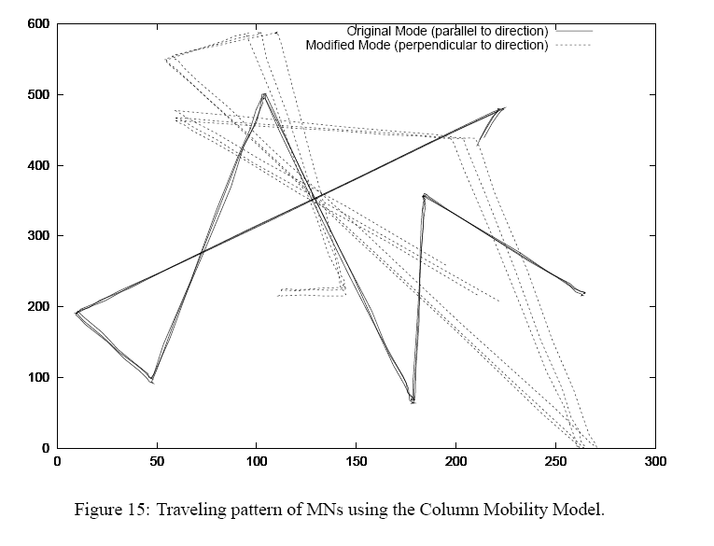
Column Mobility

Slide 15
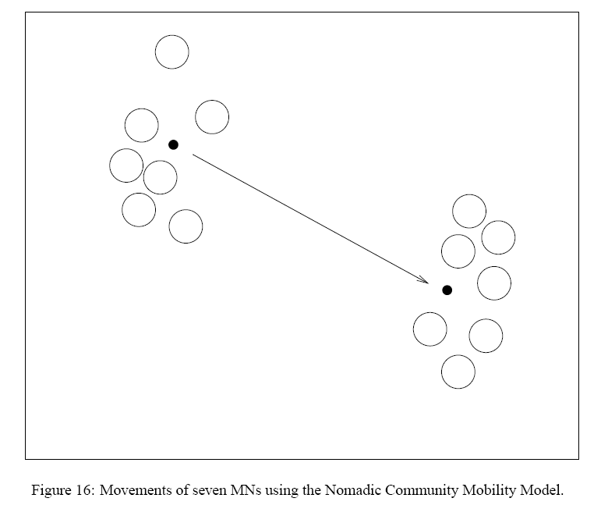
Nomadic Community Mobility

Slide 16
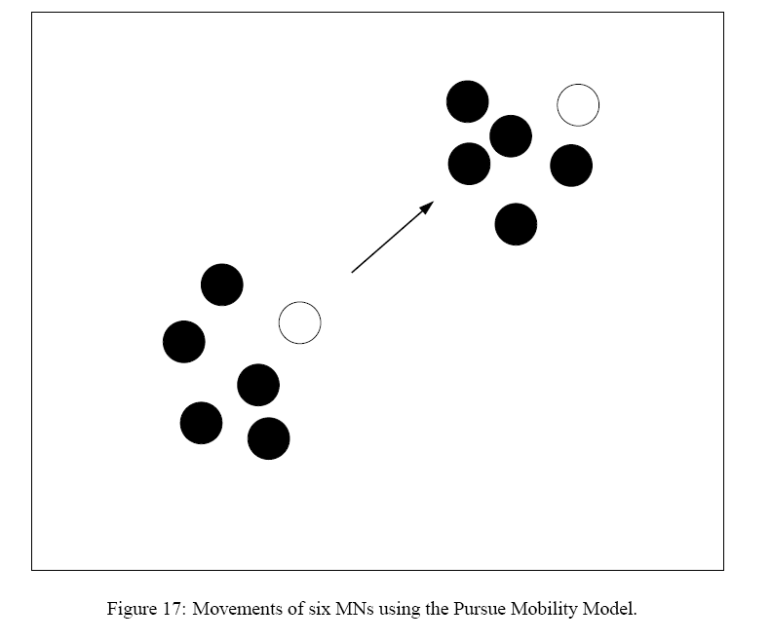
Pursue Mobility

Slide 17
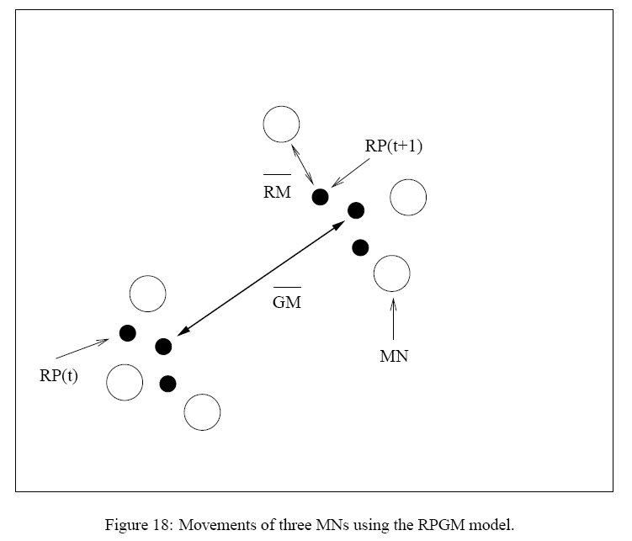
Reference Point Group Mobility Model

Slide 18
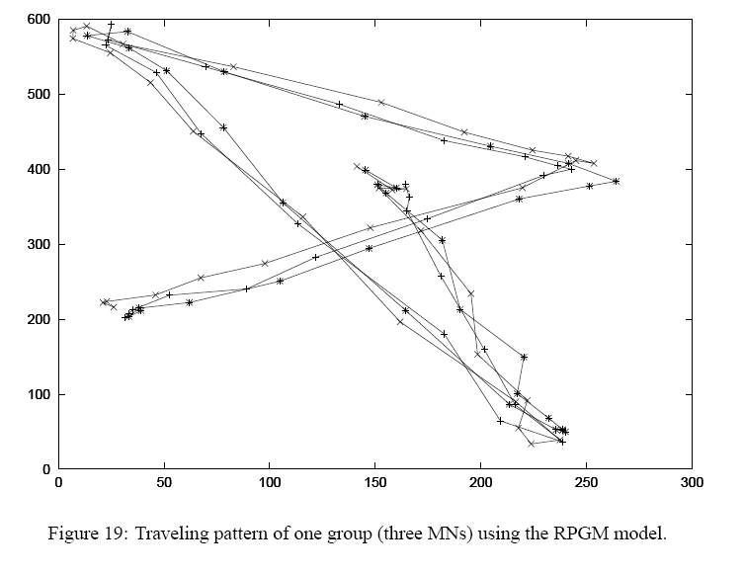
Reference Point Group Mobility

Slide 19
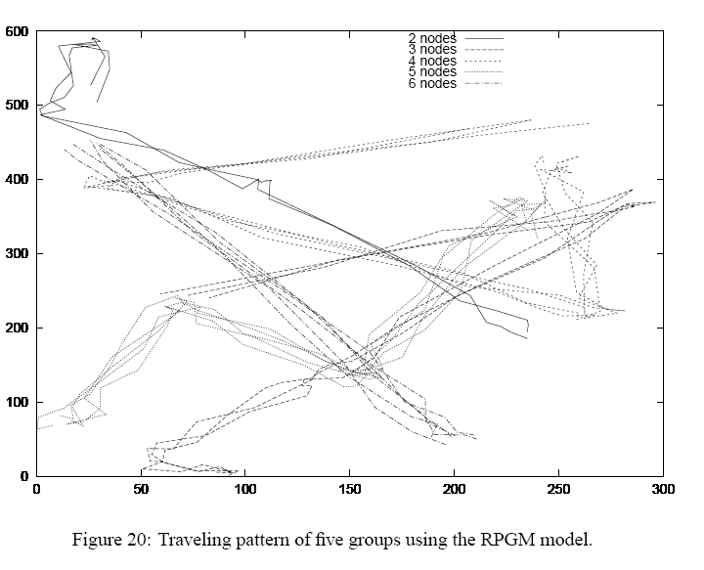
Reference Point Group Mobility

Slide 20
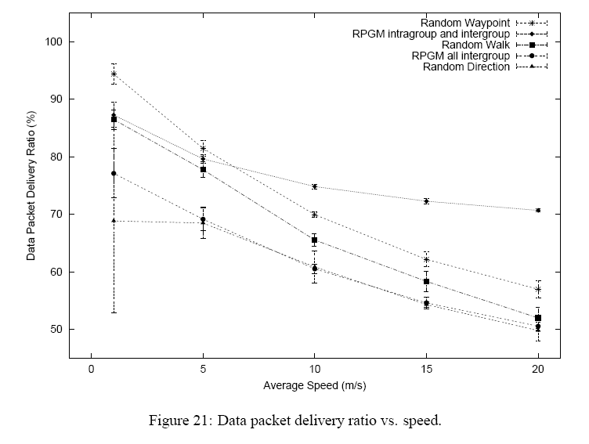
Routing Performance

Slide 21
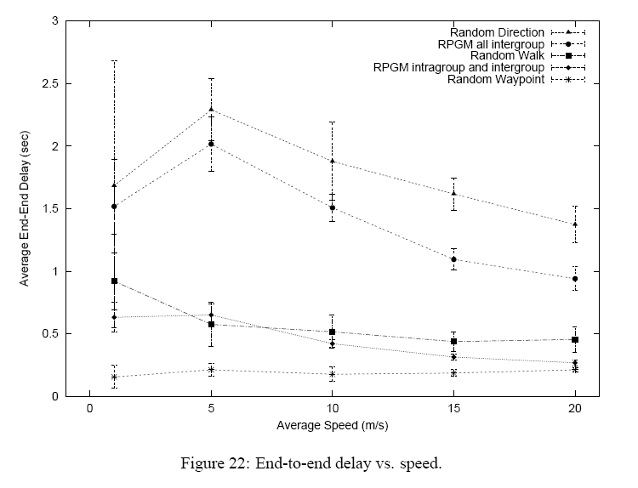
Routing Performance (Contd..)

Slide 22
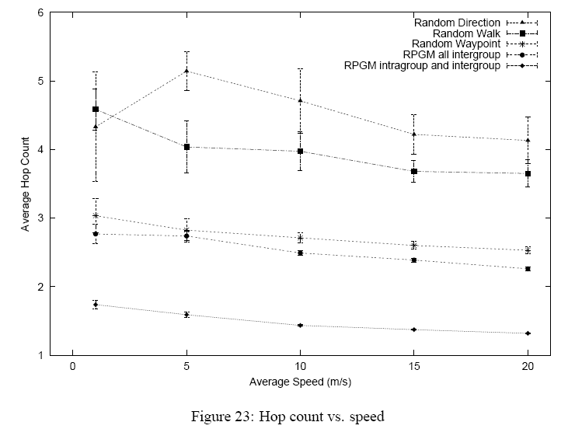
Routing Performance (Contd..)

Slide 23
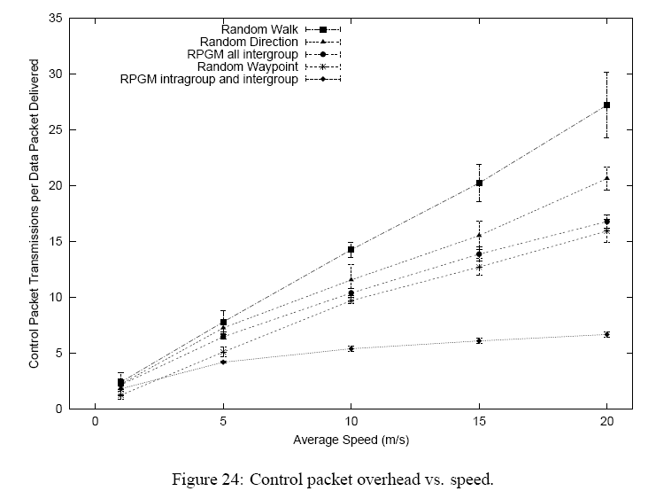
Routing Performance (Contd..)

Slide 24
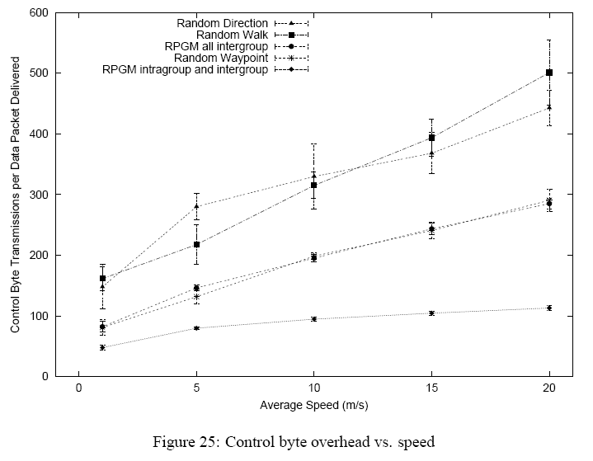
Routing Performance (Contd..)

