Slide 1
Introduction to P2P
Niloy Ganguly

Slide 2
Definition
Sharing of computer resources and services by direct exchange between systems.
Giving to and obtaining from a peer community. A peer give some resources and obtain other resources in return.

Slide 3
Background and Motivation
Client-Server architecture had several issues
  Not scalable.
  Overloaded server takes longer time to response.
  Single point of failure.

Slide 4
Solution to the issues
Main problem was centralized server.
  Distributed server model was adopted.
  Instead of a single server, data is replicated over a number of servers. It reduces load on a single server but still failed to fulfill the expectation of Internet users.

Slide 5
Introduction to P2P
In such a situation P2P was introduced which is
  Distributed.
  Scalable.
  Fault tolerant.
  Cost sharing.
  Anonymity.
  Dynamism.
  Node acts as a client as well as server.
  Search may take longer time.

Slide 6
Mostly used for
  File Sharing
  Telephony
  Media Streaming
Most popular applications using P2P are
  Bit-torrent
  KAZAA
  edonkey
  Gnutella
  DC++
  Skype

Slide 7
Evolution of P2P Network
First Generation: Centralized server-client p2p networks
  Napster
Second Generation: Searching decentralized p2p networks
  Gnutella
Third P2P-Generation: indirect and encrypted
  Freenet, I2P
The fourth P2P-Generation: Streams over P2P
  Peercast, Cybersky

Slide 8
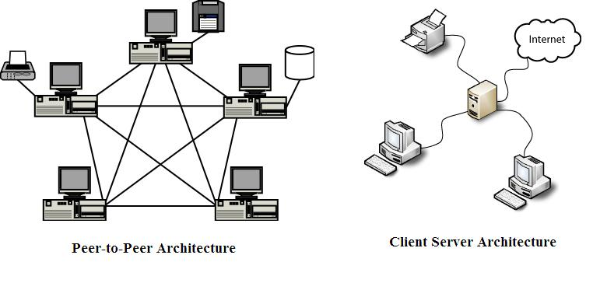
Architecture

Slide 9
Overlay Network
Definition: An overlay network is a computer network which is built on top of another network. Nodes in the overlay can be thought of as being connected by virtual or logical links, each of which corresponds to a path, perhaps through many physical links, in the underlying network. [wikipedia]
Example: Distributed systems such as cloud computing, peer-to-peer networks, and client-server applications are overlay networks because their nodes run on top of the Internet. Internet was built as an overlay upon the telephone network

Slide 10
Classification of P2P network
Pure: No centralized server, all peers talk to each other directly.
Hybrid: There is a server for indexing and name resolution.

Slide 11
Based on how the nodes in the overlay network are linked to each other, we can classify the P2P networks as
  Unstructured
  Structured.

Slide 12
Unstructured P2P network
An unstructured P2P network is formed when the overlay links are established arbitrarily.
Easy to construct as new peer can join in arbitrary manner.
Flooding is used for searching results in lots of redundant message.
Query may take longer time to resolve even it may not be resolved.

Slide 13
Cont..
Popular data is more likely to be found quickly.
Rare data either takes longer time or not found.
Popular P2P networks are mostly unstructured for example
  Napster
  Gnutella
  Kazaa

Slide 14
Structured P2P
Structured P2P networks employ a globally consistent protocol to ensure that any node can efficiently route a search to some peer that has the desired file, even if the file is extremely rare.
More structured pattern of overlay links.
Most common type of structured P2P network is the distributed hash table (DHT).

Slide 15
Distributed hash tables (DHT)
class of decentralized distributed systems that provide a lookup service similar to a hash table; (key, value) pairs are stored in the DHT.
Any participating node can efficiently retrieve the value associated with a given key.
Change in the set of participants causes a minimal amount of disruption.
Scalable.

Slide 16
Construction of DHT
Most DHTs use some variant of consistent hashing to map keys to nodes.
A keyspace partitioning scheme splits ownership of this keyspace among the participating nodes.
A node will store the values for all the keys it is responsible for.
The address space is a parameter of DHT. Several real world DHTs use 128 bit or 160 bit key space

Slide 17
Cont..
To store a file with given filename and data in the DHT, the SHA-1 hash of filename is generated, producing a 160-bit key k.
Each participating node is assigned a single key called its identifier (ID).
δ(k₁,k₂) is the distance between key k1 and key k2 where k1 is the key corresponding to a file and k2 is a key corresponding to a node.

Slide 18
Cont..
File is stored in the node for which δ(k₁,k₂) is minimum.
Storing data
  o store a file with given filename and data in the DHT, the SHA-1 hash of filename is generated, producing a 160-bit key k, and a message put(k,data) is sent to any node participating in the DHT. The message is forwarded from node to node through the overlay network until it reaches the single node responsible for key k as specified by the keyspace partitioning. That node then stores the key and the data.

Slide 19
Retrieval of the data
  Any other client can then retrieve the contents of the file by again hashing filename to produce k and asking any DHT node to find the data associated with k with a message get(k). The message will again be routed through the overlay to the node responsible for k, which will reply with the stored data.

Slide 20
Issues
How to route
How to divide keyspace
How to handle churn

Slide 21
Consistent Hashing
Definition: Consistent hashing is a scheme that provides hash table functionality in a way that the addition or removal of one slot does not significantly change the mapping of keys to slots.

Slide 22
consistent Hashing
“view” = subset of all hash buckets that are visible
Desired features
  Balanced – in any one view, load is equal across buckets
  Smoothness – little impact on hash bucket contents when buckets are added/removed
  Spread – small set of hash buckets that may hold an object regardless of views
  Load – across all views # of objects assigned to hash bucket is small

Slide 23
Cont..
Construction
  Assign each of C hash buckets to random points on mod 2^{n} circle, where, hash key size = n.
  Map object to random position on circle
  Hash of object = closest clockwise bucket
0
14
Bucket
12
4
8
Smoothness → addition of bucket does not cause much movement between existing buckets
Spread & Load → small set of buckets that lie near object
Balance → no bucket is responsible for large number of objects

Slide 24
Case Study (Chord)
introduced in 2001 by Ion Stoica, Robert Morris, David Karger, Frans Kaashoek, and Hari Balakrishnan, and was developed at MIT.
Chord is one of the four original distributed hash table protocols, along with CAN, Tapestry, and Pastry.

Slide 25
Cont..
Using the Chord lookup protocol, node keys are arranged in a circle.
The circle cannot have more than 2^{m} nodes. The circle can have IDs/keys ranging from 0 to 2^{m} − 1 where m is the length of hash key.
Each node has a successor and a predecessor.
The successor to a node (or key) is the next node (key) in the identifier circle in a clockwise direction.

Slide 26
Cont..
If there is a node for each possible ID, the successor of node 2 is node 3, and the predecessor of node 1 is node 0.
Normally there are holes in the sequence. For example, the successor of node 153 may be node 167 (and nodes from 154 to 166 will not exist).
If there are N nodes and K keys, then each node is responsible for roughly K / N keys.

Slide 27
Cont..
When a new node joins or leaves the network, responsibility for O(K / N) keys changes.
If each node knows only the location of its successor, a linear search over the network could locate a particular key.
Chord requires each node to keep a "finger table" containing up to m entries. The i^{th} entry of node n will contain the address of successor(n + 2^{i}).

Slide 28
resources
http://www.p2p-security.com/about-p2p/the-four-generations
Description of WWIVnet architecture
  http://en.wikipedia.org/wiki/WWIVnet (A heirarchical architecture: node->area_coordinator->group_coordinator->network_coordinator)
1994 - Linker34 released by Jayson Cowan first application to take file list requests and send files on a p2p network called WWIVnet with over 2000 users.
Napster
  http://ntrg.cs.tcd.ie/undergrad/4ba2.02-03/p4.html

Slide 29
Cont..
1st generation and 2nd generation
  Napster (1st ), Gnutella (2nd )
  http://ntrg.cs.tcd.ie/undergrad/4ba2.02-03/p4.html
There are three major types of P2P network:
Pure P2P:
  peers act as clients and server
  there is no central server.
  there is no central router.
Hybrid P2P:
  Has a central server that keeps information on peers and responds to requests for that information.
  Peers are responsible for hosting the information as the central server doesn't store files, for letting the central server know what files they want to share and for downloading its shareable resources to peers that request it.
  Route terminals are used addresses, which are referenced by a set of indices to obtain an absolute address.
Mixed P2P:
  Has both pure and hybrid characteristics.

Slide 30
2nd generation:
  Gnutella, gnutella1, kazaa
3rd Generation
  Gnunet, Freenet, I2P
4th Generation
  BitTorrent

