Slide 1
Lectures 8 & 9
Spectral Graph Theory
February 3, 2009
Monojit Choudhury
monojitc@microsoft.com

Slide 2
Spectral Graph Theory
Systematic study of the Eigenvalues and Eigenvectors of the adjacency matrix or the corresponding Laplacian matrix of the graph

Slide 3
The Spectrum
Compute the Eigenvalues of the adjacency matrix A
Let they be λ₁≥ λ₂ … ≥ λ_{n}
Spectrum of the graph is the plot of the Eigenvalues with their corresponding multiplicities.

Slide 4
Examples
Find out the eigenvalues and eigenvectors for a triangle
Can you generalize for an n-clique?
What about a complete bipartite network?

Slide 5
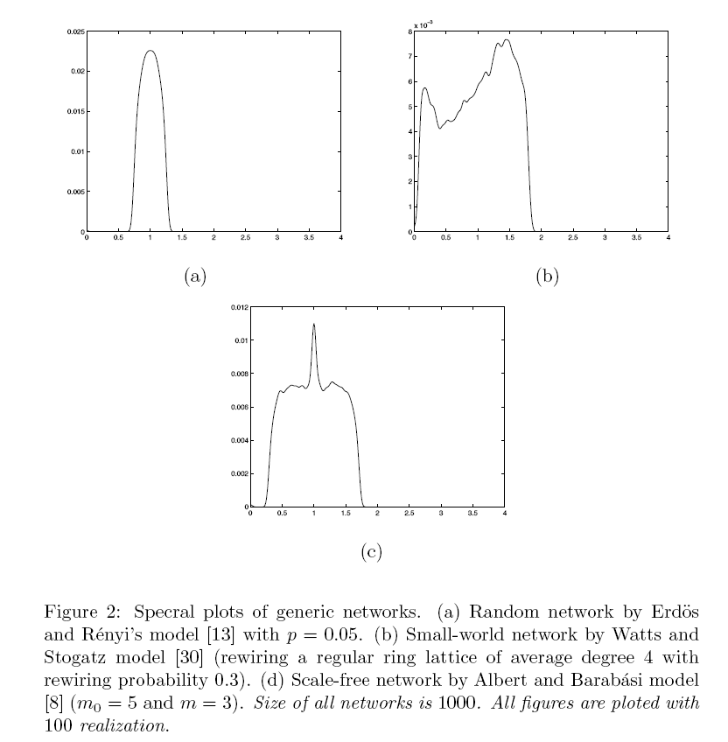
Spectral Plots of RandomNetworks
Banerjee and Jost (2007) Spectral Plots and Representation and Interpretation of Biological Data

Slide 6
Alternative Interpretations
Matrix as a set of linear equations
  Singularity
  Invertibility
Matrix as a arrangement of column vectors

Slide 7
Interesting & Important Properties
Eigenvalues and Eigenvectors of
  Diagonal matrices
  Triangular matrices
Eigenvalues and Eigenvectors of A^{T}
Now can you prove that a Markov matrix will have an Eigenvalue 1?

Slide 8
More properties of Eigenvalues
Trace of Matrix is the sum of the Eigenvalues
Diagonalization of Matrices
  S⁻¹AS = Λ
Frobenius norm of symmetric matrices
  Spectral coverage

Slide 9
Rank of a Matrix
Rank of a matrix
= Number of linearly independent rows
= Number of non-zero eigenvalues
Algebraic vs. Numerical rank
Relationship among rank, structural similarity and motifs.

Slide 10
Dimension Reduction
A matrix/graph is an n-dimensional entity
Can we represent the same using r (< n) dimensions?
Approximate representation of graphs/matrices
  Multidimensional Scaling
  Factor analysis

Slide 11
Principal Eigenvector
Corresponds to the largest eigenvalue
All positive
The direction in which the mean of the projection of the row vectors is maximum
Most important factor
Eigenvector centrality

Slide 12
The second eigenvector
Always orthogonal to the principal eigenvector
Used for spectral clustering
Random walk based clustering
  Chinese whispers (Biemann, 2005)
  Affinity Propagation (Frey and Dueck, 2007)

Slide 13
A case study (Mukherjee et al. 2009)
/s/
/s/
1
1
l₂
l₁
/p/
/k/
1
/n/
1
1
3
l₂
One-mode projection
2
One-mode projection
/k/
1
l₃
1
l₁
2
1
1
l₃
/t/
1
/t/
2
/d/
2
1
1
l₄
l₄
/d/
2
1
/p/
/n/
LangGraph
PlaNet
PhoNet
A
l₁ l₂ l₃ l₄
B
/s/ /p/ /k/ /t/ /d/ /n/
B′
l₁ l₂ l₃ l₄
/s/
/p/
/k/
/t/
/d/
/n/
1
0
1
0
0
0
0
1
1
1
0
0
1
0
0
1
0
1
0
1
1
1
1
1
/s/
/p/
/k/
/t/
/d/
/n/
0
0
1
0
0
1
0
0
2
2
1
1
1
2
0
2
1
1
0
2
2
0
1
2
0
1
1
1
0
1
1
1
1
2
1
0
l₁
l₂
l₃
l₄
0
1
1
1
1
0
1
3
1
1
0
2
1
3
2
0
A^{T}A – D′
AA^{T} – D

Slide 14
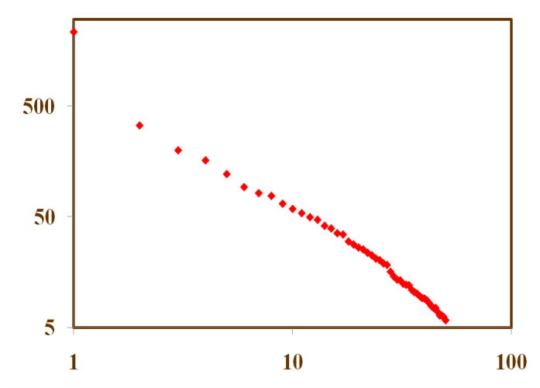
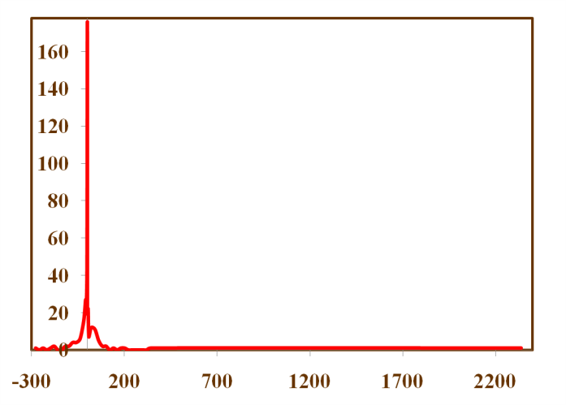
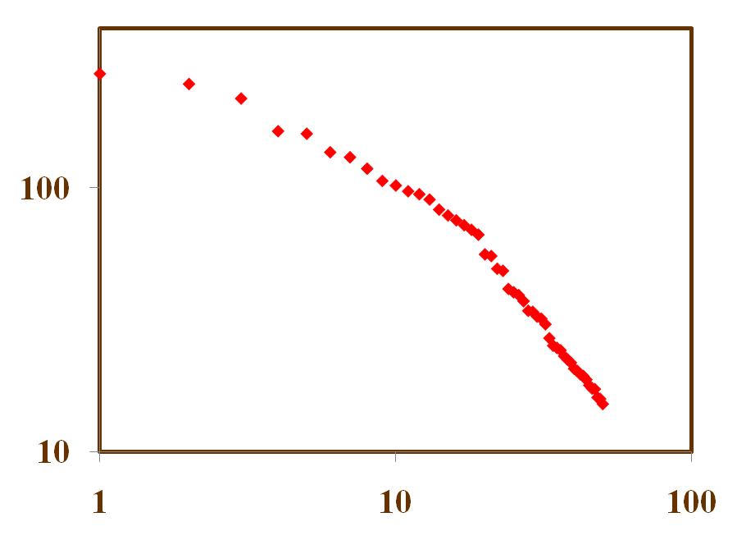
The Spectrum
Power-law exponent: -1.33
Eigenvalues
Bulk of eigenvalues concentrated around zero
Index of sorted eigenvalues
Power-law exponent: -0.88
Eigenvalues
Eigenvalues
Index of sorted eigenvalues

Slide 15
The spectral coverage
1st Eigenvector: 89%
2nd Eigenvector: 92%
3rd Eigenvector: 93%

Slide 16
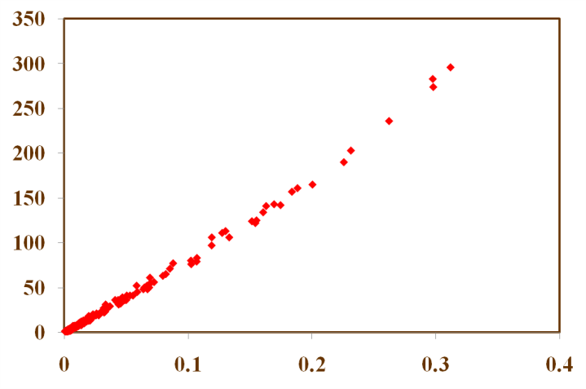
First Eigenvector and Frequency
Correlation: 0.99
Frequency
First eigenvector components

Slide 17
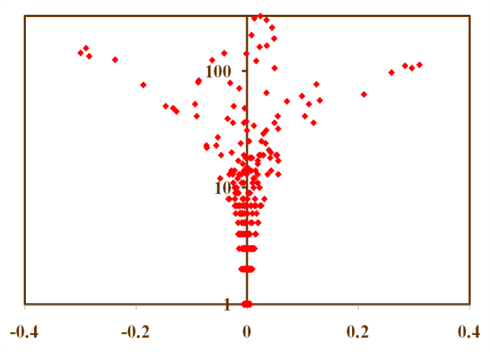
Second Eigenvector
Frequency
Second eigenvector components

