Slide 1
Deformation of the network due to node removal

Slide 2
Deformation of the network due to node removal
Removal of a node along with its adjacent links changes the degrees of its neighbors
  Hence changes the topology of the network
Let initial degree distribution of the network be p_{k}
Probability of removal of a node having degree k is f_{k}
We represent the new degree distribution p_{k}’ as a function of p_{k} and f_{k}
Department of Computer Science, IIT Kharagpur, India

Slide 3
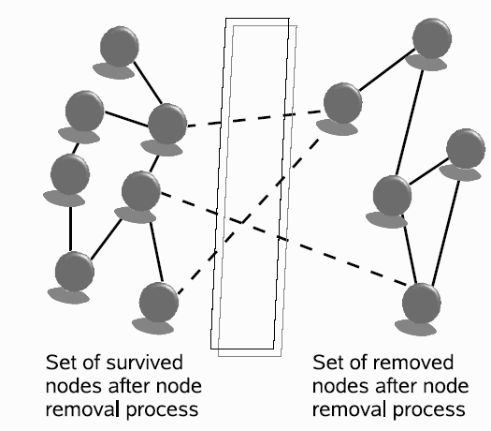
Deformation of the network due to node removal
In this diagram, left node set denotes the survived nodes and right node set denotes the removed nodes
The change in the degree distribution is due to the edges removed from the left set
We calculate the number of edges connecting left and right set (E)
Department of Computer Science, IIT Kharagpur, India

Slide 4
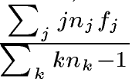

Deformation of the network due to node removal
The total number of tips in the surviving node set is
The probability of finding a random tip that is going to be removed is
The ‘-1’ signifies that a tip cannot
connect to itself.
The total number of edges running between two subset
Department of Computer Science, IIT Kharagpur, India

Slide 5

Deformation of the network due to node removal
Probability of finding an edge in the surviving (left) subset that is connected to a node of removed (right) subset
Department of Computer Science, IIT Kharagpur, India

Slide 6
Deformation of the network due to node removal
Removal of a node reduces the degree of the survived nodes
Node having degree > k becomes a node having degree k by losing one or more edges
Probability that a survived node will lose one edge becomes
Department of Computer Science, IIT Kharagpur, India

Slide 7


Deformation of the network due to node removal
Probability of finding a node having degree k (p_{k}’) after removal of nodes following f_{k}, depends upon
1. Probability that nodes having degree k, k+1, k+2 … will lose 0, 1, 2, etc edges respectively to become a node having degree k
2. Probability that nodes having degree k, k+1, k+2 … will sustain k number of edges with them
Hence
Where denotes the fraction of nodes in the survived (left) node set having degree q
Department of Computer Science, IIT Kharagpur, India

Slide 8
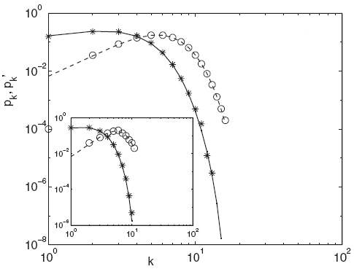
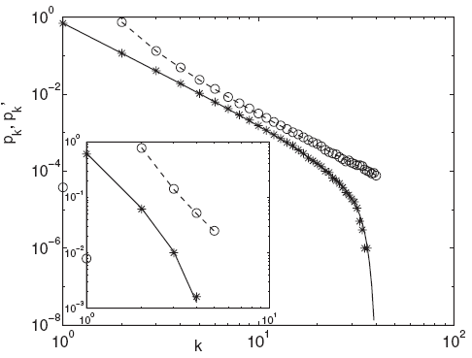



Deformation of the network due to node removal
Degree distribution of the Poisson and power law networks after the attack of the form
Main figure shows for N=10⁵ and inset shows for N=50.
Department of Computer Science, IIT Kharagpur, India

