Slide 1
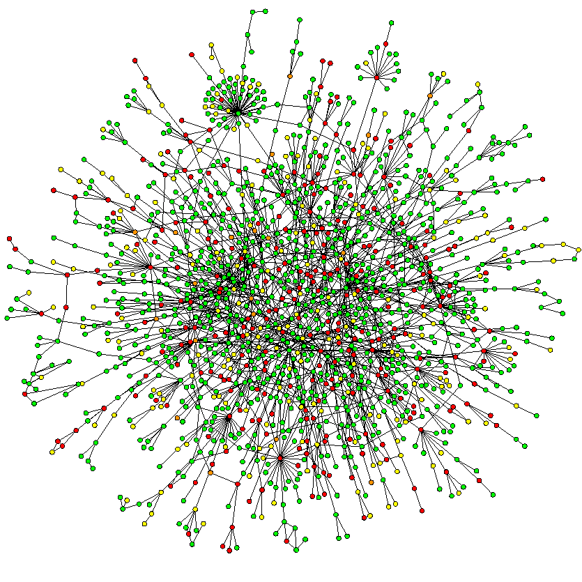
Complex Network Theory – An Introduction
Niloy Ganguly

Slide 2
Complex systems
Made of many non-identical elements connected by diverse interactions.
NETWORK

Slide 3
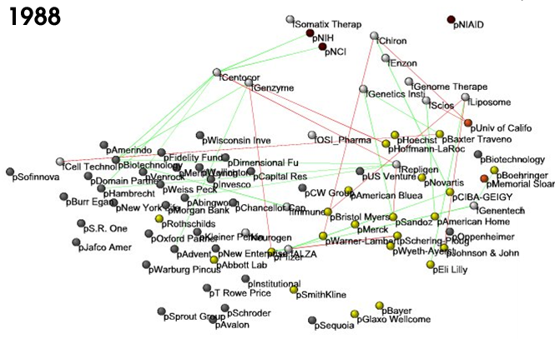
Business ties in US biotech-industry
Nodes: companies: investment
pharma
research labs
public
biotechnology
Links: financial
R&D collaborations
http://ecclectic.ss.uci.edu/~drwhite/Movie

Slide 4
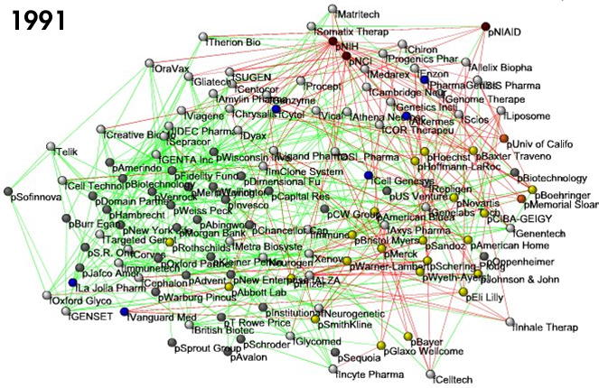
Business ties in US biotech-industry
Nodes: companies: investment
pharma
research labs
public
biotechnology
Links: financial
R&D collaborations
http://ecclectic.ss.uci.edu/~drwhite/Movie

Slide 5
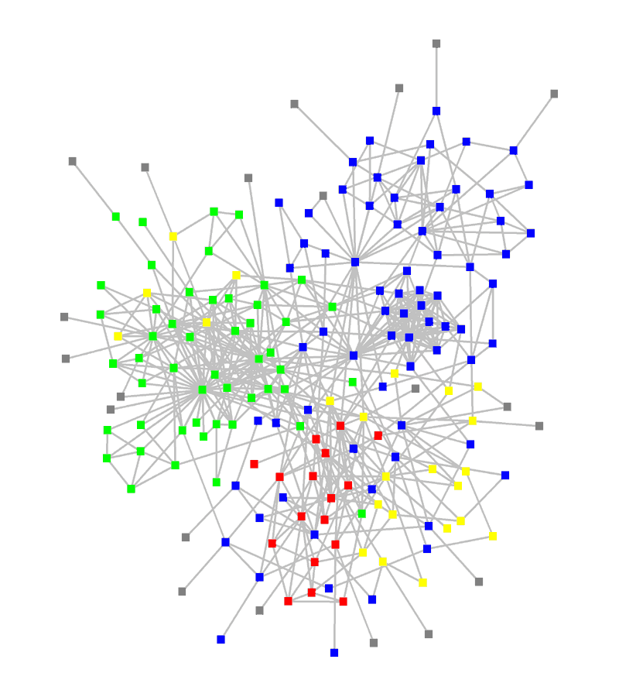
Structure of an organization
Red, blue, or green: departments
Yellow: consultants
Grey: external experts
www.orgnet.com

Slide 6
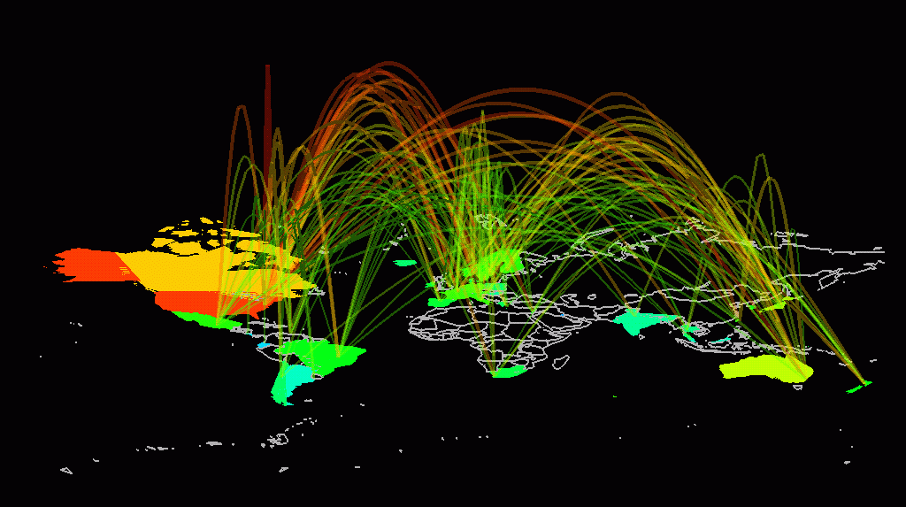
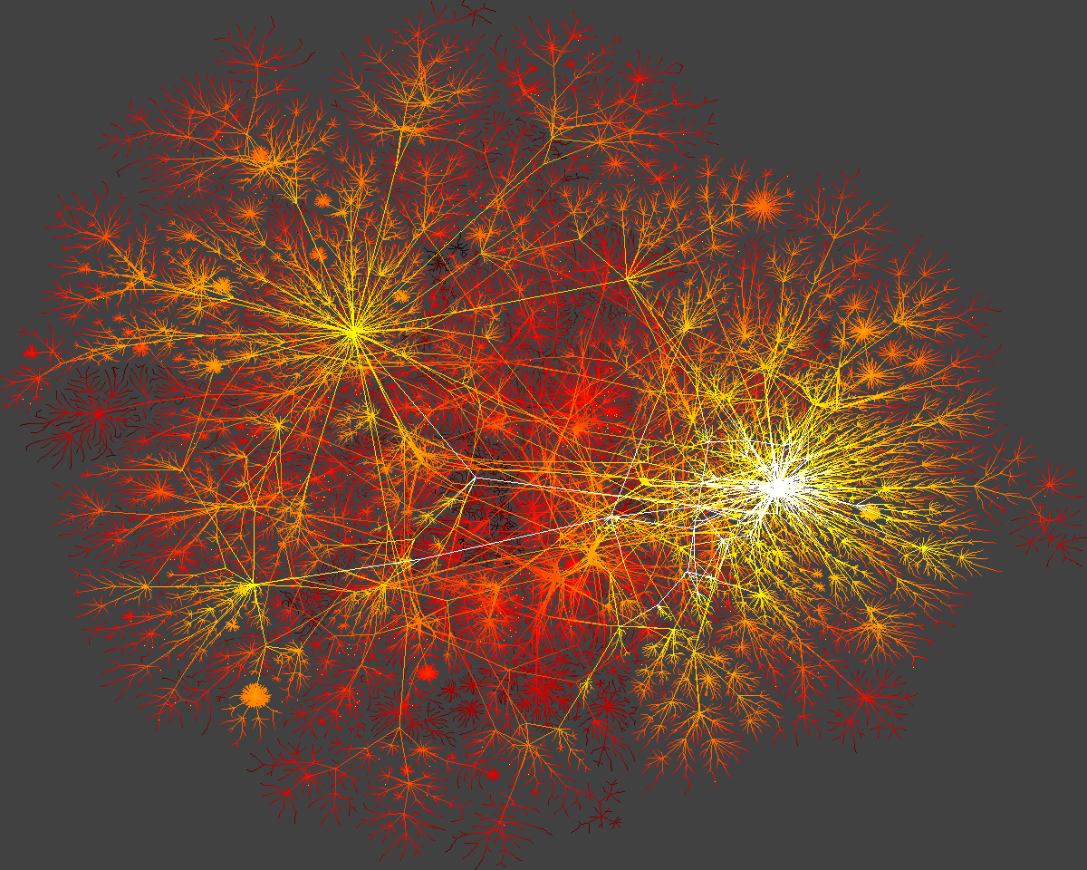
Internet

Slide 7
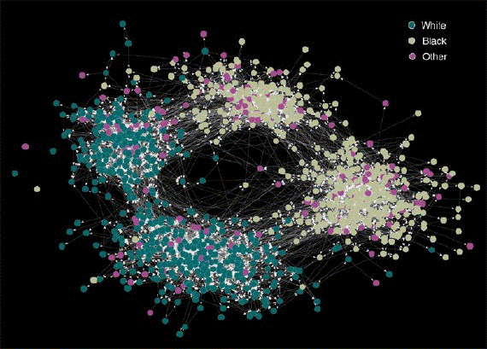
Friendship Network

Slide 8
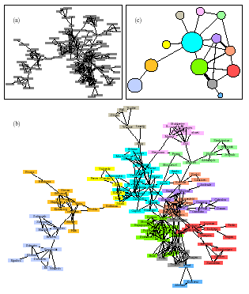
Network Collaboration Network

Slide 9
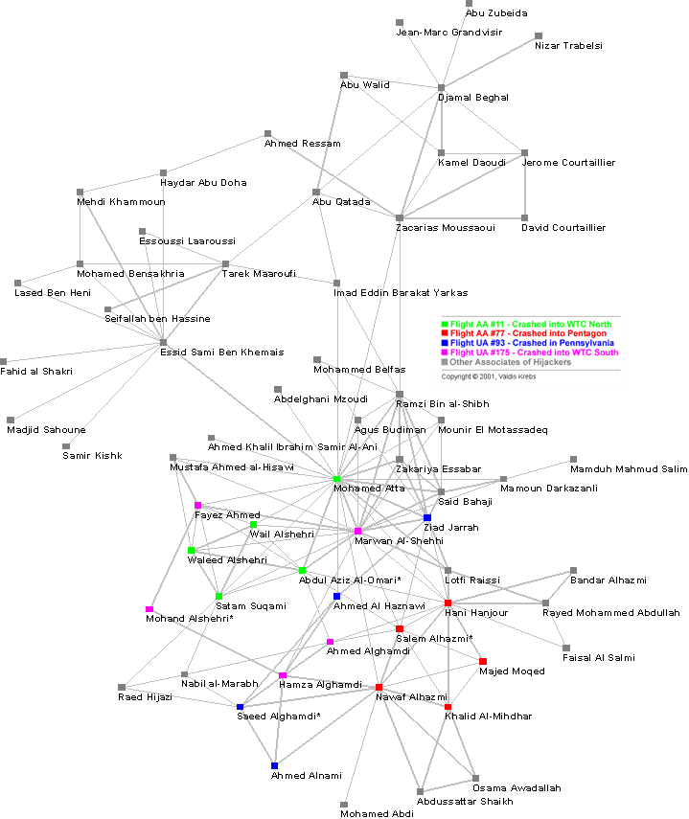
9-11 Terrorist (?) Network
Social Network Analysis is a mathematical methodology for connecting the dots -- using science to fight terrorism. Connecting multiple pairs of dots soon reveals an emergent network of organization.

Slide 10
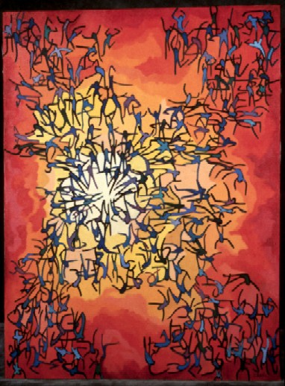
Swedish sex-web
Nodes: people (Females; Males)
Links: sexual relationships
4781 Swedes; 18-74;
59% response rate.
Liljeros et al. Nature 2001

Slide 11
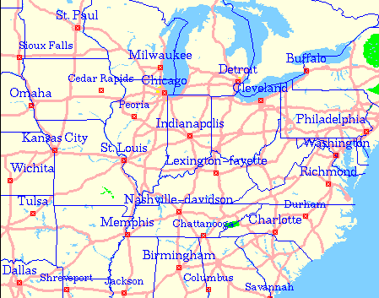
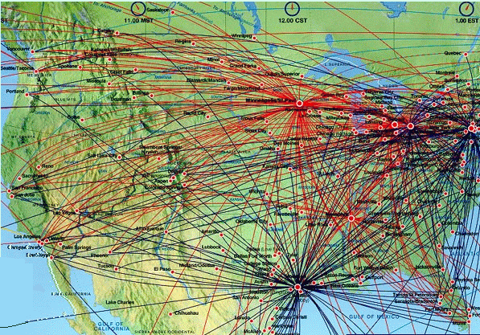
Road and Airlines Network
-
-

Slide 12
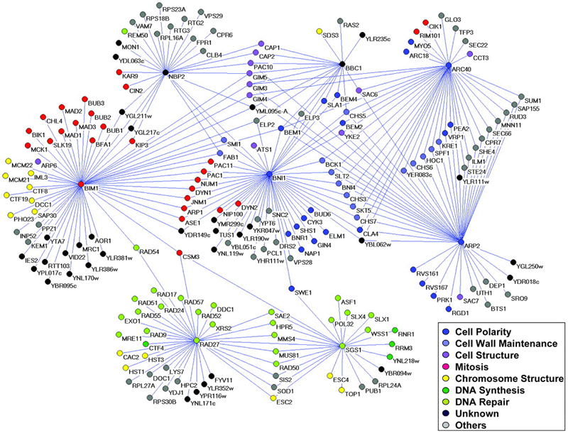
Genetic interaction network

Slide 13
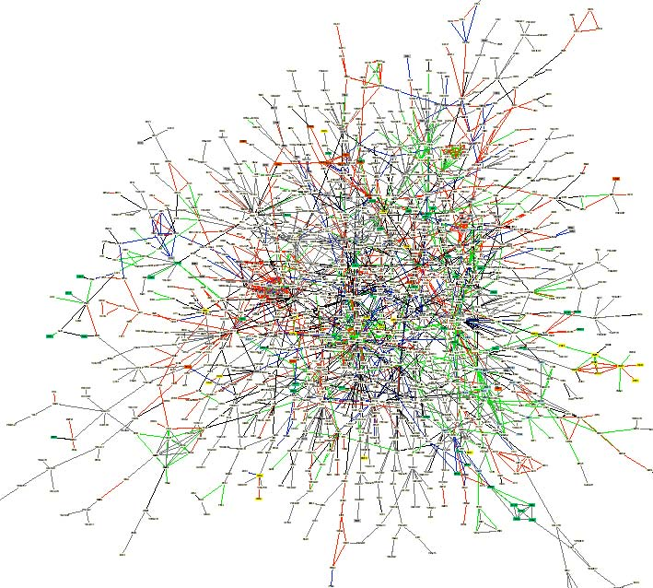
Yeast protein-protein interaction network
Notes:
An interaction map of the yeast proteome assembled from published interactions. The map contains 1,548 proteins (boxes)
and 2,358 interactions (connecting lines). Proteins are colored according to their functional role: proteins involved in
membrane fusion (blue), chromatin structure (gray), cell structure(green), lipid metabolism (yellow), and cytokinesis (red).

Slide 14
What Questions can be asked
Does these networks display some symmetry
Are these networks creation of intelligent objects or they have emerged.
How have these networks emerged
    Underlying simple rules leading to their complex formation

Slide 15
What Questions can be asked
Can we predict some outcomes/ make statements about the health of the system represented by the network
Are these networks robust against failure
Does these networks help in information flow
How can we engineer (build) such network, (engineering complex systems).

Slide 16
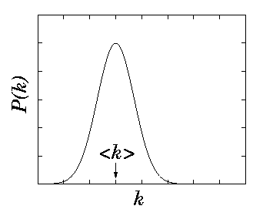
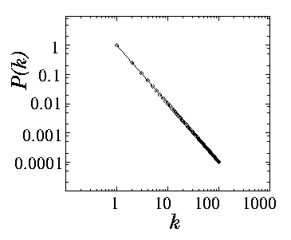
Symmetry
Poisson distribution
Power
-
law distribution
Scale
free Network
Exponential Network

Slide 17
Friendship Network (Community)

Slide 18
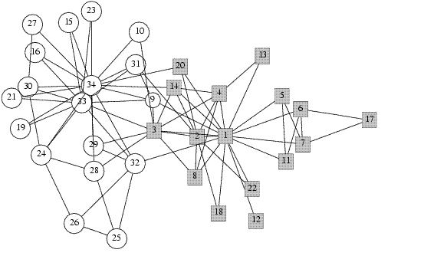
Karate Club
Instructors 1 and 33

Slide 19
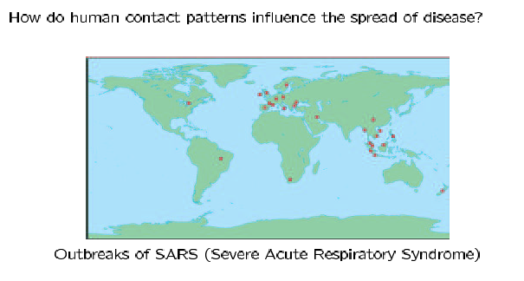
The Small World Effect

Slide 20
The Small World Effect
Even in very large social networks, the average distance between nodes is usually quite short.
Milgram’s small world experiment:
Target individual in Boston
Initial senders in Omaha, Nebraska
Each sender was asked to forward a packet to a friend who was closer to the target
Friends asked to do the same
Result: Average of ‘six degrees’ of separation.
S. Milgram, The small world problem, Psych. Today, 2 (1967), pp. 60-67.

Slide 21
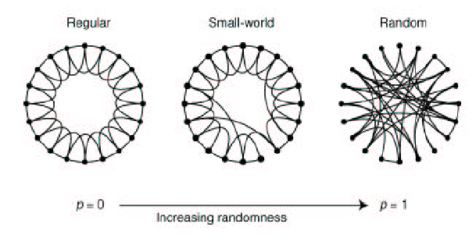
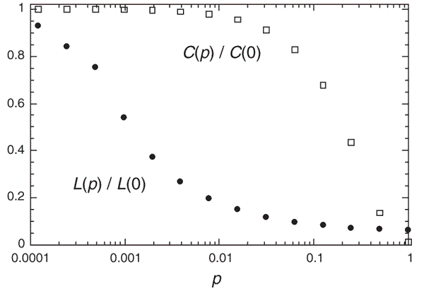
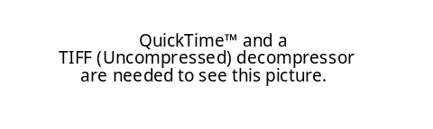
Watts-Strogatz ‘Small World’ Model (Simple Rules)
Watts and Strogatz introduced this simple model to show how networks can have both short path lengths and high clustering.
D. J. Watts and S. H. Strogatz, Collective dynamics of “small-world” networks, Nature, 393 (1998), pp. 440–442.

Slide 22
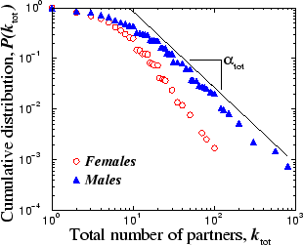
Swedish sex-web
Nodes: people (Females; Males)
Links: sexual relationships
4781 Swedes; 18-74;
59% response rate.
Liljeros et al. Nature 2001

Slide 23

Swedish sex-web
Nodes: people (Females; Males)
Links: sexual relationships
Internet
Robust against random failure
Vulnerable against attack
4781 Swedes; 18-74;
59% response rate.
Liljeros et al. Nature 2001

Slide 24
9-11 Terrorist (?) Network
How to conduct investigation

Slide 25
Some interesting Problems
Consonants (Language) Networks
Marriage Networks
Collaboration Networks
Build Networks which are robust as well as efficient
Actors Network

Slide 26
Area of Application
Techniques to design algorithms on dynamic graphs
Performance evaluation/optimization on networks
Information retrieval from large, complex, social networks

Slide 27
Course Outline
Techniques to analyze networks
Special types of networks – random networks, power law networks, small world networks
Models of network growth
Processes taking place on network – search, epidemics
Case Study

Slide 28
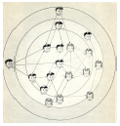

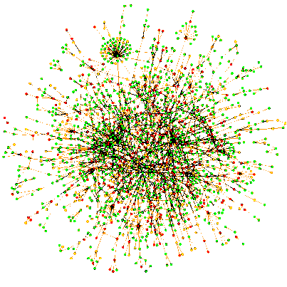
Traditional vs. Complex Systems Approaches to Networks
Traditional Questions:
Social Networks:
Who is the most important person in the network?
Graph Theory:
Does there exist a cycle through the network that uses each edge exactly once?
Complex Systems Questions:
What fraction of edges have to be removed to disconnect the graph?
What kinds of structures emerge from simple growth rules?

